Slide 1


ONCOGENETICS
„Origin, evolution and treatment of cancer“
Assoc. Prof. Martin Trbušek, Ph.D.
Department of Internal Medicine – Hematology and Oncology
University Hospital Brno
Faculty of Medicine, Masaryk University

Slide 2
CANCER: definition and basic classification
CANCER is an abnormal cell growth with subsequent spreading throughout the body creating metastases
Basic division follows the cell (tissue) of origin:
Carcinomas derive from an epithelial tissue - e.g. breast, lung, colon or pancreatic
cancer
Sarcomas originate from mesenchymal cells (conective tissue) – e.g. bone tumors
Cancer of blood cells or hematopoietic system – leukemias and lymphomas
Germ cell tumors – e.g. ovarian cancer or seminomas

Slide 3
Somatic mutation theory (SMT) vs.
Tissue organization field theory (TOFT)
Origin of cancer: conceptual theories
SMT:
Default setting of a cell is quiescence and cancer represents „an escape“ from it.
Malignant cell manifests a selective growth advantage over healty counterparts.
TOFT:
Default setting of a cell is infinite proliferation (phylogenetically)
These are tissues what keep our cells in a resting stage and prevent their
unlimited proliferation
Sonnenschein and Soto, Progress Biophys Mol Biol, 2016
Šmardová and Koptíková, Klinická onkologie 2016

Slide 4
Origin of cancer: role of heredity
Inherited tumors (incl. hereditary cancer syndromes)
5-10% of all cancer cases
e.g. Li-Fraumeni syndrome associated with TP53 mutations
or xeroderma pigmentosum involving mutations in DNA
repair genes
Sporadic tumors – the rest, originate in a somatic tissue
Genetic defects are underlying cause in both cases;
In addition, 15-20% of cancer involve an infectious agent (causality)
e.g. high risk HPVs in cervical carcinoma

Slide 5
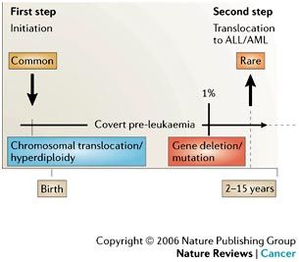
(Specific) aetiology of childhood leukemia
Analysis of „Guthrie cards“
or cord blood cells
…in monozygotic twins
Greaves , Nat Rev Cancer 2016

Slide 6
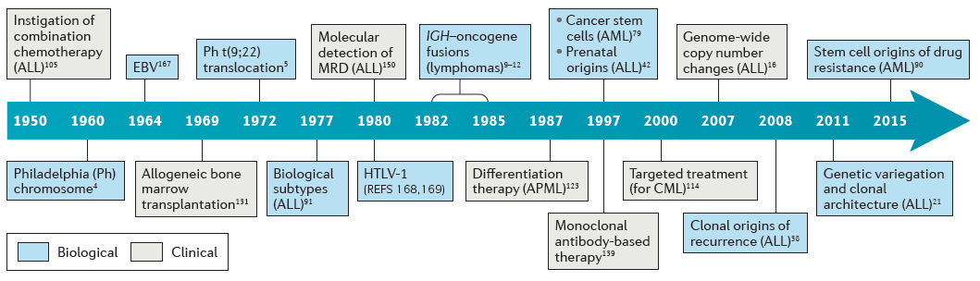
Contribution of leukemia and lymphoma research to the SMT
Leukemias and lymphomas represent up to 10% of all cancers worldwide
Greaves , Nat Rev Cancer 2016

Slide 7
Leuk and Lymp: hallmark aberrations enable molecular classification
Blood cancers have got quite clear „accomplices“
Typical translocations
Chronic myelogenous leukemia; t(9;22) BCR-ABL
Mantle cell lymphoma; t(11;14) Cyclin D1/IgH
Folicullar lymphoma; t(14;18) Bcl-2/IgH
Burkitt lymphoma; t(8;14) c-Myc/IgH
… or other characteristic aberrations
Chronic lymphocytic leukemia; del 13q, del 11q, del 17p, trisomy 12

Slide 8
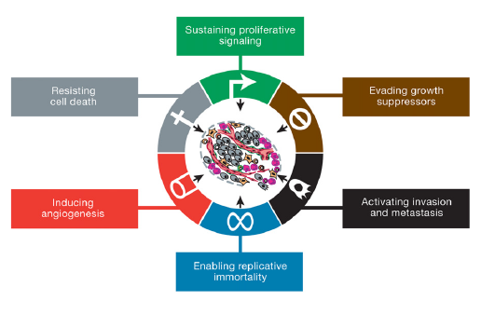
Classic hallmarks of cancer
Hanahann and Weinberg, Cell 2001

Slide 9
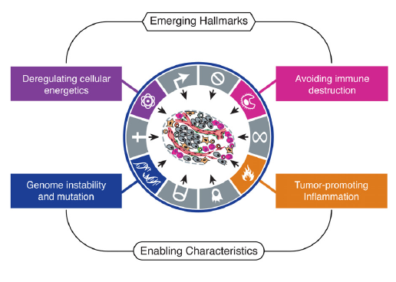
Emerging (additional) hallmarks of cancer
Reprogramming of a cellular metabolism and an escape from the immune system
Hanahann and Weinberg, Cell 2011

Slide 10
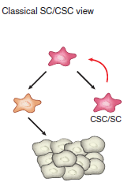
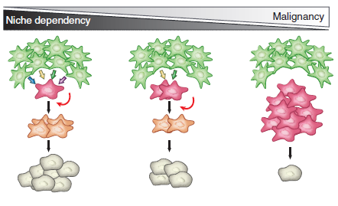
Role of cancer stem cells (CSC) in tumor initiation and progression
Only a proportion of cancer cells (CSC)
in a given tumor population is able
to self-renew (proliferate) infinitely
Human body contains ~10¹⁴ cells
~10¹¹ cells are renewed every day
from the stem cells
Adopted from Batlle and Clevers
Nature Med 2017

Slide 11
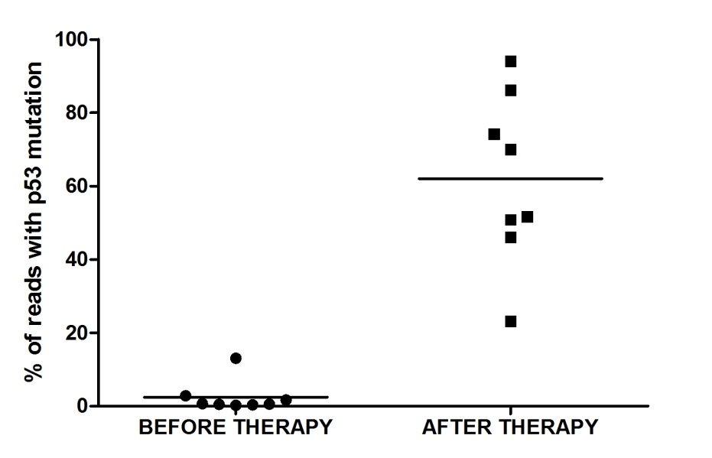
Cellular origin of cancer vs. therapy
Tumors originate from stem cells or progenitor cells, the development of which
is skewed by favoring self-renewal over differentiation
This phenomenon hardly aggravates
successfull (curable) therapy through
a minimal residual disease presence
and subsequent relapse based on
a resistant clone proliferation
BEFORE THERAPY
AFTER THERAPY
wtTP53
wtTP53
mutTP53
mutTP53

Slide 12
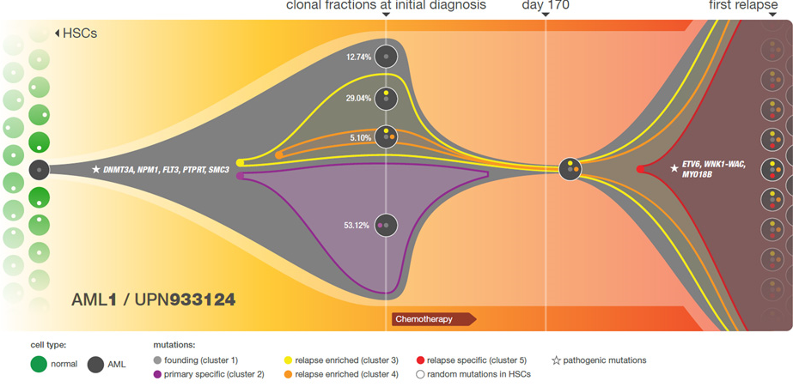
Clonal evolution and a narrow throat of therapy:
case of AML
Ding et al.,Nature 2012

Slide 13
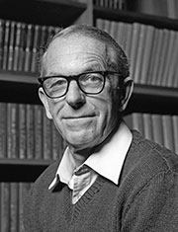
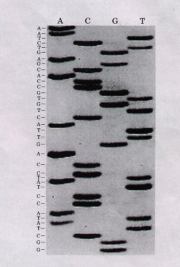
Gene mutations as a hallmark of cancer
Classic PAGE
³⁵S labelling
Frederick Sanger
Cambridge University

Slide 14
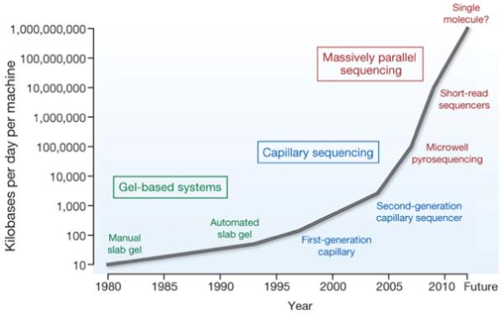
Breath-taking technological advancements
in DNA sequencing
Stratton et al., Nature 2009

Slide 15
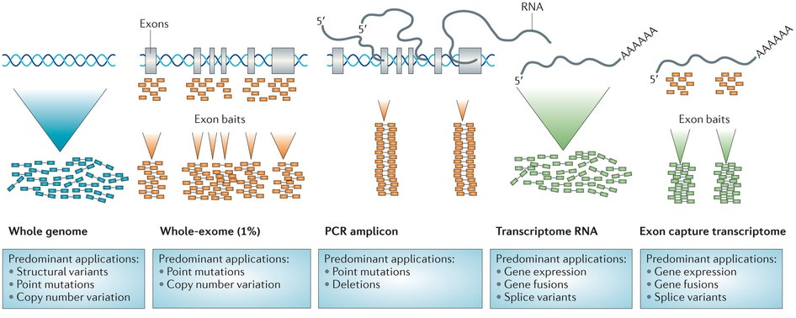
State-of-the-art: custom-directed NGS
Genome Exome Amplicon Transcriptome
Simon et al., Nat Rev Drug Discovery 2013

Slide 16
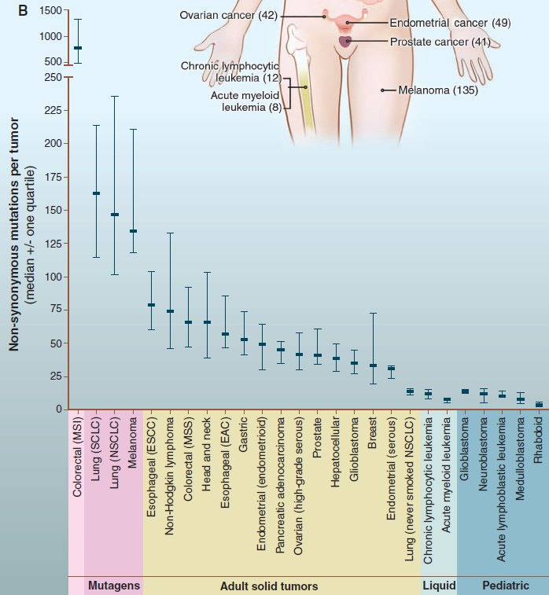
Cancer
Genome Landscapes
Driver mutations
vs.
Passenger mutations
Driver genes: ~125
71 TS/54 ONC
PRINCIPALS OF
DARWINIAN SELECTION
Vogelstein et al. Science 2013

Slide 17
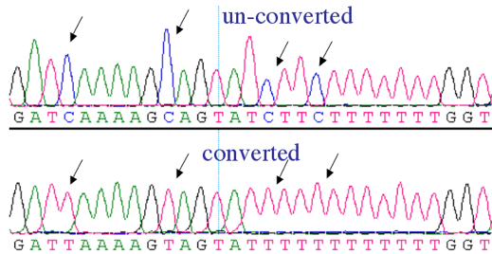
Additional cancer genome modifications
Epigenetic silencing of tumor-suppressor genes (promoter methylation)
Global (whole-genome) hypomethylation

Slide 18
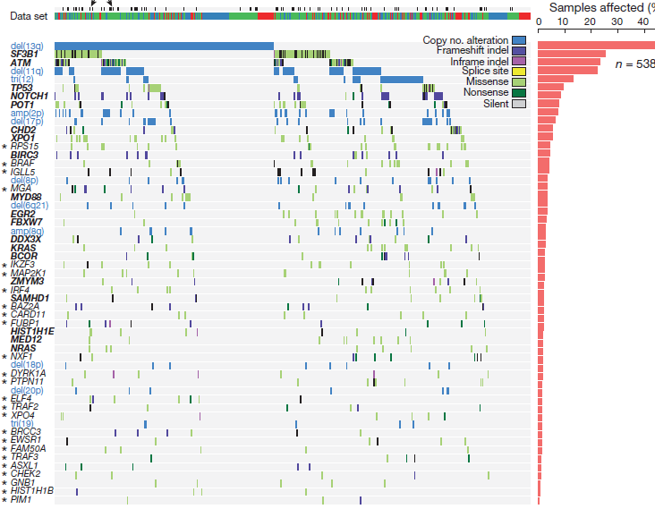
Recurrent mutations in cancer – CLL as an example
Landau et al.,
Nature 2015
The most frequent mutations in the genes: SF3B1, ATM, TP53

Slide 19
Intraclonal heterogeneity wthinin tumor population
Count | Coverage | Frequency | Gene_function | RefGene | Exon_number | cDNA | Codon
1752 | 1752 | 100 | exonic | ATM | exon40 | c.5948A>G | p.N1983S
2261 | 2452 | 92,21 | exonic | ATM | exon22 | c.3161C>G | p.P1054R
690 | 2962 | 23,3 | exonic | ATM | exon50 | c.7311C>A | p.Y2437X
100 | 1203 | 8,31 | exonic | ATM | exon24 | c.3433_3435del | p.1145_1145del
74 | 1433 | 5,16 | exonic | ATM | exon30 | c.4578C>T | p.P1526P
46 | 1281 | 3,59 | exonic | ATM | exon43 | c.6258T>A | p.Y2086X
243 | 8231 | 2,95 | splicing | ATM | exon19 | c.2921+1G>A | p.P962Q
19 | 699 | 2,72 | exonic | ATM | exon25 | c.3705_3709del | p.P1235fs
25 | 1087 | 2,3 | exonic | ATM | exon5 | c.480delT | p.S160fs
24 | 1046 | 2,29 | exonic | ATM | exon5 | c.483G>C | p.Q161H
67 | 3357 | 2 | exonic | ATM | exon26 | c.3837G>A | p.W1279X
73 | 5626 | 1,3 | exonic | ATM | exon26 | c.3952_3960del | p.1318_1320del
64 | 5151 | 1,24 | exonic | ATM | exon49 | c.7181C>T | p.S2394L
11 | 904 | 1,22 | exonic | ATM | exon63 | c.9022C>T | p.R3008C
42 | 3514 | 1,2 | exonic | ATM | exon10 | c.1402_1403del | p.K468fs

Slide 20
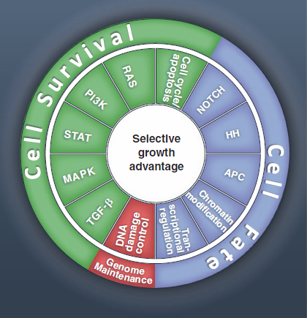
(12) affected biochemical pathways in cancer
99.9% of all alterations in cancer cells
provides no selective growth advantage
Mutability of human genome is normal;
However, normal is also to avoid aberrant,
dangerous cells through continuously
operating apoptosis….
Vogelstein et al., Science 2013

Slide 21
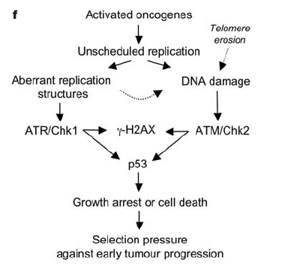
Model of tumor initiation and progression
Bartkova et al., Nature 2005

Slide 22
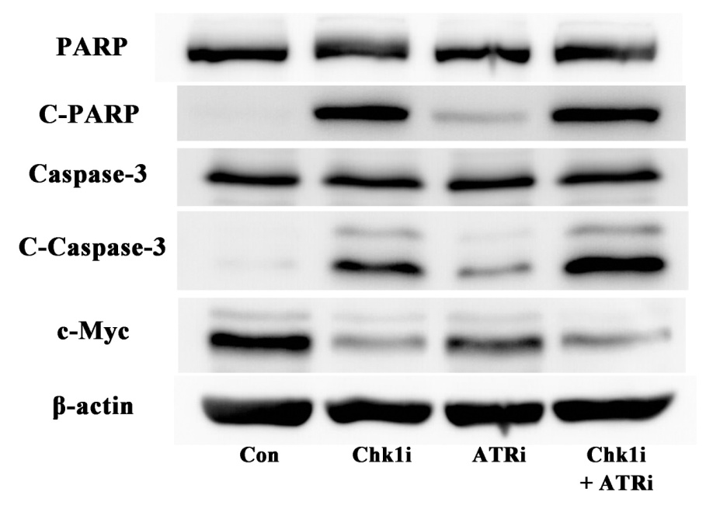
Interfence with DNA replication results in apoptosis induction in tumor cells
Cleaved proteins PARP and Caspase-3 demonstrate a presence of advanced apoptosis after the Chk1 inhibition; cells: MEC-1, TP53-mutated CLL

Slide 23
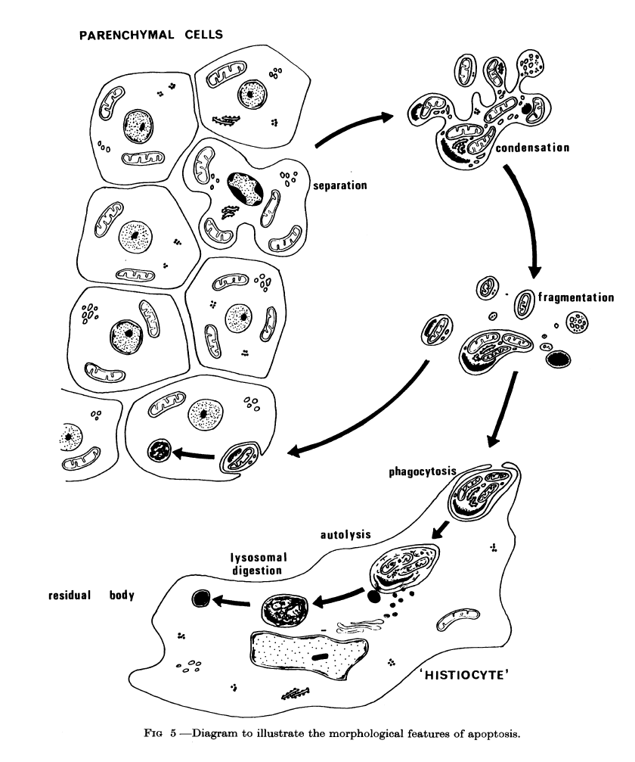
Apoptosis: „optimal cell death“ in cancer therapy
Physical cell distruction
„Trash“ elimination
(recycling)
Kerr et al., Br J Cancer 1972

Slide 24

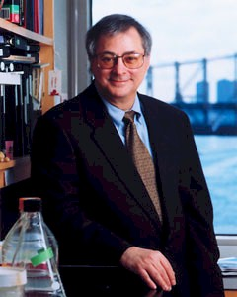
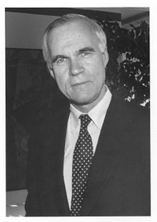
Discovery of p53 protein: a milestone in oncology research
Reported in 1979, interaction with a T-antigen of SV40 virus
David P. Lane
Imperial Cancer Research Fund, London
Arnold J. Levine
Princeton University, New Jersey
Lloyd John Old
Memorial Sloan-Kettering Cancer Center, New York

Slide 25
The p53 research from the historical perspective
Oncogene or tumor-suppressor?
Eliyahu D et al. Participation of p53 cellular tumour antigen in transformation
of normal embryonic cells. Nature 1984; 312: 646-9.
Parada LF et al. Cooperation between gene encoding p53 tumour antigen
and ras in cellular transformation. Nature 1984; 312: 649-51.
Jenkins JR et al. Cellular immortalization by a cDNA clone encoding the
transformation-associated phosphoprotein p53. Nature 1984; 312: 651-4.

Slide 26
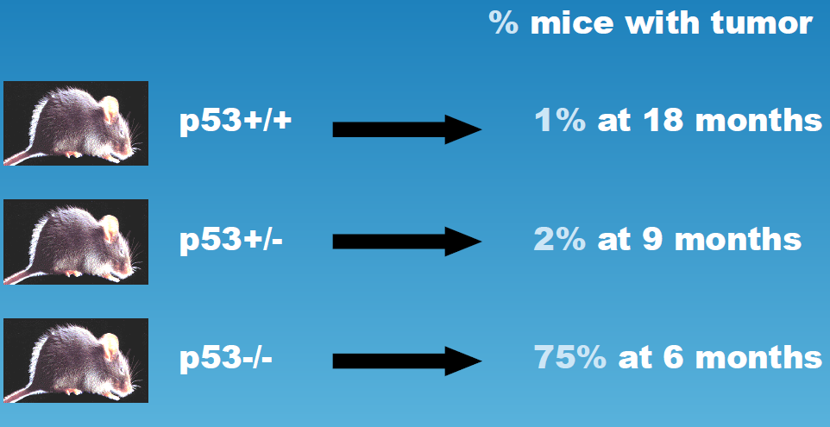
Impact of the TP53 gene disruption on tumor development
Elefants have low cancer rates (Peto paradox)
This is (among others) owing to ~20 copies of the TP53 gene
Donehower et al., Nature 1992
Adopted from: IARC TP53 database

Slide 27
Hypoxia
Telomere shortening
DNA damage
ATM
DNA PK
ATR
Oncogene activation
?
Transcription-
dependent
role of p53
p14^{ARF}
?
Post-translational modification of p53
activation and stabilisation
p53 ubiquitination and degradation
MDM2
p53
Cell cycle
checkpoints
Inhibition of pathological angiogenesis
Apoptosis
DNA repair
Senescence
p21^{WAF}
14-3-3σ
GADD 45
Reprimo
PUMA
NOXA
Bax
KILLER/DR5
p53AIP1
Fas/Apo1/ CD95
PIGs
GADD45
p48
p53R2
p21^{WAF}
Tsp1
BAI1
Maspin
GD-AIF
Notes:
Podrobněji k dráze p53:
poškozeni (…) - signalizováno dalšími proteiny - modifikace p53, aktivace a stabilizace. Aktivovaný p53¨- aktivace transkripce genů zahrnutých v… i represe a protein-protein interakce
Přísná regulace hladiny p53 v normální buňce - přes MDM2.
p53 - tr. faktor, funguje jako tetramer, 393 aminokyselin, 50 kDa

Slide 28
Cancer from the point of view of the cell cycle
G1 → S → G2 → M
G1/S S G2/M
Checkpoints
Ability to continue
with the cell division
DNA
Universal inactivation
Loss of p53, Rb, p16
etc.

Slide 29
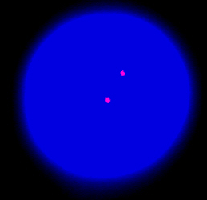
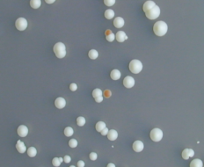
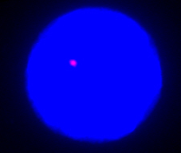
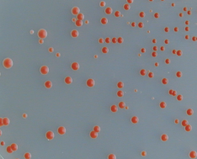
Analysis of the TP53 gene in CLL patients
in the University Hospital Brno
Del(17p) using I-FISH
Mut TP53 using FASAY and DNA sequencing
Wt
Mut
17p-
Notes:
29

Slide 30
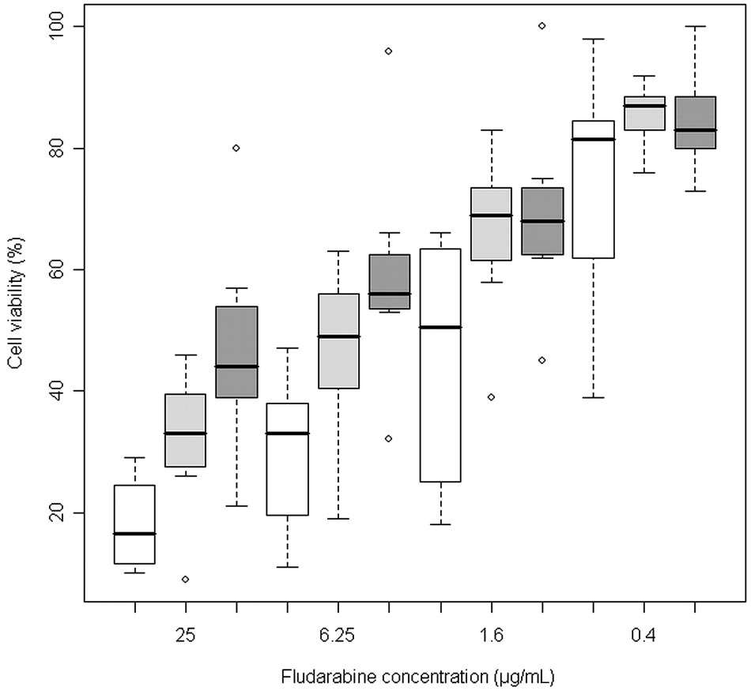
TP53 defects impair a therapeutic response
Test of cellular
viability in vitro
Treatment FLU 48 h
Malcikova J et al., Blood 2009

Slide 31
DNA damage induces p53-dependent response
Real time PCR, treatment 24 h

Slide 32
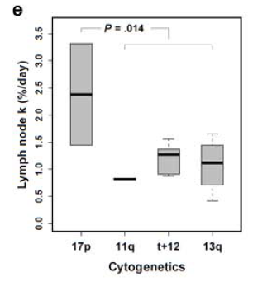
TP53 defects support tumor cells´ proliferation
²H₂O accumulation
in leukemic cells
located in LNs
Herndon et al., Leukemia 2017

Slide 33
p53 mutations associate with poor survival in CLL patients
A: wt-p53/mut-IgVH
MS: not reached
B: mut-p53/mut-IgVH
MS: not reached
C: wt-p53/unmut-IgVH
MS: 69 months
D: mut-p53/unmut IgVH
MS: 23 months
vs. (B) P=0.016
vs. (D) P=0.018
vs. (D) P<0.001
(A) vs.(C) P<0.001
Note: survival assessed from time of p53 defect identification / investigation showing wt-p53

Slide 34
Individual p53 mutations differ in their impact
Fig. A: all mutations
Fig. B: mutation + del(17p)
A: wt-p53
MS: 69 months
B: nonmissense p53 mutations
MS: 36 months
C: p53 missense out of DBMs
MS: 41 months
D: p53 missense in DBMs
MS: 12 months
(D) vs. (C) P=0.009
(D) vs. (B) P=0.002
Trbusek et al., J Clin Oncol 2011

Slide 35
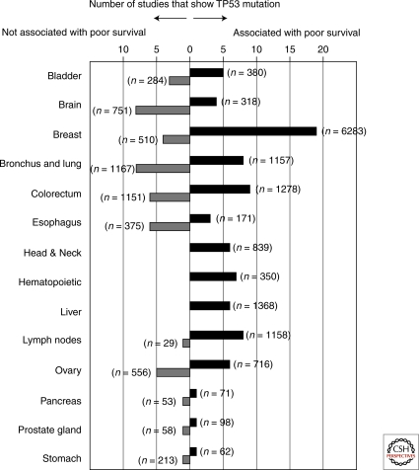
Prognostic impact of TP53 mutations in cancer
Adopted from:
Robles AI, Harris CC: Clinical outcomes and correlates of TP53 mutations and cancer.
Cold Spring Harb Perspect Biol 2010; 2: a001016

Slide 36
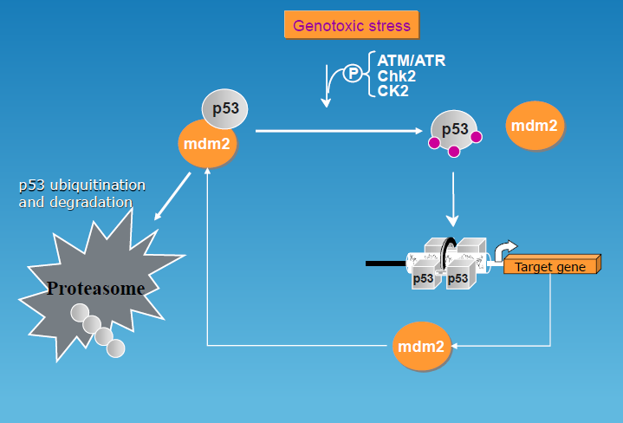
p53 activation: breaking a loop with MDM2
Adopted from: IARC TP53 database

Slide 37
Impact of ATM defects on p53 activation
1,2 – wt
3,4 – sole 11q-
5,6 – ATM-mut-1
7,8 – ATM-mut-2
Odd columns: controls
Even columns: IR (5Gy)
Navrkalova et al., Haematologica 2013

Slide 38
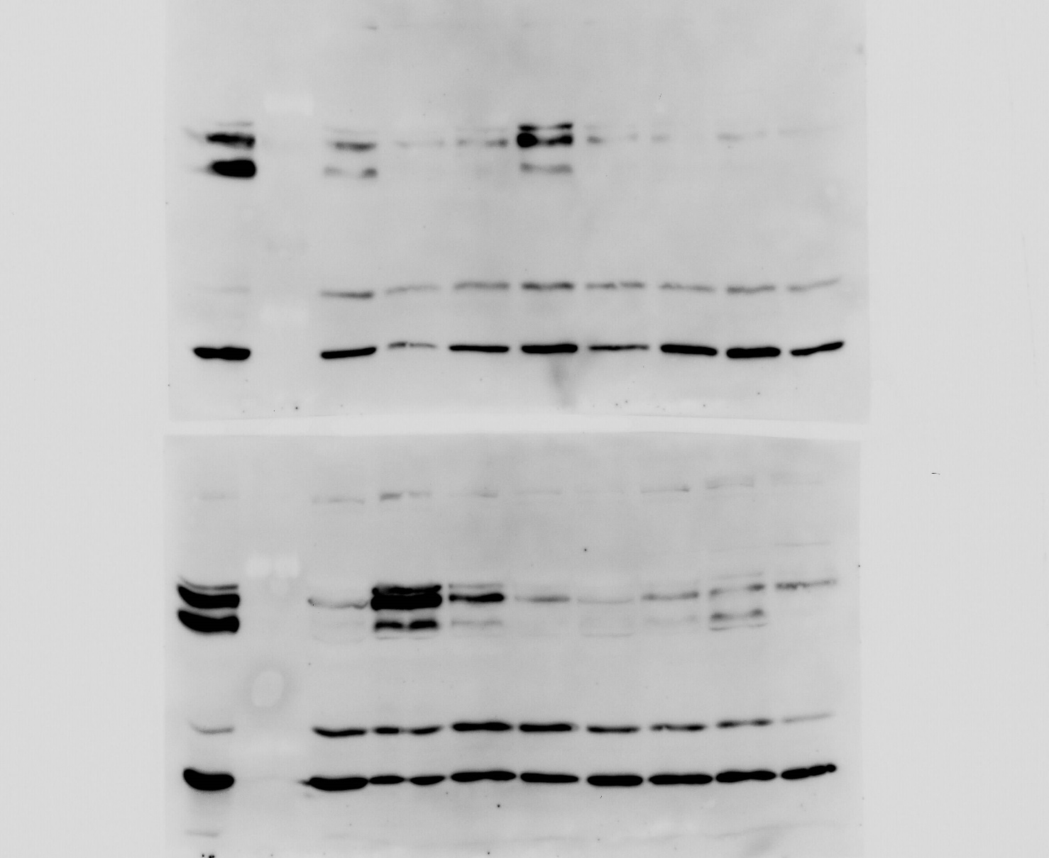
Onocogenes: driving cancer cell´s proliferation
CLL patients
WB c-Myc
Frequently TFs
Cooperation ONC/TS

Slide 39
Treatment of cancer
Surgery (primary site, localized matastases); local radiotherapy
Systemic therapies
(Combination) chemotherapy; total body irradiation
Stem cell transplantation (hematopoiteic and solid tumors)
Immunotherapy , including „CAR T-lymphocytes“
„Differentiation“ therapy (e.g. ATRA in APML)
Use of monoclonal antibodies
Targeted therapy (small molecule inhibitors)

Slide 40
Progress in the treatment of cancer
Satisfactory outcomes
Chronic myeloid leukemia
Some childhood leukemias (e.g. ALL, ETV6-RUNX1-positive)
Hodgkin´s lymphoma
Testicular tumor in young men
Favorable genetic features:
Hallmark abnormality, low genomic instability
Low pressure to inactivate the TP53 tumor-suppressor gene

Slide 41
Progress in the treatment of cancer
Unsatisfactory outcomes
Malignant melanoma (metastatic variant, OS ˂10% at 5 years)
TP53-mutated chronic lymphocytic leukemia (median OS ~3 years)
Cervical carcinoma (high-risk HPVs, direct p53 inactivation)
Unfavorable genetic features:
Genetic heterogeneity of tumor cell population
Inactivation of genes responding to therapeutic intervention
within the DNA damage response (DDR) pathway

Slide 42
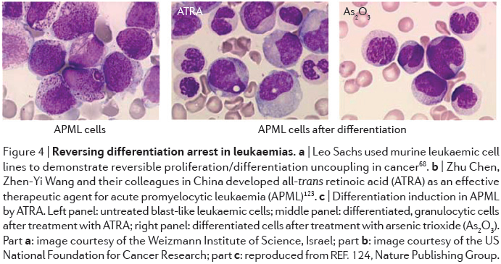
Treatment „by differentiation“: APL
Greaves, Nat Rev Cancer 2016

Slide 43
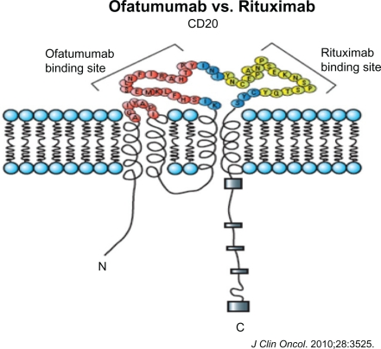
Therapy using monoclonal antibodies
Targeting to a cell surface epitope
(specificity vs.effectivity)
1st mAb in clinic: rituximab, 1997
Available also fo solid cancers
(e.g. trastuzumab in breast cancer)
Complex machanisms of action
(CDC, ADCC, apoptosis)

Slide 44
Protein targeting (inhibition) using small molecules
Kinases: relatively „easy“inhibition of enzymatic activity
All clinically approved small molecule drugs target kinases
Oncogenes: only minority of them have enzymatic activity
In contrast, many oncogenes have multiple interactions
Tumor-suppressors: very difficult replacement of the lost function. An option is to target a complementary activated pathway (e.g. BRCA loss → addiction to PARP activity).
Adopted from: Vogelstein B et al. Cancer Genome Landscapes, Science 2013

Slide 45
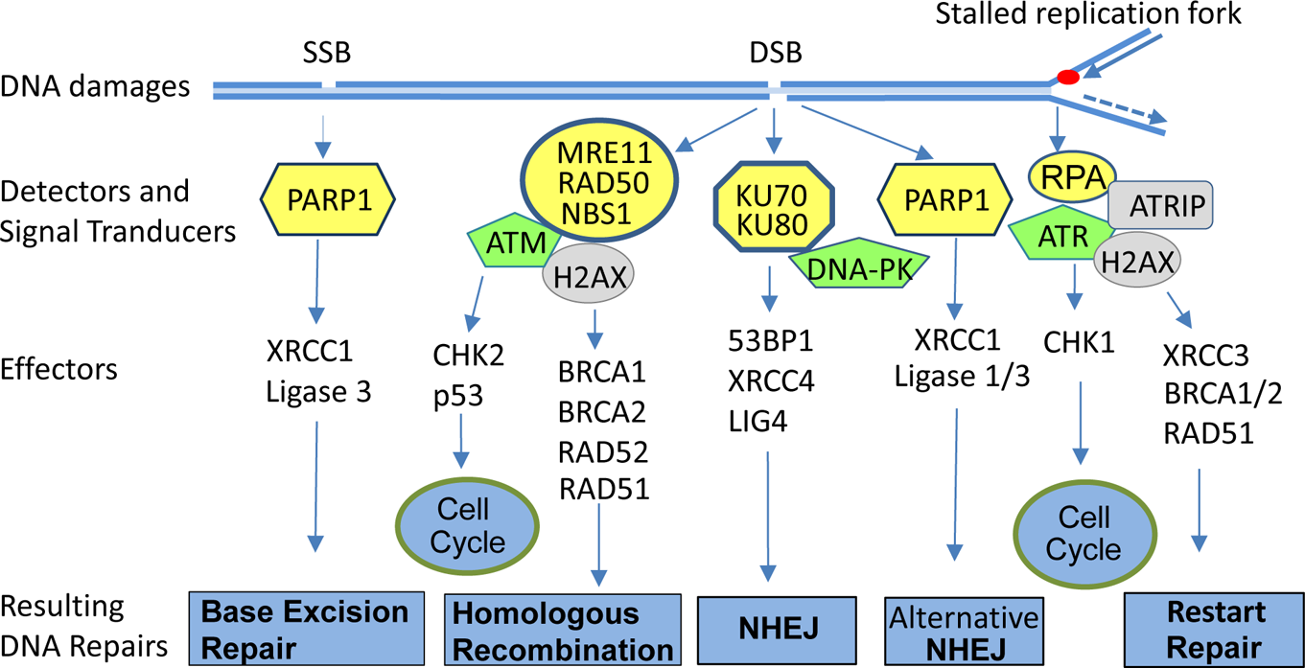
Synthetic lethality within DNA damage response
Adopted from: Fang B, J Med Chem 2014

Slide 46
Specific targeting may lead to distinct outcomes
Mutation V600E in BRAF protein is detected in malignant melanoma (MM)
as well as in metastatic colorectal cancer (CRC)
However, a specific inhibitor of BRAF signalling (Vemurafenib) is hihgly effective
in MM, but not in CRC
The reasons is an activation of the PI3K/AKT pathway eliminating the effect
of the inhibition in the latter cancer

Slide 47
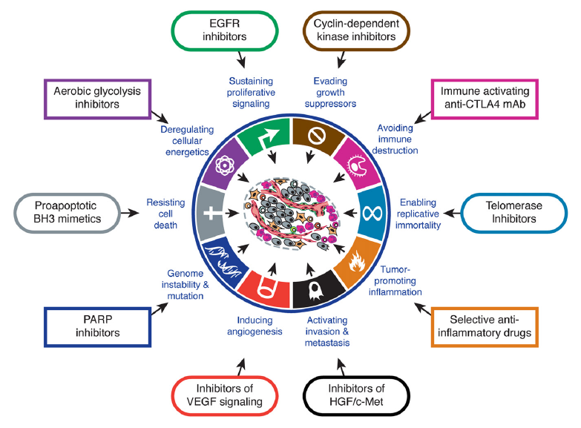
Current portfolio of specific molecular targeting

Slide 48
Summary
Cancer is a „disease of genes“, regardless of the presence or absence of
a heritable predisposition
Genetic background of different cancers have some common features,
but overall variability is huge and requires „the cancer-specific“ approach
Major obstacle of effective therapy represent in many cancers defects
in the TP53 gene (or the p53 pathway in general)
Technologial advancements in tumor cell analyses are enormous (e.g. NGS),
however the data interpretation remains sometimes (frequently?) elusive
Molecular therapy seems to be directed to a patient-specific „coctail“
of several drugs with accompanying mechanisms of action
(no „one pill“ at horizon…..)

Slide 49
THANK YOU VERY MUCH
FOR YOUR ATTETION! m.trbusek@volny.cz

