Slide 1
INJURIES
IN CLINICAL TERMINOLOGY

Slide 2
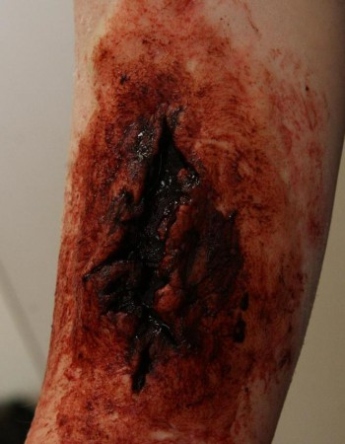
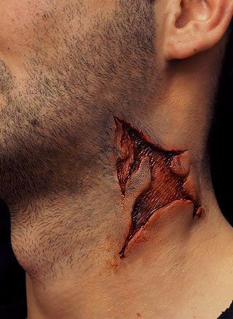
Vulnus lacerum
Tear wound = a wound produced by the tearing of body tissue.
External lacerations may be small or large and may be caused in many ways, such as a blow from a blunt instrument, a fall against a rough surface, or an accident with machinery.
Lacerations within the body occur when an organ is compressed or moved out of place by an external or internal force.

Slide 3
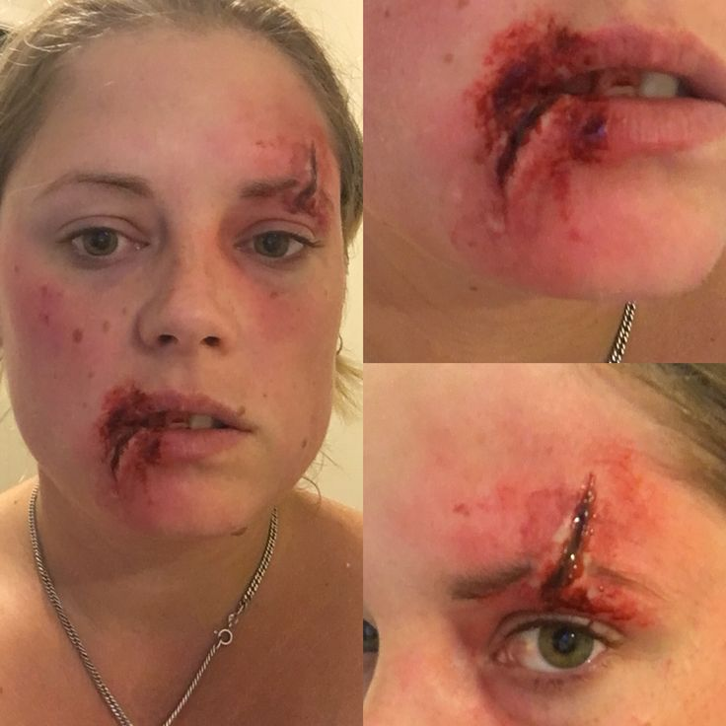
Put the words in correct order
supercilii - oris - l. - vulnus - sin.- labii - et- lacerum - inferioris
vulnus lacerum labii inferioris oris et supercilii l. sin.

Slide 4
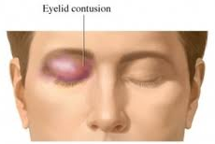
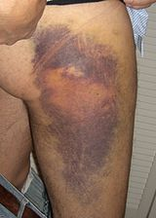
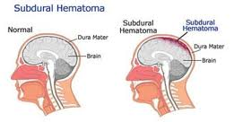
Bruise wound = an injury to tissues with skin discoloration and without breakage of skin. Blood from the broken vessels accumulates in surrounding tissues, producing pain, swelling, and tenderness, and the discoloration is the result of blood seepage just under the skin.
Haematoma
=localized swelling filled with blood
Vulnus contusum = contusio

Slide 5
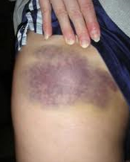
Fill in missing endings
is
Contusio femor__ later__ dextr__ cum haematomat__
is
i
e

Slide 6
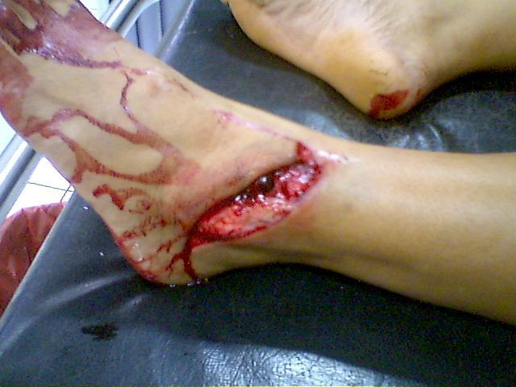
Vulnus contusolacerum
= lacerocontusum

Slide 7
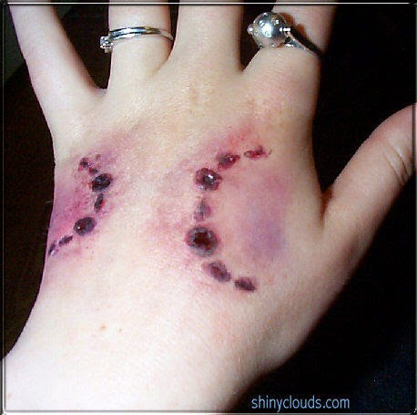
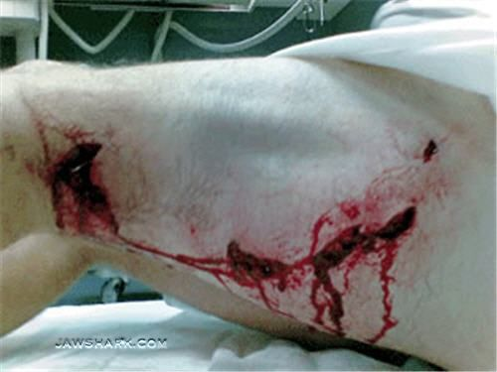
Vulnus morsum
Bite wound
= usually a puncture
or laceration, caused by teeth. An animal bite usually results in
a break in the skin but also includes contusions from the excessive pressure on body tissue from the bite. The contusions can occur without a break in the skin.
Animal bites often result in serious infections and mortality.

Slide 8
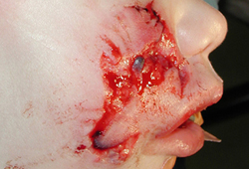
Translate the diagnose
Bite wounds of the right face after an animal bite ?
Vulnera morsa faciei lateris dextri post morsum animalis

Slide 9
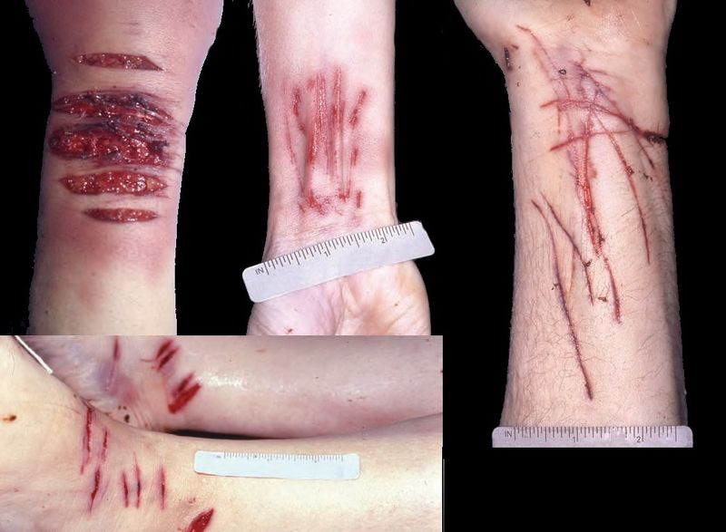
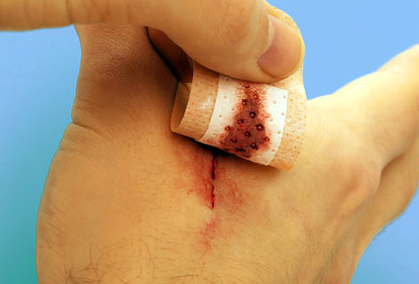
Vulnus scissum / incisum
cut wound = incision
= a wound made by pulling of a sharp instrument, leaving even edges. They may be as minimal as a paper cut or as significant as a surgical incision. or a wound made by a sharp instrument.

Slide 10
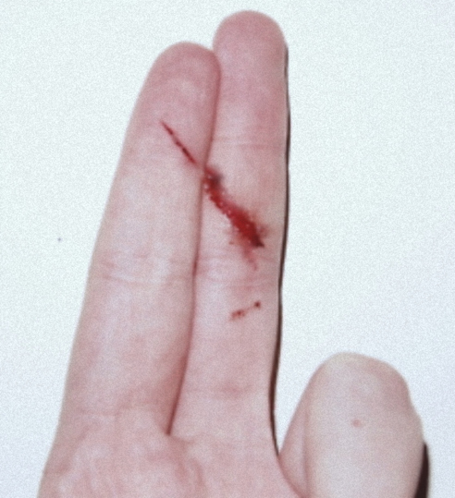
Give full forms of the abbreviations and numbers
vv. scissa dig. II-III manus l. sin.
vulnera scissa digiti secundi et tertii manus lateris sinistri

Slide 11
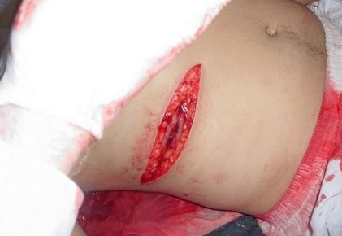
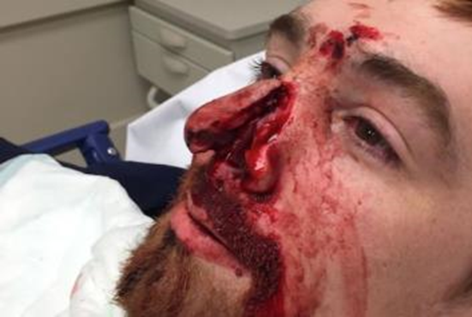
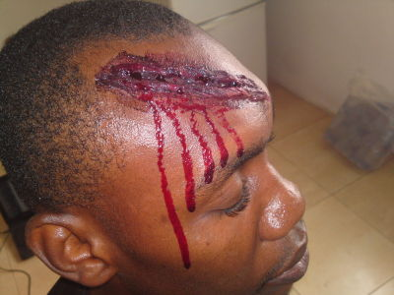
Vulnus sectum
A cut wound = a wound caused by falling of a sharp object, typically an axe or a knife...

Slide 12
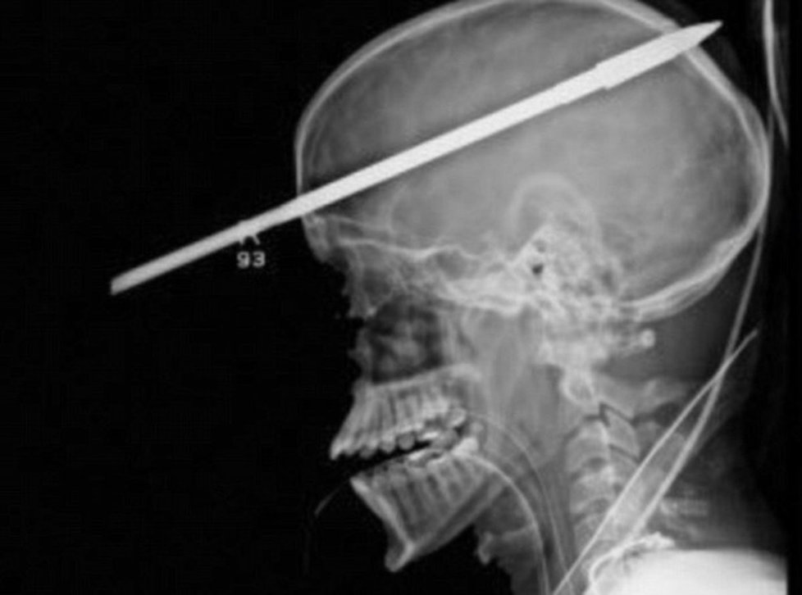
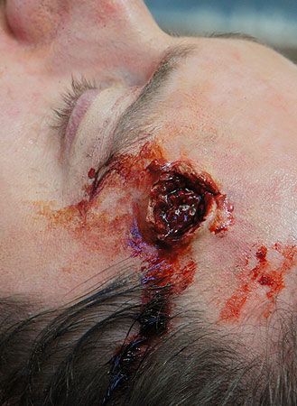
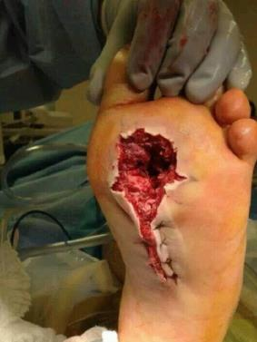
Vulnus sclopetarium
A gunshot wound (GSW) (ballistic trauma or bullet wound)
= a wound caused by the discharge of arms or munitions.
Ballistic trauma can be fatal or cause long-term consequences.

Slide 13
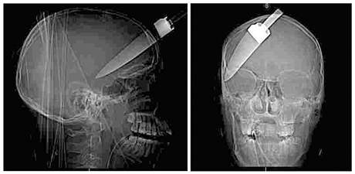
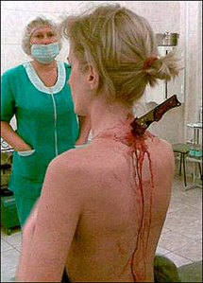
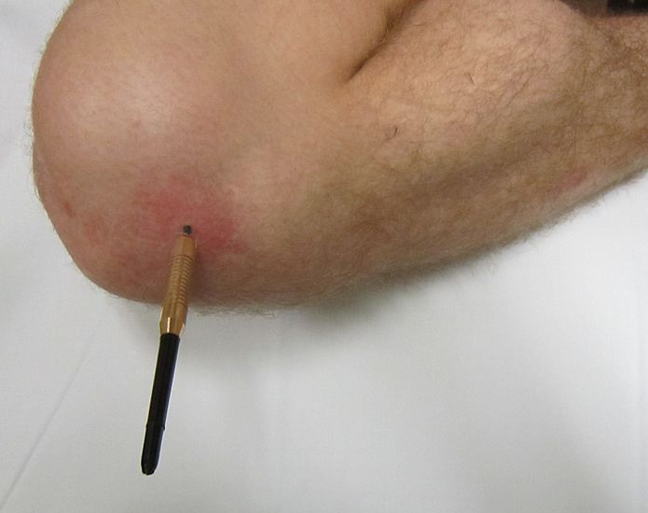
Vulnus punctum
stab wound
= a specific form of penetrating trauma to the skin that results from a knife or a similar pointed object that is "deeper than it is wide".
Stab wounds can occur not only from knives, but also from ice picks, pens, broken bottles, and even coat hangers.
Even though stab wounds are inflicted at a much greater rate than gun shot wounds, they account for less than 10% of all penetrating trauma deaths.

Slide 14
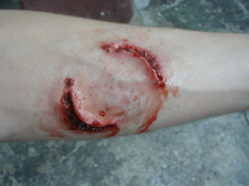
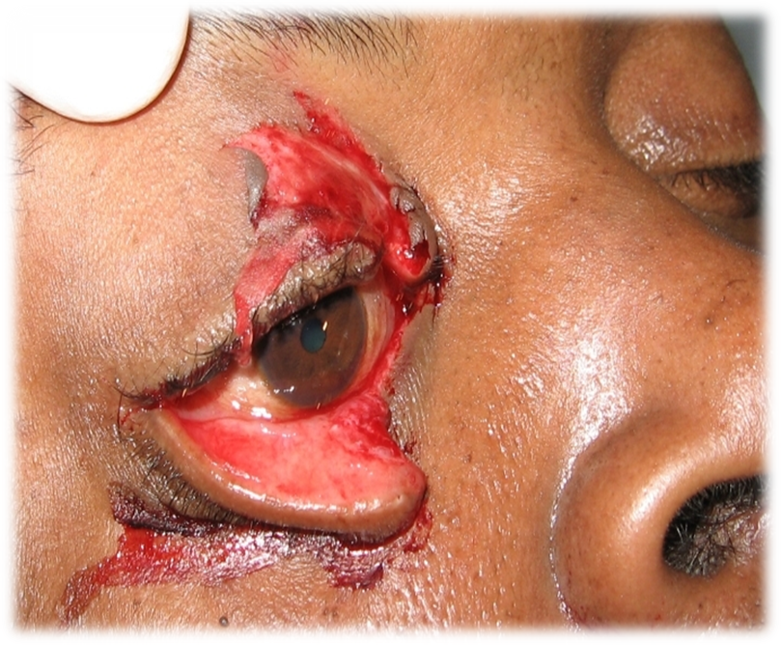
vulnus ________ regionis __________
vulnera ______________________________________??

Slide 15
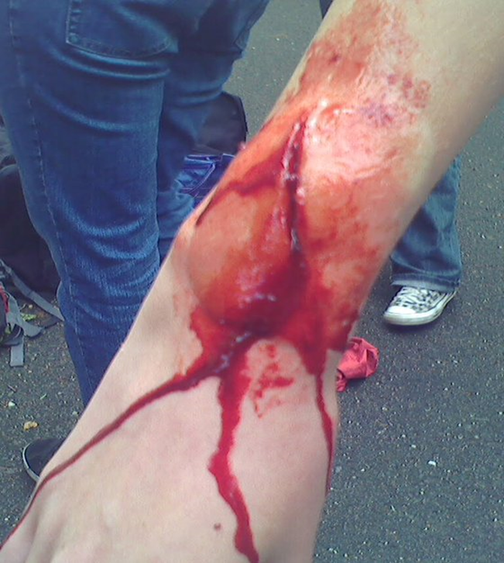
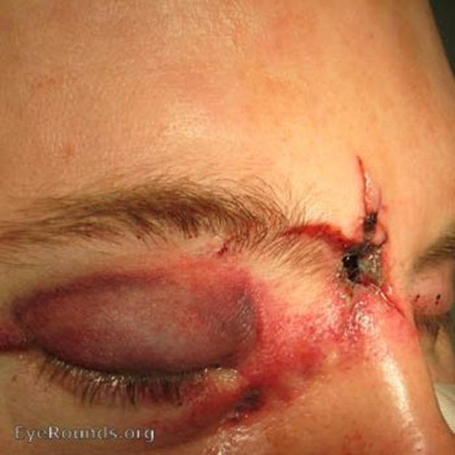
vulnus ______________________???
mors propter ________________?

Slide 16
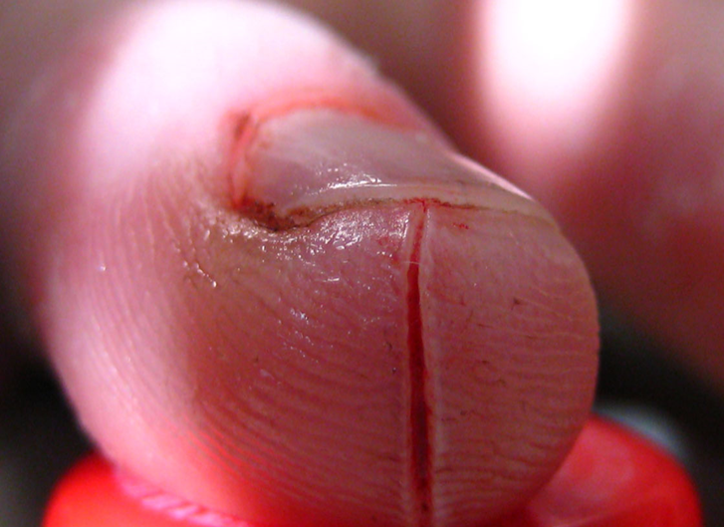
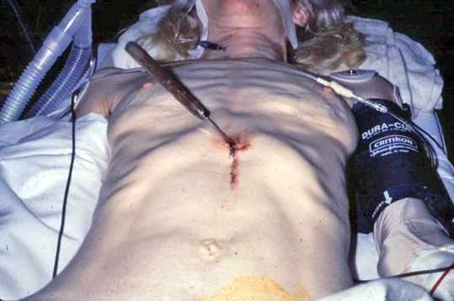
???

Slide 17
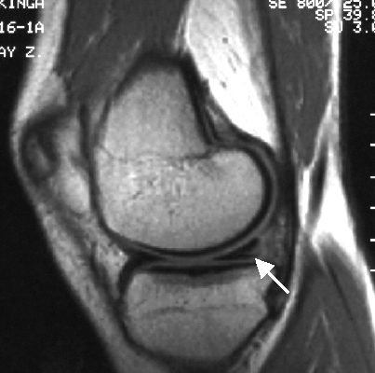
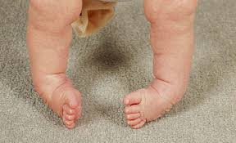
laesio, onis, f. deformitas, atis, f.
Torn meniscus
club foot in a baby
= any damage of an organ or tissue that leads to its damagedfunction
= permanent bodily malformation of the shape of and organ opart of the body

Slide 18
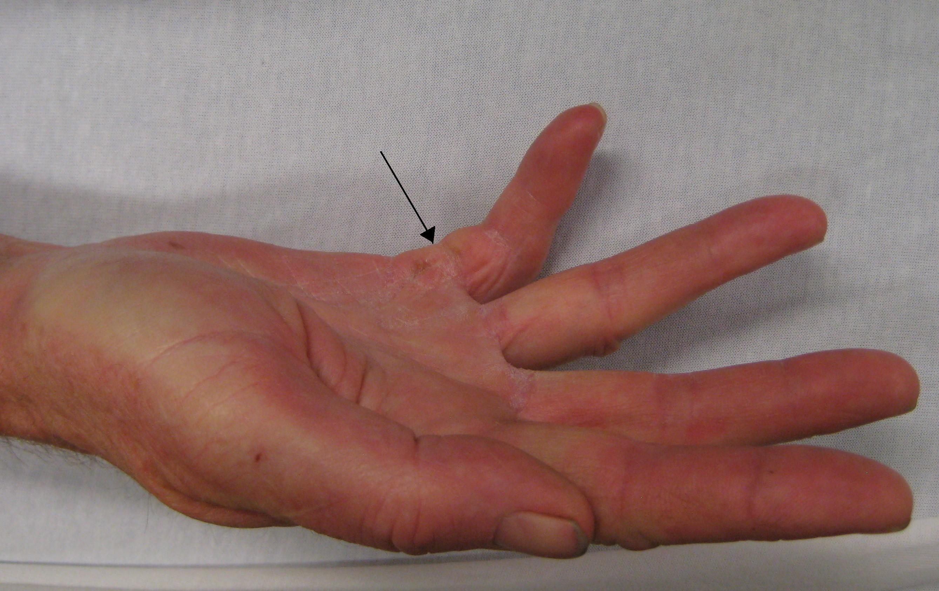
laesio – ligamentum – musculus – flexor – digitus – minimus – manus – latus – sinister
ENDINGS??

Slide 19
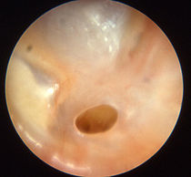
vulnus contus__ femor__ dextr__ cum haematomat__
MISSING ENDINGS??
perforatio membranae tympani
status post _____________________???

Slide 20
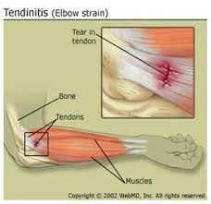
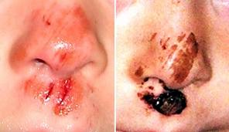
distensio, onis, f excoriatio, onis, f.
a strain (of muscle, ligament, etc.)
a scratch or abrasion of skin

Slide 21
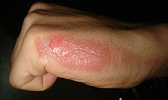
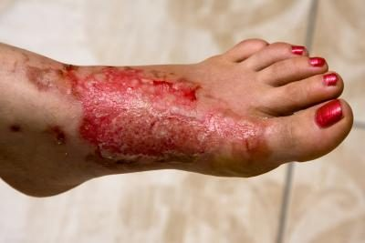
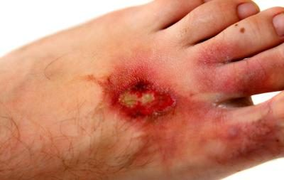
Combustio, onis, f. = a burn
2nd degree/grade burn
3rd degree/grade burn
infected burns
-change in the color of the skin around the burn, swelling, strange odor, the wound sinks deeper into the skin and gets larger, green or yellow pus develops, a fever

Slide 22
Write a diagnose of this second degree burn
Combustio antebrachii l. sin. gradus secundi
*gradus, us, m. = degree, stage – always expressed in Genitive!

Slide 23
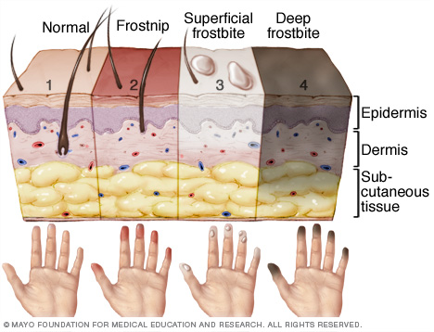
Congelatio, onis, f.
frostbite

Slide 24
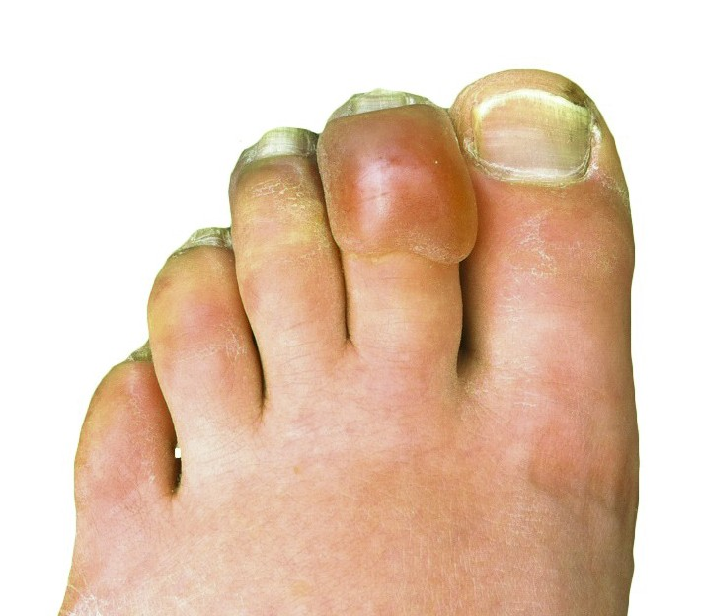
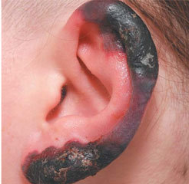
Congelatio auriculae
l. dx./ l. sin.
Congelatio digiti secundi pedis l. sin.

Slide 25
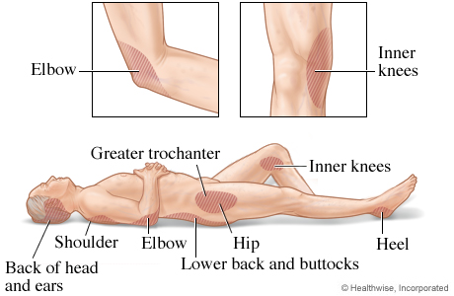
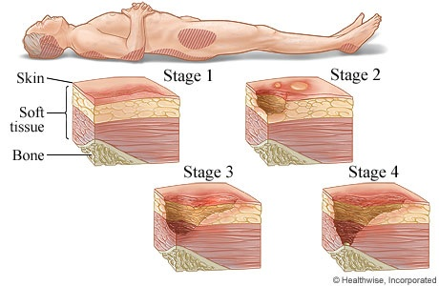
Decubitus, us, m.
bedsore = a pressure ulcer due to local interference with circulation; persons most at risk are those who are emaciated (nutritionally deficient in protein), obese, immobilized by traction
or anything else, diabetic,
or suffering from a circulatory
disorder.

Slide 26
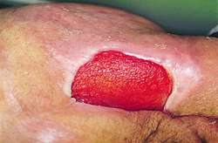
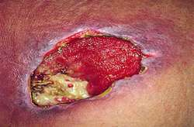
Decubitus, us, m.
stage 1 pressure ulcer
stage 2 pressure ulcer
stage 3 pressure ulcer

Slide 27
Internal injuries
fractura – luxatio – distorsio
contusio
commotio
perforatio
laceratio
haematoma
abruptio
laesio
distensio

Slide 28
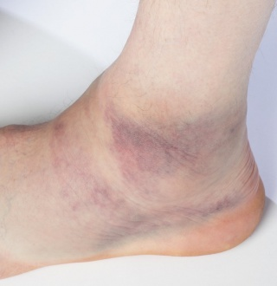
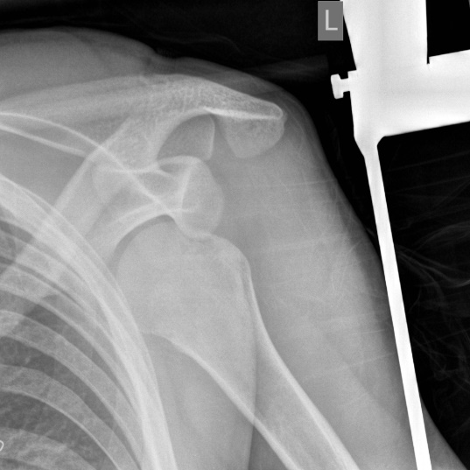
Bones, ligaments, soft tissues
OS = ostesynthesis; FE = ferrum (iron)
articulationis sacroiliacae
repositionem
= severe damage of soft tissues
???
???
Vulnus contusum/distorsio tali/malleoli l. sin.
Luxatio (capitis) humeri l. sin.
Notes:
Decollément = severe damage of soft tissues – undeclined, French origin; distorsio malleoli l. sin.; luxatio humeri l. sin.

Slide 29
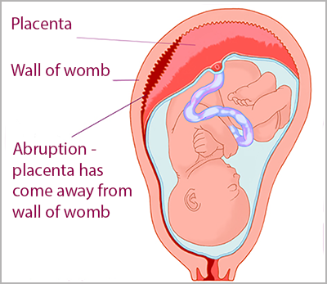
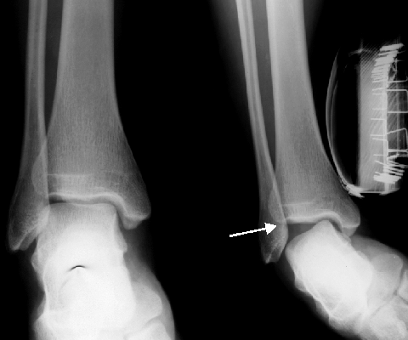
distorsio, onis, f.
= a joint injury in which some of the fibers of a supporting ligament are ruptured but the continuity of the ligament remains intact
= a tearing away, separation, or detachment
abruptio, onis, f.

Slide 30
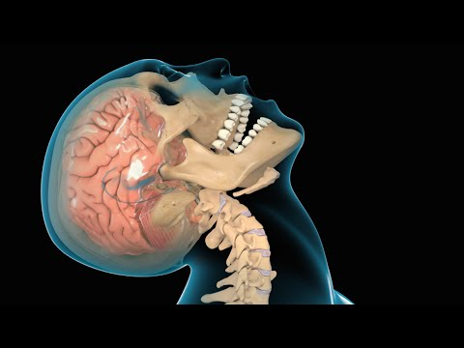
Organs, soft tissues
epidural haematoma in the left parietal region
haematoma epidurale reg. parietalis l.sin.
traumatic brain injury (TBI) ?
commotio cerebri

Slide 31
Organs, soft tissues
partial abruption of placenta in the 36th week (+ 4 days) of pregnancy?
abruptio placentae partialis in grav. hebd. 36+4
in graviditatis hebdomade
traumatic perforation of the tympanic membrane in the right ear ?
perforatio tympani l. dx. traumatica
Notes:
Perf abr laes

Slide 32
laceratio _____________??
contusio lienis
mors propter _______________??

Slide 34
Basic structure of a diagnose
1) problem: Nominative
fractura; corpora aliena; subluxatio
2) localization: Genitive (rarely preposition)
cruris l.dx.; calcanei; circum genu
3) further specification of the problem:
traumatica; non dislocata; comminutiva
Notes:
Chvilku makají, pak skontrolovat jestli mají dobrou structure

Slide 35
Specifics of clinical Latin
Side expressed by l.sin./l.dx.
The specifying adjective usually stands in the end:
perforatio tympani l. dx. traumatica
Abbreviations - disloc., comm., mult.

Slide 36
A three-year-old boy was playing with a plastic ball while in the
backseat of a car. The father heard a gasp, saw that the child was
unconscious, and suspected the child to aspirate the toy ball.
Emergency personnel intubated the child, no foreign body was
visualized then. The child was dead on arrival at the hospital.
During the postmortem examination, a radiograph of the head and
neck showed a spherical foreign body located in the oropharynx.
The oropharynx contained a toy soccer ball 2.5 cm in diameter.
Notes:
Corpus alienum sphaeroideum oropharyngis
Sphaeroideus, a, um - význam koncovky –oideus, + iné príklady geometr. tvarov (rhomboideus, conoideus, deltoideus, cuboideus, ellipsoideus)
Oropharynx, gis, m. - požiadať ich, aby sa pokúsili vysvetliť, ako je slovo vytvorené (os, oris, n. + pharynx, gis, m.)

Slide 37
A healthy 25-year-old man presented to the surgical clinic with a hole in the roof of his mouth, present for a year, and he requested surgical correction. The patient reported a 5-year history of nasal cocaine use from which he had recently abstained. Examination revealed a large perforation of the nasal septum and middle palate. Local complications of intranasal cocaine abuse include chronic rhinitis, sinusitis, epistaxis, ossification or necrosis of the nasal septum, and in rare cases, palatal perforation.
Notes:
Perforatio (per)magna septi nasi et partis medialis palati duri
Cocainismus/Abusus cocaini in anamnesi
Praesenti tempore abstinentia cocaini

