Slide 1
Basic medical terminology
Seminar 10

Slide 2
Adjectives of the 3rd declension
3 types according to the number of endings in nom. sg.:
3 endings: -ER (M.), -(E)RIS (F.), -(E)RE (N.)
acer, acris, acre; biventer, biventris, biventre;
celer, celeris, celere
2 endings: -IS (M.+F.), -E (N.)
brevis, breve
= most frequent type
: e.g.: gravis, e; cranialis, e; muscularis, e;
costalis, e; femoralis, e
1 ending: -X, -S (M.+F.+N.) = most common endings
e. g. simplex, icis; descendens, entis

Slide 3
Adjectives of the 3rd declension
Dictionary entry
ADJECTIVES OF the 1st and 2nd DECLENSION
  albus, a, um M.//F.//N.
  niger, a, um M.//F.//N.
ADJECTIVES OF the 3rd DECLENSION
  acer, is, e M.//F.//N.
  brevis, e M.+ F.//N.
  simplex, icis / ascendens, ntis M.+F.+N.//GENITIVE SG.!

Slide 4
2-form adjectives of the 3rd declension
nom. sg.: -IS (M.+F.), -E (N.)
Underived adjectives e.g. brevis, e = short; gravis, e = heavy, difficult
levis, e = light; tenuis, e = thin, slender
Derived adjectives ending in -alis, e/-aris, e cranialis, e = cranial muscularis, e = muscular
(epxress relation, pertaining or belonging to)
Compound adjectives ending in -formis, e pisiformis, e = pisiform vermiformis, e = vermiform
(shaped like, looking like, Latin equivalent to the Greek suffix -oideus, a, um)
Derived adjectives ending in -bilis, e operabilis, e = operable sanabilis, e = sanable
(capable of)

Slide 5
1-form adjectives of the 3rd declension
nom. sg. -X, -NS (M.+F.+N.)
Underived adjectives e.g. recens, recentis = recent, new
latens, latentis = latent, not manifested
Originally participles of verbs ending in -ans, antis and -ens, entis
(refer to action)
migrans, antis = migrating, floating ascendens, entis = ascending
Compound adjectives ending in -ceps, cipitis biceps, bicipitis = biceps
(refer to head-like structures ˂ caput, itis, n.)
Derived adjectives ending in -plex, plicis simplex, icis = simple duplex, icis = double, twofold
(refer to number, multiplicity)

Slide 6
Adjectives of the 3rd declension: declension paradigms
ADJECTIVES of the 1st and 2nd declension:
nervus (M.), vena (F.), septum (N.)
ADJECTIVES of the 3rd declension:
pelvis (M. + F.) BUT!!! abl. sg. -i
rete (N.)

Slide 7
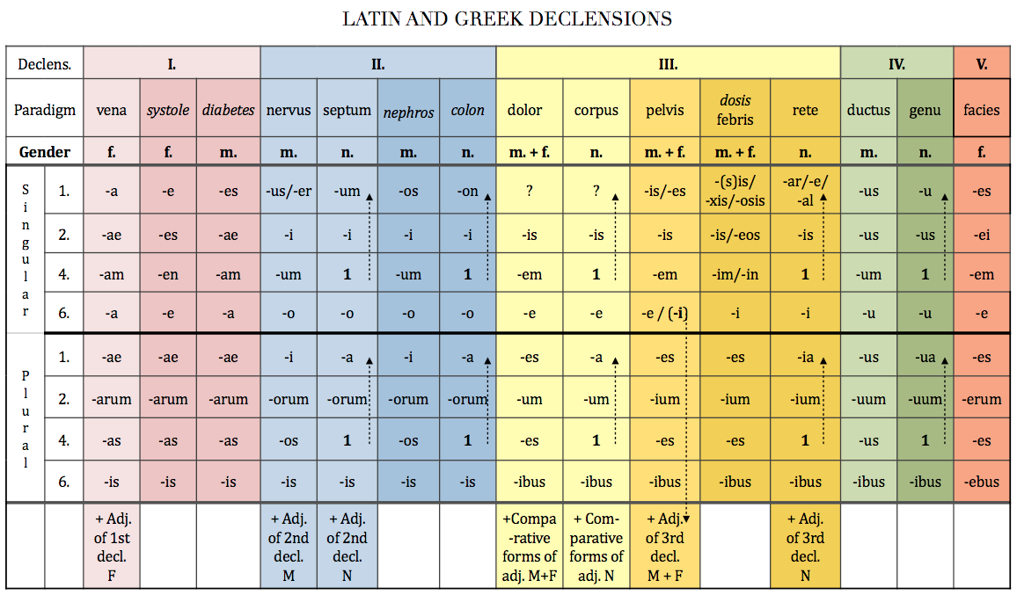

Slide 8


musculus aorta
BREVIS DESCENDENS
BREVIS DESCENDENTIS
BREVEM DESCENDENTEM
BREVI DESCENDENTI
BREVES DESCENDENTES
BREVIUM DESCENDENTIUM
BREVES DESCENDENTES
BREVIBUS DESCENDENTIBUS
caput colon
BREVE DESCENDENS
BREVIS DESCENDENTIS
BREVE DESCENDENS
BREVI DESCENDENTI
BREVIA DESCENDENTIA
BREVIUM DESCENDENTIUM
BREVIA DESCENDENTIA
BREVIBUS DESCENDENTIBUS

Slide 9
Adjectives of the 3rd declension
 | SG. |  | PL.
 | M. + F. | N. | M. + F. | N.
1 | -x, -ns -is -er/-is | -x, -ns -e -e | -es | -ia
2 | -is |  | -ium
4 | -em | = 1. | -es | = 1.
6 | -i |  | -ibus

Slide 10
Adjectives of the 3rd declension
 | three forms: m. / f. / n. | two forms: m. + f. /n. | one form: m. + f. + n.
1. (sg.) | acer acris acre | brevis breve | simplex
2. | acr-i-s | brev-is | simplic-is
4. | acr-e-m acr-e | brev-em breve | simplic-em simplex
6. | acr-i | brev-i | simplic-i
1. (pl.) | acr-es acr-ia | brev-es brev-ia | simplic-es simplic-ia
2. | acr-i-um | brev-ium | simplic-ium
4. | acr-e-s acr-i-a | brev-es brev-ia | simplic-es simplic-ia
6. | acr-ibus | brev-ibus | simplic-ibus

Slide 11
Form agreed attributes
Musculus + biventer, is, e
!fossa + biventer, is, e
!ganglion + biventer, is, e
nervus + communis, e
arteria + communis, e
crus + communis, e
lobulus + simplex, cis
articulatio + simplex, cis
crus + simplex, cis
3-forms
2-forms
1-form
Number of forms in nom. sg.

Slide 12
Derive adjectives using suffixes -alis, e/-aris, e
costa/ cost- + alis ⇢ costalis, e
femur/ femor- + alis, e ⇢ femoralis, e
musculus/ muscul- + aris, e ⇢ muscularis, e
dorsum intestinum cervix labium
facies nasus pulmo viscera
apex digitus margo medulla
rectum orbita maxilla pectus
ren patella vagina tonsilla
sternum abdomen frons paries
superficies vestibulum spina bronchus!
pars! os, oris cranium dens

Slide 13
Compare and tell the difference
ulcus gastris perforatum
perforatio membranae tympanicae
ulcus intestini crassi perforans

Slide 14
Complete the chart the same expression the same case
REN MIGRANS
 |  |  | MUSCULI BICIPITIS
 | ULCERA MOLLIA
 |  |  |  | RAMORUM COMMUNICANTIUM
 |  | ARTERIIS GASTRICIS

Slide 15
Complete the chart
REN MIGRANS | ULCUS MOLLE | ARTERIA GASTRICA | MUSCULUS BICEPS | RAMUS COMMUNICANS
RENIS MIGRANTIS | ULCERIS MOLLIS | ARTERIAE GASTRICAE | MUSCULI BICIPITIS | RAMI COMMUNICANTIS
RENES MIGRANTES | ULCERA MOLLIA | ARTERIAE GASTRICAE / ARTERIAS GASTRICAS | MUSCULI BICIPITES / MUSCULOS BICIPITES | RAMI COMMUNICANTES / RAMOS COMMUNICANTES
RENUM MIGRANTIUM | ULCERUM MOLLIUM | ARTERIARUM GASTRICARUM | MUSCULORUM BICIPITIUM | RAMORUM COMMUNICANTIUM
RENIBUS MIGRANTIBUS | ULCERIBUS MOLLIBUS | ARTERIIS GASTRICIS | MUSCULIS BICIPITIBUS | RAMIS COMMUNICANTIBUS

