Slide 1
Basic medical terminology
Seminar 11

Slide 2
Adjectives of the 3rd declension: revision
How many types of 3rd declension adjectives do we have? What are the differences between them?
According to which paradigms do we decline adjectives of the 3rd declension? Are there any irregularities?
Explain the meanings of the following adjective suffixes and give examples:
-bilis, e; -formis, e; -plex, plicis; -ceps, cipitis

Slide 3
a) Classify the adjectives into groups according to their declensions. b) Give the number of their nominative singular forms.
centralis, e opticus, a, um parietalis, e
ischiadicus, a, um tenuis, e crassus, a, um
ascendens, ntis sigmoideus, a, um suprarenalis, e
thyroideus, a, um biliaris, e felleus, a, um
longus, a, um brevis, e multiplex, icis
apertus, a, um cysticus, a, um migrans, ntis
solaris, e ruber, a, um rectus, a, um
biceps, itis acutus, a, um catarrhalis, e

Slide 4
Connect nouns with different types of adjectives
ischiadicus, a, um | tuber | parietalis, e
longus, a, um | caput | brevis, e
lentus, a, um | sepsis | puerperalis, e
induratus, a, um | hepar | mobilis, e
cysticus, a, um | ren | migrans, antis
complicatus, a, um | fractura | simplex, cis
acutus, a, um | urocystitis | catarrhalis, e
magnus, a, um | musculus | biceps, pitis
medius, a, um | pars | cranialis, e

Slide 5
Connect nouns with different types of adjectives
centralis, e | canalis | opticus, a, um
ischiadicus, a, um | tuber | frontalis, e
tenuis, e | intestinum | crassus, a, um
rectus, a, um | musculus | biceps, pitis
ascendens, tis | colon | transversus, a, um
thyroideus, a, um | glandula | suprarenalis, e
biliaris, e | vesica | felleus, a, um
longus, a, um | caput | brevis, e
solaris, e | eczema | ruber, a, um

Slide 6
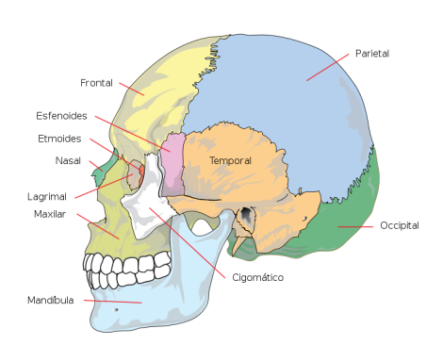
Name the bones of the skull using adjectives derived from the given nouns
paries, etis, m.
frons, frontis, f.
sphen
ethmos
tempus, oris, n.
nasus, i, m.
lacrima, ae, f.
occiput, itis, n.
zygon

Slide 7
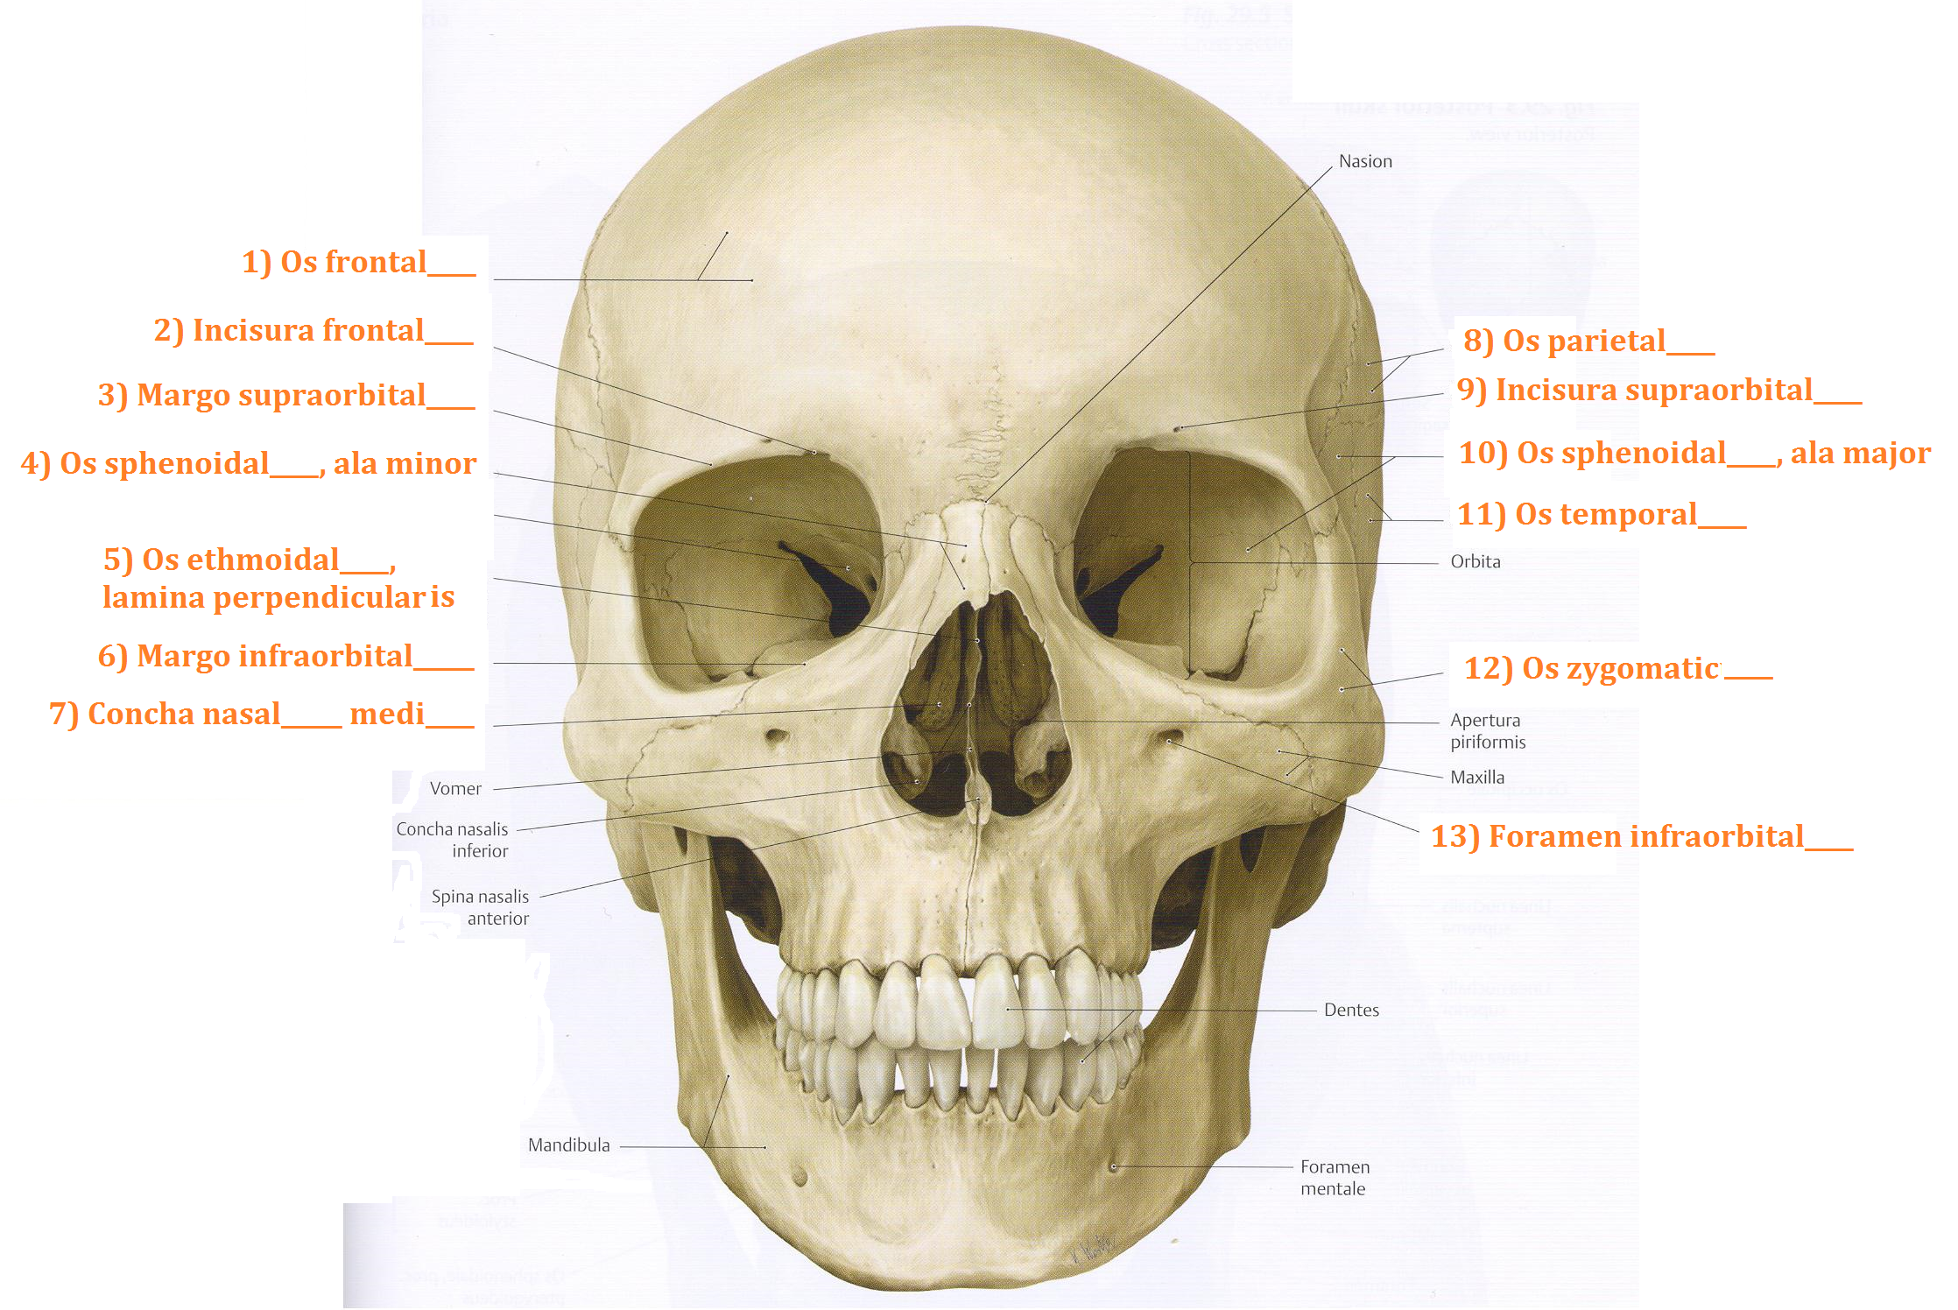
Fill in missing endings

Slide 8
Give the nouns from which the underlined adjectives are derived
term | nom. sg. | gen. sg. | gender | declension | meaning
os frontale
margo supraorbitalis
concha nasalis media
os parietale
os temporale
os occipitale

Slide 9
Fill in missing terms
The space in the body below the chest is cavitas ______________.
Channel formed of the holes in the centre of each vertebra, through which the spinal cord passes is canalis _________________.
The eight cranial nerve which governs hearing and balance is nervus ____________________.
Patient that is unable to move/walk is patiens ___________________.
Disease which develops all the time is morbus ____________________.
One of the two muscles which lie across the chest is musculus ________________________.
One of the two endocrine glands at the top of the kidneys is glandula _______________________ .
pectoralis, e
vertebralis, e
abdominalis, e
suprarenalis, e
progrediens, entis
immobilis, e
vestibulocochlearis, e
Notes:
Abdominalis//vertebralis//vestibulocochlearis//immobilis//progrediens/pectoralis// suprarenalis

Slide 10
Fill in logical opposites
Dentes lactei <> _______________
Arcus dentalis maxillaris <> _______________
Facies digitalis dorsalis <> _______________
Ligamentum palpebrale laterale <> _______________
Fractura malleoli medialis <> _______________
Caries profunda <> _______________
Os longum <> _______________
Ulcus durum <> _______________
Fractura simplex <> _______________
Pars lateralis <> _______________
Notes:
Permanentes, mandibularis, plantaris, mediale, lateralis, superficialis, breve, molle, multiplex, medialis

Slide 11
Form anatomical/clinical terms
Caries + dens (pl.) + permanens, entis
Rete + articularis, e + cubitus
In + canalis + centralis, e + medulla + spinalis, e
Tuber + frontalis, e + os + frontalis, e
Operatio + pars + descendens, entis + et + ascendens, entis + duodenum
Capsula + articularis, e + humerus
Processus (pl.) + vertebra (pl.) + columna + vertebralis, e
Ruptura + musculus + biceps, pitis + brachium
Septem (7) + ligamentum (pl.) + teres (pl.) + corpus + humanus, a, um
Tunica + mucosus, a, um + intestinum + tenuis, e
Vena + comitans, antis + nervus + hypoglossus, a, um
Notes:
capsulitis

Slide 12
Find mistakes
Musculi levatores costarum brevium
Glandulae suprarenale
Vena iliaca communa
Organum vestibulocochlearis
Trauma gravis articulationis genus sinistri
Therapia urocystitidis gravidis
Ramus communicant cum nervi ulnari
breves
suprarenales
communis
vestibulocochleare
grave
gravis
communicans
nervo

Slide 13
Join the terms with the preposition in
term | in + direction | in + position
intestinum crassum/tenue
colon sigmoideum/ascendens
vesica fellea/biliaris
musculus rectus/biceps
fractura aperta/multiplex
urocystitis acuta/catarrhalis

Slide 14
Form anatomical terms, do not change the word order
fossula (pl.) --- tonsillaris, e
rete --- articularis, e --- cubitus
musculus --- biceps, itis --- brachium
geniculum --- canalis --- nervus --- facialis, e
ligamentum --- teres, etis --- hepar/uterus
arteria --- iliacus, a, um --- communis, e
pars --- descendens, ntis --- duodenum
ramus --- communicans, antis --- cum --- nervus --- ulnaris, e
musculus (pl.) --- levator (pl.) ---- costa (pl.) --- brevis, e (pl.)

Slide 15
Match the expressions to form clinical terms
Trauma grave articulationis acutae
Symptomata urocystitidis multiplices
Caries profunda dentis exacerbans
Insufficientia cordis herpetis simplicis
Therapia permanentis
Fracturae columnae vertebralis genus l. dx.

Slide 16
Put the terms into correct order to form diagnoses. Do not change the endings.
lacerum mentalis
occipitalis vulnus
regionis et
l. dx. musculi
bicipitis ruptura
partialis femoris
cruris status
distalis fracturae
post l. sin.
operationem partis
nasalium fractura
dislocatione
ossium sine

Slide 17
Translate into Latin
Suprarenal gland
Simple joints
Lateral margin of the nail
Fossa for the lacrimal gland (literally of the lacrimal gland)
Nucleus of the abducent nerve
Vein accompanying the hypoglossal nerve (literally accompanying vein of the hypoglossal nerve)
Short gastric arteries
Common carotid artery
Fissure of the round ligament
Long/short head of the biceps muscle of the femur
Orifice of the vermiform appendix

Slide 18
Examples of authentic diagnoses
code | diagnosis
K928 | Corpus alienum intestini tenuis perforans
C259 | Carcinoma capitis pancreatis inoperabile, metastases hepatis multiplices
S019 | Vulnera lacera regionis frontalis, dorsi nasi, labii superioris oris et vestibuli oris
C348 | Tumor lobi medii pulmonis l. dx. ad pericardium, diaphragma et nervum phrenicum increscens
C186 | St. p. colectomiam subtotalem propter carcinoma coli descendentis
M4795 | Vulnus punctum cubiti sin., corpus alienum vitreum in situ
S5250 | Fractura intraarticularis partis distalis radii sin. dislocata comminutiva
S9220 | Fractura ossis cuboidei et navicularis pedis l. dx. sine dislocatione
S863 | Ruptura musculi tricipitis surae l. dx. suspecta
K928 | Corpora aliena vitrea multiplicia antebrachii l. dx.
S300 | Contusio regionis lumbalis dorsi gravis

Slide 19
Look up all adjectives in the diagnoses and write them down in their dictionary forms
3-form adjectives | 2-form adjectives | 1-form adjectives

Slide 20
Translate the diagnoses into English and put the underlined terms in the opposite number
code | diagnosis
K928 | Corpus alienum intestini tenuis perforans
C259 | Carcinoma capitis pancreatis inoperabile, metastases hepatis multiplices
S019 | Vulnera lacera regionis frontalis, dorsi nasi, labii superioris oris et vestibuli oris
C348 | Tumor lobi medii pulmonis l. dx. ad pericardium, diaphragma et nervum phrenicum increscens
C186 | St. p. colectomiam subtotalem propter carcinoma coli descendentis
M4795 | Vulnus punctum cubiti sin., corpus alienum vitreum loci vulneris
S5250 | Fractura intraarticularis partis distalis radii sin. dislocata comminutiva
S9220 | Fractura ossis cuboidei et navicularis pedis l. dx. sine dislocatione
S863 | Ruptura musculi tricipitis surae l. dx. suspecta
K928 | Corpora aliena vitrea multiplicia antebrachii l. dx.
S300 | Contusio dorsi regionis lumbalis gravis

