Slide 1
Basic medical terminology I
Seminar 12

Slide 2
4th declension = u-stems
genitive singular ending: -ūs
mostly masculines: ductus, ūs, m. = duct
(= mainly words with nom. sg. ending - sus, - tus, - xus)
several neuters: genū, ūs, n. = knee
gender exceptions: manus, ūs, f. = hand
acus, ūs, f. = needle
+ names of trees

Slide 3
4th declension: masculines
2 nouns with abl. pl. ending -ubus:
arcus, us, m. = arch >> arcubus
artus, us, m. = limb, joint >> artubus
 | singular | plural
nom. | duct-us | duct-ūs
gen. | duct-ūs | duct-uum
acc. | duct-um | duct-ūs
abl. | duct-ū | duct-ibus

Slide 4
Decide on the declension of the given nouns
tractus, us, m.
musculus, i, m.
corpus, corporis, n.
ulcus, eris, n.
manus, us, f.
visus, us, m.
nervus, i, m.
methodus, i, f.
crus, cruris, n.

Slide 5
4th declension: neuters
only two 4th declension neuters are actually used
in medical terminology:
genu, us, n. = knee
cornu, us, n. = horn
 | singular | plural
nom. | gen-ū | gen-ua
gen. | gen-ūs | gen-uum
acc. | gen-ū | gen-ua
abl. | gen-ū | gen-ibus

Slide 6
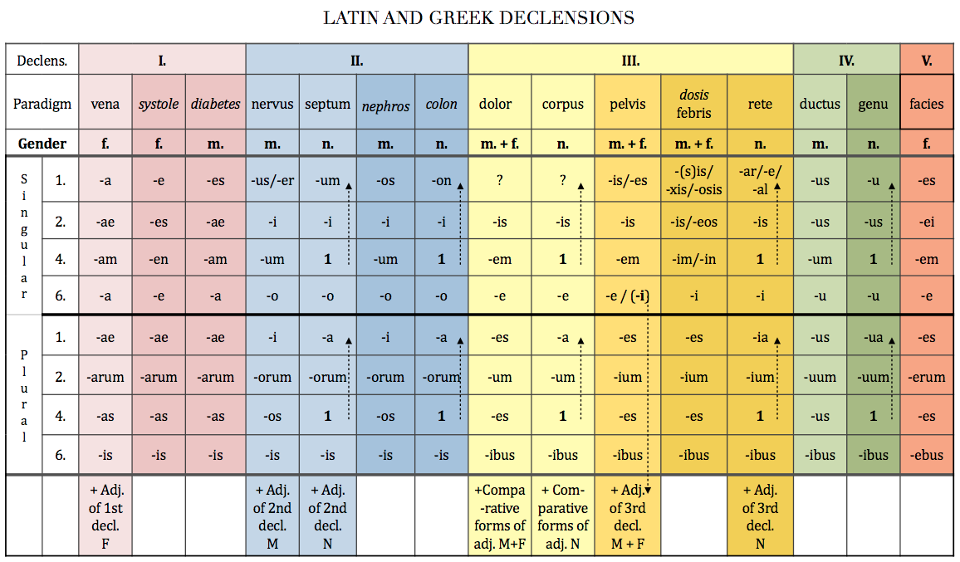

Slide 7
5th declension = e-stems
genitive singular ending: -ei
only feminines x dies, ei, m. = day
paradigm word: facies, ei, f. = face, surface
 | singular | plural
nom. | faci-es | faci-es
gen. | faci-ei | faci-erum
acc. | faci-em | faci-es
abl. | faci-e | faci-ebus
!! sg. species, speciei, f. = species !!
!! pl. species, erum, f. = mixture of dried plants (e.g. species urologicae) !!

Slide 8
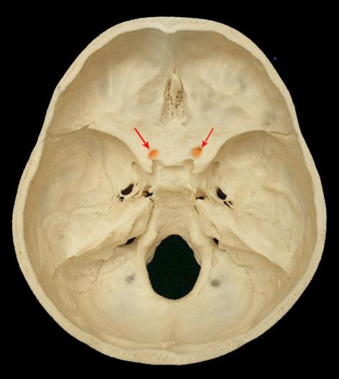
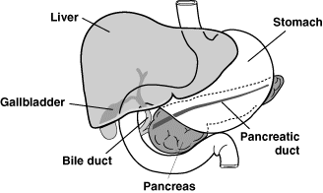
Canalis = a narrow tubular passage or channel, e.g. optic canal
Ductus = a passage with well-defined walls, esp. for the passage
of excretion or secretion
bile duct?
optic canal?
Notes:
Canalis opticus; ductus choledochus = ductus biliaris

Slide 9
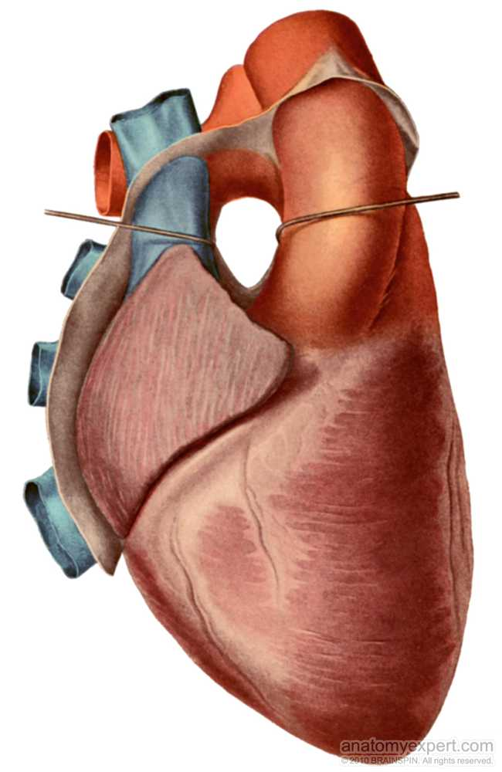
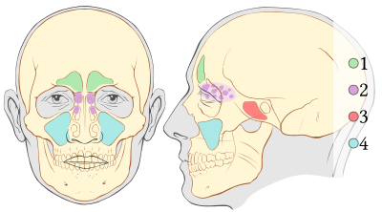
Sinus = a cavity in bone, esp. the pair cavities in the facial
part of skull; a dilated channel for venous blood
transverse sinus of pericardium?
1 frontal sinuses
2 ethmoid sinuses
3 sphenoid sinus
4 maxillary sinuses
Notes:
Sinus frontales, ethmoidales, sphenoidales, maxillares; sinus transversus pericardii

Slide 10
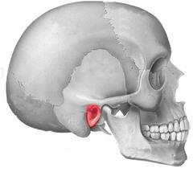
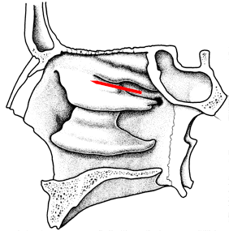
Meatus = an opening or passage, esp. one leading to the body surface;
external opening of a canal
midlle meatus of the nose?
nasopharyngeal meatus?
external acoustic meatus?
Notes:
Meatus nasi medius; meatus nasopharyngeus; meatus acusticus externus

Slide 11
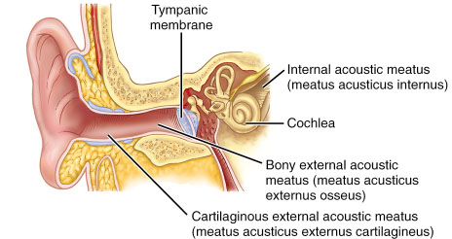
Meatus acusticus externus et internus
membrana tympani

Slide 12
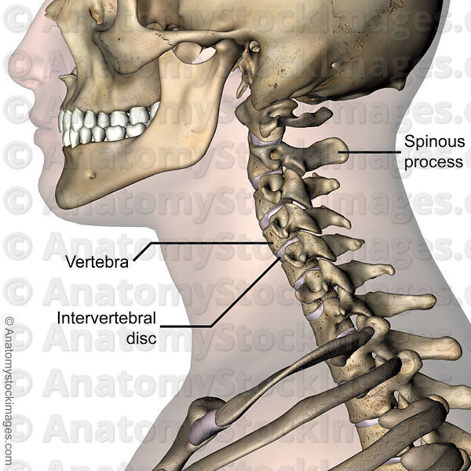
processus spinosus
discus vertebralis

Slide 13
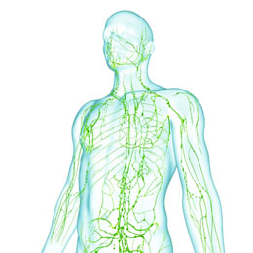
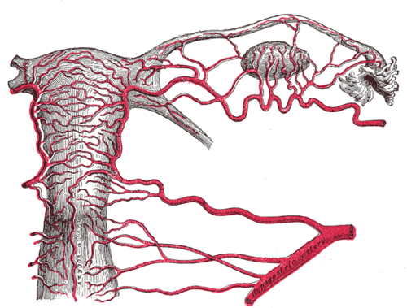
Plexus
uterine venous network/plexus?
lymphatic network/plexus?
state after the excision of a lymph node due to carcinoma?
Notes:
Plexus lymphaticus, status post excisionem nodi lymphatici propter carcinoma; plexus venosus uterinus

Slide 14
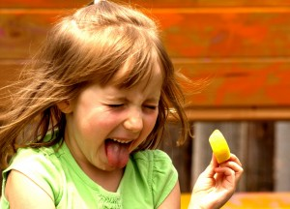
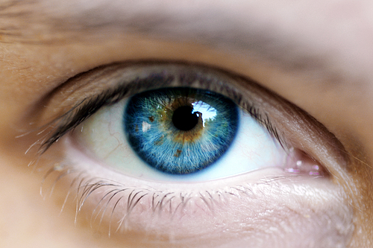
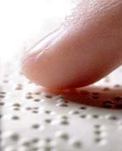
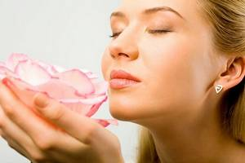
Sensus humani
visus ~ auditus ~ gustus ~ olfactus ~ tactus
1
2
3
4
5

Slide 15
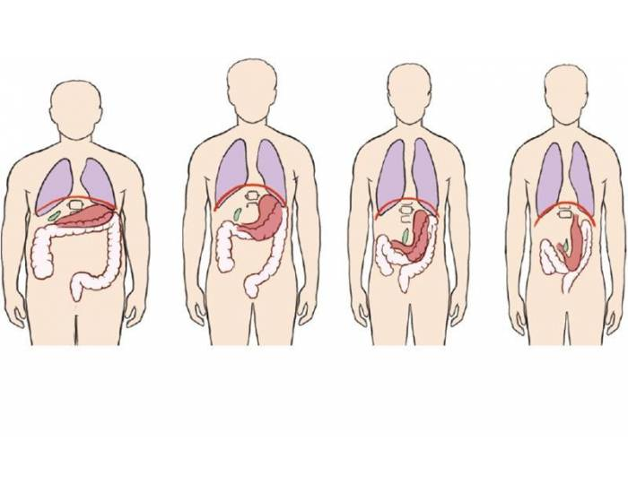
Habitus
= a general body type or constitution of a person;
posture or position of the body
A hypersthenicus
B sthenicus
C hyposthenicus
D asthenicus
a) b) c) d)
*Gr. sthenos = strength
Which of these is the average/normal?

Slide 16
Pulsus
parvus tardus celer bigeminus
Notes:
Pulsus parvus/mollis = shallow, weak pulse
Pulsus tardus = slow, rare pulse
Pulsus celer/frequens = accelerated pulse
Pulsus bigeminus = pathological pulse characterized by groups of two heartbeats close together followed by a longer pause

Slide 17
Status
post operationem ---> postoperat-ivus
propter asthma ---> asthmat-icus
propter epilepsiam ---> epilept-icus

Slide 18
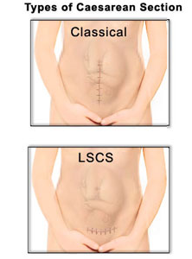
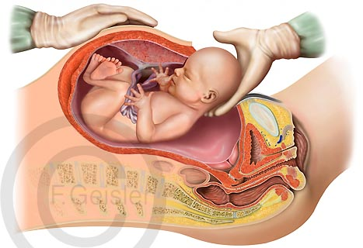
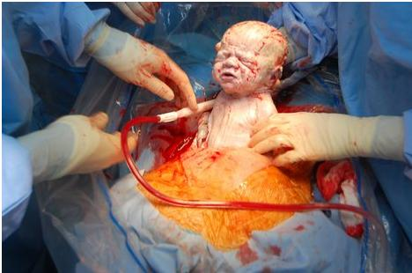
Partus caesareus = sectio caesarea
The term caesareus is derived from the Latin verb caedo, ere, cecidi, caesum = “to cut, to free by cutting”
Latin nouns ending in
-cisio (-cision in English)
are derived from the same verb: excisio, incisio, …
LSCS = Lower Segment Caesarean Section:
today the most commonly used type of Caesarean section

Slide 19
PUERPERIUM
PARTUS PRAEMATURUS
PARTUS MATURUS
PARTUS SEROTINUS
ABORTUS
before the end of week 28 of pregnancy | before the end of week 37 of pregnancy | before the end of week 42 of pregnancy | after the end of week 42 of pregnancy | during weeks 6-8 after the delivery
Graviditas tubaria extrauterina l. dx., interruptio★ graviditatis.
Haematoma vaginae post partum spontaneum★.
Funiculus umbilicalis★ circum abdomen fetus.
Ruptura parietis vaginae l. sin. intra partum, sutura parietis.
Abortus propter defectum★ congenitum fetus.
Prolapsus pedum fetus in vaginam. Sectio caesarea acuta.
Metastases ovarii l. utr., status post CA mammae l. sin., prognosis mala.
Psychosis puerperalis★ matris.

Slide 20
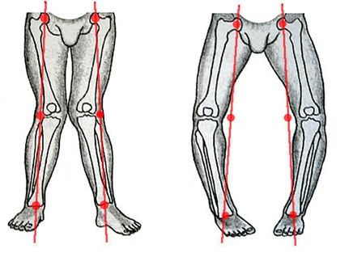
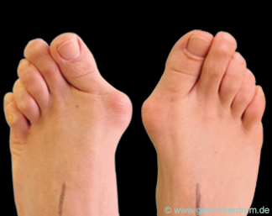
Genua valga Genua vara
state after the operation of a big toe twisted
inwards of the left foot?
Notes:
Status post operationem hallucis valgi pedis sinistri

Slide 21
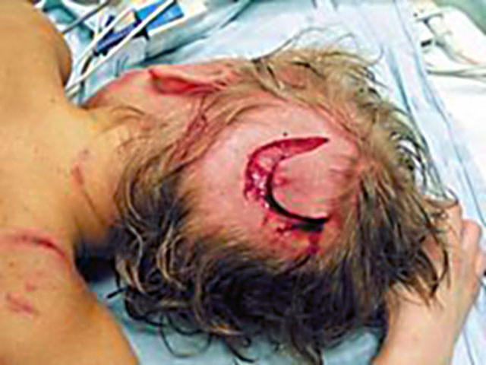
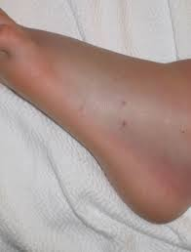
Morsus
morsus serpentis
morsus canis
Create diagnoses
according to the pictures!

Slide 22
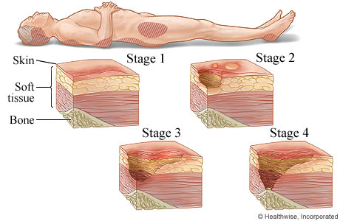
Decubitus profundus

Slide 23
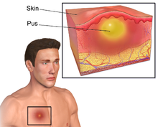
Abscessus
= a collection of pus that has built up within the tissue of the body, it may occur in any kind of solid tissue (lungs, brain, teeth, kidneys and tonsils), but most frequently appears on skin
abscessus (4x) abscessuum  abscessum abscessu  abscessibus
causae ________________
________________ ductus choledochi
excisio ________________ dolorosi ani
operatio meatus acustici sine ________________ secundario
________________ secundarii in vulneribus operativis
status post ________________ cerebri
operatio propter ________________ tubarum uterinarum
gravida cum ________________ dentium

Slide 24
In situ
morbus ischemicus cordis, cardiostimulator in situ
tumor mammae l. sin., implantatus in situ
tear wound of the head, a foreign body in the place (of the wound)?
cancer of the large intestine, carcinoma in its (original) place?
x
metastases of the tumor towards the liver?
Notes:
Vulnus lacerum capitis, corpus alienum in situ
Carcinoma intestini crassi, carcinoma in situ x metastases tumoris ad hepar

Slide 25
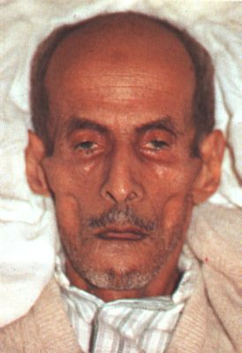
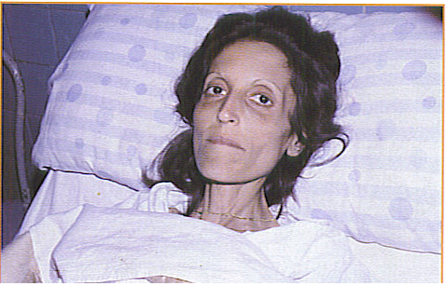
Facies Hippocratica = facies abdominalis
The facial expression produced by impending death or long illness (accompanied by pain), excessive evacuations, excessive hunger, and the like, e.g. by peritonitis (inflammation of peritoneum) or cholera.
The nose is sharp, the eyes sunken, the temples fallen in, the ears cold and drawn in and their lobes distorted, the skin of the face hard, stretched and dry, and the colour of the face pale or dusky.

Slide 26
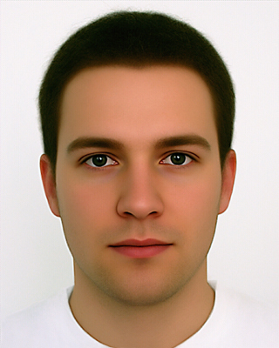
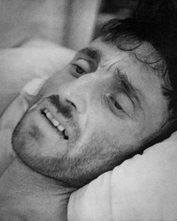
Facies composita
= normal, calm facial
expression of a healthy
person
Facies dolorosa
= facial expression showing signs of pain

Slide 27
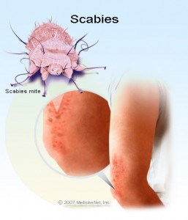
Scabies
(Lat. scabere = to scratch)
= a contagious skin disease caused by a tiny mite (Sarcoptes scabiei) laying eggs under the skin, the characteristic itching is caused by the reaction to the feces of the mite
grey ointment against scabies?
Notes:
Unguentum griseum contra scabiem

Slide 28
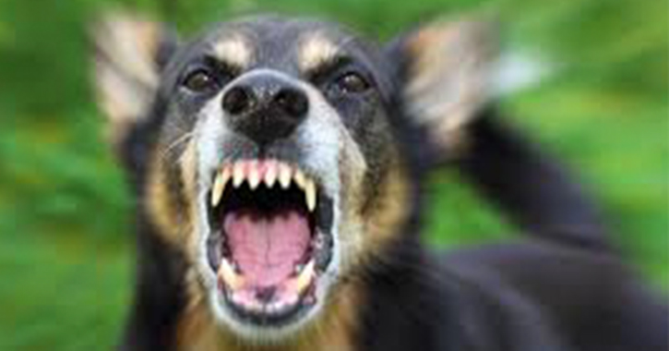
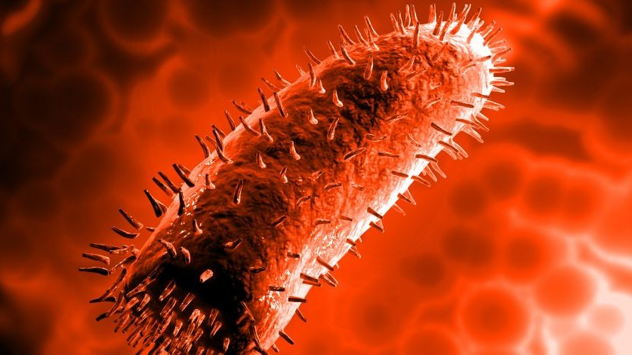
Rabies
= an acute viral disease (a virus of the family Rhabdoviridae) of the central nervous system transmitted through saliva from the bite of an infected animal, it is also called hydrophobia because of the typical symptom of the disease; the symptoms include extreme thirst, fever, depression, confusion, hard swallowing, muscle spasms, sensitivity to touch, light or loud noise; if not prevented, it is almost always fatal
r. silvatica
r. domestica
death due to rabies after the bite of an animal?
Notes:
Exitus propter rabiem post morsum animalis

