Slide 1
Basic Medical Terminology
Seminar 2

Slide 2
Pronunciation practice
Infarctus myocardii recens
Fractura comminutiva colli femoris lateris dextri
Commotio cerebri
Vulnus punctum thoracis ad pulmonem lateris sinistri penetrans
Aethylismus chronicus
Appendicitis acuta
Intoxicatio carboneo hydroxydato (CO) gradus maioris

Slide 3
Pronunciation practice
Typhus recurrens
Tonsillitis purulenta recidivans
Diabetes mellitus stabilis
Dermatitis allergica protrahens
Vitium cordis acquisitum
Infarctus haemispherii sinistri cerebri, Hemiparesis
Nephrolithiasis, colica renalis subsequens
Tumor ventriculi ad investigationem et observationem

Slide 4
Revision: Latin declensions
How do I decide to what declension a Latin noun belongs?
on the basis of the ending of genitive singular
What are the genitive endings of Latin declensions?

Slide 5
Revision: Latin declensions
What is the stem of a Latin word?
a form to which individual case endings are attached
a part of the word which remains after the removal of the ending of genitive singular
How can we identify the stem of a Latin noun?
we take the genitive form (sg.) and remove the genitive ending
vena, ven-ae
musculus, muscul-i; diameter, diametr-i
auris, aur-is; corpus, corpor-is
arcus, arc-us; genu, gen-us
facies, faci-ei

Slide 6
Practice: give the declensions of the nouns (cf. Handout 2, task 2)
0. corpus, oris, n.
cutis, is, f.
1. caput, itis, n.
2. capilli, orum, m.
3. facies, ei, f.
4. os, oris, n.
lingua, ae, f.
5. mentum, i, n.
6. axilla, ae, f.
7. brachium, ii, n.
8. cubitus, i, m.
9. antebrachium, ii, n.
10. carpus, i, m.
11. pollex, icis, m.
12. palma, ae, f.
13.,18. digitus, i, m.
14. sulcus, i, m.
15.,28. penis, is m.
16. femur, oris, n.
17. genu, us, n.
19. frons, frontis, f.
20. oculus, i, m.
21. nasus, i, m.
22. auris, is, f.
23. bucca, ae, f.
24. collum, i, n.
cervix, icis, f.
25. pectus, oris, n.
26. abdomen, inis, n.
27. hypogastrium, ii, n.
29. truncus, i, m.
30. manus, us, f.
31. crus, cruris, n.
32. tarsus, i, m.
talus, i, m.
33. pes, pedis, m.
34. hallux, ucis, m.
3
3
3
2
5
3
1
2
1
2
2
2
2
3
1
2
2
3
3
4
3
2
2
3
1
2
3
3
3
2
2
4
3
2
2
3
3

Slide 7
Practice: find the stems of the nouns (cf. Handout 2, task 3)
ex: caput, capit-is
skeleton, skeleti
os, ossis
cranium, cranii
orbita, orbitae
collum, colli
cervix, cervicis
thorax, thoracis
costa, costae
discus, disci
processus, processus
vertebra, vertebrae
pelvis, pelvis
coxa, coxae
ilia, ilium
coccyx, coccygis
ischium, ischii
pubes, pubis
symphysis, symphysis
nasus, nasi
dens, dentis
mandibula, mandibulae
clavicula, claviculae
scapula, scapulae
sternum, sterni
humerus, humeri
arcus, arcus
radius, radii
ulna, ulnae
metacarpus, metacarpi
carpus, carpi
phalanx, phalangis
femur, femoris
patella, patellae
tibia, tibiae
fibula, fibulae
metatarsus, metatarsi

Slide 8
Revision: Gender
The grammatical gender of a noun affects the form of all other words related to it (i.e. adjectives, pronouns, verbs).
>> Latin adjectives change their forms depending on the ii noun to which they refer.
ENGLISH – 3 genders:
HE – refers to male humans and animals
SHE – refers to female humans and animals
IT – inanimate objects or animals
LATIN – 3 genders:
masculine -> discipulus (he-student), musculus (muscle)
feminine -> discipula (she-student), vena (vein)
neuter -> corpus (body)

Slide 9
Revision: number and case
LATIN = INFLECTIONAL LANGUAGE
In many languages, Latin and Greek among them, nouns decline = inflect (change their form) for number and case.
Inflection for number involves singular (sg.) : plural (pl.) forms (eg. forearm : forearms = antebrachium : antebrachia) and is present in English as well.
Inflection for case involves changing the form of the noun according to its syntactic function/meaning. Latin has an extensive case system in which a special form is used for every specific meaning. In medical terminology, 4 out of 6 Latin cases are used to express the following meanings:

Slide 10
Revision: cases and their functions
LATIN
system of specific case endings + prepositions
1. NOMINATIVE – subject (ending)
2. GENITIVE – dependency of two nouns, possession (ending)
4. ACCUSATIVE – object, movement
= direction (preposition + ending)
6. ABLATIVE – place, location, instrument, cause (preposition + ending)
ENGLISH
word order + prepositions
subject of a phrase
possessive case = “of”
prepositional phrase
prepositional phrase
Accusative + ablative = prepositional cases
(i.e. they are used only after prepositions).

Slide 11
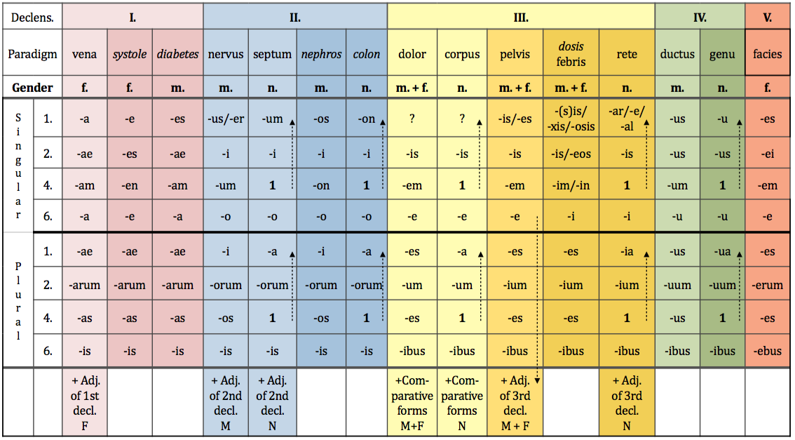
Nominative singular and plural

Slide 12
Change the following words into plural (cf. Handout 2, task 4)
coxae
cervicis
coxa_ _ _ _ _ _ _ _ cervix_ _ _ _ _ _ _ _
_ _ _ _ _ _ _ _ _ _ _ _ _ _ _ _ _ _ _ _ _
_ _ _ _ _ _ _ _ _ _ _ _ _ _ _ _ _ _ _ _ _
mentum_ _ _ _ _ _ arcus _ _ _ _ _ _ _ _
_ _ _ _ _ _ _ _ _ _ _ _ _ _ _ _ _ _ _ _ _
_ _ _ _ _ _ _ _ _ _ _ _ _ _ _ _ _ _ _ _ _
I
cox-
III
cervic-
coxae
cervices
menti
arcus
II
ment-
IV
arc-
menta
arcus

Slide 13
Introduction to Latin syntax
AGREED ATTRIBUTE
= noun + adjective (agreement in gender, number and case)
Example: musculus (m.) longus = long muscle
fractura (f.) aperta = open fracture
caput (n.) longum = long head
NON-AGREED ATTRIBUTE
= noun in nominative + noun in genitive
Meaning: state of dependency, possession
Translation: “of”
Example: fractura costae //fracturae costarum
fracture of a rib fractures of ribs
! = rib fracture = rib fractures

Slide 14
Genitive singular and plural

Slide 15
Form non-agreed attributes (cf. Handout 2, task 5)
ex: caput + costa > caput costae head of a rib
caput + femur ->
caput + fibula ->
caput + humerus ->
caput + phalanx ->
caput + radius ->
caput + talus ->
caput + ulna ->
caput femoris
caput fibulae
caput humeri
caput phalangis
caput radii
caput tali
caput ulnae

Slide 16
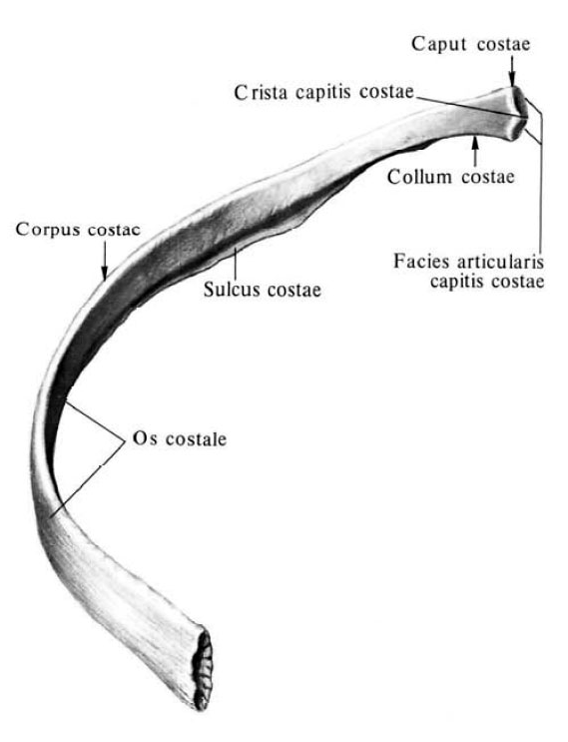
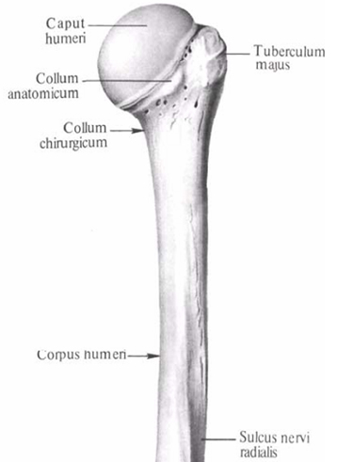

Slide 17
Prepositions and prepositional phrases
Denote:
spatial relations sub, infra, post
temporal relations post, ante
causal relations propter, e/ex
other cum, sine
Can be connected with:
Accusative case
(majority of prepositions used in medical terminology)
Ablative case (A/AB, CUM, DE, E/EX, PRO, SINE)
both Accusative and Ablative case = IN, SUB

Slide 18
Accusative and ablative singular and plural

Slide 19
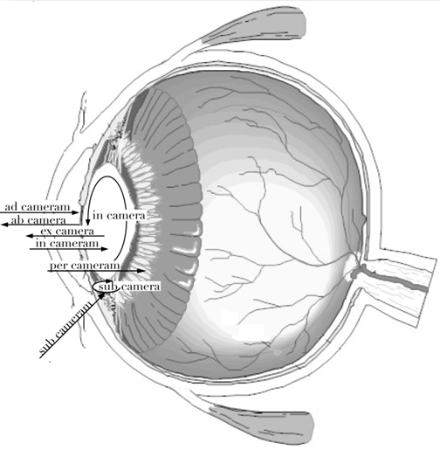
Camera bulbi
posterior

Slide 20
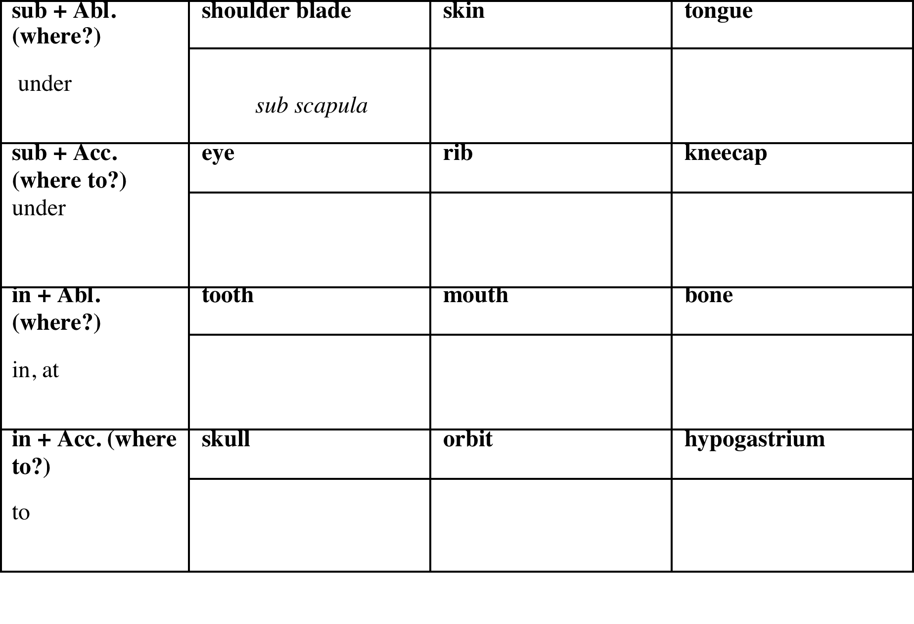
Connect nouns with prepositions (cf. Handout 2, task 6)
sub scapula
sub cute
sub lingua
sub oculum
sub costam
sub patellam
in dente
in ore
in osse
in cranium
in orbitam
in hypogastrium

Slide 21
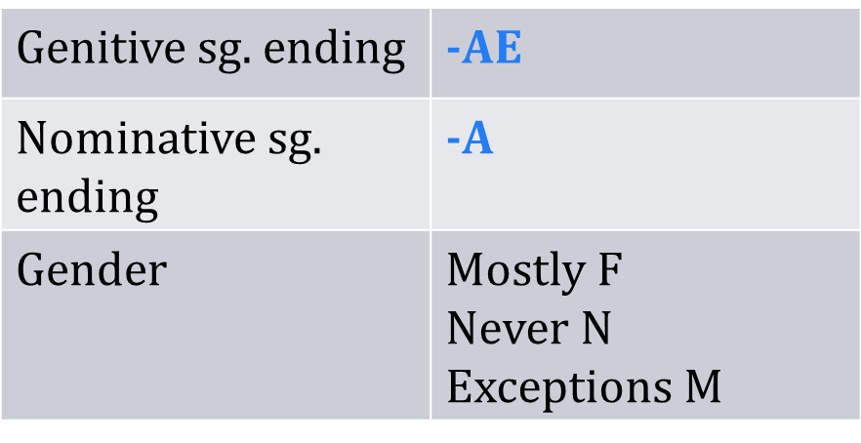
1st declension (a-stems): Latin nouns
Latin nouns belonging to the 1st declension have:
Nouns of the 1st declension of MASCULINE GENDER:
Names of specialists – e.g. dentista, ae, m.
Names of muscles – e.g. agonista, ae, m.

Slide 22
1st declension: Latin nouns

Slide 23
1st declension: Latin paradigm
case | singular | plural
nom. | vena | venae
gen. | venae | venarum
accus. | venam | venas
abl. | venā | venis

Slide 24
1st declension: nouns of Greek origin
Nouns of Greek origin belonging to the 1st declension have:
Genitive sg. ending | -ES | -AE
Nominative sg. ending | -E | -ES
Gender | F | M

Slide 25
1st declension: nouns of Greek origin

Slide 26
1st declension: Greek paradigms
 | systole, es, f. | diabetes, ae, m.
nom. sg. | systole | diabetes
gen. sg. | systoles | diabetae
accus. sg. | systolen | diabetam
abl. sg. | systole | diabeta
all nouns declined like systole, es, f. are of feminine gender
all nouns declined like diabetes, ae, m. are of masculine gender
paradigms vena, systole, and diabetes have identical plural endings !!!

Slide 27
1st declension: Latin and Greek paradigms in plural

