Slide 1
Basic Medical Terminology
Seminar 3

Slide 2
Pronunciation practice
Musculus latissimus dorsi
Pars respiratoria tunicae mucosae nasi
Vena aquaeductus cochleae
Hiatus oesophageus
Protuberantia occipitalis externa
Cum anaemia perniciosa
Nucleus ruber

Slide 3
Revision
What is a non-agreed attribute?
Give an example.
Which cases are used with Latin prepositions?
Explain the difference in meaning between
in venam and in vena.
Which Latin prepositions require the use of the ablative case?

Slide 4
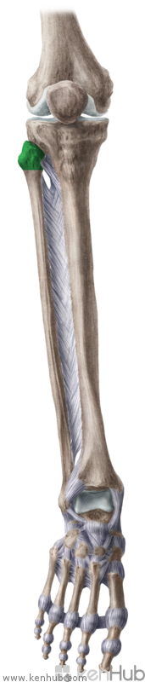
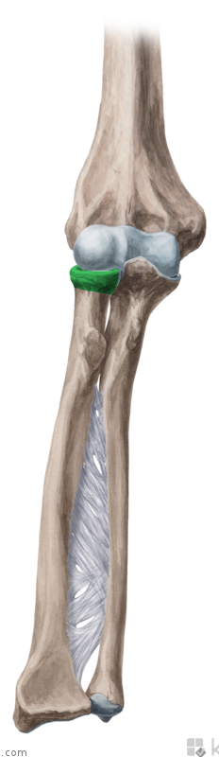
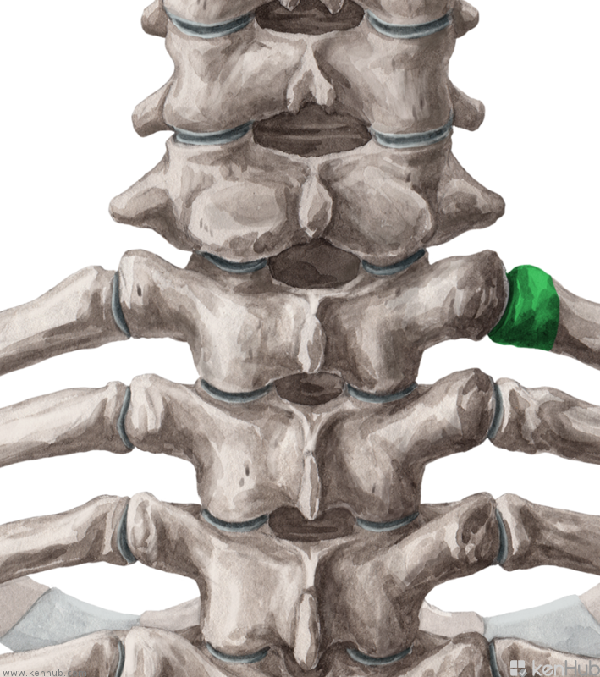
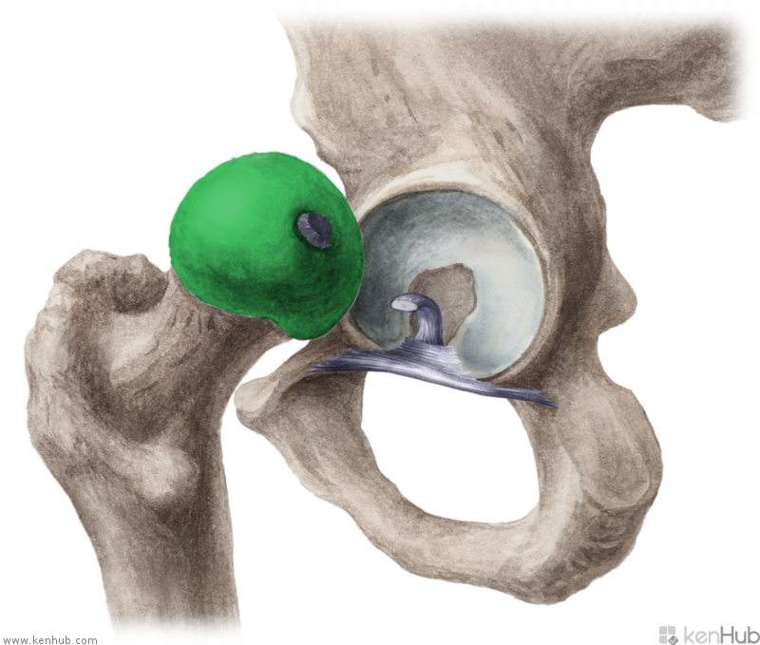
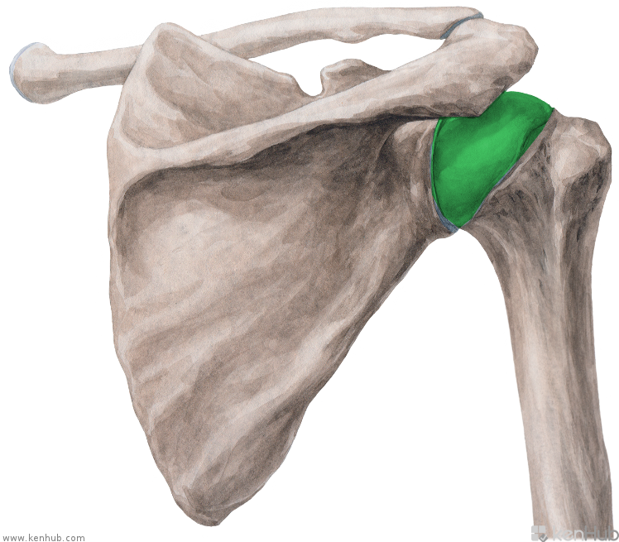
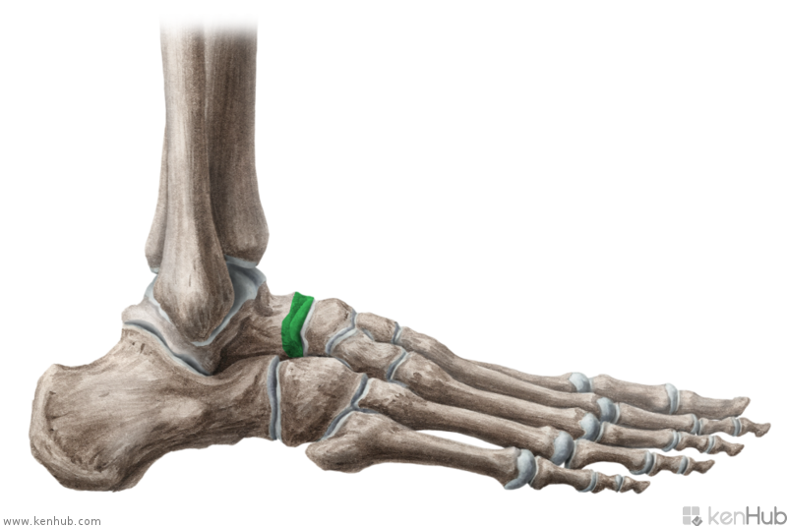
C
D
A
E
F
B
Head of… ?
Notes:
Na všetkých obrázkoch je hlavica nejakej kosti: úlohou študentov je preložiť anat. termíny do latinčiny.
A. Caput costae, B. Caput humeri, C. caput fibulae, D. caput radii, E. caput femoris, F. caput tali

Slide 5
Create meaningful diagnoses!
aorta ~ sclera ~ ulna ~ digitus ~ maxilla ~ ligamentum ~ trachea ~ tibia
RUPTURA ___________________
___________________
___________________
___________________
FRACTURA ___________________
___________________
___________________
___________________

Slide 6
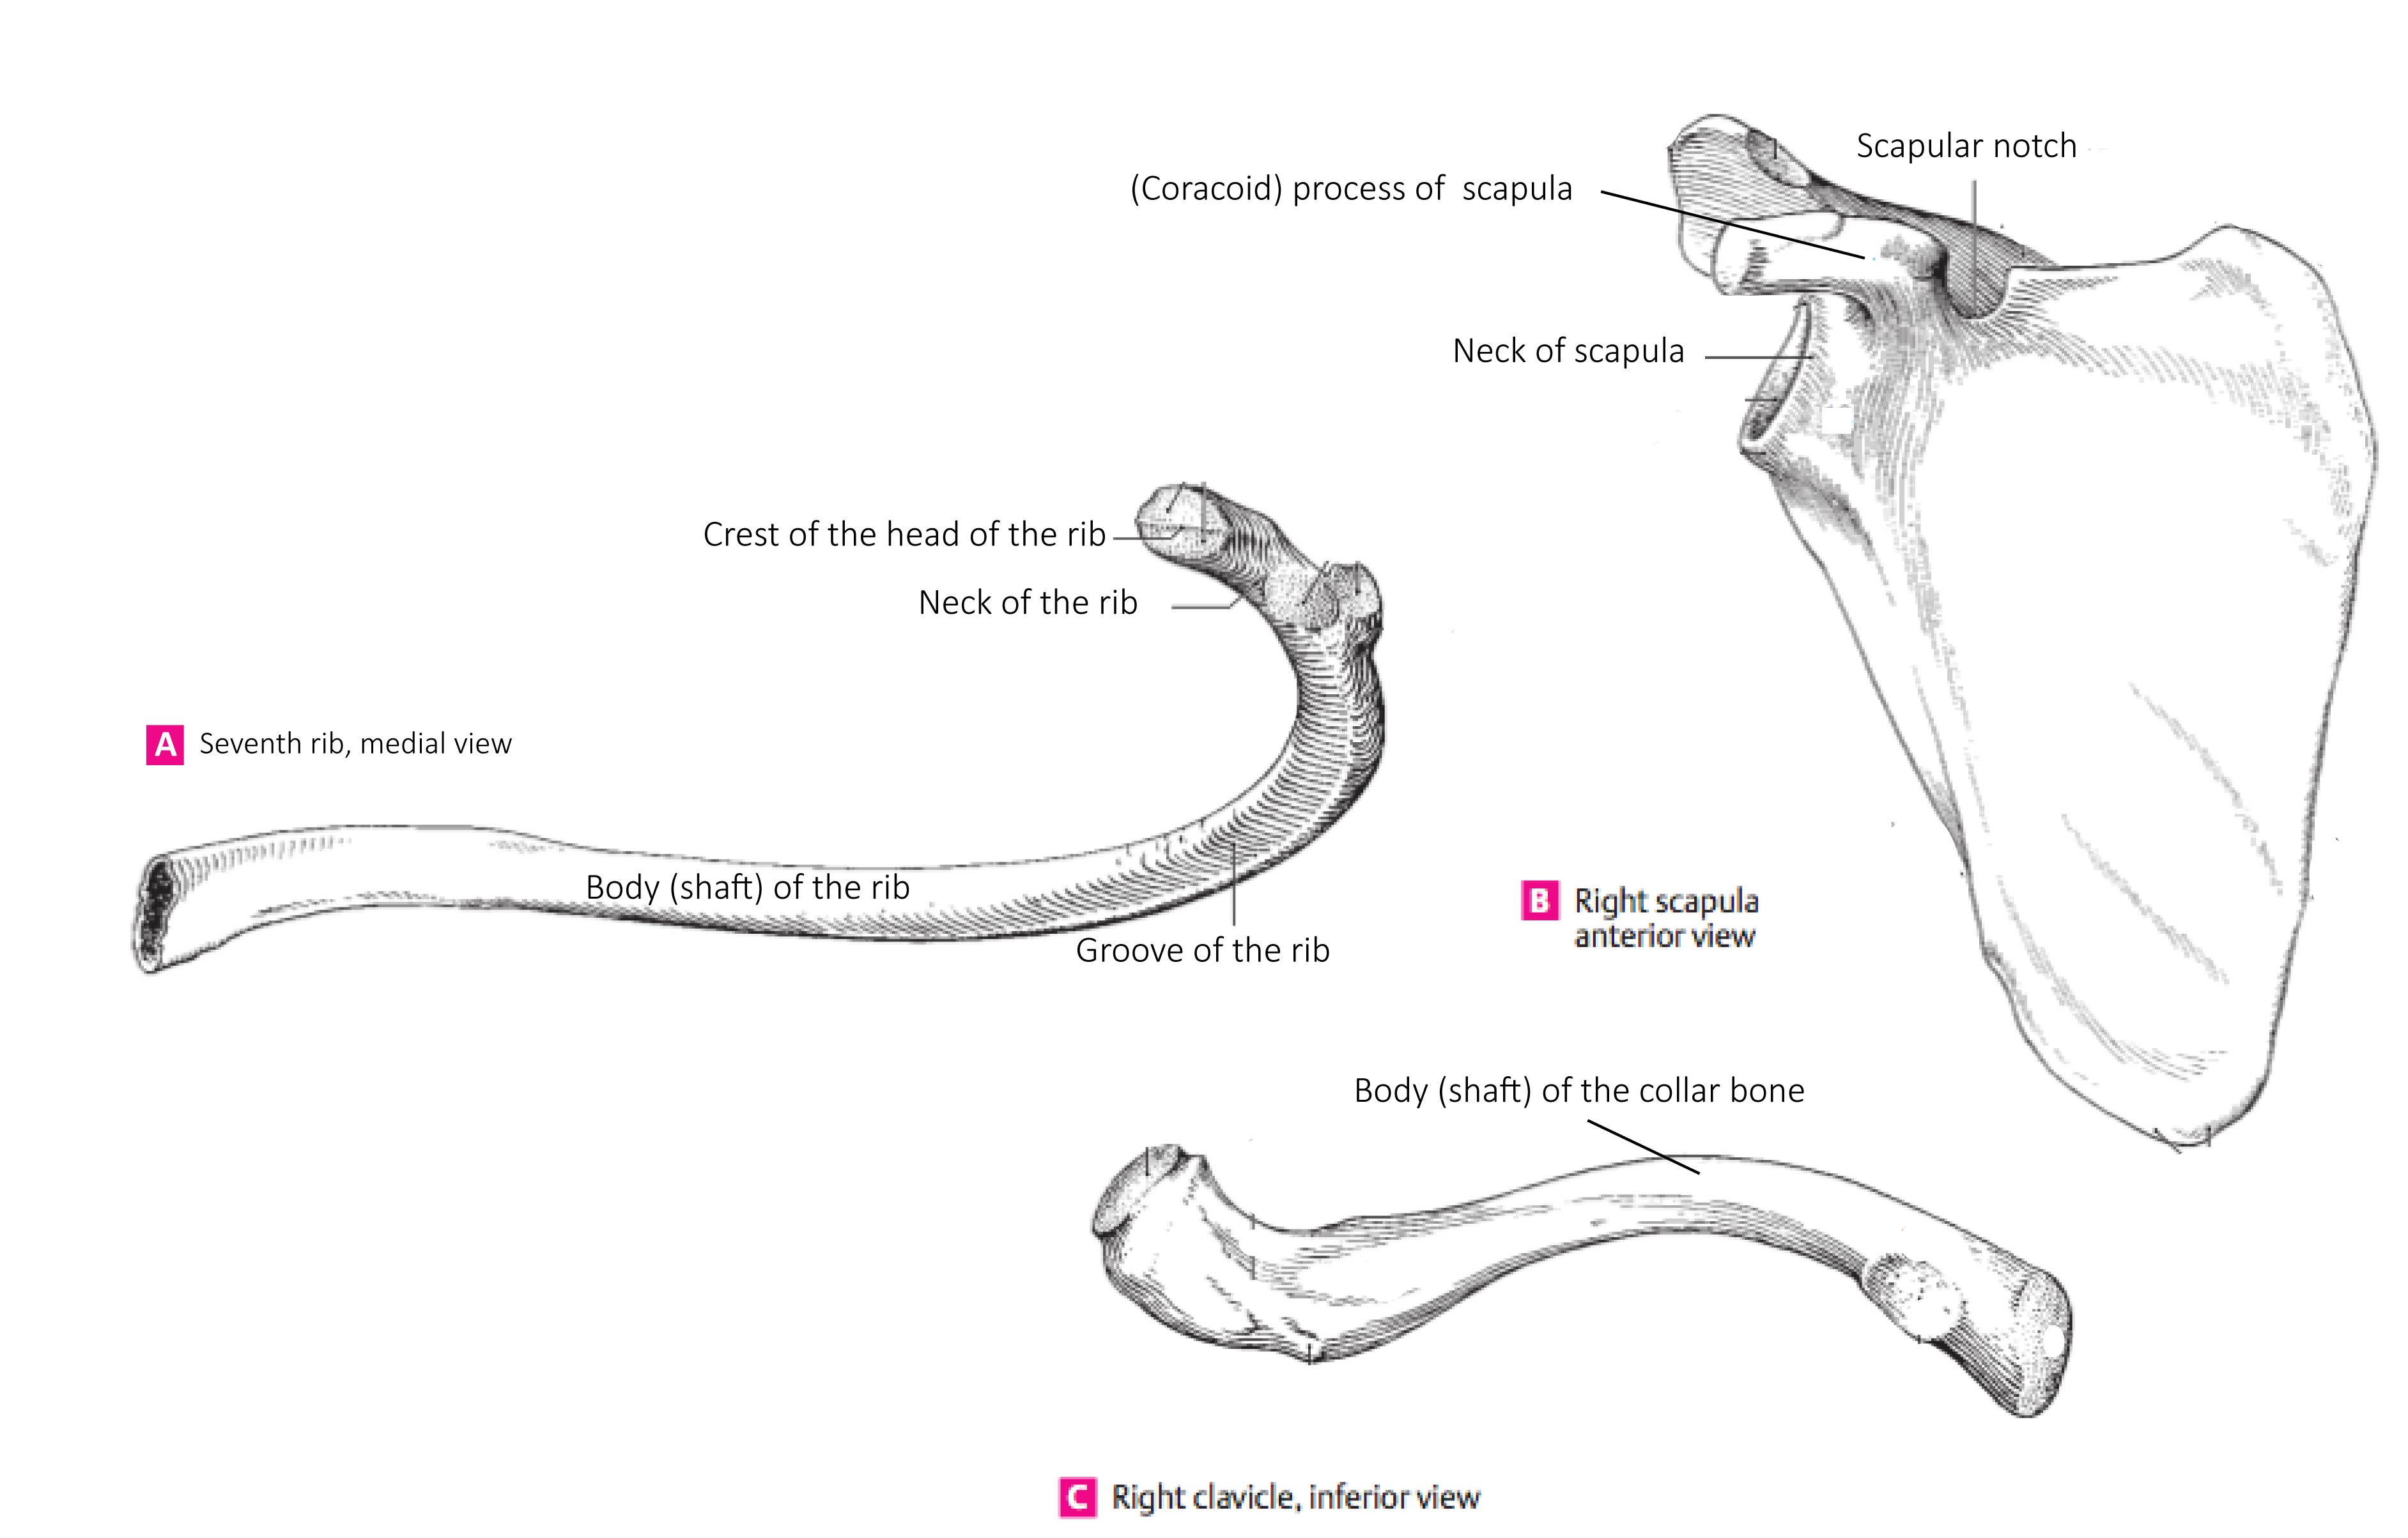
Translate into Latin
(Handout 3, task 2)

Slide 7
Latin adjectives
their function is to describe a noun
their form depends on the noun to which they refer >>
NOUN + ADJECTIVE = AGREED ATTRIBUTE
(agreement in gender, case and number)
Example: musculus longus (nom. sg. m.)
vena cava (nom. sg. f.)
ligamentum latum (nom. sg. n.)

Slide 8
Adjectives of the 1st and 2nd declension
magnus, a, um
magnus magna magnum
m. f. n.
dexter, tra, trum
dexter dextra dextrum
m. f. n.
(* liber, libera, liberum)
Connect the following nouns with the adjectives above:
coxa cervix
oculus nervus
crus arcus
fibula femur
collum septum

Slide 9
Agreed-attribute
Find the right adjectives for the nouns in the triangles
and change the whole phrases into Gen. sg.
dextra
dextrum
dexter
dextrum
genu
orbita
pes
dexter
dextrum
dextra
dextra
dexter

Slide 10
Non-agreed vs. agreed attribute
Singular
1. fractura vertebrae fractura complicata
2. (causa) fracturae vertebrae fracturae complicatae
4. (post) fracturam vertebrae (post) fracturam complicatam
6. (cum) fractura vertebrae (cum) fractura complicata
Plural
1. fracturae vertebrarum fracturae complicatae
2. (causa) fracturarum vertebrarum fracturarum complicatarum
4. (post) fracturas vertebrarum fracturas complicatas
6. (cum) fracturis vertebrarum fracturis complicatis
What is the difference in declining between the two phrases?

Slide 11
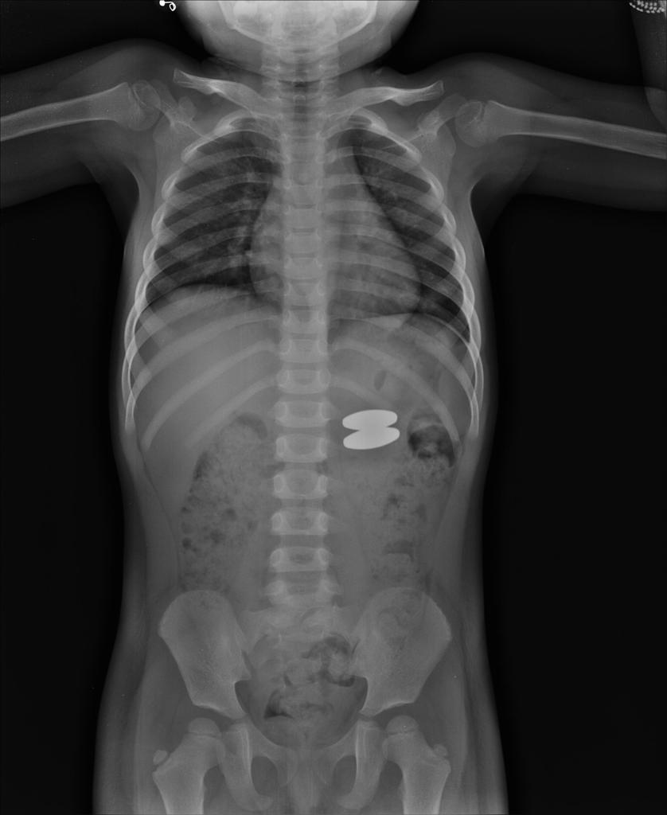
Read and guess the meaning:
Dg.:
Corpus alienum trac. GI l. sin. sine compl, sine inflam.
Corpus alienum tractus gastrointestinalis lateris sinistri sine complicationibus, sine inflammatione
Notes:
Preč’tať, pokúsiť sa preložiť, ako zaujímavosť možno uviesť, že na r. snímke je dieťa, ktoré prehltlo 2 kovové magnetky

Slide 12
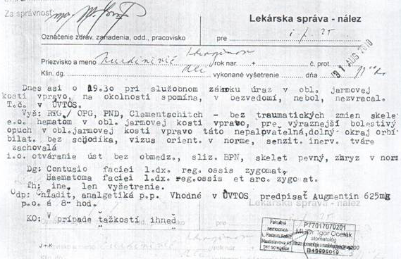
Contusio faciei l.dx. reg. ossis zygomat.
Contusio faciei lateris dextri regionis ossis zygomatici
Haematoma faciei l. dx. reg. ossis et arc. zygomat.
Haematoma faciei lateris dextri regionis ossis et arcus zygomatici
Notes:
Prečítať a pokúsiť sa preložiť, demonštrovať skratky, záznam je z väzenského zariadenia, poukazuje pravdepodobne na silný úder do tváre a neprimeraný zákrok väzenskej polície (táto inf. Je pre zaujímavoať, nemusí byť uvedené)

