Slide 1
Basic medical terminology
Seminar 5

Slide 2
Revision
How do we recognize nouns of the 1st declension? Which paradigms are used and what are the differences between them? Are there any gender exceptions?
What is the distinguishing feature of the nouns of the 2nd declension? How about their gender(s) and gender exceptions? How many paradigms are used and how do they differ from each other?
Can you see any regularities in the neuter paradigms?
How do we decline the adjectives of the 1st and 2nd declension?
What is the difference between adjectives liber and ruber?
Translate the following terms and explain the difference between them: apertura thoracis – apertura thoracica.

Slide 3
Noun + adjective = agreed attribute
In order to connect a noun with the right form of an adjective, we have to know the GENDER of the noun.
e.g.: morbus, i, m.
periculosus, a, um
periculosus
masculine
feminine
neutre
morbus
periculosa
periculosum

Slide 4
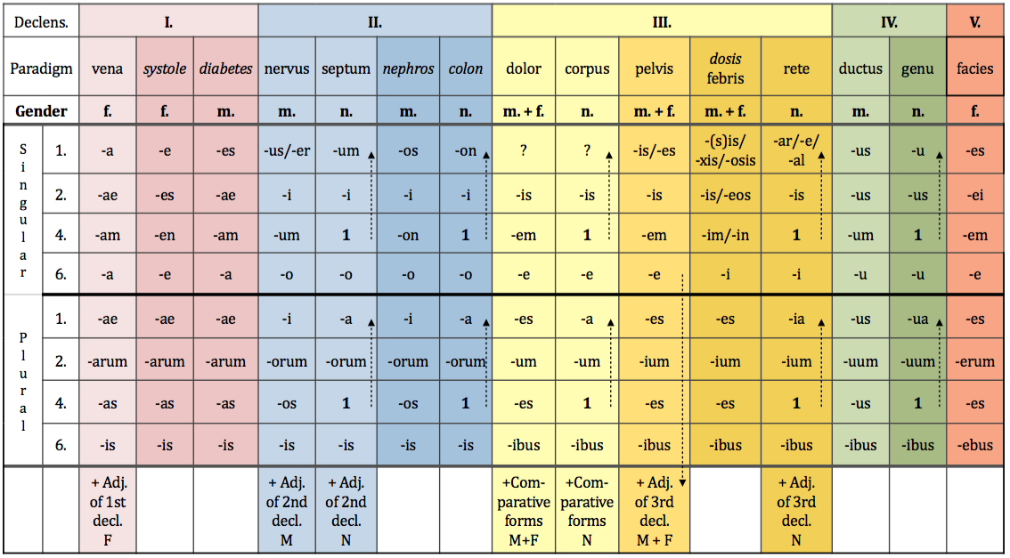
periculosa
periculosus
periculosum

Slide 5
Noun + adjective = agreed attribute
The adjective always has to be of the same GENDER, CASE and NUMBER as the respective noun.
dangerous disease -> morbus periculosus
cause of dangerous disease -> causa morbi periculosi
after dangerous disease -> post morbum periculosum
with dangerous disease -> cum morbo periculoso

Slide 6
Noun + adjective = agreed attribute
Agreement in GENDER, CASE and NUMBER does NOT mean that the adjective and the respective noun have the same endings!!!!
e.g. periodus, i, f.
  ->periodus longa
after a long period
  post periodum longam
longus
periodus
longa
longum
The noun and the adjective are BOTH feminines (GENDER) in accusative (CASE) singular (NUMBER), but they do not have the same endings.

Slide 7
Decide on declension and paradigm
chole
medulla
nephros
ascites
methodus
tarsus
diabetes
collum
dentista
colon
palatum
oculus
therapia
diameter
cancer
tibia
olecranon
lamina

Slide 8
Connect nouns with adjectives
nucleus + ruber, bra, brum
palatum + durus, a, um
tibia + dexter, tra, trum
methodus + novus, a, um
diabetes + mellitus, a, um
therapia + chirurgicus, a, um
nephros + sinister, tra, trum
r(h)aphe + medianus, a, um
nucleus ruber
palatum durum
tibia dextra
methodus nova
diabetes mellitus
therapia chirurgica
nephros sinister
r(h)aphe mediana

Slide 9
Connect
sine + digitus primus
  sine digito primo
ad + rhaphe mediana
  ad raphen medianam
in + palatum durum (position)
  in palato duro
fractura + tibia dextra
  fractura tibiae dextrae
cum + methodus nova
  cum methodo nova
propter + diabetes mellitus
  propter diabetam mellitum

Slide 10
Give the gender, case and number of the nouns
palata
angulis
oculos
ovariorum
nephron
diametro
icterum
olecranon
methodi
palatum, i, n. / nominative pl. or accusative pl.
angulus, i, m./ ablative pl.
oculus, i, m./ accusative pl.
ovarium, ii, n./ genitive pl.
nephros, i, m./ accusative sg.
diameter, tri, f./ ablative sg.
icterus, i, m./ accusative sg.
olecranon, i, n./ nominative or accusative sg.
methodus, i, f./ genitive sg. or nominative pl.

Slide 11
Decide what is correct
The cause of secundary anaemia
A causa anaemia secundaria B causa anaemiae secundariae
Insufficiency of the valve of the aorta
A insufficientia valvae aortae B insufficientia aortae valvae
Because of acute dyspnoea
A propter dyspnoen acutam B propter dyspnoen acuten
Fracture of the right collar bone
A fractura dextra clavicula B fractura claviculae dextrae

