Slide 1
Červené oko – diferenciální diagnostika

Slide 2
Červené oko
„Červené oko“ je znamení pro patologii předního nebo zadního segmentu očního, očnice nebo očních adnex.

Slide 3
Anamnesa
Systémová onemocnění
Oční onemocnění
Rozvoj očních obtíží
Charakter obtíží (typ bolesti, sekrece…)

Slide 4
Orbit – preseptal cellulitis
Infection of the subcutaneous tissues anterior to the orbital septum.
Causes
  Skin trauma - laceratio, insect bites (S. aureus or S. pyogenes)
  Spread of local infection - from an acute hordeolum or dacryocystitis.
  From remote infection of the upper respiratory tract or middle ear by haematogenous spread
Signs - Unilateral, tender and red periorbital oedema

Slide 5
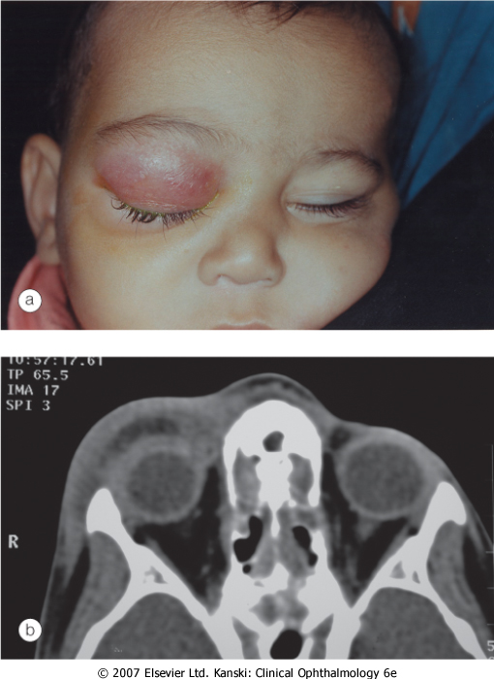

Slide 6
Orbit - Bacterial orbital cellulitis
Life-threatening infection of the soft tissues behind the orbital septum, mainly in children
The most prevalent causative organisms are S. pneumoniae, S. aureus, S. pyogenes and H. influenzae.
Pathogenesis
Sinus-related - ethmoidal, typically affects children and young adults.
Extension of preseptal cellulitis
Local spread from adjacent dacryocystitis, and mid-facial or dental infection
Haematogenous spread

Slide 7
Orbit - Bacterial orbital cellulitis
Presentation is with a rapid onset of severe malaise, fever, pain and visual impairment
Signs
Unilateral, tender, warm and red periorbital oedema
Proptosis, lid swelling
Painful ophthalmoplegia
Optic nerve dysfunction

Slide 8
Orbit - Bacterial orbital cellulitis
Complications
Ocular complications - exposure keratopathy, raised intraocular pressure, occlusion of the central retinal artery or vein, endophthalmitis and optic neuropathy
Intracranial complications - meningitis, brain abscess and cavernous sinus thrombosis
Subperiosteal abscess - along the medial orbital wall
Orbital abscess in post-traumatic or postoperative cases.

Slide 9
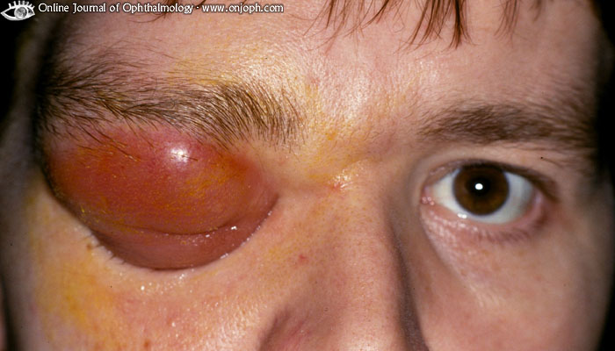

Slide 10
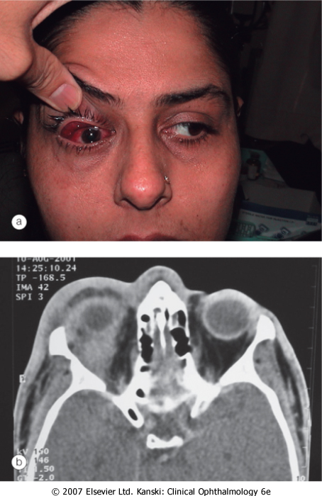

Slide 11
Dry Eye Disorders
There is inadequate tear volume or function resulting in an unstable tear film and ocular surface disease.
Keratoconjunctivitis sicca (KCS) refers to any eye with some degree of dryness.
Xerophthalmia describes a dry eye associated with vitamin A deficiency.
Xerosis refers to extreme ocular dryness and keratinization that occurs in eyes with severe conjunctival cicatrization.
Sjögren syndrome is an autoimmune inflammatory disease which is usually associated with dry eyes.

Slide 12
Dry Eye Disorders
Symptoms
feelings of dryness, grittiness and burning - worsen during the day, transient blurring of vision, redness and crusting of the lids

Slide 13
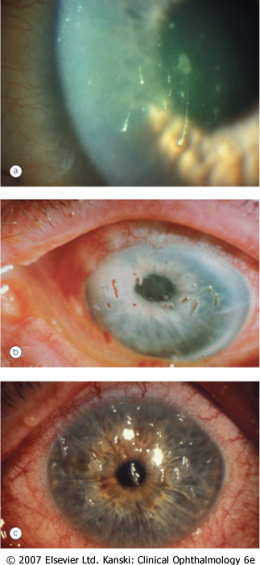

Slide 14
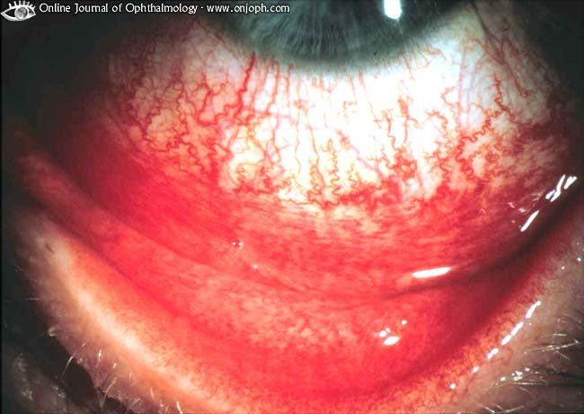
Conjunctiva
Conjunctival injection is diffuse, beefy-red and more intense away from the limbus
Instillation of 10% phenylephrine drops will constrict the conjunctival and superficial episcleral vasculature

Slide 15
Conjunctivitis
Bacterial - H. influenzae, S. pneumoniae, S. aureus
Papillary reaction over the tarsal plates
Mucopurulent discharge
Gonococcal keratoconjunctivitis - pseudomembrane formation, Lymphadenopathy, Corneal ulceration

Slide 16
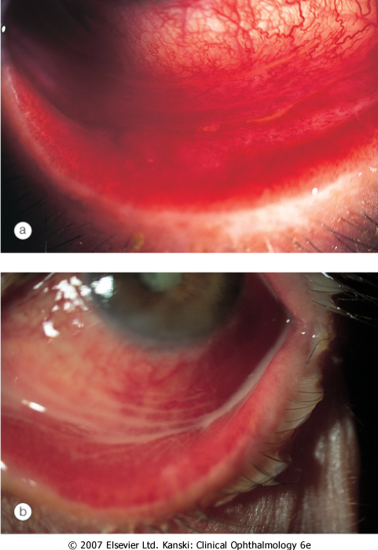

Slide 17
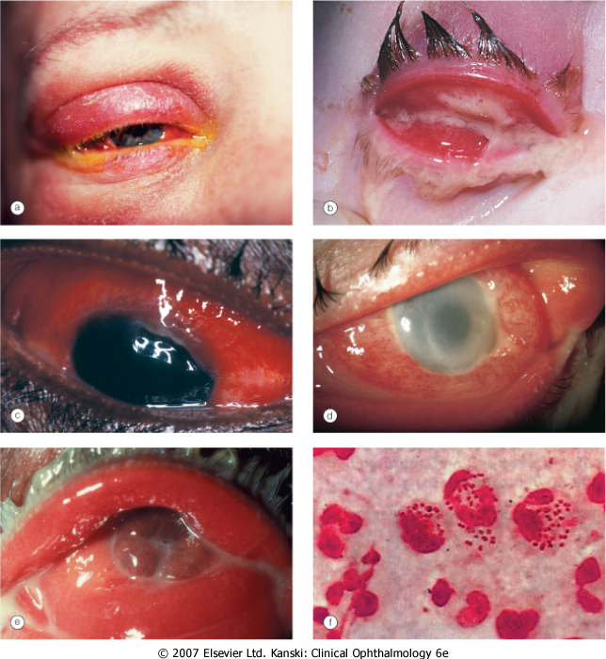

Slide 18
Conjunctivitis
Viral conjunctivitis
Adenoviral keratoconjunctivitis - the most common external ocular viral infection
Sporadic or occur in epidemics in hospitals, schools and factories
Transmission of this highly contagious virus -respiratory or ocular secretions
Dissemination is by contaminated towels or equipment such as tonometer heads

Slide 19
Conjunctivitis
Presentation
Unilateral watering, redness, discomfort and photophobia
The contralateral eye is typically affected 1-2 days later, but less severely
Eyelid oedema and tender pre-auricular lymphadenopathy.
Follicular conjunctivitis

Slide 20
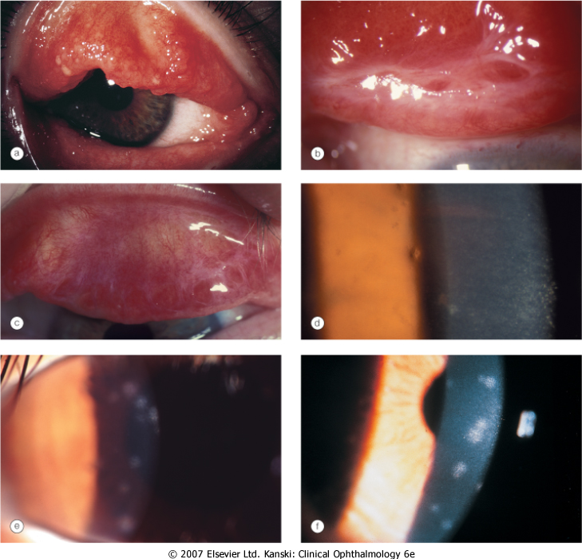

Slide 21
Conjunctivitis
Acute allergic rhinoconjunctivitis
Seasonal allergic conjunctivitis (hay fever) - onset during the spring and summer
The most frequent allergens are tree and grass pollens
Perennial allergic conjunctivitis causes symptoms throughout the year with exacerbation in the autumn when exposure to house dust mites, animal dander and fungal allergens is greatest
Presentation - redness, watering and itching, associated with sneezing and nasal discharge

Slide 22
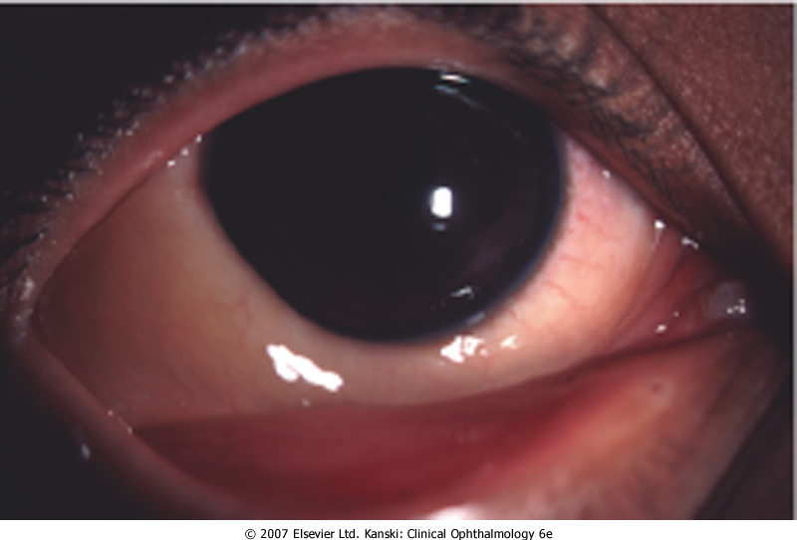

Slide 23
Cornea – infectious keratitis
Keratitis – bacterial (P. aeruginosa ,S. aureus, S. pyogenes)
Risk factors - Contact lens wear, trauma
Presenting symptoms - pain, photophobia, blurred vision and discharge
Signs
An epithelial defect, infiltrate around the margin, circumcorneal injection
Stromal oedema and small hypopyon
Progressive ulceration may lead to corneal perforation and endophthalmitis.

Slide 24
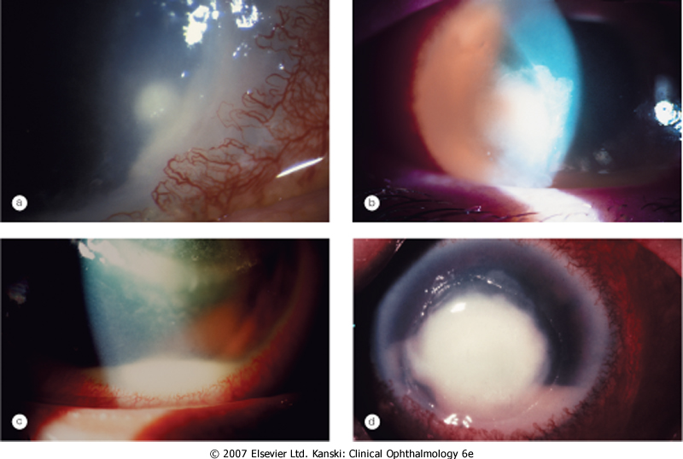

Slide 25
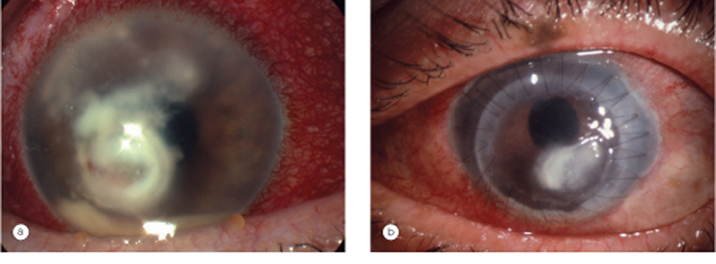
Cornea – infectious keratitis
Keratitis – fungal (stromal infiltrate with indistinct margins, surrounded by satellite lesions, hypopyon)

Slide 26
Cornea – infectious keratitis
Keratitis viral – herpes simplex virus
linear-branching (dendritic) ulcer, corneal sensation is reduced

Slide 27
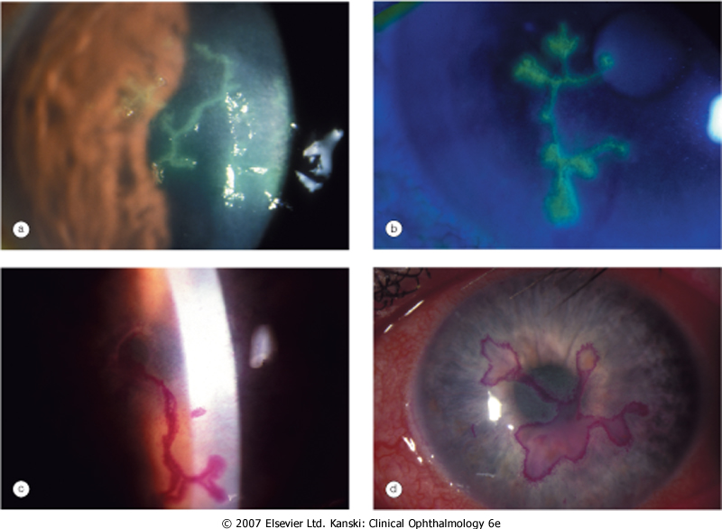

Slide 28
Episclera
Episcleritis – simple (sectoral or diffuse) , nodular – young, female
Presentation - always sudden
The eye becoming red and uncomfortable within an hour of the start of an attack - hotness, pricking or generalized discomfort
Without systemic associations

Slide 29
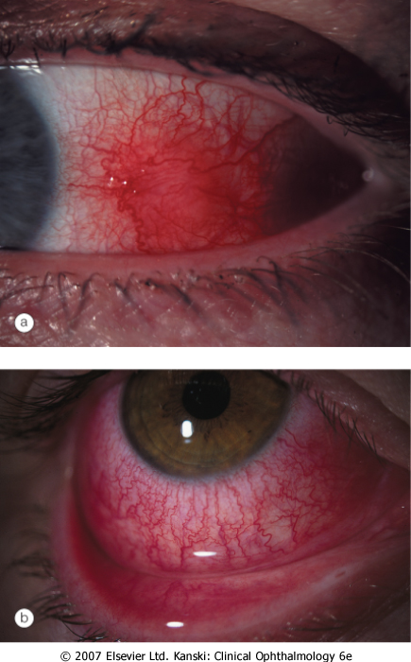

Slide 30
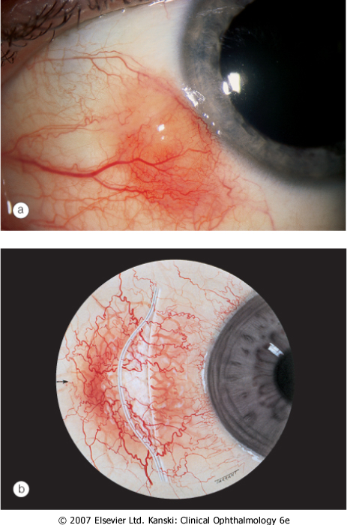

Slide 31
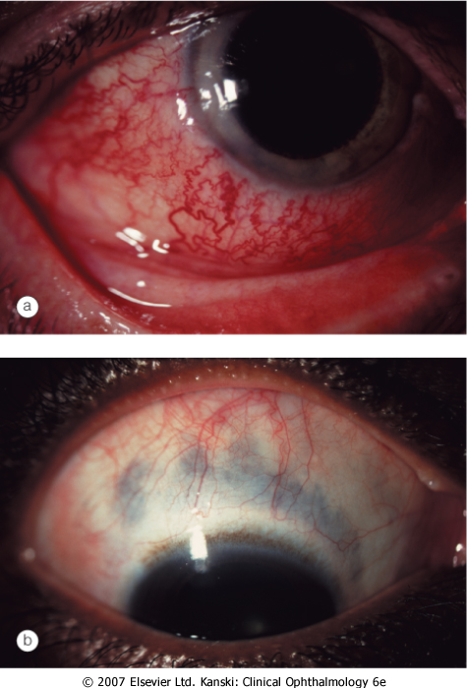
Sclera
Scleritis - oedema and cellular infiltration of the entire thickness of the sclera
Anterior non-necrotizing scleritis – diffuze or nodular
Redness,pain which may spread to the face and temple

Slide 32
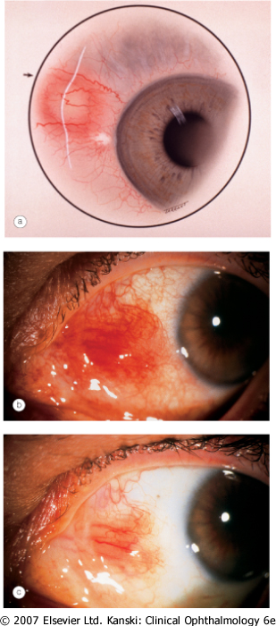

Slide 33
Sclera
Necrotizing anterior scleritis with inflammation
pain - severe and persisten
Scleral thinning due to necrosis allows the blue choroid to show through the translucent hydrated scar tissue that has replaced normal sclera

Slide 34
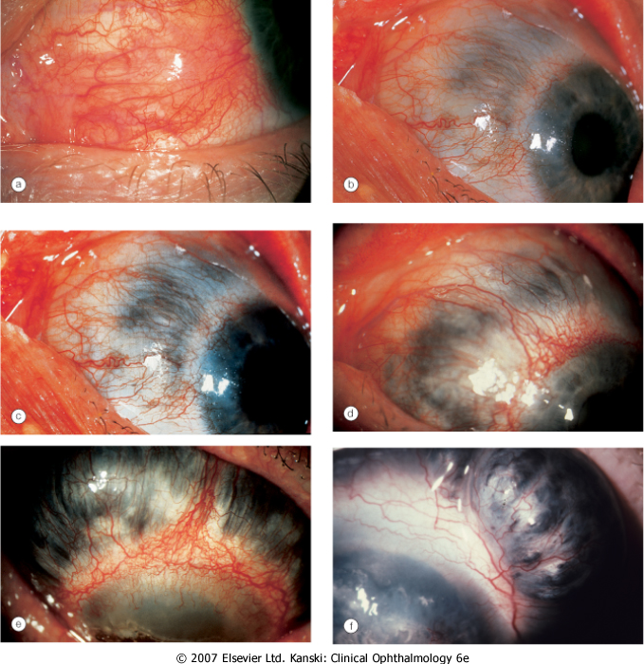

Slide 35
Sclera
Scleromalacia perforans
Specific type of necrotizing scleritis without inflammation that typically affects elderly women with long-standing rheumatoid arthritis
Yellow scleral necrotic plaques near the limbus without vascular congestion

Slide 36
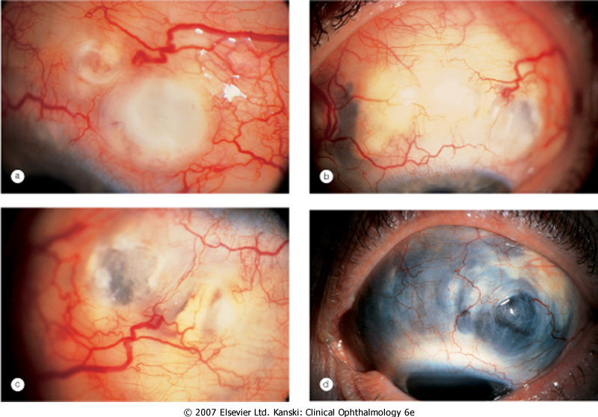

Slide 37
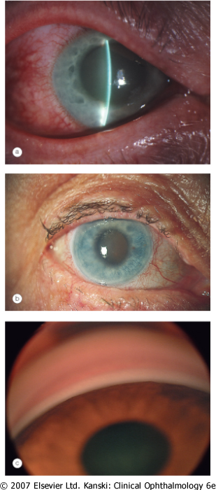
Glaucoma - Acute congestive angle closure

Slide 38
Uveitis
Anterior uveitis may be subdivided into:
Iritis in which the inflammation primarily involves the iris.
Iridocyclitis in which both the iris and ciliary body are involved
Ciliary injection - peripheral hyperemia of the anterior ciliary vessels which produces a deep red or rose color of the corneal stroma, and must be distinguished from hyperemia of the conjunctival vessels. May spread to the perilimbic corneal tissue. Called also ciliary flush.

Slide 39
Anterior uveitis
Ciliary (circumcorneal) injection
Miosis due to sphincter spasm Endothelial dusting by myriad of cells is present early and gives rise to a 'dirty' appearance
Aqueous cells
Aqueous flare reflects the presence of protein due to a breakdown of the blood-aqueous barrier
Aqueous fibrinous exudate
Hypopyon
Posterior synechiae may develop quite quickly and must be broken down before they become permanent

Slide 40
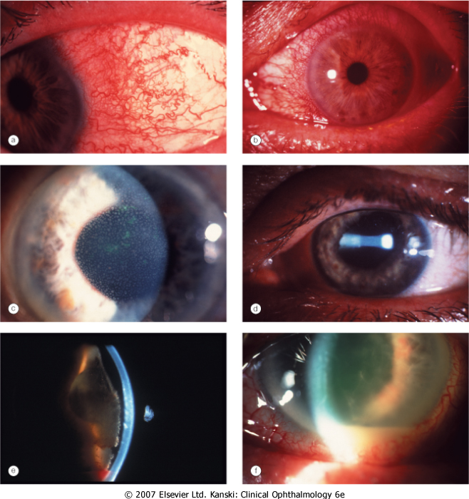

Slide 41
Acute endophtalmitis
Acute inflammation of all ocular structure
Endogennous or exogennous (surgery,trauma)
Signs - chemosis, corneal injection, relative afferent pupil defect, corneal haze, fibrinous exudate and hypopyon, vitritis with impaired view of the fundus

Slide 42
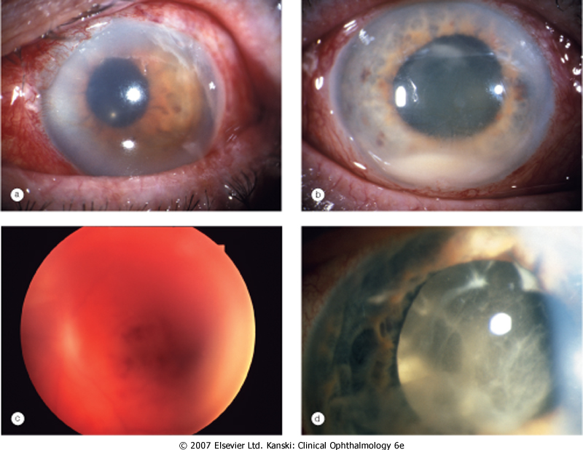
Acute endophthalmitis

Slide 43

End !!!!

