Slide 1
Psychopathology
Seminars from Psychiatry - VLA
Prof. MUDr. Tomáš Kašpárek Ph.D.

Slide 2
Outline
Introduction – why, what, how
Domains of psychopathology

Slide 3
Aim – learning outcomes
To learn the vocabulary – symptoms of mental illness
To learn the concepts of discrete psychological functions
To learn the description of major and most frequent symptoms
Next lecture: how to examine a patient

Slide 4
Norm and pathology
Personal
  Subjective ego-dystonic experience
  Significant change in habitual experience and behaviour
    Does not need to be realised – recognized by peers
Cultural
  Conformist and non-conformist behaviour
    Usual behaviour and experience corresponding to the culture and individual’s position within it
    Non-conformity is not a sign of psychopathology
Typical clinical pictures = overt signs of mental illness
  Hallucinations, catatonia…
Always search for the reason of behaviour: “Why”?
Notes:
Výraz „ego-dystonic experience“ („netolerované prožívání“) mi poradil známý, psycholog, prosím přesto autora o ověření

Slide 5
Domains of psychopathology
Personality
Affect, emotions
Cognition
  Attention, memory and learning, perception, thinking and decision making
Behavior

Slide 6
Perception

Slide 7
Perception
Illusions - distortions
Hallucinations – absence of stimuli
  Sensory modality
    Auditory: 3rd person perspective, commenting, imperative, contrary
    Visual: simple (flashes…), complex scenes, microzoopsia…
    Tactile, Gustatory, Olfactory, Movements
  Intrapsychic hallucinations (see delusions of control)
    Thought broadcasting, thought imputation/amputation, thought echo’s
  Location/source of hallucinations – inadequate (from a teeth, toe…)

Slide 8
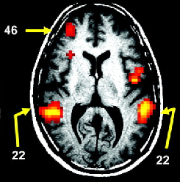
Abnormal autonomy
Auditory hallucinations associated with the activation of T-P and F cortex
Hoffman et al., 2007

Slide 9
Abnormal coordination of sensorimotor cortex
Corollary discharge:
  a copy of the motor plan sent to the sensory cortex (“efference copy”)
  the ensuing perception pattern recognized as resulting from a self-generated action
  …we are not able to tickle ourselves...
Absence of the “efference copy” in the sensory cortex = perception of exogenous origin
Schizophrenia: inner voice = hallucinations
Ford et al., 2001; Ford and Mathalon, 2004; 2005

Slide 10
Thought disorders

Slide 11
Quantitative disturbances: Speed
Decrease
  slowing of the flow of associations, slowed and diminished verbal production (bradypsychism)
  blocking of thoughts - cessation of the flow of associations ( patient stops the verbal production without any recognisable impulse from surroundings)
Increase
  flight of thoughts: excessive speed of thinking manifested as extreme speed in speech (= logorrhoea)

Slide 12
Quantitative disturbances: Structure
perseverative thinking
  involuntary persistence of response to some question or topic, verbigeration - a meaningless repetition of specific word or phrase
circumstantiality
  indirect speech that is delayed in a reaching the point, characterised by an overinclusion of details
tangentiality
  patient never gets from desired point to desired goal
illogical (paralogical) thinking
  thinking containing erroneaous conclusions or internal contradiction
neologism
  new word created by the patient often by combining syllables or other words
incoherent thinking
  thought that is not understandable
  word salad: incoherent mixture of words and phrases

Slide 13
Impairement of associations/abstract thinking - semanting priming
loosenning of associations: tangentiality, paralogic thoughts
absence of abstraction - hyperconcretism
Semantic priming: automatic (implicit) memory systém
  tunes your associations based on current content of mind
  network of representations (words, meanings)
  optimal performance = focused activation around the network node

Slide 14
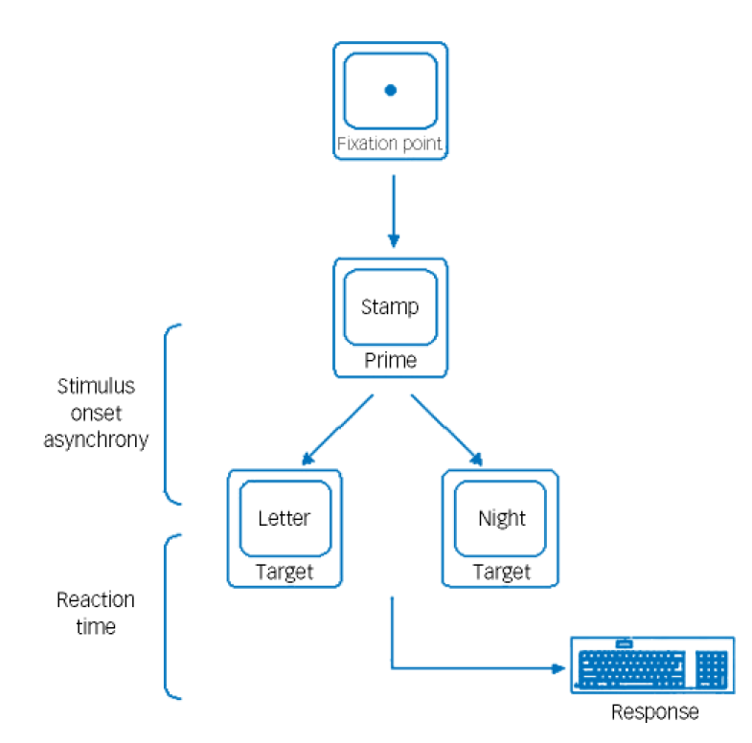
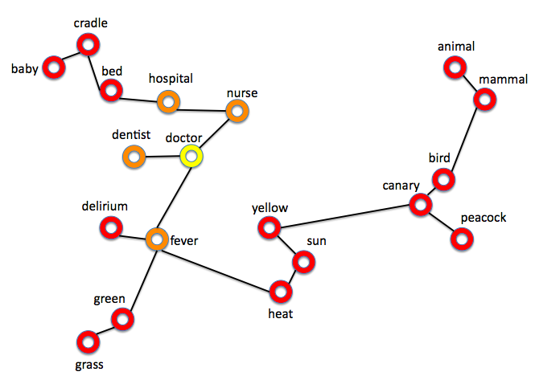
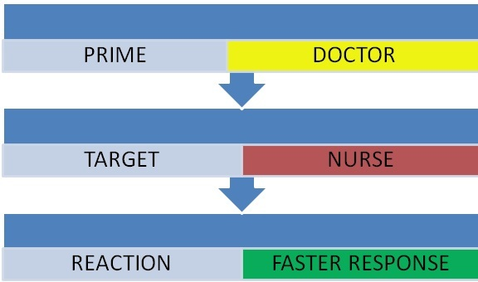
Lexical decision task
DA in cortical networks: SNR
...focus of activation in the network

Slide 15
Semantic priming and Formal Thought Disorder
Meta-analysis of 36 studies (Pomarol-Clotet et al., 2008)
  SCH vs. NC d = 0,7 (95% CI -0,02 – 0,16)
  FTD vs. NC d = 0,38 (95% CI 0,21 – 0,55)
  = increased priming in FTD – fast response to distant words = more extensive network activation
  = loosening of associations

Slide 16
Qualitative disturbances: content of thoughts, believes

Slide 17
Delusions
= False beliefs
  inadequate/bizzare content
  based on incorrect inference about external reality
  not consistent with patient‘ s intelligence and cultural background
  cannot be corrected by reasoning
  influence on behaviour
Formation (development)
  Delusionoal mood – feeling that something is wrong, different, unreal
  Delusional perception – things have special meaning, perceived as significant
  Making sense out of it = ”AHA”, delusion formation

Slide 18
Basal DA pathology in SCH
Cortex
D1 hypoactivity
Limbic system
D2/D3 hyperactivity
DA
DA
VTA
VTA

Slide 19
DA system regulation
Cortex
Glu
Glu
Limbic system
GABA
DA
DA
VTA
VTA

Slide 20
SCH – DA system dysregulation
Cortex
Glu
Glu
Limbic system
GABA
DA
DA
VTA
VTA

Slide 21
Why does psychosis develop?
Cortex
Glu
Glu
STRESS
AMPHETAMINE
Limbic system
GABA
DA
DA
VTA
VTA

Slide 22
Mesolimbic DA hyperactivity = psychosis
Mesolimbic DA system signals the importance (salience) of a stimulus
  i.e., which perceptions, thoughts… are important and which of them are not;
  which ones deserve attention (“attribution of salience“)
  automatic process: you have no control over it, you cannot recollect willingly - insight
  experiential quality: ‘you know it by heart’
Dysregulation in SCH – inadequate attribution of importance to neutral stimuli
  Delusions = explanation of abnormal significance
Kapur 2003

Slide 23
D2R blockade = antipsychotic
Incorrect attribution of significance
Abnormal significance strengthened by repetition
DA dysregulation
PSYCHOSIS
Preventing the incorrect attribution of significance
Gradual weakening of the incorrect significance
Blockade of D2 hyperactivity
Modified according to Kapur 2003

Slide 24
Melancholic delusions (depressive)
delusion of self accusation
  false interpretation of real past event resulting in feeling of guilt
hypochondriac delusion
  false belief of having a fatal physical illness
nihilistic delusions
  false feeling that self, others or the world is non-existent or ending
delusions of failure
  false belief that one is unable to do anything useful
delusion of property (ruin)
  false belief that one lost all property

Slide 25
Delusions of grandeur (manic)
delusion of importance
  exaggerated conception of one‘s importance
delusion of power, extrapotence
  exaggerated conception of one‘s abilities/possibilities
delusion of identity
  false belief of being the offspring of member of an important family

Slide 26
Paranoid Delusions
based on ideas of reference (false ideas that behaviour of others refers to a patient):
delusion of persecution
  false belief that one is being persecuted
delusion of infidelity
  false belief that one‘s lover is unfaithful
erotomanic delusion
  false belief, that someone is deeply in love with them

Slide 27
Delusions of control
= false feeling that one‘s will, thoughts, feelings, or movements are controlled by another agent
thought withdrawal
  false belief that one‘s thought are being removed from one‘s mind by other people of forces
thought insertion
  false belief that thought are being implanted in one‘s mind by other people or force
thought broadcasting
  false belief that one‘s thought can be heard by others
thought control
  false belief that one‘s thoughts are being controlled by other people of forces

Slide 28
Obsession
persistence of an irresistible thought, repetitive thought
ego-dystonic
stereotypical, monotonous
cannot be eliminated from consciousness by will
associated with anxiety, interferes with directed behavior, attention
vs. preoccupation of thought: certain idea is in the centre of thinking, is coming back, usually associated with a strong affective tone (date, money, success…)

Slide 29
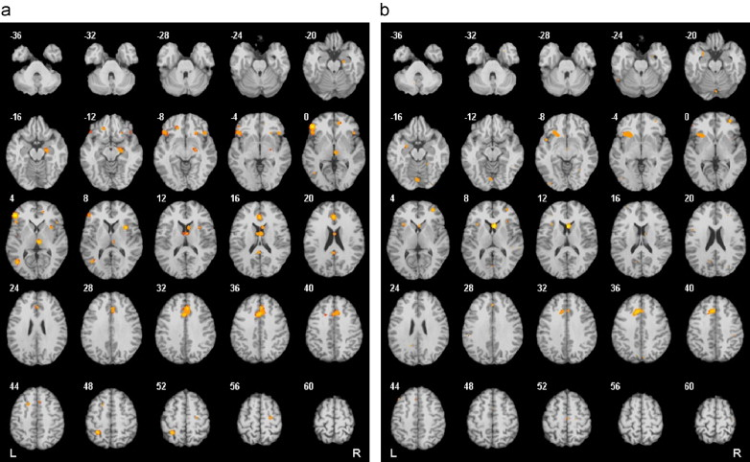
Function of the brain in OCD
Meta-analysis of fMRI studies (Menzies et al., 2008)
  Hyperfunction of OFC (BA 10, 47), AC (BA 32), the motor area (BA6), PostCing (BA 30), PreCun (BA7), OC, NcCaud, Thal
  Hypofunction of OFC (BA 47), AC (BA 32), Ins, PFC (BA44), NcCaud, Putamen, HIP, CRBL

Slide 30
Functional implication
OFC hyperactivity
  the OFC encodes the representations of values (positive, negative; representations as well as operations)
cognitive styles (“evaluation”)
  inflated perception of responsibility
  overestimation of danger
Treatment (SSRI, BT) = decrease in ↑ in the OFC, AC, NcCaud, Thal (Swedo et al., 1992; Schwartz et al., 1996)
= goals of NCH and DBS in patients resistant to treatment
  cingulotomy (anterior), capsulotomy (anterior limb), subcaudate tractotomy, limbic leucotomy (cingulotomy + subcaud. tractotomy)
  DBS OCD = chron. stimulation of ant. limb of int. capsule
    ca 60% of patients resistant to conventional treatment respond to DBS! (Greenberg et al., 2008)

Slide 31
Other disturbances of content of thoughts
overvalued idea:
  unreasonable, sustained false belief maintained less firmly than a delusion
poverty of content:
  thought that gives little information because of vagueness, empty repetitions, or obscure phrases
symbolic and magical thinking
  real objects have other, symbolic meaning, in magical thinking words, situations, action have special power and meaning
autistic (dereistic) thinking
  preoccupation with inner, private world

Slide 32
Memory
Prof. MUDr. Tomáš Kašpárek, Ph.D.

Slide 33
„Life cycle“ of a memory trace
Immediate memory
  information stored for 15-20s
Short-term memory
  consolidation of the memory trace – several minutes to 2 days
  medial temporal structures
Long-term memory
  formed trace
  large cortical areas

Slide 34
„Quantitative“ dysfunctions
Amnesia: short/long-term memory impairment in a state of normal consciousness
  anterograde: failure to form new information
  retrograde: failure to recall old information
    organic (head trauma, tumor, surgery etc.)
    dissociative amnesia: patchy or selective - inability to recall previously learned information with normal functioning in the present (normal learning)
Hypomnesia
Hypermnesia: unusually vivid memory
  mania, posttraumatic stress disorder (intrusive memories), obsessive or paranoid personality traits

Slide 35
Imaging repressed memories
37-year-old female patient with conversion paralysis
  premature birth with normal development
  dysfunctional family, from 4 years children’s homes, reports sexual abuse
  problem behaviour in adolescence, self-mutilation, TS
  numerous unqualified jobs
sudden development - a month after her daughter’s TS, immediately after her boyfriend’s announcement he was leaving
  “while we talked, something clicked in my head” and she collapsed, did not communicate for several minutes
  she woke up with right-sided paresis and anaesthesia - negative neurological + imaging examination
Kanaan et al., 2007

Slide 36
Assessment of life events and fMRI
significant life events
  daughter’s TS, break-up
  break-up = “pathogenetic event” (clinical significance, relation to development, potential for secondary gain…)
  in contrast, subjectively not too significant: repression of emotions
fMRI paradigm
  sentences/comments concerning 2 severe events and 1 non-severe life event; untrue statements: forces the patient to recall details of the event
  contrasts
    severe x non-severe event
    TS of the daughter x break-up of the relationship

Slide 37
Findings
memory of the break-up vs. TS and a neutral event
  higher activation of
    the amygdala – emotional activation
    the anterior cingulum (BA 32) – automatic regulation of emotions
    inferior frontal gyrus (BA46) – cognitive area
    premotor areas – preparation of the motor plan
  higher deactivation of
    the left motor cortex (BA4) – area corresponding to motor deficit
The neurophysiological correlate of clinically evident repression of emotions related to signif memories
  in contrast to insuff. subj. experiencing of the breakup, high emotional activation and at the same time reduced activity is apparent in the motor cortex in the area responsible for innervation of the region with the deficit

Slide 38
„Qualitative“ dysfunctions
paramnesias – retrospective falsification of memories during its recollection (awareness of recalled memory, failure to proper class time and situation of memory acquirement)
confabulation – filling memory gaps with inaccurate information; frontal lobe and self-monitoring?
deja vu – sensation of previously experienced situation when experiencing the first time
  false awareness of memory
  common in normality, increased in fatigue, intoxication, complex partial seizures

Slide 39
Dementia
persistent diminution of cognition in the setting of a stable level of consciousness
three main symptomatic domains:
  neuropsychologic: cognitive decline
  neuropsychiatric: behavioral and psychological symptoms
  activities of daily living

Slide 40
Dementia – General cognitive dysfunction
memory: learning, recall, recognition
executive functions: planning, flexibility
thought disorders and language (disorganized structure, fluency...)
  perseveration (following a topic after its change), echolalia (repetition of other's speech)…
  abstraction (concrete thinking...)
judgment, insight (non-realistic planning, judging situations...)
attention: shift of attention, distractibility
visuospatial abilities (reproduction of a complex drawing...)
higher cortical functions - gnosis and praxis: apraxia, agnosia, aphasia

Slide 41
Amnestic disorders

Slide 42
Characteristics
Definition: acquired impaired ability to learn and recall new information (and past events sometimes)
No attention deficit or clouding of consciousness (delirium), no other cognitive dysfunction (dementia)
Secondary syndromes caused by systemic medical or primary cerebral diseases, substance abuse disorders, medical adverse effects

Slide 43
Etiology
Diencephalic and middle temporal lobe structures (mammillary bodies, hippocampus)
Causes of amnestic syndrome:
  closed head trauma
  penetrating missile wounds
  focal tumors
  surgical intervention
  herpes simplex encephalitis
  infarction of the territory of the posterior cerebral artery
  hypoxia
  chronic use of alcohol with thiamine deficiency
Transient forms – linked with CVS disorders, pathology in the vertebrobasilar system, episodic physiologic or metabolic disorders, acute intoxications, seizures

Slide 44
Clinical notes
Transient global amnesia
  episodes of transitory inability to learn new information (to form memories)
  variable inability to recall memories from the episode
  restoration to completly intact cognitive state
  no behavioral changes x may be confusion, perplexity
sudden/gradual onset – according to the cause (head trauma, CNS event, chronic toxic exposure)
disorientation – may be to place and time due to severe mnestic disorder x spared orientation to person (dementia)
lack of insight
confabulations

Slide 45
Delirium

Slide 46
Characteristics
transient cognitive disorder
core features: impairment of consciousness with attention deficit, rapid onset, fluctuating course.
other phenomena may appear more prominent, but are not always present
  psychomotor changes (agitation), perceptual changes as illusions and hallucinations, disorganized thought, delusions, disturbances of sleep, emotional changes (irritability, flatness of emotions)...

Slide 47
Disturbances of emotions

Slide 48
Emotions - terminology
Emotion
  complex feeling state
  Psychic, somatic, behavioral components
Affect
  short term emotional/affective state
Mood
  longer term emotional/affective state

Slide 49
Disturbances of emotions
Range of emotional states
  flattening of emotions
  decreased emotional reactivity
Emotional tenacity
  Lability
  Incontinence
Appropriateness
  incongruent emotions
Ambivalence – contrary emotions

Slide 50
Disturbances of affects
Pathological affect
  intensive emotional reaction
  behavioral changes - aggressivity
  short period of qualitative disorder of consciousness (obnubilation)
  amnesia
Uncontroled affect
  no changes of consciousness, no amnesia

Slide 51
Disturbances of moods
Anxiety, phobia, fear
Depression
Mania

Slide 52
Depression - syndrom
Affective symptoms
  depressed mood – bad, down, black, opressive – distinguish from sadness
  anhedonia
  (anxiety)
Motivation
  loss of interest in usual activities
  inability to perform, initiate activity (abulia)
Cognitive
  evaluation, self-esteem
  attention, memory
  negative cognitive biases
Suicidal activity – hoplessness, suicidal thoughts etc.
Vegetative, „somatic“
  insomnia, anorexia. decreased libido, loss of energy and fatigue, psychomotor retardation

Slide 53
Mania - syndrom
Affective symptoms
  expansive moods: mania, euforia, iritability, dysforia
Cognitive
  increased speed vs. decreased accuracy: cognition (flight of ideas), memory (hypermnesia), speech (pseudoincoherence), decisions (risky)…
  distractibility
  inflated unrealistic self-esteem
Behavioral
  hyperactivity, restlessness
  overinvolvement – socially, sexually, occupationally…
Vegetative, somatic
  insomnia (decreased need to sleep), anorexia (decreased need to eat), increased energy

Slide 54
Catatonia

Slide 55
Disturbance of voluntary movements
“Positive“
  agitation
  active negativism
  mannerism (odd caricature of normal movements)
  stereotypies (repetitive, nonsensical movements)
  grimacing
  echolalia, echopraxia
„Negative“
  mutism
  passive negativism
  catalepsy (passive induction of a posture held against gravity)
  posturing (spontaneous and active maintenance of posture against gravity)
  waxy flexibility (slight and even resistance to positioning by examiner)
  stupor (no psychomotor activity)

Slide 56
Next steps – clinical vignettes
Have a look at videos:
  Depression: https://www.youtube.com/watch?v=4YhpWZCdiZc
  Mania: https://www.youtube.com/watch?v=zA-fqvC02oM
  Hallucinations: https://www.youtube.com/watch?v=0tn8xLQY53U
  Hallucinations and delusions: https://www.youtube.com/watch?v=ZB28gfSmz1Y
  Delirium: https://www.youtube.com/watch?v=lJH1AoVuVS0
  Delirium: https://www.youtube.com/watch?v=hwz9M2jZi_o
  Anxiety: https://www.youtube.com/watch?v=Ii2FHbtVJzc
  Panic attack: https://www.youtube.com/watch?v=9YaS_4tXBNU
  Catatonia: https://www.youtube.com/watch?v=_s1lzxHRO4U
  Obsessions, Compulsions: https://www.youtube.com/watch?v=xMwOLoPFKlM
  Obsessions, Compulsions: https://www.youtube.com/watch?v=syM6XYzht20
  Conversion: https://www.youtube.com/watch?v=_jOuqAcgMrA
  Suicide: https://www.youtube.com/watch?v=A-m_aIQfXZA

