Slide 1
DRUGS USED IN HEART FAILURE, ANTIARRHYTHMICS

Slide 2
Heart Failure
Vital organs chronically suffer from inadequate blood perfusion (caused by dysfunction of the myocard of ventricles due to various diseases)…
de novo
decompensation of CHF
CHRONIC
ACUTE
Ischaemic Heart Disease
Cardiomyopathy
Arterial hypertension
Severe dysrrhytmias
myocarditis
Acute Coronary Syndroma (AIM…)
pulmonary oedema
cardiogennic shock
Hypertension crisis
Acute arrhytmia…..
right, left ventricles
Diastolic failure
Systolic failure
(more often in older patients)
(decreased contractility)

Slide 3
Heart Failure
Cardiac output CO
=
Stroke volume SV
x
Heart rate HR
Decreased CO…. ↓ SV or ↓ HR
Primary compensation by ↑ HR… leads to ↑ metabolic demand…vicious circle
Factors influencing SV…
Preload
= fiber length-dependent activation…tension of the heart muscle before contraction (EDV)
Afterload
= Resistance to which the heart must pump blood
Contractility
= cardiac contractility (inotropy)

Slide 4
Compensatory mechanisms of HF…

Slide 5
Ventricle volume overloading
Ventricle pressure overloading
Preload
⇧ Afterload
↑ Contractility and Stroke volume ⇨ activation of sympathetic activity
↑ Enddiastolic volume ⇨muscle contraction less efficient ⇨ RAAS activation
inotropics
diuretics
Metabolic decompensation
Fluid and Na+ retention
Peripheral vasocontriction
ACEi/sartans
Hypertrophy of left vetricle
spironolakton

Slide 6
CHRONIC
HEART FAILURE

Slide 7
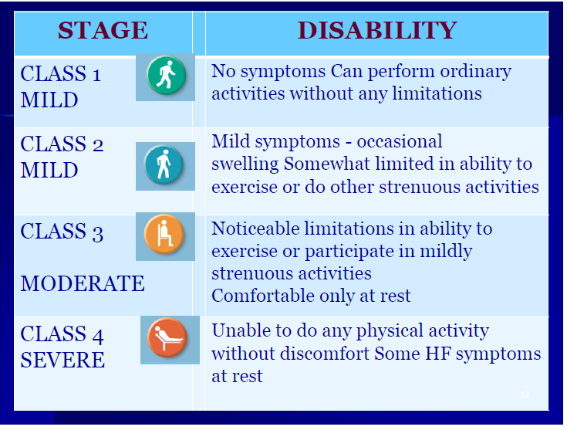
Clinical symptoms…
Shortness of breath (at rest or exertion)
Fatigue
Oedema
tachycardia
tachypnoe
peripheral oedema
hepatomegaly

Slide 8
ACEi /sartans
RAAS inhibition
⇨ affect heart remodelation
↓ vascular resistance
(↓ volume + vasodilatation)
↓ preload
↓ afterload
THE DRUG OF FIRST CHOICE FOR HEART FAILURE
ARNI
Valsartan + sakubitril (inhibitor of neprilisin)
Nesiritide je rekombinant human natriuretic peptid type B
.

Slide 9
Beta-blockers
Decreased sympathetic activity (indicated only in patients with compensated HF)
or
Bradins
⇩ SF
⇩ dromotropic effect
⇩ chronotropic effect
The pacient have to be haemodynamically stabilised before BB teratment. Start with low dose, that incease if tolerated ( 1-2 weeks interval)

Slide 10
Aldosteron – antagonists
Antagonists of AR
Inhibit fibroblast proliferation
Second line tretament (ACEi a BB as firt choice) – some RCT show decreased mortality (low dose add-on therapy )
spironolakton
Not combine with other potassium- sparing diuretics

Slide 11
Drugs with positive inotropic effect
↑ contractility (inotropy)
↑ Ca²⁺ v sarcoplasma
⇨ ↑ Ca²⁺ influx
´
⇨ beta-receptor stimulation
⇨ signaling pathway interference
Cardiotonics
Katecholamins
PDE-3 inhibitors
2. ↑ binding of troponin C to the action of Ca²⁺
Calcium sensitizers

Slide 12
ACUTE
HEART FAILURE

Slide 13
ACUTE HEART FAILURE
Acute oedema
Acute Coronary Syndroma
pulmonary oedema
cardiogenic shock
Hypertensive crisis
Acute arrhytmia
Acute myocarditis
cardiomyopathy
Aortic dissection
Acute valvular regurgitation…
Strong diuretics – furosemid i.v.
Bolus, continual infusion
Hypertensive crisis
Nitrates (nitroglycerin i.v. ) – BP monitoring !!
↑ contractility
Inotropics
levosimendan
dopamin ⇨ vasocontrction - incease BP + renovascular vasodilatation
dobutamin
Severe systemic hypotension
Antiarrhytmics
norepinephrin i.v.
beta blockers
amiodaron
digoxin
Cardial Intervention
PTCA, PCI (angioplasty, stents)

Slide 14
DIURETICS and aldosteron antagonists

Slide 15
DIURETICS
Mechanism of antihypertensive action:
- decrease in plasma volume
- decrease in peripheral resistance
- vasodilatation
- act via several mechanisms directly in kidney on different parts of nephron:
proximal tubules
ascending limb of Henle loop
distal tubules
collecting ducts

Slide 16
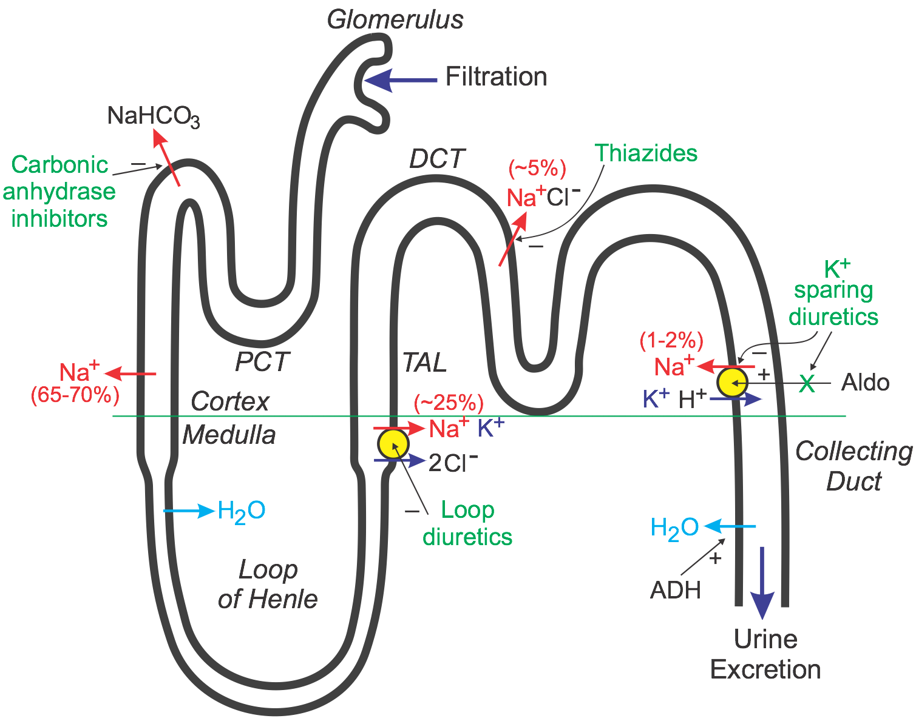

Slide 17
CLASSIFICATION
THIAZIDES (distal tubules)
LOOP DIURETICS
POTTASIUM-SPARING DIURETICS
ALDOSTERON RCP: ANTAGONISTS
CARBOANHYDRASE INHIBITORS (proximal tubulus)
OSMOTIC DIURETICS

Slide 18
Thiazides (distal tubules)
MECHANIS OF ACTION
Cl⁻/Na⁺ symport inhibition in distal tubules. Inhibition of Na⁺ resorbtion ⇨ inhibition of H2O reabsorbtion ⇨ ↑ diurhesis
Na⁺ transport capacity in distal tubulus (5-8%) ⇨ lower diuretic effect
if ↓ GFR 0,5ml/s…loop diuretics indicated
slow onset af antihypertensive effect

Slide 19
Thiazides
PK
- well absorbed, excreted in proximal tubules
- diuretic effect lasts up to 12 hours, hypotensive effects with 3-4 days delay
- latency occurs also in withdrawal
INDICATION
Hypertension (essential), manly in combination
Heart Failure (prevention of cardial oedema)
AE
hypokalaemia, metabolic alkalosis, hyperuricemia, hypovolemia

Slide 20
Thiazides
DRUGS
hydrochlorothiazid
chlortalidon
longer half-life than hydrochlorothiazid
indapamid
metipamid
indapamid in combination with ACEi in DM patients (prospective RCT)

Slide 21
Loop diuretics
MECHANIS OF ACTION
Inhibition of 4 ions contransport (Na, K, 2xCl)
very strong, short effects (significant loss of ions)
RAA system activation – long-term treatment is not recommended
.

Slide 22
DRUG
Loop diuretics
furosemid
Strong effect
Also in patients with ↓ GF
INDICATION
lung oedema
congestive heart failure
hypercalcemia (furosemid)
chronic renal failure
forced diuresis (intoxications)
post-operative anuria

Slide 23
Loop diuretics
AE
Ion imbalance (loss of Na⁺, Cl⁻, K⁺, Ca²⁺, Mg²⁺)
Osteoporosis
Hypovolemia ⇨ risk of trombosis
DRUG INTERACTIONS
Furosemid bounds to albumin ⇨ ↑ plasmatic level of metformin, amiodaron, digoxin,…
↑ Nephrotoxicity of cefalosporins

Slide 24
Potassium sparing diuretics
Antagonists of aldosteron receptors
MECHANISM OF ACTION
Na⁺/K⁺ antiport inhibition through direct channel affecting, or as aldosterone receptor inhibitors
Potassium sparing diuretics
Directly ion channel
aldosteron. rcp. antagonists
aldosteron receptor antagonisation

Slide 25
inhibition of resorbtion Na⁺ ionts + H2O
inhibition of excretion K⁺ ionts → potassium sparing
Antagonists of aldosteron receptors:
Extrarenal effect - inhibition of fibroblast proliferation in myocard and vessels
Mg²⁺ sparing
Indicated for pts. with HF

Slide 26
DRUG
Potassium sparing
amilorid
Weaker effect, used in combinations with other potassium-loss causing diuretics
INDICATION
Hypertension in combination
Prevention of cardial oedema

Slide 27
DRUG
Antagonist of aldosteron
spironolakton
(often combined with furosemide)
positive effects on remodelation → in heart failure also in monotherapy
Antiandrogenic effect
Inhibition of bounding of testosteron to rcp.
Inhibition of P-glp efflux pump
AE - gynecomastia, menstruation problems

Slide 28
INDICATION
Hypertension (in combination with furosemid, e.g. resistent HT form)
Primary hyperaldosteronism
Heart failure
eplerenon
MoA:
Selective antagonist of mineralokortikoid receptors

Slide 29
Diuretics in general
Advantages:
useful combinations with others AHT
increase effect of other AHT effects
no influence on CNS
cheap
Disadvantages:
metabolic effects (thiazides)
low tolerance (elderly)

Slide 30
Diuretics
AE:
potassium depletion (except K⁺ sparing)
hyperuricemia (thiazides, loop diuretics)
weakness, nausea
imbalance in glycid and lipid metabolism (thiazides)
hypovolemia, hypotension (furosemid)
hyperkalaemiaa (amiloride, spironolactone)
Chronic therapy – disruption of kidneys functioning
CI:
gout (thiazides)
renal failure, hyperkalaemia (K⁺ sparing)
relative: pregnancy, metabolic syndrome

Slide 31
INDICATION of diuretics (general)
Thiazides
Loop diuretics
HT older pts.
Systolic isolated HT
Chronic heart failure in combination
HT in renal insufficiency
Chronic heart failure Hyperkalcemia
Pulmonary oedema
K-sparing
+
Aldosteron antagonists
Resistent form of hypertension (spironolakton)
HT and primary hyperaldosteronism (spironolakton)
Chronic heart failure

Slide 32
ACEi /sartans
Previous lecture
DRUGS with POSITIVE INOTROPIC EFFECTS
Cardiac glycosides (cardiotonics)
Katecholamines
PDE-3 inhibitors
Ca²⁺ sensitizers

Slide 33
Cardiac glycosides (cardiotonics)
MECHANISM OF ACTION:
Inhibition of Na+/K+ ATPasa pump
⇨ increase intracellular sodium concentration (Na+/Ca+ exchange transporter
⇨ secondary rise of Ca²⁺ ⁻
⇨ increased contractility ⇨ ↑inotropic effect efekt
Activation of parasympatics (n. vagus) and ACH release
⇨ SA node, AV conduction slow
⇨ ↓ chronotropy
⇨ ↓ dromotropy ⇨ antiarrhytmic effect
DRUG
digoxin

Slide 34
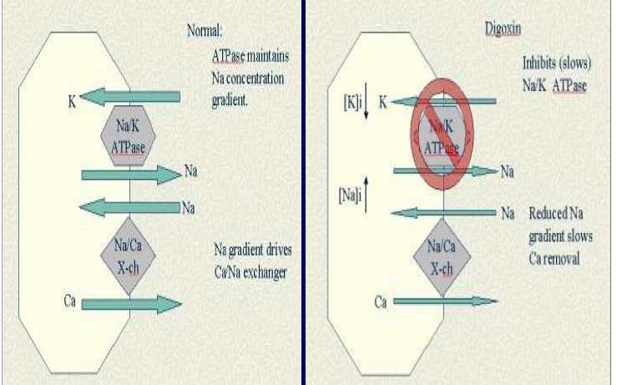
Cardiac glycosides (cardiotonics)

Slide 35
PHARMACOKINETICS
t_{1/2} = 36 hours
TDM (plasma level 0,5–1,5 ng/ml)
Variable bioavailability (50-70 %)
P-glp pump substrate (drug interaction ! )
Binding to the albumin 20-40%
Renal elimination, GFR depending
Liver metabolization app. 20 %

Slide 36
ADVERSE EFFECTS
Cardial, CNS and GI – clinically significant
DIGITALIS INTOXICATION
Cardial signs
↓ intracelullar K+ leds to ↑ excitability (tachyarrhytmia)
Parasympatic activation (sinus bradycardia, AV blocades)
Others :
CNS: Visual disturbance (yelow colors, disorientation, confusion
GI: Anorexia, nausea, vomiting

Slide 37
DRUG INTERACTIONS
Strong or moderate Pglp pump inhibitors
…should increase plasmatic level of digoxin
verapamil, amiodaron, propafenon, telmisartan, cyklosporin, antimycotics (ketokonazol), macrolides ATB (clarithromycin)
DIGITALIS INTOXICATION
Hypocalemia should leads to digoxin intoxication

Slide 38
INDICATION
Chronic HF
Sinoatrial tachyfibrilation
CONTRAINDICATION
AV blockades
Cardial insufficiency with bradycardia
Digoxin intoxication
RELATIVE: aIM

Slide 39
Catecholamines
norepinephrin
α₁ rcp. agonist increase BP
dopamin
Dose-dependent
D rcp. ⇨ renovascular dilatation
β₁ rcp. ⇨ inotropic effect
↑ dose α₁ rcp. Agonist ⇨ increase BP
INDICATION
Severe hypotension (NA)
Vasodilatation of renal vessels (dopamin)

Slide 40
Catecholamines
adrenalin, dobutamin
stimulation β₁ rcp.
β₂ rcp.
↑contractility (inotropy)
vasodilatation
INDICATION
Acute HF, cardiopulmonal resuscitation
PK:
Low bioavailability ⇨ i.v. administration
Short half-life (2 minutes)
AE:
Arrhytmogenic effect

Slide 41
PDE-3 inhibitors
MECHANISM OF ACTION
cAMP-dependent phosphodiesterase- myocardial isophorm3 - inhibitor
arterial dilatation (reduction of afterload)
cardiostimulation (+ chrono-, ino- a dromotropic effects)
DRUGS
milrinon
INDICATION
Treatment of acute and refractory HF
AE:
Decreased BP, headache
Proarrhytmogenic effect – less used

Slide 42
Calcium sensitizers agent
MECHANISM OF ACTION
↑ the force of contraction of the heart by binding troponin C and sensitising it to the action of Ca²⁺ ⇨
Binds to the K_{ATP} channel – membrane hyperpolarization ⇨ ↓ opening of the Ca_{L} channel ⇨ vasodilatation (systemic, lung)
DRUG:
levosimendan
PK:
i.v. infusion
Metabolised to active metabolite with long half-life (80hrs)
INDICATION
Acute HF

Slide 43
ANTIARRHYTMICS

Slide 44
Antiarrhythmic agents Vaughan-Williams classification (based on electrophysiological effects, 1970)
 | Active agents | Clinical use | MoA
Class I a | Prajmalin | Limited use | Interfere with Na+ channel / effects on cardiac potentials
Class I b | Lidocain | Ventricular tachycardia
Class I c | Propafenon | Atrial fibrilation, reccurent tachyarrhythmias
Class II | B –blockers (metoprolol, atenolol | Tachyarrhythmias | decrease conduction through the AV node
Class III | Amiodaron, Sotalol Dronedaron Ibutilid | Vetnricular tachycardia Atrial fibrilation - the most effective AA | K+ channel blocker, prolong repolarisation ( QT int.)
Class IV | Ca channel blockers | Atrial fibrilation - rate reduction Paroxysmal supraventricular tachycardia prevention | Ca++ channel blocker

Slide 45
Others…
Drug class | Mechanism of action | Drug
Cardiac glycosides | Parasympathetic activation | digoxin
Bradins | ↓ depolarization of SA pacemaker | ivabradin
Agonists of β₁ rcp | positive chronotropic, dromotropic, bathmotropic effects | catecholamines
 | ↓ depolarization of SA and decreased AV conduction | adenosin

Slide 46
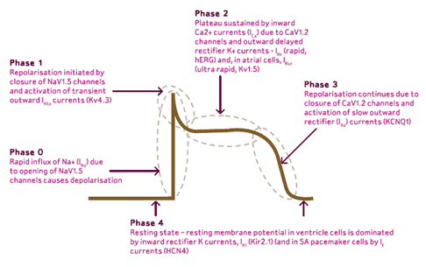
THE PHASE OF ACTION POTENCIAL
Phase 0: rapid depolarition
Phase 1: partial repolarization
Phase 2: plateau
Phase 3: final repolarization
Phase 4: resting stage

Slide 47
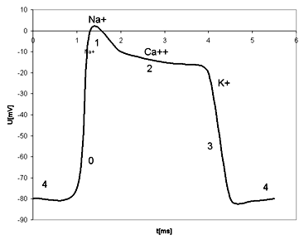
Four classes of antiarrhytmics
IV. class
Ca²⁺
III. class
K⁺
II. class
Na⁺
I. class

Slide 48
ANTIARRHYTMICS class I
Class I drug block sodium channel
Inhibit action potential propagation in excitable cells
Membrane-stabilising activity
⇨ reduce the maximum rate of depolarisation
Subgroups:
IA prajmalin
Risk of torsade de pointes
IB lidokain
IC propafenon
Prophylaxy and treatment of supraventricular arrhytmias
Now seldom used

Slide 49
ANTIARRHYTMICS class II
Antiarrhytmic effect caused by lowering of proarrhytmogenic effect of sympathetic activity (negative chrono-,dromo- a bathmo-tropic effects)
Leads to:
Increase the refractory period of the AV node
Prevent reccurent attacks of SVT
⇨ prolongation of repolaritazion
INDICATION:
Prophylaxy of supraventrikular and ventricular tachyarrhytmias
Sinoatrial fibrillation

Slide 50
ANTIARRHYTMICS class III
Class III inhibit potassium channel involved in cardiac repolarization, mainly I_{kr} ⇨ prolong the cardiac action potential
⇨ prolong repolarization
DRUGS
amiodaron, sotalol
superior in reducing
the recurrence of ventricular arrhythmias and atrial fibrillation – but many Aes !
The most often used
INDICATION
Pharmacological cardioversion (fibrillation or flutter)
Prophylaxy of fibrillation or flutter

Slide 51
Amiodaron pharmacokinetic:
Active metabolite (desmetylamiodaron) highly lipophilic ⇨ accumulates in the liver, skin and fat
Bioavailability of amiodarone is quite variable (ranges 22 to 95%, with better absorption when it is given with food)
Loaded dose (3-6x higher for weeks, orally)
Extensively bound in tissues
Long elimination half-life (40-50 days)
Biotransformation - izoenzymes CYP (mainly CYP2C9, CYP2D6, CYP3A4)
P glp inhibitor
Liver elimination
Drug interaction

Slide 52
DRUG INTERACTIONS
amiodaron x digoxin
↑ digoxin plasma level
P-glp. pump
Dose changes
amiodaron x statins
(simvastatin)
↑ plasma level – clinically significant
amiodaron x CCB
amiodaron x BB (lipophylic)
P-glp. pump + CYP3A4

Slide 53
Adverse effects dose-dependent
MoA
dysrrhytmia
decreased heart contractility
2. Specific AEs
reverzible corneal deposits
blue´discoloration of the skin is (10%)
irriversible severe lung fibrosis
3. Thyreoid toxicity
Hypothyreosis (10%)
Typerthyreosis (less common)
All antiarrhytmics
to avoid sun exposure due to photosensitivity

Slide 54
ANTIARRHYTMICS class IV
Blocking voltage-sensitive calcium-channel
Slow conduction in the SA and AV nodes
Shorten the plateau of the action potential
Reduce the force of contraction
Antiarrhytmic effect of verapamil is better than diltiazem
Not indicated for patients with left vetricle dysfunction of heart failure

Slide 55
Other antiarrhytmics
atropin (parasympatolytic effect)
MoA: competitive inhibition of M₂ rcp in SA a AV nodes
I: treatment of sinus bradycardia
PK: i.v. administration
adenosin
MÚ: activation of adenosin rcp. A₁ in SA a AV nodes slow conduction
Activation of rcp. A₂ – vasodilatation
I: re-entry arrhytmias
PK: i.v. bolus centrally

Slide 56
Thank you for your attention

