Slide 1
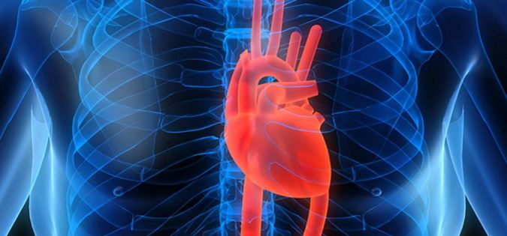
Treatment of Ischaemic Heart Disease /Coronary Artery Disease/

Slide 2
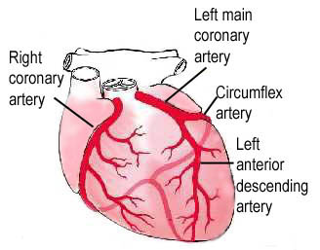

ISCHAEMIC HEART DISEASE
Group of diseases with the presence of myocardial ischemia, which occurs on the basis of the pathological process in the coronary vessels.
Organic - atherosclerosis (95%), thrombus, arteritis..
Functional - coronary spasm or combined
Reducing the flow in coronary arteries>>> ischemia
Notes:
The commonest form of hearth disese caused by Atheroma in the coronary artheries, complcated by trombosis on ruptered atheromatous plaque

Slide 3
Ischaemic Heart Disese is part of
CARDIOVASCULAR DISEASES
Together with…
Hypertenzion
Chronic Hearth Failure
Dysrhytmia
Notes:
Tato skupina je velmi heterogenní.
Mezi další choroby patří hypertenze, chronické srdeční selhání (akutní, chronické ) – AP, IM, arytmie, ….
Skupiny léčiv používané k léčbě ICHS nejsou specifické pouze pro léčbu ICHS, používají se některé z nich i k léčbě hypertenze, srdečního selhání, arytmie atd.
anti-anginal drugs act indirectly by reducing cardiac work
smooth muscle relaxation of coronary artery, reducing cardiac work

Slide 4
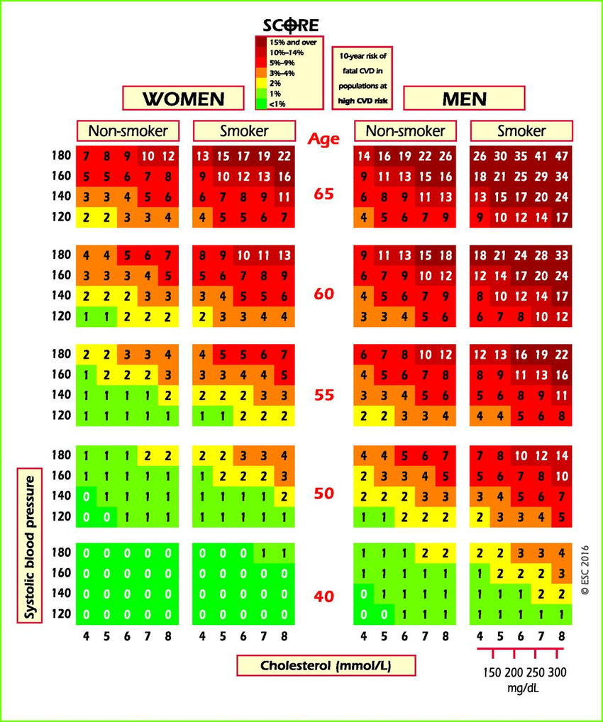
Risk factors and stratification
Risk factors
gender
Smoking status
Cholesterol level
Systolic blood pressure
RISK STRATIFICATION of CARCIOVASCULARS DISEASE
Strategy and type of pharmacotherapy
Notes:
STK = systolický krevní tlak
SCORE = systematic coronary risk estimation
Podrobněji budou mít na cvičení

Slide 5
CARDIOVASCULAR DISEASES
Inhibition of RAAS
ACE inhibitors (ACEi)
AT₁ receptor antagonists (sartans)
Renin inhibitors
Natriuretic peptides
Inhibiton of sympathetic system*
Antagonization of β +/- α receptors
Increase of diuresis/natriuresis
Diuretics
*Activation durig acute phase (NA, dobutamin)

Slide 6
Vasodilatation
Ca-channel blockers (CCB)
Activation of pottasium-channel (A-K_{ATP})
Nitrates and NO donors
Periferal vasoprotective drugs
Inhibitors of phosphodiesterase-5 (PDE-5)
↑myocardial contraction
Ca senzitizers
Inhibitors of phosphodiesterasis-3 (PDE-3)
Cardiac glycosides
Coordination of cardiac rhytm
Antidysrhytmics
Drugs with positive effect on vascular endothelium
Vazoprotectives

Slide 7


ISCHAEMIC HEART DISEASE
Risk factors:
Should not be influenced - age, gender, family history
Should be influenced - hypertension, hyperlipoproteinaemia, smoking, stress, obesity, physical inactivity, dietary habits

Slide 8
ISCHAEMIC HEART DISEASE
CLASSIFICATION
Acute (unstable) CAD
Unstable
angina
Acute myocardial infarction
Sudden death
Chronic (stable) CAD
Silent ischaemia
Angina pectoris
Syndrom X
Dysrhytmias
Mixed AP
Exertional AP
Variant AP

Slide 9
ANGINA PECTORIS
Most frequent clinical manifestations of IHD
caused by the myocardial ischemia, in which the patient has chest pain (stenocardia).
Imbalance between myocardial oxygen supply and demand
Anti-anginal drugs act indirectly by smooth muscle relaxation of coronary artery and reducing cardiac work

Slide 10
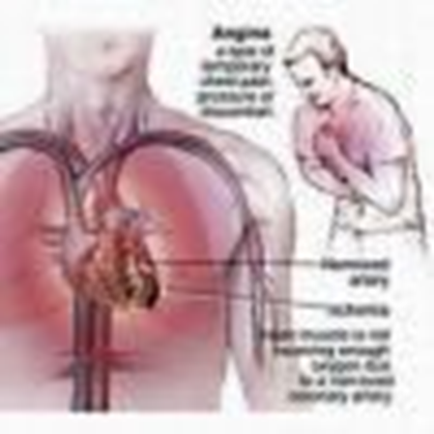

ANGINA PECTORIS
Classification of severity:
I. stenocardia provoked by extraordinary exertion
II. stenocardia provoked more than usual exertion
III. stenocardia provoked by regular exertion stenocardia
IV. stenocardia provoked by minimal exertion or at rest

Slide 11
Therapy of Ischaemic Heart Disese:
Non-pharmacological
life-style, smoking, diet…
Pharmacological
Acute Intervention
PTCA /PCI
DRUG_ELUTING STENTS
cytostatics (tacrolimus, sirolimus, paclitaxel…) slowly releases a drug to block cell proliferation
PTCA = Percutaneous transluminal coronary angioplasty
PCI = Percutaneous coronary intervention (angioplasty with stent)
Notes:
PTCA or Percutaneous Transluminal Coronary Angioplasty is the process of dilating a coronary artery stenosis using an inflatable balloon and a metallic stent introduced into the arterial circulation via the femoral, radial or the brachial artery. Percutaneous Coronary Intervention is another name given to this procedure. Therefore, there is no difference between PTCA and PCI.

Slide 12
Therapy
Stopping or slowing progress of atherogenesis
⇨ LIPID-LOWERING DRUGS
Compenzation of DM ⇨ ANTIDIABETICS
Provention of vascular thrombus occlusion
⇨ ANTIPLATELET DRUGS
Obesity as disease ⇨ ANTI-OBESITY DRUGS
Notes:
Antiobezitika – zvláště, ty ze skupiny sym
stopping or slowing progress of atherogenesis
control of risk factors:
- correction of BP – antihypertension th.
- corrections of lipids – hypolipidemics
- DM – glucose control - antidiabetics
patomimetik nejsou ideální pro KVS , především ICHS, protože zvyšují práci srdce
Prevention of vascular thrombus occlusion

Slide 13
Improvement of coronary blood flow
Drugs that improve improve perfusion of the myocardium
1. NITRATES and NO donors
2. CALCIUM CHANNEL BLOCKERS - dihydropyridines Pottasium-channel activation
Reducing the metabolic demand
(slow the heart)
3. BETA-BLOCKERS
2. CCB -non-dihydropyridines
4. IVABRADIN (I _{f} )

Slide 14
VASODILATOR DRUGS
Play a major role in the treatment of cardiovascular diseases (able to relax vascular smooth muscle)
Notes:
Teď si probereme skupinu léčiv, která jsou schopna navozovat relaxaci hladké svaloviny cév, ne všechny skupiny jsou však vhodné pro ICHS,
ale jejich indikací je třeba arteriální hypertenze, o které budeme více mluvit příští hodinu

Slide 15
VASODILATION should be achieved by:
Plasma membrane voltage-dependent calcium channel
Calcium antagonists ⇨ CCB
Activation of ATP-sensitive pottasium channel ⇨ A-K_{ATP}
Increasing cellular concentration of cAMP/cGMP
Nitric oxide increase ⇨ nitrates and NO donors
Inhibition of phosphodiesterase-5 ⇨ PDE-5 inhibitors
Increase cytoplasmic cyclic nucleotides ⇨ prostacyclines
Blocade of endothelin system
inhibition of endothelin rcp. ET_{A} a ET_{B} ⇨ antagonists of endothelin rcp.
Notes:
Of either cAMP or cGMP

Slide 16
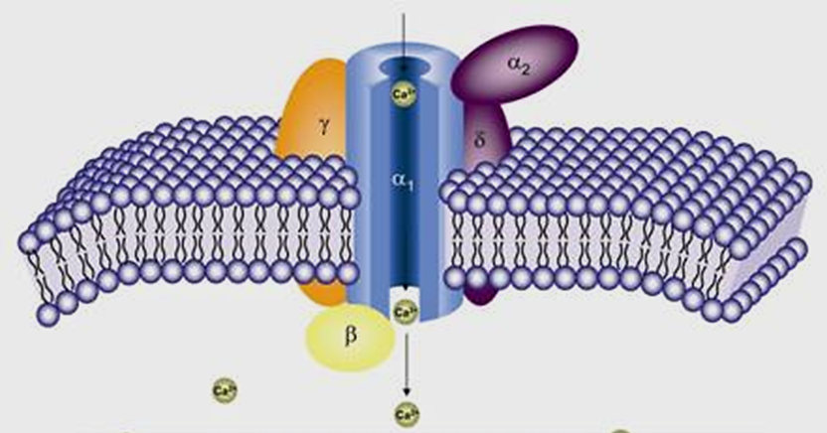
CALCIUM Channel Blockers (CCB)/ CALCIUM Antagonists / CALCIUM Entry Blockers
Notes:
They block entry rather than preventing the intracellular action

Slide 17
Ca²⁺ channel blockers/ Ca²⁺ antagonists/ Ca²⁺ entry blockers/ works by blocking voltage-gated calcium channels type L in cardiac muscle and blood vessels.
sinoatrial node (SA) and atriventricular node (AV) – Ca²⁺ initiates action potentials ⇨ controlling cardiac rate and rhythm
↓ intracellular calcium leading to ↓ cardiac contractility
In blood vessels ↓ vascular smooth muscle and therefore ↑ vasodilation. Vasodilation decreases total peripheral resistance

Slide 18
Mechanism of Action
- block cellular entry of Ca²⁺ through voltage-gated L-type channels
Cardiac action
(SA, AV nodes)
Vascular Smooth Muscle
(generalised arterial/arteriolar dilatation, coronary vasodilatation)
(biliary, urinary tract, uterus – less important therapeutically )
negative inotropic, chronotropic and dromotropic effects
Vazodilatation
⇨ periferal resistence decreased
„selectivity“ of CCB
Notes:
The main effects are on cardiac and smooth vessles
Other type of smooth muscle aleso relaxed

Slide 19
Classification
CCB
DIHYDROPYRIDINES
accoring to half life…
Greater effect on vascular smooth muscle and coronary vessels than on the hearth
= relatively smooth muscle selective
NON-DIHYDROPYRIDINES
Preferentially effects the heart (AV block and cardiac slowing by their actions on conducting tissue, but causes reflex tachycardia)
= relatively cardioselective

Slide 20

DIHYDROPYRIDINES
CCB
Short half-life
NIFEDIPIN
immediatelly causes vazodilatation ⇨ reflex tachycardia
SR drug form
Intermediatte half-life
FELODIPIN
NITRENDIPIN, LERKANIDIPIN
Long half-life
AMLODIPIN, LACIDIPIN
Highly vasoselective

Slide 21
DIHYDROPYRIDINES
CCB
INDICATION
Hypertenzion (monotherapy or combination)
CONTRAINDICATION
Cardiogenic shock, acute hearth failure
ADVERSE EFFECTS
Dose-dependent perimaleolar oedema flushes, gingival hyperplasia (dose-dependent).
Conventional drug forms
Headache, flushes, palpitation, hyponsension, rexlef tachycardia

Slide 22
NON-DIHYDROPYRIDINES
CCB
DILTIAZEM, VERAPAMIL
SA a AV nodes:
negative chronotropic  action potential in SA node
negative dromotropic effect  rate of conduction
negative batmotropic effect  irritability
negative inotropic effect  force of contraction
(SR – slow release forms)
ANTIDYSRHYTMICS IV. class
(Vaughan/Williams)

Slide 23
NON-DIHYDROPYRIDINES
CCB
INDICATION
Treatment and prophylaxy of supraventricular tachyarhytmias
Treatment of preeclampsia (verapamil)
CONTRAINDICATION
SA blocade, AV-blocade type 2.a 3.
bradycardia (↓ 50 beats/min)
Non-compensated heart failure with ↓ systolic function
Gravidity (exemption for life-threatening condition – eclampsia)

Slide 24
NON-DIHYDROPYRIDINES
CCB
ADVERSE EFFECTS
Negative inotropia - bradykardia
obstipation (smooth muscle GI) (VERAPAMIL)

Slide 25
PHARMACOKINETICS
CCB
High protein binding
Variable bioavailability (0-30%)
Variabile half-life
cytochrom P450 involved - inhibitors CYP3A4 and substrate of P-gp
– VERAPAMIL, DILTIAZEM
DILTIAZEM, VERAPAMIL
⇨ ↑plazmatic concentration of statins
RISK OF DRUG INTERACTION
VERAPAMIL + digoxin
⇨ renal excretion decreased
Phenobarbital, fenytoin, karbamazepin ⇨ decrese plasmatic level of verapamil and diltiazem

Slide 26
POTTASIUM-CHANNEL ACTIVATORS (A-K_{ATP})
Opening of K_{ATP} leads to ↑ sarcoplasmatic pottasium draslíku ⇨membrane hyperpolarisation ⇨ ativation of Ca_{L} decreased
I: patients who remain symptomatic despite optimal management
MINOXIDIL, NIKORANDIL currently not available in CZ

Slide 27
Organic Nitrates

Slide 28
MECHANISM OF ACTION
Metabolised to nitric oxide – stimulation of guanylyl cyclase ⇨ incerasing formation of cGMP ⇨ ↓ intracellular calcium ⇨ Smooth muscle relaxation
Nitrates
Enzymatic step – reaction with tissue sulfhydryl (-SH) groups - S-nitrosothiol and NO release
NO donors
Depletion of free SH-groups ⇨ tolerance (with longer-acting drugs)
Should be administered with prolonged effect
Notes:
MLC kináza /LCM – kináza (používány oba pojmy) = myosin light chain kináza, která fosforyluje lehké řetězce myosinu a aktivuje tvorbu aktin-myozinových můstků, což je princip kontrakte hladkých svalů

Slide 29
Nitrates
Nitroglycerin was synthesized by the chemist Ascanio Sobrer in 1847
Nitroglycerin is converted to nitric oxide – NO - identical to the 'endothelium-derived relaxing factor' (EDRF)
LOCAL: the direct effect on coronary artery tone - dilation of coronary arteries
SYSTEMIC: venorelaxation – consequent reduction in central venous pressure – reduce preload
Relaxation of larger muscular arteries – reduce afterload

Slide 30
INDICATION
Drugs
Short-acting
Treatment of stenokardias (sublingual)
  GLYCERYL TRINITRATE (Nitroglycerin®)
  t_{1/2} 3 minutes
  risk of tachyfylaxis / repeated admin.
  ISOSORBID DINITRATE (ISDN)
  active metabolite ISMN with longer t_{1/2}
  Unstable angina i.v.
  (i.v. infusion, higher doses lead to hypotension)
  Acute heart failure, HT crisis, aortal aneurysm
ADMINISTRATION
SUBLINGUAL / i.v. / INHALATION
  Short – acting (15-30 min)

Slide 31
DRUGS
Long-acting
INDICATION
  ISOSORBID 5-MONONITRÁT (ISMN) (t_{1/2} 5 hod.) metabolised more slowly
  Taken twice a day for prophylaxy – morning and lunch, nitrate-free period to avoid tolerance
  MOLSIDOMIN
  Prophylaxy of Stable angina
ADMINISTRATION
Orally swallowed, SR formulation

Slide 32
ADVERSE EFFECTS
Usually well tolerated
headache
Ortostatic hypotension
Tachycardia
Flush
Long-acting nitrates – tolerance, short-acting tachyphylaxis
CONTRAINDICATION
Concomitant administration of PDE-V inhibitors (sildenafil,…)

Slide 33
VASODILATATORS…
Inhibitors of phosphodiesterase-5 (PDE-5-inhibitors)
Endothelin-1 receptor antagonists
Syntetic analogs of prostacyclins

Slide 34
Inhibitors of phosphodiesterase-5 (PDE-5-inhibitors)
MECHANISM OF ACTION
Specifically inhibit isoform 5 of cGMP-dependent phosphodiesterase in in the corpus cavernosum ⇨ increased levels of cGMP, producing smooth muscle relaxation in the corpus cavernosum and allowing inflow of blood
CONTRAINDICATION
Arterial and orthostatic hypotension
Aortal stenosis
Hypertrofic cardiomyopathy
Retinitis pigmentosa
Retinopathy
Notes:
cGMP je druhý posel v signální kaskádě guanylátcyklázových receptorů

Slide 35
DRUGS
Liší se rychlostí nástupu účinku a jeho délkou
Onset 1 hod; effect 4-6 hours
SILDENAFIL
VARDENAFIL
Onset 2 hod; effect 24-48 hours
TADALAFIL
Onset 30 min; effect 12-24 hours
AVANAFIL
INDICATION
Erectile dysfunction
Pulmonary hypertension
BHP
Pulmonary hypertension
Notes:
BHP = benigní hyperplázie prostaty

Slide 36
ADVERSE EFFECTS
headache, flush, dyspepsia, nasal congestion
Mild or moderate transient difference in colour discrimination (blue/green)
priapism
RARE: Vasodilatation and hypotension,
dysrhytmia and heart failure
SILDENAFIL A VARDENAFIL inhibit partly also PDE 6 involved in phototransduction cascade in retina
Drug interactions !
nitrates or another drugs ↑cGMP
Notes:
Priapismus = (dlouhotrvající a neustupující erekce)

Slide 37
Endothelin-1 receptor antagonists
    INDICATION Pulmonary hypertension
MECHANISM OF ACTION
Block binding of endothelin-1 to ET_{A} a ET_{B} – pulmonary arthery pressure decreased
    DRUGS
    BOSENTAN - competitive non-selective antagonist of rcp ET_{A} i ET_{B}
    AMBRISENTAN -selective antagonist of receptoru ET_{A}
    Teratogenic.
    ADVERSE EFFECTS
    Hepatotoxicity (FDA requires monthly monitoring of liver function tests), anaemia (hematocrit)
Notes:
Under normal conditions, endothelin-1 binding of ET-A or ET-B receptors causes constriction of the pulmonary blood vessels. By blocking this interaction, bosentan decreases pulmonary vascular resistance. Bosentan has a slightly higher affinity for ET-A than ET-B

Slide 38
Syntetic analogs of prostacyclins
INDICATION
Pulmonary hypertension
Prostacyclins = prostaglandines PGI₂
MECHANISM OF ACTION
Increase cyclic nucleotides by increasing adenylyl cyclase aktivity – directly acting vasodilatators
DRUGS
    EPOPROSTENOL: only i.v. infusion, t_{1/2} 3-5 min.
    ILOPROST: t_{1/2} 20-25 min.
    i.v., peroral or inhalation
TREPROSTINIL: s.c. nebo i.v. infusion
Notes:
Prostacyklin je endogenní prostaglandin, který má kromě vazodilatačního účinku také cytoprotektivní vliv, snižuje adhezi leukocytů k cévní stěně, inhibuje agregaci destiček, snižuje tvorbu a sekreci endotelinu a vede k inhibici migrace a proliferace buněk.

Slide 39
Improvement of coronary blood flow
Drugs that improve improve perfusion of the myocardium
NITRATES and NO donors
CALCIUM CHANNEL BLOCKERS - dihydropyridines
Pottasium-channel activation
Reducing the metabolic demand
(slow the heart)
BETABLOKÁTORY
BKK-non-dihydropyridiny
BRADINY
Notes:
Back to previuos slides – cíle farmakoterapie ICHS

Slide 40
Β-adrenoceptor antagonists
(beta-blockers, β sympatolytics)

Slide 41
MECHANISM OF ACTION
Reverzible antagonization of adrenergic β receptors (antagonists of endogenous katecholamins)
Competitive antagonists (intrinsic activity = 0) or
Partial agonists (ISA - intrinsic sympathomimetic activity)
Non- selective
cardioselective
Notes:
Competitive antagonists (intrinsic activity = 0) or partial agonists (ISA - intrinsic sympathomimetic activity)
Non-selective or cardioselective (primary blocs of b₁ receptors)

Slide 42
Cardiovascular effects of BB
Antihypertensive action
reducing sympathetic activity, decreased heart rate, reduction in cardiac output, reduction of renin release
Myocardial action
negative chronotropic (HR), inotropic (contractility) dromotropic (vedení vzruchu) a bathmotropic (excitability)
Cardioprotective effects
- antiischaemic (decreased heart rate, reduction in cardiac output ⇨ decreased myocardial oxygen consumption)
- antidysrhythmic (II. class) ⇨ better coronary flow

Slide 43
Antagonisation of endogenous katecholamins (through β rcp.)
bronchoconstriction
reduction of renin release
metabolic effects (↓glycogenolysis, lipolysis)
Antiglaucomatic effect
Long term use of β blockers ⇨ hypersensitization , receptor up-regulation ⇨ REBOUND FENOMEN

Slide 44
CLASSIFICATION
  lipophylic
  hydrophylic
Selectivity (non-selective x cardioselective)
Partial agonistic aytivity ( with ISA x withou ISA)
Combined effect (antagonisation of α -receptor, direct vasodilatation)
ISA - β₁ rcp. ⇨ increase the heart rate at rest, but reduce during exercise

Slide 45
PHARMACOKINETIC
  Depends on lipophylity/hydrophylity
  Lipophylic
  High resorption from GI
  High first pass efect and protein-binding
  Longer t_{1/2}
  Central effects (cross HEB)
  CYP2D6 metabolization
METOPROLOL
Preferably SR form
Genetic polymorphism ⇨ AUC difference 10-30x
Drug interaction with CYP2D6 inhibitors
Notes:
Bylo zjištěno, že AUC lipofilních betablokátorů se liší u rychlých a pomalých metabolizérů 10-30 násobně.
Např, metoprolol má plazmatický poločas u pomalých metabolizérů víc než 10 hodin, u středních a rychlých (většinová populace) 3-5 hodin, u velmi rychlých jen 2 hodiny.

Slide 46
PHARMACOKINETIC
  Depends on lipophylity/hydrophylity
  Hydrophylic
  Decreased resorption
  Don´t cross HEB
  ↓ t_{1/2}
  Renal excretion – glomerulal filtration
! Renal insuficiency
Variable half-life …2-10 min (esmolol - hydrophylic); 30-50 hod (nebivolol- lipophylic)

Slide 47
Drugs
1) „1. generation“
NON_SELECTIVE
β₁ + β₂ receptors
CARDIOSELEKTIVE
β₁ selective
 | sotalol hydrophilic timolol hydrophilic Antiglaucomatic drug
ISA + | karteolol
 | atenolol hydrophilic betaxolol hydrophilic (less) bisoprolol hydrophilic (less) metoprolol lipophylic esmolol hydrophilic t_{1/2} = 2-10 min
ISA + | acebutolol hydrophilic celiprolol hydrophilic ISA na β₂-rp ⇨VAZODILATATION
Combined | nebivolol lipophylic t_{1/2}= 30-50 hours
Metabolised to an active metabolite that potentiates the L/NO pathway - vasodilatation

Slide 48
2) Betablockers with combined activity (alpha and beta antagonists)
„2. generation“
  CARVEDILOL - lipophylic
Selective antagonist of α₁-rp ⇨ vazodilatation
Non-selective antagonist of β-receptors
Reduction of renin release - ↓ RAAS
Antioxidative effect
INDICATION: hypertension, chronic cardiac failure
  LABETALOL - hydrophylic
Selective antagonist of α₁-rp ⇨ vazodilatation
Non-selective antagonist of β-receptors
Partial agonist (ISA) of β₂-rp
INDICATION: hypertension in pregnancy, i.v. severe hypertension crisis

Slide 49
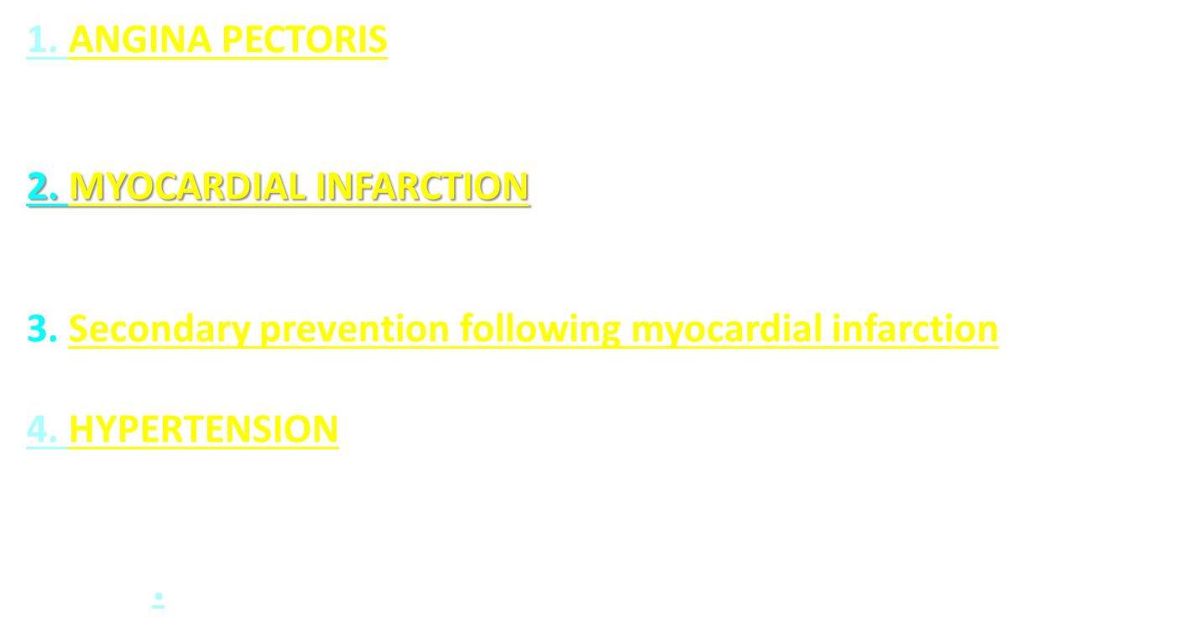
MAIN INDICATION
1. ANGINA PECTORIS
Monotherapy or combination, not first
2. MYOCARDIAL INFARCTION
mainly n$egative chronotropic effect, antidyshrytmic effect$
3. Secondary prevention following myocardial infarction
4. HYPERTENSION
Monotherapy or combination, not longer first choise
.

Slide 50
MAIN INDICATION
4. Hearth Failure
sympato-adrenergic hyperactivation decreased, antidysrhytmic effect BISOPROLOL, METOPROLOL (SR), KARVEDILOL, NEBIVOLOL
only in well-compensated patients because of negative inotropic effect !
5. Therapy and prophylaxy of dysrhytmias (II. class)
supraventricular dysrhytmias, atrial fibrilation or flutter

Slide 51
OTHER USES:
Thyrotoxicosis
Severe infantile haemangioma
Benign essential tremor
Anxiety to control symptoms (palpitation, treamor…)
Glaucoma
e.g. Timolol eye drops
!! Up to 80 % eye drops should be absorbed - systemic effect - bradycardia and bronchospasm !

Slide 52
ADVERSE EFFECTS
Non-selective BB (through β₂-rcp).
BRONCONSTRICTION ⇨ relative KI: pacients with AB/CHOPN (…cardioselective nebivolol)
COLD EXTREMITIES
ERECTILE DYSFUNCTION
HYPOGLYCAEMIA
FATIGUE, INSOMNIA
CARDIOVASCULAR
hypotension
bradykardia
AV-blocades

Slide 53
CONTRAINDICATION
Hearth failure (exception well-compenated HF, low doses)
SA a AV blocades (II. and III. grades)
Hypotension
Bradycardia (<50 beats/min)
RELATIVE CONTRAINDICATION
Astma bronchiale
COPD
Diabetes mellitus
Depression
Erectile dysfunction

Slide 54
Bradines

Slide 55
MECHANISM OF ACTION
Selective inhibition the pacemaker I_{f} in SA node ⇨ slowing the heart rate ⇨ allowing more time for blood to flow to the myocardium (only negative chronotropic effect)
DRUG
IVABRADIN
INDICATION
Symptomatic treatment of myocardial ischaemia in patients with AP / chronic heart failure NYHA II-IV
  in adults unable to tolerate or with a contra-indication to the use of beta-blockers or in combination with beta-blockers in patients inadequately controlled with an optimal beta-blocker

Slide 56
