Slide 1
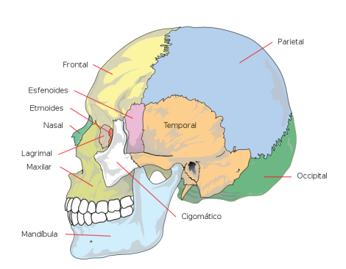
Name bones of skull, use nouns as hints
Paries, etis, m.
Frons, frontis, f.
Sphen
Ethmos
Tempus, oris, n.
Nasus, i, m.
Lacrima, ae, f.
Occiput, itis, n.
Zygon
Mandibula, ae, f.

Slide 2
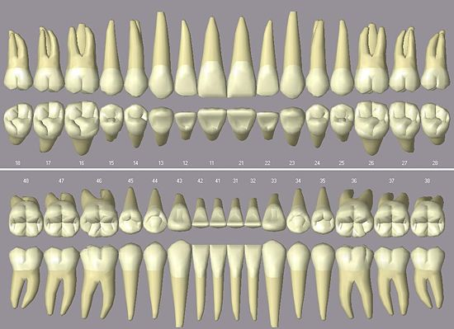
Name types of permanent teeth
4
3
2
1
2
3
4

Slide 3
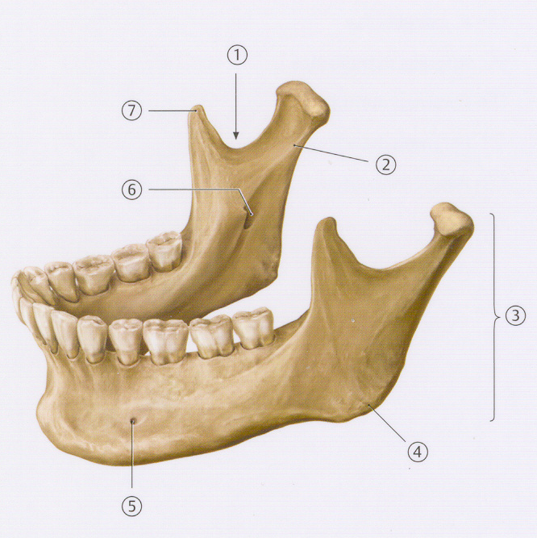
Name the main parts of the lower jaw
The notch of lower jaw
Processus condylaris
Process that projects superiorly to the upper jaw: r _ _ _ m _ _ _ _ _ _ _ _ _
Angle between the body and the process of the upper jaw: a_ _ _ _ _ _ m_ _ _ _ _ _ _ _ _
opening for the mental nerve: f_ _ _ _ _ _ mentale
Opening on the inner aspect of the process of lower jaw: f_ _ _ _ _ _ m_ _ _ _ _ _ _ _ _
Coronoid process?

Slide 4
Name the main parts of the tooth
A
C_ _ _ _ _ d_ _ _ _ _
C_ _ _ _ _ d_ _ _ _ _ = C_ _ _ _ _ d_ _ _ _ _
B
C
R _ _ _ _ d_ _ _ _ _
D
A_ _ _ r_ _ _ _ _ _ d_ _ _ _ _
Notes:
A corona dentis; B cervix dentis = collum dentis; C radix dentis; D apex radicis dentis

Slide 5
Name the parts of tooth as seen in the longitudinal section
the extremely hard substance surrounding the crown of tooth? E_ _ _ _ _ _ _ = s_ _ _ _ _ _ _ _ _ a_ _ _ _ _ _ _ _ _
D
E
predominant mass of tooth?
D_ _ _ _ _ _ _ = s_ _ _ _ _ _ _ _ _ e_ _ _ _ _ _ _
F
pulp cavity of tooth?
C_ _ _ _ _ _ d_ _ _ _ _
G
gingival margin?
M_ _ _ _ gingivalis
H
Alveolus dentalis
I
substance similar to bone surrounding the tooth?
C _ _ _ _ _ _ _ = s _ _ _ _ _ _ _ _ _ o_ _ _ _
J
canal between the pulp cavity and the apical foramen?
C_ _ _ _ _ _ r _ _ _ _ _ _ d_ _ _ _ _
Notes:
Enamelum = substantia adamantina; dentinum = substantia eburnea; cavitas dentis; margo gingivalis; cementum = substantia ossea; canalis radicis dentis

Slide 6
Create stomatosurgical diagnoses
Fractura Laceratio Luxatio Vulnus | alveolus caput mandibulae gingiva enamelum radix corona corpus mandibulae labium | contusolacer, a, um complicatus, a, um traumaticus, a, um

Slide 7
Translate types of tooth fractures : ICD S 02.50-54
Fracture of
tooth
enamel
Simple fracture of the tooth crown not penetrating to the
dental pulp
Complicated fracture of the tooth crown penetrating to the dental pulp
Fracture of the tooth root
Fracture of the tooth crown and tooth root

Slide 8
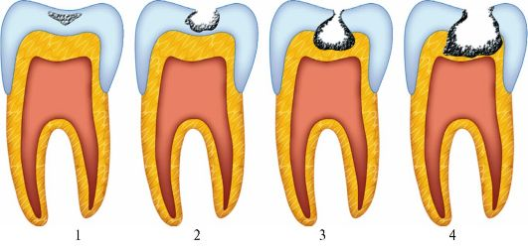
1) Number types of tooth decay based on its severity, start from the simplest 2) Identify all adjectives, which declension are they?
4
3
6
2
5
1
caries profunda simplex
caries media
caries ad pulpam penetrans
caries superficialis
caries profunda pulpae proxima
caries incipiens

Slide 9
Fixation via the miniplate according to Champy
Champy´s line of the osteosynthesis of lower jaw
miniplate load-sharing semi-rigid fixation technique popularized by French doctor M. Champy

Slide 10
osteosynthesis according to Champy due to fracture of the process of lower jaw on the left side?

Slide 11
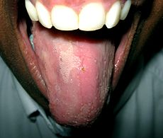
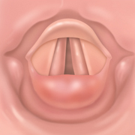
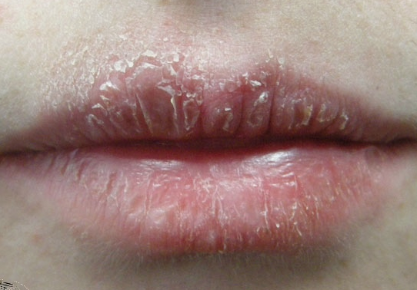
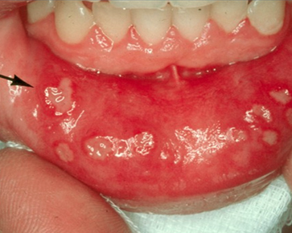
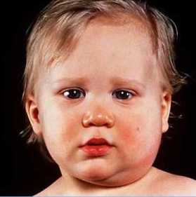
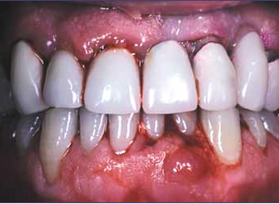
Inflammationes
MKN K 14.0 | MKN J 37.0 | MKN K 13.0
MKN K 05.3 | MKN K 12.0 | MKN B 26.0
Notes:
Glossitis = inflammation linguae; laryngitis = inflammatio laryngis; cheilitis= inflammatio labiorum; periodontitis= inflammatio periodontii; stomatitis = inflammatio oris; parotitis = inflammatio parotis

Slide 12
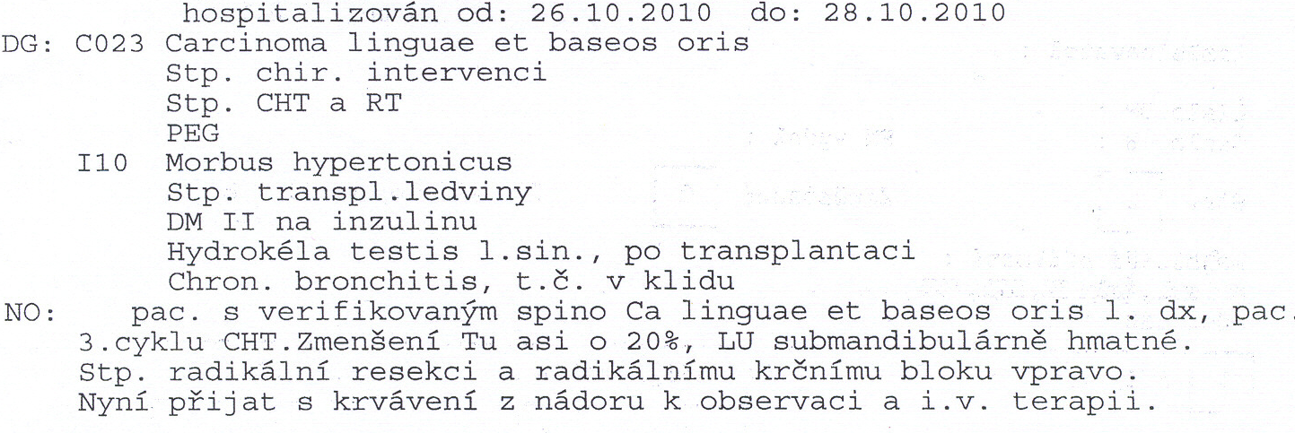
Translate the underlined phrases, guess the meaning of the abbreviations

