Slide 1
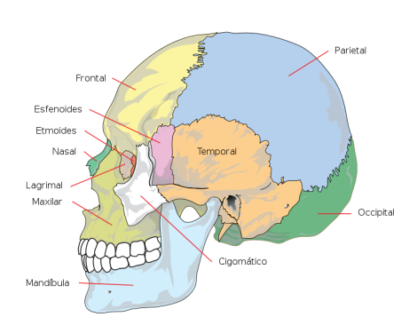
Name bones of skull using adjectives derived from the following nouns
Paries, etis, m.
Frons, frontis, f.
Sphen
Ethmos
Tempus, oris, n.
Nasus, i, m.
Lacrima, ae, f.
Occiput, itis, n.
Zygon
Mandibula, ae, f.

Slide 2
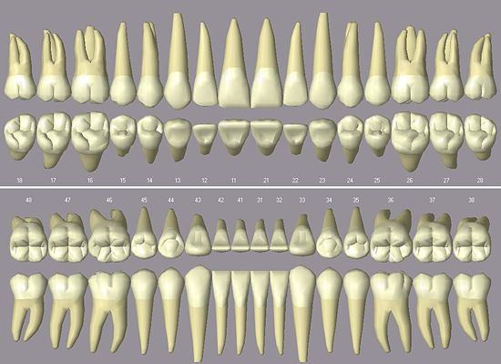
Name types of permanent teeth
4
3
2
1
2
3
4

Slide 3
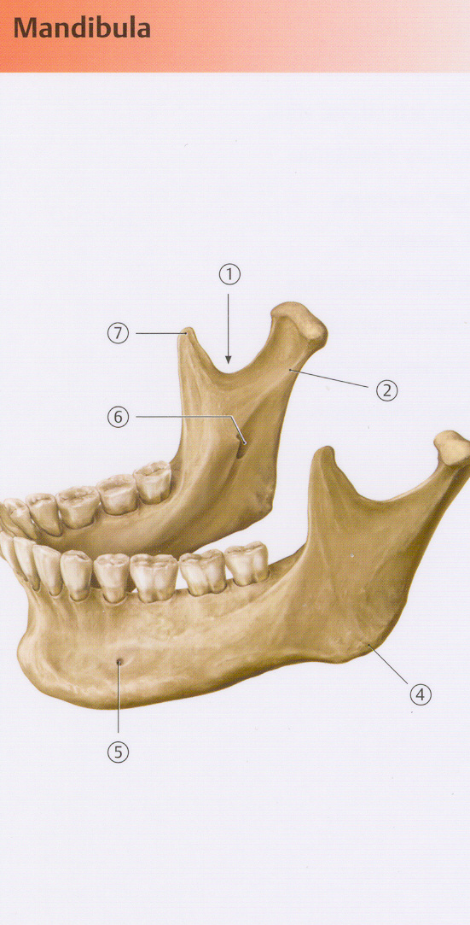
Name the main parts of the lower jaw
The notch of lower jaw?
Processus condylaris
Process that projects superiorly to the upper jaw: r _ _ _ m _ _ _ _ _ _ _ _ _
Angle between the body and the process of the upper jaw: a_ _ _ _ _ _ m_ _ _ _ _ _ _ _ _
opening for the mental nerve: f_ _ _ _ _ _ m_ _ _ _ _ _
Opening on the inner aspect of the process of lower jaw: f_ _ _ _ _ _ m_ _ _ _ _ _ _ _ _
Coronoid process?

Slide 4
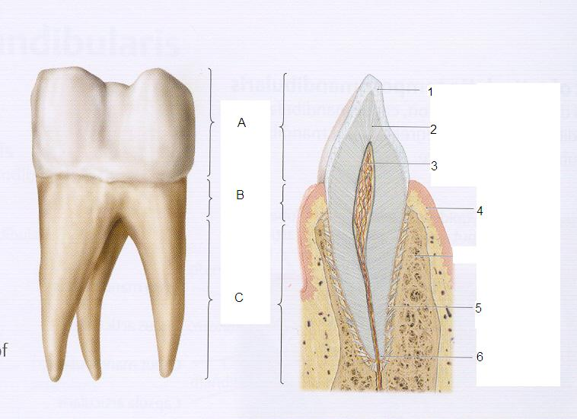
Name the main parts of the tooth
A
C_ _ _ _ _ d_ _ _ _ _
C_ _ _ _ _ d_ _ _ _ _ = C_ _ _ _ _ d_ _ _ _ _
B
C
R _ _ _ _ d_ _ _ _ _
D
A_ _ _ r_ _ _ _ _ _ d_ _ _ _ _
Notes:
A corona dentis; B cervix dentis = collum dentis; C radix dentis; D apex radicis dentis

Slide 5
Name the parts of tooth as seen in the longitudinal section
the extremely hard substance surrounding the crown of tooth? E_ _ _ _ _ _ _ = s_ _ _ _ _ _ _ _ _ a_ _ _ _ _ _ _ _ _
D
E
predominant mass of tooth?
D_ _ _ _ _ _ _ = s_ _ _ _ _ _ _ _ _ e_ _ _ _ _ _ _
F
pulp cavity of tooth?
C_ _ _ _ _ _ d_ _ _ _ _
G
gingival margin?
M_ _ _ _ g_ _ _ _ _ _ _ _ _
H
Alveolus dentalis
I
substance similar to bone surrounding the tooth?
C _ _ _ _ _ _ _ = s _ _ _ _ _ _ _ _ _ o_ _ _ _
J
canal between the pulp cavity and the apical foramen?
C_ _ _ _ _ _ r _ _ _ _ _ _ d_ _ _ _ _
Notes:
Enamelum = substantia adamantina; dentinum = substantia eburnea; cavitas dentis; margo gingivalis; cementum = substantia ossea; canalis radicis dentis

Slide 6
Create stomatosurgical diagnoses
Fractura Laceratio Luxatio Vulnus | alveolus caput mandibulae gingiva enamelum radix corona corpus mandibulae labium | contusolacer, a, um complicatus, a, um traumaticus, a, um

Slide 7
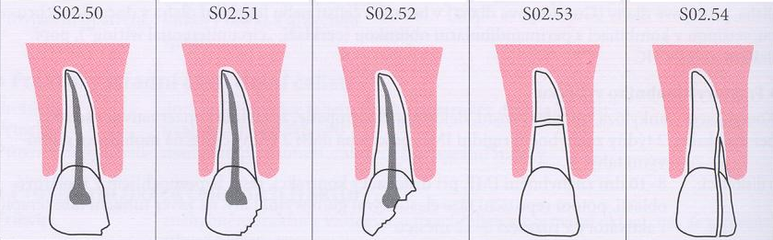
Fracturae dentium
the fracture
of enamel
the non-complicated fracture of the crown of tooth
(not pertaining to the dentine)
the complicated fracture of the crown of tooth
(pertaining to the dentine)
the fracture of the root of tooth
the fracture of the crown and root of tooth

Slide 8
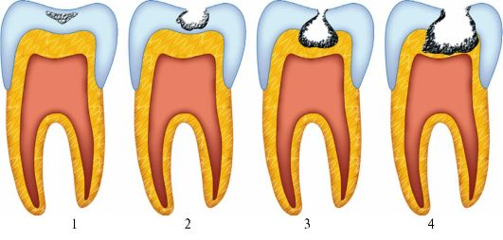
Put the diagnoses into proper order
BASED ON THE EXTENT OF THE damage
caries profunda simplex
caries media
caries ad pulpam penetrans
caries superficialis
caries profunda pulpae proxima
caries incipiens

Slide 9
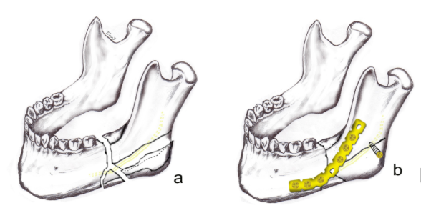
osteosynthesis according to Champy due to fracture of the process of lower jaw on the left side?
according to = secundum + Acc

Slide 10
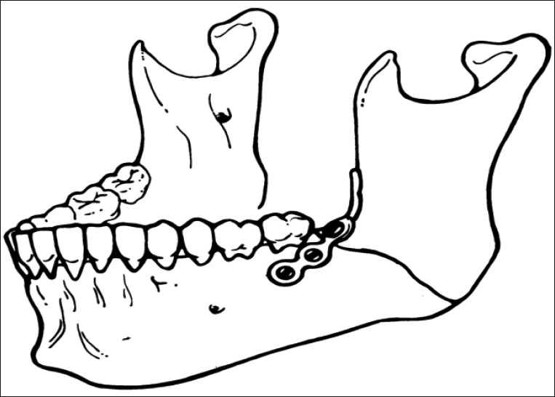
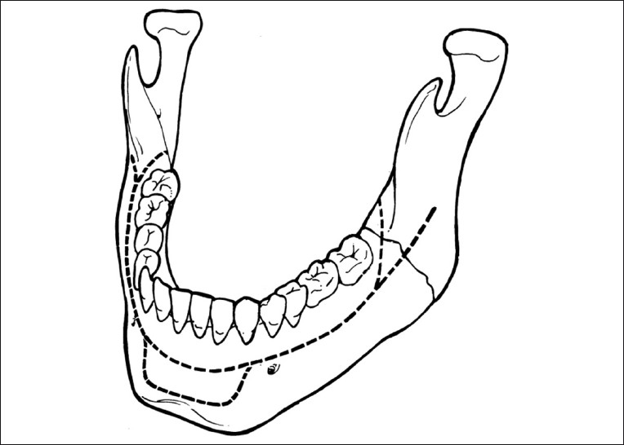
Fixation via the miniplate according to Champy
Champy´s line of the osteosynthesis of lower jaw
miniplate load-sharing semi-rigid fixation technique popularized by French doctor M. Champy

Slide 11
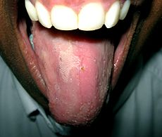
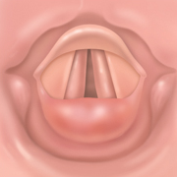
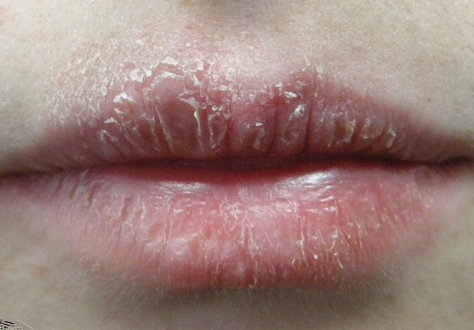
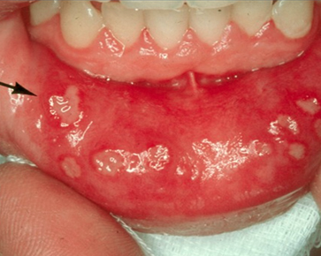
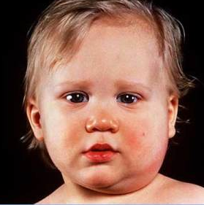
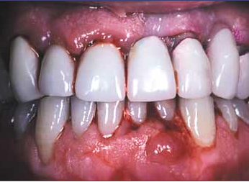
NAME THE InflammationS
MKN K 14.0 | MKN J 37.0 | MKN K 13.0
MKN K 05.3 | MKN K 12.0 | MKN B 26.0
Notes:
Glossitis = inflammation linguae; laryngitis = inflammatio laryngis; cheilitis= inflammatio labiorum; periodontitis= inflammatio periodontii; stomatitis = inflammatio oris; parotitis = inflammatio parotis

Slide 12
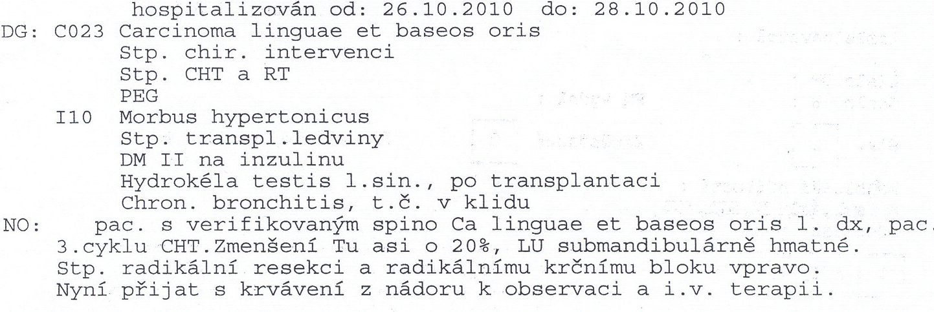
Translate the underlined phrase
guess the meaning of the abbreviations

