Slide 1
Questions
What is the form of an adjective dependent on?
What are the Nominative endings of adjectives?
How do we decline the adjectives like magnus, a, um (liber, era, erum)?

Slide 2
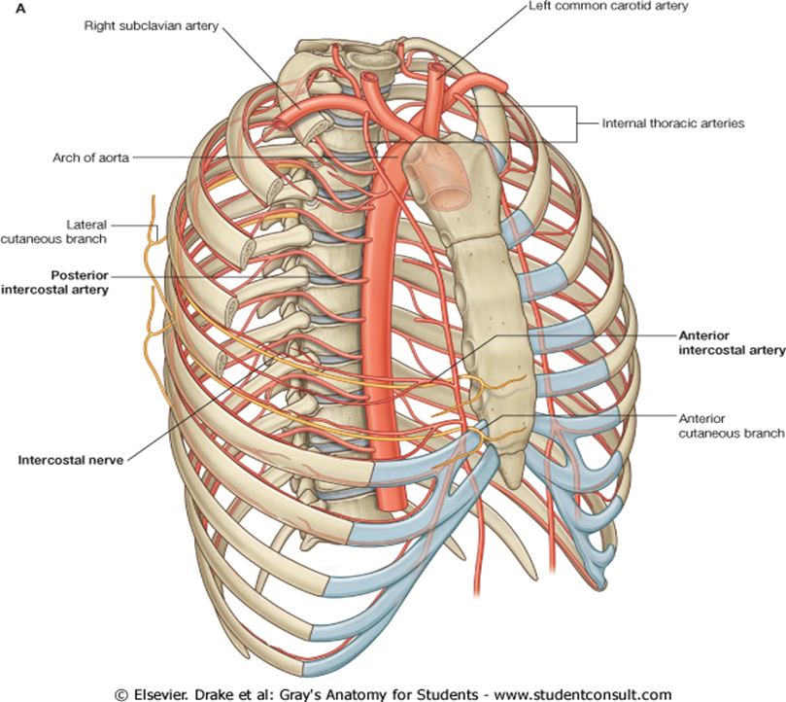
internal thoracic artery?

Slide 3
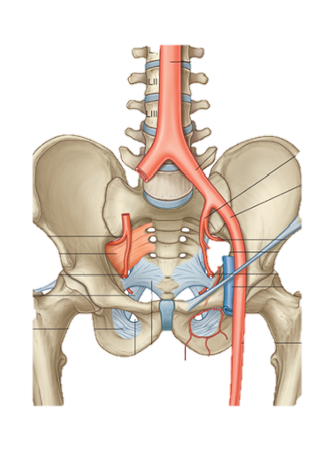
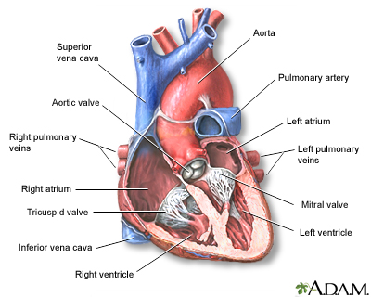
external iliac artery? arch of aorta?

Slide 4
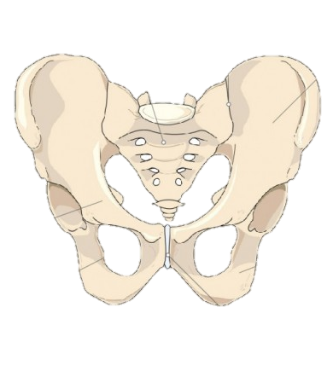
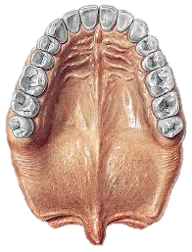
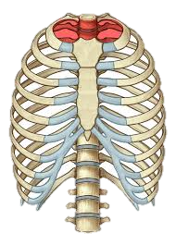
aperture of pelvis? medial rhaphe? thoracic aperture?

Slide 5
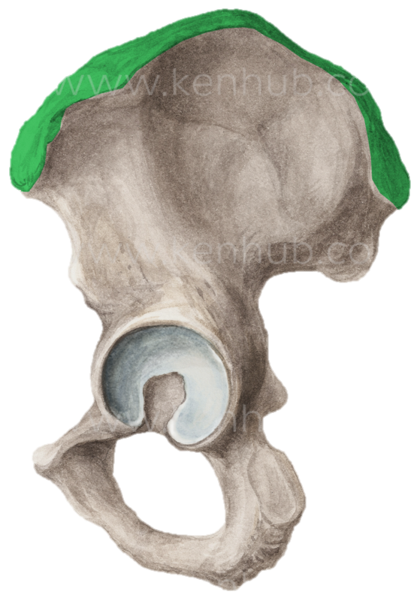
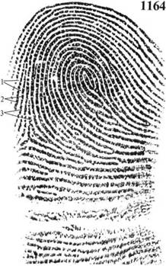
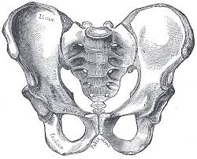
iliac crest? ridges of skin (dermal ridges)? pubic crest?

Slide 6
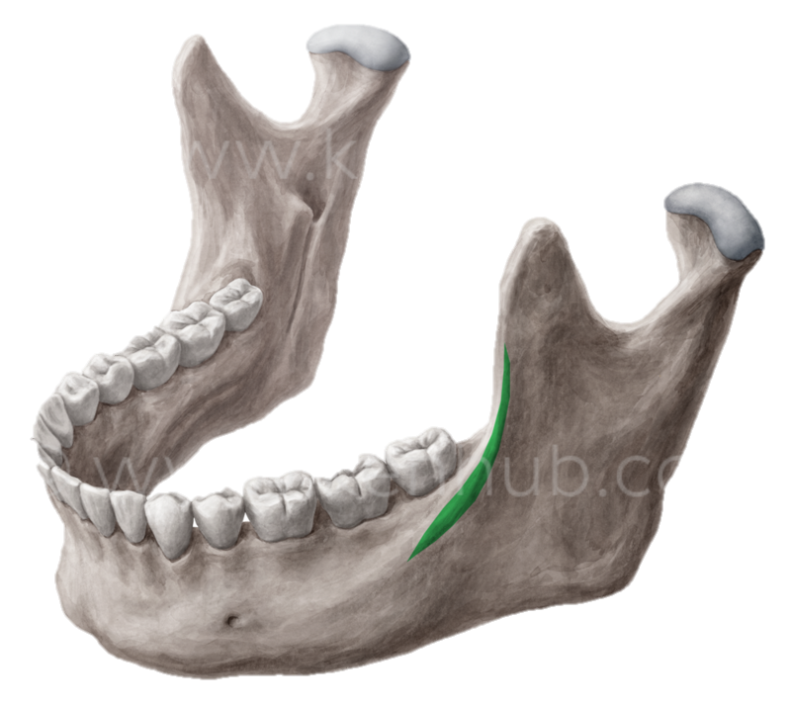
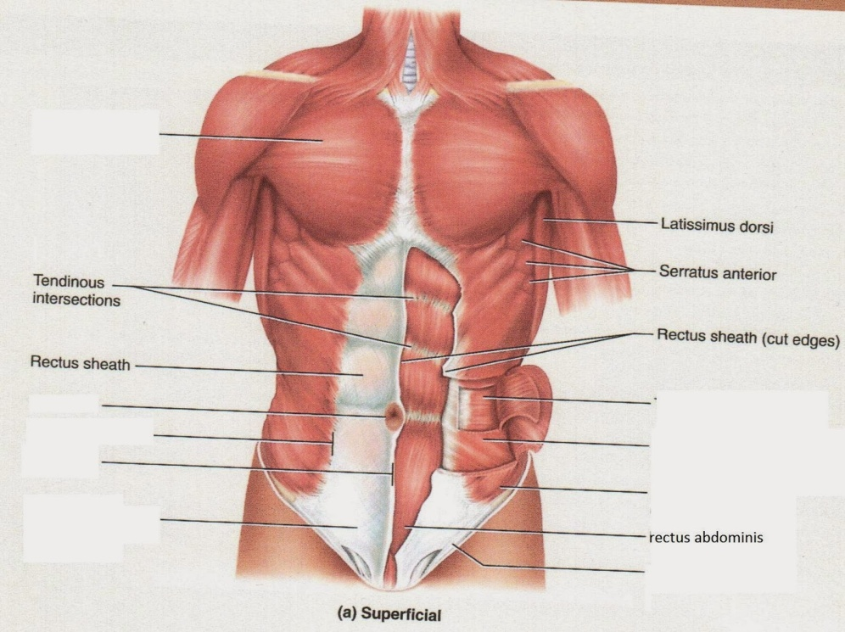
oblique line of lower jaw? white line?

Slide 7
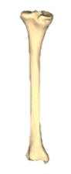
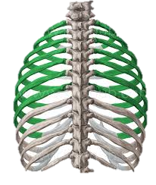
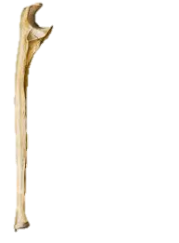
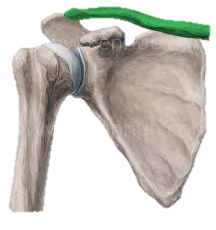
right tibial bone? right collar bone? true ribs? left ulnar bone?

Slide 8
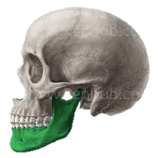
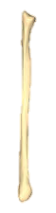
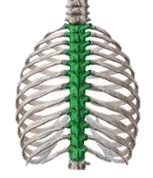
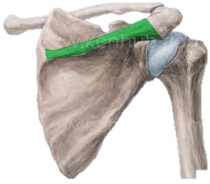
left lower jaw? right fibula? spine of right shoulder blade? thoracic vertebras?

Slide 9
Ordinal numbers
primus, a, um
secundus, a, um
tertius, a, um
quartus, a, um
quintus, a, um
sextus, a, um
septimus, a, um
octavus, a, um
nonus, a, um
decimus, a, um
undecimus, a, um
duodecimus, a, um

Slide 10
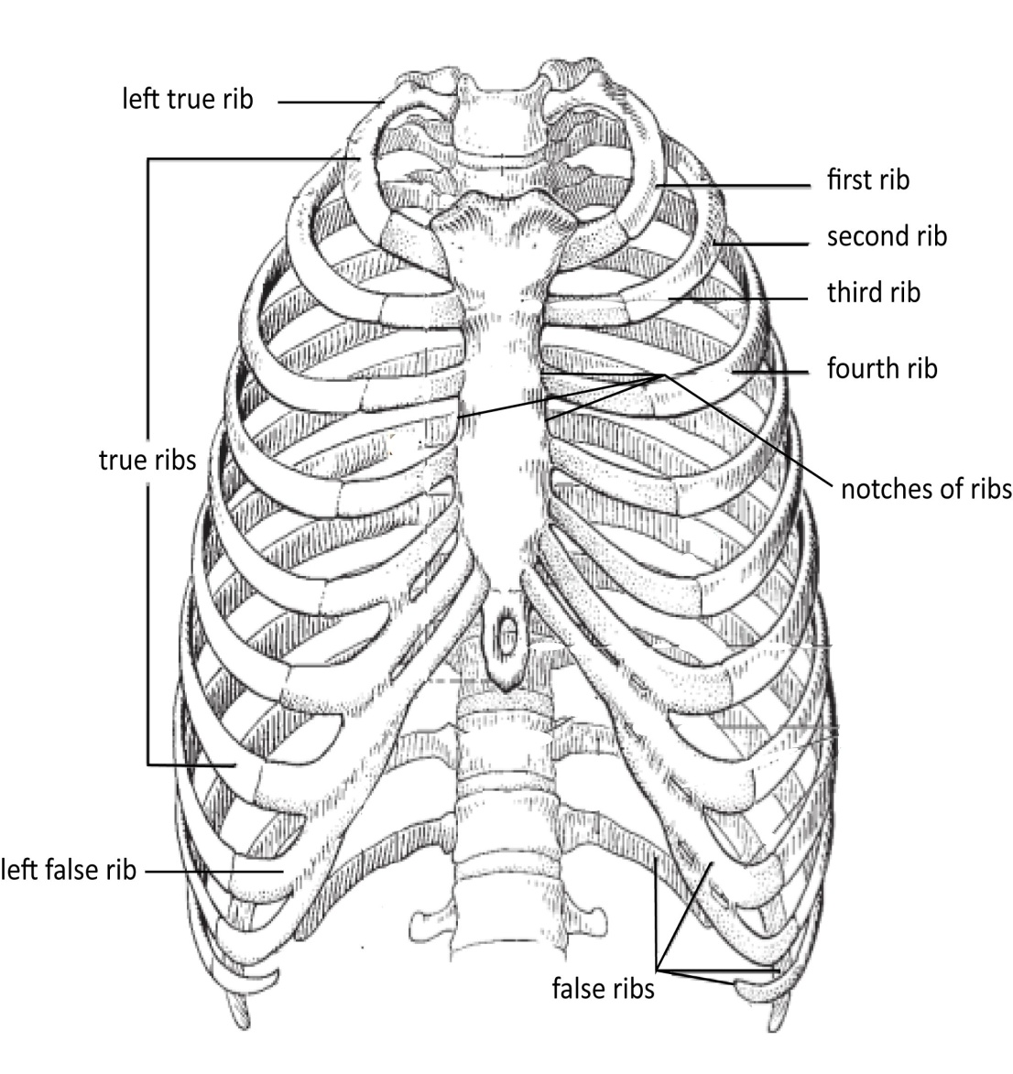
Ribs

Slide 11
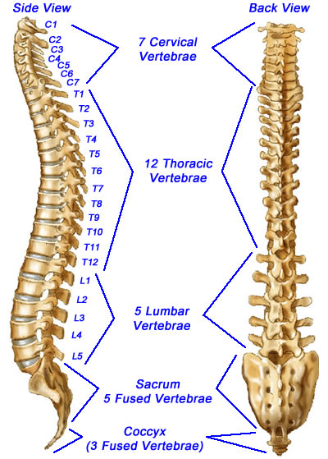
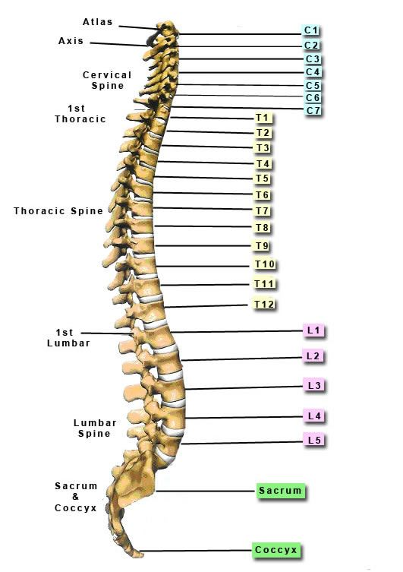
Vertebrae

Slide 12
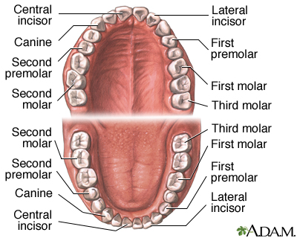
Teeth

Slide 13
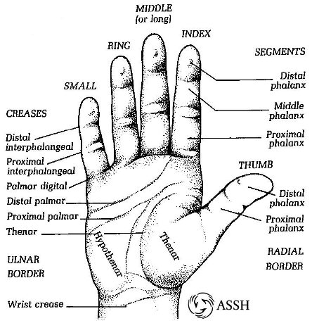
Fingers

Slide 14
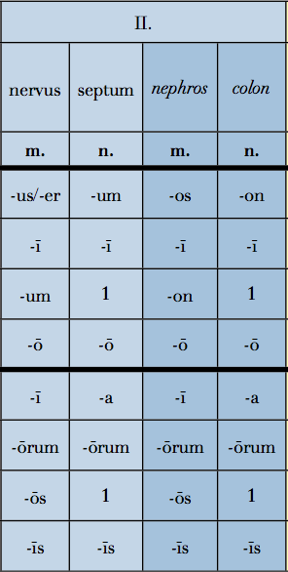
2nd declension
Latin Greek
TYPICAL ENDINGS IN NOM. SG.
–US/-ER (Latin) / -OS (Greek)
Gender M (F)
–UM (Latin) / -ON (Greek)
Gender N
Gen. sg. –I
Nouns of female gender in this declension are exceptions:
methodus, i, f.
periodus, i, f.
diameter, tri, f.

