Slide 1
Preclinical course (aVLTP05X)
Introduction

Slide 2

Preclinical course: what is it?
75h. in the laboratory
5 credits
lectures
measurements
paper research
working with data
test
lectures
paper research
working with data
test
measurements

Slide 3
Lectures
Anthropometric parameters
PWV (applanation tonometry)
PWA (applanation tonometry)
CAVI and ABI (VaSera)
Baroreflex sensitivity (photoplethysmography)
ECHO
How to work with data
(19.10. – 23.10.)

Slide 4
What can I do now?
choose a topic
start with paper research

Slide 5
Topics
Renal denervation
Asthma bronchiale
Obesity
Anticancer therapy
Hormonal contraception

Slide 6
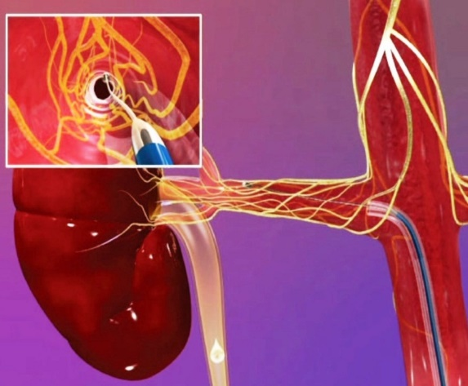
Renal denervation
elevated blood pressure despite taking three
optimally doses medications, typically:
  a diuretic
  a calcium-channel blocker
  an ACE inhibitor
renal sympathetic denervation: endovascular catheter based procedure using radiofrequency ablation

Slide 7
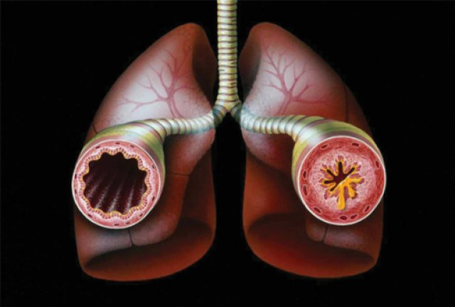
Asthma bronchiale
a long-term inflammatory disease of the airways of the lungs
symptoms:
  reversible airflow obstruction
  easily triggered bronchospasms
medication:
  Long-term asthma control medications:
    inhaled
    leukotriene modifiers
    combination inhalers
  Quick-relief (rescue) medications:
    short-acting beta agonists
    anticholinergic agents
    oral and intravenous corticosteroids.

Slide 8
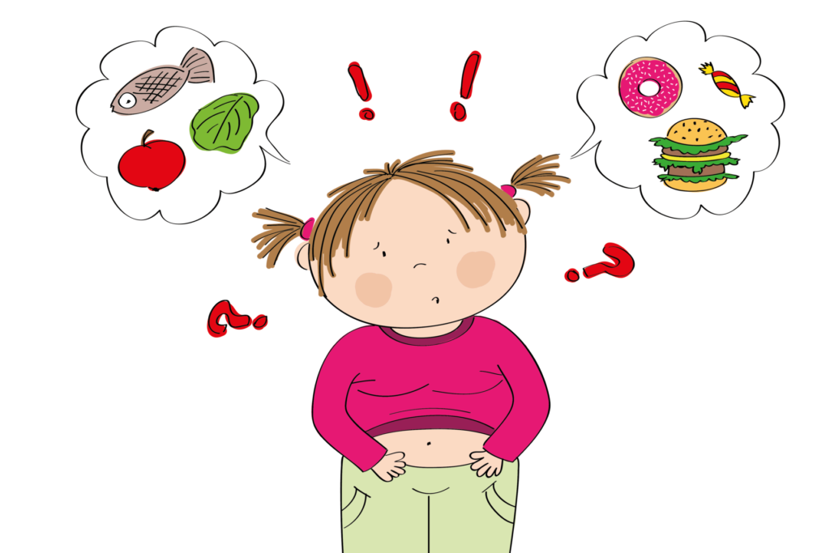
Obesity
childhood obesity is one of the most serious public health challenges of the 21st century
alimentary obesity
one-month stay in children hospital

Slide 9
What else?
ALL
Hormonal contraception

Slide 10
Topics
Link

