Slide 1
REGULATION/DYSREGULATION in BLOOD PRESSURE

Slide 2


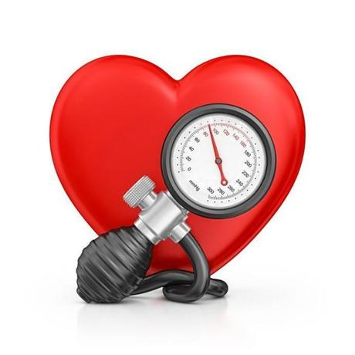

Blood pressure – the most important parameter in cardiovascular system – „high-profile“ parameter

Slide 3
Blood pressure (BP) – pressure of the blood to the wall of the vessels
Systolic BP, diastolic BP, pulse pressure, mean arterial pressure (MAP)
BP = CO x R CO – cardiac output, R – resistance
CO = SV x HR SV – stroke volume, HR – heart rate
Notes:
Czech proverb says: repetition is the mother of wisdom…we will talk about basic characteristics of blood pressure:

Slide 4
ESH AND ESC GUIDELINES
2013 ESH/ESC Guidelines for the management of arterial
hypertension
The Task Force for the management of arterial hypertension of the European
Society of Hypertension (ESH) and of the European Society of Cardiology (ESC)
Authors/Task Force Members: Giuseppe Mancia (Chairperson) (Italy) * , Robert Fagard (Chairperson)

Slide 5
Classification BP values
category | Systolic BP | Diastolic BP
 | (mmHg) | (mmHg)
optimal | < 120 | < 80
normal | 120 – 129 | 80 – 84
high normal pressure | 130 – 139 | 85 – 89
Hypertension - mild | 140 – 159 | 90 – 99
Hypertension - moderate | 160 – 179 | 100 – 109
Hypertension - severe | ≥ 180 | ≥ 110
Isolated systolic hypertension | ≥ 140 | < 90
According the Guidelines of European Society of Cardiology 2013

Slide 6
2018 ESC/ESH Guidelines for the management
of arterial hypertension
The Task Force for the management of arterial hypertension of the
European Society of Cardiology (ESC) and the European Society of
Hypertension (ESH)
Authors/Task Force Members: Bryan Williams* (ESC Chairperson) (UK),
Giuseppe Mancia* (ESH Chairperson) (Italy), Wilko Spiering (The Netherlands),
Enrico Agabiti Rosei (Italy), Michel Azizi (France), Michel Burnier (Switzerland),
Denis L. Clement (Belgium), Antonio Coca (Spain), Giovanni de Simone (Italy),
Anna Dominiczak (UK), Thomas Kahan (Sweden), Felix Mahfoud (Germany),
Josep Redon (Spain), Luis Ruilope (Spain), Alberto Zanchetti† (Italy), Mary Kerins
(Ireland), Sverre E. Kjeldsen (Norway), Reinhold Kreutz (Germany),
Stephane Laurent (France), Gregory Y. H. Lip (UK), Richard McManus (UK),
Krzysztof Narkiewicz (Poland), Frank Ruschitzka (Switzerland),
Roland E. Schmieder (Germany), Evgeny Shlyakhto (Russia), Costas Tsioufis
(Greece), Victor Aboyans (France), and Ileana Desormais (France)
European Heart Journal (2018) 39, 3021–3104

Slide 7
Classification of BP
It is recommended that BP be classified as
optimal, normal, high–normal, or grades
1–3 hypertension, according to office BP.

Slide 8
Changes in recommendations
2013
Diagnosis: Office BP is recommended for screening and diagnosis of hypertension.
2018
Diagnosis: It is recommended to base the diagnosis of hypertension on:
Repeated office BP measurements; or Out-of-office BP measurement with ABPM and/or HBPM if logistically and economically feasible.

Slide 9
Treatment thresholds
2013
Highnormal BP (130–139/85–89 mmHg): Unless the necessary
evidence is obtained, it is not recommended to initiate antihypertensive drug therapy at high–normal BP.
2018
Highnormal BP (130–139/85–89 mmHg): Drug treatment may be
considered when CV risk is very high due to established CVD, especially
CAD.

Slide 10
Definitions of hypertension according to
office, ambulatory, and home blood pressure levels
Category SBP(mmHg) DBP(mmHg)
Office BPa >_140 and/or >_90
Ambulatory BP
Daytime (or awake) mean >_135 and/or >_85
Night-time (or asleep) mean >_120 and/or >_70
24 h mean >_130 and/or >_80
Home BP mean >_135 and/or >_85
BP = blood pressure; DBP = diastolic blood pressure; SBP = systolic blood
pressure.
aRefers to conventional office BP rather than unattended office BP.

Slide 11
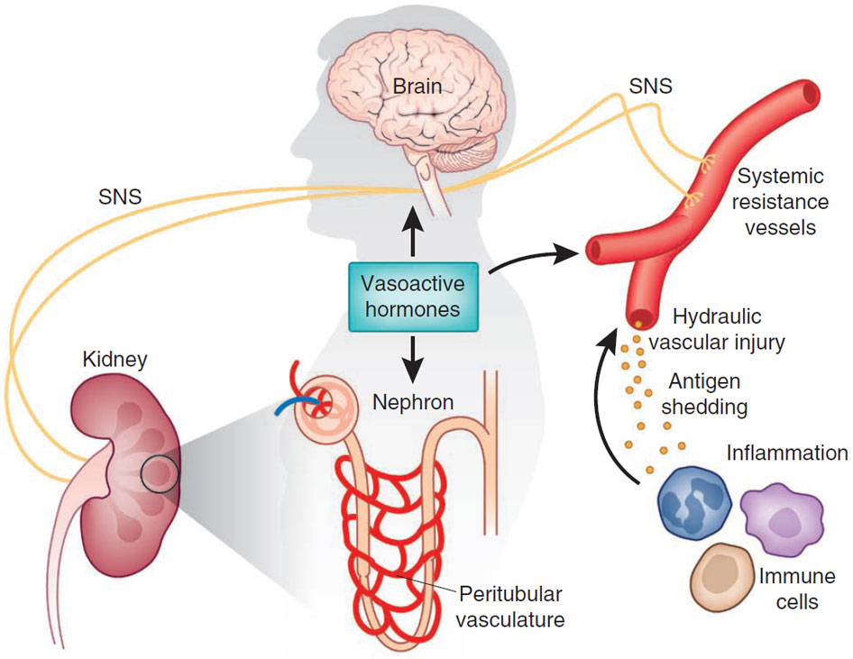
Regulation of blood pressure – complex process
compliance
Vasoconstriction: angiotensin II, vasopresin, epineprin (α₁), serotonin, PGF/TXA_{2,} endotelin, cofein, NPY
sympatikus parasympatikus
baroreflex
Vasodilatation:
NO, adrenalin (β₂), adenosin, acidosis, histamin, PGD₂/PGE₂/PGI₂, prostacyclins, VIP, bradykinin
RAAS
ANP/BNP
ADH
Thomas M Coffman, Under pressure: the search for the essential mechanisms of hypertension , Nature Medicine 17, 1402–1409 (2011)

Slide 12
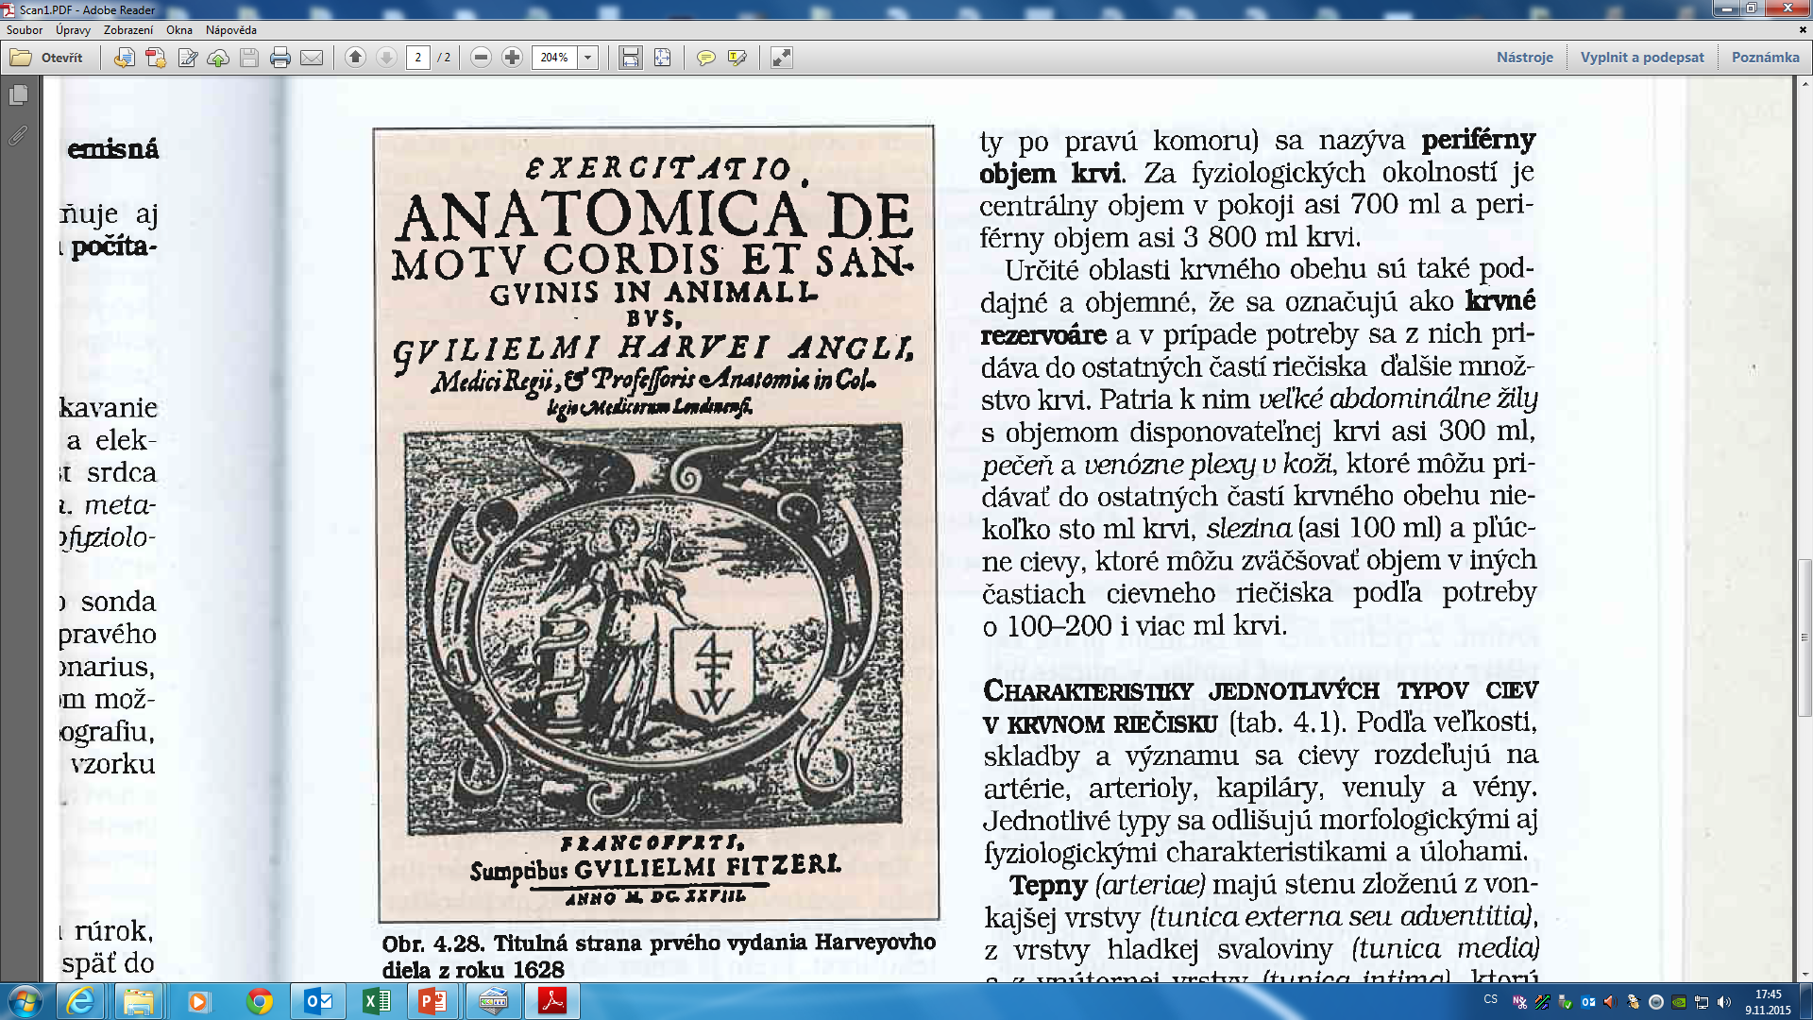
let me remark that 400 years ago

Slide 13
REGULATION IN CARDIOVASCULAR SYSTEM
Main function:
keep relatively constantaneous arterial blood pressure
keep perfusion of tissues

Slide 14
Regulation of vessels tone
Tone of the vessels = basic tension of the smooth muscle inside of the wall
(vasoconstriction x vasodilatation)
Regulation - local autoregulation
- system regulation

Slide 15
Autoregulation
Autoregulation – the capacity of tissues to regulate their own blood flow
Myogenic theory – Bayliss phenomenon (as the pressure rises, the blood vessels are distended and the vascular smooth muscle fibres that surround the vessels contract; the wall tension is proportional to the distending pressure times the radius of the vessels – law of Laplace)

Slide 16
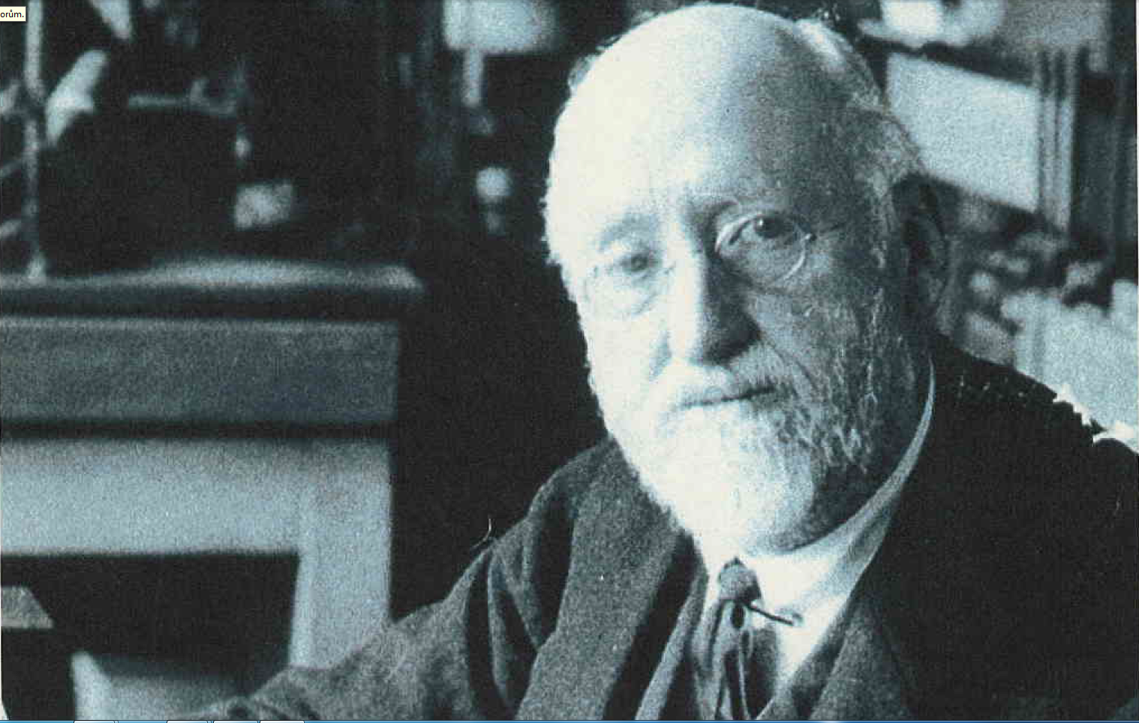

Slide 17
Autoregulation
Metabolic theory – vasodilator substances tend to accumulate in active tissue, and these metabolites also contribute to autoregulation
  ending products of energetic metabolism – CO₂, lactate acid, K⁺
  effect of hypoxia (circulation: vasodilatation x pulmonary circulation: vasoconstriction)
  Adenosin – coronary circulation: vasodilatation

Slide 18
Autoregulation
by substances which releasing from:
  endothelium
  tissues

Slide 19
Substances secreted by the ENDOTHELIUM
Vasodilatation:
Nitric oxide (NO) from endothelial cells
(originally called: EDRF)
Prostacyclin is produced by endothelial cells
Vazoconstriction:
Endothelins (polypeptids – 21peptides)
three isopeptides: ET 1, ET 2 , ET 3

Slide 20
Substances secreted by the tissues:
Histamine – primarily tissue hormones.
General affect: vasodilatation - decrease periphery resistence, blood pressure
KININS: 2 related vasodilated peptides
Bradykinin + lysylbradykinin (kallidin).
Sweat glands, salivary glands
10x strongers than histamine
Relaxation of smooth muscle, decrease blood pressure

Slide 21
Systemic regulation
By hormones
Catecholamines – epinephrine, norepinephrine - effect as activation of sympathetic system
RAAS - stress situation
ADH - general vasoconstriction
Natriuretic hormones - vasodilatation

Slide 22
Neural regulatory mechanism
Autonomic nervous system
Sympathetic: vasoconstriction
All blood vessels except capillaries and venules contain smooth muscle and receive motor nerve fibers from sympathetic division of ANS (noradrenergic fibers)
Regulation of tissue blood flow
Regulation of blood pressure
Parasympathetic part: vasodilatation
Only sacral parasympathetic cholinergic fibres (Ach) inervated arteriols from external sex organs

Slide 23
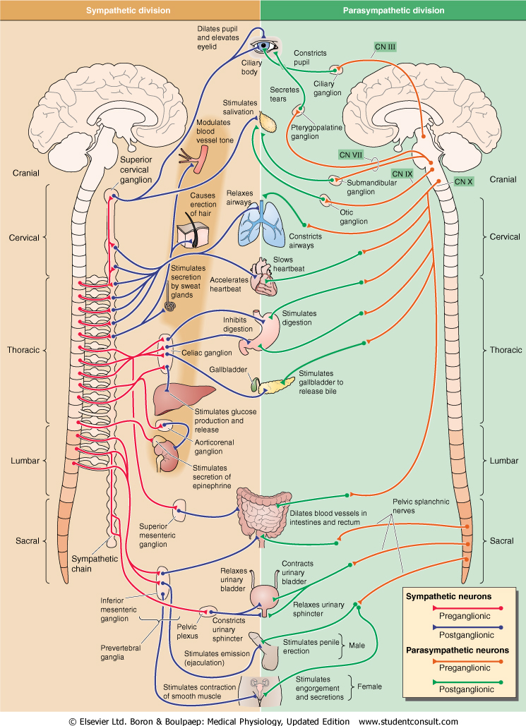
Sympathetic nervous system
Fight or flight response
Energy/store consumption
Preganglionic neuron
– Spinal cord
-Thoraco - lumbar system
Ganglia Paravertebral
Truncus sympathicus
Majority
Prevertebral
-Plexus aorticus
Mostly diffuse effect
Parasympathetic nervous system
Rest and digest response
Energy conservation/en. store production
Preganglionic neuron
– Brain stem and spinal cord
– cranio-sacral system
Ganglia
Close to target organs or intramurally
Mostly local effect

Slide 24
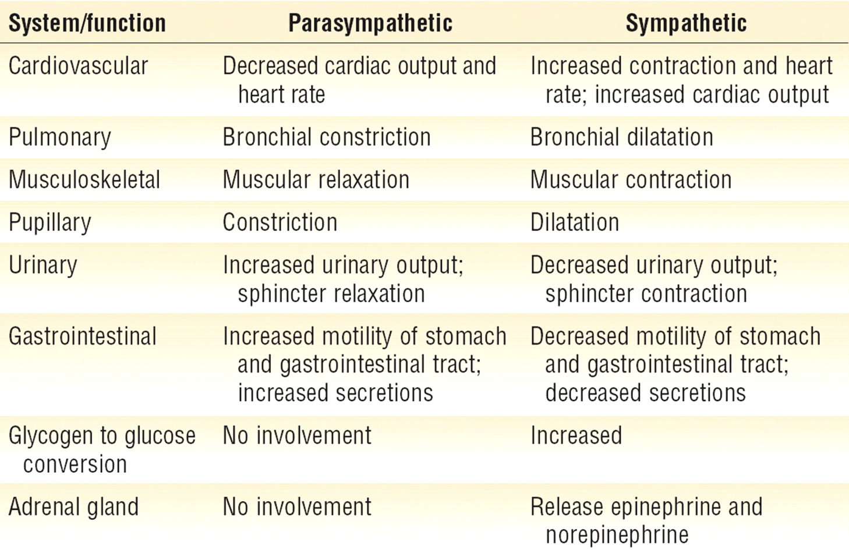
Sympatthetic nervous system
Fight or flight response
Energy/store consumption
Preganglionic neuron
– Spinal cord
-Thoraco - lumbar system
Ganglia Paravertebral
Truncus sympathicus
Majority
Prevertebral
-Plexus aorticus
Mostly diffuse effect
Parasympathetic nervous system
Rest and digest response
Energy conservation/energy store production
Preganglionic neuron
– Brain stem and spinal cord
– cranio-sacral system
Ganglia
Close to target organs or intramurally
Mostly local effect

Slide 25
INTEGRATION of regulation in cardiovascular system
The regulation of the heart:
  Rami cardiaci n. vagi
Cardiac decelerator center - medula oblongata (ncl.dorsalis, ncl. ambiguus) – parasympathetic fibres of nervus vagus
: vagal tone (tonic vagal discharge)
Negative chronotropic effect (on heart rate)
Negative inotropic effect (on contractility)
Negative dromotropic effect (on conductive tissue)

Slide 26
INTEGRATION of regulation in cardiovascular system
The regulation of the heart:
  nn. cardiaci
Cardiac accelerator center – spinal cord, sympathetic ganglia – sympathetic NS
Positive chronotropic effect (on heart rate)
Positive inotropic effect (on contractility)
Positive dromotropic effect (on conductive tissue)

Slide 27
INTEGRATION of regulation in cardiovascular system
Vasomotor centre (regulation for function of vessels)
Medula oblongata
presoric area (rostral and lateral part –vasoconstriction – increase blood pressure
depresoric area (medio-caudalis part – vasodilatation, decrease of blood pressure)

Slide 28
INTEGRATION of regulation in cardiovascular system
Influence by central nervous system
  cerebral cortex
  limbic cortex
  hypothalamus

Slide 29
Regulation of blood pressure
Short - term regulation
- baroreflex
Middle - term regulation
- humorals regulation
sympathetic - catecholamines
RAAS (decrease perfusion pressure in kidney – secretion of renin)
ADH
Long – term regulation
- kidney regulation

Slide 30
BAROREFLEX
IX.
NTS
X.
arteries
veins
BAROREFLEX

Slide 31
Baroreflex – in every day life
Orthostatic – clinostatic reaction
Valsalva maneuvre - defecation

Slide 32
CITLIVOST BAROREFLEXU
BAROREFLEX SENSITIVITY
změna délky tepového intervalu vyvolaná změnou systolického krevního tlaku o 1 mmHg
A change of duration of pulse interval (in ms) due to a change of systolic blood pressure by 1 mmHg
Laboratorní metody:
Laboratory methods:
- aplikace phenylephrinu
- Phenylephrin aplication
- neck suction
- neck suction
- Valsalvův manévr
- Valsalva manoever
Spontánní metody:
Spontaneous methods:
v časové doméně
in time-domain
- sekvenční analýza
- Sequence analysis
ve spektrální doméně
in frequency-domeain
- vzájemná spektrální analýza
- cross-spectral analysis
- α-index
- α-index

Slide 33
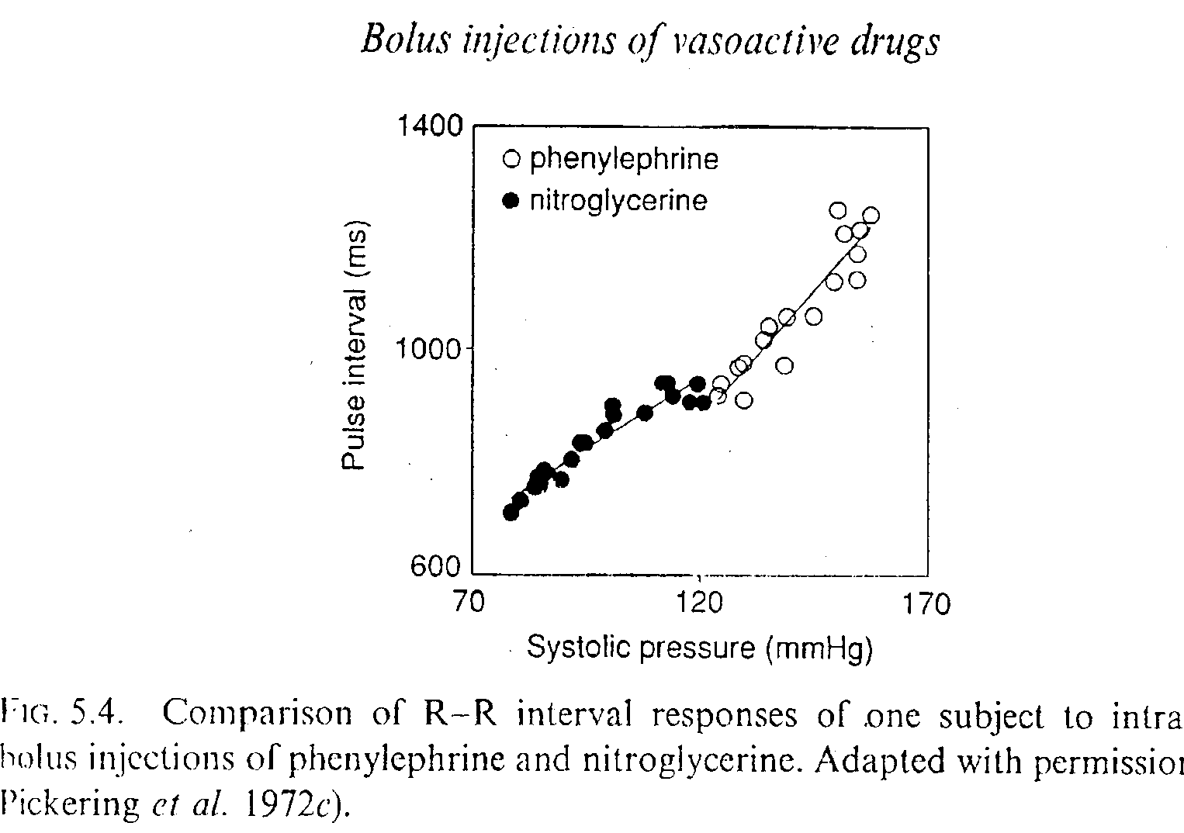
BAROREFLEX SENSITIVITY
- Phenylephrin aplication

Slide 34
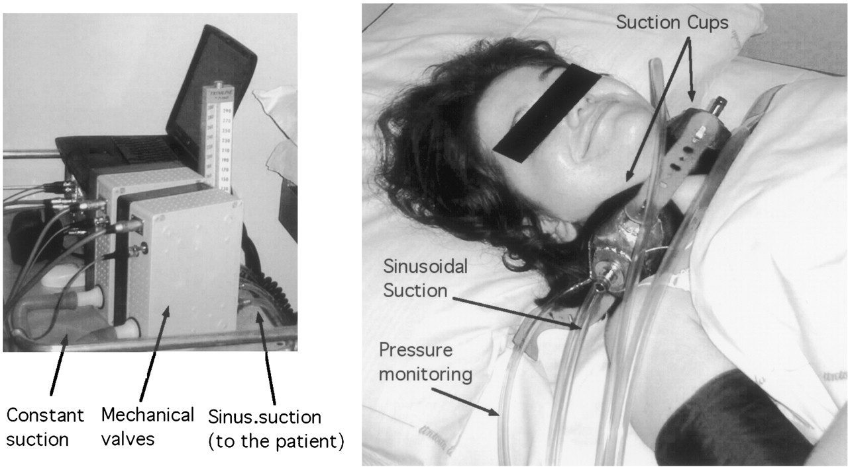

Furlan R et al. Circulation 2003;108:717-723
BAROREFLEX SENSITIVITY
- Neck suction

Slide 35
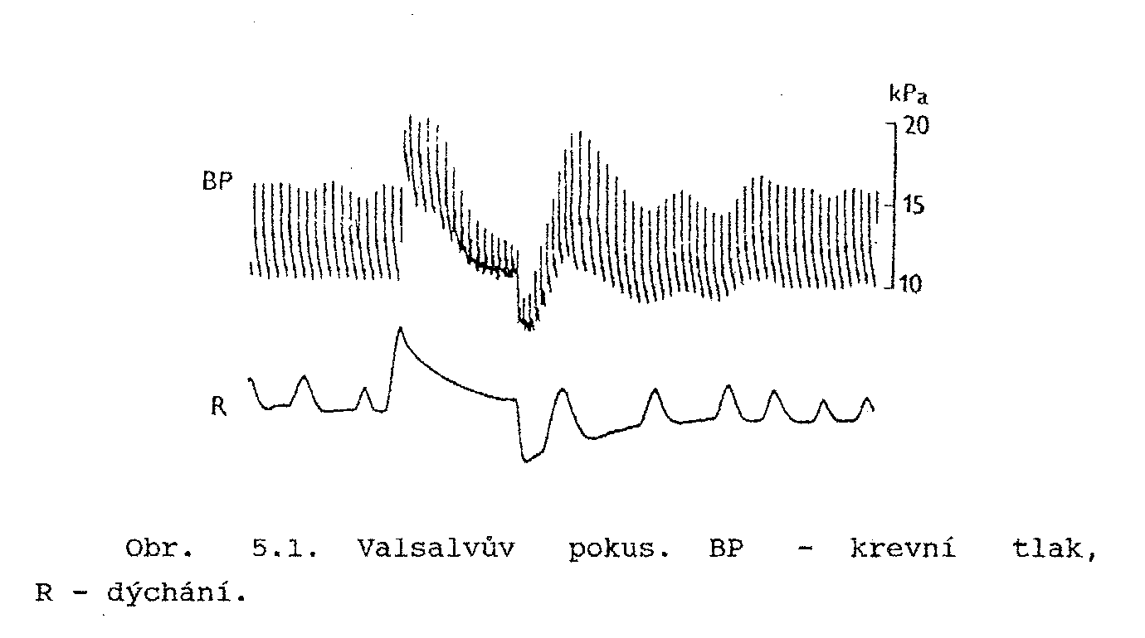
(BP)VRCOPPMAP BP-blood pressure, VR-venous return, CO-cardiac output, PP – pulse pressure, MAP-mean arterial pressure
BAROREFLEX SENSITIVITY
- Valsalva manoever

Slide 36
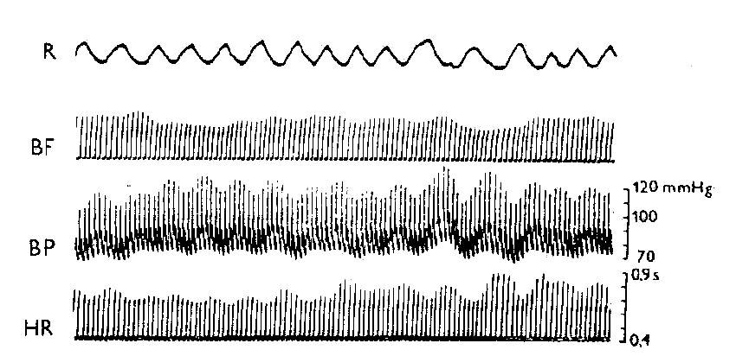
Records of circulatory parameters

Slide 37
Spectral analysis:
Carried out under standard conditions at various maneuvers (supine, standing); evaluated with 300 representative intervals RR / NN /
Another mathematical processing (Fourier transform) -length RR intervals are converted to cycles in Hz
The spectrum is divided into several components – low (LF: the sympathetic modulation) and high frequency (HF: vagal modulation)
People with reduced heart rate variability have a 5 times higher risk of death

Slide 38
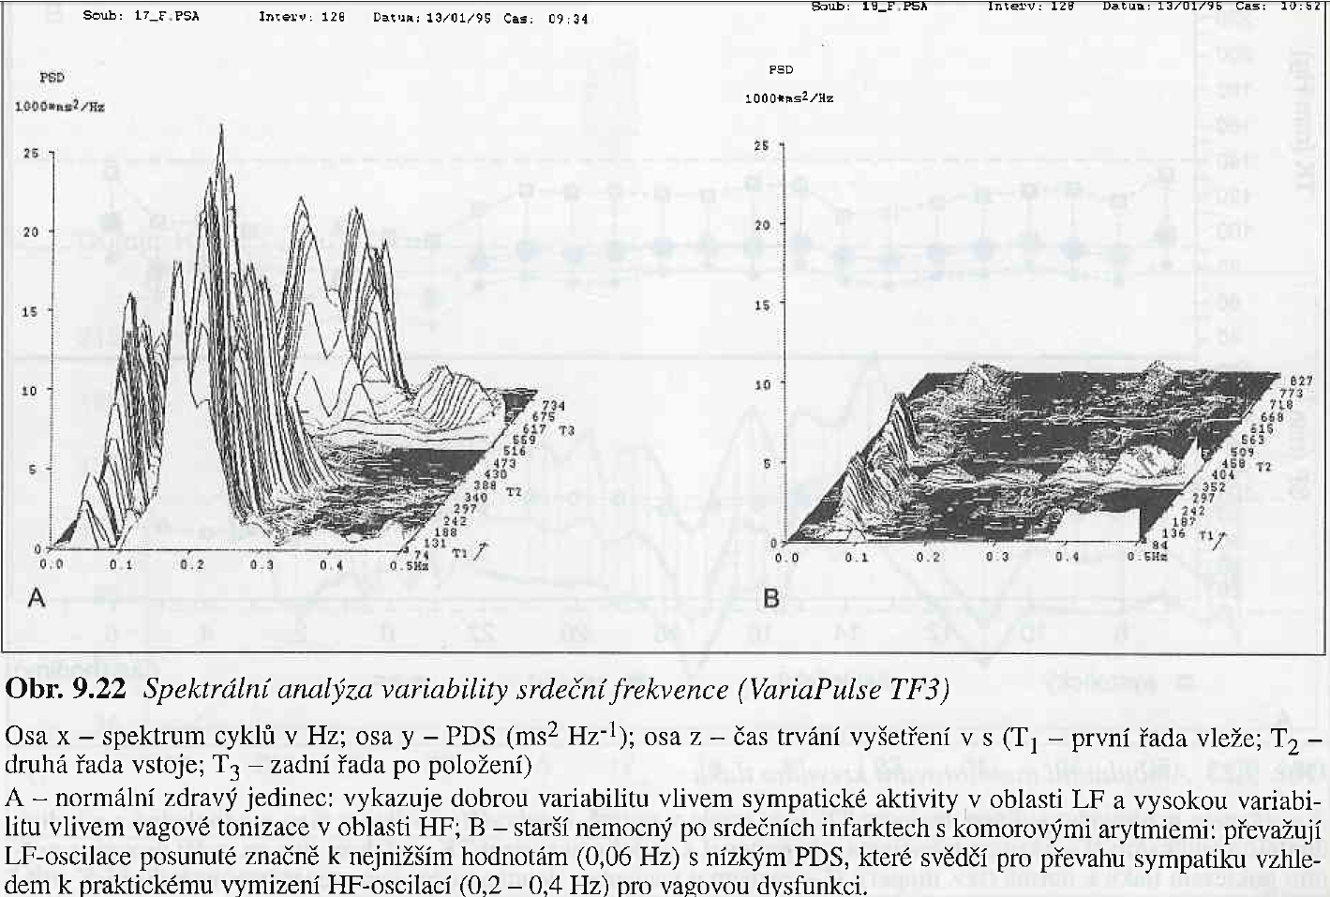

Slide 39
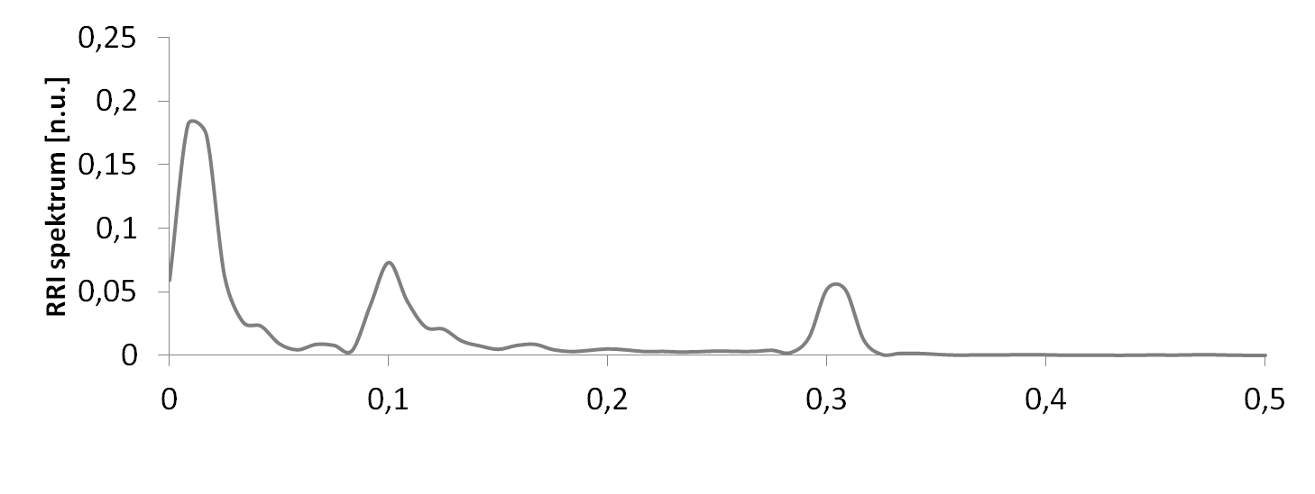
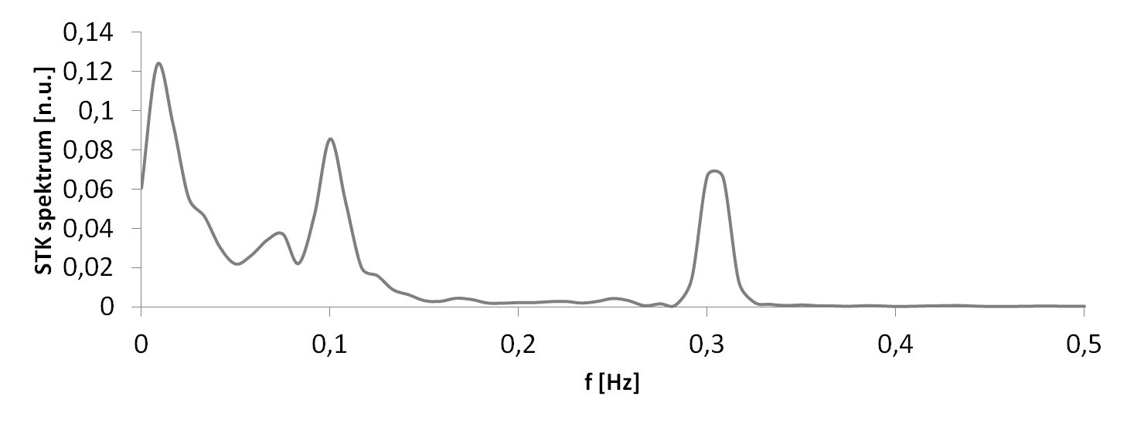
VARIABILITY of circulatory parameters
Parasympathetic NS
Sympathetic NS
Baroreflex
Respiratory sinus arrhythmia
Baroreflex
changes in intrathoracic pressure

Slide 40
Resetting of baroreflex
During repeated raising of blood pressure - e.g. in chronic hypertension - the force of baroreflex reaction on systemic blood pressure is lower
??? Why???mechanical changes in baroreceptors – decrease sensitivity due to structure changes on the vessels wall OR dysfunction of endotelium OR down-regulation in the brain center due to their increasing frequency of stimulation
Resseting of baroreflex can regulate the changes in blood pressures, but the resseting is unable to go back on „normal“ level
Resetting is a partially reversible – during a short-term influence of raising blood pressure
Notice: in clinical practice:
  !start treatment of hypertension in time!

Slide 41
Middle – term regulation 1 catecholamines
Mediators of sympathetic nerves for baroreceptors and chemoreceptors
Sympathetic nervous system stimulates releasing of epinephrine and norepinephrine from adrenal medulla – main function: vasoconstriction – chronotropic effect – inotropic effect
Its function start during minutes or hours

Slide 42
Middle – term regulation 2
Renin - angiotensin - aldosteron
System in kidney
+
extrarenal system (in other tissues – brain, adrenal medulla, gonades, eyes)
+
Intermediate system – heart, smooth muscles
Renin – in juxtaglomerular cells in kidney
In liver – glycoprotein angiotensinogen – release angiotensin I (dekapeptid) – due to angiotensin converting ensyme to angiotensin II(oktapeptid) or angiotensin III (aminopeptidase)
Angiotensin II – other way – chymase – in th heart and arterioles
(it is reason why during treatment by ACE blocatores – the angiotensin level is not reduce)

Slide 43
Secretion of renin is modulated by
Sympathetic nervous system – beta 1 receptors activation – main mechanism of secretion of renin
Second way – by special mechanism due to sensitivity on sodium
  exists a special intrarenal mechanism – negative sodium billance increase the renin secretion
  ???? hypothesis – macula densa register of sodium concentration in renal tubular system – this information transports to juxtaglomerular cells where activated renin-angiotensin system (has an influence on secretion of renin – release angiotensin II );
  Increse level of sodium – decrease releasing of renin (mediator – Nitric Oxide)
???Arterial pressure – stretch receptors (baroreceptory) in vas afferens (juxtaglomerular cells) – influence on blood pressure in kidney or also in systemic circulation???

Slide 44
Angiotensin II - Effects (Owerview)
Vasoconstriction
Change in renal hemodynamics – decrease of blood flow in kidney and glomerular filtration
Influence on reabsorption of sodium in renal tubules
It invokes or enhances the presynaptic release of noradrenaline
Stimulates the release of ADH
Effect of ANGIOTENSIN III
Stimulation of aldosterone secretion from the adrenal cortex

Slide 45
Middle – term regulation 3
ADH - vasopressin
During a strong decline of blood pressure
from posterior pituitary – vasoconstriction
May be: slowly effect – retention of water in distal tubule and proximal part of collecting ducts

Slide 46
Long – term regulation
Little is known about how this occurs
Pressure diuresis regulates the volume in circulation and keep „pressure homeostasis“
Blood pressure increases longer than 2 hours (persistant increase)– started pressure diuresis, its time duration a lot of days (increase blood pressure – increase excretion of sodium - osmotic activity – increase excretion of water ---decrease extravascular volume and decrease blood pressure)
a single control system which is not subject to adaptation – the action takes as long as the pressure is returned to the original values (or if its action is not reversed by other mechanisms)
With persistent decrease of BP - the opposite effect

Slide 47
Long – term system of pressure natriuresis
It is a cascade of regulatory processes:
the mechanical effect of increased blood flow through the kidney ... increased blood flow in the kidney papilla - increased renal interstitial hydrostatic pressure - increased tight junction of epithelial cells of the renal tubules for sodium - increased sodium excretion - increased excretion water - decrease in volume of circulatory fluids - pressure drop in the systemic circulation
System of internal renal baroreceptors ... pressure increase in vas afferens ... restriction of renin production - attenuation of renal sympathetic stimulation - decrease in sodium reabsorption, reduction of fluid volume - pressure drop
Na⁺- K⁺ - ATPase inhibitory factor – released from adrenal medulla (steroid-like digitalis - possibly ouabain)
Increased AT₂ receptor expression for angiotensin II (may antagonize the effects of inadequate AT₁ receptor stimulation, in rat experiments demonstrated - increased sodium and water excretion)
Others: bradykinin, urodilatin, renal natriuretic peptides

Slide 48
Methodology of blood pressure measurement
Misinterpretation of values

Slide 49
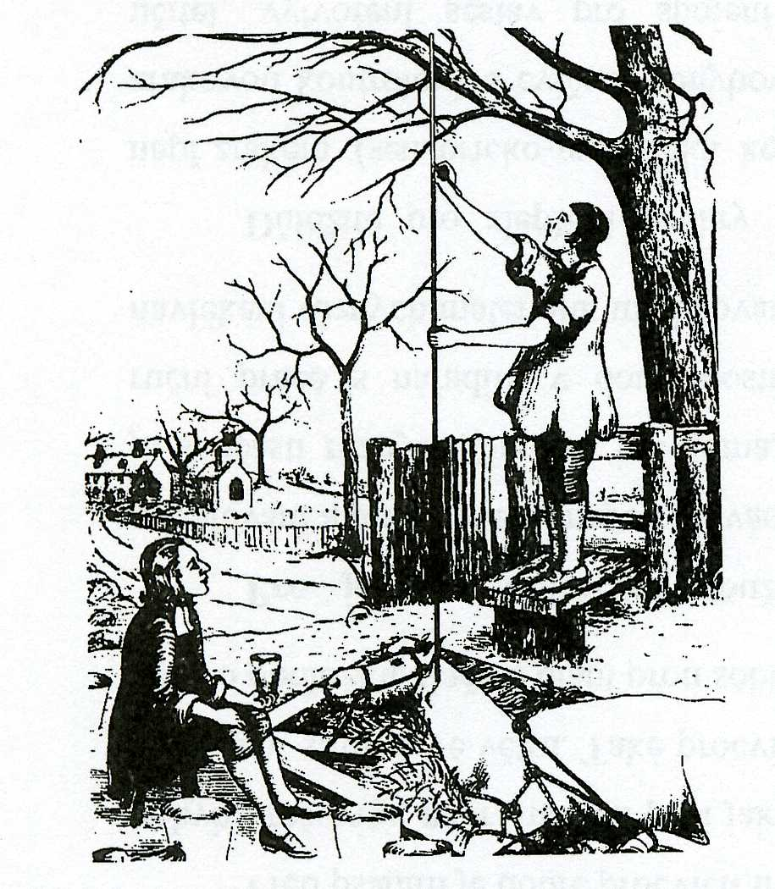

Slide 50
Blood pressure measurement
The system pressure values are, for technical reasons, dependent on:
Measuring method used
  Non-invasive methods:
    auscultatory
    oscillometry
    ultrasound
    photopletysmography
  Invasive methods
    indirect – Swan-Ganz´s catheter
    direct – catheter with a pressure sensor at the end
Methodology
  Clinical measurement – in ambulance - practitioner
  Home measurement
  24hour ambulatory blood pressure monitoring

Slide 51
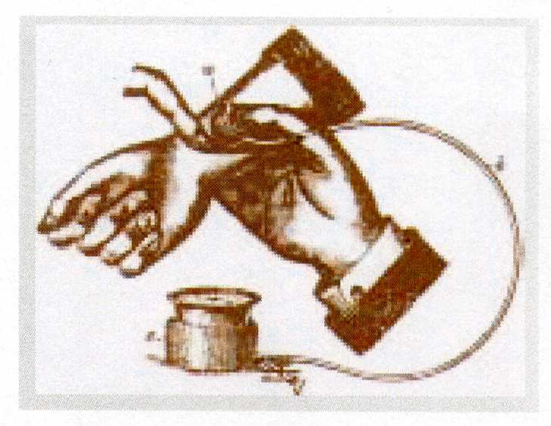
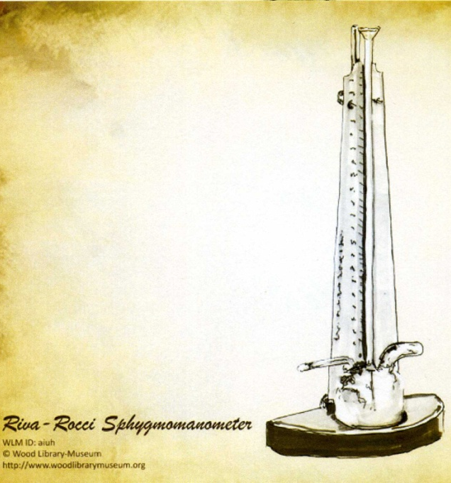
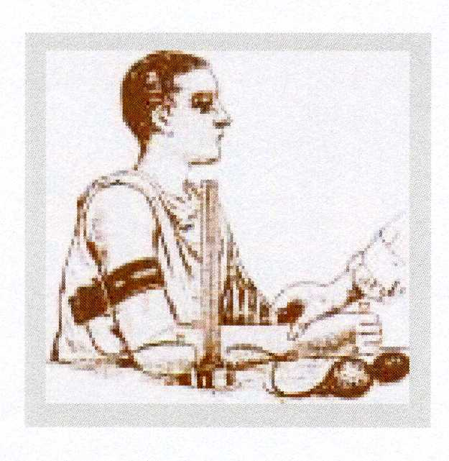
Palpatory method
Austrian Von Basch
„aneroid sfygmomanometr“
With baloon on wrist
1876
Italian physician
Riva Rocci
„mercury sfygmomanometr“
With cuff on the arm
1896

Slide 52
Auscultatory methods
based on detection of Korotkoff phenomenons
„gold standard“
with comparison on intra-arterial measurement of blood pressure – we will find: lower values for SBP and higher values of DBP
/this is only technical systemic mistake – does not matter/
According a guidelines for diagnostic of arterial hypertension: we diagnose arterial hypertension: repeated blood pressure increase above 140/90mmHg, demonstrated at least in two out of three measurements using the auscultation method in the clinical setting

Slide 53
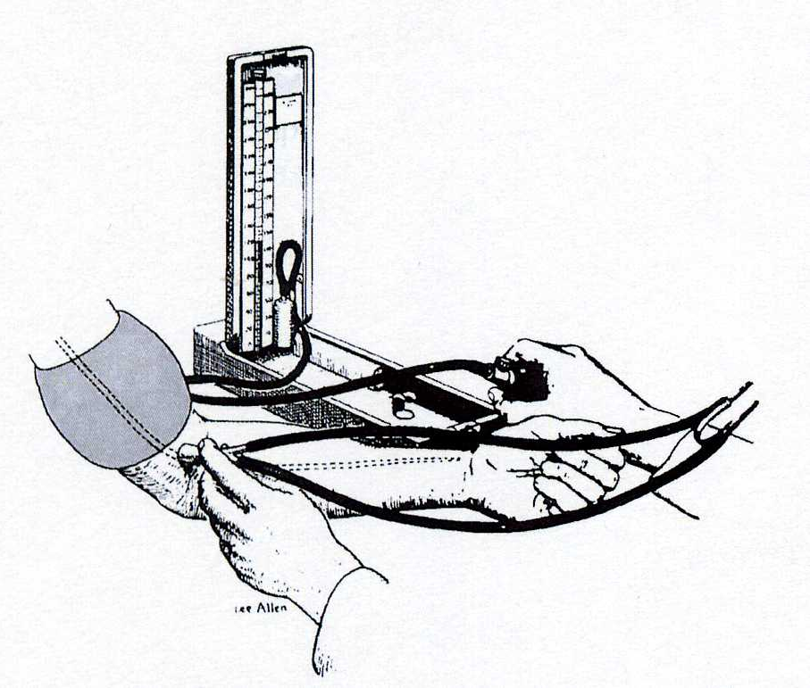
Auscultatory method
Russian army surgeon
Nikolaj Korotkoff
1904
„mercury sfygmomanometr“
The cuff on the arm,
stethoscope in the area of the elbow

Slide 54
Oscillometric method
Author: Mr. Marey – the first describe on 1876
It has been repeatedly demonstrated that the oscillation of BP in the sphygmomanometric cuff is measured during its gradual discharge - the point of maximum oscillation corresponds to the mean arterial pressure measured invasively
Oscillations begin approximately around systolic pressure values and continue after deflation of the cuff = both systolic and diastolic pressure is estimated only indirectly based on empirical derived algorithms
  Advantage: Less susceptible to external noise
  Disadvantage: definitely unreliability in physical activity - distortion by motion artifacts + susceptible to low-frequency mechanical vibrations

Slide 55
Ultrasound method
The device includes an ultrasonic vibration generator and an ultrasonic sensor - placement via the brachial artery and under the sphygmomanometric cuff
When deflate the cuff, it induces a systolic movement of the arterial wall that causes the Doppler phase shift in the transmitted ultrasound signal; diastolic BP is calculated by a significant reduction in arterial wall motions
Other variant: systolic BP based on blood flow detection - in newborns and small children

Slide 56
Digital photoplethysmography
Continuously blood pressure measurement - „beat to beat“ – from digital artery
Profesor Jan Peňáz – Department of Physiology – Masaryk university in Brno - patent 1969
Disadvantage: can not be used in conditions with peripheral vasoconstriction (shock states, vasoneurosis, diabetic angiopathy)

Slide 57
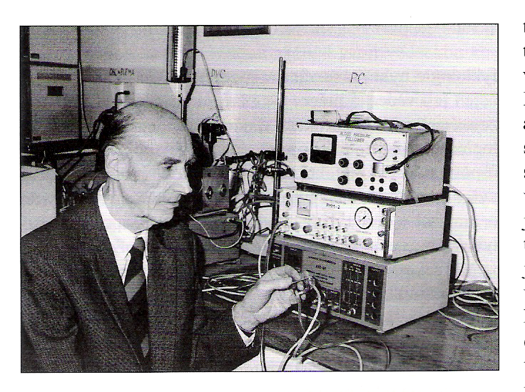

Slide 58
We need than pressure in the cuff corresponded to the pressure of the digital artery
Method: photopletysmography
Recorded photoelectric plethysmogram
The new term: Transmural pressure – Pt (the pressure across the wall of the artery)
BP (blood pressure inside artery), Pc (pressure in cuff), Pt (transmural pressure)
We estimated: BP=Pc ….Pt=0 …..photoplethysmogram registered the highest amplitude of oscilation
Step by step increase of Pc, in the moment of the highest amplitude – feed-back loop started for obtained(keeping) the constant volume of the finger

Slide 59
Penaz patent
He used the signal from the photocell to control the external cuff pressure and that to keep the finger volume unchanged. This has achieved that pressure in the cuff monitors blood pressure in the artery.

Slide 60
Record of breathing and waves in circulatory parameters
(Peňáz´s photoplethysmomanometr)

Slide 61
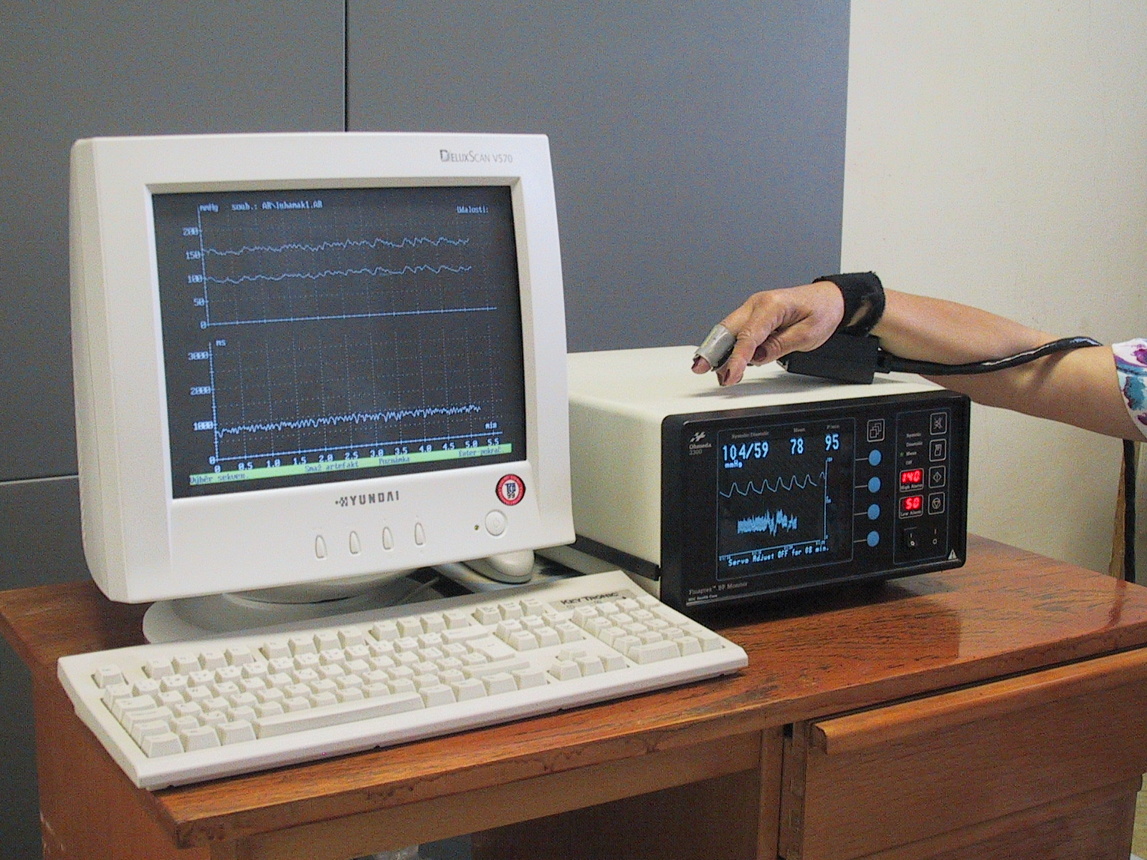
Finapres (Ohmeda, USA)

Slide 62
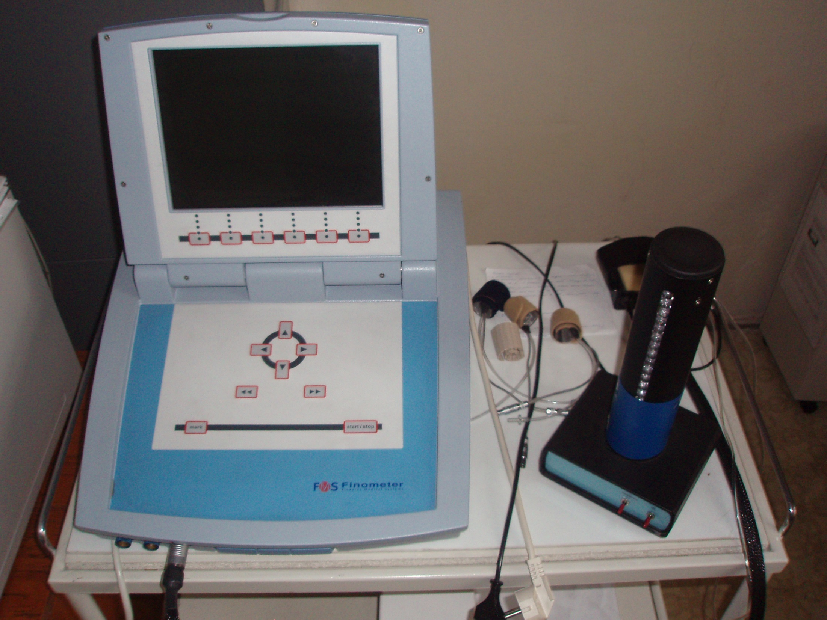

Slide 63
Invasive measurement of blood pressure
The most accurate measurement method of BP – BUT HIGH RISK:
- difficult accessibility, risk of infection diseases
Usage: BP monitoring in critical states (coronary units, intensive care units); in more complex therapeutic procedures
  Indirect - Swan-Ganze catheter - hollow tube, on the vessel side with a hole, the other side connected to the sensor - filled with physiological solution - transfer of pressure changes from the vessel's light towards the sensor – inaccurate
  Direct – special sensor – special microsensor on the vessel side - the blood pressure signal is transmitted from it
  up-to-date catheters - signal transmission via fiber optics
  Important for the diagnosis of all forms of pulmonary hypertension

Slide 64
Methodology
Clinical statement
In keeping with a good practice is still auscultation method able to report reliable results
We must rely on white-coat hypertension versus masked hypertension in some patients
There is always higher BP in the case of BP measurement by physician and lower values measured by nurse or technician

Slide 65
Methodology 2
„Home“ blood presure measurement
Advantage: measurement by patients, elimination of white-coat hypertension effect, measurement in long period
Disadvantage: technical problem, correct measurement by patient
Classic oscillometry method – cuff on the arm
  Attention on location of measurement on the wrist - in the vertical position - pressure above 15-20 mmHg higher than on the arm, even when in the heart position the SBP is higher by 2-3mmHg than on the arm
  Finger position cuff (non digital photoplethysmography) - Higher values of 4 mmHg than on the arm (another characteristic of the pulse curve in the finger artery)
  Values at home measurements are always lower than in the clinical setting – Hypertension society recommendation: BP higher than 135/85mmHg - are increased !

Slide 66
Methodology 3
24 hour ambulatory blood pressure monitoring
Advantage: an overview of absolute values and variability in time-defined periods (! but still intermittent measurement!)
Oscillometric method
Information: SBP, DBP, pulse pressure, mean arterial pressure - profile of absolute values at monitored intervals; average and standard deviation for the period under review; % of the blood pressure parameters above the specified upper limit; calculation of different indexis; determination of variability of blood pressure fluctuation
The number of BP increases in more than 40% of all values in either on night – or day-time interval – dg: arterial hypertension
ABPM values are lower than clinical values - recommendations:
normal: below 135/85 daily and night under 120/70; 24 hour diameters 130/80 mmHg

Slide 67
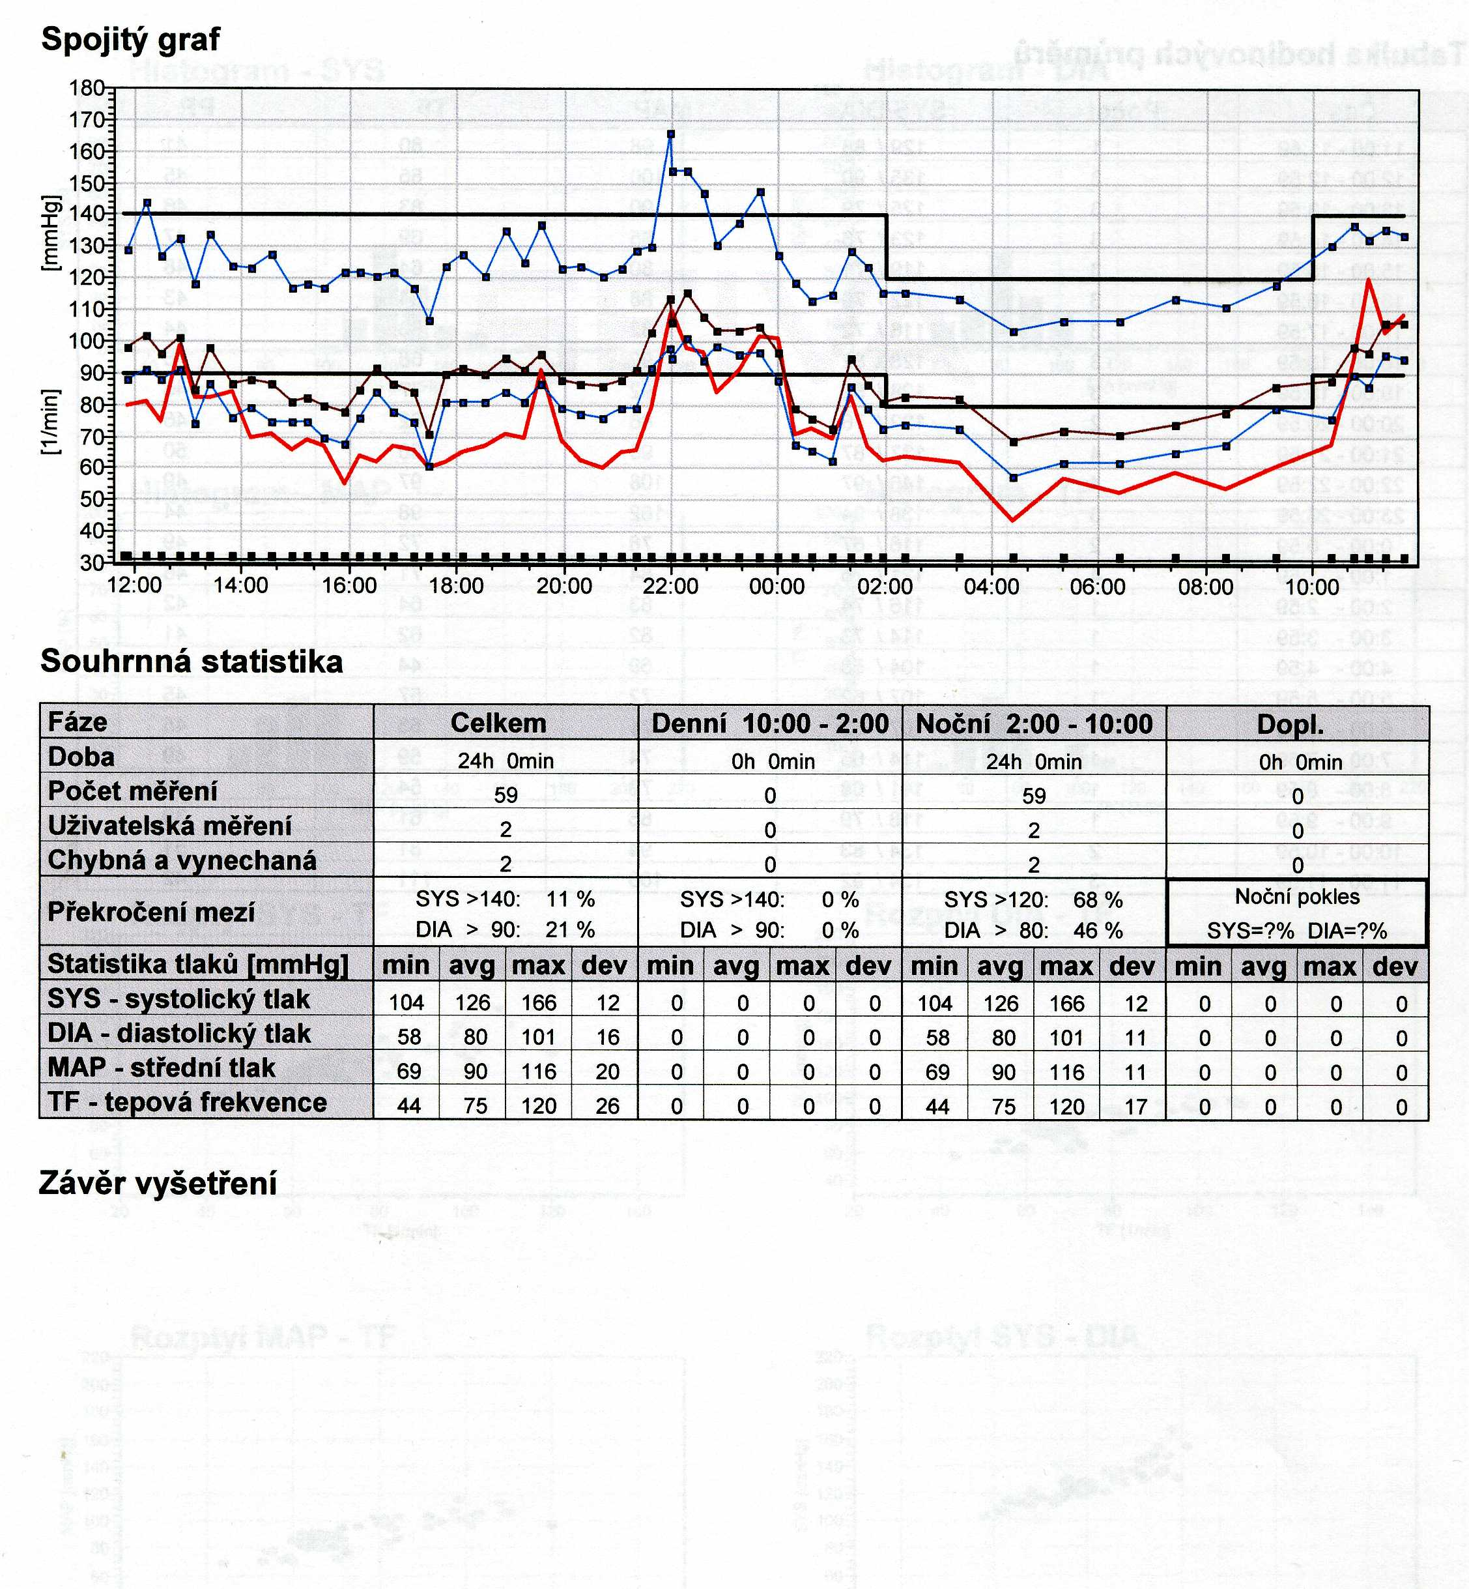

Slide 68
Methodology 4
Continuously blood pressure measurement
Beat to beat record by Penaz method
BP is dynamic parameter
  variability of fluctuation of heart rate and blood pressure – regulation by baroreflex – cooperation both parts of autonomic nervous system (symphathetic and parasymphathetic part)
  Necessary component in clinical tests - head up table test (on inclined plane) and BP dysregulation in young subjects - dif.dg syncope
  BP regulation research - maneuvers – Valsalva etc. ... ..
  BP measurement in extreme situations: supersonic airplane pilots – overload condition, the cosmic program – weightlessness condition etc.

Slide 69
Blood pressure
in children

Slide 70
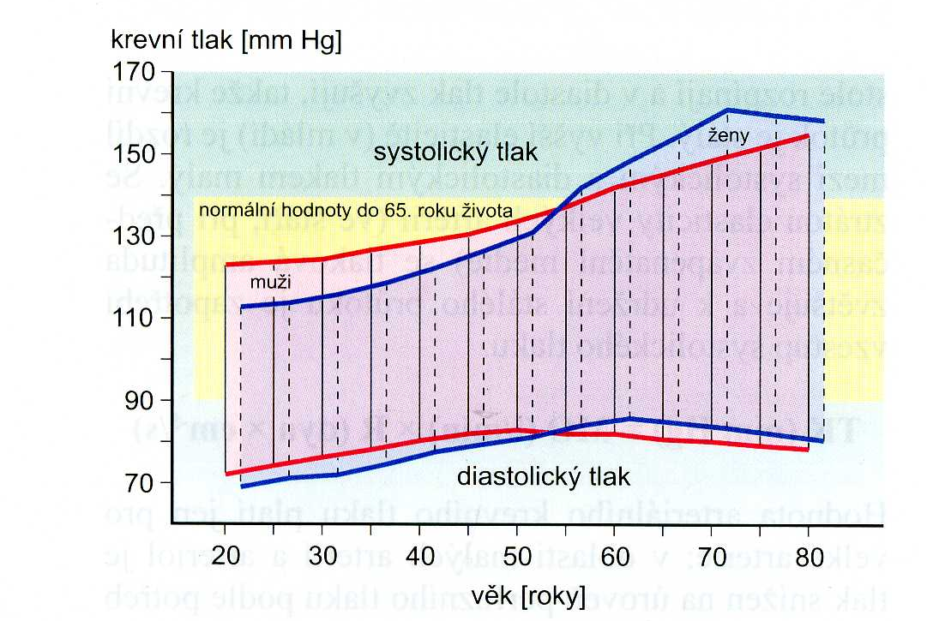
Age influence on blood pressure in man and female
Fölsch et al., Patologická fyziologie, Grada 2003

Slide 71
Classification BP values
category | Systolic BP | Diastolic BP
 | (mmHg) | (mmHg)
optimal | < 120 | < 80
normal | 120 – 129 | 80 – 84
high normal pressure | 130 – 139 | 85 – 89
Hypertension - mild | 140 – 159 | 90 – 99
Hypertension - moderate | 160 – 179 | 100 – 109
Hypertension - severe | ≥ 180 | ≥ 110
Izolated systolic hypertension | ≥ 140 | < 90
According the Guidelines of European Society of Cardiology 2013

Slide 72
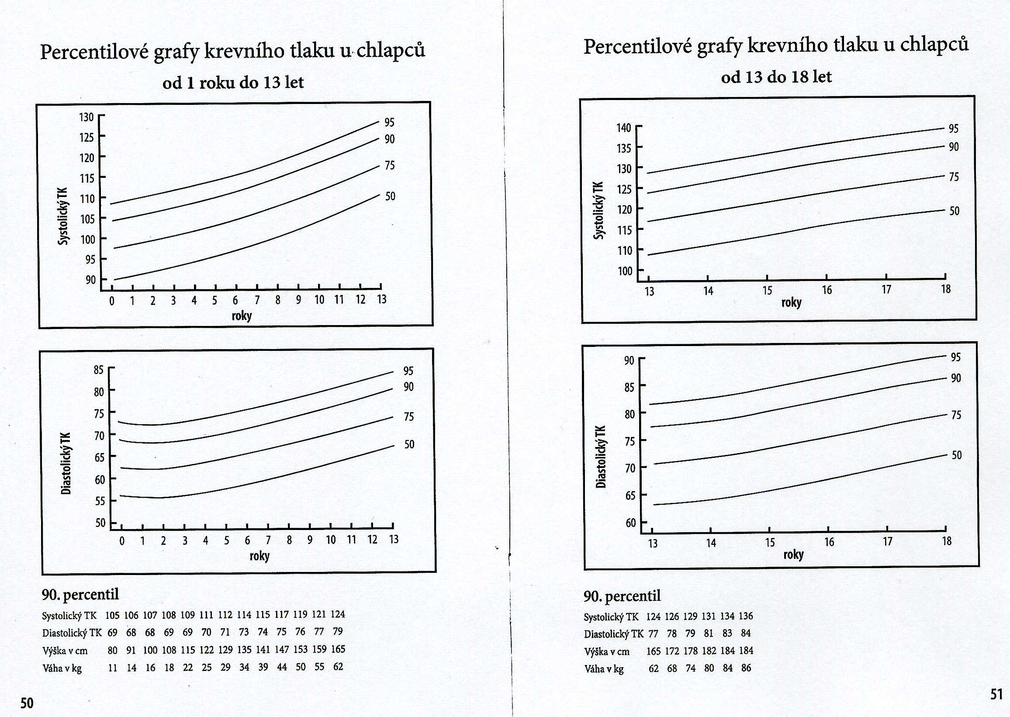

Slide 73
Current Hypertension Reports
October 2017, 19:84 | Cite as
Updated Guideline May Improve the Recognition and Diagnosis of Hypertension in Children and Adolescents; Review of the 2017 AAP Blood Pressure Clinical Practice Guideline
Janis M. Dionne

Slide 74
For children aged 1 to 13 years/aged ≥13 years
Normal BP: <90th percentile // <120/ <80 mmHg
Elevated BP: ≥ 90th percentile to <95th percentile//120/ <80 to 129/ <80 mmHg
  or 120/80 mmHg to <95th percentile (whichever is lower)
  Stage 1 HTN: : ≥ 95th percentile to <95th percentile+12 mmHg//130/80 to 139/89 mmHg
    Or 130/80 to 139/89 mmHg (whichever is lower)
  Stage 2 HTN: ≥ 95th percentile +12 mmHg// ≥140/90 mmHg
    Or ≥140/90 mmHg (whichever is lower)
    Flynn JT, Kaelber DC, Baker-Smith CM, Blowey D, Carroll AE, Daniels SR, et al., for the Subcommittee on Screening and Management of High Blood Pressure in Children. Clinical practice guideline for screening and management of high blood pressure in children and adolescents. Pediatrics. 2017;140(3):e20171904. https://doi.org/10.1542/peds.2017-1904.

Slide 75
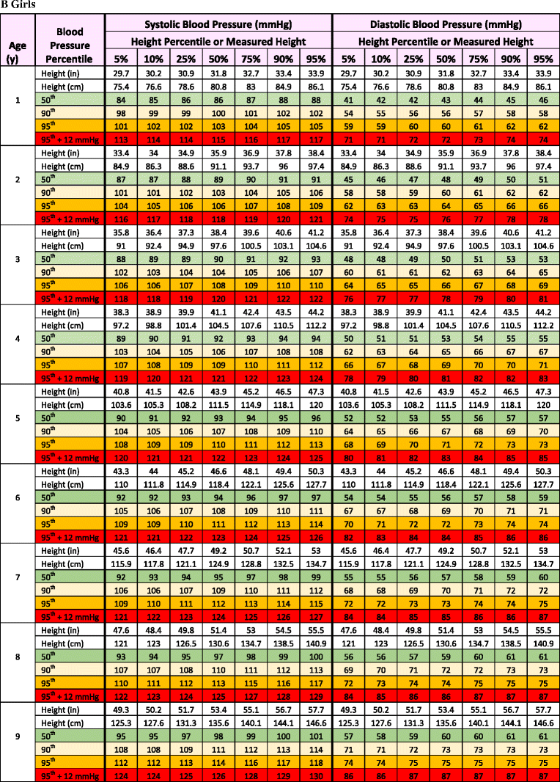
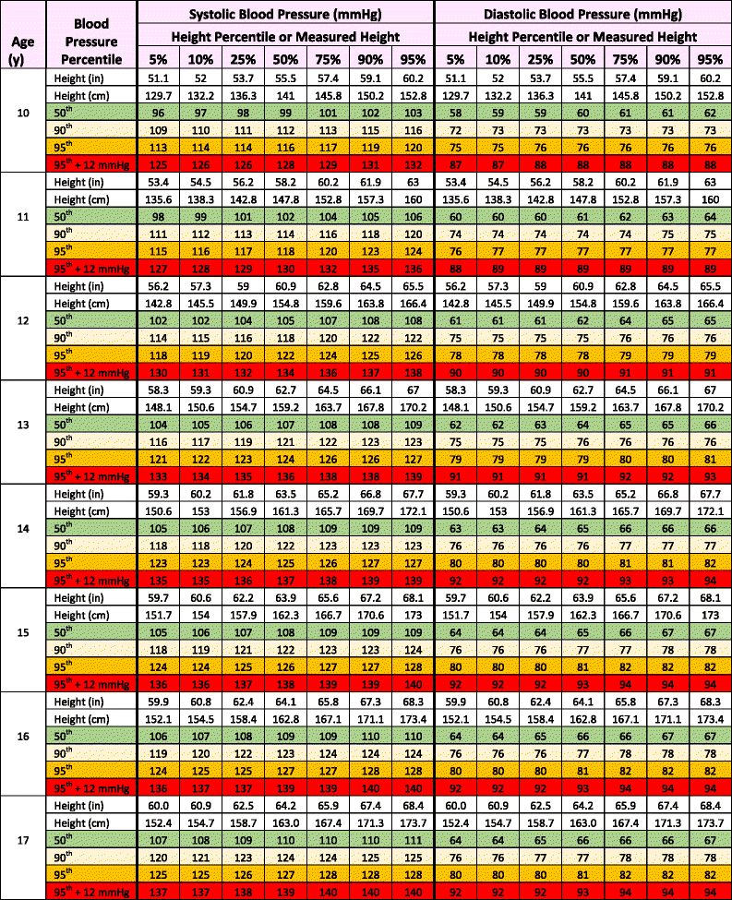

Slide 76
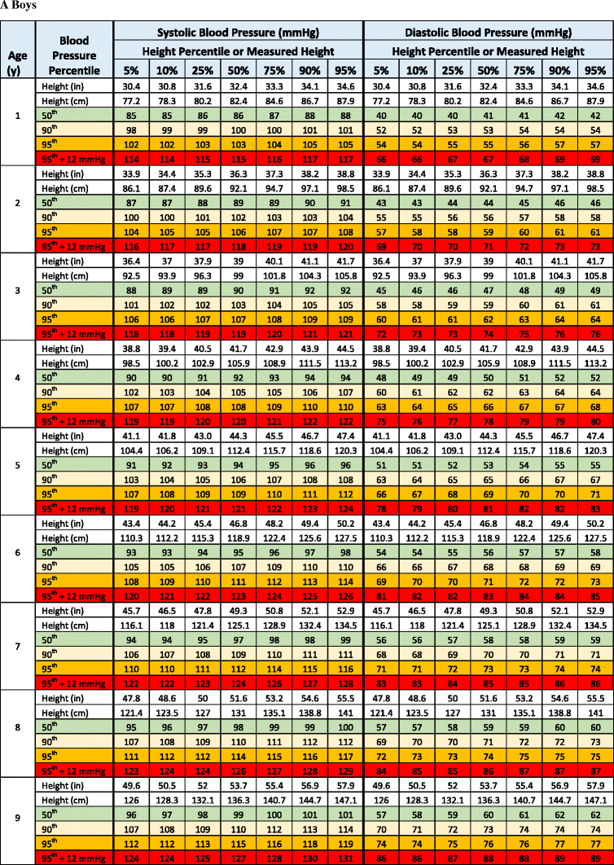
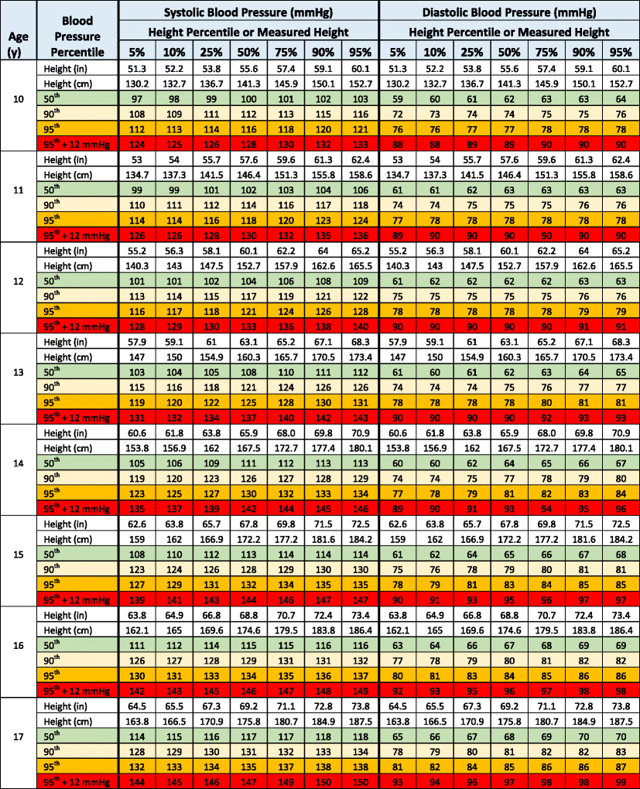

Slide 77
Blood pressure
Immediately after birth – high blood pressure:
  Stress after delivery, increase concentration of catecholamine and cortizol
After 1st day …….. 70/50 mmHg:
  Open of pulmonary and intestine circulation
During pubertas:
  Development of regulatory mechanism
  Stimulation of external world

Slide 78
Newborn 80/46 mmHg 10.6/6.1 kPa
3 years 100/67 13.3/8.9
10-11 years 111/58 14.8/7.7
13-14 years 118/60 15.7/8.0

Slide 79
Blood presure measurement in newborn and children
Korotkoff method – for children over 1 year – use a correct size of cuff
In the newborns, auscultation phenomena are poorly audible - there may be an underestimation of SBP
better use the ultrasound method of the blood flow detector

Slide 80
The size of cuff
Body weight age size of cuff
1 500 g newborn 2.5 cm
5 kg 3 month 4.5 cm
10 kg 15 month 6 cm
30 kg 9 year 7.5 cm
more than
30 kg 10 and more years 12 cm

Slide 81
Specific features measurement
Pregnant women
  Physiological profile of pregnancy - decrease of BP with increase in cardiac output and large decrease of peripheral resistance = special hyperkinetic conditions - Korotkoff phenomena we auscultated even after deflation of the cuff - diastolic BP we estimated in IV phase of Korotkoff phenomena
  Elderly people with atherosclerosis - poor compressibility of the artery wall by a compression cuff - we need to inflate more - so we measure falsely higher SBP values - pseudohypertension
  Obese persons – using the right size of the cuff !!!!! using a standard cuff – overstocking of SBP
  Dynamic physical exercise - auscultation method may underestimate SBP by 15 mmHg, during recovery phase - overstatement of up to 30mmHg SBP; DBP less frequently but falsely low - better use for DBP measurement reading from phase IV of Korotkoff sounds

Slide 82
Actual blood pressure values are dependent on:
factors that are conditioned by the organism
on the measurement method
in which conditions the measurements are performed (methodology)
even on accuracy and reliability of instruments (technical page - necessary tests and calibration of pressure device / 1 year)
THIS MUST BE ALLOWED TO CONSIDER AT THE MEASUREMENT IN CLINICAL PRACTICE

Slide 83
THANK YOU FOR YOUR ATTENTION

