Slide 1
Abdominal surgery
-commonly deals with a large problems in the abdominal region and digestive tract

Slide 2
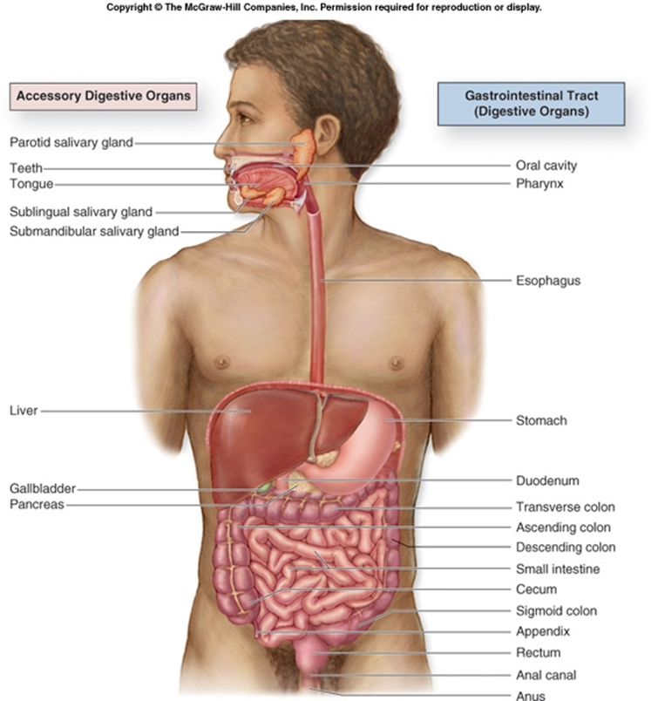

Slide 3
Where to start?
 | Inflamation | Tumors | Trauma | Morfologie/Fyziologie
Oesophagus | GERD | SpinoCa |  | Atrezia
Stomach | Ulcus | AdenoCa |  | Hiatové hernie
Intestine | M.Crohn, UC | Adeno Ca |  | Divertikls, maldigestion/malabsorption
Anus | UC, Abscess | Adeno/Spino |  | haemorrhoids
Biliary tract | cholecystitis | cholangioCa |  | lithiasis
Hepar | Hepatitis, abscess | Meta, hepatocellular |  | cyst
Pankreas | pancreatitis | AdenoCa |  | p. divisum
Spleen | abscess | Hemalology | Delayed rpt
Abdominal wall |  |  | Blunt/sharp/…. | Hernia

Slide 4
Diagnostics
Anamnesis
Clinical exam
Laboratory methods/tests
Radiodiagnostics (sono, RTG, CT, NMR, PET)
Endoskopic methods
Functional tests (manometry, pH metry…)

Slide 5
Therapy
Conservative
Miniinvasive (endoskopy, angiografy/embolisation, …)
Invasive (OP)
Curative X Paliative

Slide 6
Esophagus
GERD: inflamation…overgrow of cylindric epithelium…Baret´s oesophagus (precancerosis)
Esophageal Diverticulum
* true (all the wall layers) x spurious (mucosa and submucosa are going through the muscle layer)
* tractive (arising due the external traction) x pulsar (arising due the higher intraluminar pressure)
* Faryngeal (Zenker´s) x parabronchial (middle) x epifrenic
Achalazia: motility disorder…swellowing/passage problems …dilatation
Atrezia: embryonal/congenital impassibility
Varices: compound with portal hypertrnsion
Hernias of diaphragma: slide x paraesofageal, Hiss angle

Slide 7
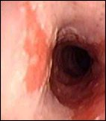
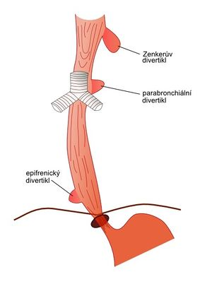
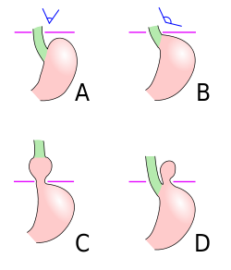
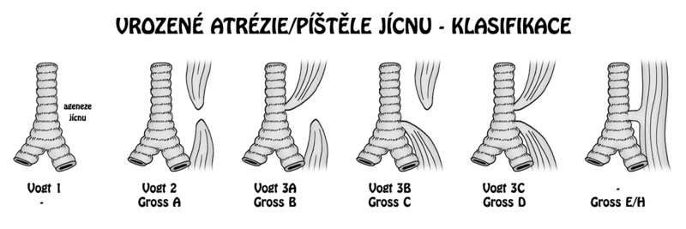
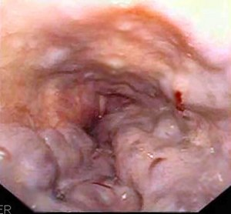

Slide 8
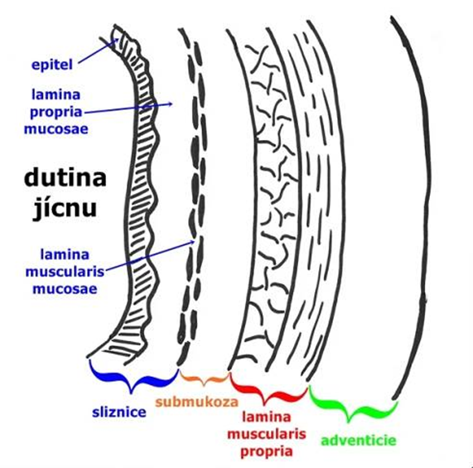
Esophageal tumor
Benign: not common
Malign: mostly in G-E junction
Spinocelular
AdenoCa
Symptoms: dysphagia, bleeding
Dg: gastroskopy, biopsy
Th: often paliative (stents)

Slide 9
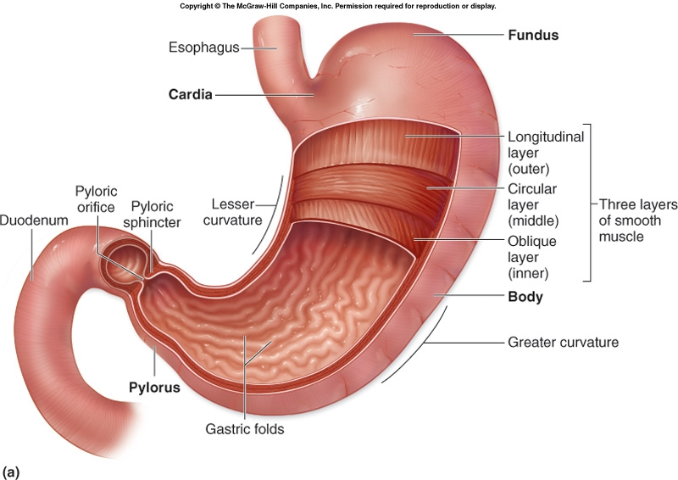
Stomach
Specific HCl environment
ulcus – mucosal defekt, going to submukosa or deeply
erosion – mucosal defekt limited in mucosa (not through muscularis interna into submukosa).
Dysbalance is leading to desease/problems
Agresiv factors – HCl, pepsin, NSA, ethanol, smoking, coffe, spicy food, Helicobacter pylori infection
Protective factors – mucin/phlegm, prostaglandin, secretion HCO₃, food

Slide 10
Ulcus ventriculi – pain (visceral) in epigastrium after the food (antacidas not leading to decrease the problems)
Food aversion, fullness, heartburn, intermittent vomiting with bile – the patients are hungry from fear
Within elderly patients
Duodenal ulcus – pain in epigastrium in hungry (often leads to problems in the night/sleeping – „night hungry pain“)
Food ant antacids leading to relief
Typical seasonal incidence for 1–2 weeks in spring and autumn
Within younger patients

Slide 11
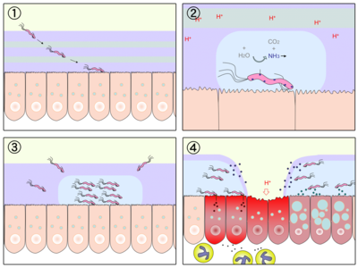
Ulcus desease
Diagnostic: endoskopic methods, H. pylori detection
Therapy: on the first place conservative (H. Pylori eradication, H2 blockers, PP blockers)
Surgical therapy: today only treating the complications (acute bleeding/perforation, chronic stenosis)

Slide 12
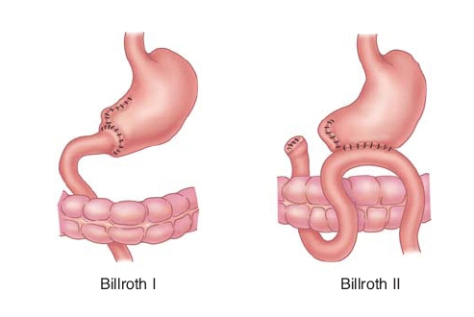
Ventrical tumors
Benig: polyps
Malign: AdenoCa
Decreasing incidence in CZ
Dominating in Asia (Japan)
- another dietary usage
CAVE: often without clinical symtoms for a long time

Slide 13
Small intestine
Congenital: Meckel´s diverticulum, malrotation, atrezia, Gasser´s divertikulum (spurious)
Malabsorbtion: Celiakia
Maldigestion
M. Crohn (IBD): multiorgan/system desease, mostly in the digestive tract region, first of all as acute appendicitis signs
Tumos
  Benign (polyps)
  Malign (not common)
  Carcinoid: the tumor outgoing fron the cells of DNES (difuse neuroendocrine system), earlier called APUD-system (amine precursors uptake and decarboxylation system). Relatively rare, but the incidence is increasing

Slide 14
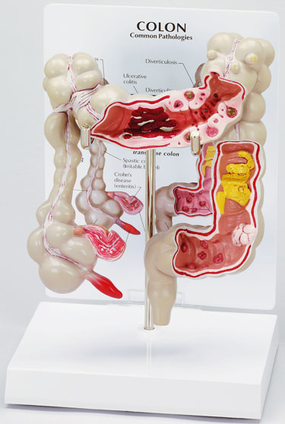
Large bowel
Diverticls - higher risk of inflamation and perforation, bleeding
Colitis ulcerosa (IBD) - chronic desease of bowel mucosa. Disease usually starting in anus and limited into large bowel
  CAVE: System desease, the problems could be out of digestive systém
Tumors
  Benign (polyps/adenomas)
  Familiar polyposis (prekancerosis)
  Malign (AdenoCa)

Slide 15
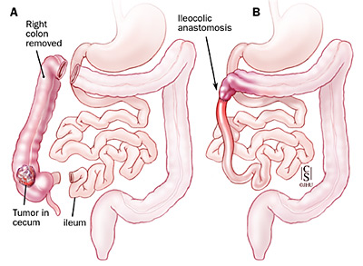
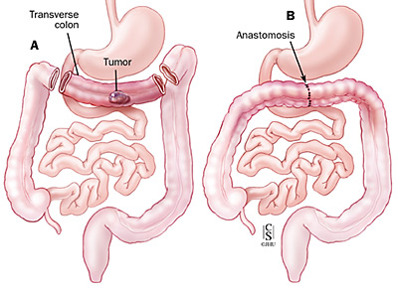
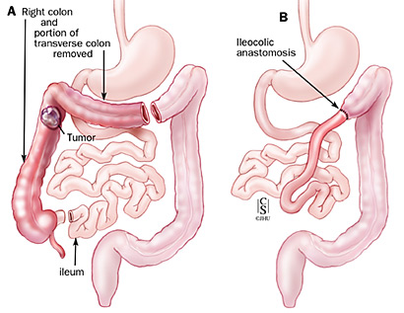
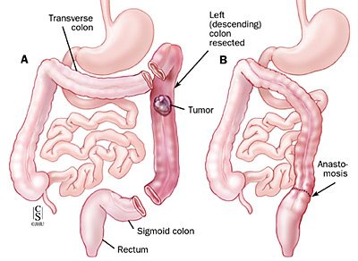

Slide 16
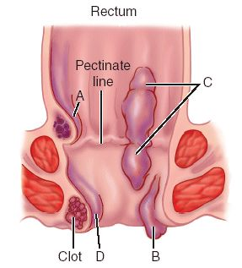
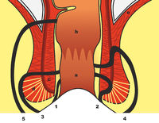
Anus
Atrezia, anal stenosis
Haemorrhoids
Sphincter disorders (↑↓)
Fissura ani
Fistula Absces
Condylomata
Tumors
  Benign
  Malign (Spino x Adeno)

Slide 17
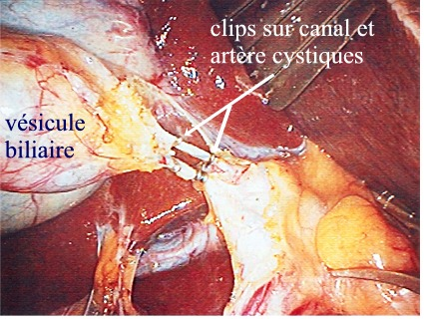
Biliary tract
Atrezia
Stenosis
Inflamation
Lithiasis: without signs in cca 60% of people
Tumors: cholangioCa
Icterus≠desease=sign

Slide 18
Liver
Inflamation (ethanol, viruses)
Steatosis
Cirhosis
Cyst
Parasites
Abscess (imunocompromitation)
Hemangiomas
Malignities
  HepatocellularCa
  Methastases (often)

Slide 19
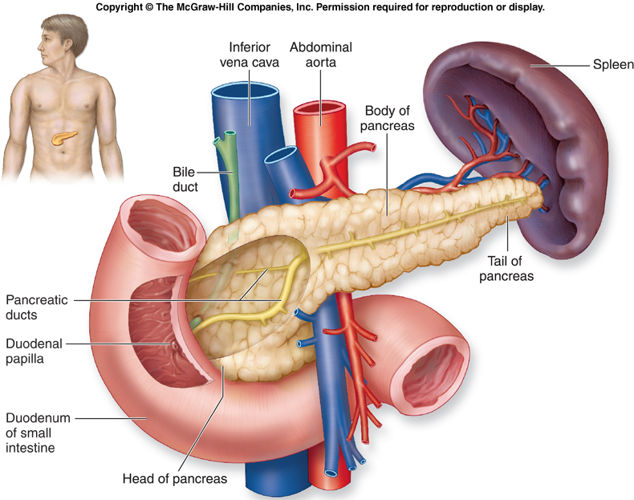
Pankreas
Disorder of exocrine function
Disorder of endocrine function
Congenital: pankreas divisum
Inflamation
  acute chronical
Tumor
  Adeno Ca
  Endocrine tumors
    F.e.: Insulinoma

Slide 20
Spleen
Renculisation
Abscesuss
Hematological deseases
Trauma!!!
  Delayed rupture
OPSI
  overwhelming post-splenectomy infection
  typically characterized by either meningitis or sepsis, and are caused by encapsulated organisms including Streptococcus pneumoniae.

Slide 21
Abdominal Wall
Omphalocoele
  /gastroschisis
Hernias
Inflamation is rare (phlegmona)
Trauma
  Blow x Blunt
  Penetrating x Non-…
Right x False/wrong
Congenital x gained
External x Intern
Rare x Common

Slide 22
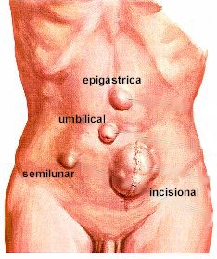
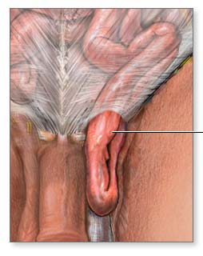
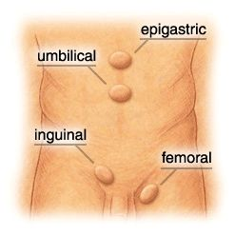

Slide 23
RHB in surgery
Importance: integral part of therapy!!!
  Prevention of T-E/dekubits/bronchopneumonia
  Restore/preservation of function
  Adaptation to changes of status/ability/posibilities
Curative physiotherapy:
  Mobilisation considering to wounds and status after OP
  mobilisation with minimal pain
  breath rehabilitation

Slide 24
Fyzikal fyziotherapy
- Increase or reliefe the pain
elektroléčba – el. proud způsobuje dráždění svalové tkáně, nervů
- využívá se tepelný účinek
SS proud – dráždí nerv při ochrnutí
- je to proud galvanický (má malou intenzitu)
- zvyšuje metabolismus tkání, snižuje otoky, zmírňuje bolest
střídavý proud – je faradický (má malou frekvenci)
diatermie – k prohřívání tkání, má vysokou frekvenci
DD proud (diadinamic) – stejnosměrný proud, zmírňuje bolest
UZ – vysokofrekvenční záření, uvolňování srůstů, svalových napětí, snižuje bolest
radiation – UV (horské slunce) – zlepšuje prokrvení, tvorba vit D, celkové posílení organismu,
kožní onemocnění – lupénka
- infračervené záření (solux) – zlepšuje prokrvení, napětí svalového tonu
heat – rozšíření cév, lepší prokrvení, zvýšení metabolismu, podpora růstu buněk, uvolňuje
svalový spasmus
cold – zúžení cév, snížení prokrvení, snižuje matabolismus
Wather-therapy – účinek na celý organismus, tepelná, chemická a mechanická složka
- sprchy, střiky, otěry, obklady
mechanotherapy – přímý tah a tlak,
masáž, akupunktura

