Slide 1
Internal environment, care in ICU, wound healing
MUDr. Martin Petráš

Slide 2
Internal environment-homeostasis
The human body is surrounded by external environment, that provides nutrients and oxygen that are necessary for life.
The human body has an internal environment, which is maintained by dynamic processes of biological regulatory-mechanisms.
Dynamic constancy of internal environment is defined as HOMEOSTASIS, and is carried out by organ systems working together

Slide 3
Internal environment
Internal environment is maintained more or less constant, and within narrow range of limits.
Disturbance or breach of these limits can cause disease, or can prove fatal.
More specifically, internal environment is described as extracellular fluids – blood plasma and interstitial fluids

Slide 4
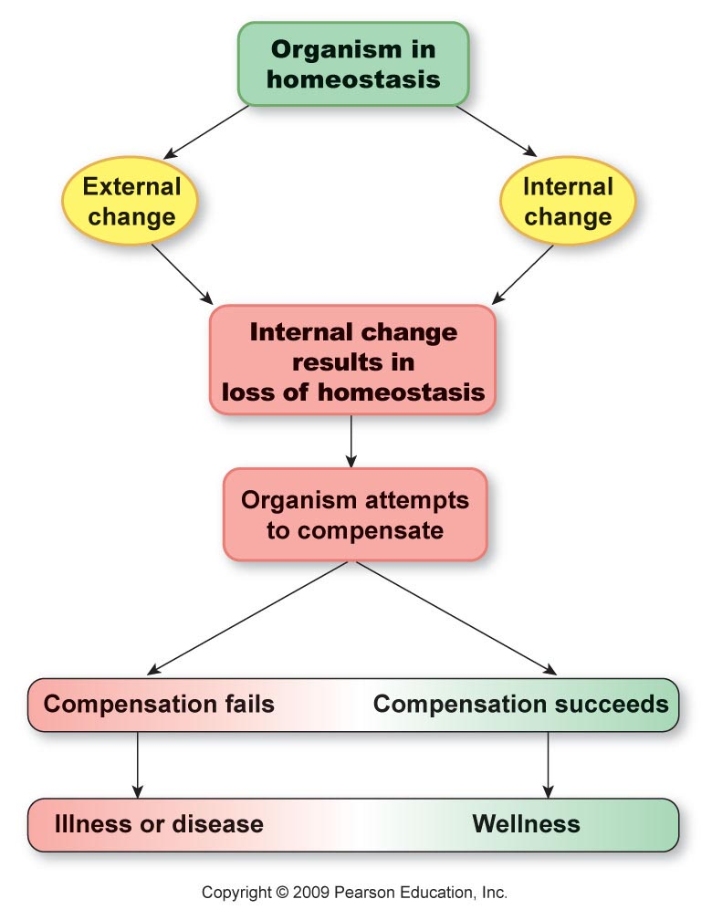

Slide 5
Body fluids
circa 60% body weight
Intracellular – 40%
Extracellular – 20%
  Interstitial
  Intravasal
Transcelular – cerebral spinal fluid (CSF), joint fluid, fluids of GI tract
*plus „third space“ fluids - patologic state

Slide 6
Fluid balance/24 hours:
Intake:
  Fluids (water)– 1500ml
  Water in food– 700ml
  Endogenous (metabolic) water– 300ml
Excretion:
  Diuresis – 1500ml
  Breath – 400ml
  Sweat– 200ml
  Stool – 200ml

Slide 7
Internal environment
There are many factors that need to be maintained within narrow limits. Some of the most important are:
temperature - 35,5 37 ° C
water and electrolyte concentration – Na+,K+,Cl-
pH of body fluids – pH 7,36 7,44
blood glucose level - 3,9 7,2 (ideally 5,5)
blood pressure - 120/80 129/89
blood and tissue oxygen and carbon dioxide levels
sat. 95-100 % O2, paCO higher less than 75 mmHg

Slide 8
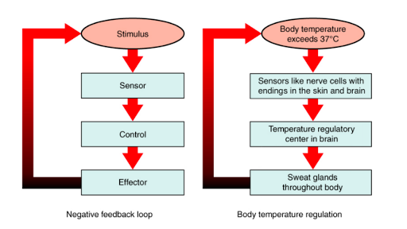
Basic concept
Majority of regulation processes work on „negative feedback“ system.
e.g. body temperature should range from 35-37°C

Slide 9
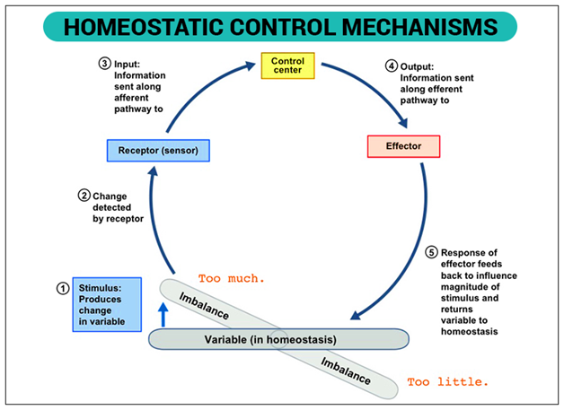

Slide 10
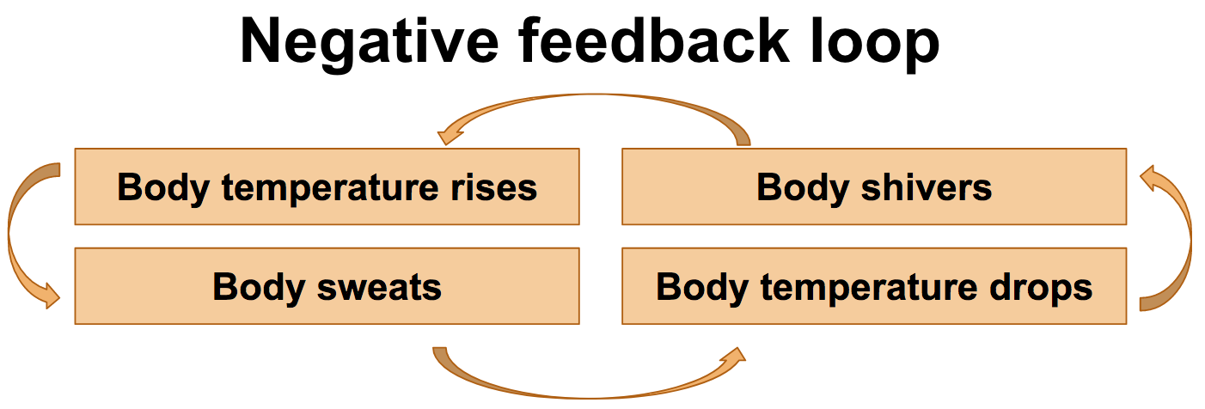
In general, negative feedback system decreases the stimulus

Slide 11
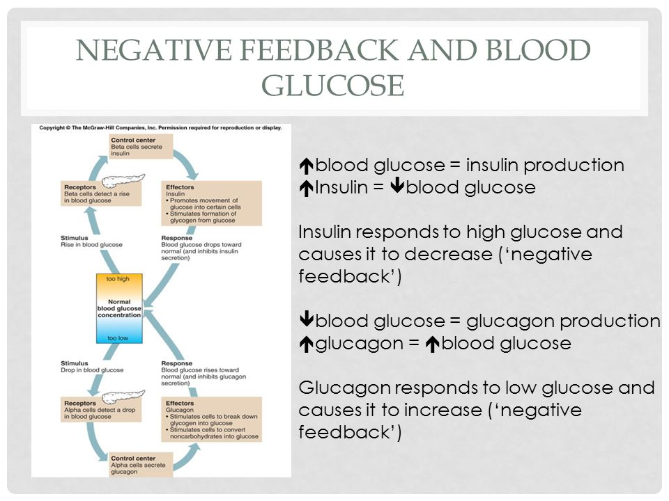
Another example?

Slide 12
Is there any „possitive feedback“ system?
Oh yes there is ☺
Positive feedback systems are not that common in humans.
In possitive feedback systems, the output enhances or exaggerates the original stimulus.
Can you think of at least one example?

Slide 13
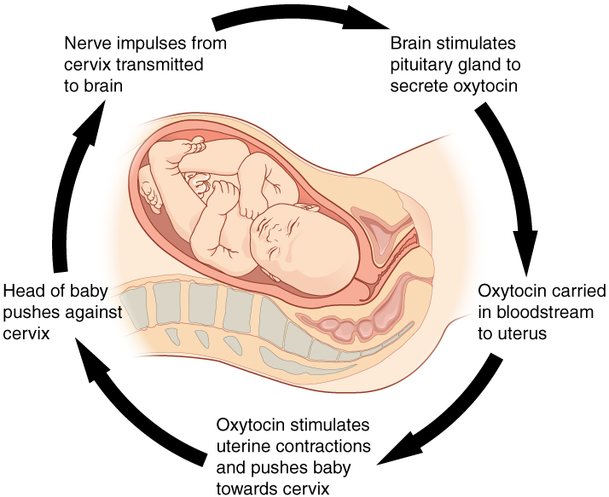
Positive feedback

Slide 14
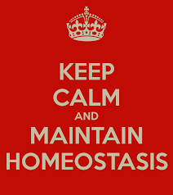
Thank you for your attention ☺

Slide 15
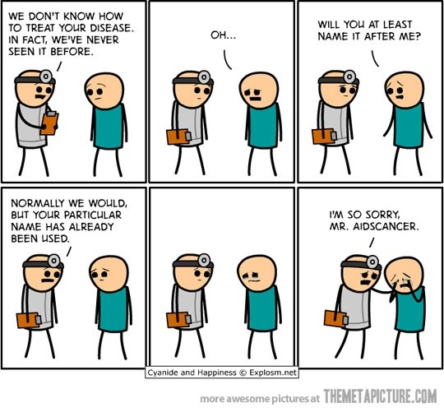
BREAK ☺

Slide 16
ICU
Definition?
Intensive care units cater to patients with severe and life-threatening illnesses and injuries, which require constant, close monitoring and support from special equipment and medications, in order to ensure normal bodily functions. They are staffed by highly trained doctors and nurses who specialise in caring for critically ill patients.
Patients may be transferred directly to an intensive care unit from an emergency department if required, or from a ward if they rapidly deteriorate, or immediately after surgery if the surgery is very invasive and the patient is at high risk of complications, or might be unstable

Slide 17
Care in ICU
-critical care is a term used to describe as the care of patients who are extremely ill, and whose clinical condition is unstable, or potentially unstable, and may lead to death

Slide 18
ICU equipment
ICU equipment includes patients monitoring devices, respiratory and cardiac support, pain management applicators, emergency resuscitation devices, and other life-support equipment, designed to care for patients who are seriously injured, have a critical, or life- threatening illness, or have undergone a major surgical procedure, and require 24 hour monitoring

Slide 19
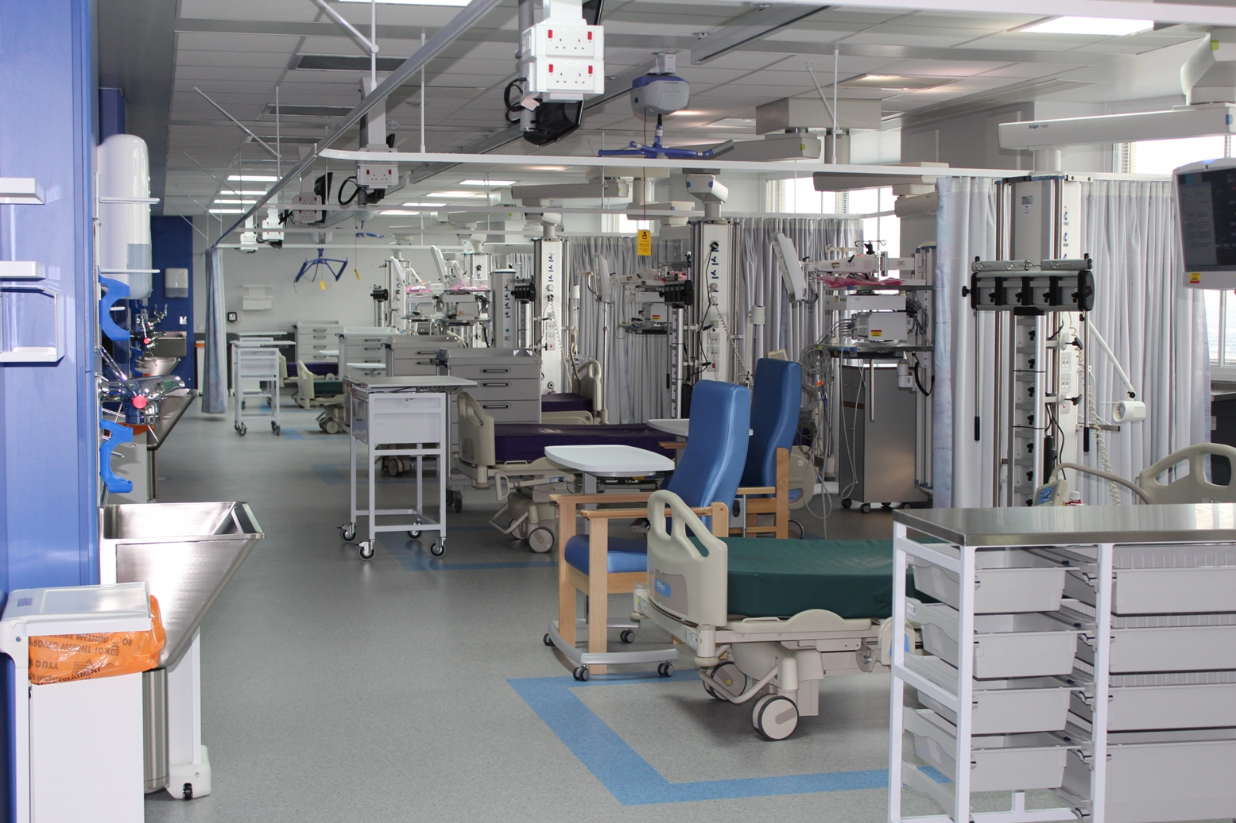

Slide 20
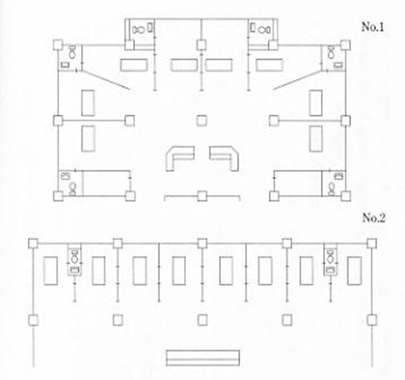

ICU design
Difference in structure between ICU and standard department

Slide 21
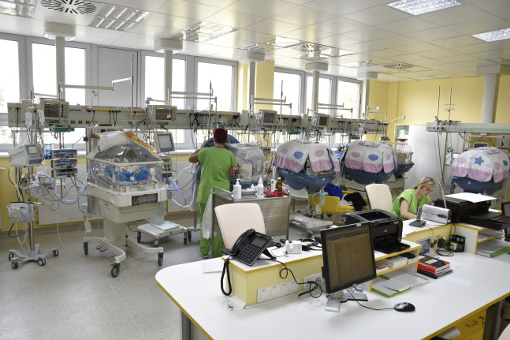
Example
Central station- place for bureaucracy, doctors,nurses

Slide 22
Size of the ICU
Average size is 6-8 beds
less than 6 beds is considered uneconomical
it should not exceed 12 beds
It is wiser to create several ICU units with less beds than vice-versa

Slide 23
Classification of ICU care units
Level - I unit:
-provides monitoring, observation and short term ventilation.Nurse patient ratio is 1:3, and the medical staff are not present in the unit all the time.
Level – II unit:
-provides monitoring, observation, and long –term ventilation with resident doctors. The nurse patient ratio is 1:2, and usually the junior medical staff is available all the time (with consultations if needed)

Slide 24
Level III – unit:
-provides all aspects of intensive care, including invasive haemodynamic monitoring, dialysis,etc...
Nurse patient ratio is 1:1.

Slide 25
Types of ICU units
Neonatal intensive care unit (NICU)
Paediatric intensive care unit (PICU)
Coronary care unit (CCU)
Cardiovascular intensive care unit (CICU)
Surgical intensive care unit (SICU)
Trauma intensive care unit (TICU)
.....
........
...........

Slide 26
Care in ICU
Regardless of the underlying cause of the illness, the provision of meticulous supportive care is essential to the management of any critically ill patient. Back in 2005, Jean Louis Vincent popularised the FAST HUGGS mnemonic for recalling the key issues to review when looking after a critically ill patient.
or you can extend it a little: FAST HUGGS IN BED PLS
F eeding/fluids I ndwelling catheter care/removal
A nalgesia N asogastric tube
S sedation
T hromboprophylaxis B owel care
E nvironment
H ead –up position D e-escalation of treatment/support
U lcer prophylaxis
G lycemic control P sychosocial help
G ood infection control
S pontaneus breathing trial

Slide 27
Fluids: it is very easy to accidentaly overdose patient with fluids ! That can impact on morbitidy and mortality-be cautious
Feeding: always use p.o. way if possible
Analgesia: critically ill patients are prone to intensive pain – better pain management, sooner release
Sedation: important in ventilated patients . In non-ventilated patients, helps to treat anxiousness and delirium
Tromboprophylaxis: patients are bed-bound-risk of DVT/PE
Head –up position: easier breathing, low risk of food aspiration
Ulcers prophylaxis: both gastric and pressure ulcers – prevent them, document them, treat them
Glycemic control: even in non-diabetic patients, blood glucose can change from hypoglycemia to hyperglycemia-measure, treat
Good infection control: proper antiseptic technique, ATBs – prophylaxis of VAP, CAUTI, CVCAS
Spontaneous breathing trial: or so called „sedative vacation“

Slide 28
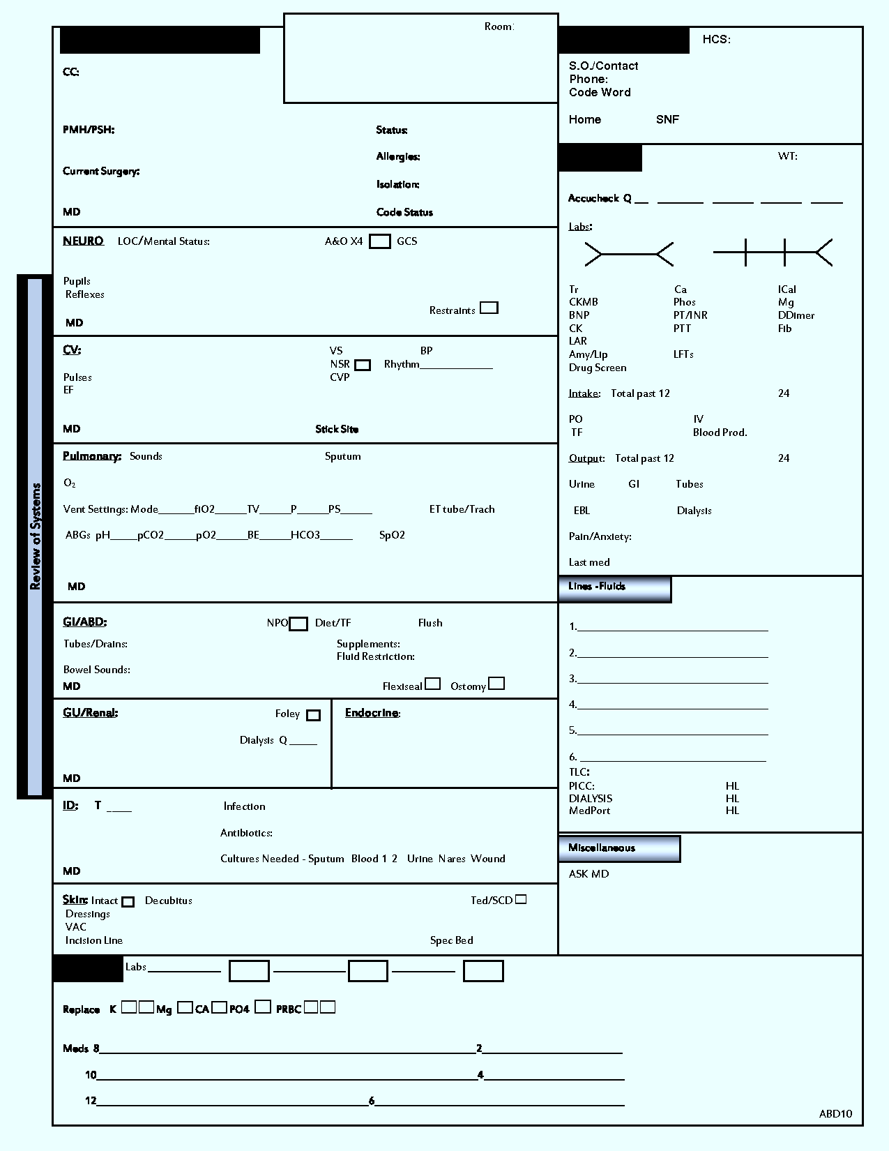
Daily review sheet

Slide 29
Daily progress note
Subjective: short narrative on how patient feel/did
Objective: vital signs and at least general physical overview – lung,cardio,abdomen, wounds,signs of TED, labs, control X-ray,etc...
A/P (actions and plans): write down what has been done with a patient, and what is planned for him/her
NEVER!!! NEVER just COPY and PASTE!!! – can result in a big f**k up ☺ (for the patient, and also for you)

Slide 30
Role of physiotherapy in ICU
Physiotherapist role in the ICU can be separated into two key areas – respiratory and rehabilitation
Physiotherapist plays an important role during „weaning“ – gradual process leading to extubation of the patient, leaving him to breath spontaneously

Slide 31
Respiratory physiotherapy
Patients in ICU may require mechanical ventilation to help them breath. However, this stops patient from coughing and clearing the daily load of sputum ( cca 100ml/day).
In case of respiratory infection, this amount can be increased significantly.
Physiotherapists with their techniques help patient to clear the airways of built up sputum collection, and decrease the possible complications.

Slide 32
Repiratory physiotherapy
Early activity: such as getting into the chair or verticalisation/walk training – these encourage deep breaths and coughing
Positioning: to allow gravity to help sputum to drain from the lungs
Manual techniques (shaking, vibrations):
these are applied to the ribs to try to loosen and clear the sputum

Slide 33
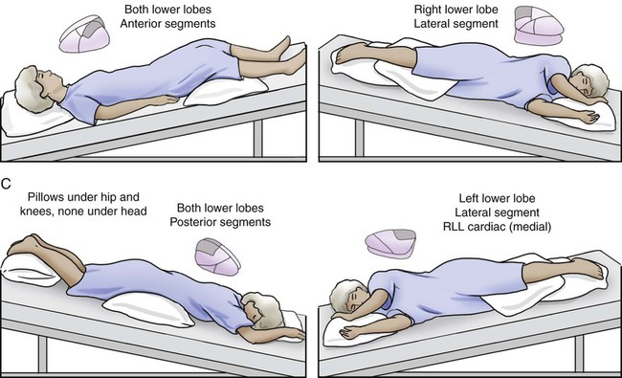
Each position optimally for 10 minutes

Slide 34
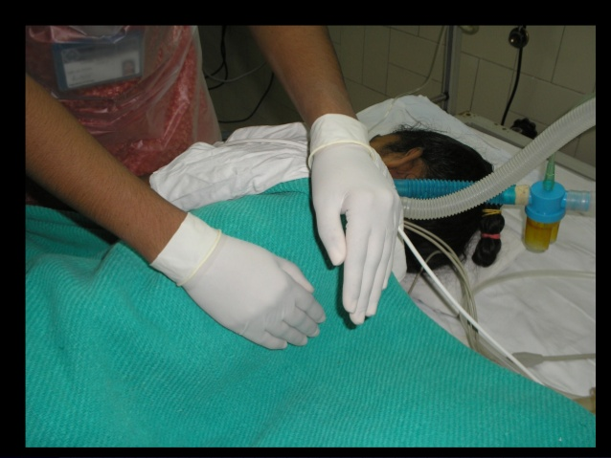
Vibrations consist of a fine oscillation of the hands, directed inwards, against the chest, performed on exhalation after deep inhalation.
Helps move loosened mucus towards larger airways

Slide 35
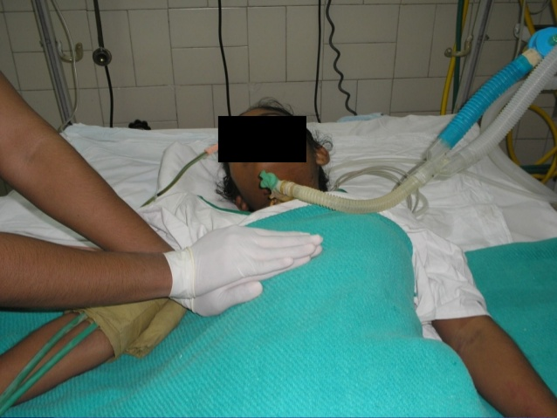
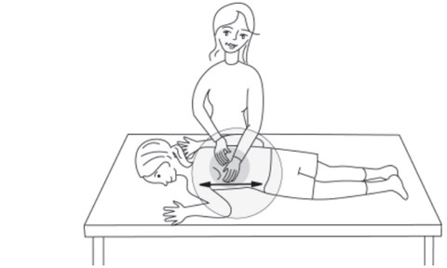
Shaking is a coarser movement
in which the chest wall is rhytmically
compressed.
Drainage, and also stimulates cough

Slide 36
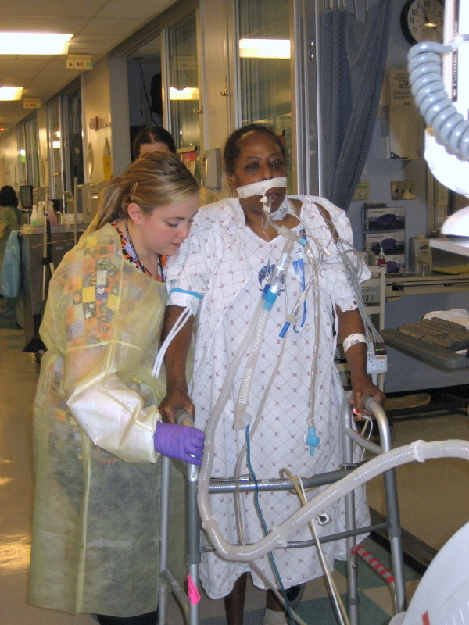
Rehabilitation in ICU
Gradual practice of
walk

Slide 37
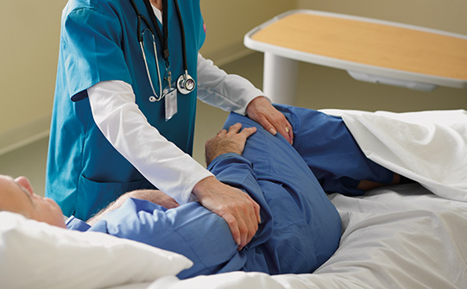
Prophylaxis or pressure ulcers
Pressure ulcers are avoidable by proper positioning

Slide 38
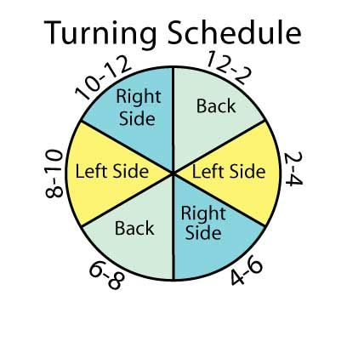
Pressure ulcers
Patients turning schedule

Slide 39
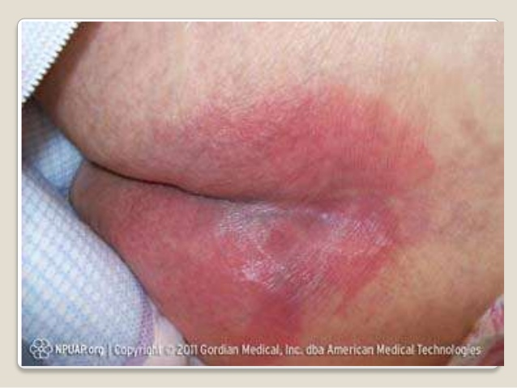
Pressure ulcers, decubitus ulcer, bed sore

Slide 40
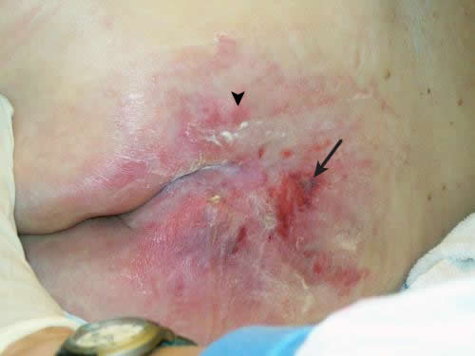

Slide 41
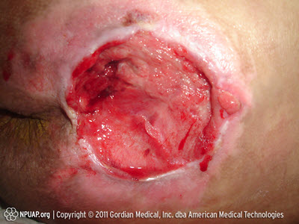

Slide 42
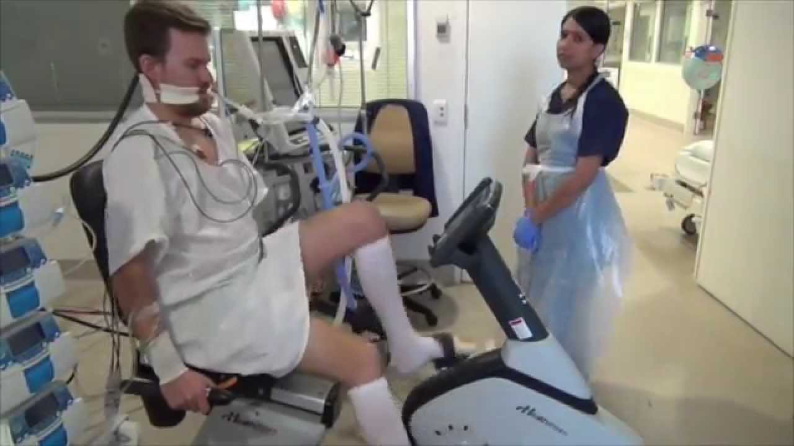
ICU rehabilitation
Cycling in ICU

Slide 43
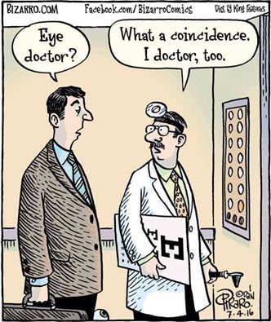
Short brake....really, a short one

Slide 44
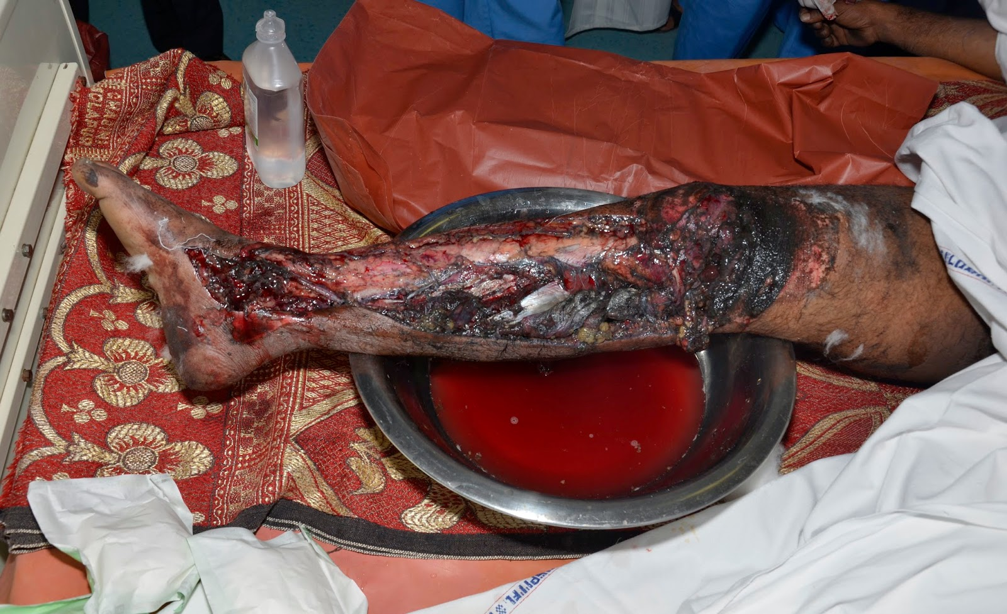
WOUND HEALING
What is a wound? Wound is a breach in continuity of skin, mucosa or surface of an organ.
There are many different categories of wounds, and they can be classified according to different aspects.

Slide 45
Wound types and classification
1.According to depth: superficial and deep
2.According to complexity: simple and complicated
3.According to their penetrance: (non) –penetrant
Division according to possible ways of treatment:
clean or mechanically contaminated
aseptic or septic (biologically clean or infected)
poisoned (animal or chemical poisons)

Slide 46
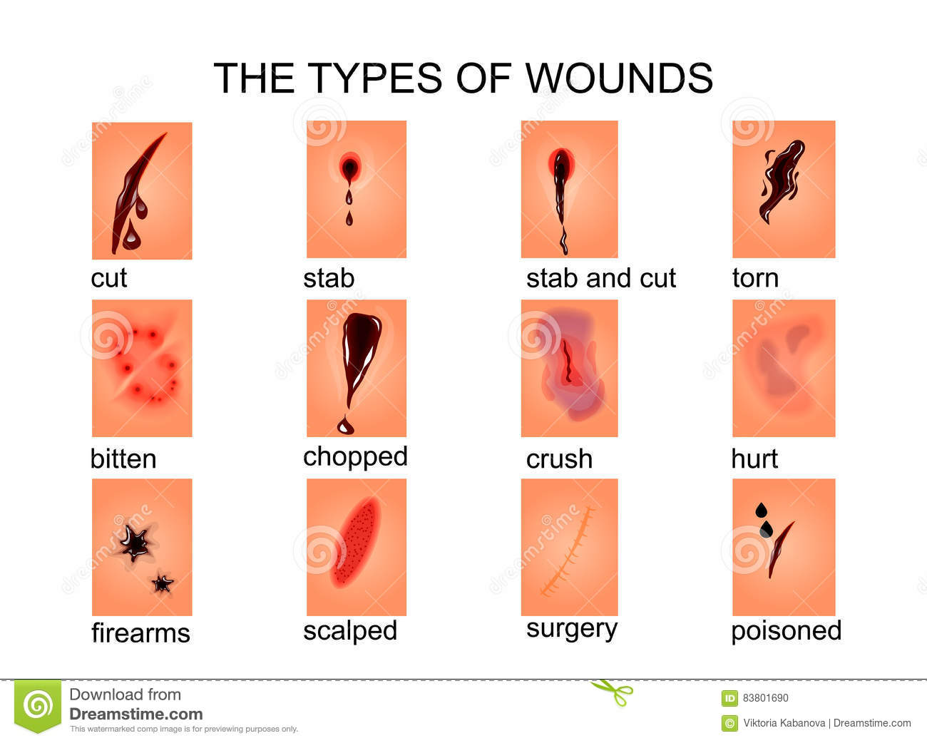

Slide 47
Wound types
vulnus scissum (incision wound)
vulnus sectum (cut wound)
vulnus punctum (stab wound)
vulnus sclopetarium (shot wound –GSW)
vulnus morsum (bite wound)
vulnus lacerum (tear wound)
vulnus contusum ( contusion wound)

Slide 48
Wound healing
Two main types:
primary , secondary or tertiary wound healing
Primary wound healing (sanatio per primam intentionem):
Ideal way of wound healing – when wound edges are in close contact, and inflammation is minimal.
Primary healing occurs in six steps:
1.coagulation and inflammation – fibrin connection of w.edges
-elevation of CO2 concentration, decrease in O2
-leucocytes and macropages migrate to wound site
-hemostasis, production of sterile inflammation, angiogenesis, accumulation of colagene

Slide 49
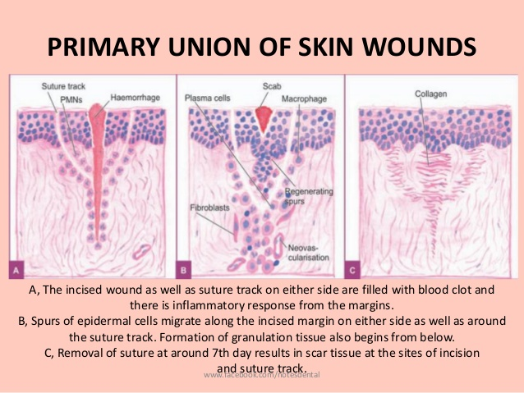
2.Fibroplasia and matrix storage:
-replication of fibroblasts, stimulated by several cell agents – IGF,TGF,PDGF – released from thrombocytes
macrophage - cytokine production
newly proliferated fibroblasts excrete proteoglycans and colagene – these form the base matrix for wound connection

Slide 50
3. Angiogenesis: - 2nd to 4th day after trauma
-in PPI healing, blood vessels create anastomosis – they start to grow due to released cytokines and cell factors
4.Epitalisation: -replication of epithelial cells thanks to TGF factors
5. Colagene fiber maturation: -fibroblasts and leukocytes produce colagenasis, which reduce the formation of primary colagene – this takes up to 18 months
6. End of healing: - if growth factors and cytokines are not balanced, hypertrophy may occur – this can happen due to chronic or repeated inflammation, corpus alienum in wound, irritation

Slide 51
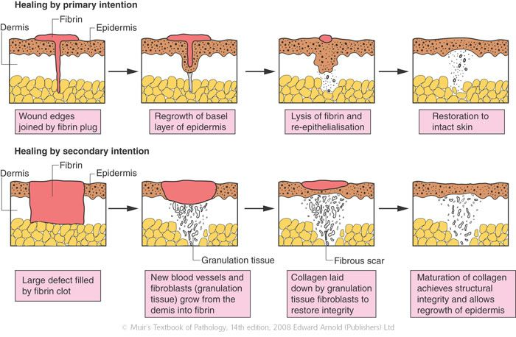

Slide 52
Secondary wound healing
Secondary intention is implemented when primary intention is not possible.
This is due to wounds being created by major trauma in which there has been a significant loss in tissue or tissue damage, etc...
The wound is allowed to granulate.
Surgeon may pack the wound with a gauze or use a drainage system.
Granulation results in a broader scar.
Healing process can be slow due to presence of drainage from infection.
Wound care must be performed daily to encourage wound debris removal to allow for granulation tissue formation.
Using antibiotics or antiseptics for the surgical wound healing by secondary intention is controversial.
Examples: gingivectomy, gingivoplasty, tooth extraction , poorly reduced fractures, burns, severe lacerations, pressure ulcers, infected wounds, diabetic ulcers

Slide 53
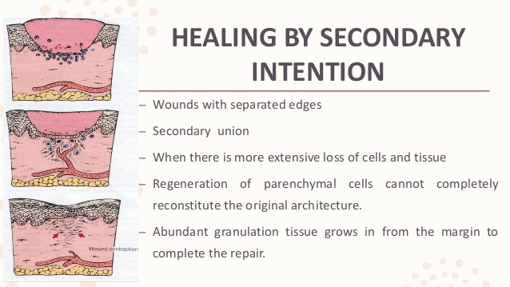

Slide 54
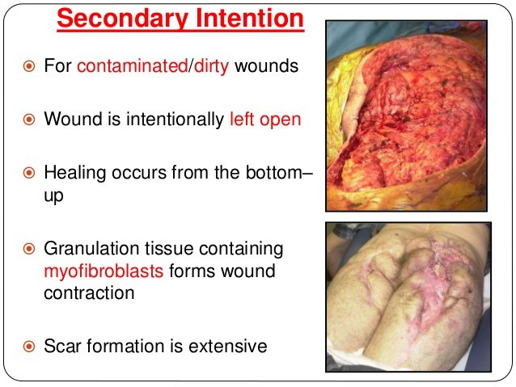

Slide 55
Not infected wound is quickly covered in layer of fibrine, surrounding tissue is blood soaked, immigration and exsudation of cell elements starts.
Around blood vessels, thin and delicate layer of granulation tissue is formed
Whole granulation tissue produces liquid of yellow colour-larger collection of this fluid forms seroma. In combination with blood elements, it forms scab.
Granulation and epitelisation process continues under crust
Epitelisation stops in case of overproduction of granulation tissue from beneath – „caro luxurians“ image (proud flesh)

Slide 56
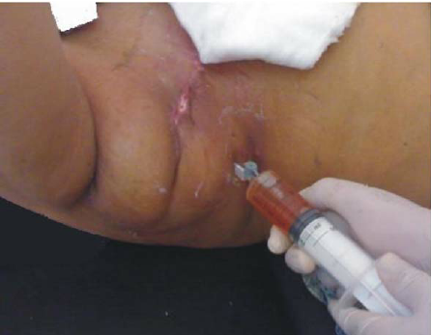
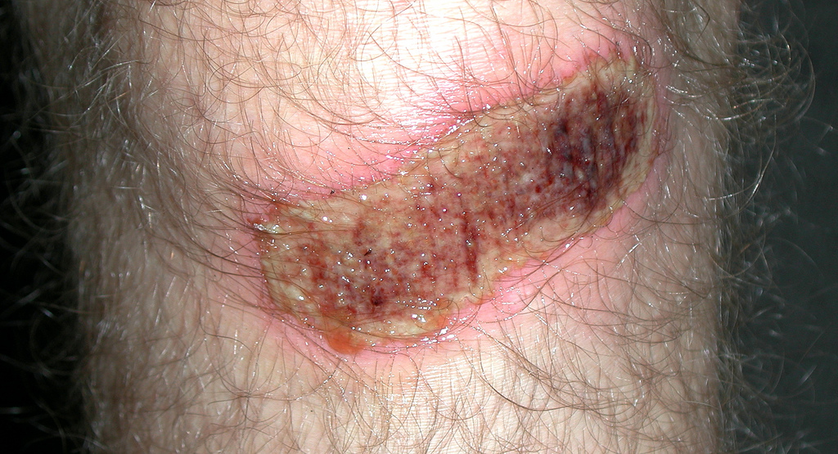
SEROMA
SCAB

Slide 57
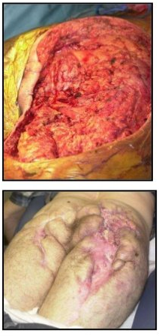
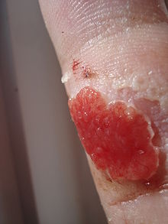
Caro luxurians – over-production of granulation tissue. Epitelisation from sides is limited or not possible.
Wound healed by secondary
healing.
proud flesh

Slide 58
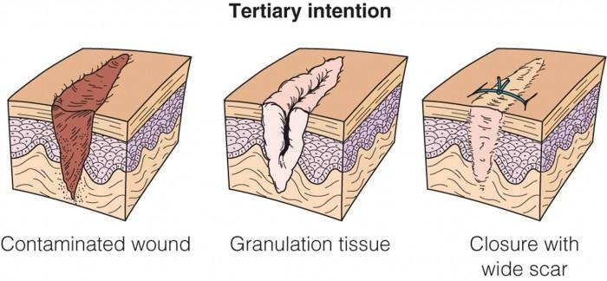
Tertiary healing
(Delayed primary closure/secondary closure)
1.Initially the wound is cleaned, debrided and observed for 4-5 days, before closure.
2. Wound remains unclosed on purpose.
3. Basically its secondary tissue healing, followed by suture.

Slide 59
Complications of wound healing
Defficient scar formation: Results in wound dehiscence or rupture of the wound due to inadequate formation of granulation tissue.
Excessive scar formation: Hypertrophic scar, keloid, desmoid.
Exuberant granulation (proud flesh).
Defficient contraction (in skin grafts) or excessive contraction (in burns).
Others: Dystrophic calcification, pigmentary changes, painful scars, incisional hernia
Marjolin's ulcer
Infection

Slide 60
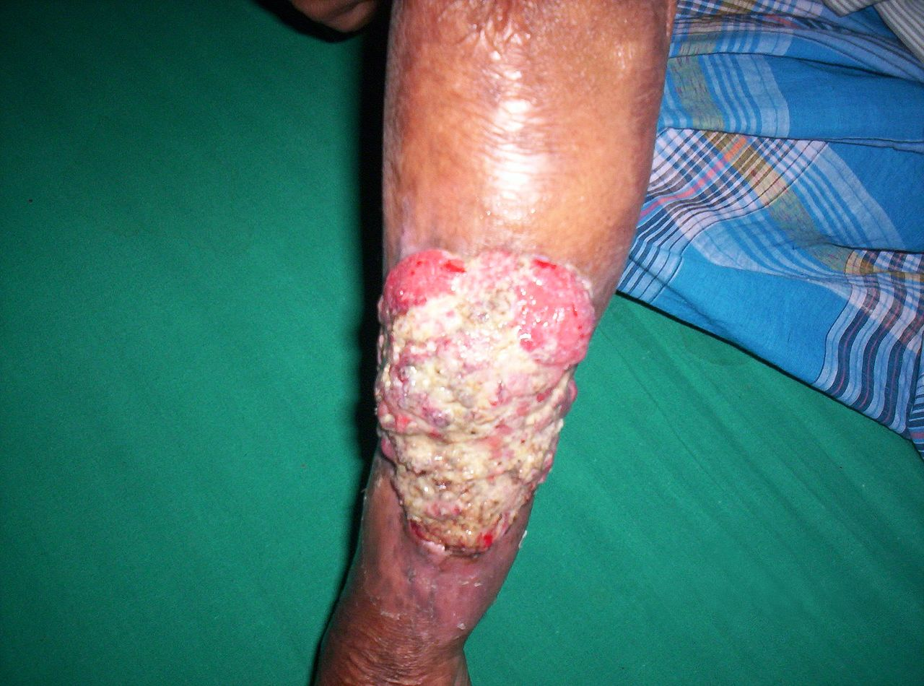
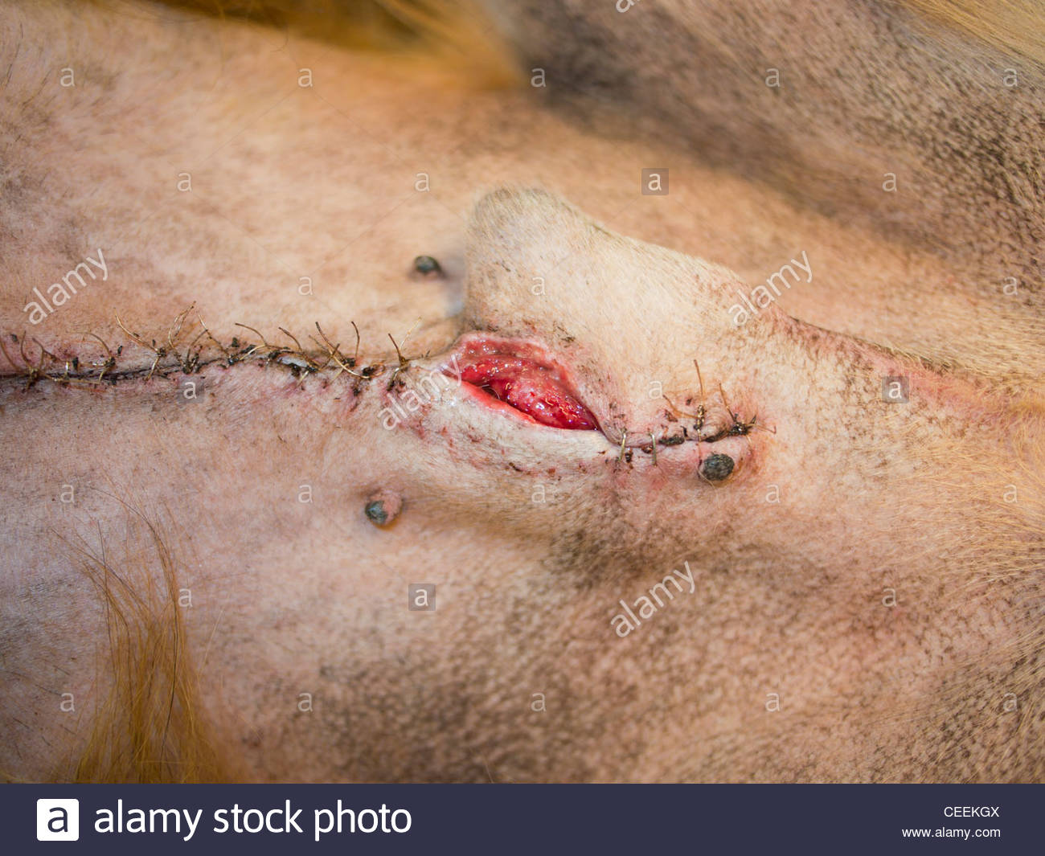
Marjolins ulcer
(squamous carcinoma)
Dehiscent wound

Slide 61
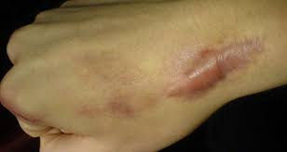
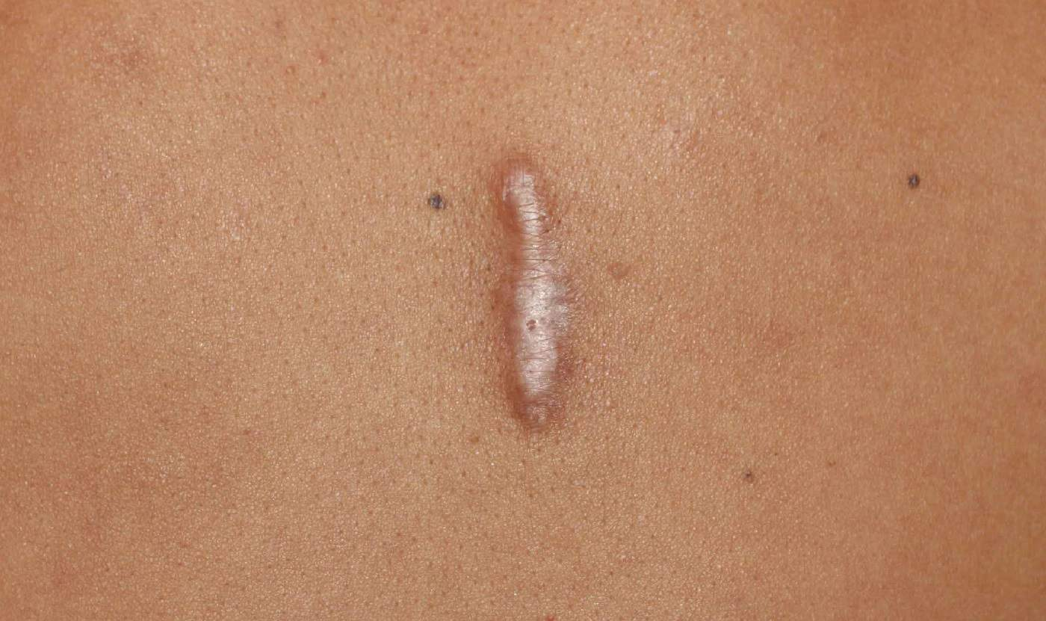
Keloid wound

Slide 62
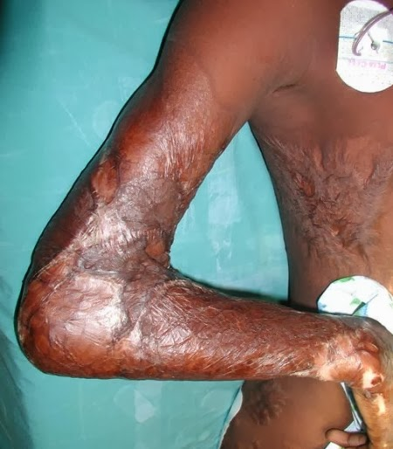
Skin contracture in burn
victim – inability to flex
cubital joint due to huge
scar

Slide 63
NPWT
Negative Pressure Wound Therapy – therapeutic technique using vacuum with dressing, allowing promotion of healing in acute, chronic or burn wounds
The use of this technique in wound management increased dramatically over the 1990s and 2000s and a large number of studies have been published examining NPWT. NPWT appears to be useful for diabetic ulcers and management of the open abdomen (laparotomy), and other, especially chronic and inflammated wounds.

Slide 64
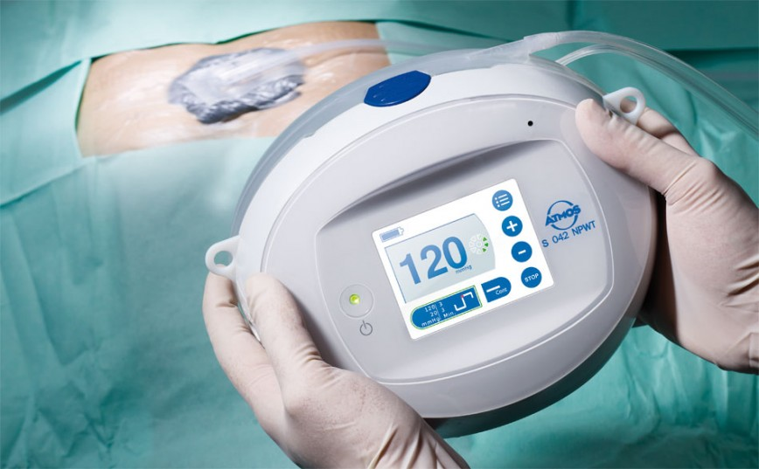

Slide 65
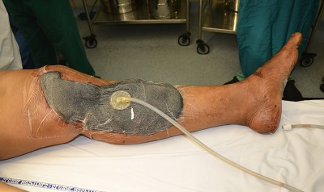
NPWT system -coverage of extensive musculo-cutaneous defect

Slide 66
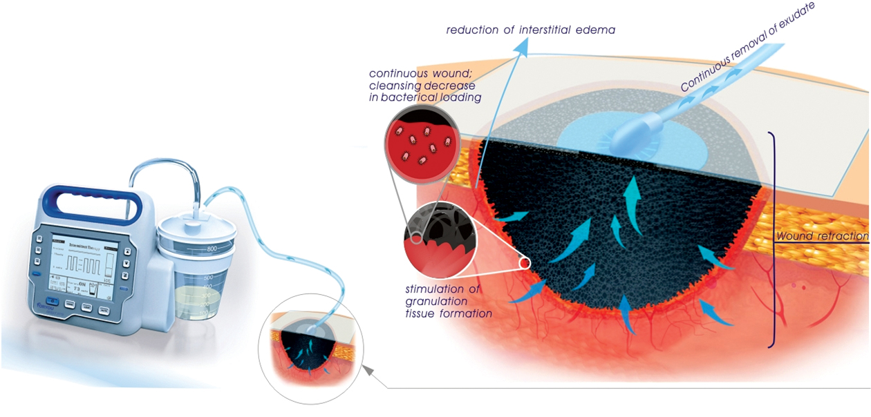

Slide 67
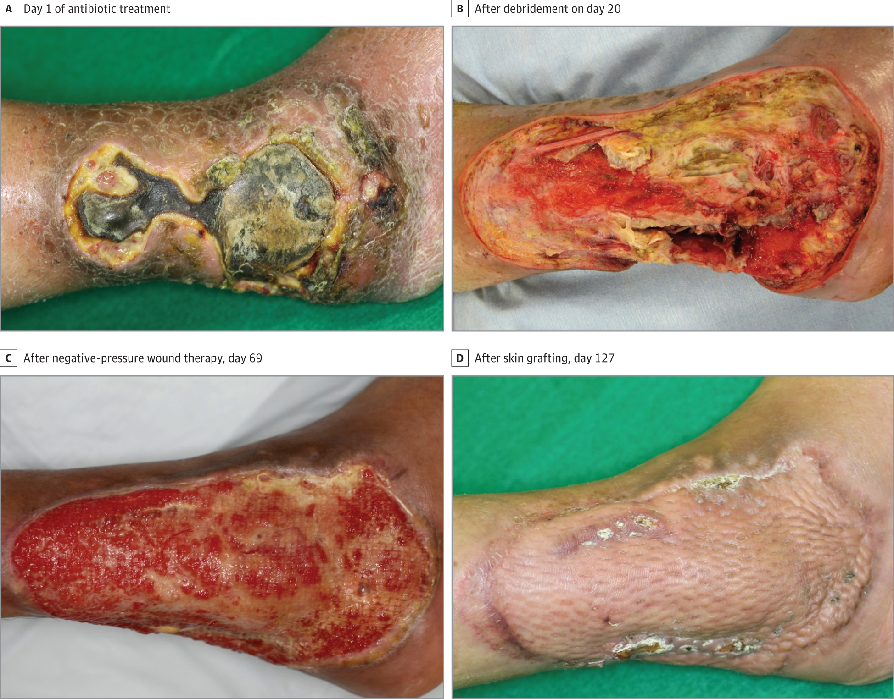

Slide 68
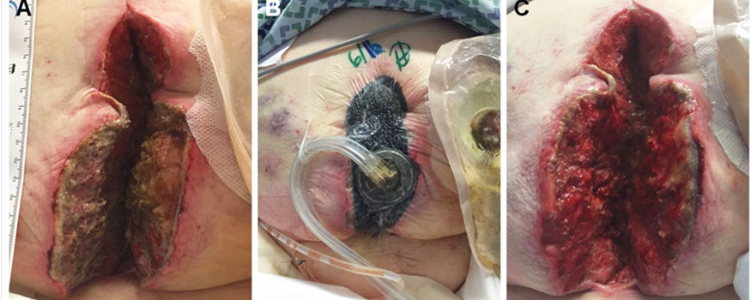
Umbilical wound treated by NPWT

Slide 69
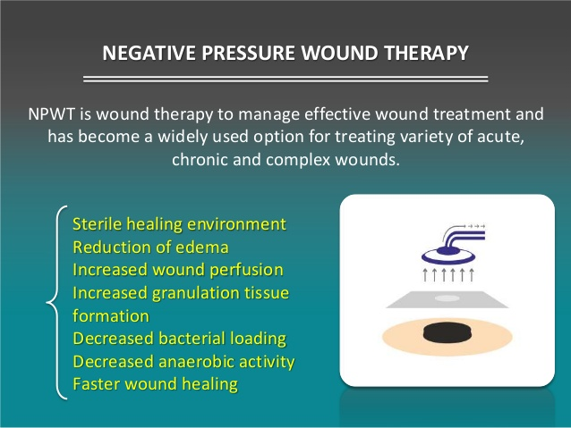

Slide 70
Contraindications
Malignancy in the wound
Untreated osteomyelitis
Non enteric and unexplored fistulas
Necrotic tissue with eschar present
Exposed blood vessels, anastomotic sites, organs and nerves in the periwound area (must avoid direct foam contact with these structures

Slide 71
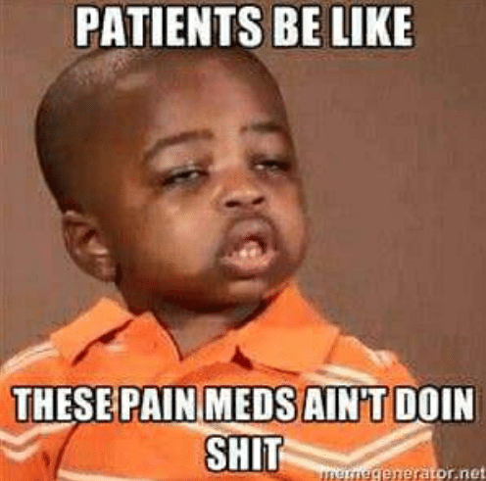
QUESTIONS?

Slide 72
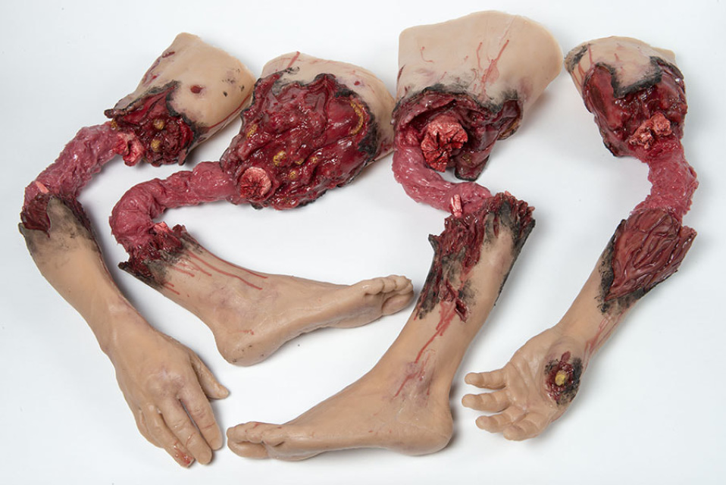
Thank you for your attention,and have a nice day ☺

