Slide 1

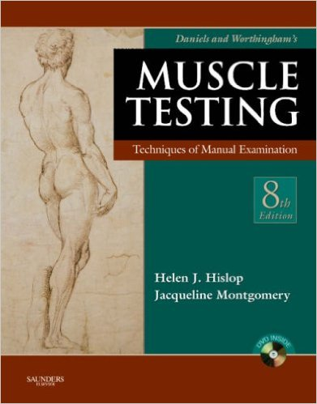
Manual muscle testing
Introduction (1)
Examination Methods in Rehabilitation, 5.10.2020
Mgr. Veronika Mrkvicová (physiotherapist)

Slide 2
Content
Muscle strength
Assessing muscle strength
Manual muscle test

Slide 3
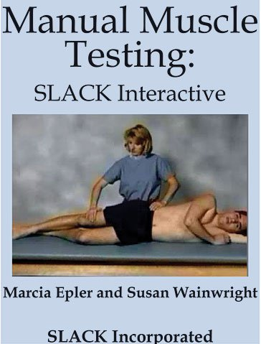
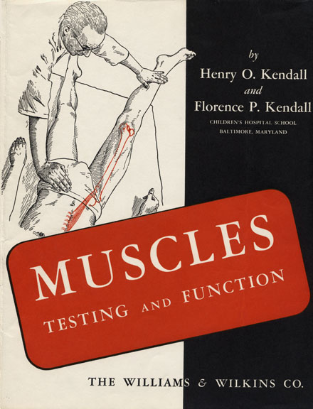
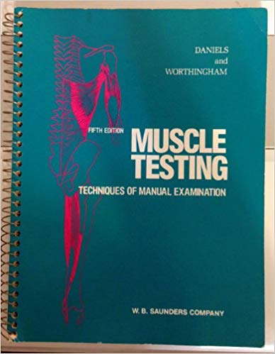
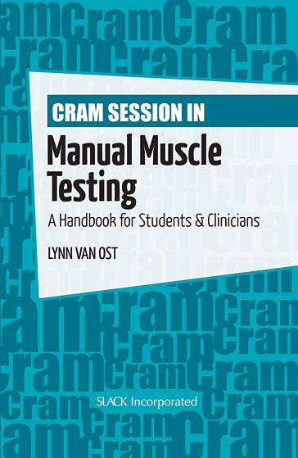
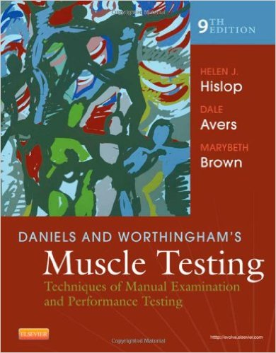
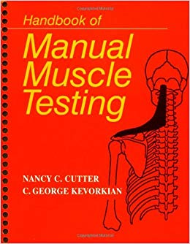

Slide 4

Introduction
The measurement of muscle function is an essential component of many neurological and physical exams
Muscle strength correlates to :
function
work productivity
general quality of life
Muscle function becomes compromised:
as we age
when associated with a skeletal impairment
as a secondary consequence of many disease processes

Slide 5
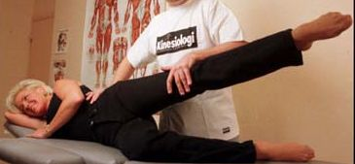
Assessing muscle function
It is an important clinical skill that is routinely used by:
Neurologists
Orthopedists
General practitioners
Occupational and physical therapists

Slide 6
Assessing muscle function
Evaluation of muscle strength is used for:
Diagnostic, differential diagnosis
Examine the improvement or deterioration of a patient’s status over time
Predictive or prognostic tool
Determine the extent of strength loss
Outcome measures in clinical research
Determine the need for compensatory measures or assistive devices
Helps in the formulation of the treatment plan
Evaluates the effectiveness of treatment

Slide 7
Assessing muscle function
There are several components of muscle performance:
Muscle performance
Muscle strength
Instantaneous muscle power
Muscle endurance
Of these performance indicators, muscle strength is the one
most commonly measured when assessing the muscle function

Slide 8
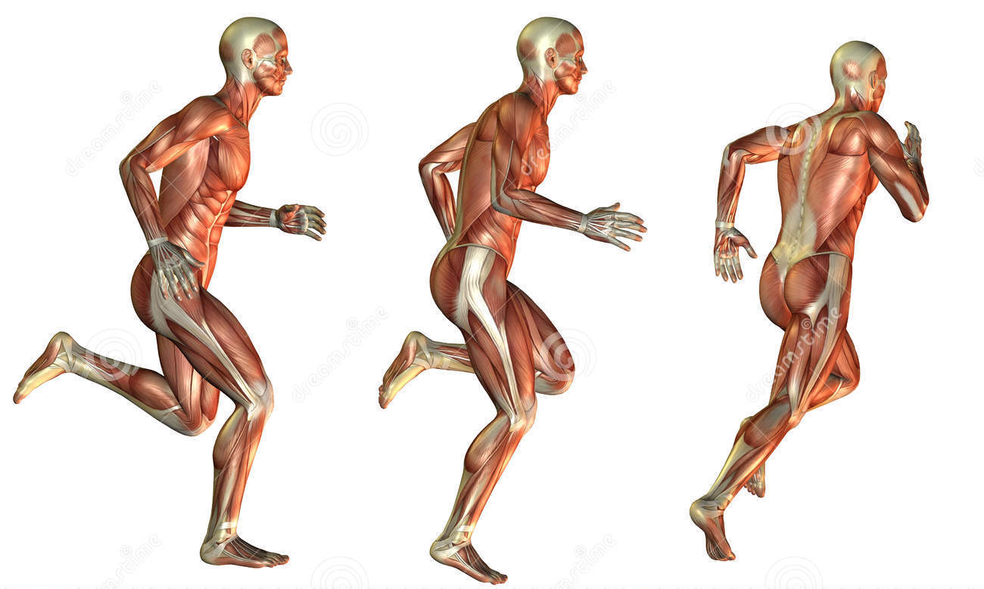
Components of muscle performance
1. Muscle performance
the capacity of a muscle to do work

Slide 9
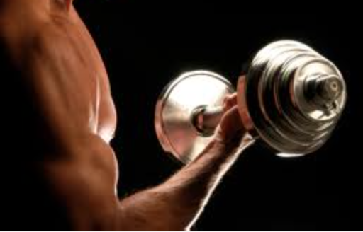
Components of muscle performance
2. Muscle strength
the force exerted by a muscle or group of muscles to overcome a resistance in one maximal effort

Slide 10
Components of muscle performance
3. Instantaneous muscle power
the mechanical power produced by the muscle (muscle force times muscle velocity)

Slide 11

Components of muscle performance
4. Muscle endurance
the ability to contract a muscle repeatedly over time

Slide 12
Assessing muscle strength
In assessing muscle strength, the conditions under which the muscle contracts must be specified so that the muscle test data can be interpreted properly
The following conditions are relevant:
Isometric contraction
Isotonic contraction
Isokinetic contraction

Slide 13
Assessing muscle strength
1. Isometric contraction
the muscle contracts while at a fixed length
2. Isotonic contraction
the muscle contracts while working against a fixed load (eg. a hanging weight)
3. Isokinetic contraction
the muscle contracts while moving at a constant velocity (generally, isokinetic contractions are only possible with the limb strapped into a special machine that imposes the constant velocity condition)

Slide 14
Assessing muscle strength
Eccentric contraction
the muscle contracts against a load that is greater than the force produced by the muscle so that the muscle lengthens while contracting
Concentric contraction
the muscle contracts against a load that is less than the force produced by the muscle so that the muscle shortens while contracting

Slide 15

Muscle weakness
It means any reduction of the normal ability of the muscle to generate force
Causes:
Muscle strain
Pain, reflex inhibition
Nerve root lesion
Tendon pathology, avulsion, rupture
Prolonged disuse/immobilization
Psychological overlay

Slide 16
Muscles work in pairs
Muscles usually work in pairs or groups (e.g. the biceps flexes the elbow and the triceps extends it) – it is called antagonistic muscle action
The working muscle is called the prime mover or agonist. The relaxing muscle is the antagonist (e.g. quadriceps and hamstrings)
The prime mover is helped by other muscles called synergists. These contract at the same time as the prime mover. They hold the body in position so that the prime mover can work smoothly

Slide 17
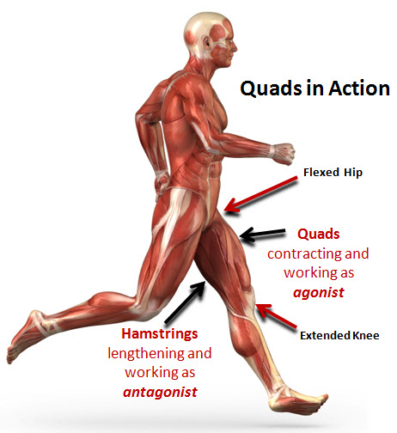
Muscles
Agonist muscles cause a movement to
occur through their own contraction
Antagonist muscles oppose a specific movement. This controls a motion, slows it down, and returns a limb to its initial position
Synergist muscles performs, or helps perform, the same set of joint motion as the agonists. Synergists muscles act on movable joints. Synergists are sometimes referred to as "neutralizers" because they help cancel out, or neutralize, extra motion from the agonists to make sure that the force generated works within the desired plane of motion

Slide 18
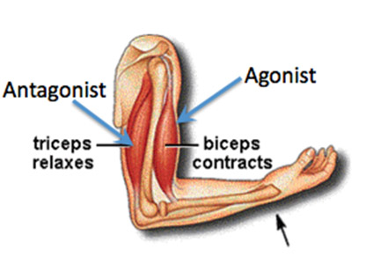
Muscles
Neutralizer Action
A muscle that fixes or holds a bone so that the agonist can carry out the intended movement is said to have a neutralising action

Slide 19
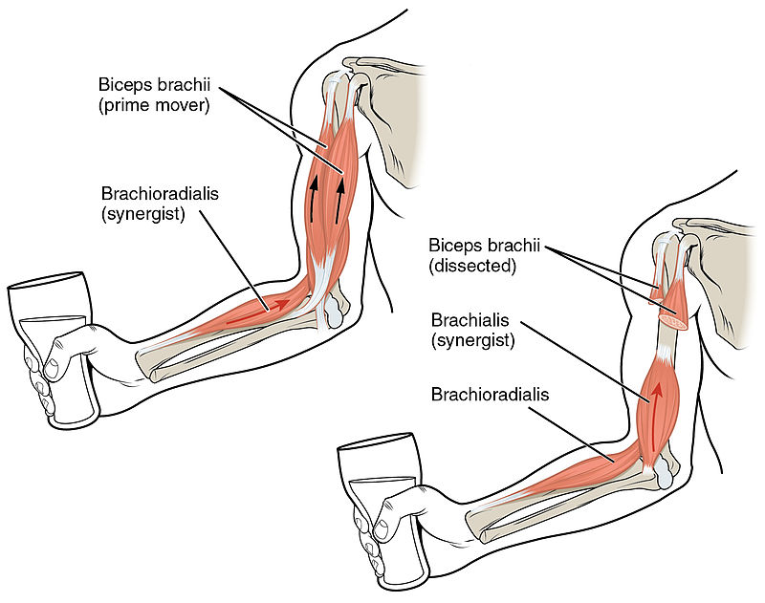
Muscle function
The biceps brachii flex the lower arm. The brachoradialis, in the forearm, and brachialis, located deep to the biceps in the upper arm, are both synergists that aid in this motion

Slide 20
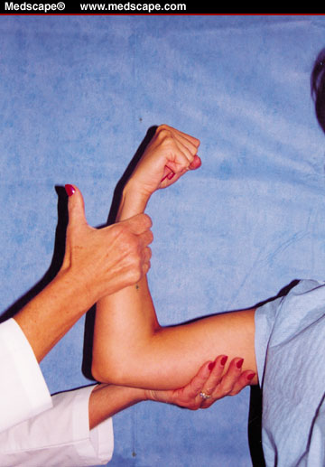
Manual muscle test (MMT)

Slide 21
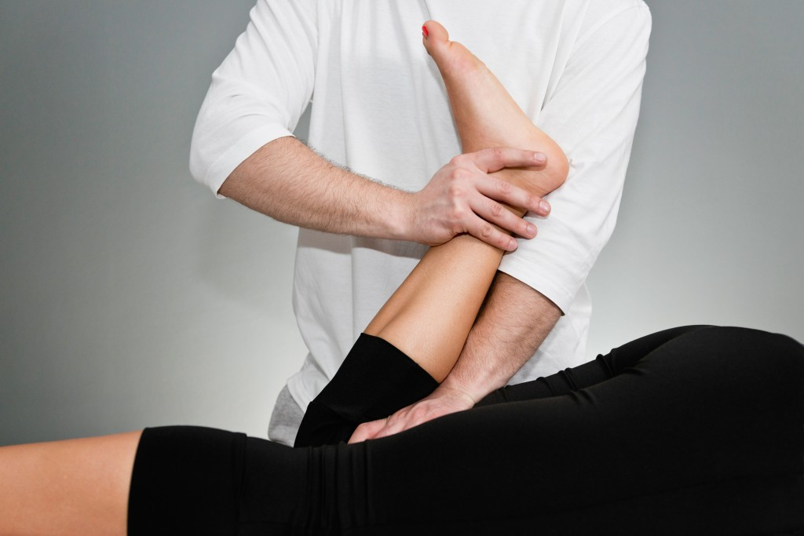
Definition
Manual muscle testing (MMT) is an attempt to determine a patient's ability to voluntarily contract a specific muscle
(Keep in mind that this does not provide information on the patient's ability to use the muscle in daily activities, or if the muscle interacts with other muscle around it in a synergistic pattern)

Slide 22
MMT
it is the simplest and most common method of assessing muscle strength
a procedure for evaluating strength and function of an individual muscle or a muscle group in which the patient voluntarily contracts the muscle against gravity load or manual resistance
quick, efficient, and easy to learn, however, it requires total cooperation from the patient and learned response levels by the assessor

Slide 23
MMT
The procedures for conducting the MMT have been standardized to assure, as much as possible, that results from the test will be reliable
The specific muscle or muscle group must be determined and the examiner must be aware of, and control for, common substitution patterns where the patient voluntarily or involuntarily uses a different muscle to compensate for a weak muscle being tested

Slide 24
MMT
To conduct a MMT, the patient is positioned in a posture appropriate for the muscle being tested, which generally entails isolating the muscle and positioning so that the muscle works against gravity
The body part proximal to the joint acted on by the muscle is stabilized
A screening test is performed by asking the patient to move the body part through the full available range of motion (ROM)
The main test is then performed either unloaded, against a gravity load, or against manual resistance, and a grade is assigned to indicate muscle strength

Slide 25
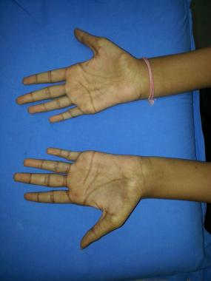
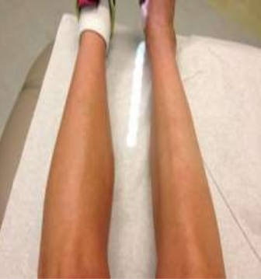
Purpose of MMT
MMT is indicated in any patient with suspected or actual impaired muscle performance, including strength, power, or endurance
Identification of specific impaired muscles or muscle groups provides information for proper treatment

Slide 26
Precautions
It is important to determine the patient's ability to resist the force to be applied
Proper positioning is important, as is instruction in breathing techniques (avoid the Val Salva)
Remember to assess surrounding area for ability to sustain muscle test
In the case of a recent fracture, post-surgical, or other tissue healing, consider post-poning muscle test

Slide 27
Note:
Always tell your client about what procedure you are going to perform and what you are going to obtain from that procedure
Remember to check the uninvolved side first and be consistent on where you apply the resistance
Also, instruct your client not to hold his or her breath as you apply force or resistance

Slide 28
Note:
Muscle origin, insertion and action
Function of participating muscles
Patterns of substitution
Ability to detect contractile activity
Ability to palpate muscle or tendon
Ability to detect atrophy
Recognize abnormal position or movement

Slide 29
MMT - grading
Manual grading of muscle strength is based on:
palpation or observation of muscle contraction
ability to move the limb through its available ROM against or without gravity
ability to move the limb through its ROM against manual resistance by the examiner
Manual resistance is applied by the examiner using one hand with the other hand stabilizing the joint
Exact locations for applying resistive force are specified and must be followed exactly to obtain accurate MMT results

Slide 30
MMT - grading
A slow, repeatable velocity is used to take the limb through its ROM, applying a resistive force just under the force that stops motion
The instructions to the patient are to use all of their strength to move the limb as far as possible against the resistance
For weaker muscles that can move the limb, but not against gravity, the patient is repositioned so that the motion is done in the horizontal plane with no gravity

Slide 31
MMT - grading
The assignment of scores is based on clinical judgment and the experience of the examiner
The amount of resistance (moderate, maximal) applied by the examiner is also based on clinical experience and is adjusted to match the muscle being tested as well as the patient’s age, gender and/or body type

Slide 32
MMT - grading
While the MMT is the most widely used method to assess muscle function, its reliability and accuracy are questionable
The MMT scores are least accurate for higher force levels
Interrater reliability for MMT is not high, suggesting that the same examiner should perform multiple tests on one subject or across subjects
All tests based on voluntary activation of a muscle are prone to artifact because of patient motivation and examiner encouragement

Slide 33
Grade 5 (Normal; 100%)
The patient or subject can complete
the whole range of motion (movement)
against gravity with maximum resistance
applied by the therapist at end-of-range

Slide 34
Grade 4 (Good;75%)
The subject can complete the whole
range of motion against gravity
with moderate resistance applied by the
physical therapist (PT) at end-range.
Testing the uninvolved limb should always
be considered to know whether you are applying
too much force on the involved limb or not

Slide 35
Grade 3+ (Fair+)
The patient can complete the motion
against gravity with minimal resistance
applied by the examiner at end-range

Slide 36
Grade 3 (Fair;50%)
The patient can only complete
the range of motion against gravity.
When external force is applied by the PT,
the patient gives way

Slide 37
Grade 2+ (Poor +)
Patient can move his or her joint at a certain
range but cannot complete the motion against gravity.
When gravity is eliminated, such as performing
the motion in side-lying, your client can perform
the movement at full range of motion with ease.
However, muscles being tested give way
immediately when you apply some resistance

Slide 38
Grade 2 (Poor;25%)
Patient cannot perform
the movement against gravity.
But patient can do complete
range of motion when pull of
gravity is eliminated.
No resistance is applied.

Slide 39
Grade 2 - (Poor -)
Initiation of movement can be done
only as gravity is eliminated.
That is, only a partial movement is observed.
Here, full range cannot be completed.

Slide 40
Grade 1 (Trace)
Patient is not able to move the joint
even with gravity eliminated.
However, closer examination by the therapist
would reveal slight muscle contraction
through palpation.

Slide 41
Grade 0 (Zero; No trace)
No contraction is noticed, even
with physical therapist's palpation (touch).

Slide 42
Grading
5 Normal subject completes ROM against gravity with maximal resistance
4+ Good Plus completes ROM against gravity with moderate-maximal resistance
4 Good completes ROM against gravity with moderate resistance
4- Good Minus completes ROM against gravity with minimal-moderate resistance
3+ Fair Plus completes ROM against gravity with only minimal resistance
3 Fair completes ROM against gravity without manual resistance
3- Fair Minus does not complete the range of motion against gravity, but does complete more than half of the range
2+ Poor Plus is able to initiate movement against gravity
2 Poor completes range of motion with gravity eliminated
2- Poor Minus does not complete ROM in a gravity eliminated position
1 Trace muscle contraction can be palpated, but no joint movement
0 Zero patient demonstrates no palpable muscle contraction

Slide 43
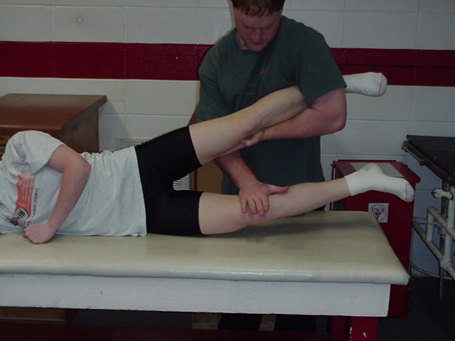
General procedure
Basic consideration:
Observation
Palpation
Positioning
Stabilization
Resistance
Validity and reliability

Slide 44
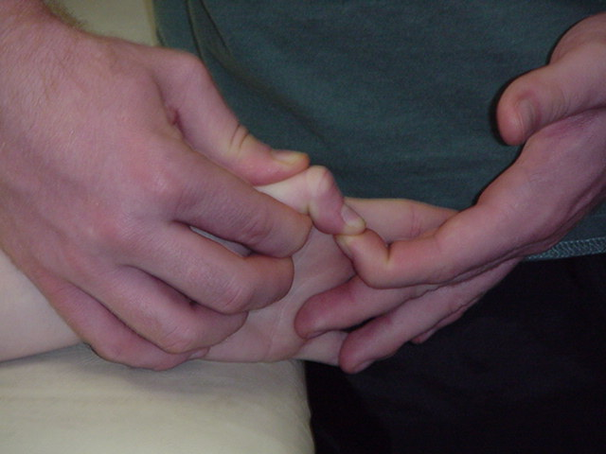
1. Observation and palpation
Observe the size and contour of muscles
Palpate contractile tissues

Slide 45
2. Position Patient
The patient and the part to be tested should be positioned comfortably on a firm surface in the correct testing position
The correct testing position ensures that the muscle fibers to be tested are correctly aligned
The patient is properly draped so that the involved body part is exposed as necessary

Slide 46
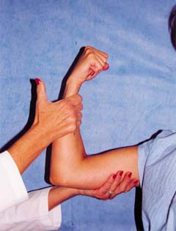
3. Stabilization
Stabilization, which helps to
prevent substitute movements
and adds validity to the muscle test, can be provided manually (or through the use of an external support such as a belt)
The stabilization is applied to the proximal segment using counter pressure to the resistance

Slide 47
4. Active Range of Motion
The patient moves through the test the body segment actively against gravity
The clinician palpates the muscle for activity and also notes any adaptive shortening (slight to moderate loss of motion), substitutions or trick movements (weakness or instability), or contractures (marked loss of motion)
The joint is then returned to the start position
If the patient is unable to perform the muscle action against gravity, the patient is positioned in the gravity-minimized position
Generally speaking, testing the muscle in the transverse plane can minimize the effects of gravity

Slide 48
Validity and Reliability
Patient Factors
  Age
  Gender
  Pain
  Fatigue
  Lower motor
  neuron disease
  Spasticity
Therapist factors
  Experience
  Manner and content
  of instructions
  Interaction
Environmental factors
  Temperature
  Distractions
Other factors
  Muscle factors
  Psychological factors
  Methodological factors

Slide 49
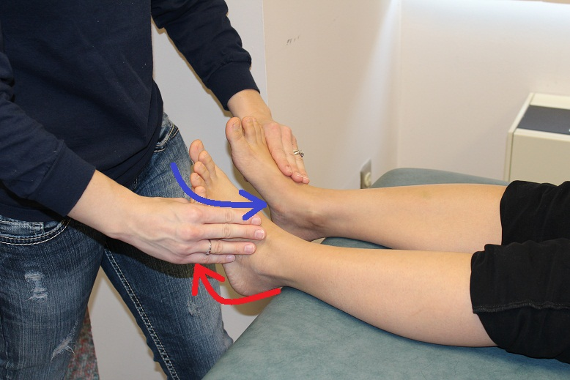
Test
The test should be completed on the uninvolved side first to find out normal strength before being repeated on the involved side
Then the patient is instructed
to complete the test
movement on the involved side
The clinician alerts the patient that resistance will be applied and then applies resistance in the appropriate direction and in a smooth and gradual fashion

Slide 50
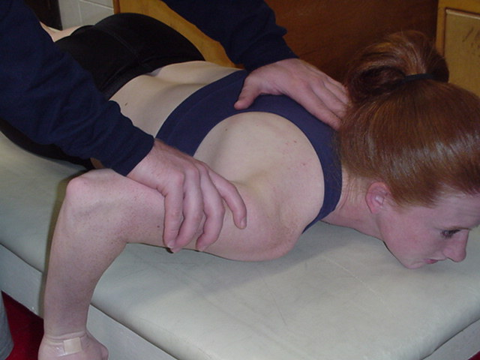
Test
The proper location for the application of resistance is as far distal as possible from the axis of movement on the moving segment without crossing another joint
Resistance should never cross an intervening joint unless the integrity of the joint has been assessed as normal
The resistance is applied in a direction opposite the muscle's rotary component and at right angles to the long axis of the segment (opposite the line of the pull of the muscle fibers)

Slide 51
Test
The appeal of the MMT is that it can be performed simply with the patient, an examiner, and a bench or table
This makes it ideal for the routine clinical environment where specialized equipment is unavailable and time is short
It is also suited for situations in which testing must be performed away from the clinic (eg. nursing homes, rural areas, or remote emergency settings)

Slide 52
Conclusion
The assessment of a patient’s muscle strength is one of the
most important vital functions that is typically monitored
Specifically, strength assessment is necessary for determining
distribution of weakness, disease progression, and/or treatment efficacy
The particular assessment approach will be, in part, dictated by the clinical circumstance or severity of illness
Several assessment techniques and tools are currently available to the healthcare provider and/or researcher, yet each has its unique attributes

Slide 53
Conclusion
MMT is a relatively quick and inexpensive method of evaluating strength however, it is somewhat subjective
By using consistent test positions, accurate joint placement and avoiding use of compensatory muscle use, results allow for increased reliability in using MMT as an evaluation tool
Keep in mind that MMT often does not correlate with a patient's ability to perform functional activities
In addition, a normal muscle grade does not necessarily indicate a patient's ability to return to his or her normal level of activity
It is important to include functional tests in any patient evaluation

Slide 54

Thank you for your attention ☺

