Slide 1
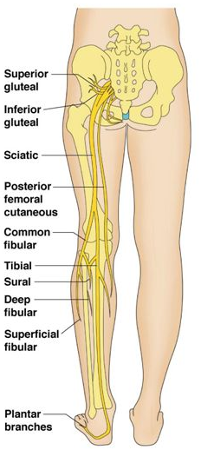
Nerves of the Lower Limb
Examination Methods in Rehabilitation (26.10.2020)
Mgr. Veronika Mrkvicová (physiotherapist)

Slide 2
Nerves of the Lower Limb
The Lumbar Plexus
  Iliohypogastricus nerve
  Ilioinguinalis nerve
  Lateral Cutaneous Femoral nerve
  Obturator nerve
  Femoral nerve
The Sacral Plexus
  Sciatic nerve
  Tibial nerve
  Common Peroneal nerve

Slide 3
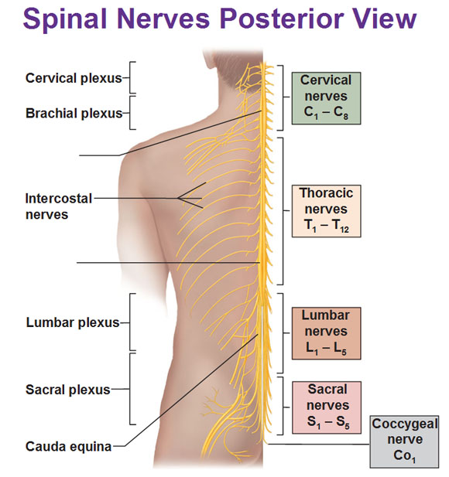
Spinal Nerves

Slide 4
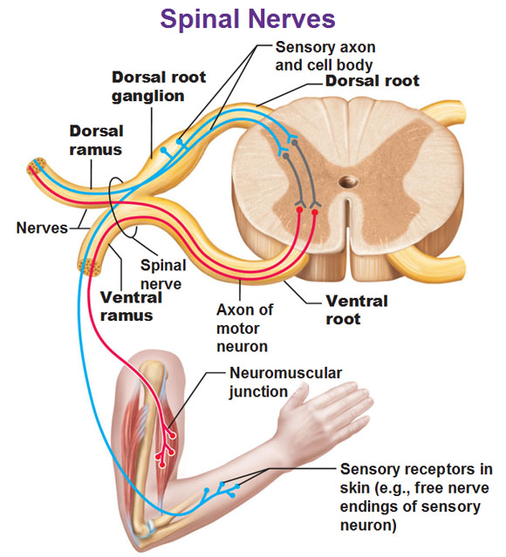

Slide 5
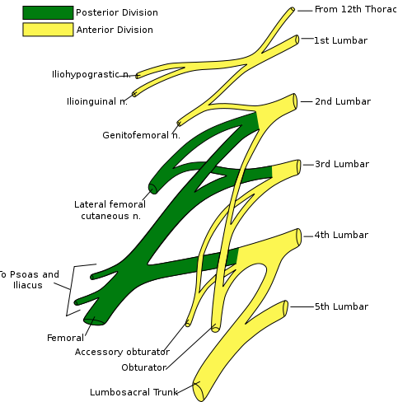
The Lumbar Plexus

Slide 6
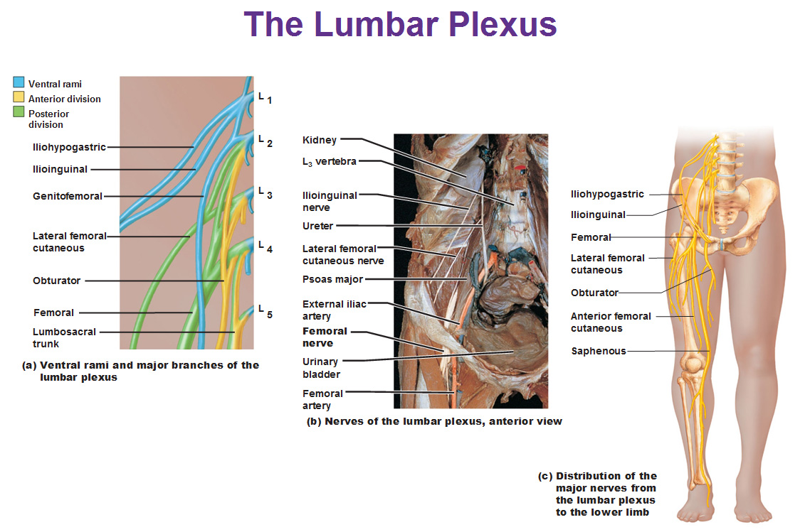

Slide 7
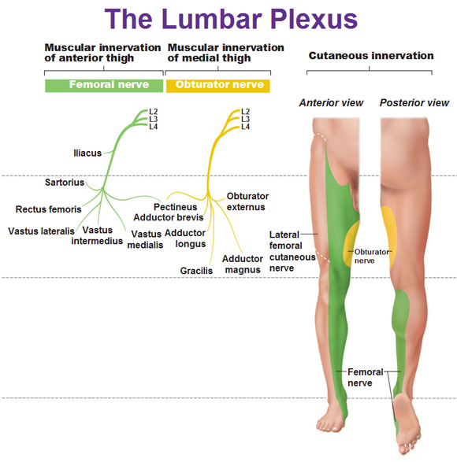

Slide 8
The Lumbar Plexus
a nervous plexus in the lumbar region of the body which forms part of the lumbosacral plexus
it is formed by the divisions of the four lumbar nerves (L1-L4) and from contributions of the subcostal nerve (T12)
additionally, the ventral rami of the fourth lumbar nerve pass communicating branches, the lumbosacral trunk, to the sacral plexus
the nerves of the lumbar plexus pass in front of the hip joint and mainly support the anterior part of the thigh

Slide 9
The Lumbar Plexus
it is formed lateral to the intervertebral foramina and passes through psoas major
its smaller motor branches are distributed directly to psoas major
while the larger branches leave the muscle at various sites to run obliquely downward through the pelvic area to leave the pelvis under the inguinal ligament
with the exception of the obturator nerve which exits the pelvis through the obturator foramen

Slide 10
The Iliohypogastric Nerve
it runs anterior to the psoas major on its proximal lateral border to run laterally and obliquely on the anterior side of quadratus lumborum
lateral to this muscle, it pierces the transversus abdominis to run above the iliac crest between that muscle and abdominal internal oblique
it gives off several motor branches to these muscles and a sensory branch to the skin of the lateral hip
its terminal branch then runs parallel to the inguinal ligament to exit the aponeurosis of the abdominal external oblique above the external inguinal ring where it supplies the skin above the inguinal ligament (i.e. the hypogastric region) with the anterior cutaneous branch

Slide 11
The Ilioinguinal Nerve
it closely follows the iliohypogastric nerve on the quadratus lumborum, but then passes below it to run at the level of the iliac crest
it pierces the lateral abdominal wall and runs medially at the level of the inguinal ligament where it supplies motor branches to both transversus abdominis
and sensory branches through the external inguinal ring to the skin over the pubic symphysis and the lateral aspect of the labia majora or scrotum

Slide 12
The Genitofemoral Nerve
it pierces psoas major anteriorly below the former two nerves to immediately split into two branches that run downward on the anterior side of the muscle
the lateral femoral branch is purely sensory. It pierces the vascular lacuna near the saphenous hiatus and supplies the skin below the inguinal ligament (i.e. proximal, lateral aspect of femoral triangle)
the genital branch differs in males and females
in males it runs in the spermatic cord and in females in the inguinal canal together with the teres uteri ligament
it then sends sensory branches to the scrotal skin in males and the labia majora in females. In males it supplies motor innervation to the cremaster

Slide 13
Genitofemoral nerve paralysis
most commonly caused by surgical trauma
  other causes reported include direct trauma to the inguinal region and tight clothing
  Symptoms
    a pain and a burning sensation in the groin, which radiates to the inner thigh (aggravating factors including walking, stooping and hyperextension of the hip)
    tenderness and possible hyperaesthesia along the inguinal canal
    provocative testing involves internal or external rotation of the hip joint

Slide 14
The lateral cutaneous femoral nerve
it pierces psoas major on its lateral side and runs obliquely downward below the iliac fascia
medial to the anterior superior iliac spine it leaves the pelvic area through the lateral muscular lacuna it enters the thigh by passing behind the lateral end of the inguinal ligament
in the thigh it briefly passes under the fascia lata before it breaches the fascia and supplies the skin of the anterior thigh

Slide 15
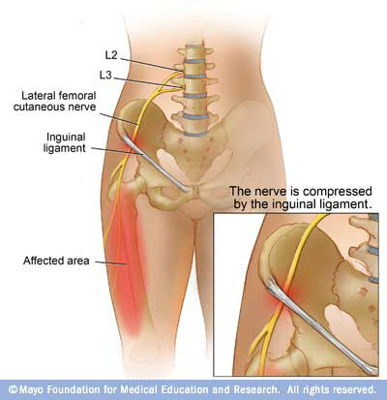
The lateral cutaneous femoral nerve
Involvement of the lateral cutaneous branch of the nerve may produce:
- painful paraesthesiae of the thigh (meralgia paraesthetica)
- mild pain near the inguinal ligament may be experienced

Slide 16
The obturator nerve
it leaves the lumbar plexus and descends behind psoas major on it medial side, then follows the linea terminalis into the lesser pelvis, and finally leaves the pelvic area through the obturator canal
in the thigh, it sends motor branches to obturator externus before dividing into an anterior and a posterior branch, both of which continues distally
these branches are separated by adductor brevis and supply all thigh adductors with motor innervation: pectineus, adductor longus, adductor brevis, adductor magnus, adductor minimus, and gracilis
the anterior branch contributes a terminal, sensory branch which passes along the anterior border of gracilis and supplies the skin on the medial, distal part of the thigh

Slide 17
The femoral nerve
it is the largest and longest of the plexus' nerves
it gives motor innervation to iliopsoas, pectineus, sartorius, and quadriceps femoris
and sensory innervation to the anterior thigh, posterior lower leg, and hindfoot
in the pelvic area, it runs in a groove between psoas major and iliacus giving off branches to both muscles, and exits the pelvis through the medial aspect of muscular lacuna
in the thigh it divides into numerous sensory and muscular branches and the saphenous nerve, its long sensory terminal branch which continues down to the foot

Slide 18
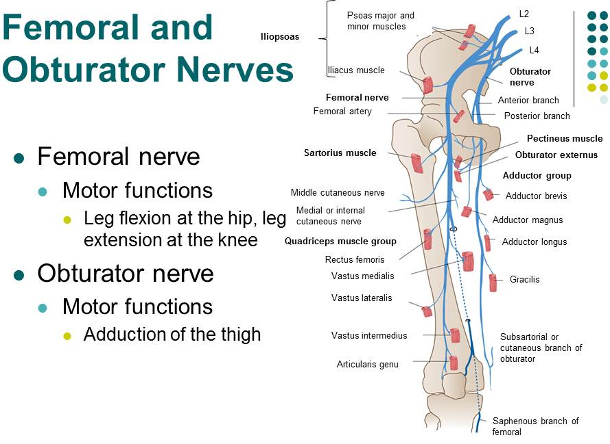

Slide 19
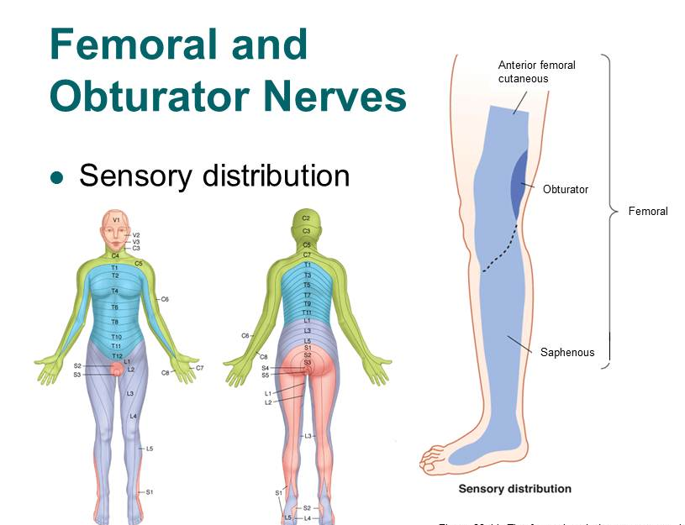

Slide 20
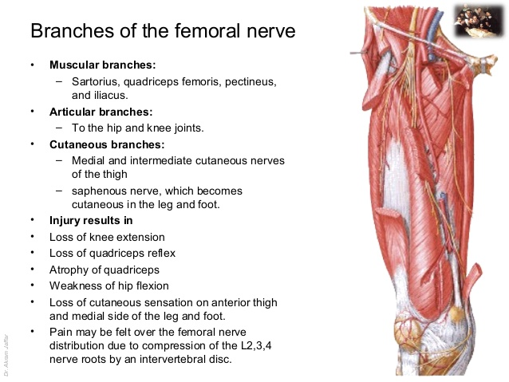
Femoral nerve paralysis
Symptoms:

Slide 21
Obturator nerve paralysis
Symptoms:
hypoaesthesia, paraesthesia or pain in the medial thigh, groin or pubic bone
weakness and a feeling of leg instability
weakness or wasting of the adductor muscles and a decrease in hip adduction and internal rotation of the hip
a circumducting gait secondary to an externally rotated hip

Slide 22
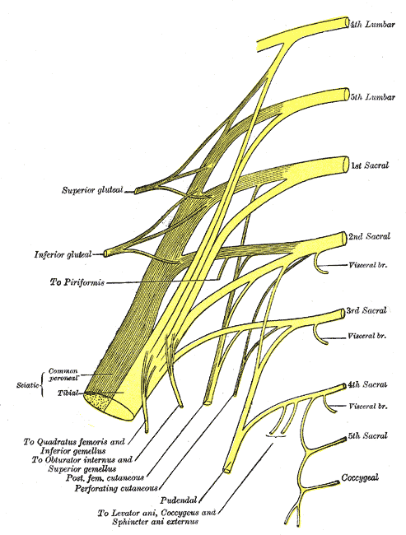
The Sacral Plexus

Slide 23
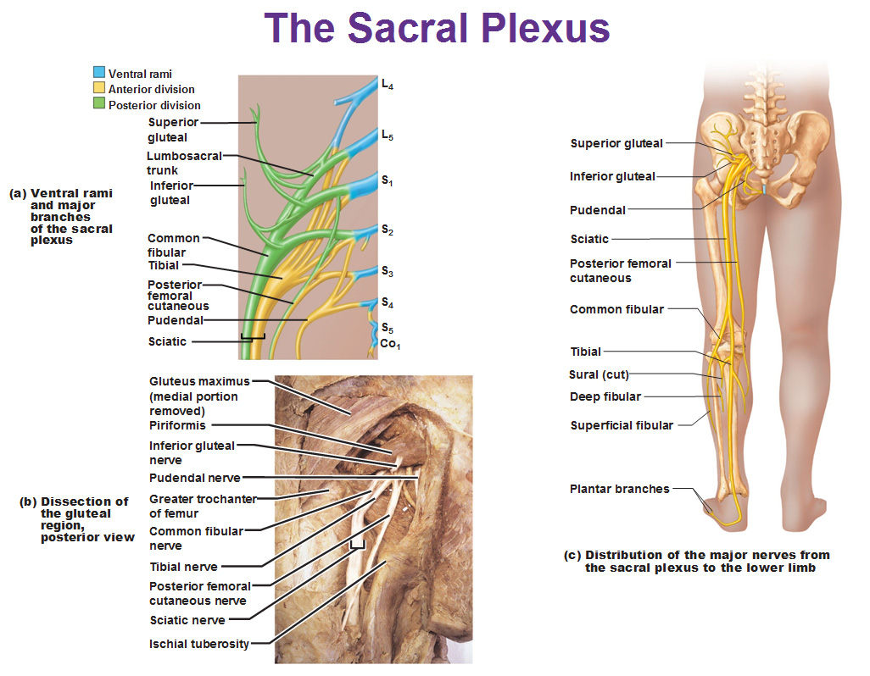

Slide 24
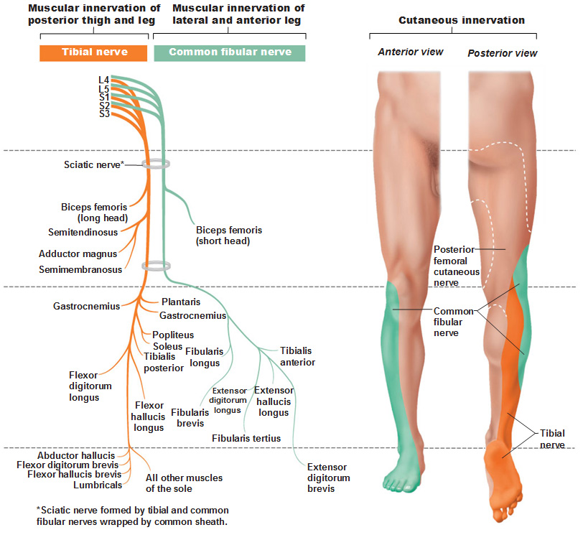

Slide 25
The Sacral Plexus
it is a nerve plexus which provides motor and sensory nerves for the posterior thigh, most of the lower leg and foot, and part of the pelvis
it is part of the lumbosacral plexus and emerges from the lumbar vertebrae and sacral vertebrae (L4-S4)
a sacral plexopathy is a disorder affecting the nerves of the sacral plexus, usually caused by trauma, nerve compression, vascular disease, or infection. Symptoms may include pain, loss of motor control, and sensory deficits

Slide 26
The Sacral Plexus
The sacral plexus is formed by:
the lumbosacral trunk
the anterior division of the first sacral nerve
portions of the anterior divisions of the second and third sacral nerves
The nerves forming the sacral plexus converge toward the lower part of the greater sciatic foramen, and unite to form a flattened band, from the anterior and posterior surfaces of which several branches arise
The band itself is continued as the sciatic nerve, which splits on the back of the thigh into the tibial nerve and common fibular nerve; these two nerves sometimes arise separately from the plexus, and in all cases their independence can be shown by dissection

Slide 27
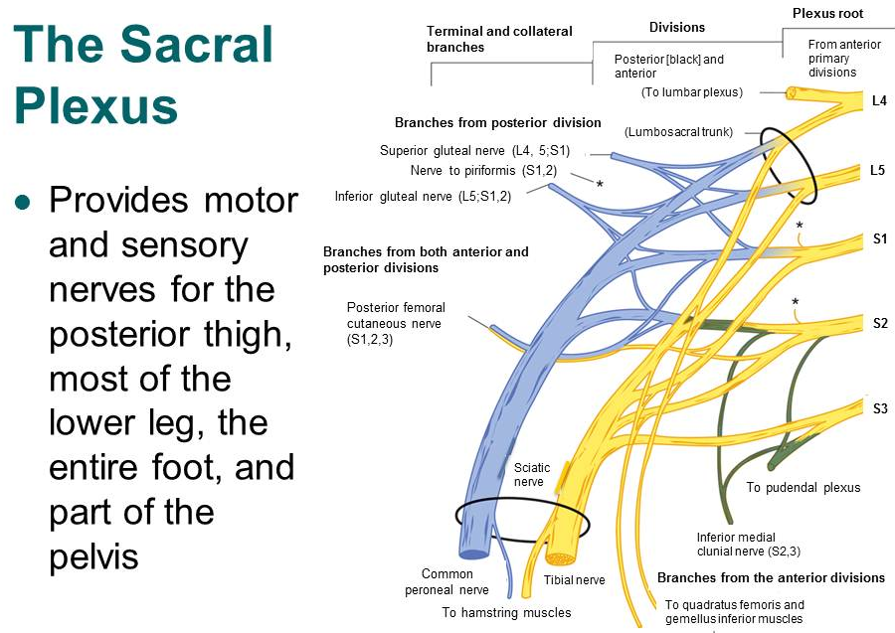

Slide 28
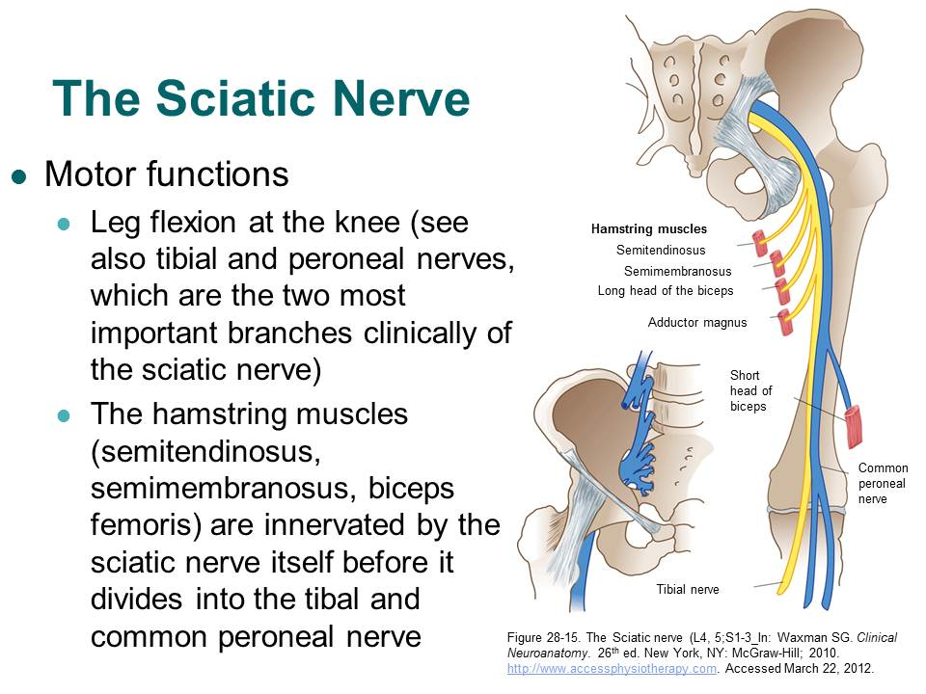

Slide 29
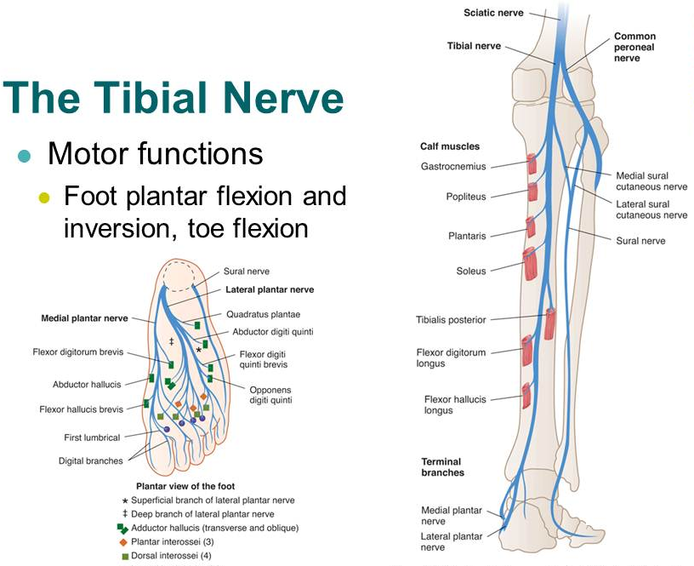

Slide 30
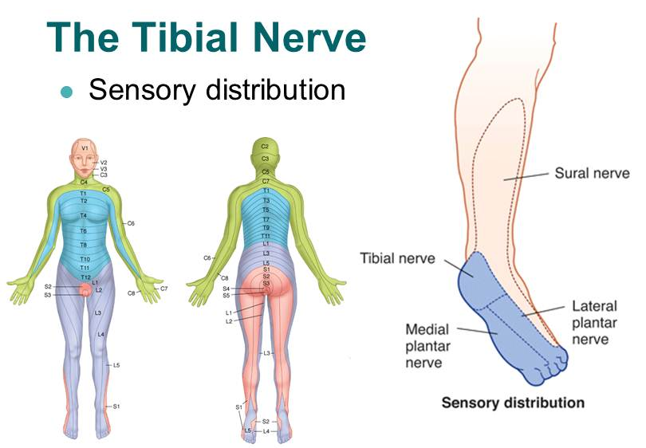

Slide 31
Tibial nerve paralysis
Symptoms:
Sensation changes on the bottom of the foot
Numbness, tingling, or other abnormal sensations
Burning sensation
Pain
Weakness of the knee or foot, difficulty with walking

Slide 32
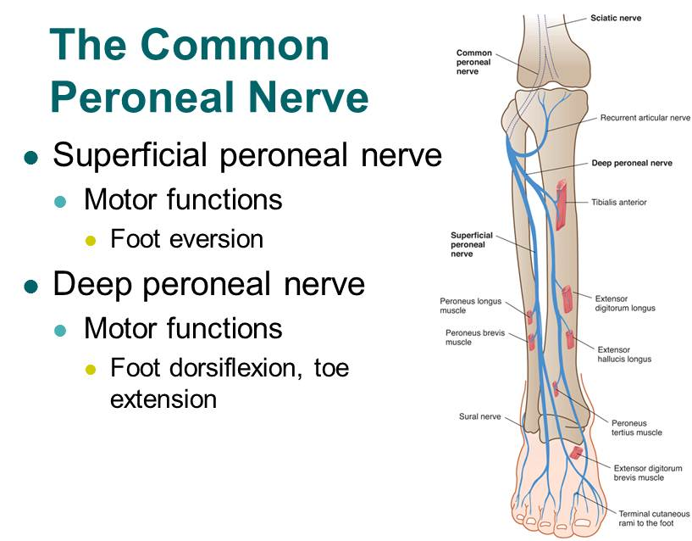

Slide 33
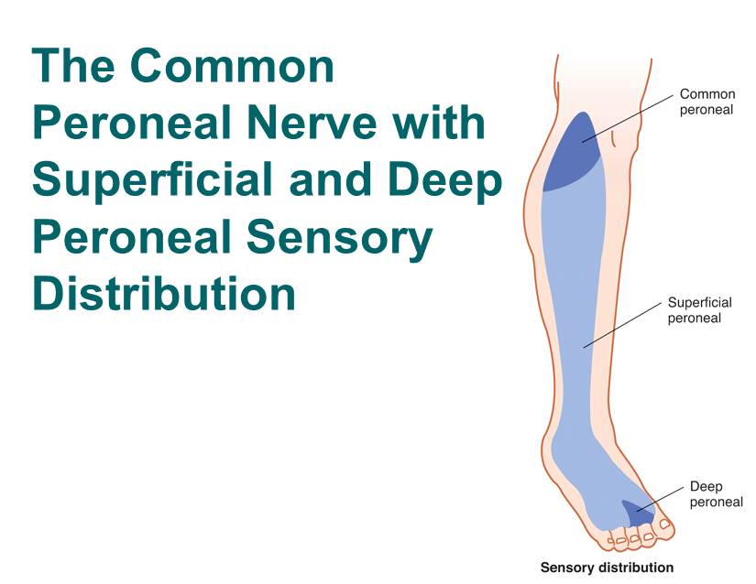

Slide 34

Peroneal nerve paralysis
Symptoms
Numbness or tingling on the anterior side or on top of the foot
Reduced sensation to touch
Weakness with lifting the foot in an upward direction and turning it outwards
Loss of function of the foot
Severe cases of peroneal nerve injury results in footdrop meaning the inability of a person to lift the foot up when ambulating
Presence of a slapping gait where the foot slaps on the ground during ambulation due to inadequate control over muscles

Slide 35
Peroneal nerve paralysis
Examination of the legs may show:
Loss of muscle control in the lower legs and feet
Atrophy of the foot or foreleg muscles
Difficulty lifting up the foot and toes and making toe-out movements

Slide 36
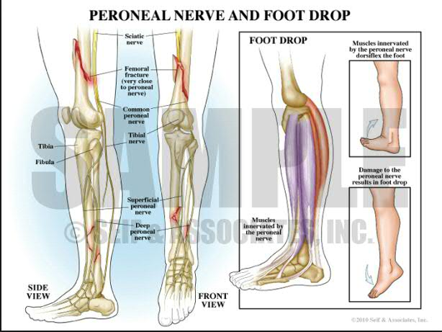

Slide 37
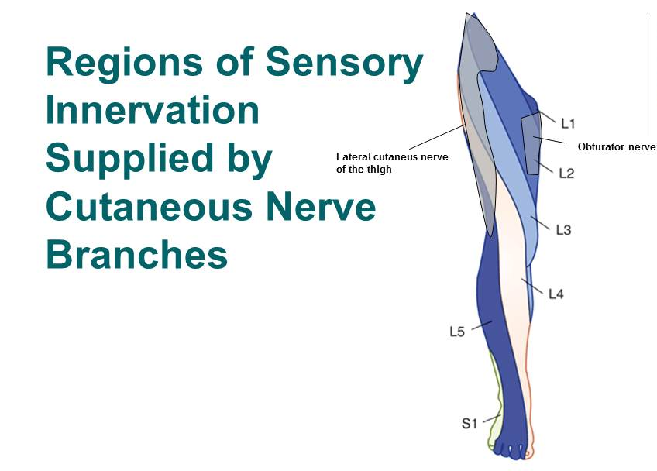

Slide 38
E-sources, literature:
https://en.wikipedia.org/wiki/Lumbar_plexus
https://en.wikipedia.org/wiki/Sacral_plexus
http://accessphysiotherapy.mhmedical.com/data/Multimedia/grandRounds/lumbar/media/lumbar_print.html
http://antranik.org/peripheral-nervous-system-spinal-nerves-and-plexuses/
http://www.gpnotebook.co.uk

Slide 39
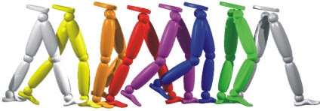
Thank you for your attention ☺

