Slide 1
Examination methods in rehabilitation, 14.12.2020
Movement patterns
Mgr. Veronika Mrkvicová
Department of Physiotherapy and Rehabilitation – MU MF

Slide 2
Topics
Evaluation of Movement Patterns
Janda's Basic Movement Patterns (6)
Hip Extension
Hip Abduction
Trunk Curl-Up
Cervical Flexion
Push-Up
Shoulder Abduction

Slide 3
Evaluation of movement patterns - introduction
Classic muscle strength testing involves providing a resistance against the characteristic movement of the tested muscle. Strength is tested along the structural lines of origin and insertion.
Functional movement is never isolated because it is produced by several muscles acting as prime movers, synergists, or stabilizers that coordinate together.
  In addition, functional strength does not require maximal activation; rather, muscle onset and timing are more important.
  Hence, classic manual muscle strength testing does not provide sufficient or reliable information about the recruitment of all the muscles involved in functional movement.

Slide 4
Evaluation of movement patterns - introduction
While manual muscle testing (MMT) is an important tool, it gives clinicians little more than a quantification of weakness.
Muscles that are tested as strong (grade 5) during MMT may actually be inhibited when performing a coordinated movement pattern.
On the other hand, muscles that are tested as weak during MMT may only be inhibited.
Janda described this as pseudoparesis (Janda 1989).
He suggested that there are 3 characteristics of pseudoparesis:
  hypotonia,
  a score of 4 out of 5 during MMT,
  delayed onset or absent EMG.

Slide 5
Evaluation of movement patterns
According to Janda, movement pattern analysis is more reliable than studying pain when assessing functional pathology because pain is very subjective.
Movement patterns are examined immediately after the postural assessment so that touch or facilitation by the clinician does not influence any motor patterns.
When observing movement patterns, the clinician should focus not only on the strength of the movement but also, and more importantly, on the sequencing and activation of all the synergists involved in the movement.
In this respect, the initiation of the movement is more important than the final phase or completion of the movement.

Slide 6
Evaluation of movement patterns
Understanding the quality and control of the movement pattern is imperative, as these characteristics may contribute to or perpetuate adverse stresses on the spine and other structures.
Although movement and activation patterns are individualized due to variability in motor control, both typical and abnormal patterns can be observed.
We focus on Janda's six basic movement patterns and their tests; these tests provide the clinician with valuable information regarding a patient's preferred movement strategy.

Slide 7
Janda's Basic Movement Patterns
Janda identified six basic movement patterns that provide overall information about a particular patient's movement quality and control:
  hip extension,
  hip abduction,
  curl-up,
  cervical flexion,
  push-up,
  shoulder abduction

Slide 8
Janda's Basic Movement Patterns
Janda offered several important guidelines to follow when assessing these movements:
The patient should disrobe as much as possible so that the clinician may visualize all parts of the body.
The clinician should provide minimal verbal cues so that the patient's preferred movement pattern may be observed.
The clinician should not touch the patient at all, as touch can be facilitatory.
The patient should perform each movement slowly over three trials.
Some patients do not need to perform all six tests at once; the clinician should decide which tests are indicated based on the postural analysis and history.

Slide 9
Janda's Basic Movement Patterns
Each test has a typical motor response as well as clinical indicators of functional pathology.
While Janda considered the firing order of these movements to be an important clinical sign, he also noted that the compensatory patterns observed during these movement tests are more valuable for diagnosis.
The beginning of the movement is the most important for information on motor control.
The clinician should observe both the left and right sides for comparison.
Muscle or limb trembling during these tests is considered a positive finding, indicating weakness or fatigue.

Slide 10

1. Hip Extension Movement Pattern Test
Movement test | Key indicators
Hip extension | Decreased gluteus maximus bulk Increased hamstring bulk Observation of spinal horizontal grooves or creases Anterior pelvic tilt Increased or asymmetrical paraspinal bulk Decreased trailing limb posture at terminal stance during gait

Slide 11
1. Hip Extension Movement Pattern Test
During the terminal stance of the normal gait cycle, the hip extends to the trailing limb posture of 10° of apparent hyperextension.
There are 5° of backward pelvic rotation that contribute to these 10° of hyperextension.
The functional significance of this trailing limb posture is that it allows the body to advance past the stable limb for forward progression.
Stiff or short hip flexors may reduce the available range in the hip and force the body to move the axis of rotation from the hip joint to a proximal point, namely the lumbar spine, in order to get the necessary forward progression.

Slide 12
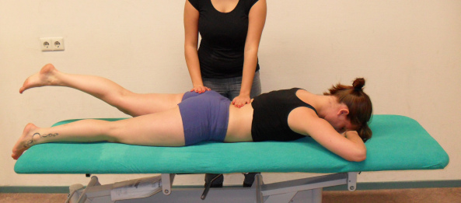
1. Hip Extension Movement Pattern Test
The hip extension movement test is analyzed clinically to determine the patient's preferred recruitment pattern.
The sequencing and degree of activation of the hamstrings, gluteus maximus, spinal extensors, and shoulder musculature are observed.
To perform this test, the patient lies prone with the arms at the sides and the feet hanging over the table to allow for neutral leg rotation
The patient's head should be placed in neutral a position. The patient is asked to lift the leg slowly toward the ceiling.
https://dl.dropboxusercontent.com/u/45755853/fewpointpronehipextension/index.html

Slide 13
1. Hip Extension Movement Pattern Test
Normally, the gluteus maximus as well as the contralateral lumbar erectors activate early in the movement.
Janda suggested that a normal pattern of activation during prone hip extension:
the gluteus maximus followed by
the hamstrings followed by
the contralateral erector spinae followed by
the ipsilateral erector spinae.

Slide 14
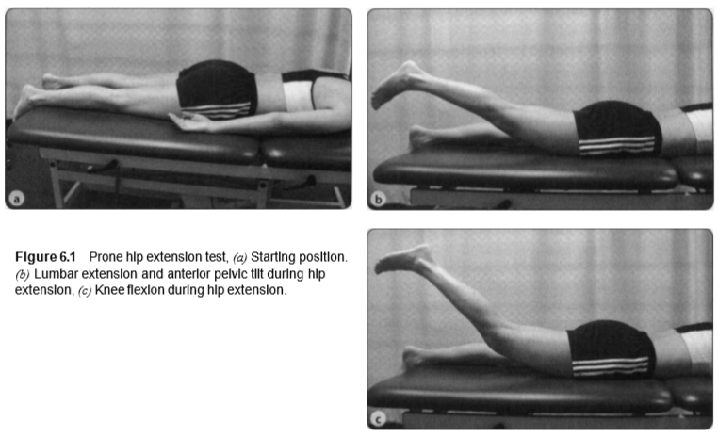
1. Hip Extension Movement Pattern Test
The most common sign of a faulty movement pattern is over activation of the hamstrings and erector spinae and delayed or absent contraction of the gluteus maximus.
The poorest pattern occurs when the thoracolumbar extensors or even the shoulder muscles initiate the movement delayed or absent the gluteus maximus contribution. Clinically, this pattern is observed as an anterior pelvic tilt with hyperlordosis in the lumbar spine as the patient lifts the leg into extension. Mechanical and compressive stresses in the lumbar spine are the result.

Slide 15
1. Hip Extension Movement Pattern Test
An inability to maintain knee extension during the test should also be noted, as this observation may suggest hamstring dominance over the gluteus maximus.
Positive findings during this test are associated with hypertrophy of the hamstrings and thoracolumbar extensors as well as atrophy of the gluteus maximus during postural analysis.

Slide 16
1. Hip Extension Movement Pattern Test
Occasionally, this faulty movement pattern overflows into the upper quarter and may be an underlying cause of neck pain. Clinicians should watch the contralateral insertion of the latissimus dorsi on the humerus for activation during hip extension. Such activation suggests poor spinal stabilization that is compensated for by a reverse action of the latissimus via the thoracolumbar fascia.
Increased activity of the upper trapezius during the hip extension test is a sign of poor prognosis.

Slide 17

2. Hip Abduction Movement Pattern Test
Movement test | Key indicators
Hip abduction | Lateral shift or rotation of pelvis Asymmetrical height of iliac crest Observation of adductor notch Adducted hips or varus position Increased lateral IT groove Positive result on single-leg stance test Trendelenburg sign or increased lateral pelvic shift during loading response during gait
Notes:
http://www.clinicalexams.co.uk/coxa-vara.asp

Slide 18
2. Hip Abduction Movement Pattern Test
During the loading response phase of the gait cycle, the lower fibers of the gluteus maximus, hamstrings, and adductor magnus act eccentrically to counteract the hip flexion torque; thus, the hip joint is stabilized with minimal trunk flexion.
In addition, the TFL, posterior gluteus medius and minimus, and upper fibers of the gluteus maximus contract eccentrically to stabilize the pelvis in the frontal plane.
The result is that during midstance of the gait cycle, the pelvis is stabilized by the hip abductor group counteracting a strong varus (adductor) torque, thus preventing a hip drop or lateral shift of the pelvis.

Slide 19
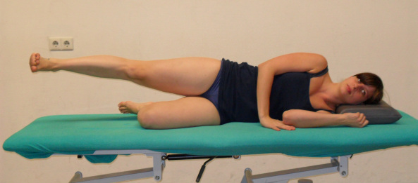
2. Hip Abduction Movement Pattern Test
The hip abduction test provides direct information about the quality of the lateral muscular pelvic brace and indirect information about the stabilization of the pelvis in the frontal plane during gait.
This test is performed with the patient lying on her side with her bottom leg in a flexed position. The top leg is placed in a neutral position, in line with the trunk.
The patient is instructed to lift the leg toward the ceiling
https://dl.dropboxusercontent.com/u/45755853/fewpointhipabduction/index.html

Slide 20
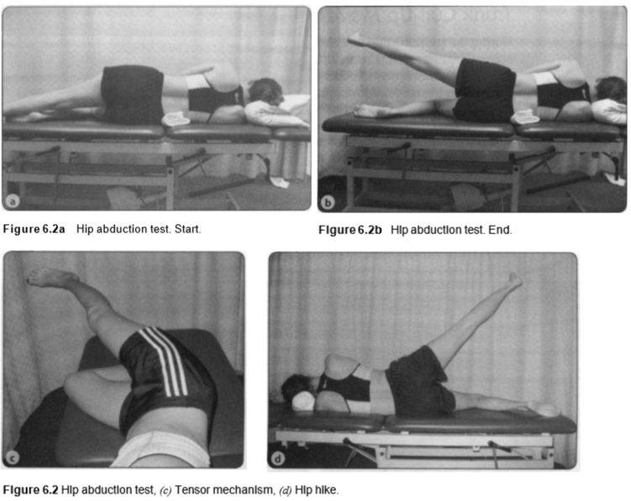
2. Hip Abduction Movement Pattern Test
The prime movers for hip abduction are the gluteus medius, gluteus minimus, and TFL, while the quadratus lumborum and abdominal muscles stabilize the pelvis during limb movement.
The normal pattern of hip abduction is abduction to about 20° without any hip flexion or internal or external rotation and with a stable trunk and pelvis – in other words, abduction without any hip elevation or trunk rotation.

Slide 21
2. Hip Abduction Movement Pattern Test
Typically, the first sign of an altered movement pattern is the tensor mechanism of hip abduction facilitated by a tight TFL. Instead of pure hip abduction in the plane of the trunk, the movement is combined with hip flexion due to the TFL's dual action as a hip flexor and abductor.
Positive findings during the hip abduction test are associated with tightness of the IT band and atrophy of the gluteal muscles on the ipsilateral side during postural analysis and a failed single-limb stance test.

Slide 22
2. Hip Abduction Movement Pattern Test
The poorest movement pattern is observed when the hip abduction is initiated by contraction of the quadratus lumborum before 20° of hip abduction, resulting in a lateral pelvic tilt or hip hike. In this case, the role of the quadratus lumborum changes from pelvic stabilizer to prime mover. Alterations observed in hip abduction can cause excessive stresses to the lumbosacral segments and hip during gait.

Slide 23

3. Trunk Curl-Up Movement Pattern Test
Movement test | Key indicators
Trunk curl-up | Decreased abdominal tone Lateral grooves in abdominal wall Impaired respiration Pseudohernia

Slide 24
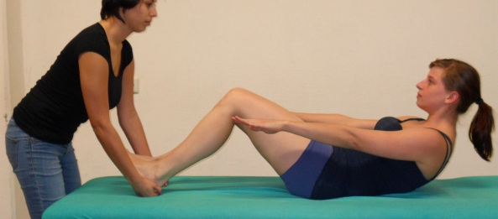
3. Trunk Curl-Up Movement Pattern Test
During the trunk curl-up, the abdominal muscles contract and shorten, thus flexing the spine. The upper trunk rounds, the lower back flattens, and the pelvis tilts posteriorly. The upward movement is completed when the scapulae clear the table.
During this phase, the heels should remain in contact with the table.
After the curl-up phase is completed, the hip flexors become dominant in further curling the spine into a sit-up position.
https://dl.dropboxusercontent.com/u/45755853/fewpointtrunkcurlup/index.html

Slide 25
3. Trunk Curl-Up Movement Pattern Test
The trunk curl-up test estimates the interplay between the iliopsoas and the abdominal muscles. With the patient supine, the clinician analyzes the patient's preferred way of curling up.
If the curl-up is performed with adequate abdominal contraction,
a flexion or kyphosis of the upper trunk is observed.
However, if the movement is performed primarily with the hip flexors, curling of the upper trunk is minimal and an associated anterior tilt of the pelvis may be observed.

Slide 26
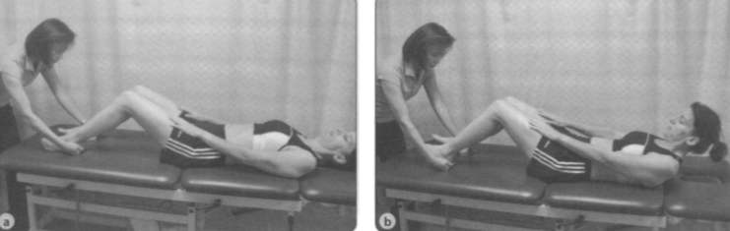
3. Trunk Curl-Up Movement Pattern Test
The patient can also perform the curl-up test with the examiner placing his hands under the patient's heels to detect early loss of pressure. If a loss of heel pressure is detected before the end of the curl-up, the test is positive, indicating the dominance of the hip flexors over the abdominal muscles.

Slide 27
3. Trunk Curl-Up Movement Pattern Test
This test has caused confusion and misinterpretation by some individuals describing a Janda crunch or Janda sit-up in which the patient performs the trunk curl while isometrically contracting the hamstrings. Janda suggested placing the hands under the patient's heels to detect heel elevation rather than provide resistance to knee flexion. Therefore, there is no such exercise as the Janda crunch, as some individuals have advocated.

Slide 28

4. Cervical Flexion Movement Pattern Test
Movement test | Key indicators
Cervical flexion | Prominence of sternocleidomastoid at mid- to distal insertion Forward head posture Increased angle (>90°) between chin and neck Impaired respiration

Slide 29
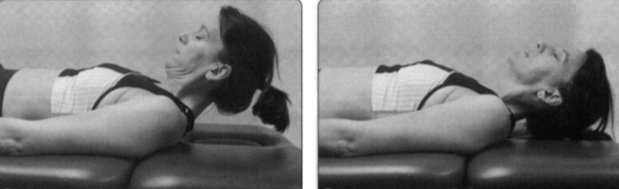
4. Cervical Flexion Movement Pattern Test
The primary deep flexors of the head and cervical spine are the longus capitis, longus colli, and rectus capitis anterior. Cervical spine and head flexion are also assisted by the SCM and anterior scalenes.
A proper movement pattern would entail cervicocranial flexion throughout the test.
The cervical flexion test estimates the interplay between the deep cervical flexors and the synergists, namely the SCM and anterior scalenes.
https://www.youtube.com/watch?v=bi6Ug91A2BI

Slide 30
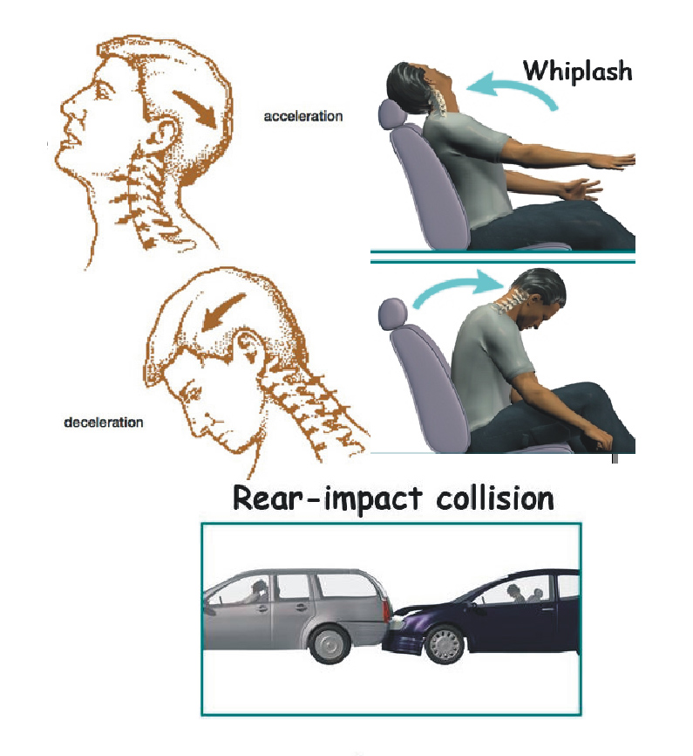
4. Cervical Flexion Movement Pattern Test
Surface EMG recordings of the SCM and direct recording of the deep neck flexor activity have demonstrated a disturbance in synergistic movement in patients with idiopathic neck pain and patients with neck pain after whiplash injury. Impairments in the strength and endurance needed by the deep neck flexors for segmental control and support are compensated for by increased activity in the superficial SCM and anterior scalene. This finding is particularly true with patients experiencing recurrent headaches.

Slide 31
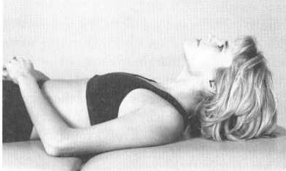
4. Cervical Flexion Movement Pattern Test
This test is positive when the chin or jaw juts forward at the initiation of the movement.
A jutting chin or jaw suggests a dominance of the SCM and scalenes over the weaker deep cervical flexors.
A forward head posture indicates weak or inhibited deep cervical flexors.

Slide 32
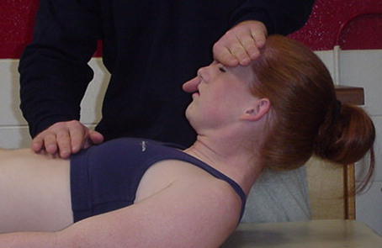
4. Cervical Flexion Movement Pattern Test
If the pattern is unclear, the clinician places 1 or 2 fingers against the patient's forehead to apply a slight resistance to the movement. This allows the clinician to detect any anterior translation of the cervical segments, which would confirm inadequate stabilization by the deep cervical flexors.

Slide 33
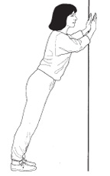
5. Push-Up Movement Pattern Test
Movement test | Key indicators
Push-up | Forward head with protracted shoulders Increased internal rotation of arms Nipples that face out superiorly and laterally (in males) Scapula winging, tipping

Slide 34
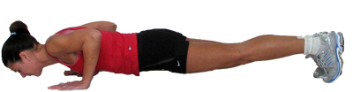
5. Push-Up Movement Pattern Test
The push-up test examines the quality of dynamic scapular stabilization.
When the patient performs the test properly, the scapula abducts and upwardly rotates as the trunk is lifted upward during the push-up.
There is no associated scapular elevation.

Slide 35
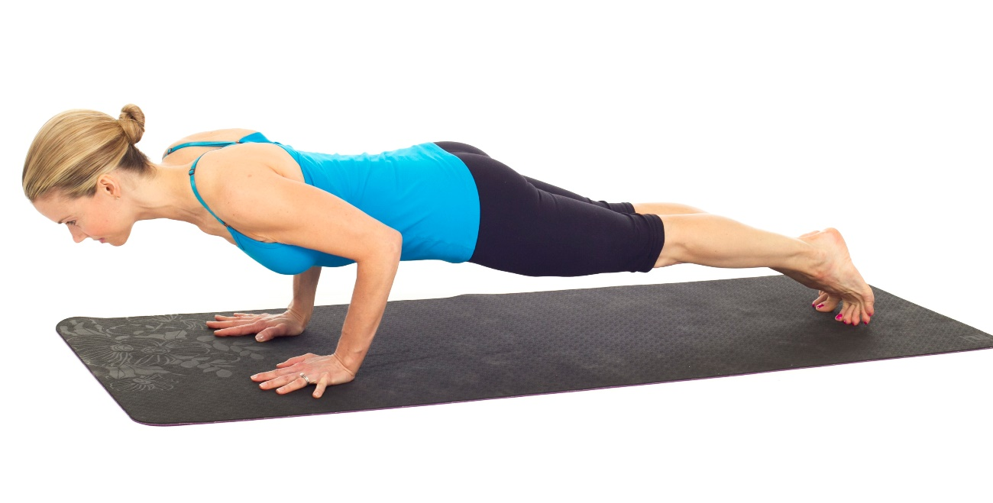
5. Push-Up Movement Pattern Test
The push-up test is performed with the patient lying in a prone position with the legs extended in preparation for performing the push-up movement from the feet. The clinician observes the quality of scapular and torso movements and notes any deviations from the ideal push-up movement.

Slide 36

5. Push-Up Movement Pattern Test
The force-coupling action of the serratus anterior and trapezius is imperative to provide the proper scapular movement, with the scapular synergists contributing to its stability.
Weakness of the serratus anterior becomes evident when the patient displays winging of the scapula or excessive scapular adduction or is unable to complete the range of scapular motion in the direction of abduction.
Dominance of the upper trapezius and levator scapulae is demonstrated by excessive shoulder elevation or shrug.

Slide 37
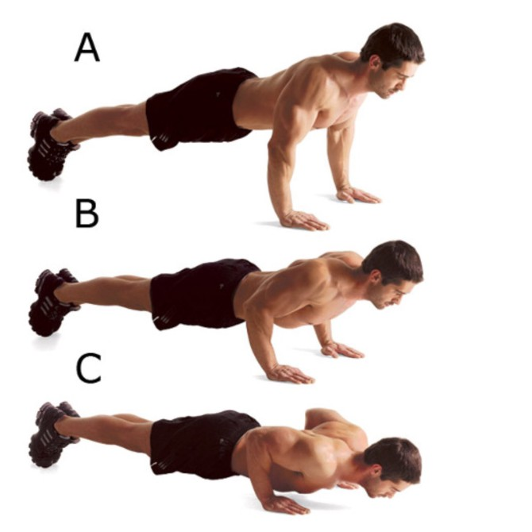
5. Push-Up Movement Pattern Test
The lowering of the body from the maximum push-up position is more sensitive in detecting excessive scapular rotation, elevation, tipping, winging, adduction, or abduction because of the eccentric loading on the muscles.
The type of impaired scapular motion detected depends on the dominance of the associated synergists involved in the push-up movement pattern.

Slide 38
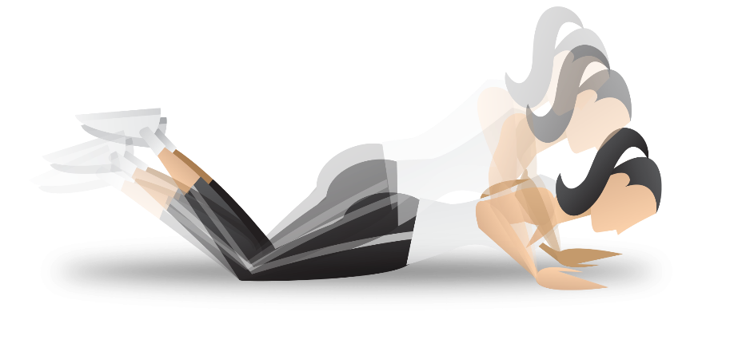
5. Push-Up Movement Pattern Test
This test is quite challenging, as it requires adequate strength and endurance of the arm and torso muscles to maintain the erect posture of the body.
If the patient is unable to perform this test with straight legs, she may perform the test with bent legs.
Scapular winging, gothic shoulders, levator notch, and excessive bulk of the pectoral muscles observed during postural analysis indicate that the clinician should include the push-up test to confirm the muscular imbalances associated with the UCS described by Janda.

Slide 39
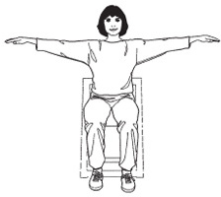
6. Shoulder Abduction Movement Pattern Test
Movement test | Key indicators
Shoulder abduction | Forward head with protracted shoulders Gothic shoulder Levator notch Scapular winging, tipping

Slide 40
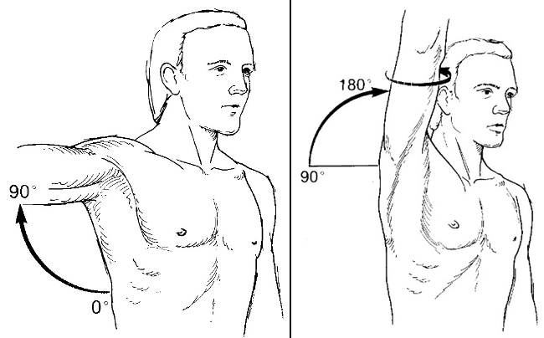
6. Shoulder Abduction Movement Pattern Test
The shoulder abduction test examines the coordination of the shoulder girdle muscles, namely the deltoids, rotator cuff muscles, upper trapezius, and levator scapulae.
Shoulder abduction in the frontal plane consists of synergistic abduction, scapular upward rotation, and scapular elevation.

Slide 41
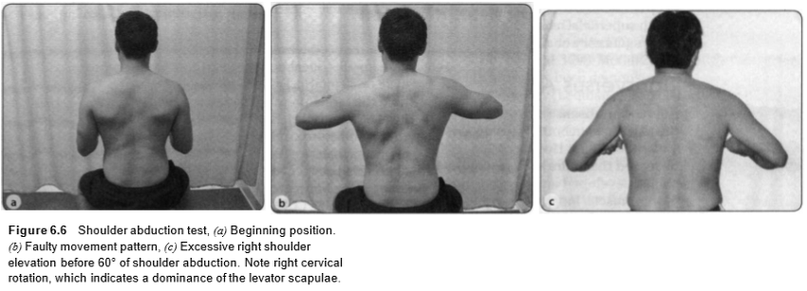
6. Shoulder Abduction Movement Pattern Test
The shoulder abduction test is performed with the patient in a seated position with the arms at the sides and the elbows flexed in order to control undesired rotation.
Shoulder abduction comprises three major actions: abduction in the glenohumeral joint, upward rotation of the scapula, and elevation of the scapula.

Slide 42
6. Shoulder Abduction Movement Pattern Test
Activation of the contralateral upper trapezius is normal for stabilization. The decisive point of this movement pattern is at 60° of shoulder abduction, where there is an associated scapular elevation. Any noticeable elevation of the shoulder girdle before 60° of shoulder abduction is positive for incoordination and impairment of the force couples among the muscles involved in shoulder abduction.
Repeated or sustained shoulder girdle arm movements may overstress the spinal structures.

Slide 43
6. Shoulder Abduction Movement Pattern Test
Possible causes of excessive scapular elevation during shoulder abduction are an overactive upper trapezius and levator scapulae.
Initiation of shoulder abduction via shoulder girdle elevation, as is seen in patients with frozen shoulder syndrome, is also considered pathological.
The worst scenario observed is contralateral lateral side bending of the trunk to initiate shoulder abduction. This movement pattern indicates severe weakness of the rotator cuff or deltoid and shortness or overactivity of the contralateral quadratus lumborum.
Hypertrophy of the upper trapezius and atrophy of the deltoid and posterior rotator cuff are associated with positive findings.
In addition, the shoulder abduction test commonly is associated with the observation of a gothic shoulder or levator notch during postural analysis.

Slide 44
e-sources, literature
Phil Page: Assessment and Treatment of Muscle Imbalance

Slide 45

Thank you for your attention ☺

