Slide 1
Examination methods in rehabilitation, 7.12.2020
Muscle imbalance
Mgr. Veronika Mrkvicová
Department of Physiotherapy and Rehabilitation – MF MU

Slide 2
Content
Janda Philosophy
Structure vs. Function
The Sensorimotor System
Tonic and Phasic Muscle Systems
What is Muscle Imbalance
Janda Syndromes
Evaluation
Summary

Slide 3
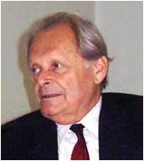
Chronic pain syndromes – Janda approach
About Janda
Vladimir Janda was born in 1928. At the age of 15, he contracted
polio. He was paralyzed as a quadriplegic and unable to walk for 2
years. He eventually recovered walking function, but developed
post-polio syndrome and was forced to use a walker until the end of
his life in 2002.
As a physician, he focused on post-polio patients early on. One of his early influences was Sister Kinney in 1947, who introduced the treatment of polio in Czechoslovakia. He served as an interpreter for Sister Kinney as a first year medical student, and decided to pursue an interest in physiotherapy after medical school. He received the “Kinney Physiotherapist” certificate after graduation from medical school. He was one of the first physicians to combine therapy and medicine in a ‘hands-on’ approach, becoming one of the earliest to practice physical medicine and rehabilitation.
He became more interested in pain syndromes of the locomotor system. His first book in 1949 at the age of 21 was on muscle testing and function, which was the first of its kind in Czech. He continued as a prolific researcher and writer; before his death, he published over 16 books and over 200 papers on muscle function.

Slide 4
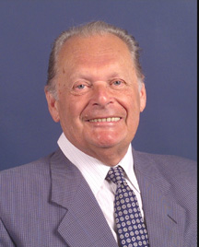
Chronic pain syndromes – Janda approach
At the age of 24, he was working in a rehabilitation center for post-polio patients. He was interested in evaluating the claims from muscle testing textbooks at the time. Using EMG, he began studying the muscle activity of the hip joint in physiotherapist students. He found muscles that weren’t supposed to be activated actually were, noting the accessory role of muscles outside of their primary movements. Specifically, he found subjects without activity in the gluteus maximus during hip extension movements used an increased pelvic tilt to accomplish the extension. This led to his lifelong passion to study movements, rather than individual muscles as was common at the time of the polio era. He recognized the importance of testing muscle function rather than strength. This was the beginning of thinking globally rather than locally in terms of muscle function.

Slide 5
Chronic pain syndromes – Janda approach
In the 1960s, Freeman and Wyke published several papers on the importance of afferent input and mechanoreceptors. They described the use of wobble boards in the treatment of chronic ankle instability. Janda noted a connection between chronic ankle instability and chronic low back pain: proprioception. This led to Janda’s development of “Sensorimotor Training”, a progressive exercise program using simple exercises and unstable surfaces. He rarely recommended strengthening exercises, instead focusing on balance and function. This was in contrast to the traditional rehabilitation approach in the 60’s and 70’s emphasizing strength training.
Janda completed his thesis in 1964 on patients with sacroiliac dysfunction, finding weakness and inhibition of the gluteus maximus, even in the absence of pain. He recognized that certain other muscles were prone to weakness. Janda subsequently defined movement patterns to estimate the quality of movement. He discovered that muscle imbalance was systematic, predictable, and involved the entire body.
In 1979, he defined his “crossed syndromes”: Upper crossed, lower crossed, and layer syndrome. He subsequently noted that his crossed syndromes were his only ‘discovery’; he always gave credit to others influencing his approach.

Slide 6
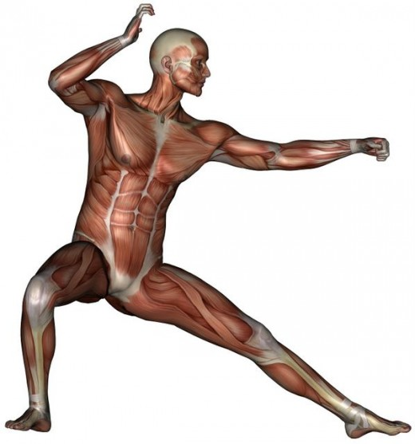
Janda Philosophy
Janda’s approach to the evaluation and management of chronic musculoskeletal pain focuses on the importance of the central nervous system in mediating chronic pain through neuromuscular imbalance.

Slide 7
Structure vs. Function
In musculoskeletal medicine, there are two main schools of thought, that is, a structural or functional approach.
In the structural approach, the pathology of specific static structures is emphasized; this is the typical orthopaedic approach that emphasizes diagnosis based on localized evaluation and special tests (X-Ray, MRI, CT Scan, etc).
On the other hand, the functional approach recognizes the function of all processes and systems within the body, rather than focusing on a single site of pathology.
While the structural approach is necessary and valuable for acute injury or exacerbation, the functional approach is preferable when addressing chronic musculoskeletal pain.

Slide 8
The Sensorimotor System
In chronic pain, special diagnostic tests of localized areas (for example, low back radiographs) are often normal, although the patient complains of pain.
The site of pain is often not the cause of the pain. Recent evidence by supports the fact that chronic pain is centrally-mediated. Similarly, research on the efficacy of different modes of exercise management of chronic pain has shown a central effect of exercise in decreasing chronic low back pain.
This research supports the basis of Janda’s approach: the interdependence of the musculoskeletal and central nervous system. Janda states that these two anatomical systems cannot be separated functionally. Therefore, the term “sensorimotor” system is used to define the functional system of human movement. In addition, changes within one part of the system will be reflected by compensations or adaptations elsewhere within the system because of the body’s attempt at homeostasis.

Slide 9
The Sensorimotor System
The muscular system often reflects the status of the sensorimotor system, as it receives information from both the musculoskeletal and central nervous systems. Changes in tone within the muscle are the first responses to nociception by the sensorimotor system.
For example, the presence of knee effusion causes reflex inhibition of the vastus medialis. The multifidus has been shown to atrophy in patients with chronic low back pain, and muscles demonstrate increased latency after ankle sprains and ACL tears.

Slide 10
The Sensorimotor System
Because of the involvement of the CNS in muscle imbalance and pain, Janda emphasizes the importance of the afferent proprioceptive system.
A reflex loop from the joint capsular mechanoreceptors and the muscles surrounding the joint is responsible for reflexive joint stabilization.
In chronic instability, deafferentation (the loss of proper afferent information from a joint) is often responsible for poor joint stabilization.

Slide 11
Tonic and Phasic Muscle Systems
Functionally, muscles can be classified as “tonic” or “phasic”.
The tonic system consists of the “flexors”, and is phylogenetically older and dominant. These muscles are involved in repetitive or rhythmic activity (Umphred, 2001), and are activated in flexor synergies.
The phasic system consists of the “extensors”, and emerges shortly after birth. These muscles work eccentrically against the force of gravity and emerge in extensor synergies (Umphred, 2001).

Slide 12
Tonic and Phasic Muscle Systems
The tonic system muscles are prone to tightness or shortness, and the phasic system muscles are prone to weakness or inhibition
Based on his clinical observations of orthopedic and neurological patients, Janda found that this response is based on the neurological response of nociception in the muscular system.
For example, following structural lesions in the central nervous systems (such cerebral palsy or cerebrovascular accident), the tonic flexor muscles tend to be spastic and the phasic extensor muscles tend to be flaccid. Therefore, patterns of muscle imbalance may be due to CNS influence, rather than structural changes within the muscle itself.

Slide 13
Tonic (postural) muscles
  muscles with a predominance of tonic function (= muscles with a tendency to shorten and hypertrophy) – ensure upright posture (because they have permanent working resting tension)
  contain mostly red muscle fibers, rich in myoglobin
  are evolutionarily older, have a low threshold of irritation, characterized by a slower process of contraction, longer latency and greater resistance to stress (slower fatigue)
  its function often replace muscle activity of weakened phasic muscles (they discard them of the muscle interplay and may cause muscle imbalances)
Notes:
http://www.muscleimbalancesyndromes.com/what-is-muscle-imbalance/
Human movement and function requires a balance of muscle length and strength between opposing muscles surrounding a joint. Normal amounts of opposing force between muscles are necessary to keep the bones centered in the joint during motion; this would be considered ‘muscle balance’. On the other hand, ‘muscle imbalance’ occurs when opposing muscles provide different directions of tension due to tightness and/or weakness. When a muscle it too tight, the joint tends to move in that direction and is limited in the opposite direction since this is typically ‘the path of least resistance.’ For example, the quadriceps and hamstrings of the knee joint perform opposite motions; an imbalance between the two could put undue stress on the joint. A tight hamstring would not allow the joint to glide normally or fully extend, which could put extra stress on the quadriceps muscle and patella (knee cap).
Muscle imbalances can be characterized by either side-to-side (right versus left) or front-to-back (agonist versus antagonist) differences in muscle length or strength. Most musculoskeletal pain syndromes are caused by front-to-back differences, or imbalances of muscles surrounding a joint, rather than side-to-side differences.
There are also 2 recognized causes of muscle imbalance. The first is a biomechanical cause from repeated movements in one direction or sustained postures. The biomechanical causes of muscle imblance have been popularized by Kendall and Sahrmann. The second cause is a neuromuscular imbalance due to the predisposition of certain muscle groups to be either tight or weak. The neuromuscular approach was popularized by Janda, and is based on movement patterns that evolve from birth. Dr. Janda noted that the ‘tonic’ group of muscles are prone to tightness and the ‘phasic’ group is prone to weakness:

Slide 14
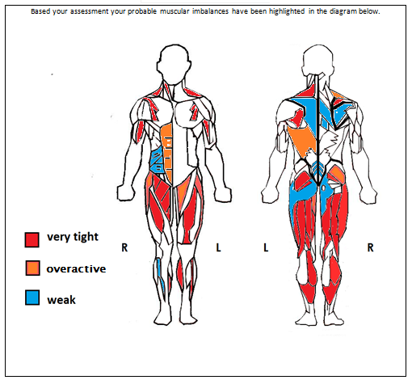
Posturální svaly
PHASIC AND POSTURAL MUSCLES
MUSCLES WITH A TENDENCY TO SHORTEN
OVERLOADED MUSCLES
MUSCLES WITH A TENDENCY TO WEAKEN
Notes:
http://liveep.com.au/wp-content/uploads/2012/07/eg.png

Slide 15
Tonic (postural) muscles - LL
  Soleus
  Tibialis Posterior
  Hip Adductors
  Hamstrings
  Rectus Femoris
  Iliopsoas
  Tensor Fascia Lata
  Piriformis
Notes:
http://is.muni.cz/do/1451/e-learning/kineziologie/elportal/pages/funkce_svalu.html

Slide 16
Postural(tonic) muscles - UL
  Pectoralis Major & Minor
  Upper Trapezius
  Levator Scapulae
  flexors generaly (m. biceps brachii, flexors of a wrist and fingers)

Slide 17
Postural (tonic) muscles – trunk, head, neck
  Erector-Spinae (thoraco-lumbar)
  Suboccipital muscles
  Quadratus Lumborum
  Latissumus Dorsi
  Scalenes
  Sternocleidomastoid
  masticatory muscles
  (m. masseter,
  m. temporalis)

Slide 18
Phasic muscles
Peroneus Longus, BrevisTibialis Anterior
Vastus Medialis, Lateralis
Gluteus Maximus, Medius, Minimus
Rectus Abdominus
Serratus Anterior
Rhomboids
Lower Trapezius
Deep neck flexors
Upper limb extensors

Slide 19
Tonic and Phasic Muscle Systems
It’s important to note that this classification is not rigid, in that some muscles may exhibit both tonic and phasic characteristics.
It should also be noted that in addition to neurological predisposition to tightness or weakness, structural changes within the muscle also contribute to muscle imbalance.
However, in chronic pain that is centralized within the CNS, patterns of muscle imbalance are often a result of neurological influence rather than structural changes.

Slide 20
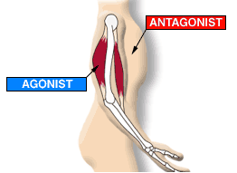
What is Muscle Imbalance
Human movement and function requires a balance of muscle length and strength between opposing muscles surrounding a joint.
Normal amounts of opposing force between muscles are necessary to keep the bones centered in the joint during motion; this would
be considered ‘muscle balance’.

Slide 21
What is Muscle Imbalance
On the other hand, ‘muscle imbalance’ occurs when opposing muscles provide different directions of tension due to tightness and/or weakness. When a muscle is too tight, the joint tends to move in that direction and is limited in the opposite direction since this is typically ‘the path of least resistance.’
For example, the quadriceps and hamstrings of the knee joint perform opposite motions; an imbalance between the two could put undue stress on the joint. A tight hamstring would not allow the joint to glide normally or fully extend, which could put extra stress on the quadriceps muscle and patella (knee cap).

Slide 22
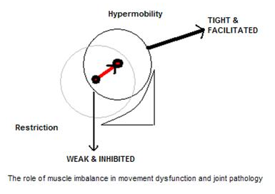
What is Muscle Imbalance
Muscle imbalances can be characterized by either side-to-side (right versus left) or front-to-back (agonist versus antagonist) differences in muscle length or strength.
Most musculoskeletal pain syndromes are caused by front-to-back differences, or imbalances of muscles surrounding
a joint, rather than
side-to-side differences.

Slide 23
What is Muscle Imbalance
There are also 2 recognized causes of muscle imbalance.
The first is a biomechanical cause from repeated movements in one direction or sustained postures. The biomechanical causes of muscle imbalance have been popularized by Kendall and Sahrmann.
The second cause is a neuromuscular imbalance due to the predisposition of certain muscle groups to be either tight or weak. The neuromuscular approach was popularized by Janda, and is based on movement patterns that evolve from birth. Dr. Janda noted that the ‘tonic’ group of muscles are prone to tightness and the ‘phasic’ group is prone to weakness.

Slide 24
What is Muscle Imbalance
Muscle imbalance is the altered relationship between the muscles that are prone to inhibition or weakness and the muscles that are prone to tightness or shortness.
Imbalance is not an isolated response of an individual muscle but rather a systemic reaction of a whole series of striated muscles.
Janda proposed that the development of tightness or weakness does not occur randomly but occurs in typical patterns.
Muscle length tests, end-feel assessment, and muscle palpation are integral to the functional evaluation of musculoskeletal pain syndromes.

Slide 25
What is Muscle Imbalance
When muscles become imbalanced, they can cause joint pain.
Dr. Janda identified 3 specific muscle imbalance syndromes associated with chronic musculoskeletal pain:
Upper Crossed Syndrome
Lower Crossed Syndrome
Layer Syndrome

Slide 26
Janda Syndromes
Over time, these imbalances will spread throughout the muscular system in a predictable manner. Janda has classified these patterns as “Upper Crossed Syndrome” (UCS), “Lower Crossed Syndrome” (LCS), and “Layer Syndrome” (LS) (Janda, 1987, 1988). [UCS is also known as “cervical crossed syndrome”; LCS is also known as “pelvic crossed syndrome; and LS is also known as “stratification syndrome.”]
Crossed syndromes are characterized by alternating sides of inhibition and facilitation in the upper quarter and lower quarter.
Layer syndrome, essentially a combination of UCS and LCS is characterized by alternating patterns of tightness and weakness, indicating long-standing muscle imbalance pathology.

Slide 27
Janda Syndromes
Upper crossed syndrome is characterized by facilitation of the upper trapezius, levator, sternocleidomastoid, and pectoralis muscles, as well as inhibition of the deep cervical flexors, lower trapezius, and serratus anterior.
Lower crossed syndrome is characterized by facilitation of the thoraco-lumbar extensors, rectus femoris, and iliopsoas, as well as inhibition of the abdominals (particularly transversus abdominus) and the gluteal muscles.

Slide 28
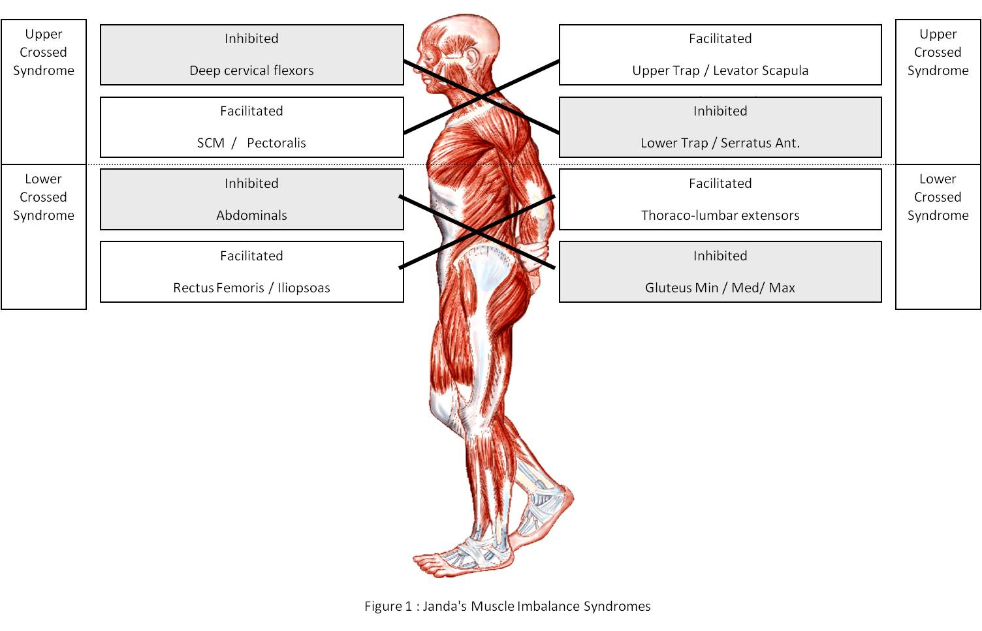

Slide 29
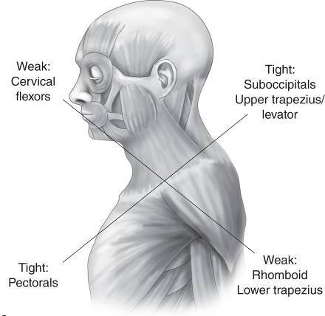
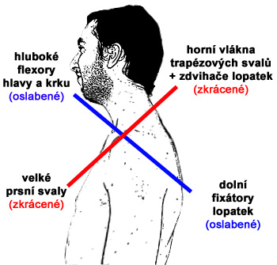
UPPER CROSSED SYNDROME (UCS)
(proximal or shoulder girdle crossed syndrome)
tightness of the upper trapezius and levator scapula on the dorsal side crosses with tightness of the pectoralis major and minor
weakness of the deep cervical flexors ventrally crosses with weakness of the middle and lower trapezius.
http://www.jandaapproach.com/

Slide 30
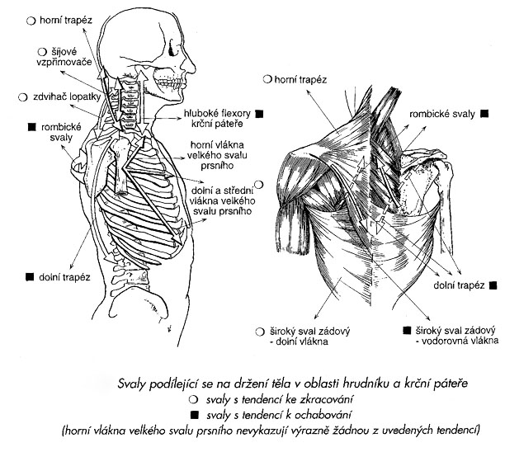

Slide 31
UPPER CROSSED SYNDROME (UCS)
This pattern of imbalance creates joint dysfunction, particularly at the atlanto-occipital joint, C4-C5 segment, cervicothoracic joint, glenohumeral joint, and T4-T5 segment.
Janda noted that these focal areas of stress within the spine correspond to transitional zones in which neighboring vertebrae change in morphology.
Specific postural changes are seen in UCS, including forward head posture, increased cervical lordosis and thoracic kyphosis, elevated and protracted shoulders, and rotation or abduction and winging of the scapulae.
These postural changes decrease glenohumeral stability as the glenoid fossa becomes more vertical due to serratus anterior weakness leading to abduction, rotation, and winging of the scapulae. This loss of stability requires the levator scapula and upper trapezius to increase activation to maintain glenohumeral centration.

Slide 32
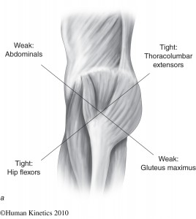
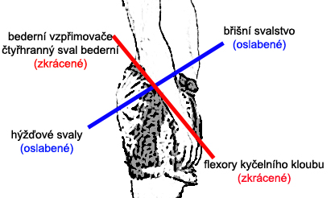
LOWER CROSSED SYNDROME (LCS)
(distal or pelvic crossed syndrom)
tightness of the thoracolumbar extensors on the dorsal side crosses with tightness of the iliopsoas and rectus femoris
weakness of the deep abdominal muscles ventrally crosses with weakness of the gluteus maximus and medius.
Notes:
http://is.muni.cz/do/rect/el/estud/fsps/js12/ztv/web/pages/03-funkcni-poruchy-text.html
http://www.florbalovytrener.cz/cviceni-brisnich-svalu/

Slide 33
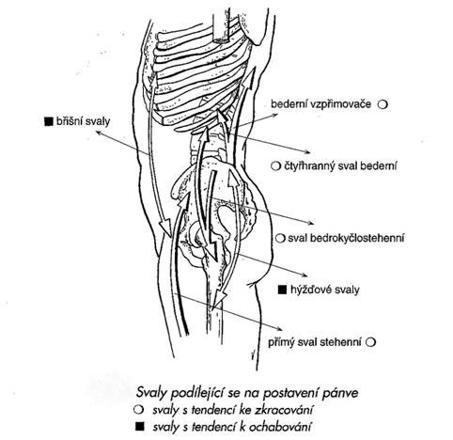

Slide 34
LOWER CROSSED SYNDROME (LCS)
This pattern of imbalance creates joint dysfunction, particularly at the L4-L5 and L5-S1 segments, SI joint, and hip joint.
Specific postural changes seen in LCS include anterior pelvic tilt, increased lumbar lordosis, lateral lumbar shift, lateral leg rotation, and knee hyperextension.
If the lordosis is deep and short, then imbalance is predominantly in the pelvic muscles; if the lordosis is shallow and extends into the thoracic area, then imbalance predominates in the trunk muscles.

Slide 35
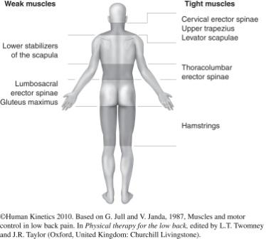
LAYER SYNDROM (LS)
(“Stratification Syndrome”)
a combination of both upper and lower crossed syndromes.
There is marked impairment of motor regulation that has increased over
a period of time.
Patients with layer syndrome have
a poorer prognosis than those with isolated UCS or LCS due to the long-standing dysfunction.
This pattern is often seen in older adults and in patients suffering unsuccessful surgery for herniated nucleus pulposus (HNP).

Slide 36
LAYER SYNDROM (LS)
Alternating layers of hypertrophic and weakened muscles.
When looking at the human body profile from behind from the bottom part first observed:
hypertrophic and shortened ischiocrural muscles
hypotrophic gluteal and L / S erectors of the spine
hypertrophic erectors Th / Lp
weakened rhomboidei muscles
hypertrophic upper fixators of the shoulder girdle
On the front surface of the body
weakened abdominal muscles
expressive drawing of m. pectoralis major (lawer part) and SCM
other hidden to sight – m. iliopsoas, rectus fem.

Slide 37
Janda Syndromes
By using Janda’s classification, clinicians can begin to predict patterns of tightness and weakness in the sensorimotor system’s attempt to reach homeostasis.
Janda noted that these changes in muscular tone create a muscle imbalance, which leads to movement dysfunction.
Muscles prone to tightness generally have a “lowered irritability threshold” and are readily activated with any movement, thus creating abnormal movement patterns. These imbalances and movement dysfunctions may have direct effect on joint surfaces, thus potentially leading to joint degeneration. In some cases, joint degeneration may be a direct source of pain, but the actual cause of pain is often secondary to muscle imbalance. Therefore, clinicians should find and treat the cause of the pain rather than focus on the source of the pain.

Slide 38
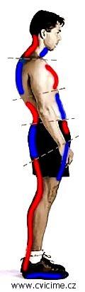
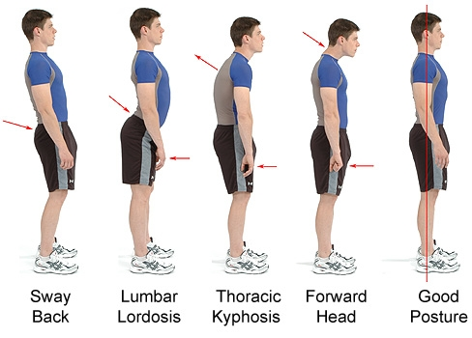
muscle imbalance => poore posture
Notes:
http://www.cvicime.cz/cviceni-praha/anatomie/funkce.html
http://restoremyposture.com/

Slide 39
Janda Evaluation
Systematic evaluation of muscular imbalance begins with static postural assessment, observing muscles for characteristic signs of hypertonicity or hypotonicity.
This is followed by observation of single leg stance and gait.
Static posture, gait and balance often give the best indication of the status of the sensorimotor system.
Computerized force plate posturography is often valuable in quantifying sensory and motor deficits.
Next, characteristic movement patterns are assessed, and specific muscles are tested for tightness or shortness.
Surface electromyography is useful in quantifying muscle activation patterns.
All the above information collected provides the clinician a system to determine or rule out the presence of muscle imbalance syndromes. Furthermore, identification of specific patterns and syndromes of imbalance also provides the clinician to choose appropriate interventions to address the cause of the dysfunction.

Slide 40
Summary
In summary, the Janda approach emphasizes the importance of the CNS in the sensorimotor system, and its role in the pathogenesis in musculoskeletal pain.
In particular: the neurological pre-disposition of muscles to exhibit predictable changes in tone, and the importance of proprioception and afferent information in the regulation of muscle tone and movement.
Therefore, assessment and treatment focus on the sensorimotor system, rather than the musculoskeletal system itself. Using
a functional, rather than a structural approach, the cause of musculoskeletal pain can be quickly identified and addressed. The Janda approach can be a valuable tool for the clinician in the evaluation and treatment of chronic musculoskeletal pain.

Slide 41
e-source, literature
http://www.muscleimbalancesyndromes.com/janda-syndromes/layer-syndrome/
http://www.jandaapproach.com/
Phil Page: Assessment and Treatment of Muscle Imbalance
Vladimír Janda a kol.: Svalové funkční testy

Slide 42

Thank you for your attention ☺

