Slide 1
Assessment methods in rehabilitation, 23.11.2020
Muscle shortening
Mgr. Veronika Mrkvicová
Department of Physiotherapy and Rehabilitation – MF MU

Slide 2
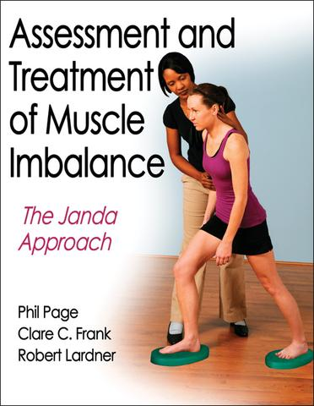
Content
Muscle Shortening
The Importance of Shortened Muscle
Postural Muscles
The Assessment of Shortened Muscle Groups

Slide 3
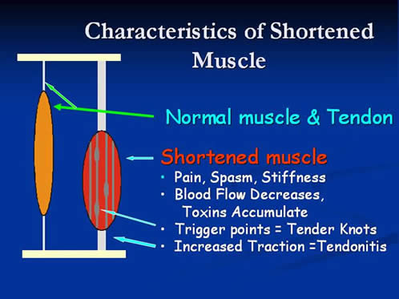
Muscle Shortening
  muscle at rest does not reach its normal length
  passive stretching does not allow a full range of physiological motion of the joint
  has increased muscle tone, the state is not accompanied by evidence of increased electrical activity
  this is a functional disorder of the motor system – it is reversible

Slide 4
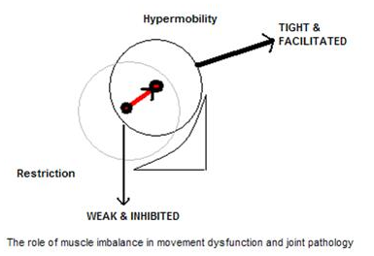
The Importance of Shortened Muscle
  muscle activation is greater than is economical, leads to overloading
  limit the range of
  motion in the joint
  leads to:
    decentred joint
    thighness weakness
    muscle imbalance
  affects:
    the body statics
    locomotive programs
Notes:
http://www.muscleimbalancesyndromes.com/what-is-muscle-imbalance/
Human movement and function requires a balance of muscle length and strength between opposing muscles surrounding a joint. Normal amounts of opposing force between muscles are necessary to keep the bones centered in the joint during motion; this would be considered ‘muscle balance’. On the other hand, ‘muscle imbalance’ occurs when opposing muscles provide different directions of tension due to tightness and/or weakness. When a muscle it too tight, the joint tends to move in that direction and is limited in the opposite direction since this is typically ‘the path of least resistance.’ For example, the quadriceps and hamstrings of the knee joint perform opposite motions; an imbalance between the two could put undue stress on the joint. A tight hamstring would not allow the joint to glide normally or fully extend, which could put extra stress on the quadriceps muscle and patella (knee cap).
Muscle imbalances can be characterized by either side-to-side (right versus left) or front-to-back (agonist versus antagonist) differences in muscle length or strength. Most musculoskeletal pain syndromes are caused by front-to-back differences, or imbalances of muscles surrounding a joint, rather than side-to-side differences.
There are also 2 recognized causes of muscle imbalance. The first is a biomechanical cause from repeated movements in one direction or sustained postures. The biomechanical causes of muscle imblance have been popularized by Kendall and Sahrmann. The second cause is a neuromuscular imbalance due to the predisposition of certain muscle groups to be either tight or weak. The neuromuscular approach was popularized by Janda, and is based on movement patterns that evolve from birth. Dr. Janda noted that the ‘tonic’ group of muscles are prone to tightness and the ‘phasic’ group is prone to weakness:

Slide 5


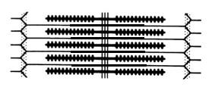
Representation of the shift of actin and myosin microfilaments in the sarcomere when stretched muscle contraction, by easy contraction and strong contraction
(www.smw.ch/content/smw-2011-13319)
myosin
EASY CONTRACTION
aktin
STRETCHED MUSCLE CONTRACTION
  CONTRACTION IN SHORTENING
  = weakness in thighness
Notes:
Overlap, bridges, the strenght of contraction is less

Slide 6
Scheme of muscle strength depending on the length of the sarcomere (Janura, 2003)
Weakness in tighness
The mechanism of formation is as follows: in the resting length of
the muscle is to create the maximum number of cross-bridges. Sarcomere length reaches 2-2.5 microns. This way you can achieve maximum muscle strength. With the stretching of
the muscle fiber number of cross-linking decreases, because there is a reduced overlap of actin and myosin. And therefore reduces
the potential strength. Otherwise - in sarcomere shortening below
2 microns – begin to overlap thin actin filaments. And there is again a decreased active tension.

Slide 7
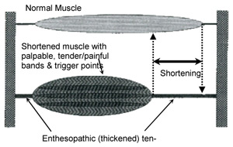
Postural Muscles
A tendency of muscle shortening is noticeable not only during illness but also as an apparently typical reaction by some muscle groups even in normal circumstances.
These muscles are responsible for standing position, and above all standing on one leg. This is the most common postural position for human
Those muscles with a postural function are genetically older and demonstrate less reaction to different injuries.
They have different physiological and probably also biochemical qualities than muscles with mainly phasic function.

Slide 8
Postural Muscles
  muscles with a predominance of tonic function (= muscles with
  a tendency to shorten and hypertrophy) – ensure upright posture (because they have permanent working resting tension)
  contain mostly red muscle fibers, rich in myoglobin
  are evolutionarily older, have a low threshold of irritation, characterized by a slower process of contraction, longer latency and greater resistance to stress (slower fatigue)
  its function often replace muscle activity of weakened phasic muscles (they discard them of the muscle interplay and may cause muscle imbalances)
Notes:
http://www.muscleimbalancesyndromes.com/what-is-muscle-imbalance/
Human movement and function requires a balance of muscle length and strength between opposing muscles surrounding a joint. Normal amounts of opposing force between muscles are necessary to keep the bones centered in the joint during motion; this would be considered ‘muscle balance’. On the other hand, ‘muscle imbalance’ occurs when opposing muscles provide different directions of tension due to tightness and/or weakness. When a muscle it too tight, the joint tends to move in that direction and is limited in the opposite direction since this is typically ‘the path of least resistance.’ For example, the quadriceps and hamstrings of the knee joint perform opposite motions; an imbalance between the two could put undue stress on the joint. A tight hamstring would not allow the joint to glide normally or fully extend, which could put extra stress on the quadriceps muscle and patella (knee cap).
Muscle imbalances can be characterized by either side-to-side (right versus left) or front-to-back (agonist versus antagonist) differences in muscle length or strength. Most musculoskeletal pain syndromes are caused by front-to-back differences, or imbalances of muscles surrounding a joint, rather than side-to-side differences.
There are also 2 recognized causes of muscle imbalance. The first is a biomechanical cause from repeated movements in one direction or sustained postures. The biomechanical causes of muscle imblance have been popularized by Kendall and Sahrmann. The second cause is a neuromuscular imbalance due to the predisposition of certain muscle groups to be either tight or weak. The neuromuscular approach was popularized by Janda, and is based on movement patterns that evolve from birth. Dr. Janda noted that the ‘tonic’ group of muscles are prone to tightness and the ‘phasic’ group is prone to weakness:

Slide 9
The Assessment of Shortened Muscle Groups
Must be exact as a muscle function test for a weakened muscles, and the same standardized routine must be maintained.
As it is difficult to determine the exact grade of many muscles,
a general estimate is considered sufficient.
Where it is possible we measure the angle between two extremities
To obtain a reliable evaluation, the assessment of shortened muscles can be very accurate: the starting position, method of fixation and direction of movement must be observed extremely carefully
As in muscle function testing the prime mover must not be exposed to external pressure

Slide 10
The Assessment of Shortened Muscle Groups
If possible, the force exerted on the tested muscle must not work over two joints.
The examiner performs at an even speed a slow movement that brakes slowly at the end of the range.
To keep the stretch and the muscle irritability about equal
the movement must not be jerky.
Pressure or pull must always act in the required direction of movement.
Muscle shortening can only be correctly evaluated if the joint range is not decreased as is a bony limitation or joint restriction.

Slide 11
Muscles with Mainly Postural Function
Sternocleidomastoid
Pectoralis major (clavicular and sternal end)
Trapezius (upper part)
Levator scapulae
The upper extremity flexors
Quadratus lumborum
Back extensors
  Erector spinae
  Longissimus thoracis
  Rotatores
  Multifidus
Hip flexors
  Iliopsoas
  Tensor fasciae latae
  Rectus femoris
Hip external rotators
  Piriformis
Hip adductors
  Pectineus
  Adductor longus
  Adductor brevis
  Adductor magnus
Hamstrings
  Biceps femoris
  Semitendinosus
  Semimembranosus
Ankle plantar flexors
  Gastrocnemius
  Soleus
  Tibialis posterior

Slide 12
Muscles with Mainly Phasic (Dynamic) Function
Scaleni
Pectoralis major (abdominal part)
Subscapularis
The upper extremity extensors
Trapezius (lower part)
Rhomboidei
Serratus anterior
Rectus abdominis
Obliquus abdominis externus
Obliquus abdominis internus
Gluteus minimus, medius, maximus
Vastus medialis and lateralis
Tibialis anterior
Peronei

Slide 13
https://www.youtube.com/watch?v=SPlBzpIug2o
https://www.youtube.com/watch?v=9JMEvmXSgUI

Slide 14
Assessment

Slide 15
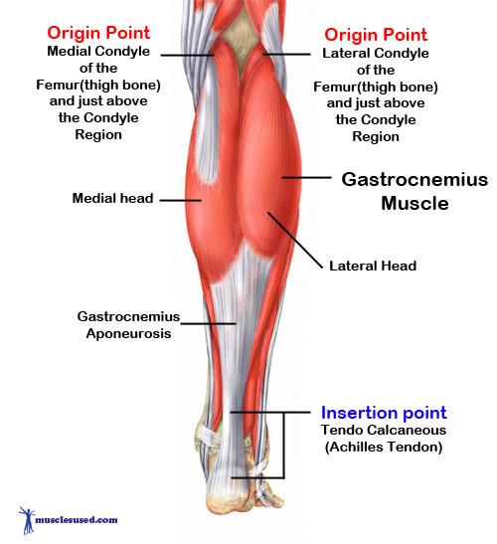
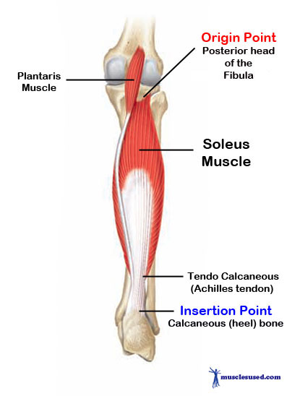
M.Triceps Surae
Notes:
Details:
Origin distal femur (gastrocnemius), posterior tibia (soleus)
Insertion achilles tendon, calcaneus
Artery posterior tibial artery
Nerve tibial nerve
Actions plantarflexion

Slide 16
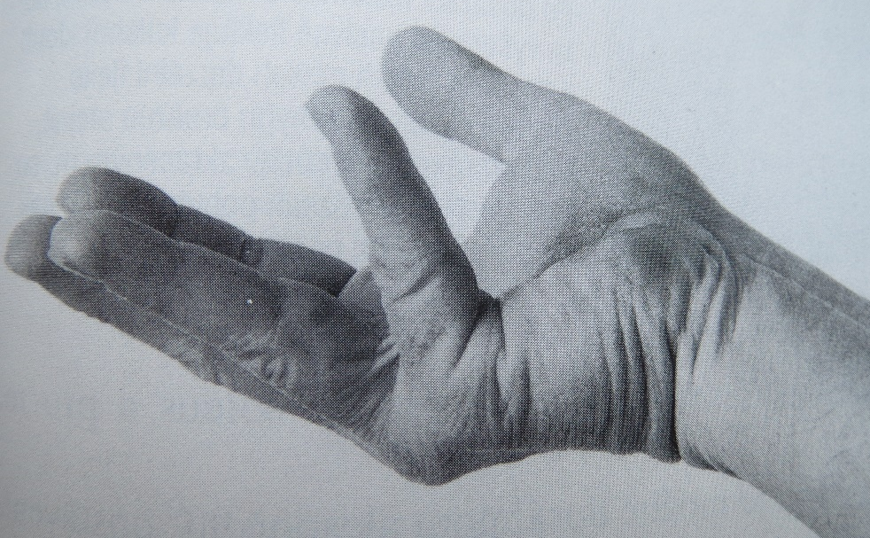
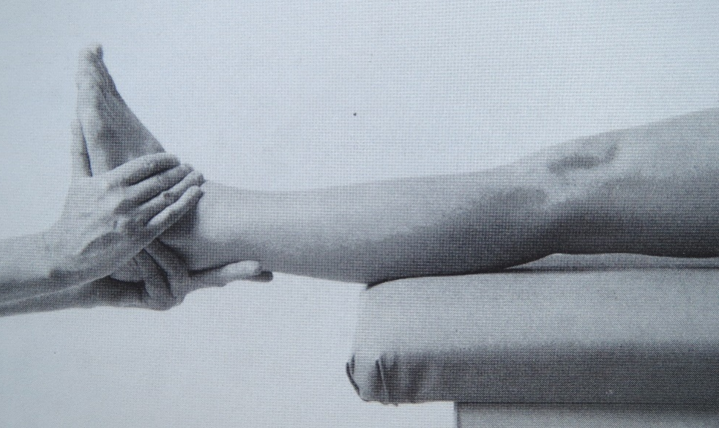
Gastrocnemius and Soleus
Gastrocnemius
Starting position: Supine lying with both legs outstretched and the heels outside of
the examination table.
Grasp: The right hand of the examiner grasps the right Achilles tendon iust above the heel without causing pressure on the tendons (when examining the left leg the examiner uses the left hand). The fingers are outstretched and the lower arm is held as
a prolongation of the lower leg. The other hand is placed on the outside edge of
the foot with the fingers on the dorsum of the foot and the thumb on the sole parallel with the outside edge.

Slide 17
Gastrocnemius and Soleus
Gastrocnemius
Fixation: Not necessary.
Stretch: The main stretch is applied to the heel distally in
the direction of the muscle fibres. The thumb of the other hand steers the forefoot wit h a light perpendicular pressure to prevent sideways movement of the foot.
Range of movement: Flexion to 90 degrees should be achieved without difficulty.

Slide 18
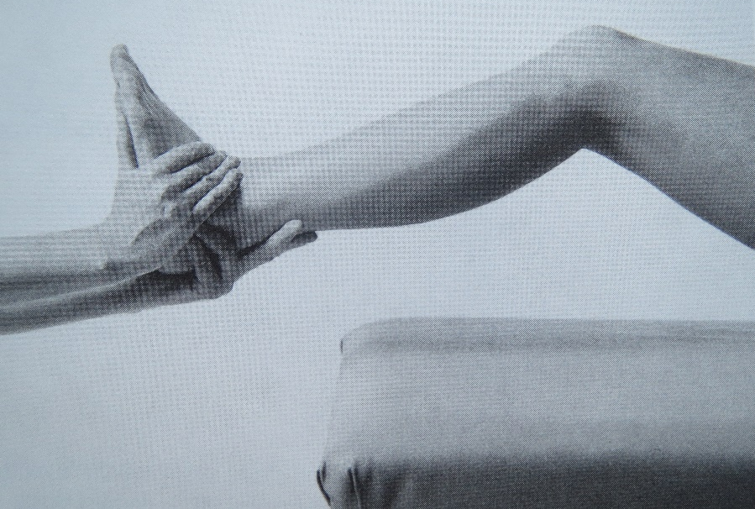
Gastrocnemius and Soleus
Soleus
The assessment is the same but the knee joint should be passively flexed to exclude gastrocnemius activity.
The examiner passively bend the knee joint after reaching
the maximum possible dorsiflexion and tries to increase the range of dorsiflexion. If it remains limited range of motion as well,
the restriction is caused by
the shortening of m. soleus.
If the range of motion
increases, then it is a shortening of
m. gastrocnemius.
https://www.youtube.com/watch?v=78-zzdJ4tvA

Slide 19
Gastrocnemius and Soleus
Ratings:
We evaluate the size of achieved dorsiflexion, and separately for the m. soleus and m. gastrocnemius.
0 - not a reduction - in the ankle joint can be achieved at least
90 degrees
1 - small shortening – in the ankle joint is missing into the 90-degree position 5 degrees
2 - large shortening – in the ankle joint is missing into the 90-degree position more than 5 degrees

Slide 20
Gastrocnemius and Soleus
Possible errors
If the examiner's thumb is not on top and not parallel with
the outside edge of the foot but more towards the middle of
the sole of the foot, then a reflex reaction of the gastrocnemius and soleus will result.
If the thumb does not press along the whole foot length , but only close to its tip, then the direction of the movement is altered and different structures are stimulated (in particular the plantar aponeurosis and quadratus plantae).
When pressure is applied incorrectly to the dorsum of the forefoot and the necessary strong stretch of the heel does not take place, the muscles in the sole of the foot but not the gastrocnemius and soleus are caused to stretch.
If the forearm is not held as a prolongation of the lower leg
the direction of the stretch is changed.

Slide 21
Gastrocnemius and Soleus
Possible errors
The leg should be stationary on the table and may not be lifted upwards.
We enable active foot dorsiflexion.
When previously tested m. soleus reached foot dorsiflexion is not hold.
We enable active flexion of the knee joint.

Slide 22
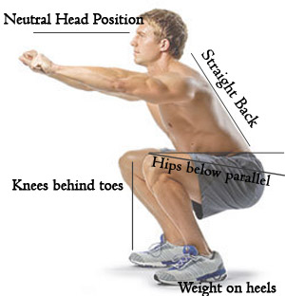
Gastrocnemius and Soleus
An orientation test for the soleus
The patient crouches with slight forward flexion of the trunk.
The knees should be parallel to, but not touching each other. If
the range of movement in the joint is not restricted, the patient should be able to squat with the heels on the floor.

Slide 23
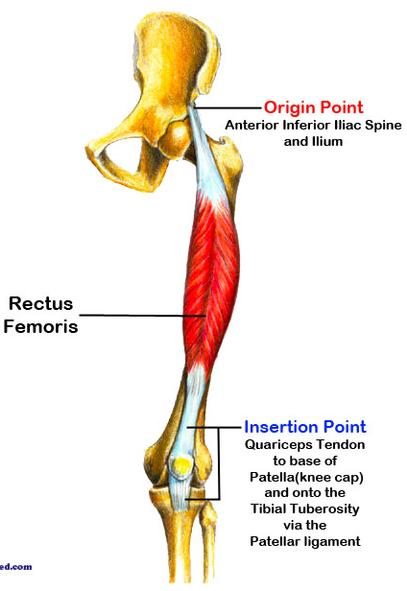
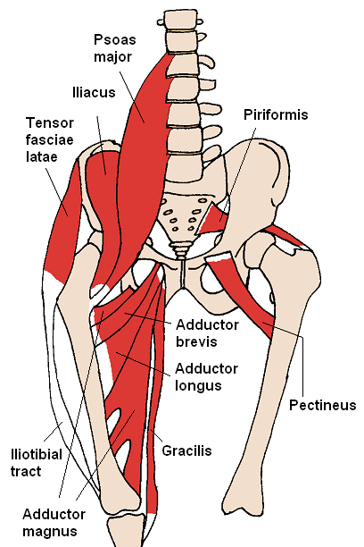
The Hip Flexors - Iliopsoas, Rectus Femoris, Tensor Fasciae Latae and Short Adductors
Notes:
Iliopsoas
Origin Iliac fossa and lumbar spine
Insertion Lesser trochanter of femur
Artery Medial femoral circumflex artery and iliolumbar artery
Nerve Branches from L1 to L3
Actions Flexion of hip
Antagonist Gluteus maximus and the posterior compartment of thigh
Rectus femoris:
Origin anterior inferior iliac spine and the exterior surface of the bony ridge which forms the groove on the iliac portion of the acetabulum
Insertion inserts into the patellar tendon as one of the four quadriceps muscles
Artery descending branch of the lateral femoral circumflex artery
Nerve femoral nerve
Actions knee extension; hip flexion
Antagonist Hamstring
Tensor fasciae latae:
Origin Iliac crest
Insertion Iliotibial tract
Artery Primarily lateral circumflex femoral artery, superior gluteal artery
Nerve Superior gluteal nerve (L4, L5, S1)
Actions Hip - flexion, medial rotation, abduction , knee - lateral rotation, Torso - stabilization
Short Adductors

Slide 24
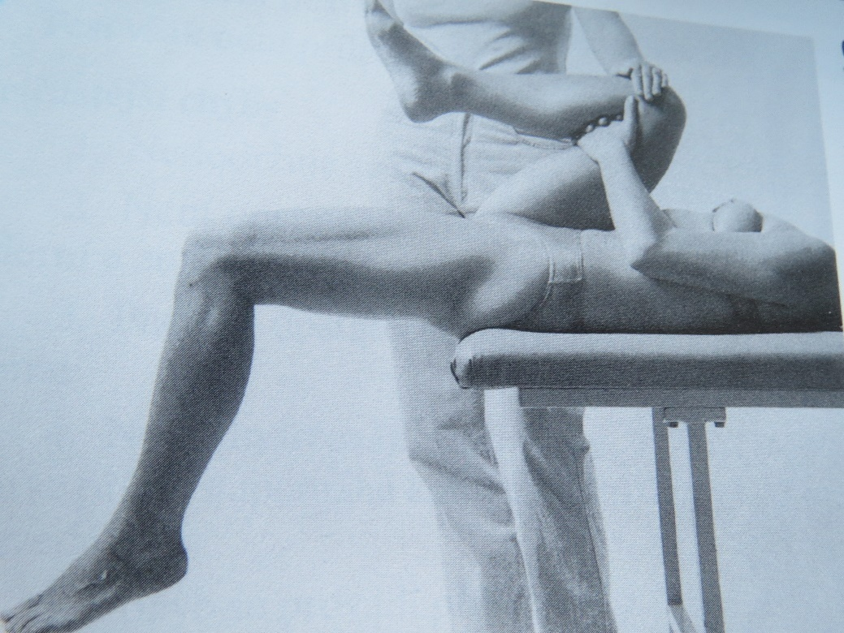
The Hip Flexors - Iliopsoas, Rectus Femoris, Tensor Fasciae Latae and Short Adductors
Starting position: Supine lying, with the coccyx just outside
the table. The passive leg is flexed as far as possible so that the pelvis is tilted backwards and the lumbar lordosis is eliminated. The leg is fixed in this position by holding the fixed knee (a long lever). If this knee flexion is painful it is better to fix the whole knee joint.

Slide 25
The Hip Flexors - Iliopsoas, Rectus Femoris, Tensor Fasciae Latae and Short Adductors
Fixation: Throughout the test the passive leg must be fixed towards the trunk by constant pressure to eliminate the lordosis of
the lumbar spine. During the evaluation the examiner pushes the leg further against the trunk.
Normal finding: The thigh is
horizontal and the lower leg hangs
vertically. The patella is situated
slightly lateral to the knee joint.
On the outer side of the thigh
there is a very slight deepening.

Slide 26
The Hip Flexors
Pathological finding:
A flexion position in the hip joint shows shortening of the iliopsoas.
The lower leg positioned diagonally downwards indicates that
the rectus femoris is shortened.
A flexion position of the hip joint with a simultaneous tendency to extension in the knee joint points to shortening of both the iliopsoas and rectus femoris.
Lateral deviation of the patella and more pronounced deepening on the outside of the thigh shows on a shortened tensor fasciae latae and iliotibial band.

Slide 27
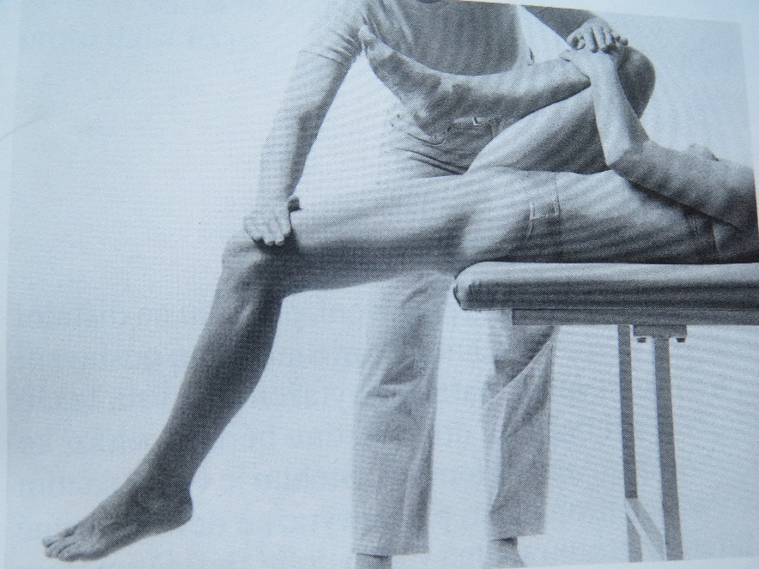
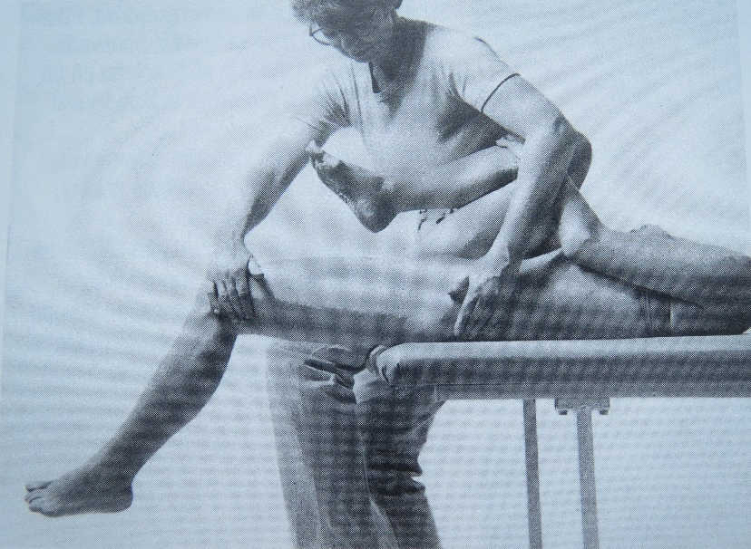
The Hip Flexors
To differentiate even more the following tests may be performed:
1. Pressure is applied to the lower third of the thigh:
  in the direction of the hyperextension of the hip joint. When extension cannot increase, this indicates shortening of
  the iliopsoas. When there is a simultaneous compensatory extension in the knee joint, this points to shortening of
  the rectus femoris.
  in the direction of the adduction of the hip joint. Increased deepening on the outside of the thigh over the iliotibial tract shows shortening of the tensor fasciae latae and the iliotibial tract.
  in the direction of the abduction of the hip joint.
  The decreased range of movement and compensatory flexion of the hip joint are signs of shortening of the one-joint thigh adductors.

Slide 28
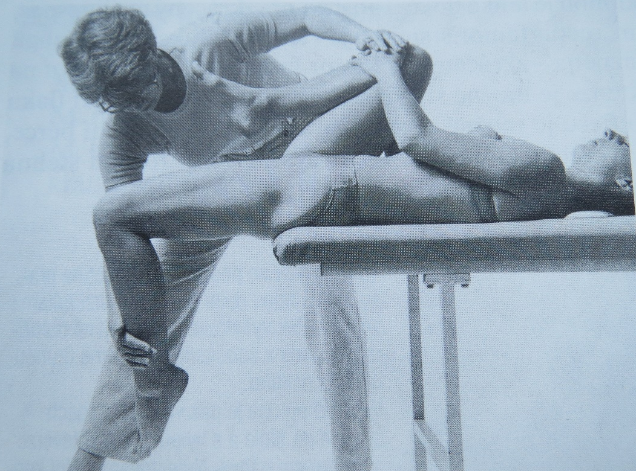
The Hip Flexors
To differentiate even more the following tests may be performed:
Pressure is applied to the lower third of the lower leg to increase knee flexion.
  If flexion is painful and difficult, this shows shortening of the rectus femoris. Further pressure may cause compensatory flexion in the hip joint, simultaneously a deepening
  appears immediately above
  the patella. This shows shortening
  of the rectus femoris.
https://www.youtube.com/watch?v=78-zzdJ4tvA

Slide 29
The Hip Flexors
Ratings:
We assess according to the position of the thigh, shin and by deviation of the patella. Further, according to possibility to compress the thigh into the hyperextension, the lower leg to flexion and thigh to hyperabduction.
0 - not a reduction – the thigh in horizontal without deviation,
the lower leg hanging vertically to the ground with relaxed knee, patella slightly shifted laterally. On the outer surface of the thigh is only a slight depression. When there is a pressure on the distal third of the thigh to hyperextension, we can compress the thigh slightly bellow the horizontal, when there is a pressure on the lower third of the tibia towards flexion, we may slightly larger flexion in the knee joint.

Slide 30
The Hip Flexors
Ratings:
1 - small shortening – the hip is slightly in flexion position – shortened
m. iliopsoas, lower leg sticking out diagonally forward – shortened
m. rectus femoris, thigh in a light abduction and depression on the lateral side of the thigh is highlighted – shortened m. tensor fasciae latae.
When there is a pressure on the distal third of the thigh to hyperextension, we can compress the thigh into the horizontal, when there is a pressure on the lower third of the tibia towards flexion, it is possible to achieve vertical position of the lower leg, but without a compensatory flexion of the hip joint. When there is a pressure on the lower third of the thigh from
the lateral side, we can achieve position without any deviation into abduction.

Slide 31
The Hip Flexors
Ratings:
2 - large shortening – the hip is in significant flexion position, when there is a pressure on the distal surface of the thigh towards the hyperextension, there is not possible to achieve a horizontal position of the thigh – shortened m. iliopsoas.
Leg sticking out diagonally forward, patella is pulled upwards, so it is visible and easy to palpate the upper edge. When there is a pressure on
the lower third of the tibia, it leads to compensatory flexion of the hip – shortened m. rectus femoris.
Thigh in abduction position, on the lateral surface of the thigh is significant depression, patella significantly deviates outside and we can see its outer edge. When there is a pressure on the lateral side of the lowet third of the thigh towards the adduction the depression on the lateral surface of the thigh is highlighted and adduction can not be done – shortened m. tensor fasciae latae.

Slide 32
The Hip Flexors
Possible errors
Insufficient fixation of the pelvis enables a change of position and increased lordosis of the lumbar spine.
The patient is not relaxing sufficiently and the lower leg is knowingly held in slight flexion in the knee joint.
The direction of the pressure may not be maintained. In particular during examination of a shortened rectus femoris, compensatory flexion in the hip may be supported if pressure is wrongly directed upwards during passive flexion in the knee joint.
The movement may be performed too quickly.
The muscle groups may not be differentiated.
The patient fixes the not tested leg only by himself and no additional fixation may be given.
In the orientation test in standing, forward flexion of the trunk or increased lumbar lordosis may be allowed during the movement, together with lateral rotation in the hip joint of the leg to be tested.

Slide 33
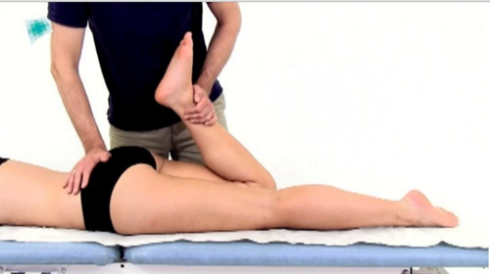
The Hip Flexors
Orientation tests for the iliopsoas and rectus femoris
Starting position: Prone with the legs outstretched. If the iliopsoas is shortened the hip joint remains in flexion. Passive flexion in the knee joint provokes a compensatory increase of flexion in the hip joint, and hyperlordosis of the lumbar spine is a sign of shortened rectus femoris. This test is not very sensitive.

Slide 34
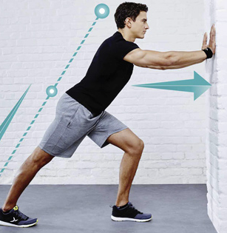
The Hip Flexors
An orientation test in standing for the iliopsoas
and gastrocnemius and soleus
The patient stands as far as possible from the table while steadying
the leg that is not to be tested against it. The leg to be tested is situated exactly in between medial and lateral rotation. The foot is in the sagittal plane and the sole rests on the floor. The knee is in extension. The position of the sole of the foot and the hip joint is checked for shortening of the gastrocnemius and soleus, and of
the iliopsoas respectively. From the standing position the patient shifts the pelvis forwards without rotating it and without increasing
the lumbar lordosis. With a shortened gastrocnemius and soleus
the heel is lifted from the floor, and with a shortened iliopsoas
the hyperextension of 5-10 degrees in the hip joint is not possible. This test is also suitable as a home exercise to stretch these muscles.
https://www.youtube.com/watch?v=l_vadzJXnco

Slide 35
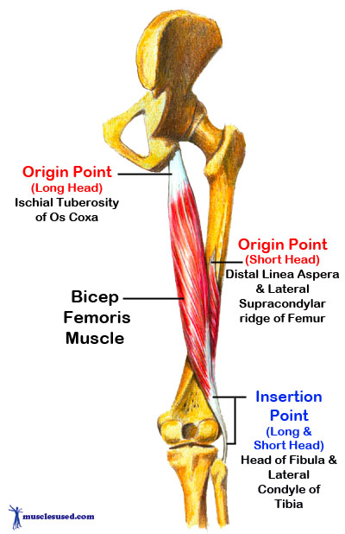
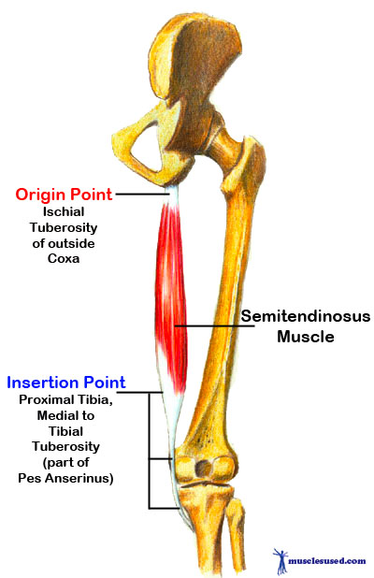
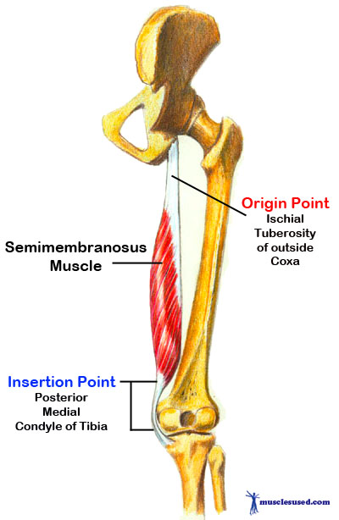
The Hamstrings - M. Biceps Femoris,
M. Semitendinosus and M. Semimembranosus
Notes:
Biceps femoris:
Origin tuberosity of the ischium, linea aspera, femur
Insertion the head of the fibula which articulates with the back of the lateral tibial condyle
Artery deep femoral artery, perforating arteries; long head of biceps femoris: perforating branches from profunda femoris artery
Nerve long head: tibial nerve, short head: common fibular nerve
Actions flexes knee joint, laterally rotates knee joint (when knee is flexed), extends hip joint (long head only)
Antagonist Quadriceps muscle
Semitendinosus:
Origin Tuberosity of the ischium
Insertion Pes anserinus (tibia)
Artery Inferior gluteal artery, perforating arteries
Nerve Sciatic (tibial, L5, S1, S2)
Actions Flexion of knee, extension of the hip joint
Antagonist Quadriceps muscle
Semimembranosus
Origin Ischial tuberosity
Insertion Medial condyle of tibia
Artery Profunda femoris and gluteal arteries
NerveTibial part of sciatic nerve (L5, S1 and S2)
Actions Extension of hip and flexion of knee
Antagonist Quadriceps muscle and Tensor fasciae latae

Slide 36
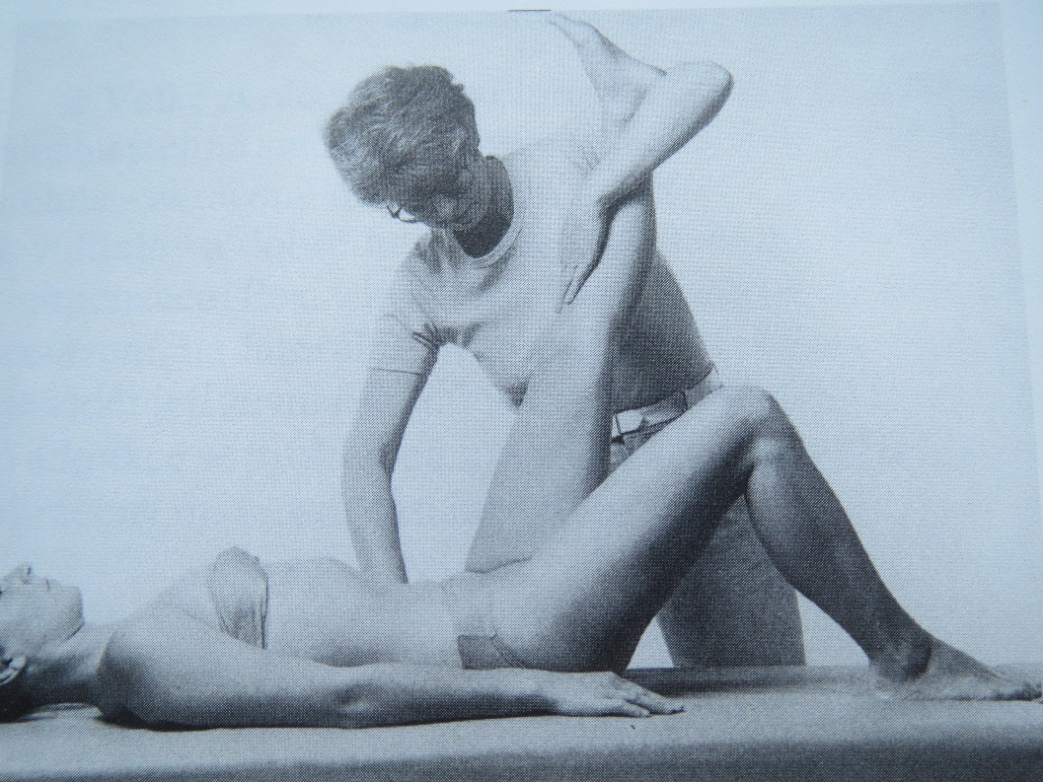
The Hamstrings - M. Biceps Femoris,
M. Semitendinosus and M. Semimembranosus
Starting position: Supine, with the leg not to be tested flexed in the hip and knee joints (passively) or (less suitably) flexed with the sole of
the foot on the table. Thus the lumbar spine is kept flat on the table and there is no kyphosis or lordosis of the lumbar spine.
Fixation: The pelvis.

Slide 37
The Hamstrings - M. Biceps Femoris,
M. Semitendinosus and M. Semimembranosus
Grasp: The examiner grasps the lower leg of the patient so that
the knee is kept in extension through pressure from above (not patella!). The heel is held in the crook of the examiner's elbow with
the foot against her upper arm to prevent lateral rotation of the leg.
Range of motion: Flexion to
90 degrees
https://www.youtube.com/watch?v=78-zzdJ4tvA

Slide 38
The Hamstrings - M. Biceps Femoris,
M. Semitendinosus and M. Semimembranosus
Ratings:
We evaluate the extent of the flexion in the hip joint. We end
the examination when we begin to feel a tendency to flex the knee of tested leg or pelvis movement (ie. tilting the pelvis backward), or when there is a muscle soreness on the dorsal side of the thigh.
0 - not a reduction – flexion of the hip joint 90 degrees
1 - small shortening – flexion in the hip joint in range of 80-90 degrees
2 - large shortening – flexion of the hip joint is smaller than 80 degrees

Slide 39
The Hamstrings - M. Biceps Femoris,
M. Semitendinosus and M. Semimembranosus
Possible errors
Fixation is given over the knee joint on top of the patella despite the fact that the joint should be free.
At the examination the knee flexion increases together with abduction and external rotation of the hip joint. This can be made even worse if the examiner does not start the movement from his/her own shoulder joint and if he/she turns in such way that abduction is performed by the leg of the patient.
If there is shortening of the hip flexors, which is very common,
the not tested leg is not put in the flexion position during the test.
Pelvis is not fixed.

Slide 40
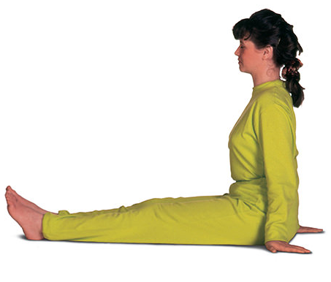
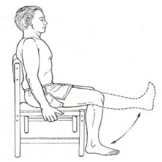
The Hamstrings - M. Biceps Femoris,
M. Semitendinosus and M. Semimembranosus
An orientation test of knee flexors
We can persuade about the lenght quality of ischiocrural muscles in
a sitting position, with extended legs in the knee joints.
Examinee should be able to achieve the vertical position of the pelvis and 90 flexion in the hip joints without flexion in knee joints.

Slide 41
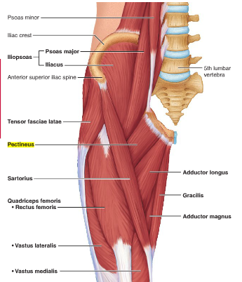
Hip Adductors – Pectineus, Adductor Brevis, Adductor Magnus, Adductor Longus, Gracilis
Notes:
Pectineus:
Origin Pectineal line of the pubic bone
Insertion Pectineal line of the femur
Artery Obturator artery
Nerve Femoral nerve, sometimes obturator nerve
Actions Thigh - flexion, adduction
Adductor brevis:
Origin anterior surface of the inferior ramus and body of the pubis
Insertion the lesser trochanter and linea aspera of the femur
Artery deep femoral artery
Nerve obturator nerve
Actions adduction of hip
Adductor magnus:
Origin Pubis, tuberosity of the ischium
Insertion Linea aspera and adductor tubercle of femur
Artery Deep femoral artery
Nerve Posterior branch of obturator nerve (adductor) and tibial nerve (hamstring)
Actions Adduction of hip (both portions), flexion of hip (adductor portion), extension of hip (hamstring portion)
Adductor Longus:
Origin pubic body just below the pubic crest
Insertion middle third of linea aspera
Artery deep femoral artery
Nerve anterior branch of obturator nerve
Actions adduction of hip, flexion of hip joint
Gracilis:
Origin ischiopubic ramus
Insertion tibia (pes anserinus)
Artery medial circumflex femoral artery
Nerve anterior branch of obturator nerve
Actions flexes, medially rotates, and adducts the hip,

Slide 42
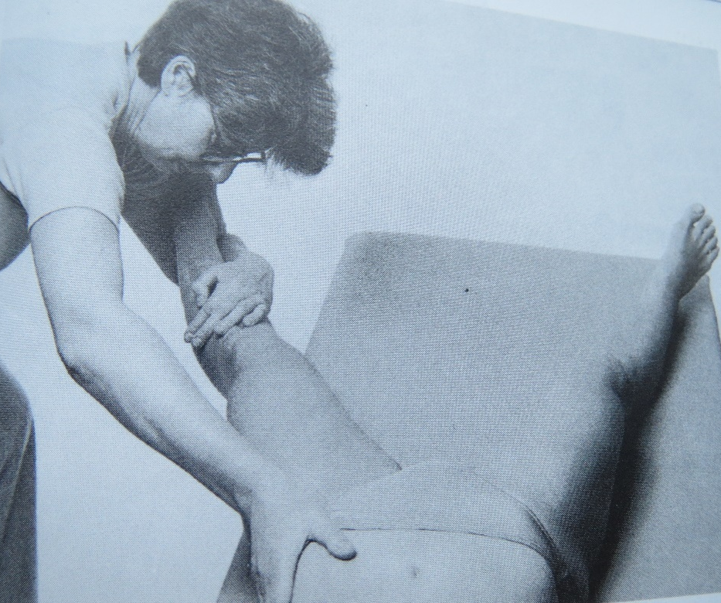
Hip Adductors – Pectineus, Adductor Brevis, Adductor Magnus, Adductor Longus, Gracilis
Starting position: Supine Iying, with the leg to be tested close to the edge of the table. The leg not to be tested is 15-25 degrees abducted in the hip joint.
Grip: The leg to be tested is placed with the heel in the crook of the examiner's elbow. Her/his hand is placed on the anterolater side of
the tibia, so maintaining the knee in extension through forward pressure on the lower leg.
The foot of the patient is steadied on the upper arm of the examiner to prevent lateral rotation in the hip joint.
Fixation: The pelvis or leg not to be tested (as far as possible).

Slide 43
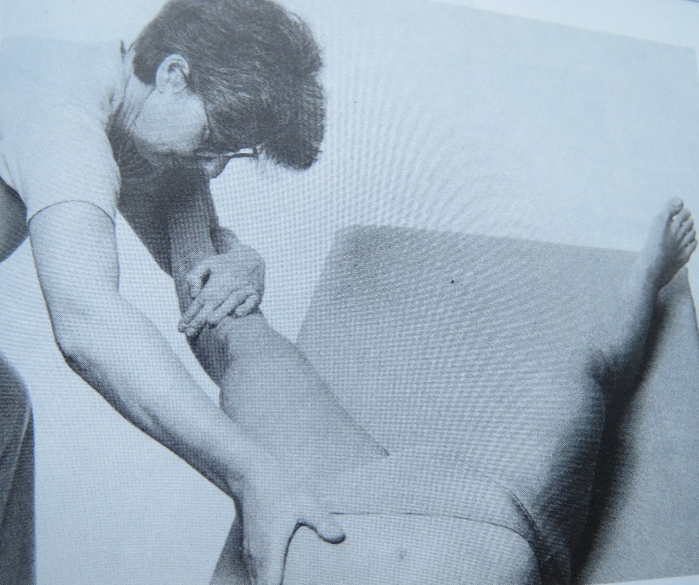
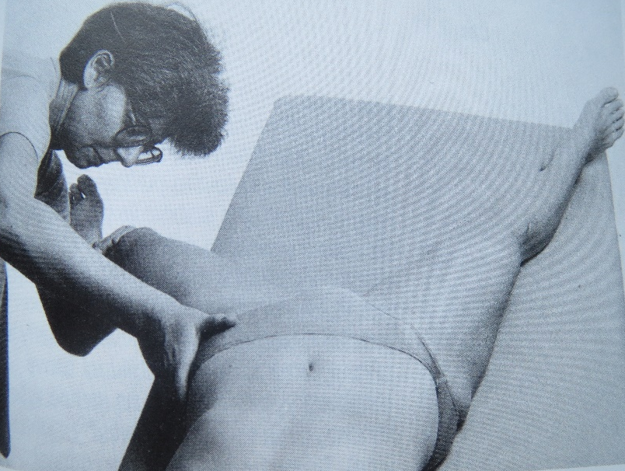
Hip Adductors – Pectineus, Adductor Brevis, Adductor Magnus, Adductor Longus, Gracilis
Movement: Abduction of the extended leg in the hip joint over the maximal range. When the full movement is performed the knee joint is passively flexed and abduction continues.
Normal range of movement: Abduction to about
40 degrees with an extended and flexed knee. If
the range of movement of the hip joint with the knee extended or flexed is limited to the same or almost
the same extent, the one-joint adductors, mainly
the pectineus and the adductors, are proved to be shortened. If the range of movement increased with
a flexed knee then the two-joint adductors (namely the gracilis, biceps femoris, semimembranosus and semitendinosus) are shortened.

Slide 44
Hip Adductors – Pectineus, Adductor Brevis, Adductor Magnus, Adductor Longus, Gracilis
Ratings:
We evaluate the extent of abduction in the hip joint when extanded and slightly flexed knee. If the abduction is limited in the same or almost the same extent in the extended and flexed knee – in terms of shortening 1-articular adductors. If enlarges the scope of abduction when flexed knee – in terms of shortening 2-articular adductors.
0 - not a reduction – abduction of the hip joint 40 degrees
1 - small shortening – abduction in the hip joint in range of
30-40 degrees
2 - large shortening – abduction of the hip joint is smaller than
30 degrees

Slide 45
Hip Adductors – Pectineus, Adductor Brevis, Adductor Magnus, Adductor Longus, Gracilis
Possible errors
During abduction there is also some flexion or lateral rotation in the hip joint.
The examination does not take place in the two different positions described, that is with an extended and a flexed knee.
The necessary slight abduction of the leg not to be tested does not take place and so the fixation of the pelvis is insufficient.
The pelvis is not fixed.
In the second phase of testing is permitted large flexion of
the knee, which by shortening of the m. rectus femoris leads to facilitation of adductors.
Forgetting that the lower leg must always be supported.

Slide 46
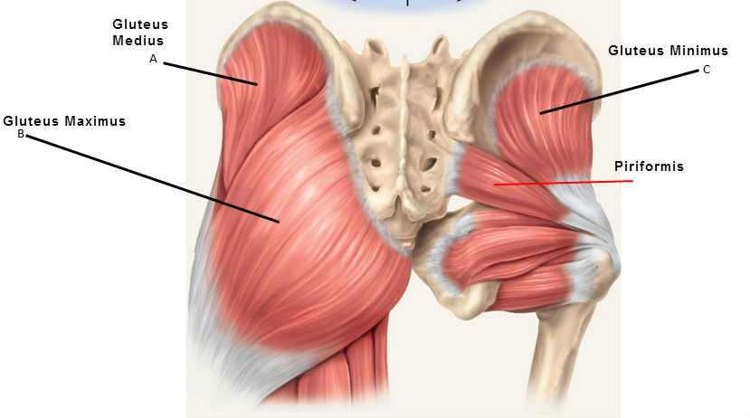
Piriformis
Notes:
Origin Sacrum
Insertion Greater trochanter
Artery Inferior gluteal, lateral sacral and superior gluteal artery,
Nerve Nerve to the piriformis (L5, S1, and S2)
Actions External rotator of the thigh

Slide 47
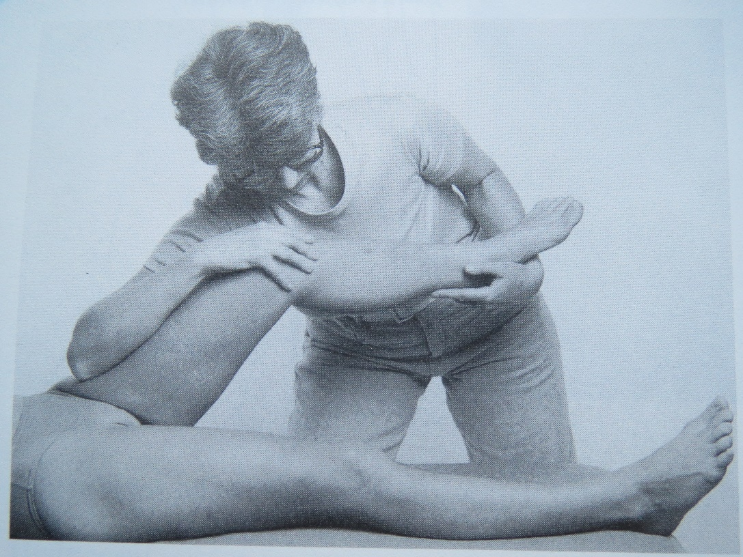
Piriformis
Starting position: Supine, with the leg to be tested flexed at the hip and knee joints.
Fixation: The pelvis through pressure from the examiner's hand against the knee in the direction of the longitudinal axis of the thigh.

Slide 48
Piriformis
Movement: Examiner performs 60-degree flexion in the hip joint. Examiner‘s hands performed the pressure on the knee side of the tested leg, thus ensuring stabilization of the pelvis (forearm of the examiner is on the thigh of the patient, and his hand is hooked on the knee. The second upper limb grips examining lower leg of
the patient, which is in horizontal position. Thus gripped lower leg,
the examiner performs the maximal adduction in the hip joint and then internal rotation in the hip joint.
https://www.youtube.com/watch?v=78-zzdJ4tvA

Slide 49
Piriformis
Ratings:
We evaluate according the possibility of performance of internal rotation and adduction.
0 - not a reduction – can be performed freely adduction and internal rotation, ie. the end feeling is soft
1 - small shortening – in case of shortened m. piriformis internal rotation is limited, moreover, adduction is limited as well.
2 - large shortening – in case of shortened m. piriformis internal rotation is limited or even impossible with hard end feel, moreover, adduction is limited.

Slide 50
Piriformis
Possible errors
Pressure against the knee is not constant during the examination and so the fixation of the pelvis is insufficient.
Adduction and medial rotation is not carried out to the end of
the range.

Slide 51
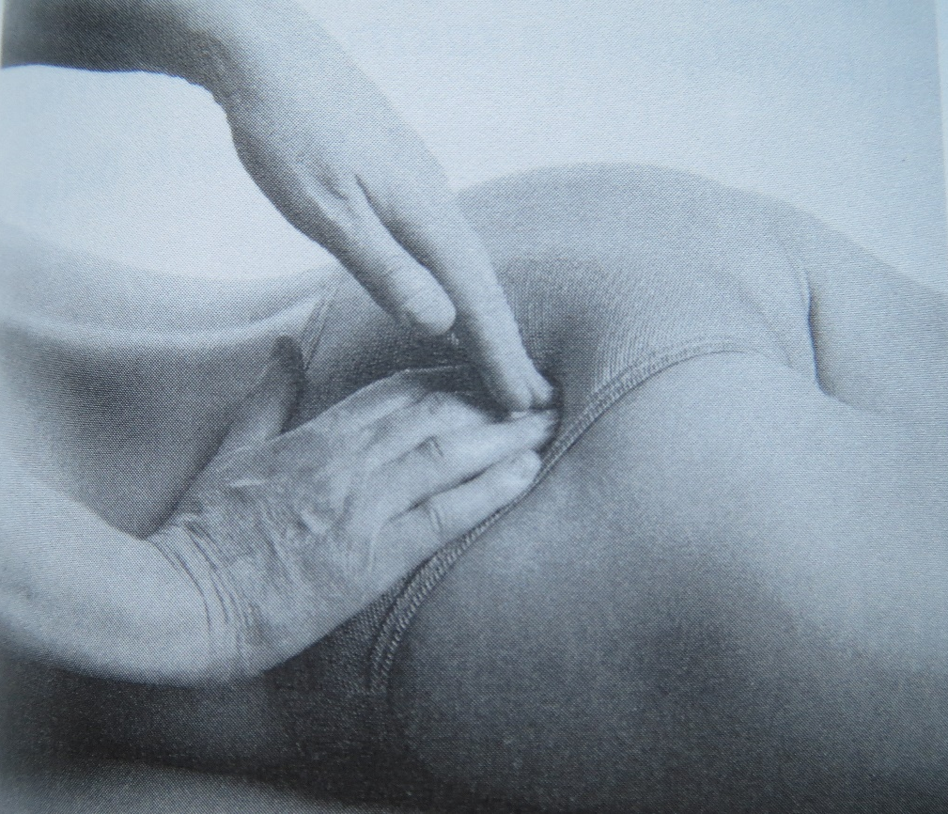
Piriformis
Palpation examination
If there is shortening of the piriformis, adduction and medial rotation are decreased and are painful at the end of the range of motion. Palpation of the piriformis usually
gives better results than
the stretch test. The palpation is
performed deeply in the area of
the greater sciatic foramen across
the muscle fibres. Normally
the muscle is not palpable, but if
there is shortening then it is felt
and it moves away under the
examiner's fingers.

Slide 52
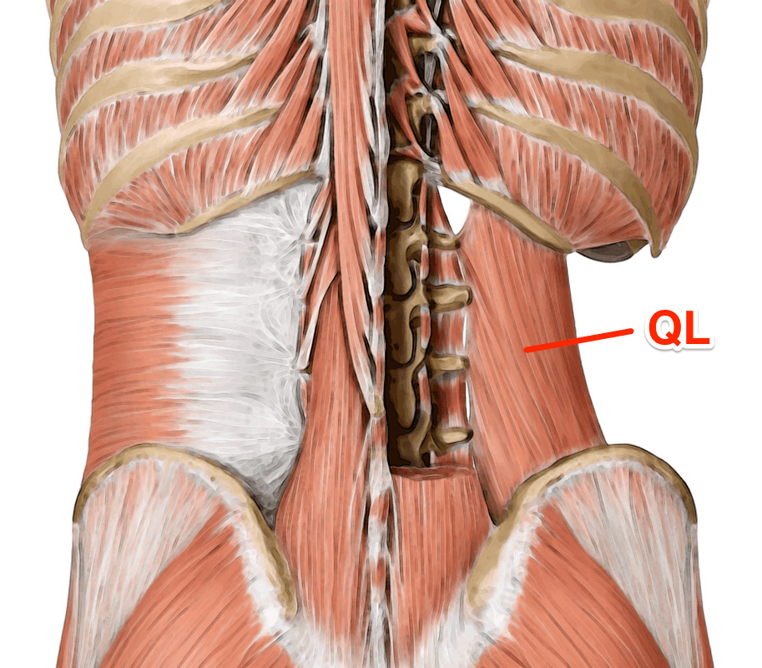
Quadratus Lumborum
Notes:
Origin iliac crest and iliolumbar ligament
Insertion Last rib and transverse processes of lumbar vertebrae
Artery Lumbar arteries, lumbar branch of iliolumbar artery
Nerve The twelfth thoracic and first through fourth ventral rami of lumbar nerves (T₁₂, L₁-L₄)
Actions Alone(unilateral), lateral flexion of vertebral column; Together (bilateral), depression of thoracic rib cage

Slide 53
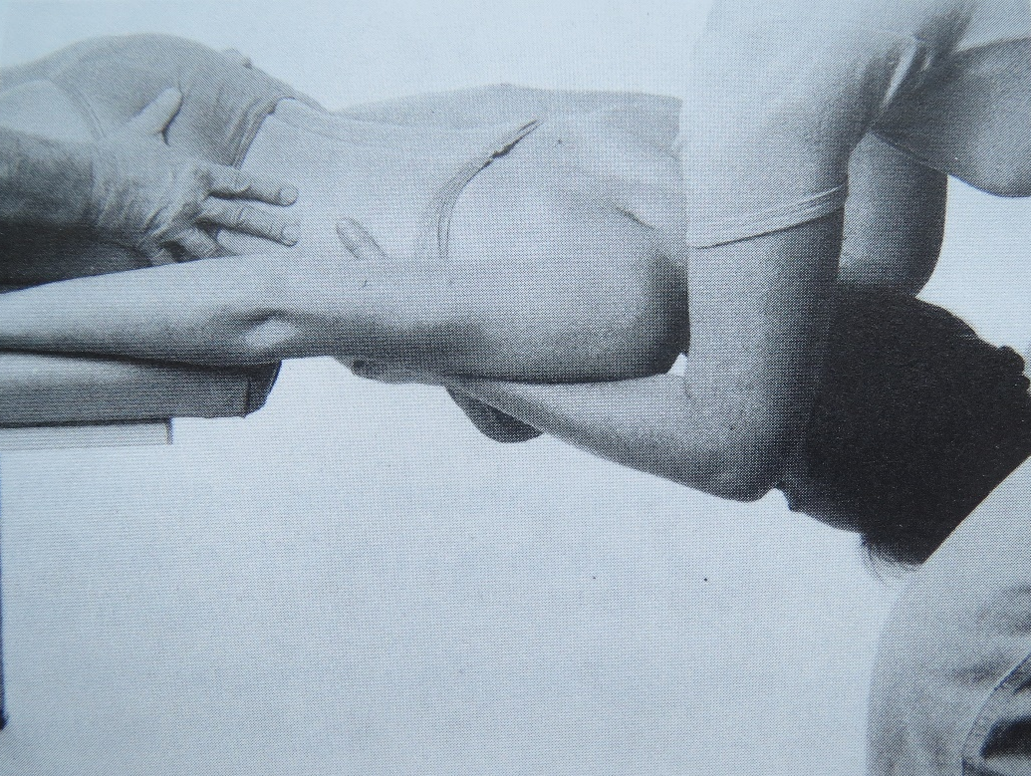
Quadratus Lumborum
First testing method
Starting position: Prone lying, with the upper part of the body over the end of the table.
Fixation: One examiner fixes the
pelvis and the legs, and during
the movement palpates
the tension of the quadratus
lumborum. The other examiner
steadies the upper part of
the patient's body with his/her
forearm without putting pressure
on the throat of the patient.

Slide 54
Quadratus Lumborum
First testing method
Movement: Side flexion of the trunk in the horizontal plane without twisting, lowering, or lifting.
Normal range: The side flexion of the trunk should be symmetrical. If there is muscle shortening,
the spinal column does not show
a smooth arched curve during side
flexion, the lumbar spine stays
very stiff and there is
a compensatory increase of
the movement in
the ThL segments.

Slide 55
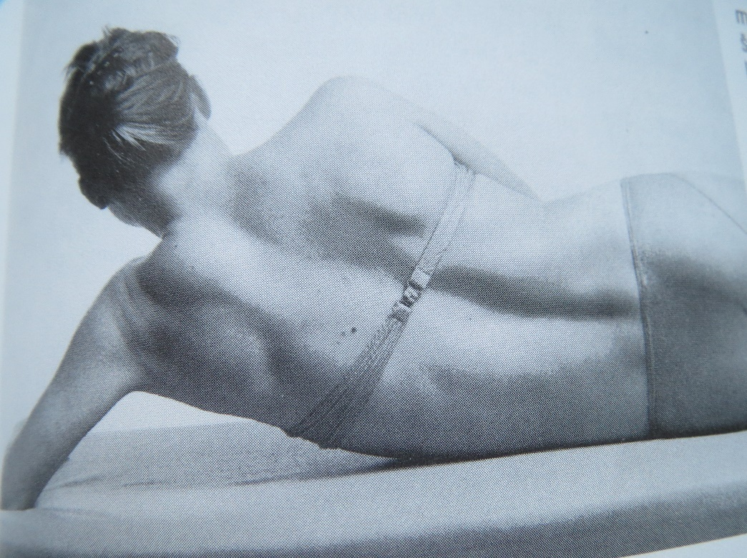
Quadratus Lumborum
Second testing method
Before the own examination we do a brand on the lateral side of the chest of
the examined in standing position. The mark is in the level of lower angel of the blade on the examined side.
Starting position: The patient lies on the side to be examined with the leg slightly flexed to stabilize the body. The top arm rests on
the body and the bottom one is slightly flexed at the elbow with the hand resting on the table above the head.

Slide 56
Quadratus Lumborum
Second testing method
Fixation: Not necessary
Movement: The patient pushes on her lower arm and therefore slowly raises her body. Thus side flexion of the trunk takes place without twisting or bending forwards or backwards. When the pelvis starts to move the movement must be stopped. If
the quadratus lumborum is shortened,
the lumbar spine is kept stiff and
the thoracolumbar segments show signs of local compensatory hypermobility. The lower waist crease stays concave.

Slide 57
Quadratus Lumborum
Second testing method
Ratings:
We measure the vertical distance of the marked point on the lateral side of the chest and table. Furthermore, we observe the lateral edge of the examined side, which, if shortening, is concave. We observe
the movement of the lumbar and thoracic spine. Always compare both sides.
0 - not a reduction – measured distance is more than 5 centimeters.
1 - small shortening – measured the distance is 3-5 centimeters.
2 - large shortening – measured the distance is less than 3 centimeters.

Slide 58
Quadratus Lumborum
Possible errors
While lying prone the neck is under pressure when the upper trunk is steadied.
During the movement there is twisting of the trunk and/or forwards or backwards bending.
The pelvis and the legs are not adequately fixed.
Palpation of the muscle to be tested is not deep enough and therefore the test is not valid.
In the orientation test in the standing position a sideways movement of the pelvis is allowed and also an increased upward movement of the shoulders.

Slide 59
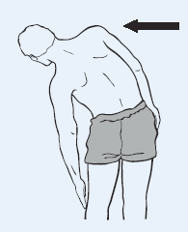
Quadratus Lumborum
Orientation test in standing
The patient is standing in side flexion without twisting the trunk forwards or backwards or lifting the shoulders. A sideways movement of the pelvis towards the opposite side must be avoided. The range
of movement of the two sides is compared.
At the end position, normally the line from the axilla of the opposite shoulder coincides with the intergluteal line. This test is not reliable in standing because the patient cannot be fully relaxed and the tested quadratus lumborum muscle contracts eccentrically during
the movement.

Slide 60
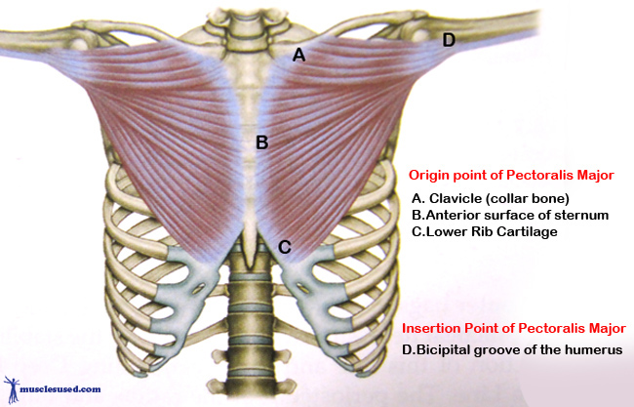
Pectoralis Major
Notes:
Origin Clavicular head: anterior border of the medial half of the clavicle. Sternocostal head: anterior surface of the sternum, the superior six costal cartilages, and the aponeurosis of the external oblique muscleInsertion Lateral lip of the bicipital groove of the humerus (anteromedial proximal humerus)
Artery pectoral branch of the thoracoacromial trunk
Nerve lateral pectoral nerve and medial pectoral nerve Clavicular head: C5 and C6, Sternocostal head: C7, C8 and T1
Actions Clavicular head: flexes the humerus, Sternocostal head: Adducts the humerus, As a whole, adducts and medially rotates the humerus. It also draws the scapula anteriorly and inferiorly

Slide 61
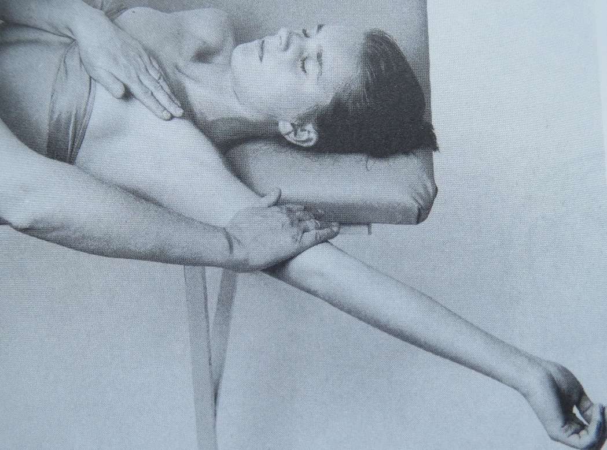
Pectoralis Major
Starting position: Supine lying, with the side to be examined near
the edge of the table and the arms alongside the body. Legs are flexed on the table.
Fixation: Before the movement has started there should be a light rotation of the thorax against its expected diagonal direction.
The fixation must be applied
before elevation of the arm.

Slide 62
Pectoralis Major
Movement:
lower sternal part – passive elevation of extended upper limb,
the arm is moved passively from the starting position outwards, across and upwards, so that the palm is directed towards
the ceiling.

Slide 63
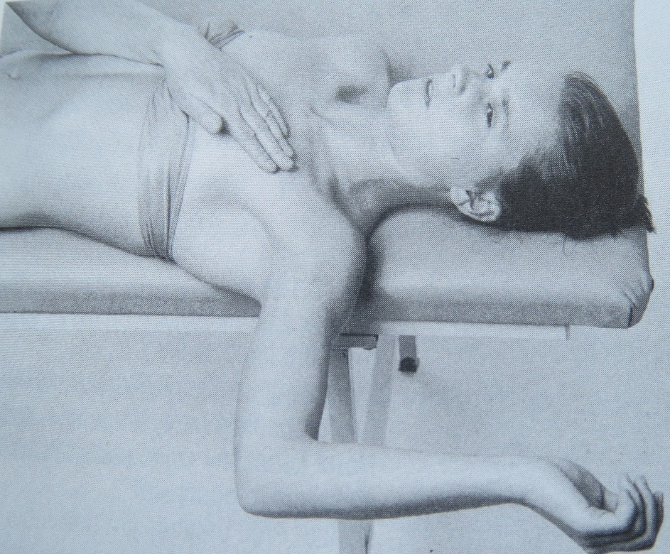
Pectoralis Major
Movement:
middle and upper sternal part – 90 degrees abduction and external rotation in shoulder, 90 degrres in elbow.

Slide 64
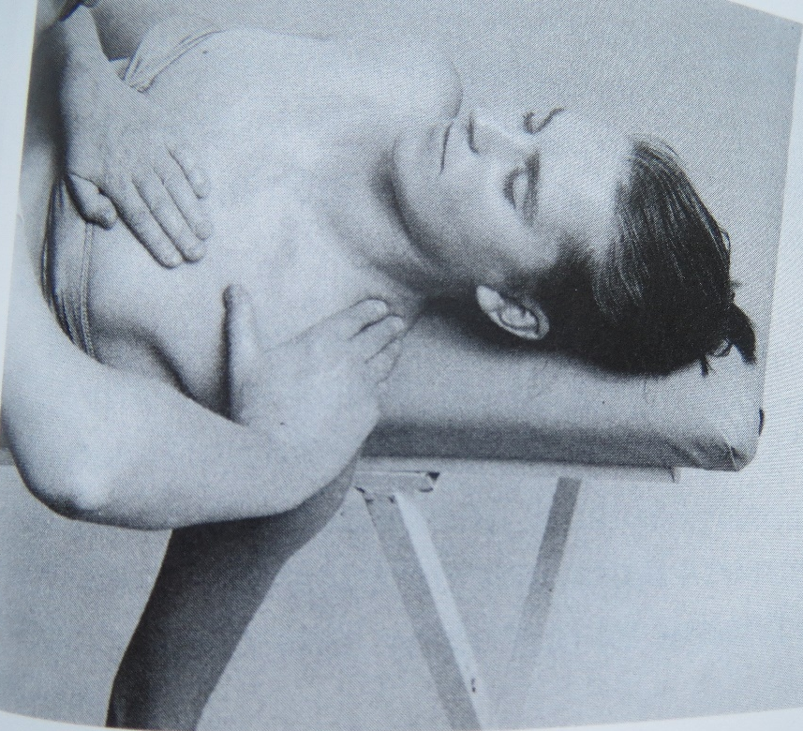
Pectoralis Major
Movement:
clavicular part and m. pectoralis minor – we let free fall upper limb extended in elbow and with external rotation in shoulder off
the table.

Slide 65

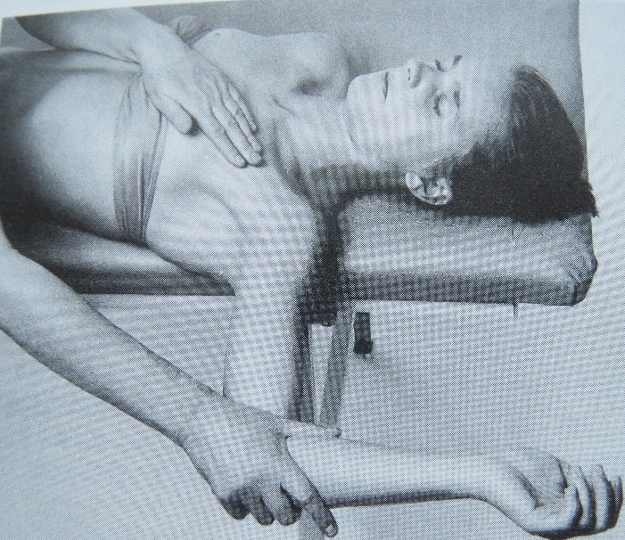

Pectoralis Major
Normal findings: The upper arm should reach the horizontal plane and with pressure in a vertical and posterior direction it should be possible to increase the range of movement. At the same time the muscle fibres are palpated in the sternal and clavicular parts of the muscle. If there is shortening the upper arm does not reach the horizontal plane and on palpation the tight muscle fibres are detected.
https://www.youtube.com/watch?v=78-zzdJ4tvA

Slide 66
Pectoralis Major
Ratings of the lower sternal and middle and upper sternal part
0 - not a reduction – the arm drops to the horizontal, range of motion still increases with a pressure on a distal portion of the humerus downwards, the arm gets below the horizontal.
1 - small shortening – the arm does not drop into the horizontal, but the arm can reach the horizontal when there is the pressure on
the distal portion of the humerus downwards.
2 - large shortening – the arm remains in a position above
the horizontal, the pressure on distal portion of the humerus can not compress the arm into the horizontal.

Slide 67
Pectoralis Major
Ratings of the clavicular part and m. pectoralis minor
We evaluate according to the possibility of pressing the arm to
the retraction and by palpation detected tension of clavicular fibers of m. pectoralis.
0 - not a reduction – compression of the arm can be performed easily, examiner does not find any increased tension of clavicular portion of m. pectoralis major by palpation.
1 - small shortening – compression of the arm can be performed, but with little resistance. Examiner simultaneously detects by palpation increased tension of the palpated part of m. pectoralis major.
2 - large shortening – compression of the arm is not possible, moreover examiner detects by palpation significant increased tension of clavicular portion m. pectoralis major. The examinee can feell this palpated tension also painfully.

Slide 68
Pectoralis Major
Possible errors
The thorax is not adequately fixed before the movement starts and so twisting of the trunk and an increased lumbar lordosis can take place.
Instead of fixing the thorax through a diagonal pull there is
a vertical push.
The pressure during the test is applied not towards the upper but towards the forearm.
The direction of the movement is not maintained and so the sternal part of the muscle fibres is not stretched to the necessary extent.

Slide 69
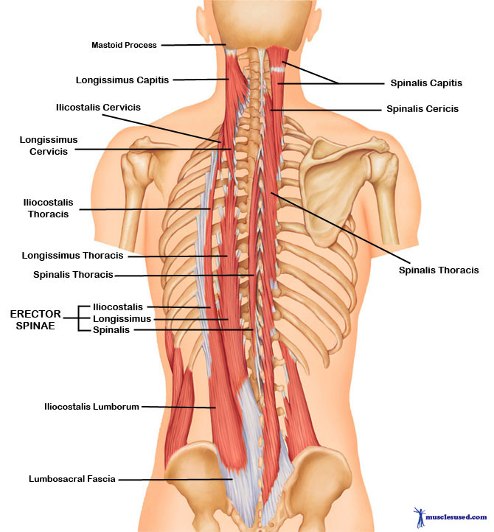
The Paravertebral Back Muscles

Slide 70
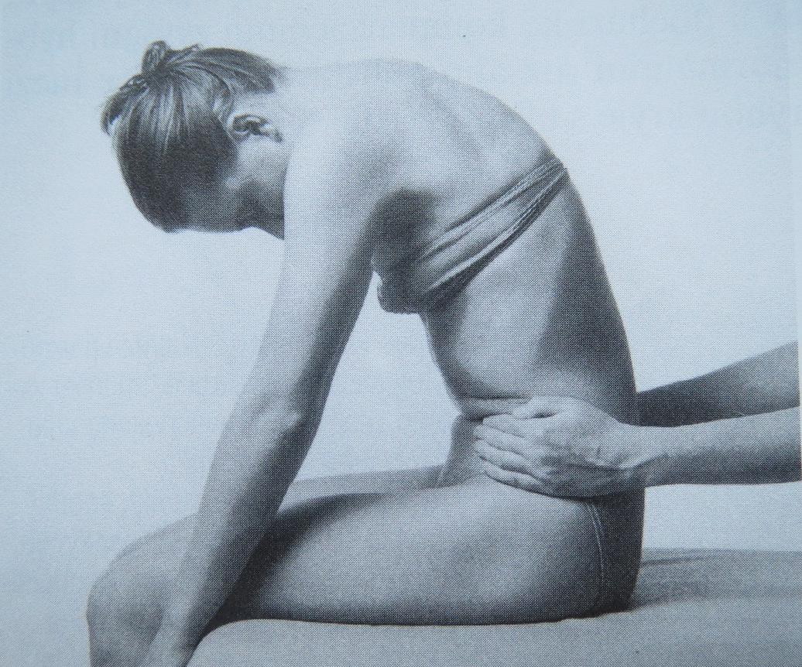
The Paravertebral Back Muscles
Starting position: The patient sits with
the knees flexed and the lower legs hanging over the edge of the table s0 that
the hamstrings are relaxed. Thighs are on
the examination table. Whole feet are supported so as to maintain the right angle in ankle joints.
Fixation: Examiner fixes the pan for iliac bones to prevent pelvic anteversion.
Movement: Forward bending to
the maximum range with the forehead moving towards the knees. The pelvis must not move.
https://www.youtube.com/watch?v=78-zzdJ4tvA

Slide 71
The Paravertebral Back Muscles
Ratings:
We measure the vertical distance forehead-thigh.
0 - not a reduction – the measured distance is not greater than 10 cm.
1 - small shortening – measured the distance is 10-15 centimeters.
2 - large shortening – measured the distance is more than
15 centimeters

Slide 72
The Paravertebral Back Muscles
Possible errors
The forward bending takes place through tilling the pelvis and not through bending the spine.
The test is not very specific!

Slide 73
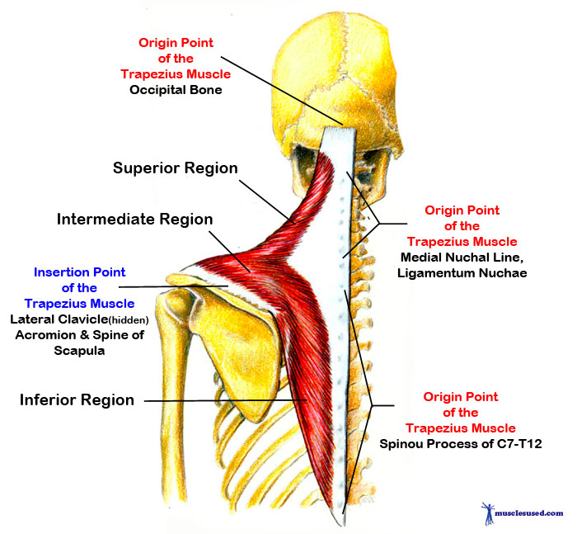
The Trapezius – Upper Part
Notes:
Origin spinous processes of vertebrae C7-T12, Nuchal ligament, Occipital Bone
Insertion external occipital protuberance, nuchal ligament, medial superior nuchal line, posterior border of the lateral third of the clavicle, acromion process, and spine of scapula
Artery superficial branch of transverse cervical artery or superficial cervical artery ^{[1]}
Nerve accessory nerve (motor), cervical spinal nerves C3 and C4 (motor and sensation)^{[2]}
Actions rotation, retraction, elevation, and depression of scapula
Antagonist serratus anterior muscle, Latissimus dorsi

Slide 74
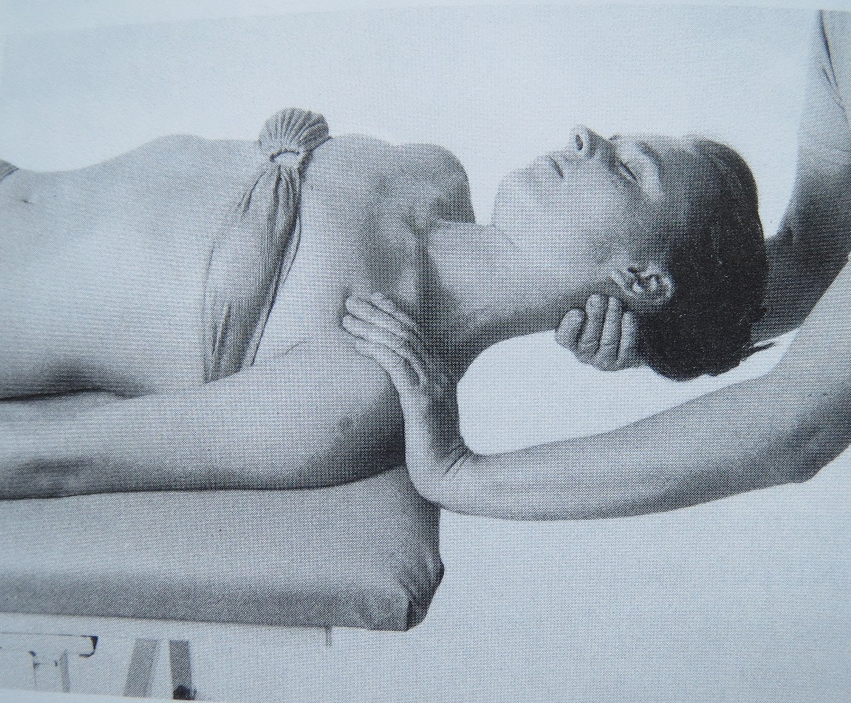
The Trapezius – Upper Part
Starting position: Supine, lower limbs slightly supported, upper limps loosely at your sides. Head off the table in the middle position supported by a physiotherapist in occiput.
Fixation: The shoulder on the side to be tested is fixed from above.

Slide 75
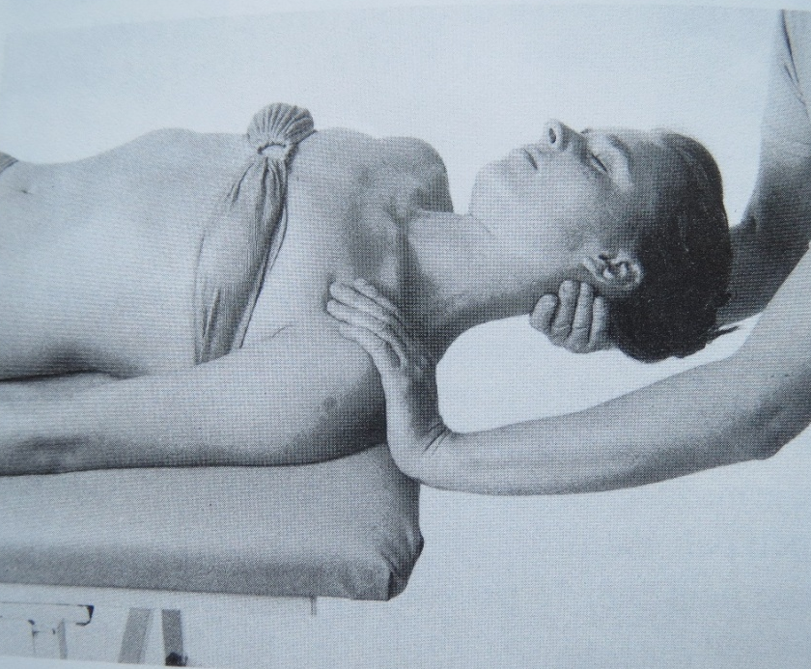
The Trapezius – Upper Part
Movement: Passive side flexion of the neck without flexion, extension or rotation. The head is moved with the ear to the opposite shoulder. Then continue with depresion of the shoulder.
Normal findings: The range of movement is compared on both sides and the fibres of the trapezius are palpated.
https://www.youtube.com/watch?v=78-zzdJ4tvA

Slide 76
The Trapezius – Upper Part
Ratings:
We evaluate the degree of the shoulder girdle compression (if inclination is limited, it is most likely a joint affair)
0 - not a reduction – compression of the arm can be performed easily
1 - small shortening – compression of the arm can be performed but with light resistance
2 - large shortening – compression of the arm can not be done, when we try to compress the shoulder we encounter stiff resistance to stop. Moreover, it can also be restricted inclination.

Slide 77
The Trapezius – Upper Part
Possible errors
Exact starting position of the head is not held.
We forget support of the knees.
The shoulder of the side to be tested is not fixed.
The movement takes place with rotation, flexion and extension of the spine.

Slide 78
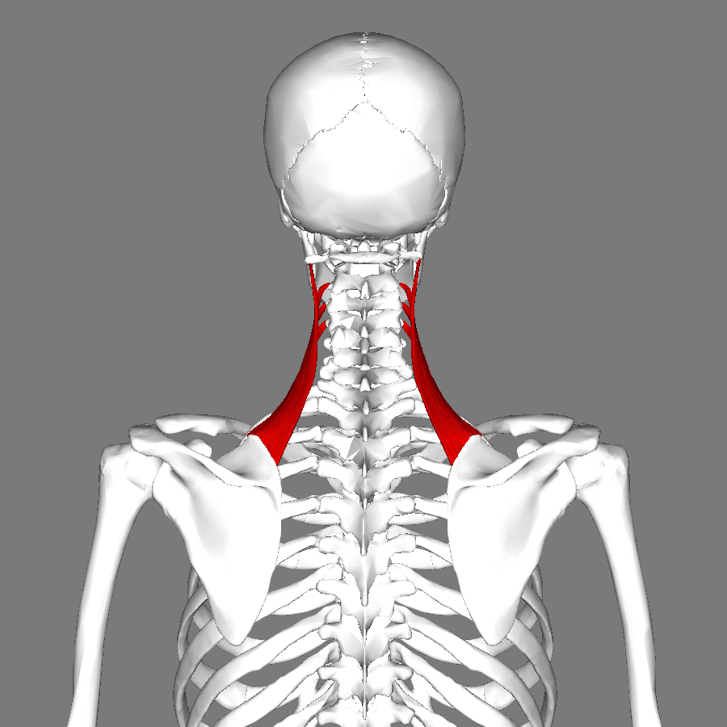
Levator Scapulae
Notes:
Origin Posterior tubercles of transverse processes of C1 - C4 vertebrae
Insertion Superior part of medial border of scapula
Artery dorsal scapular artery
Nerve cervical nerve (C3, C4) and dorsal scapular nerve (C5)
Actions Elevates scapula and tilts its glenoid cavity inferiorly by rotating scapula

Slide 79
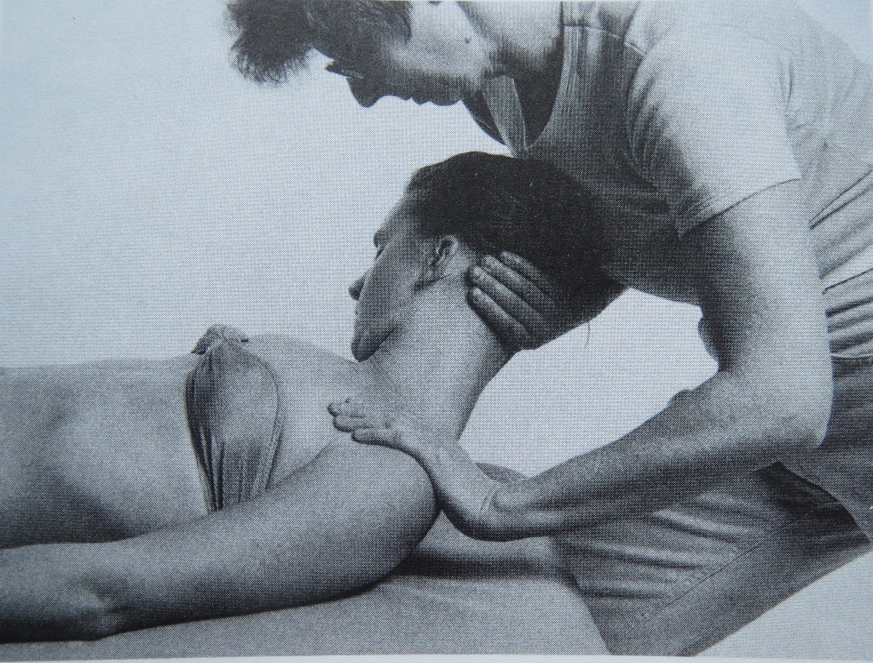
Levator Scapulae
Starting position: Supine lying with
the arms along the body. Lower limbs slightly bended. Head in the middle position on the table.
Fixation: The examiner steadies the head with one hand and stabilizes the shoulder with the other to depresion on
the examined side. Simultaneously palpates with thumb of the fixating hand
m. levator scapulae at its insertion on angulus superior scapulae.

Slide 80
Levator Scapulae
Movement: Maximal flexion in the cervical spine with rotation and side flexion towards the opposite side. If there is shortening of the levator scapulae, the range of movement is decreased and the muscle insertion painful on palpation.

Slide 81
Levator Scapulae
Ratings:
We evaluate the extent of the shoulder girdle depression (if limited inclination, rotation or flexion, it is most likely a joint affair)
0 - not a reduction – depression of the arm can be performed easily
1 - small shortening – depression of the arm can be performed but with light resistance
2 - large shortening – depression of the arm can not be done, when we try to depress the shoulder we encounter stiff resistance to stop. Moreover, there can also be restricted inclination.

Slide 82
Levator Scapulae
Possible errors
The shoulder is not adequately fixed.

Slide 83
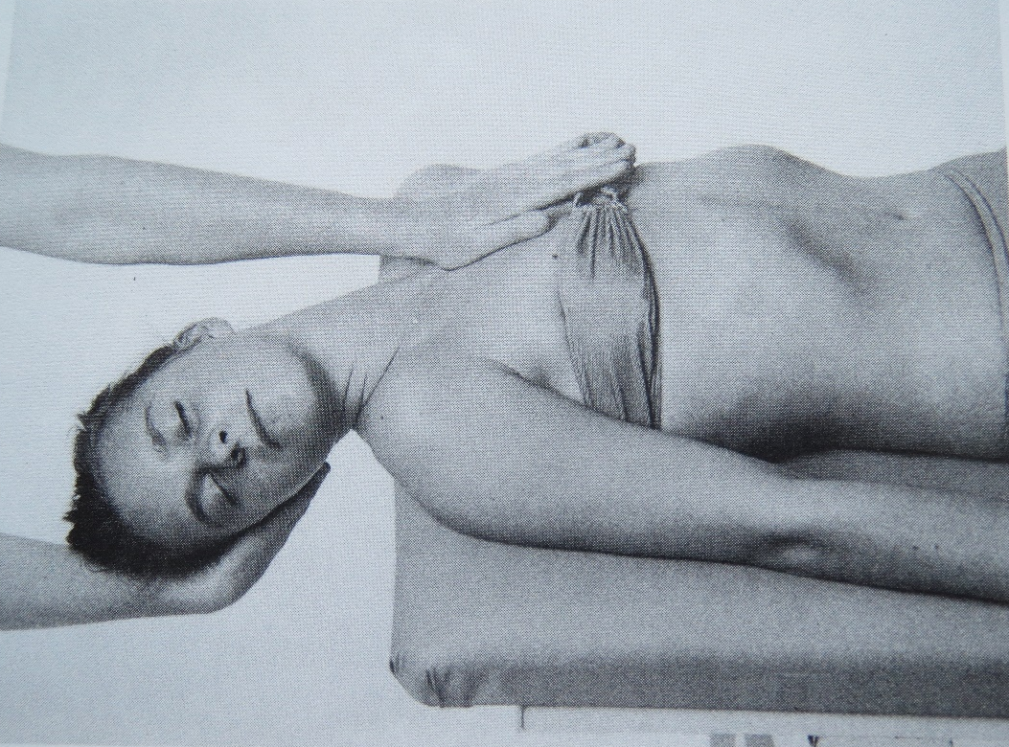
Sternocleidomastoideus
Starting position: Supine lying with the arms along the body. Lower limbs slightly bended. Head out of the table. Examiner behind the head of examinee.
Fixation: Sternum, if possible clavicula as well.
Notes:
Origin Manubrium and medial portion of the clavicle
Insertion Mastoid process of the temporal bone, superior nuchal line
Artery Occipital artery and the superior thyroid artery
Nerve Motor: spinal accessory nerve, sensory: cervical plexus, Proprioceptive: C2,C3 of ventral rami
Actions Unilaterally: contralateral cervical rotation, ipsilateral cervical flexion, Bilaterally: cervical flexion, elevation of sternum and assists in forced inhalation.

Slide 84
Sternocleidomastoideus
Movement: The examiner supports the head on occiput, makes further simultaneous extension, inclination and rotation of the head to
the side which is not assessed

Slide 85
Sternocleidomastoideus
Ratings:
The degree of shortening is evaluated by the range of extension and we palpate muscle belly and especially tendon of SCM on clavicle and sternum.
CAVE! Extension of cervical spine can impair blood circulation of
a. vertebralis…be careful at elderly!
This assessment is often unreliable because of restrictions on movement in the cervical spine!!!

Slide 86
e-sources, literature
http://www.musclesused.com/
https://quizlet.com/24689791/muscles-adductors-of-thigh-4-flash-cards/
Janda V. et al.: Muscle function testing
https://www.youtube.com/watch?v=78-zzdJ4tvA

Slide 87
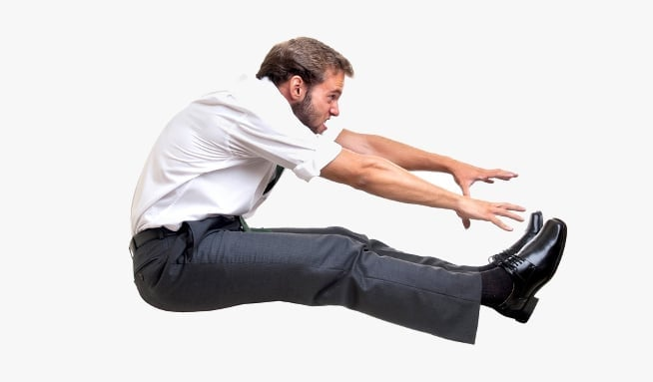
Thank you for your attention ☺

