Slide 1

INTEGUMENTARY SYSTEM
Skin thin type
thick type
Keratinized adnexa hair
nail
Nonkeratinized adnexa small sweat glands
great sweat glands
sebaceous glands
mammary glands

Slide 2
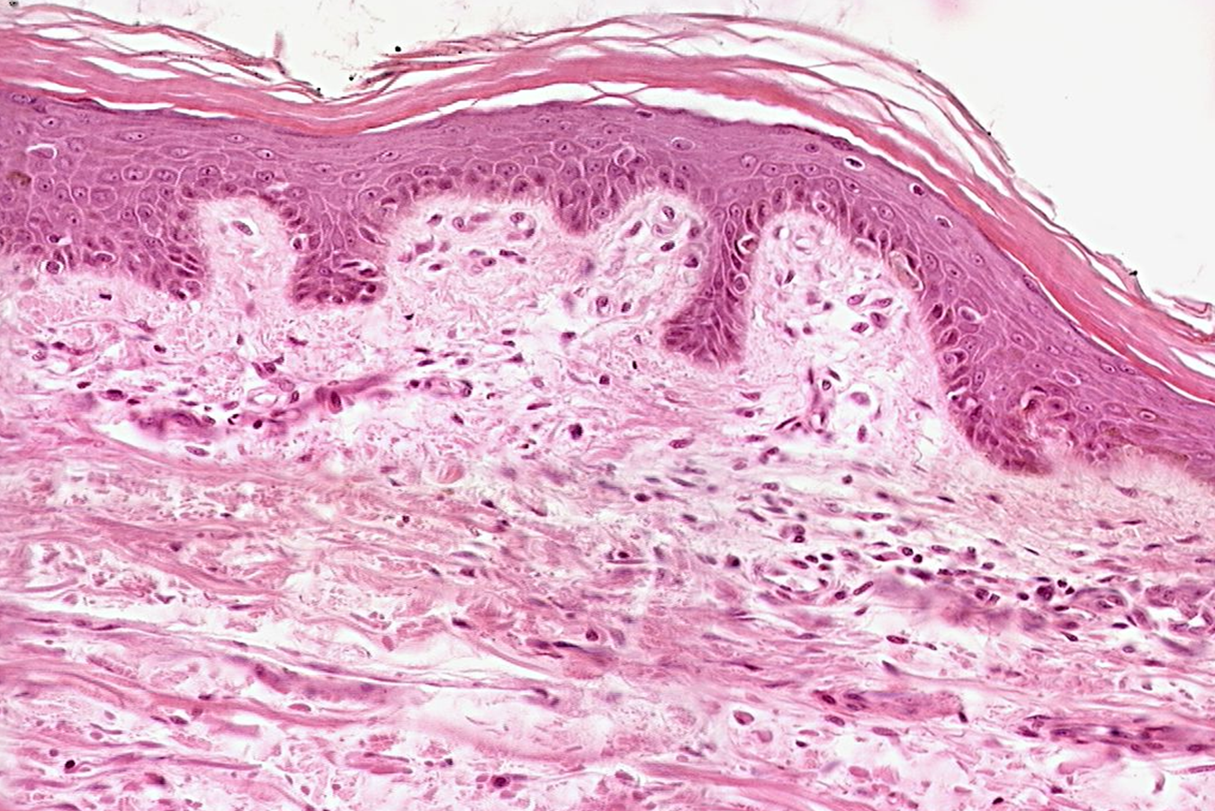
Skin (integumentum)
Epidermis
stratum corneum proprium
(stratum lucidum)
stratum granulosum
stratum spinosum
stratum basale
Dermis (corium)
pars papillaris
pars reticularis
Hypodermis)

Slide 3
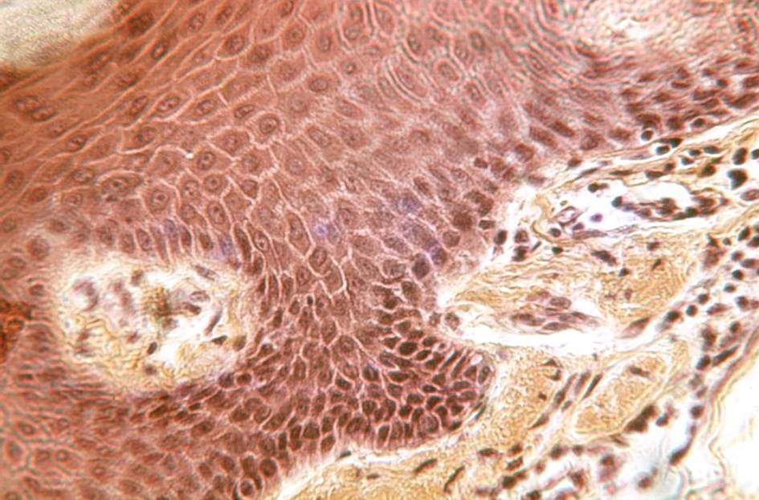
Epidermis
dermis

Slide 4
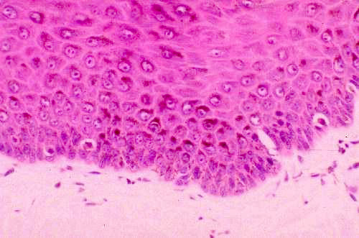
melanin
melanocytes

Slide 5
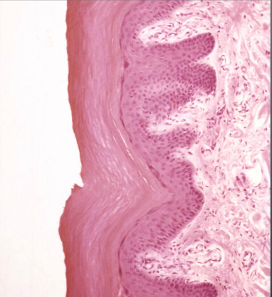
Thin skin Thick skin
Occurence: palma manus, planta pedis

Slide 6
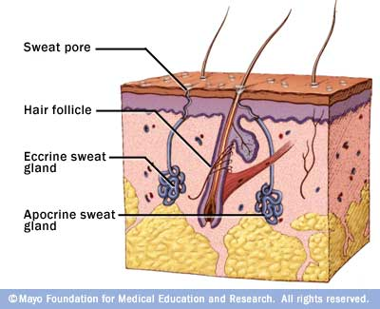
Skin glands small sweat (ecrine)
large sweat(apocrine)
sebaceous (holocrine) Gll. sebaceae
Gll. sudoriferae
General structure of glands:
excretory portion (ducts)
secretory portion
- glandular cells
- myoepithelial cells
https://dentalday.wikispaces.com/

Slide 7
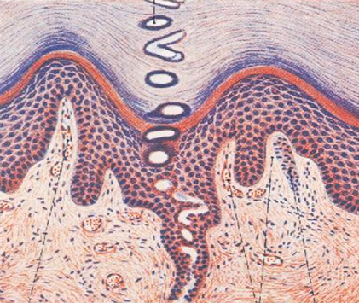

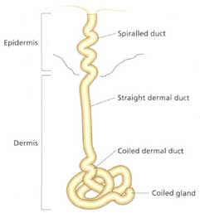
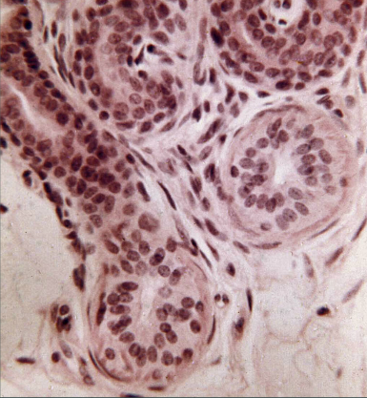
SWEAT GLANDS (gll. sudoriferae)
small ecrine
SWEAT – H₂O, NaCl₂, NH₃,
urea, uric acid, proteins

Slide 8

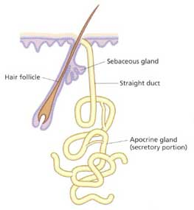
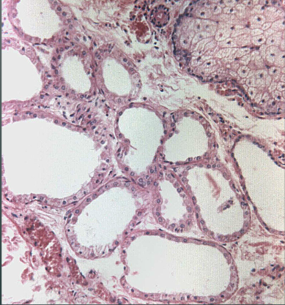
SWEAT GLANDS (gll. sudoriferae)
large apocrine
after pubery complet sweat
–pheromones, fats, steroids;
under hormonal influence

Slide 9
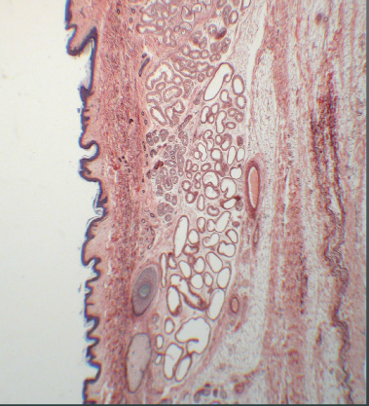

Skin from axilla – great sweat glands (apocrine, aromatic)

Slide 10
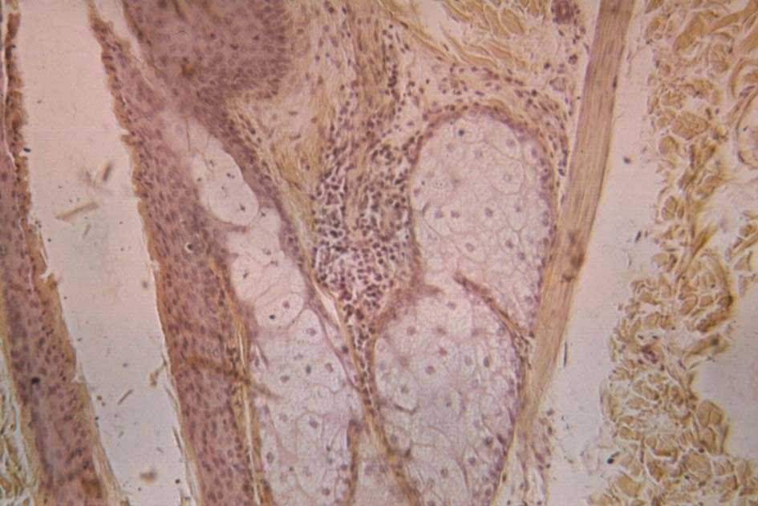
Sebaceous glands (HES)
m. arrector pili
hair follicle

Slide 11
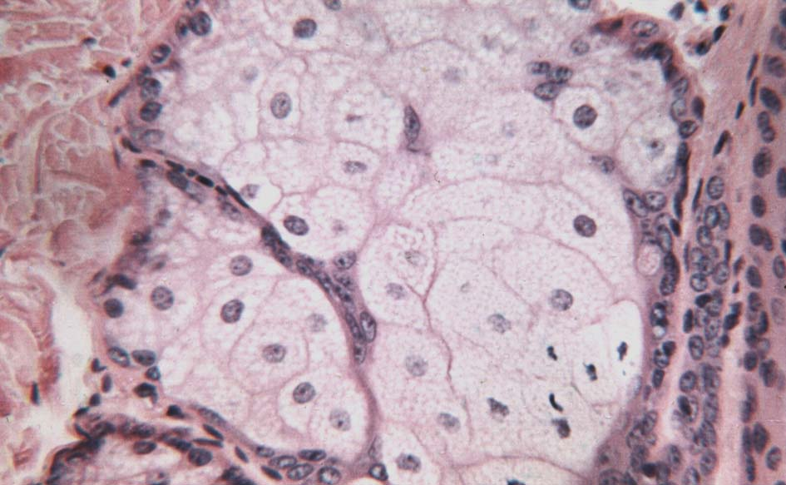
Sebaceous glands (HE)

Slide 12
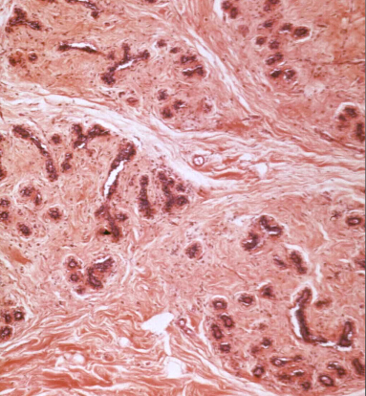
Mamma non lactans (HE)

Slide 13
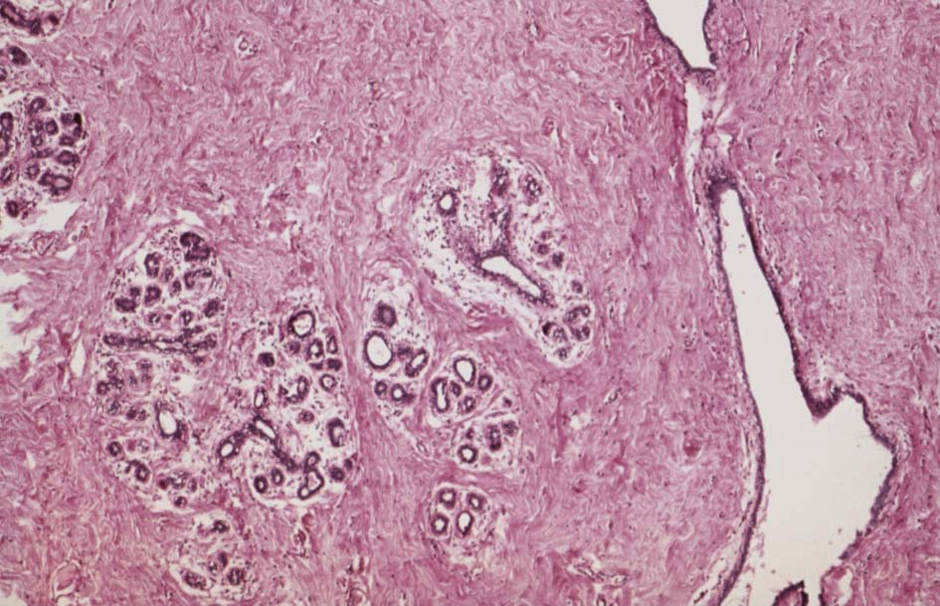
Mamma non lactans (HE)

Slide 14
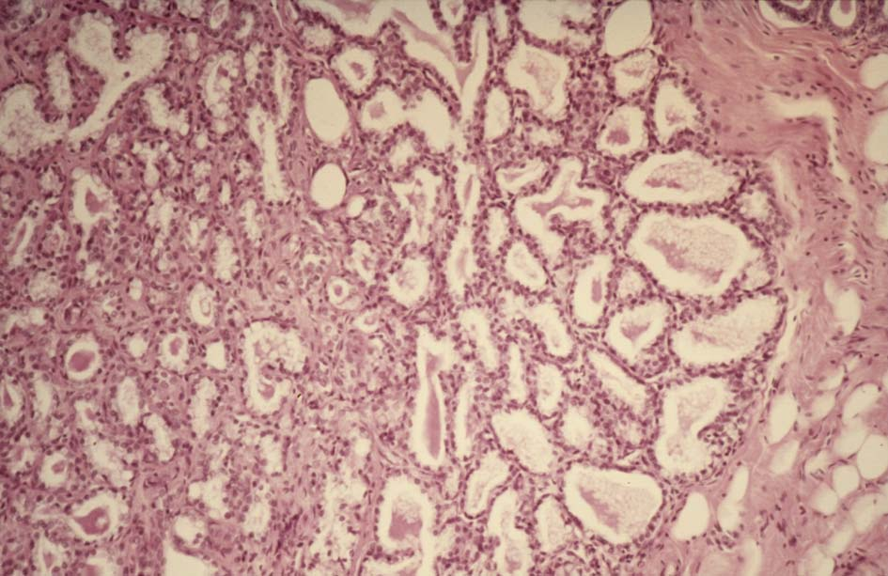
Mamma lactans (HE)

Slide 15
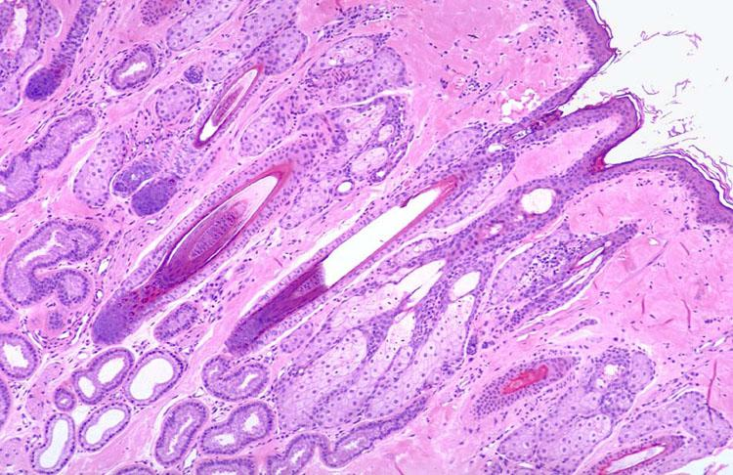
Skin from axilla with hair (HE)

Slide 16
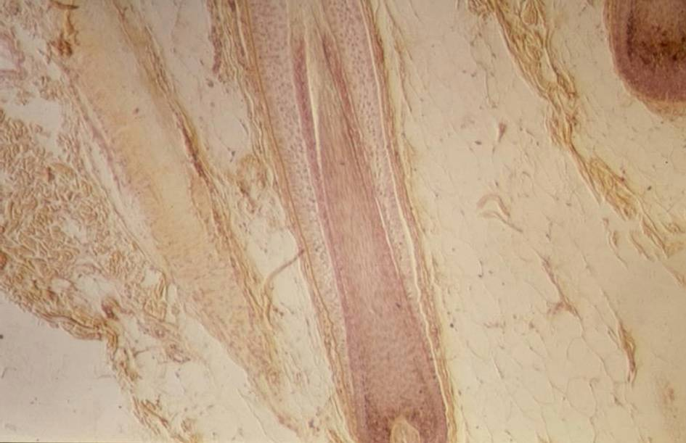
Hair (HEŠ)
m. arrector pili

Slide 17
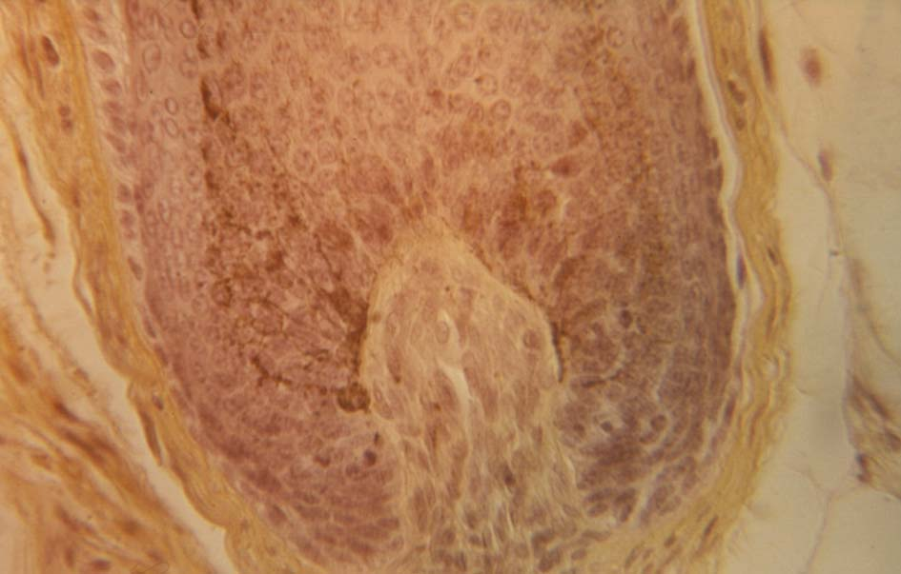
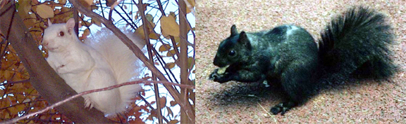
Hair – bulbus pili with melanocytes (HE)

Slide 18
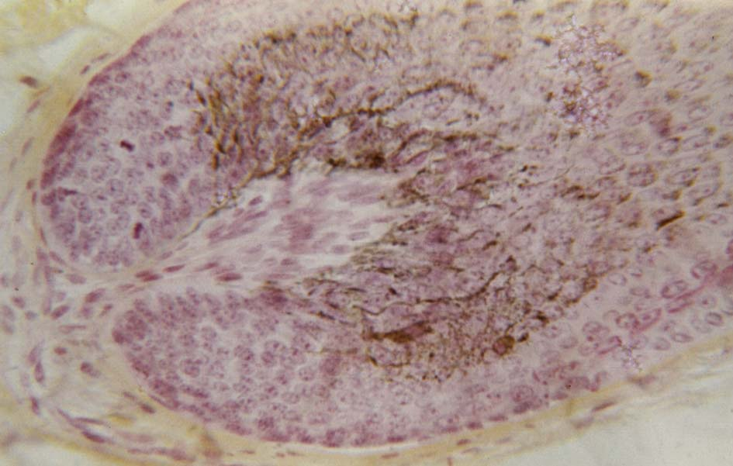
Hair – bulbus pili with melanocytes, papilla pili (HES)

Slide 19
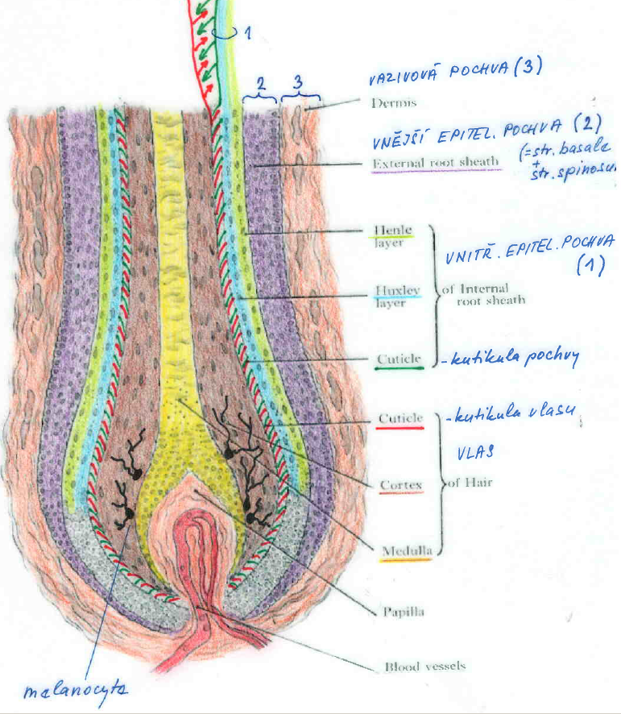
3
Hair (eng) – Vlas (cs) – Pilus (lat)
2 1
dermal sheath (1)
outer epithelial sheath(2)
Henle
Huxley
cuticle
of sheath
cuticle
of hair
cortex
medulla
dermal papilla
blood capillaries
inner epithelial sheath (3)
hair
melanocyte

Slide 20
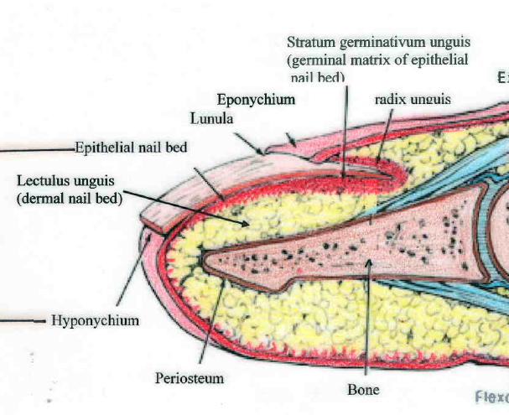
Nail (eng) – Nehet (cs) – Unguis (lat) – Onyx (gr)

Slide 21
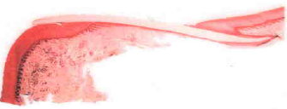
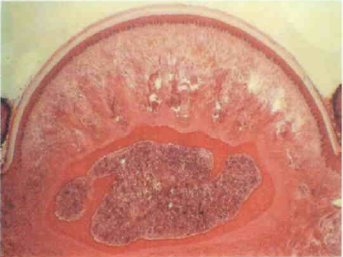
Nail (eng) – Nehet (cs) –Unguis (lat) – Onyx (gr)
Longitutudinal section
Cross section
vallum unguis nail plate
vulcus unguis
epidermal bed
dermal bed
bone

Slide 22
INTEGUMENTARY SYSTEM
Slides:
69. Skin from tip of finger
70. Skin from axilla
71. Skin with hair
72. Nail
73. Mamma non-lactans
74. Mamma lactans

Slide 23
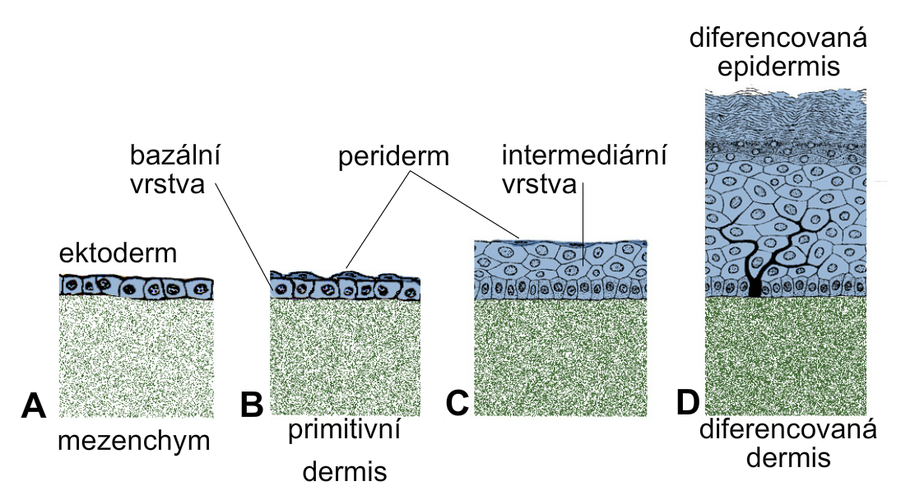
Development of epidermis and corium
differentiated
epidermis
basal intermediate
layer periderm layer
ectoderm
mesenchyme primitive differentiated
dermis dermis

Slide 24
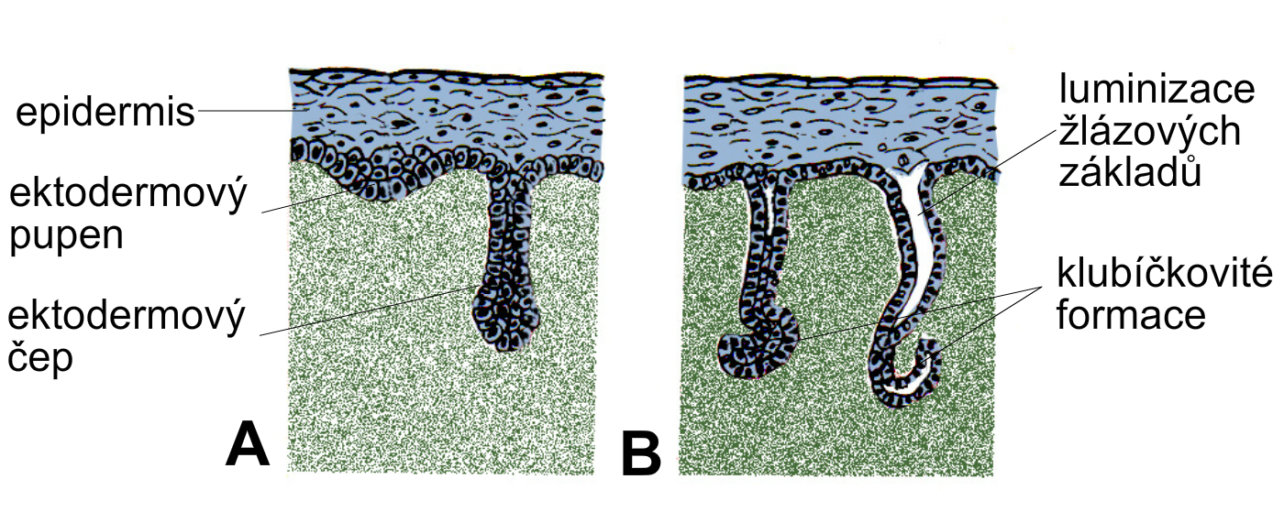
Development of sweat glands
development
of lumen
in glandular ducts
convolution
of secretory portion
epidermis
ectodermal bud
ectodermal peg

Slide 25
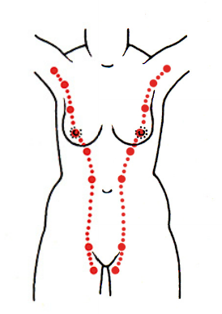
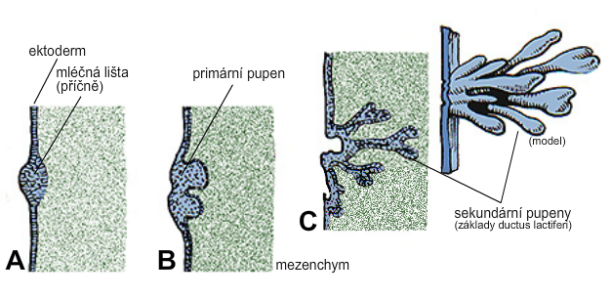
Development of mammary line and gland
B, C: primary and secondar ectodermal buds
ingrowth mesenchyme

Slide 26
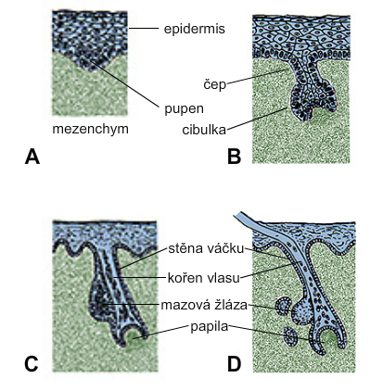
Development of hair and sebaceous gland
epidermis
peg
bud
hair bulb
mesenchyme
hair follicle
hair root
sebaceous gl.
papilla

