Slide 1
Influenza
Avian influenza
Tomáš Gergel

Slide 2
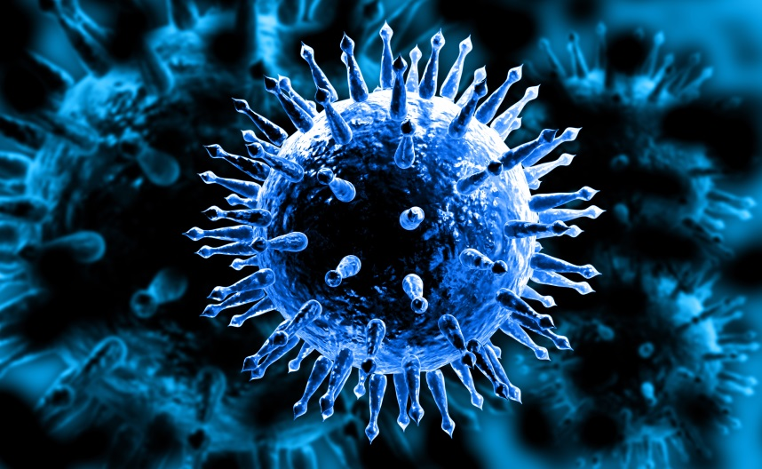
Influenza
segmented RNA viruses, family Orthomyxoviridae
Influenzavirus A - seasonal epidemics and pandemics
Influenzavirus B - milder, small epidemics
Influenzavirus C - pigs, dogs, less common, „common cold“
Influenzavirus D - pigs, cattle, no human infection was reported

Slide 3
Epidemiology
the illness occurs in outbreaks and epidemics worldwide
mainly during the winter season
self-limited infection in the general population
associated with increased morbidity and mortality in certain high-risk populations (cardiovascular ilnesses, chronic respiratory tract illnesses, immunocompromised patients,…)
CDC + WHO track influenza virus isolates throughout the world → monitor disease activity → predict the appropriate components for the annual influenza vaccine

Slide 4
infected >10% world population anually
5 millions of sever cases / year
0,5 million deaths / year
in Czech republic 3000 deaths / year

Slide 5
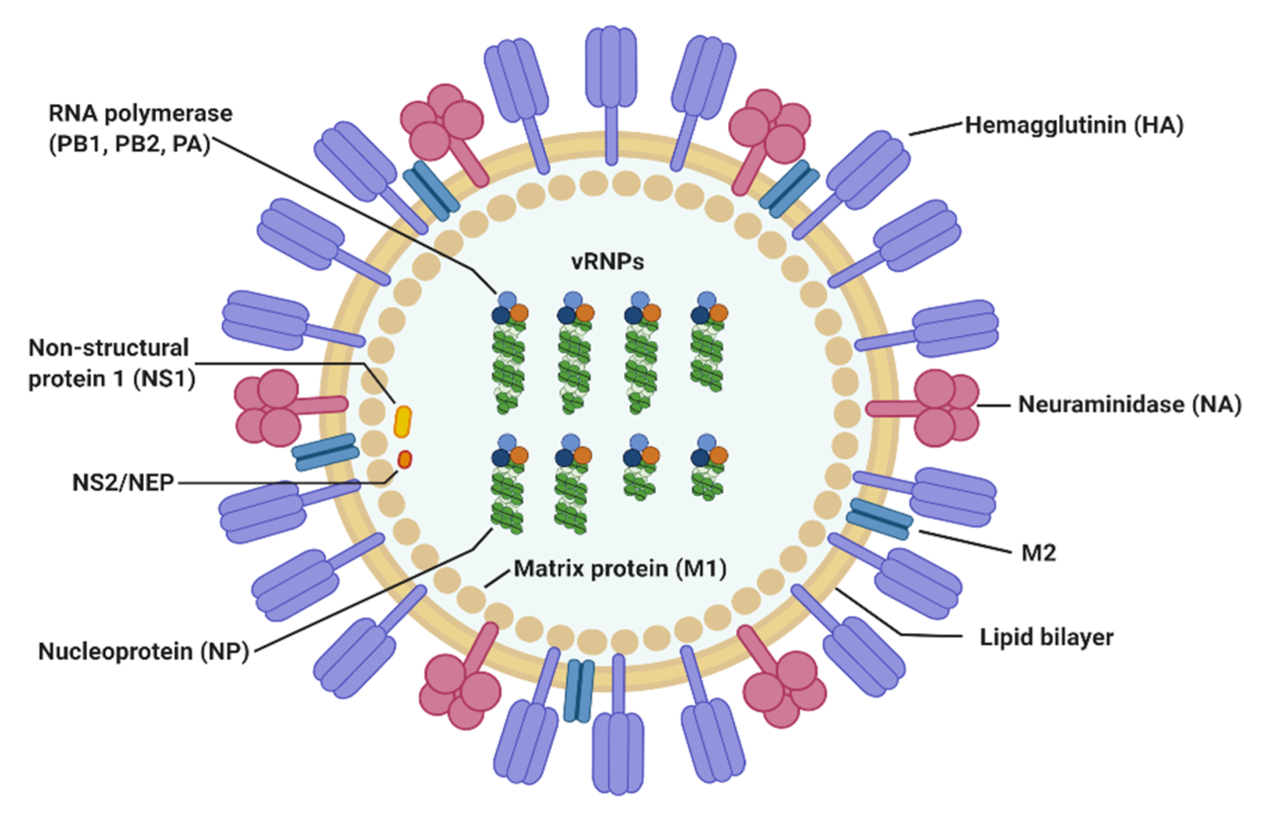

Slide 6
2 large surface antigens - glycoproteins
  Hemagglutinin - HA (H1-H18, humans only H1-H3)
    binding the viral particle to the host cell
  Neuraminidase - NA (N1-N11, humans only N1-N2)
    internalization of particle into the host cell, release the new particles from the cell
  Subtype f.e. : H1N1

Slide 7
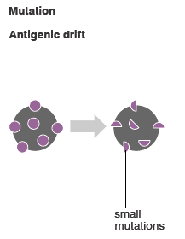
Antigenic drift
  minor antigenical change
  occurs almost annually
  results in outbreaks of variable extent and severity
  outbreaks less extensive and severe than the epidemics or pandemics associated with antigenic shifts
  point mutations in the RNA gene segments that code for the hemagglutinin or the neuraminidase

Slide 8
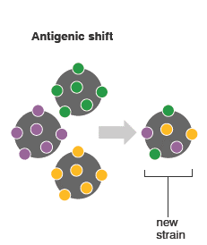
Antigenic shift
  major antigenical change
  segmented genome can be reassorted among viruses coinfecting the same cell
  reassortment between animal and human viruses - may result in the emergence of pandemic strains
  caused the pandemics of 1957, 1968 and 2009
  reassortment, switching the genom segments, among viruses coinfecting the same cell
  great role of pig and bird (avian) influenzaviruses

Slide 9
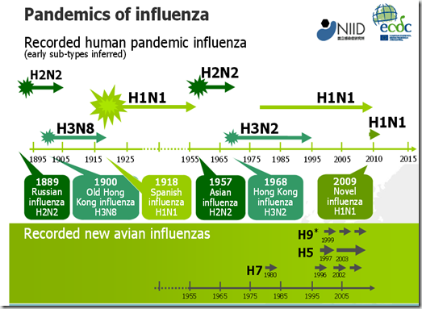

Slide 10
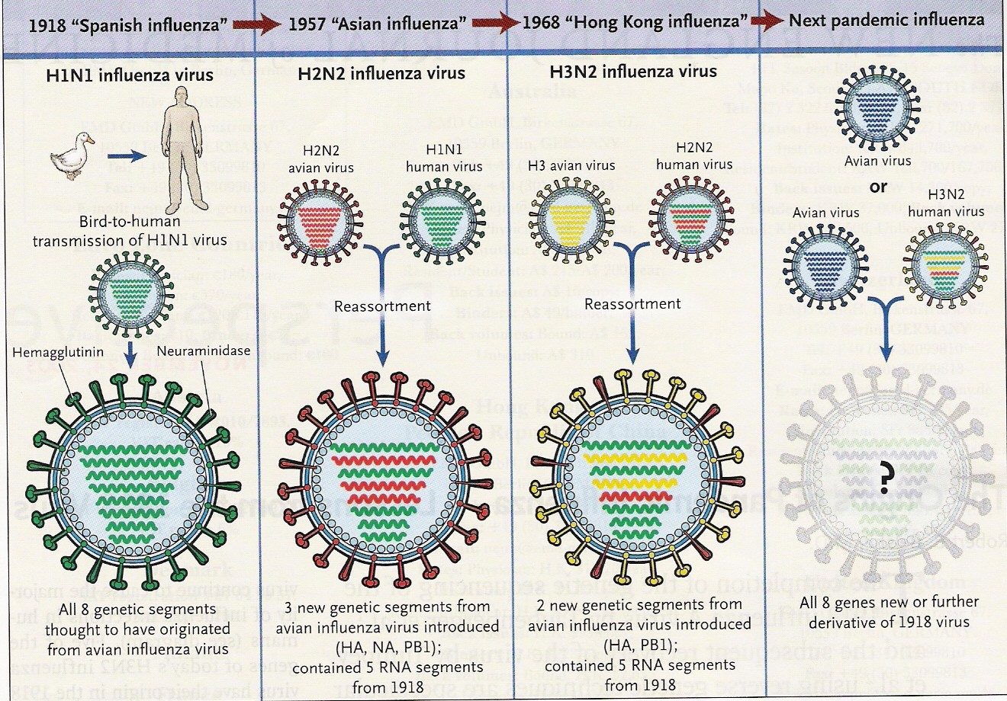

Slide 11
Outbreak characteristics
2-3 different strains circulate in a influenza season, 1 dominant
Seasonality — exclusively during the winter months in the Northern and Southern hemispheres (occur at different times of the year)
  !!! traveling to tropical regions
  persistance between outbreaks - poorly understood - import from geographically distant sites ??
Factors determining the severity of an outbreak
  not fully understood
  the susceptibility of the population = prevalence of antibodies to circulating virus = major role.

Slide 12
Outbreak characteristics
Time course of an outbreak
  begin abruptly
  peak ober 2-3 weeks
  last for 2-3 months
  earliest indicator of outbreak = increase in febrile respiratory illnesses in children → increases in influenza-like illnesses in adults
  outbreaks attack rates = 10-20% in the general population, ˃50 % in pandemics, extraordinarily high attack rates in institutionalized and semiclosed populations.

Slide 13
Transmission
large amounts of influenza virus in respiratory secretions → cough, sneezing
  → large dropplets (˃5um) - small distance (up to 2 m/6 feet)
  → small particle aerosols - long distances
  → contact with contaminated surface
    → respiratory tract
    → (ocular mucousa)
Incubation period: 1-4 days
Duration of shedding: detected 24 to 48 hours before illness onset, 5 days after onset of symptoms in avarage

Slide 14
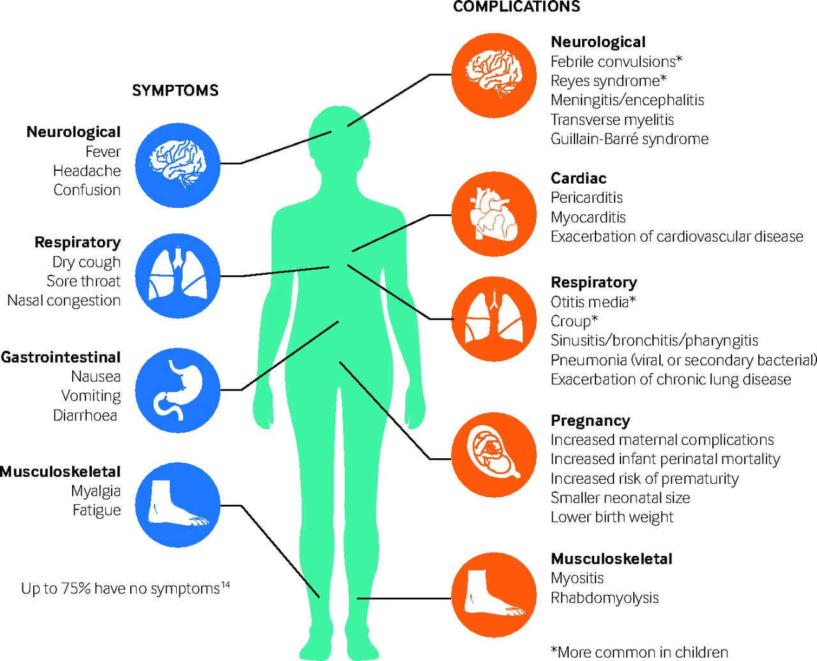
Clinical manifastation
Uncomlicated influenza
abrupt onset of fever (37.8-40.0°C), headache, myalgia, and malaise
respiratory tract illness - nonproductive cough, sore throat, and nasal discharge
GIT - vomiting, diarrhea (ussualy children)
patient appears hot and flushed
oropharyngeal hyperemia, mild cervical lymphadenopathy
physical examination is unremarkable
Lab: unspecific, leukocyte normal, leukopenia in the early state, >15,000 cells/microL suggest bacterial superinfection
improvenment usually 2-5 days
postinfluenza asthenia - persistent symptoms of weakness, fatigability, last for several weeks

Slide 15
Clinical manifastation
Complicated influenza
Pneumonia - most common complication of influenza
Primary influenza pneumonia
  severe pneumonia
  symptoms persist and increase instead of resolving
  high fever, dyspnea, cyanosis
  X-ray, CT
Secondary bacterial pneumonia
  ↑morbidity and mortality ≥65 years
  exacerbation symptoms after initial improvement , production of purulent sputum, pulmonary infiltrates
  bacterial pathogens: S. pneumoniae , S.aureus, (S.pyogenes, P.aeruginosa, H.influenzae, K.pneumoniae, M.catarrhalis, E.coli
Mixed viral and bacterial pneumonia

Slide 16
Clinical manifastation
Complicated influenza
Acute respiratory distress syndrome (ARDS) and multisystem organ failure (MOF)
Myositis and rhabdomyolysis
  most frequently in children
  extreme tenderness of affected muscles (legs)
  elevated serum creatine phosphokinase, myoglobinuria with associated renal failure
Cardiac
  ↑risk acute coronary syndrome, myocarditis and pericarditis
Central nervous system
  encephalopathy, encephalitis, transverse myelitis, aseptic meningitis and Guillain-Barré syndrome

Slide 17
Diagnosis
during season/outbreak
clinical dg.
  uncomplicated acute respiratory ilness
  not requiring hospitalization
  ↓risk of complications

Slide 18
Diagnosis
whom to test:
  symptomatic immunocompromised patients / patients at ↑risk
  patients requiring hospitalization with acute respiratory illness, including pneumonia, with or without fever
  patients requiring hospitalization with acute worsening of chronic cardiopulmonary disease (eg, COPD, asthma, coronary artery disease, or congestive heart failure)
  acute onset of respiratory symptoms with or without fever, or respiratory distress, after hospital admission

Slide 19
Diagnosis
RT-PCR
  golden standard, genome identification
  most sensitive and specific
  rapid results (1-8 hours)
  differentiates between influenza types and subtypes
  nasopharyngeal aspirates, bronchoalveolar lavage fluid, nasal and throat swabs
Rapid antigen tests
  influenza A and B viral nucleoprotein antigens in respiratory specimens
  qualitative results (+/-)
  results in approximately 15 minutes or less
  but much lower sensitivity than RT-PCR

Slide 20
Diagnosis
Viral culture
  nasal washes, throat swabs, sputum, bronchoalveolar lavage specimens
  results available in 48-72 hours
Serologic testing
  useful primarily for research purposes
  not useful for the diagnosis of acute illness - paired acute and convalescent are required
  to establish the diagnosis of influenza retrospectively

Slide 21
Treatment
Nonspecific
  fluids
  vitamins
  antipyretics/analgetics
  antitusics...

Slide 22
Treatment
Antivirals:
  neuraminidase inhibitors: zanamivir (inhalation 10 mg 1-0-1, 5 days), oseltamivir (p.o. 75 mg 1-0-1, 5 days), peramivir (i.v. 600 mg 1xdaily)
    active against both influenza A and B
  inhibitor of influenza cap-dependent endonuclease: baloxavir
    active against influenza A and B
  adamantanes: amantadine, rimantadine
    only active against influenza A
    increase in resistant isolates, adverse effects → ↓ of use

Slide 23
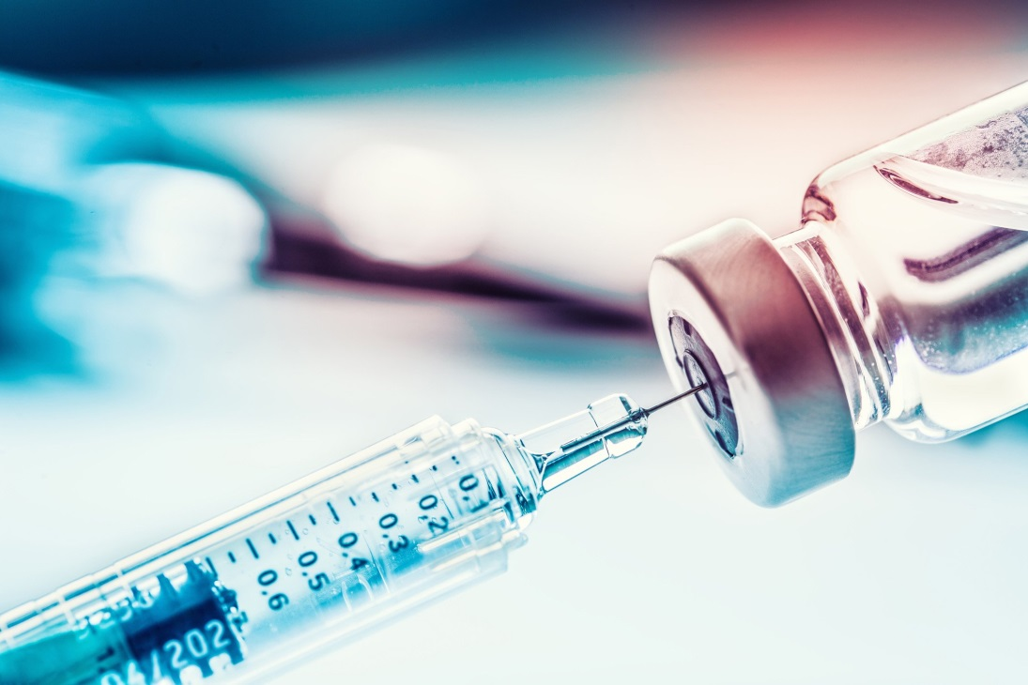
Prevention
Preexposing measures
  hand washing, aerosols (masks)
Vaccinaton
Profylactic drug use
  Oseltamivir (75 mg 1xdaily)
  Zanamivir (5 mg 1-0-1)

Slide 24
Prevention
Vaccination
most effective prevention
against hemagglutinine
every year due to antigenic drifts
  i.m. - inactivated vac., reccombinant vac.
  nasaly - live attenuated vac. (not available in CR)
  quadrivalent vac. - influenza A Ag x2 + influenza B Ag x2
  trivalent vac. - influenza A Ag x2 + influenza B Ag x1
elderly, chronicly ill, healthcare workers, long term facility workers, ...

Slide 25
Avian influenza
influenza viruses adapted to birds
mostly influenza A virus
high pathogenic avian influenza (HPAI), low pathogenic avian influenza (LPAI)
H1-16, N1-9 = many subtypes
  only H5N1, H7N3, H7N7, H7N9, H9N2 were confirmed in human
new strains typically emerge in Southeast Asia (close contact of human, bird and swine)
↑ pandemic potential, ↑ case fatality rate

Slide 26
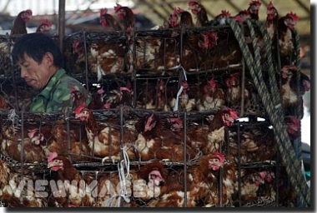

Slide 27
Transmission
Bird-to-human
  handling dead infected birds
  contact with infected (animal) fluids
  contaminated surfaces and droppings
  close contact, ↓hygiene
Human-to-human
  rare, only prolonged contact
  spreading after mutation is ↑concern
Role of pigs
  infected by avian and human strains → reassortement → new strain

Slide 28
Why so dangerous ?
avian influenza viruses attach cells via diferent receptors than human strains → these reseptors are in lower respiratory tract in human → severe pneumonia with ARDS
↓ effect of host antiviral cytokines, ↑ proinflammatory mediators → SIRS
→ ARDS
predominance of children and young adults

Slide 29
Clinical manifestation
Incubation period: 2-5 days
  respiratory illness
  GIT
  CNS
Complications: pneumonia, MOF, renal dysfunction, cardiac compromise, pulmonary hemorrhage, pneumothorax, pancytopenia
Lab: leukopenia, neutropenia, lymphopenia, thrombocytopenia,
↑ aminotransferases (AST>ALT), ↑LDH, ↑ CK, ↓ albumin

Slide 30
Diagnosis, treatment
DG:
PCR
antigen detection
serology
viral isolation
Treatment
nonspecific
only oseltamivir is recommended in specific treatment of avian flu

Slide 31
Prevention
Infection control measures
  appropriate biosafety precautions when handling suspected specimen
  higher level of infection control than for seasonal influenza viruses - eye protection and respirators (eg, N95 masks, FFP2) in addition
  patients in airborne infection isolation rooms
postexposition profylaxis – oseltamivir, zanamivir
vaccine against H5N1 is available - ??? Efficiency after 10 years ???

Slide 32
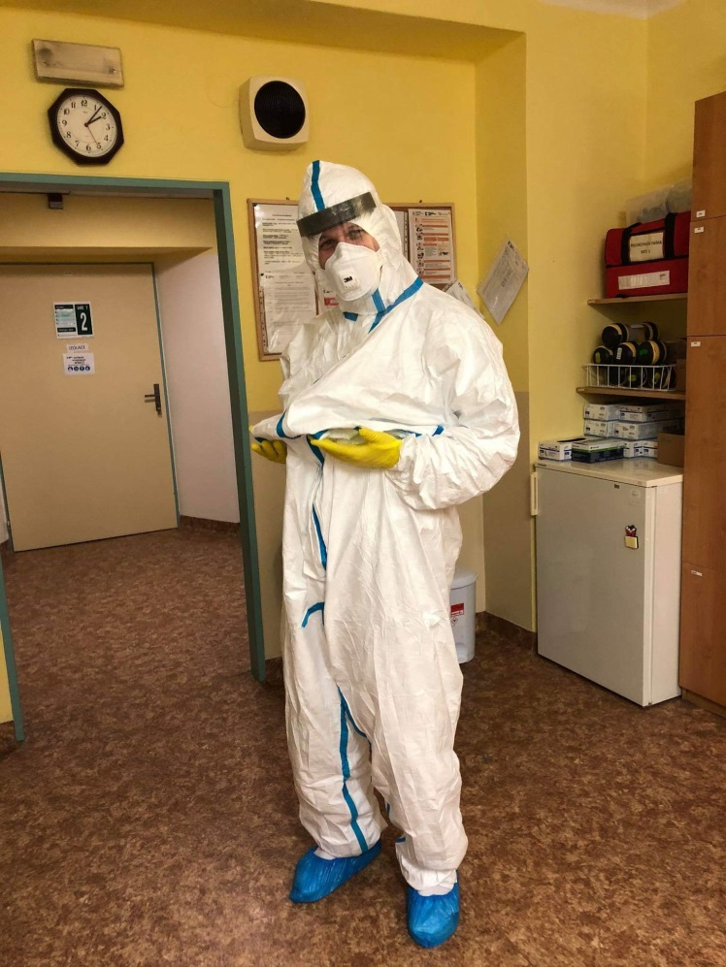
Thank you for your attention !

