Slide 1
Assessment and monitoring of nutritional status.
Principles of nutritional support, enteral and parenteral nutrition.
Dietary constituents providing a sufficient energy intake.
Michaela Králíková
Department of Biochemistry
Faculty of Medicine MU

Slide 2
Evaluation of nutritional status
Long-term state of nutrition
Actual (contemporary) state of nutrition
  Data to assess: antropometric laboratory: biochemical hematological imunological
                indirect calorimetry
Notes:
Anthropometric and laboratory indicators and calculations are often unreliable, and indirect calorimetry plays a crucial role in determining the optimal energy intake.

Slide 3
Antropometric data
Normal values
weight w, height h
BMI
Broca index
Arm muscles circumference (arm circumference – π . triceps skinfold /cm/)
triceps skinfold
body composition
18.5 – 24.9 kg/m²
h (cm) – 100 = w (kg)
♂ ≥ 25 cm, ♀ ≥ 20 cm
♂ 12.5 mm, ♀ 16.5 mm
What are your values?

Slide 4
Laboratory data
Total protein/S
Albumin /S (t_{1/2} = 21 days)
Prealbumin /S (t_{1/2} = 2 - 3 days)
Transferrin /S (t_{1/2} = 7 days)
RBP (t_{1/2} = 0.5 day)
CRP /S
Zn /S (binds to alb)
Chol (long-term indicator)
Blood count
Total lymphocytes number, number of CD4, CD8
Ig /S
Delayed skin reaction

Slide 5
Energy balance
Energy ingested = energy expended
Resting metabolic rate RMR (kJ/day) = 100 . w (kg) = 4.2 . S (m²)
reserves formation
heat production
activity
stress
• rise in body temperature by 1°C → + 15 % RMR
• activity factor: bedridden → 1.2 RMR
not - bedridden → 1.3 (heavy physical activity → 2)
• trauma factor: small surgery → 1.2
severe surgery → 1.35
sepsis → 1.6
severe burns → 2.1
What is your RMR
(in kJ, kcal)?
1 kcal = 4.19 kJ

Slide 6
Energy balance
Harris-Benedikt equation for RMR assesment
Male
BM (kcal/24 h) = 13.7516 . w (kg) + 5.0033 . h (cm) – 6.755 . age (years) + 66.473
Female
BM (kcal/24 h) = 9.5634 . w (kg) + 1.8496 . h (cm) – 4.6756 . age (years) + 655.0955

Slide 7
indirect calorimetry
Weir equation for energy expenditure
EE (kcal/ 24 h) = 3.95 . V (O₂) + 1.11 . V (CO₂)
Computational relations for estimation of substrate oxidation
Saccharides, lipids mg/min from V(O₂), V(CO₂)
Proteins g/24 h = 6.25 . nitrogen output/24 h
N_{out} (g) = c_{urea/U} . V_{u} . 100/84 . 0.028 + other (faeces, skin)
1 kcal = 4,185 kJ

Slide 8
Disorders of nutrition - malnutrition
State of nutrition linked to deficiency, dysbalance or rebundance of energy, proteins and other nutrients
Undernutrition
Simple undernutrition, simple cachexy, marasmus
Energy malnutrition
Stress undernutrition, kwashiorkor, kwashiorkor-like undernutrition
Protein malnutrition
Obesity
BMI > 30 kg/m²
Waist circumference ≥ 94 cm ♂, ≥ 80 cm ♀

Slide 9
Metabolism leading to obesity
INSULIN
Glc entering the cells (GLUT-4)
Glykolysis
Synthesis of glykogen
LPL activity
Synthesis of fatty acids → triacylglycerols → VLDL
Proteosynthesis

Slide 10
Metabolism in obesity
INSULIN RESISTANCE + RELEASE OF ADIPOKINES produced by adipose tissue (leptin, resistin, angiotensinogen, adipsin, ACE, CETP, TNFα, IL-6 et al.)
GLUCAGON
↑ lipolysis in adipose tissue → ↑ FA in blood
Excess FA to liver → formation of VLDL → ↑ TAG and chol in blood
→ ectopic accumulation of lipids
↓ activity of LPL → ↑ TAG in blood + stopped liponeogenesis
↓ utilization of glc in muscles and adipose (GLUT-4) → hyperglycemia
↑ accumulation of liver glycogen

Slide 11
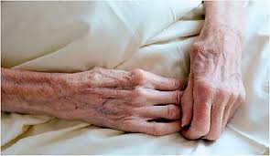
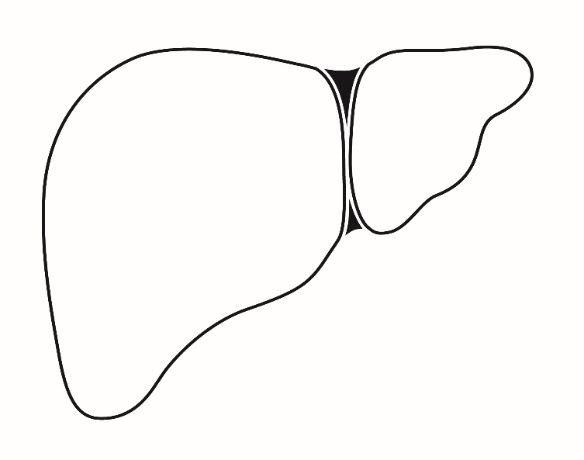


Simple undernutrition
= energy malnutrition
Insufficient intake of carbohydrates, lipids and proteins
Progressive symmetric weight loss leading to cachexy in otherwise healthy individuals with limited food intake
GLUCAGON
Lipolysis
Gluconeogenesis
Glycogenolysis

Slide 12
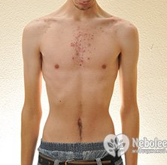
Simple undernutrition
atrophy of GIT →
restoration of nutrition p.o. is not possible!!
Sources of energy: lipolysis in adipose tissue → glycerol + acetyl-CoA →
proteolysis in striated muscles → AA for synthesis of plasma proteins
gluconeogenesis → glc
Krebs cycle → reduced cofactors → RC → ATP
synthesis of ketone bodies – en. substrate for CNS, myocardium, muscles

Slide 13
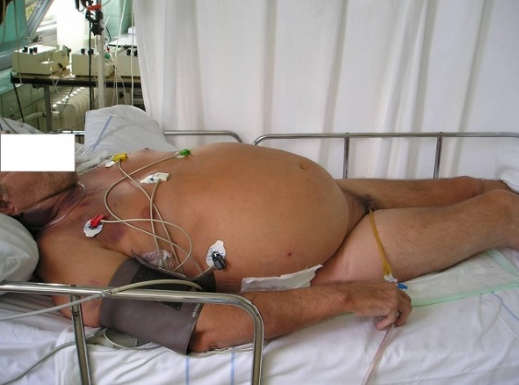


Stress undernutrition
= protein malnutrition
Insufficient protein intake + fast proteolysis
Causes: ↓ intake, ↑ loss, ↑ needs, ↑ breakdown (catabolism), ↓ synthesis (liver) = STRESS
GLUCAGON
+
STRESS HORMONES
Lipolysis
Gluconeogenesis
Glycogenolysis
Proteolysis
Notes:
The ubiquitin-proteasome system is considered to be the primary metabolic and biochemical mechanism involved in the degradation of unnecessary or damaged proteins using adenosine triphosphate (ATP) as an energy source.

Slide 14

Stress undernutrition
Presence of systemic inflammation with ↓ insulin and ↑ stress hormones, STH and proinflammatory cytokines
Sources of energy: proteolysis in muscles and albumin → AA for gluconeogenesis, proteosynthesis (AFP, wound healing…)
lipolysis in adipose tissue
Water retention, ascites and edemas at the same or increasing weight

Slide 15
Comparison of simple and stress undernutrition
 | Simple undernutrition | Stress undernutrition
Origination | weeks - months | days
Inflammation | no | present
Weight | ↓ | normal - ↑
Muscle mass | slightly ↓ | extremely ↓
Fat mass | ↓ | ↓, normal or ↑
Content of water and Na⁺ | ↓ | ↑
Serum proteins, albumin | normal | extremely ↓
Acute phase proteins (AFP) | normal | ↑
Example | geriatric cachexy, mental anorexia, m. Crohn, chronic pancreatitis | sepsis, trauma, surgery, burns, acute pancreatitis

Slide 16

Which of the findings in the child shown at right would support a diagnosis of kwashiorkor?
Shows increased serum albumin.
Shows a good appetite.
Appears plump due to increased adipose tissue.
Has markedly decreased weight for height.
Displays abdominal and peripheral edema.

Slide 17
Which of the findings in the child shown at right would support a diagnosis of kwashiorkor?
Shows increased serum albumin.
Shows a good appetite.
Appears plump due to increased adipose tissue.
Has markedly decreased weight for height.
Displays abdominal and peripheral edema.
Kwashiorkor is caused by inadequate protein intake in the presence of fair to good energy intake. Typical findings include abdominal and peripheral edema caused largely by a decreased serum albumin concentration. Anorexia is almost always present. Weight is often normal due to edema. Treatment includes a diet adequate in energy and high-quality protein.

Slide 18
The daily requirements of basic nutrients
Energy
Carbohydrates
Proteins
Lipids
Reccomended (reference) daily intake
45 – 60 % (2 (4) - 6 g glc /kg/day)
0.83 g/kg/day (0.8 – 1.6 g/kg/day)
20 - 35 % (1 – 1.5 g/kg/day), min. 15 - 20 %
Why?
Carbohydrates | Proteins (AA) | Lipids
Anabolic ratio of nutrients
6 g/kg | 1 g/kg | 1 – 1.5 g/kg
Stress ratio of nutrients
2 - 3 g/kg | 1.5 - 2 g/kg | 0.7 g/kg
UNDERNUTRITION
Notes:
The nutrient reference intake values are based on EFSA (European Food Safety Authority) recommendations since autumn 2017.
Answer: Need for essential FA (LA, ALA) and lipophilic vitamins intake.

Slide 19
carbohydrates
RDA = 2 – 6 g glc /kg / day ≈ 45 – 60% of energy supply
Enteral nutrition:
Starch, oligosaccharides (maltodextrin), sugars
Parenteral nutrition:
Glc: isoosmolar – 5% (50 g/l = 278 mmol/l), low energy content
10% (100 g/l = 556 mmol/l), 15% (150 g/l = 833 mmol/l)
– peripheral or central vein
20% (200 g/l = 1111 mmol/l) and more – only central vein

Slide 20
Osmolality of glc solutions
G5 = 5% Glc = 5 g Glc / 100 g of solution
50 g Glc / 1000 g
≈ 50 g Glc / 1 L
M_{r(Glc)} = 180
osmolarity = 50 : 180 = 0.278 mol / 1 L
= 278 mmol / 1 L
normal osmolality of blood plasma = 275 - 300 mmol / kg H₂O
The infusion of 5 % glc is isotonic with blood plasma.

Slide 21
Osmolality of glc solutions
G15 = 15% Glc = 15 g Glc / 100 g of solution
150 g Glc / 1000 g
≈ 150 g Glc / 1 L
M_{r(Glc)} = 180
osmolarity = 150 : 180 = 0.833 mol / 1 L
= 833 mmol / 1 L
The highest osmolality for infusion into a peripheral vein is 850 mmol/kg
= 15% glc solution - without any additives !!!

Slide 22
rem. – dietary fiber
Biological definition: Carbohydrates which are not lysed enzymatically in the small intestine and thus are passed into the large intestine.
Chemical definition: Non-starch polysacharides and lignin.
Adequate intake = 25 g /day - adults
  ≈ age + 5 g – teens 11 – 20 years
Water-insoluble:
celulose, hemicelulose, lignin; psyllium
Water-soluble:
pectin, inulin, gums, mucilage and storage polysaccharides
(guar gum)

Slide 23
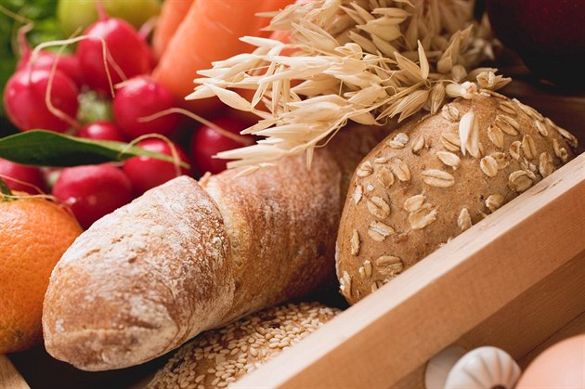
Function of insoluble fiber
Acceleration of intestinal passage, ↑ stool weight and volume
↓ resorption of bile acids, ↓ chol /S
↓ resorption of sugars
↓ resorption of lipids
↓ resorption of minerals and microelements

Slide 24
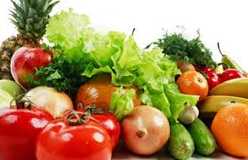
What is happening with soluble fiber in the colon?
Fermented by bacteria
Products: acetic, propionic, butyric acids
These acids are utilised by enterocytes – 70% of energy
Significance : to maintain the intestinal barrier
↑ resorption of Na⁺ and water
Notes:
Na⁺ is transported with originating FA.

Slide 25
Need of proteins
Reference daily intake of proteins* in g / kg / day
Infants (1 year) | 1.14
Toddlers (2years) | 0.97
Children, adolescents | ≈ 0,9
Adults | 0.83
Pregnant and breastfeeding women | ≈ 1.1 (0.83 g/kg/day + 1-28 g/day according to trimester)
Sportmens | 1.3 – 2.0
Parenteral nutrition (AA) or other nutritional support | 1.0 – 1.5
Minimal intake | 0.4 – 0.5
*valid in case of sufficient intake of non-protein energy
Why?
Notes:
Answer: In case of insufficient carbohydrate intake, AAs are used for gluconeogenesis.

Slide 26
Correct protein dosing – influencing morbidity and mortality
critically ill patients have higher levels of protein in parenteral nutrition – daily dose > 1.2 g / kg / day (ESPEN), up to 2 – 3.5 g / kg / day
Ensure the adequacy of total energy intake.
Excessive energy intake is a burden on many organs and leads to the storage of fats in patients' liver (overfeeding).
Compare with stress ratio of nutrients.
ASPEN (2016):
BMI < 30 kg/m² … 1,2-2,0 g/kg actual weight /day
BMI > 30 kg/m² … 2,0 g/ kg ideal weight / day
Notes:
Current studies (9/2020) show that negative protein balance, secondarily caused by serious disease, is associated with higher morbidity in patients. In severe illness, skeletal muscle fiber catabolism inevitably occurs, often leading to loss of total body protein, despite aggressive nutritional therapy.
The stress response increases the demands on energy expenditure and at the same time increases the use of protein reserves (primarily actin and myosin) in skeletal muscle proteins.
The main goal of nutritional therapy is to prevent the degradation of skeletal muscle and maintain active body mass (lean mass). In clinical practice, this goal is achieved by adding the right amount of protein and an adequate amount of energy. It is important to determine the energy expenditure of a sick patient.
Based on the results of recent studies and recommendations of professional societies (2018-2020), it is appropriate to provide critically ill patients with higher amounts of protein in parenteral nutrition with a daily dose> 1.2 g of protein per 1 kg of body weight. The protein dose can be up to 2-3.5 g / kg / day. At the same time, care must be taken to ensure the adequacy of total energy intake, as excessive energy intake is a burden on many organs and leads to the storage of fat stores in patients' liver.

Slide 27
Aminoacids (aa)
Essential
Semiessential
Val
Leu
Ile
Met
Phe
Thr
Trp
Lys
His
Arg
Gln
(Glu)
Cys
Tyr

Slide 28
Specific pharmacologic effects and indications of selected Essential aa
Val, Leu, Ile
- favour muscle proteosynthesis (especially in DM)
- inhibit sarcopenia
Why?

Slide 29
Increased needs of Semiessential aa
Arg
growth
sepsis, injuries, post-operative period (resource of optimal immunological defence mechanisms)
immunity stimulation
NO synthesis
Tyr + Cys
infants
lack of Phe and Met
liver insufficiency

Slide 30
Increased needs of Semiessential aa
Gln
stress situations – energy substrate for immune system cells (lymphocytes, macrofages, fibroblasts), enterocytes, kidneys
metabolic substrate for NA bases synthesis (cell division - mucosis, bone marrow)
important source of nitrogen, the main AA of plasma
maintaining the intestinal barrier (toxins, starvation, radiation, inflammation)
Unstable in parenteral nutrition solutions!

Slide 31
Select correct answers: With regard to protein in the diet:
It may contribute to the supply of energy.
Supplies only seven of the essential amino acids.
Is a source of ammonia which is detoxified through urea production.
Must include an animal source to provide all essential amino acids in the diet.

Slide 32
Select correct answers: With regard to protein in the diet:
It may contribute to the supply of energy.
Supplies only seven of the essential amino acids.
Is a source of ammonia which is detoxified through urea production.
Must include an animal source to provide all essential amino acids in the diet.
The carbon skeleton of amino acids can contribute to energy supply.
All essential amino acids can be provided through dietary protein.
Ammonia is a toxic end product of amino acid metabolism that is converted to urea in the liver and then excreted through the kidneys.
Using a variety of vegetable sources it is quite possible to provide all essential amino acids.

Slide 33
Lipids
RDI = 0.5 – 1.5 g /kg/ day ≈ 20 – 35% of energy supply
source of essencial FA, fat-soluble vitamins
Enteral nutrition:
vegetable oils (rapeseed, sunflower, soya, coconut)
Parenteral nutrition:
10-20% lipid emulsions (of olive, soybean oil
+ event. fish, coconut)
Give names
of essential FA.
Notes:
LA 18:2 (9,12), ALA 18:3 (9,12,15)

Slide 34
Significance of fatty acids according to their chain lenght
2 - 4 C: resorption to portal vein, probably inhibit chol synthesis in the liver energy for enterocytes (70% of en., intestinal barrier)
6 - 10 C: fast energy: resorption to portal vein, β-oxidation without carnitine; component of MCT
≥ 12 C: resorption to thoracic duct (as CM), carnitine needed for their transoprt to mtch matrix; component of LCT
12 – 16 C: energy, atherogenic
≥ 18 C: energy, structure of PL, TAG
20 C (DHGLA, AA, EPA): synthesis of eicosanoids

Slide 35
Saturated fatty acids with 12C – 16C chain
Highly atherogenic, increase total cholesterol
lauric 12:0 – increases total and HDL cholesterol
myristic 14:0 (Myristica fragrans) – 4x more efective than 16:0
palmitic 16:0
↑ synthesis of chol de novo
↓ affinity of LDL-receptors to LDL (only C14:0 and C16:0?)

Slide 36
Saturated fatty acids with 12C – 16C chain sources
Fatty acid (% of total FA) | Coconut fat | Palm fat | Palm kernel fat | Milk fat | Lard | Olive oil | Rapeseed oil | Sunflower oil
Butyric 4:0 | x | x | x | 3.6 | x | x | x | x
Capronic 6:0 | 0.5 | x | 0.3 | 2.2 | x | x | x | x
Caprylic 8:0 | 7.8 | x | 4.4 | 1.2 | x | x | x | x
Caprinic 10:0 | 6.7 | x | 3.7 | 2.5 | x | x | x | x
Lauric 12:0 | 47.5 | 0.2 | 48.3 | 4.5 | x | x | x | x
Myristic 14:0 | 18.1 | 1.1 | 15.6 | 14.6 | 1.7 | x | x | x
Palmitic 16:0 | 8.8 | 44.0 | 7.8 | 30.2 | 25.0 | 8.4 | 3.6 | 6.3
Stearic 18:0 | 2.6 | 2.0 |  | 10.5 | 15.0 | 2.5 | 1.5 | 4.6
Palmitooleic 16:1 (9) | X | X | x | 5.7 | 3.0 | 0.7 | x | X
Oleic 18:1 (9) | 6.2 | 39.2 | 15.1 | 16.7 | 45.0 | 78.0 | 61.6 | 26.7
Linoleic 18:2 (9, 12) | 1.6 | 10.1 | 2.7 | 2.4 | 8.0 | 8.3 | 21.7 | 61.2
α-linolenic 18:3 (9, 12, 15) | x | 0.4 | x | x | x | 0.8 | 9.6 | x
Pánek J.: Odborné výživové hodnocení palmového a palmojádrového tuku 2015
Notes:
C12-16 FA are highlighted in bold.

Slide 37
Lipids – preferable rq
CO₂
O₂
RQ =
glc: C₆H₁₂O₆ + 6 O₂ → 6 CO₂ + 6 H₂O
RQ = 6 / 6 = 1.0
palmitic a.: C₁₆H₃₂O₂ + 23 O₂ → 16 CO₂ + 16 H₂O
RQ = 16 / 23 = 0.7
Lower CO₂ production during oxidation of FA – important source of energy in ventilatory problems.

Slide 38
Daily requirement for basic nutrients
Water | 30 – 40 ml /kg ≈ 2(♀)-2.5(♂) l/d
Energy | 25 – 30 kcal = 105 – 126 kJ /kg
Glc | 2 – 6 g /kg
Lipids | 1 – 1.5 g /kg
AA | 0.8 – 1.6 g /kg
Sodium | 1 – 2.5 mmol /kg
Potassium | 1 – 2.5 mmol /kg
Calcium | 0.05 – 0.1 mmol /kg
Magnesium | 0.1 – 0.2 mmol /kg
Phosphorus | 0.4 mmol /kg
Vitamins
Trace elements
1 kcal = 4.19 kJ

Slide 39
Select correct answers: In the provision of dietary energy:
Carbohydrates are preferred as they do not contribute to increasing body fat stores.
Fats are not required as all energy and essential nutrition requirements can be met from other sources.
The calorific value of lipids exceeds that of carbohydrate.
Stored carbohydrate in the liver (as glycogen) is depleted after 18–24 h starvation.

Slide 40
Select correct answers: In the provision of dietary energy:
Carbohydrates are preferred as they do not contribute to increasing body fat stores.
Fats are not required as all energy and essential nutrition requirements can be met from other sources.
The calorific value of lipids exceeds that of carbohydrate.
Stored carbohydrate in the liver (as glycogen) is depleted after 18–24 h starvation.
Excess carbohydrate in the diet can be converted to fat and stored as fat in adipose tissue
A source of fat is required to provide the essential fatty acids, linoleic and α-linolenic acids, in the diet.
The calorific value of lipids is 38 kJ/g compared to 17 kJ/g for carbohydrates.
The reserves of glycogen in the liver are relatively small and comparatively quickly depleted.

Slide 41
micronutrients
= vitamins + microelements
from day one until the and of hospitalization
Adapt RDI to individual needs (especially for microelements)
Monitoring of levels - always necessary after dose adjustment, liver and renal disease ; repeated checks recommended (ESPEN)
Causes of deficiency: insufficient or inappropriate administration, increased or changed needs for nutrients, increased losses

Slide 42
micronutrients
In critically ill patients are often present deficiencies of
zinc, iron, selenium,
vitamins A, B and C.
However, decreased serum levels may not correspond to the current deficiency, but only to redistribution (sequestration in the liver and RES).
Thoughts on the composition of trace element mixes have recently shifted towards a minimum of manganese, iron, copper and a higher supply of selenium and zinc.
Notes:
Tyto poznatky se odrazily do složení preparátů, které jsou v současnosti dostupné k suplementaci.

Slide 43

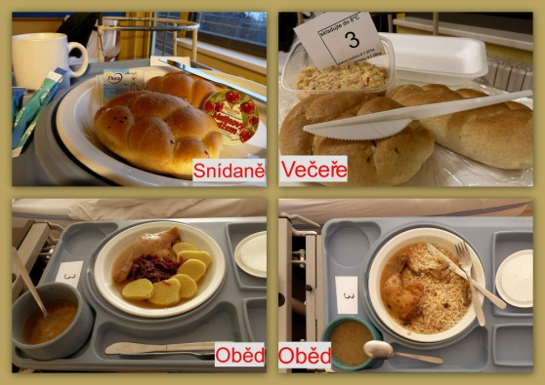
Basic concept of clinical nutrition
Normal food (made at home, in restaurants, hospitals; including gluten- or lactose- free diet, food alergies)
Diet
Nutritional support
                Fortified diet (oral nutrition support)
                Enteral tube feeding
                Parenteral nutrition

Slide 44
diet system in CR – basic diets
No. | Name | Energy value kJ | Specification
0 | fluid | 6 000 – 12 000
1 | pappy | 9 500
2 | GIT- saving | 9 500 | Fried food – free. Proteins 80 g, lipids 70 g, sacchar. 320 g
3 | basic (rational) | 9 500 | Proteins 80 g, lipids 70 g, sacchar. 320 g
4 | with fat restriction | 9 500 | Limited lipid content 55 g.
5 | residue-free | 9 500 | Without dietary fibres.
6 | with protein restriction | 9 500 | Limited protein content 50 g.
8 | reducing | 5 300 | Limited energy value.
9 | diabetic | 7 400 | Limited saccharides content 225 g.
10 | saltless | 9 500 | Limited salt content.
11 | nutritive | 12 000 | Increased energy value.
12 | infant | 5 500 | 1.5 – 3 years.
13 | pediatric | 7 000, 8 800 | 4 - 6, 6 - 12 years.
1 kcal = 4.19 kJ
Notes:
The 14-type diet system was created in 1983 with a last update in 1991.
Diets are marked with numbers, have a defined caloric value and the content of basic nutrients (proteins, fats, carbohydrates, vit. C)
The diet system in a specific health care facility is an internal document that determines which diets are prepared in the health care facility and specifies them.

Slide 45
diet system in CR – special diets
No. | Name | Energy value | Specification
0S | tea |  | Nutritionally deficient!!!
0-ND | nutritionally defined | 8 000 - 12 000 kJ | Individual.
4S | with strict fat restriction | 7 000 kJ | Limited energy and lipid content.
9S | diabetic chary | 7 400 kJ | Limited carbohydrates content 225 g + fried food – free.

Slide 46
diet system in CR – standardized and special diets
Gluten-free diet
Lactose-free diet
Pancreatic diet – in accute pancreatitis
Renal diet – in chronic renal failure
Vegetarian diet etc.

Slide 47

Algorithm of nutritional support
Why?
Normal food?
Feeding of patient, insreased supervision, individual diet
Oral nutrition support
Enteral tube feeding
Parenteral nutrition
yes
Is p.o. intake possible?
yes, partly
no
yes
Is GIT functional?
no

Slide 48
Algorithm of nutritional support
Nutritional therapy in stable patients
Nutritional therapy in hemodynamically unstable patients
requiring significant circulatory support by catecholamines, volume expansion or administration of blood derivatives
early initiation of enteral nutrition
correct supply of macro- and micronutrients
careful monitoring of glycaemia
nutritional support by parenteral route
in case of normalization of blood pressure possible recovery of EN
Notes:
The basic principles of nutritional therapy in stable ICU patients include early initiation of enteral nutrition (EN), proper supply of macro- and micronutrients, and careful glycemic control.
In case of haemodynamic instability in patients requiring significant circulatory support by catecholamines, volume expansion or administration of blood derivatives, nutritional support should be provided parenterally and EN administration should be delayed. In case of normalization of blood pressure, EN can be restored with careful monitoring of signs of gastroenteral intolerance (eg abdominal distension, increase in gastric residues, decrease in stool, obstructed peristalsis, increase in metabolic acidosis and base deficiency).

Slide 49
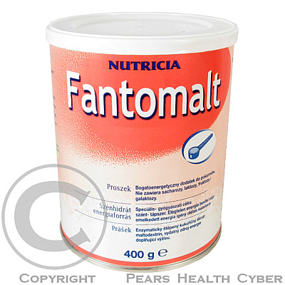
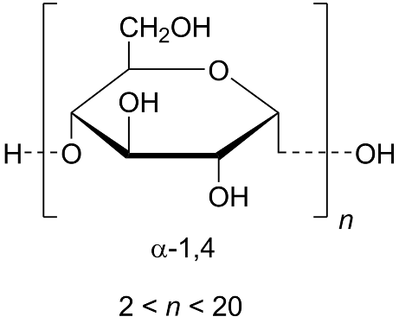
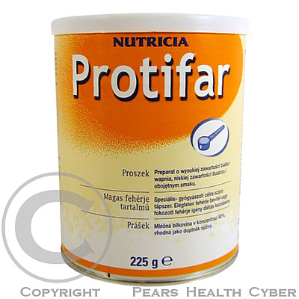
Kinds of nutritional support
Normal meal enriched with energy, macronutrients, or micronutrients.
Fortified diet
Enteral nutrition
Parenteral nutrition
maltodextrin
(enzymatically digested corn starch)
concentrated milk protein,
emulsifier (soya lecithin)

Slide 50
Enteral nutrition
Sipping
Tube feeding
Nutritionally incomplete
Nutritionally complete

Slide 51
Energy (calorific) value of nutrition support
hypocaloric < 1 kcal/1 ml = < 4.19 kJ/1 ml
isocaloric 1 kcal/1 ml = 4.19 kJ/1 ml
hypercaloric > 1 kcal/1 ml = > 4.19 kJ/1 ml

Slide 52
sipping
= oral nutrition support
the most used nutrition support
advantages:
  ready to use, easy to consume
  defined content of energy and nutrients
  defined content of vitamins and trace elements
  easily absorbed
  good bioavailability

Slide 53
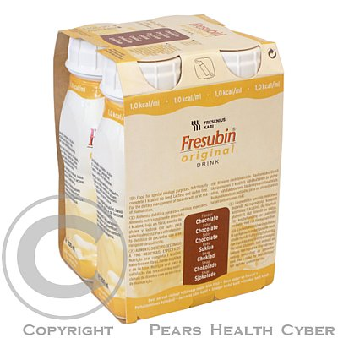

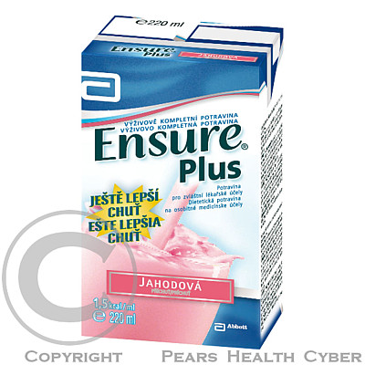
sipping
Proteins – milk, soya
Carbohydrates – maltodextrin, sucrose
Vegetable oils
Vitamins
Trace elements
Minerals

Slide 54

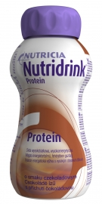
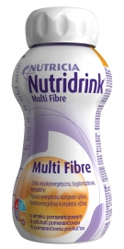
sipping
Generally 1 – 1.5 kcal/ml (4.19 – 6.28 kJ/ml)
16-20 % proteins, 25-30 % lipids and 50-54 % carbohydrates
Products with higher energy content: 1.2 – 1.6 – 2.0 kcal/ml 5 – 6.7 – 8.4 kJ/ml
requirement for highly energy-rich diet (Tu), limited oral intake (organic reasons, dysorexia)
Products with higher protein content:
Better wound healing; surgery, Tu, seniors.
Products with diet. fiber: ↑ bowel motility, ↓ constipation, soften stools, ↓ absorption of diet. fat and chol, source of short FA (C2-4) after fermentation

Slide 55

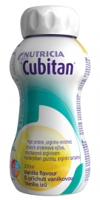
Sipping – special products
DM – maltodextrin is replaced with starch, other dextrins or fructose, lower content of proteins and energy
↑ Gln – better immune response, regeneration precesses
Patients with s decubiti (↑ proteins, Arg, vit. C, A, E, trace elements)

Slide 56
(enteral) Tube feeding
= complete nutrition via a tube to patients who cannot obtain nutrition by mouth, are unable to swallow safely, or need nutritional supplementation
Through the nose | Percutaneous (through the abdomen)
Nasogastric tube | Faryngostomy Esophagostomy Gastrostomy (PEG)
Nasoduodenal tube | Extended gastrostomy
Nasojejunal tube | Jejunostomy (PEJ)
STERILE!

Slide 57
Mode of delivery
Bolus method - only into the stomach boluses 50 − 300 ml 2 - 3 hour intervals
Continuously - enteral pump steady over 16–24 hours daily intermittently during the day with night break intermittently during the night with day break

Slide 58
What is administered
Mixed hospital diet
Polymer nutrition (defined nutritionally)
Oligomer nutrition (defined chemically)
Intact proteins (kasein)
Polysaccharides
Lipids (TG with long-chain FA = LCT)
Dietary fiber
Osmolarity ≤ 400 mmol/l
Stomach, duodenum
Vitamins
Minerals
Trace elements
AA, di-, tripeptides
Disaccharides, maltodextrin
Lipids (MCT + LCT)
Osmolarity > 450 mmol/l
Jejunum
Which is the most common side effect during administration of oligomer nutrition?
Notes:
MCT - source of en., LCT n-3 - anti-inflammatory, antithrombogenic effect (eicosanoids).
Answer: Osmotic diarrhea.

Slide 59
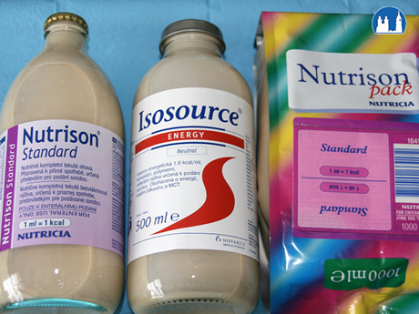
Polymer nutrition
undigested nutrients ≈ similarity to natural food in terms of absorption
In patients with functional GIT with digestion enzymes production.
Hypocaloric, isocaloric, hypercaloric We start with hypocaloric nutrition and raise the energy content according to patient´s tolerance.
Special products with increased protein content
    with dietary fiber
    DM etc.

Slide 60
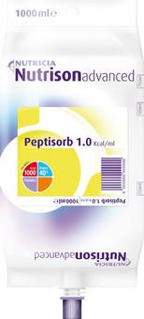
Oligomer nutrition
Sterile, isocaloric (1 kcal/1 ml)
Název | Energy (kcal/ 100 ml) | Proteins (g/100 m) | Carbohydrates (g/100 ml) | Lipids (g/100 ml) | Fiber (g/100 ml)
Nutrison Advanced Peptisorb Pack | 100 | 4-0 | 17.6 | 1.7 | 0
Survimed OPD | 100 | 4.5 | 15.0 | 2.4 | 0
Novasource Peptide | 100 | 3.8 | 12.5 | 3.9 | < 0.3

Slide 61
Parenteral nutrition
= the delivery of nutrition intravenously
Indications
people who are malnourished or at risk of malnutrition, respectively, and meet either of the following criteria:
inadequate or unsafe oral and/or enteral nutritional intake
a non-functional, inaccessible or perforated (leaking) gastrointestinal tract

Slide 62
Parenteral nutrition
Advantages
Disadvantages
Exactly defined intake of nutrients
Possibility of nutrition modulation according to actual needs
Rapid treatment of any metabolic collapse
Suitable for patients with a complete absence of small intestine
Non-physiological
Complications (catheter tunnelling, infection, blood clot, metabolic)
Costs

Slide 63
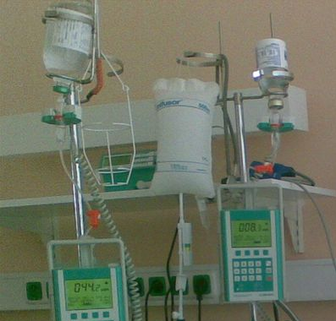
Parenteral nutrition
Complete
Incomplete
Short-term (< 2 weeks)
Long-term (> 2 weeks)

Slide 64
Mode of delivery
Continuous administration
preferred method of infusion
Cyclical delivery
when using peripheral venous cannulae with planned routine catheter change
A gradual change from continuous to cyclical delivery should be considered in patients requiring parenteral nutrition for more than 2 weeks.

Slide 65
Route of access
Central venous catheter
Peripheral venous catheter
V. cava sup.
v. subclavia l. dx.
v. jugularis
(v. brachiocephalica sin.)
V. cava inf.
v. femoralis
≥ 900 mmol/l
Peripheral vein in a limb
For short-term parenteral nutrition (< 14 days)
< 850-900 mmol/l
< 600 mmol/l children
glc ≤ 15% (= 833 mmol/l),
AA ≤ 5%
Different balanced regimens for peripheral and central venous application!
Notes:
To deliver adequate calories more often central venous access is used.

Slide 66
Selected recommendations of ESPEN (European Society of Clinical Nutrition and Metabolism) for parenteral nutrition
Why parenteral nutrition
the patient is unable to take oral food, it is necessary to supply nutrients bz different route than GIT
When and how to start PN
within 24 hours after patient´s administration
as supplementary nutrition to enteral nutrition (if energy intake via enteral nutrition is not sufficient) after 2 days
all-in-one
Composition of PN
Amino acids + glucose + lipids + electrolytes + microelements + vitamins
Nutritional requirements must not be underestimated, especially in ICU patients, who are more likely to develop malnutrition (according to studies, up to 43% of patients in the ICU).
← risk of malnutrition, increased risk of mortality and morbidity

Slide 67
What is administered
Water + electrolytes: 30 - 40 ml/kg/day (according to current patient´s needs)
Energy: ± 120 kJ/kg/day (according to current patient´s needs)
min. 105 kJ (25 kcal )/kg/day

Slide 68

What is administered
Carbohydrates: glc 2 - 6 g/kg/day
            xylitol max 0.125 g/kg/hour
            Rate of administration 0.5 g/kg/hour, under the stress conditions 0.25 g/kg/hour (the half-speed!)
            No sucrose, fru, sorbitol!
            Avoid hyperglycaemia!
Notes:
Hereditary fru intolerance (1 : 20 000, absence of aldolase B) – accumulation of fru-1-P (liver, kidneys, enterocytes)
Extremely high fructose intake via infusion can lead to the consumption of large amounts of phosphate, which is then not available for the synthesis of ATP. (fru → fru-1-P → glyceraldehyde + DHAP)

Slide 69
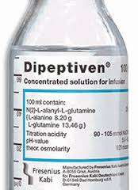
What is administered
AA: 1.0 – 1.5 g/kg/day all (essent., semiessent., nonessent.) essential 45-50% of the total share No protein hydrolysates, blood plasma fractions! Rate of administration 0.1 g/kg/hour
Gln in critically ill pat. 0.2-0.4 g/kg/day
AA = proteosynthesis substrates and skeletal muscle protection.
With insufficient energy supplies, part of AAs is used for energy yield => to provide sufficient protein synthesis, the total energy of infused nutrients must be covered with 20% AA and 80% carbohydrates + lipids.
Gln separately as Ala-Gln

Slide 70
What is administered
Lipids: 0.7 – 1.5 g/kg/day ratio of energy from lipids : saccharides = 1 : 1
10-20% lipid emulsions – 270 – 410 mmol/kg H₂O;
of soya, olive, fish oil (LCT),
coconut fat (MCT);
separate (S, F) or combinations (S+O, S+C+F, S+O+C+F);
emulsifier = lecithin), particle size max. 1 μm, utilisation as CM
Rate of administration 100-150 mg/kg/hour
ESPEN compared parenteral olive oil and soybean based products and made recommendations for the use of olive oil based emulsions.

Slide 71

Lipid preparations with the addition of fish oil
Source of ω-3 fatty acids, high content of EPA and DHA
Example: NuTRIflex® Omega: ω-6:ω-3 PUFA = 3:1
(Optimal benefit ratio ω-6: ω-3 PUFA = 2:1 to 4:1)
Reduction of
organ complications
Shortening the length of stay in the hospital
Reduced costs
Emulsions made from pure soybean oil
should not be fat of the first choice in critically ill patients!
Notes:
Fish oil reduces the incidence of SIRS (Systemic Inflammatory Response Syndrome) and CARS (Compensatory Anti-Inflammatory Response Syndrome) and hence the incidence of infectious complications, internal organ damage and dysfunction observed with an excess of omega-6 FA. This positive effect in treatment is reflected in the reduction of hospitalization time and the reduction in the number of complications, ie. the reduction in total costs.

Slide 72
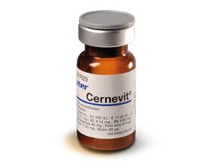
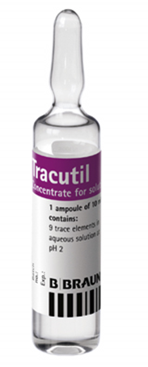
What is administered
Vitamins and trace elements: from day one
Medicines: hydrophilic vit. (Soluvit) lipophilic vit. (Vitalipid) hydrophilic + lipophilic vit. (Cernevit)
microelements (Tracutil, Addaven, Elotrace, Nutryelt)
RDI or individual needs
F, Mn, Cu, Zn, Se, I, Cr, Mb
Fe

Slide 73
Select correct answers: With regard to vitamins in the diet:
Body stores of water-soluble vitamins are typically higher than those of fat-soluble vitamins.
Vitamin C is an antioxidant vitamin which helps maintain iron in the reduced (ferrous) form.
Thiamine deficiency can be found in chronic alcoholism when it may contribute to neurological and cardiac problems.
Folic acid in excess can lead to increased incidence of neural tube defects in pregnancy.
Retinol (vitamin A) can be partially derived from dietary hydrolysis of β-carotene.

Slide 74
Select correct answers: With regard to vitamins in the diet:
Body stores of water-soluble vitamins are typically higher than those of fat-soluble vitamins.
Vitamin C is an antioxidant vitamin which helps maintain iron in the reduced (ferrous) form.
Thiamine deficiency can be found in chronic alcoholism when it may contribute to neurological and cardiac problems.
Folic acid in excess can lead to increased incidence of neural tube defects in pregnancy.
Retinol (vitamin A) can be partially derived from dietary hydrolysis of β-carotene.
There are normally relatively large stores of fat-soluble vitamins (e.g. A and D) but little storage of water-soluble vitamins.
Ferrous iron is the more reduced ionic form of iron whose formation is assisted by the anti-oxidant qualities of vitamin C.
Poor nutrition and associated thiamine deficiency is a recognised serious problem in chronic alcoholism.
There is a clear association between folic acid deficiency and an increase in neural tube defects in pregnancy. Folic acid supplementation in pregnancy is advised.
Dietary β-carotene can be hydrolysed in the intestine to form retinol.

Slide 75

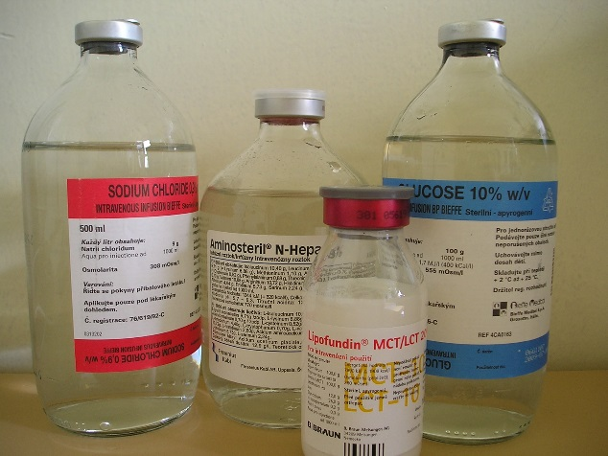
Application systems
ESPEN recommends
Multi-bottle system
All-in-one system
Original system
Risk of infection, imprecize dosage, rate of administration of distinct nutrients
Uneven nutrient intake
Unhandy
Suitable for emergency care
Possibility of fast composition change, addition of medications
↓ risk of infection
Comfortable
Better utilisation of nutrients
Allows the simultaneous administration of required
nutrients out of one container
It is impossible to change the composition
Costs

Slide 76
All-in-one solutions
One-chamber
Multi-chamber
Individually prepared in hospital pharmacy just before administration
Commercially-produced
Two-chamber (AA + sugars)
Three-chamber (AA + sugars + lipid emulsion)
Chambers are separated by a seal, which is broken just before application
1 bag / 24-hours

Slide 77
2 kinds of multi-chamber bags
2-chamber bags
3-chamber bags
Amino acids
Glucose
Amino acids
Glucose
Fat emulsion
Notes:
2-chamber bags
Provide different formulations with amino acids, carbohydrates and electrolytes. According to individual patient requirements, lipids can be added via the lipid additive port and trace elements and other micronutrients can be added via the additive port.
3-chamber bags
Provide different formulations and bag volumes with amino acids, carbohydrates and fat and are available with or without electrolytes.
For individual needs, trace elements and other micronutrients can be added via the additive port.

Slide 78
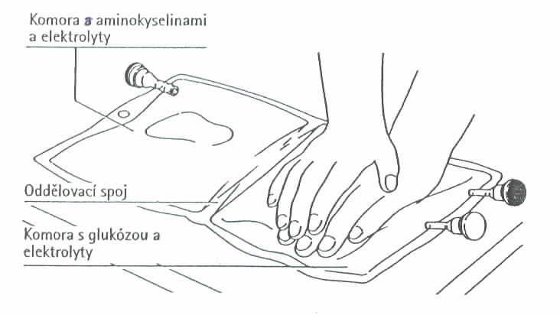
the chamber with amino acids
and electrolytes
peel seal
the chamber with glucose
and electrolytes
TWO-IN-ONE SOLUTION OF GLC AND AAs

Slide 79
Why are the bags produced in pharm. companies multi-chamber?
AA + glc aldimin
(H)
(H)
N H₂ O = C N = C
The amino group –NH₂ from amino acids reacts with the carbonyl group of saccharides giving aldimin, e.g. „Schiff´s base“ (Maillard´s reaction).
Therefore the solution of amino acids cannot be sterilized in the mixture with saccharides.

Slide 80
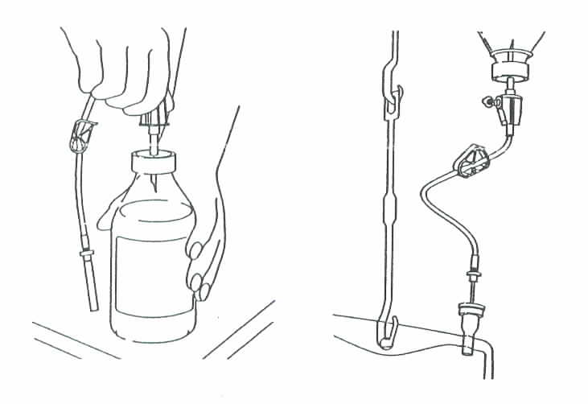
HOW TO ADD LIPIDS OR ELECTROLYTES TO A 2-CHAMBER BAG
Additive port

Slide 81
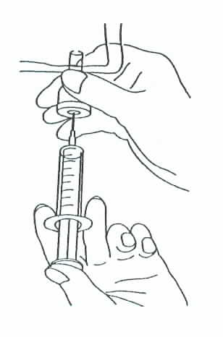
HOW TO ADD MEDICATIONS TO AN ALL-IN-ONE BAG
Injection port

Slide 82
Example and possibilities of a 2-chamber all-in-one bag

Slide 83
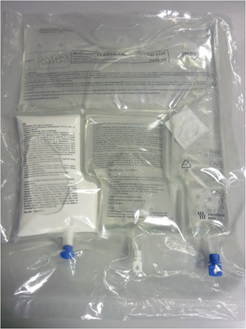
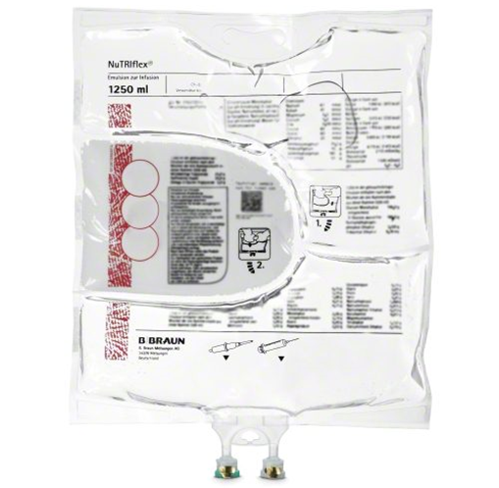
All-in-one bags - examples

Slide 84
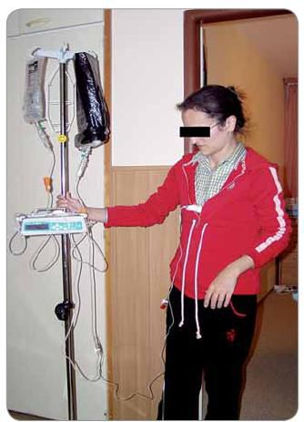

Home parenteral nutrition
Static mode
Mobile mode
classic infusion pump stand
infusion connection at about 16:00, the next morning at 8:00 will disconnect
equipped with alarms triggered when moving
From 1 Jan 2015, a new reimbursement code has been approved in CR: a mobile pump + backpack is included, the necessary nutrients and solutions for use.
↑ mobility of patients (> 50% out of bed)
Pump weight 300-700 g, battery life 12-24 h + external battery
Notes:
Mobile home parenteral nutrition significantly improves mobility and thus the quality of life of affected patients.

Slide 85
Refeeding syndrome
syndrome consisting of metabolic disturbances that occur as a result of reinstitution of nutrition to patients who are starved or severely malnourished
Etiology:
hypophosphatemia
hypomagnesemia
hypokalemia

Slide 86
Development of Refeeding syndrome
Starvation →
Refilling of glc →
Accompanied by:
P ⁻ P ⁻
P ⁻ P ⁻ P P ⁻ P ⁻ P ⁻ P ⁻ P –
P ⁻
P ⁻ P ⁻
P ⁻ P ⁻
P ⁻
P⁻
P⁻
P⁻
P⁻
P⁻ P⁻
glycolysis
K⁺ Mg²⁺
Mg²⁺
Mg²⁺
K⁺
K⁺
Notes:
Starvation leads to exhaustion of energy phosphate reserves necessary for basic cell functions (membrane transport incl. Na⁺/K⁺ ATPase, metabolism etc.).
After refilling of glc when nourishing the patient and also due to insulin, resumption of the metabolic pathways that require the supply of phosphates occurs and so phosphates and glc move into the cells.
Together with P and glc, also K and Mg move IC, resulting in a decrease of plasma levels and hence the development of symptoms.

Slide 87
symptomatology
paresthesias, weakness, muscle paralysis, inability to breathe
mental changes (confusion, delirium)
retention of water and Na⁺
arrythmias
cardiac arrest, heart failure
coma and even death

Slide 88
Criteria for determining people at high risk of developing refeeding syndrome
Patient has one or more of the following:
BMI less than 16 kg/m²
unintentional weight loss > 15% within the last 3–6 months
little or no nutritional intake for more than 10 days
low levels of potassium, phosphate or magnesium prior to feeding.
Or patient has two or more of the following:
BMI less than 18.5 kg/m²
unintentional weight loss > 10% within the last 3–6 months
little or no nutritional intake for more than 5 days
a history of alcohol abuse or drugs including insulin, chemotherapy, antacids or diuretics.

Slide 89
The prescription for patients at high risk of developing refeeding syndrome should consider:
starting nutrition support at a maximum of 10 kcal (42 kJ)/kg/day, increasing levels slowly to meet or exceed full needs by 4–7 days
using only 5 kcal/kg/day in extreme cases (for example, BMI less than 14 kg/m² or negligible intake for more than 15 days) and monitoring cardiac rhythm continually in these people and any others who already have or develop any cardiac arrythmias
restoring circulatory volume and monitoring fluid balance and overall clinical status closely
providing immediately before and during the first 10 days of feeding: thiamin 200–300 mg daily, vitamin B complex full dose daily and a balanced multivitamin/trace element supplement
providing oral, enteral or intravenous supplements of K (2–4 mmol/kg/day), P (0.3–0.6 mmol/kg/day), Mg (0.2 mmol/kg/day intravenous, 0.4 mmol/kg/day oral) Pre-feeding correction of low plasma levels is unnecessary.

Slide 90
Overfeeding syndrome
= metabolic complications from overfeeding the patient
patients at high risk of developing overfeeding problems = malnutrition pacients with too high total daily dose of nutrients
Energy need 125–145 kJ/kg/day of actual weight,
at the beginning of nutr. support RDA of energy and
nutrients should be reduced by up to half

Slide 91
Overfeeding syndrome
Excessive glc administration
hyperglycemia
insulin stimulation
osmotic diuresis
and dehydration
hypertriglyceridemia,
hyperlipoproteinemia
↑ production of CO₂
hypercapnia
respiratory failure
liver steatosis

Slide 92
Select correct answers: parenteral nutrition
Is usually delivered via a central vein.
Can be used to maintain nutrition at home in some patients who require constant nutritional support.
Must provide adequate calories from carbohydrate, typically using 5% dextrose.
May lead to low levels of potassium, magnesium and phosphate as part of the refeeding syndrome.

Slide 93
Select correct answers: parenteral nutrition
Is usually delivered via a central vein.
Can be used to maintain nutrition at home in some patients who require constant nutritional support.
Must provide adequate calories from carbohydrate, typically using 5% dextrose.
May lead to low levels of potassium, magnesium and phosphate as part of the refeeding syndrome.
The hyperosmolar glc and AA solutions are irritant and can lead to thrombophlebitis if a peripheral vein is used.
With careful supervision and patient education this is possible in those who require long-term nutritional support.
In order to deliver adequate calories from carbohydrate, a hypertonic solution of 20% glc is required. Otherwise, the volume of 5% glc to deliver adequate calories is excessively high.
All these ions are incorporated into the cells and can be rapidly depleted from the extra cellular compartment when nutrients are provided to allow cell growth and repair. The high glc levels stimulate insulin secretion which encourages movement of the these ions into the cell.

Slide 94

What is the formulation of individually prepared parenteral nutrition bag?

Slide 95
We have solutions: glc 5%, 10%, 15%, 20%, 40%
AA (Aminoplasmal, Neonutrin) 5%, 10%, 15% lipids (Lipofundin, SMOFlipid, Lipoplus) 20%
Man, 35 years, height 185 cm, weight 60 kg, m. Crohn, hospitalization for subileus, stenosis of terminal ileum
Fluids: 30 - 40 ml/kg/day = 1800 - 2400 ml
Nutrients: anabolic ratio:
Glc 6 g/kg actual weight:
6 x 60 = 360 g glc: 900 ml 40% glc – central vein!
AA 1 g/kg ideal weight:
1 x 85 = 85 g AA: 850 ml 10% solution – central vein!
Lipids 1 g/kg actual weight:
1 x 60 = 60 g: 300 ml 20% solution

Slide 96
We have solutions: glc 5%, 10%, 15%, 20%, 40%
AA (Aminoplasmal, Neonutrin) 5%, 10%, 15% lipids (Lipofundin, SMOFlipid, Lipoplus) 20%
Man, 40 years, height 180 cm, weight 85 kg, hospitalization for severe burns
Fluids: 30 - 40 ml/kg/day = 2550 - 3400 ml
Nutrients: Stress ratio:
Glc 2.5 g/kg actual weight:
2.5 x 85 = 212,5 g glc: 500 ml 40% glc (1 000 ml 20% glc) – central vein!
AA 2 g/kg ideal weight:
2 x 80 = 160 g AA: 1000 ml 15% (1600 ml 10%) solution – central vein!
Lipids 0,7 g/kg actual weight:
0.7 x 85 = 60 g: 300 ml 20% solution

Slide 97
We have solutions: glc 5%, 10%, 15%, 20%, 40%
AA (Aminoplasmal, Neonutrin) 5%, 10%, 15% lipids (Lipofundin, SMOFlipid, Lipoplus) 20%
Man, 25 years, height 190 cm, weight 80 kg, in ICU after surgery of comminuted fracture of tibia
Fluids: 30 - 40 ml/kg/day = 1800 - 2400 ml
Nutrients: stress ratio:
Glc 2.5 g/kg actual weight:
2.5 x 80 = 200 g glc: 500 ml 40% glc (1 000 ml 20% glc) – central vein!
AA 2 g/kg ideal weight:
2 x 90 = 180 g AA: 1 200 ml 15% solution (1800 ml 10%) – central vein!
Lipids 0.7 g/kg actual weight:
0.7 x 80 = 56 g: 280 ml 20% solution

