Slide 1
Significance of Na⁺, K⁺ and Cl⁻ investigation
MUDr. Miroslava Hlaváčová, PhD.
Department of biochemistry
Faculty of Medicine, Masaryk University

Slide 2
Sodium cation

Slide 3
Sodium balance and distribution
Na⁺ concentration in plasma | 135 - 145 mmol/L
Na⁺ concentration in cell | 3 - 10 mmol/L
Na⁺ intake | 140 - 260 mmol/day (8 - 15 g NaCl)
Na⁺ renal excretion | 120 - 240 mmol/day
Na⁺ excretion via GIT | 10 mmol/day
Na⁺ excretion via sweat | 10 - 80 mmol/day
Na⁺ total excretion | 140 - 260 mmol/day
The concentration gradient between ECF and ICF is maintained principally by the Na+/K+ pump.

Slide 4
Assessment of plasma concentration
anamnesis, clinical symptoms
S-osmolality: 2x[Na ⁺] + [glucose] + [urea] (ca. 285 mmol/kg)
Tonicity : 2x[Na⁺] + [glucose]
Evaluation of extracellular volume (dehydration, euvolemia, edema)
S – albumin
U - Na ⁺
ADH: water reabsorption (distal convoluted tubule)
aldosterone: reabsorption of Na⁺ (+ H₂O) and excretion of K ⁺,H ⁺
atrial natriuretic peptide: excretion of Na⁺ (and water)

Slide 5
Definitions of plasma sodium imbalance
hyponatremia – the Na⁺ concentration in the serum is below the physiological range
mild 130 - 135mmol/L
moderate 120 - 130 mmol/L
severe < 120 mmol/L
acute – last less than 48 hours or the increase in plasma concentration is higher than 0.5 mmol/L/h
chronic - last more than 48 hours or the increase in plasma concentration is lower than 0.5 mmol/L/h
TIME DIVISION IS NECESSARY FOR THE SPEED OF THERAPY!
hypernatremia – the Na⁺ concentration in the serum is above the physiological range, severe above the 155 mmol/L

Slide 6
Hyponatremia
one of the most common electrolyte imbalance
symptoms depend on the severity of hyponatremia and the speed of development
symptomatic hyponatremia – 33% mortality or permanent brain damage, in chronic form 25%

Slide 7
Symptoms of hyponatremia
brain edema, increased intracranial pressure, myelinolysis, nausea or vomiting, lung edema with hypoxia
no signs if the development of hyponatremia is slow
beware kids and older people – weaker symptoms even in severe hyponatremia
risk factors: hypoxemia (vicious circle), female sex (estrogens), alcoholism, hepatopathy , et al.

Slide 8
Hyponatremic encefalopathy
hyponatremia in ECF
↓
movement of water into cells including brain cells
↓
brain edema
↓
compensational mechanisms decrease the osmolality of ICF (24 – 48 hours)
↓
reduction of brain edema
beware of quick therapy!!

Slide 9
Hyponatremic encefalopathy II.
quick increase of plasma concentration (e.g., rapid correction of hyponatremia)
↓
plasma becomes relatively more osmotic compared to ICF
↓
movement of water from ICF back to ECF
↓
dehydration of brain cells
↓
syndrome of central pontine and extrapontine myelinolysis (osmotic demyelination syndrome)

Slide 10
Types of hyponatremia
Osmolality = 2[Na ⁺] + [glucose] + [urea]
90%
Isoosmolar /
Isotonic
Hyperosmolar /
Hypertonic
Hypoosmolar /
Hypotonic
pseudohyponatremia (interference of lipids and proteins using some types measurement)
Hyperglycemia
Mannitol
Ethylene glycol
low ECF volume (hypovolemic)
increased ECF volume (hypervolemic)
normal ECF volume (euvolemic / isovolemic)

Slide 11
Hyperosmolar hyponatremia
every increase in plasma glucose concentration by 5 mmol/L above the physiological range decreases the plasma sodium concentration by approx. 1.5 mmol/L
correction formula:
P_{Na}x = P_{Na}+ / (1- P_{Glc} * f)
f = 0,002
P_{Na}x corrected plasma sodium concentration
P_{Na}+ measured plasma sodium concentration
P_{Glc} measured plasma glucose concentration

Slide 12
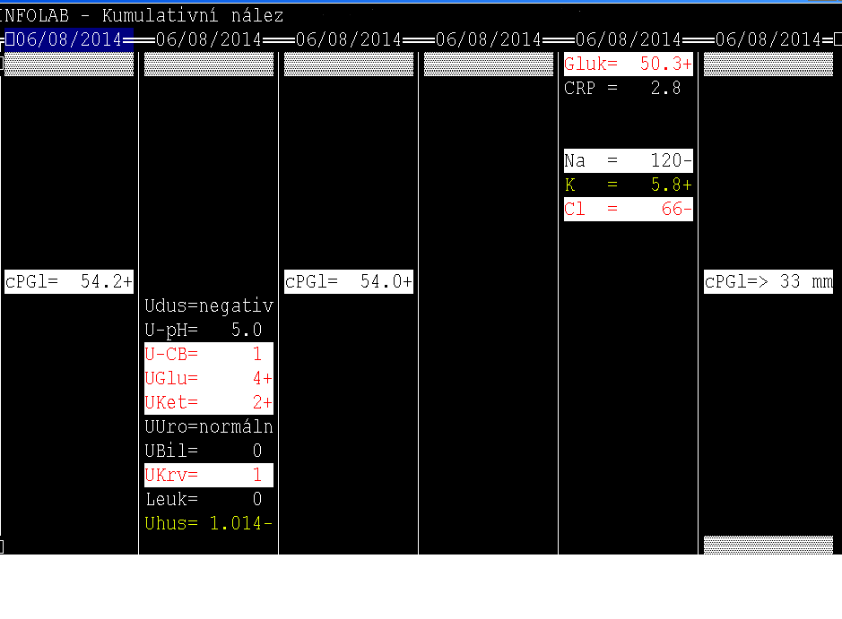

Slide 13
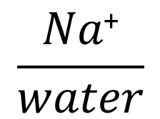
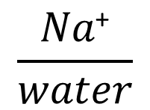
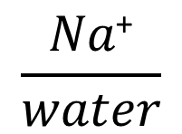
Hypoosmolar hyponatremia
relative imbalance between the volume of ECF and the amount of sodium cations included
[Na ⁺]
hypovolemic
hypervolemic
euvolemic

Slide 14
Hypovolemic hypoosmolar hyponatremia
Na⁺ loss is higher than loss of free water (volume of ECF is reduced)
Extrarenal loss
diarrhea, vomiting, burns
third spacing of fluid (ileus, peritonitis, fistulas, burns, etc.)
Renal loss
diuretics
aldosterone deficiency
Signs
Dehydration, risk of kidney failure and blood circulation
Therapy
isotonic saline
ICF
ECF

Slide 15
Hypervolemic hypoosmolar hyponatremia
retention of water of hypoosmotic fluid
Nonrenal causes
cirrhosis, heart failure, nephrotic syndrome with the development of edema (hypoalbuminemia)
Renal causes
acute renal failure
Signs
edemas, gain of weight
Therapy
fluid restriction, water restriction, diuretics
ICF
ECF

Slide 16
Isovolemic hypoosmolar hyponatremia
retention of pure water with later redistribution into intracellular space
Syndrome of inappropriate antidiuretic hormone secretion (SIADH)
brain trauma, pneumonia, lung cancer
drugs – carbamazepine, barbiturates, hydrochlorothiazide
Therapy
water intake restriction, antagonists of ADH receptors
ICF
ECF

Slide 17
Basic notes to therapy
it is important to:
judge the severity of hyponatremia, time course of sodium levels and cause of hyponatremia
assess the ECF volume and osmolality
treat the cause of hyponatremia if possible
consider the correction (max. 8 – 12 mmol/L/ 24h in symptomatic patients, in asymptomatic even slower)
monitor the level of plasma sodium concentration hourly

Slide 18
Calculation of sodium deficit
deficit Na⁺ = m (in kg) * F * (140 – measured plasma Na⁺ concentration)
(F = 0.6 for men a 0.55 for women)
target value of plasma sodium concentration: half of the distance between measured value of plasma sodium concentration and value 140 mmol/L
deficit Na⁺ _{target} = m (in kg) * F * (target value of plasma sodium concentration - measured plasma Na⁺)

Slide 19
Hypernatremia
most common cause of increased osmolality
very often caused by water deficit rather than sodium cation excess
hyperosmolality cause the movement of water from ICF to ECF with dehydration of (brain) cells
compensational mechanism is the increase of solute particles in brain cells
rapid therapy cause brain edema

Slide 20
Signs of hypernatremia
mostly neurological – because of the water movement in brain cells
thirst
irritability, spasticity, aggressivity, insomnia, hyperventilation, coma → death
intracranial bleeding (volume changes of brain tissue)

Slide 21
Causes of hypernatremia
category | example
decreased body sodium (loss of water > Na⁺) | extrarenal: sweating, diarrhea renal: osmotic diuresis (diabetes mellitus)
normal body sodium (loss of pure water) | extrarenal: fever renal: diabetes insipidus
increased body sodium (retention of Na⁺ > water) | steroid treatment, Cushing‘s syndrome, increase intake of sodium (iatrogenic application of hyperosmolar saline, provoking of vomiting by salt solution, castaways adrift at sea)

Slide 22
Therapy of hypernatremia
the same rules as in therapy of hyponatremia (cause, severity, time course)
typical treatment is rehydration, oral or intravenous (combination of 5% glucose and saline according to estimated loss of water and sodium) or diuretics (in case of retention of water and Na⁺)

Slide 23
Potassium cation

Slide 24
Potassium balance and distribution
K⁺ concentration in plasma | 3.8 – 5.2 mmol/l
K⁺ concentration in cell | 100 - 160 mmol/l
K⁺ concentration in urine | 30 - 80 mmol/l
intracellular reserve | 3200 mmol
extracelullular reserve | 60 mmol
K⁺ intake | 50 - 100 mmol/24 h.
K⁺ excretion | 50 - 100 mmol/24 h.
K⁺ is the main intracellular cation – at least 95% of the body's potassium is found inside the cells

Slide 25
Plasma potassium concentration and pH
they are dependent (decrease of pH by 0.1 increase plasma potassium concentration by approx. 0.6 mmol/L)
more accurate is Kazda's formula :
Plasma potassium concentration = 33,05 – 3,87*plasma pH
pH = 7 matches the plasma potassium concentration 6 mmol/L and pH = 7.7 matches the plasma potassium concentration 3.3 mmol/L
AND IF THE VALUES DO NOT MATCH EACH OTHER?

Slide 26
Definitions of plasma potassium imbalance
hypokalemia – the plasma K⁺ concentration is below the physiological range
mild 3.0 – 3.5 mmol/L
moderate 2.5 – 3.0 mmol/L
severe < 2.5 mmol/L
hyperkalemia – the K⁺ concentration in the serum is above the physiological range
mild 5.5 – 6.5 mmol/L
moderate 6.5 – 7.5 mmol/L
severe > 7.5 mmol/L

Slide 27
Types of hypokalemia
Altered internal distribution
Altered external balance
Other
deficient intake of K⁺
artefact (collection of blood from a vein near to site of IV infusion)
excessive losses of K⁺
Hypokalemia must not be equated with depletion of body K⁺. Although most patients with K⁺ depletion have hypokalemia, acute changes in the distribution of K⁺ in the body can offset any effects of depletion or excess.

Slide 28
Hypokalemia due to altered internal distribution of K⁺
altered internal distribution = shift of K⁺ into cells
alkalosis
insulin (beware of hypokalemia after starting the treatment of diabetic ketoacidosis)
adrenaline (e.g. after MI)
cellular incorporation of K⁺ (parenteral re-feeding, rapidly proliferating leukemic cells)

Slide 29
Hypokalemia due tu altered external balance
deficient intake of K⁺
chronic and severe malnutrition, anorexia nervosa
excessive losses of K⁺ from the renal tract
hyperaldosteronism, diuretic therapy, renal tubular acidosis, Bartter‘s syndrome
excessive losses of K⁺ from the GI tract
vomiting, diarrhea or laxative abuse, fistula

Slide 30
Signs of hypokalemia
muscle weakness, spasms
disturbances of cardiac conduction
constipation or paralytic ileus
disturbed concentration of urine and polyuria

Slide 31
Principles of therapy
measure the plasma magnesium concentration – it is necessary for activity of Na⁺/K⁺ ATPase
calculate the deficit of potassium
K _{deficit} (in mmol)=(K _{normal lower limit} - K _{measured}) x body weight (kg) x 0.4
correction depends strongly on the kidney function
IV administration is recommended in severe hypokalemia or if the plasma potassium level is not responding to oral administration
maximal dose is 10 - 20 mmol/L/h
7.5% KCl contents 1mmol/L of K⁺ in 1 ml
check the plasma potassium concentration hourly

Slide 32
Types of hyperkalemia
Altered internal distribution
Altered external balance
Other
increased intake of K⁺
pseudohyperkalemia
decreased losses of K⁺

Slide 33
Causes of hyperkalemia
altered internal distribution
acidosis, uncontrolled diabetes mellitus (lack of insulin), cellular necrosis
increased intake
rare, only in combination with renal insufficiency
decreased excretion
renal diseases, mineralocorticoid deficiency

Slide 34
Pseudohyperkalemia
increased amount of potassium in plasma that occurs due to excessive leakage of K⁺ from cells during or after blood is drawn
excessive use of tourniquet
lack in processing the blood after the collection
hemolysis
leukocytosis (> 50 · 10⁹/l)
trombocytosis (> 750-1000 · 10⁹/l)

Slide 35
Principles of therapy
increase of shift of K+ into cells (glucose + insulin, alkalization, correction of hyponatremia)
diuretics in nonrenal causes
calcium gluconate (counter the neuromuscular effect of hyperkalemia)
renal dialysis in severe hyperkalemia

Slide 36
Practical notes to therapy
plasma potassium concentration must be judged together with clinical condition of patients (ECG!), acid – base balance, renal functions and possible K+ depletion
hypokalemia with acidosis and hyperkalemia with alkalosis are potentially critical
hypokalemia with increased potassium in urine is usually caused by renal disorder, hypokalemia with decreased excretion fraction of potassium has usually extrarenal cause. Conversely in hyperkalemia.
therapy of hyperkalemia must be quick with monitoring of electrolyte balance every half an hour.

Slide 37
Chloride anion

Slide 38
Chloride balance and distribution
Cl⁻ concentration in plasma | 98-107 mmol/L
Cl⁻ concentration in cell | 3 mmol/L
Cl⁻ intake | 140-260 mmol /24h (8-15 g NaCl)
Cl⁻ renally excretion | 120-240 mmol / 24h
Cl⁻ excretion via intestines | 10 mmol / 24h
Cl⁻ excretion via sweat | 10-80 mmol / 24h
Cl⁻ total excretion | 140-260 mmol / 24h

Slide 39
Chlorides and acid-base balance
chlorides are necessary for the calculation of anion gap and unmeasured anions
corrected chlorides – reflect the influence of hydration on plasma chloride concentration (how would be the plasma chloride concentration if the plasma sodium concentration is 140 mmol/l)
Corrected chlorides = [Cl⁻] ×(140 ÷[Na⁺])

Slide 40
Hypochloremia
is an electrolyte disturbance in which there is an abnormally low level of the chloride ion in the blood (< 98 mmol/l)
accompanied by hypochloremic alkalosis, hypokalemia, and usually hyponatremia
Causes:
Nonrenal:
loss of GI fluids – vomiting, fistula in proximal part of GIT
Renal:
increased renal excretion of Cl⁻ – polyuric stage of renal failure, a massive treatment with diuretics
Treatment: correction of the underlying cause, saline, 7.5% KCl if the hypokalemia is also present

Slide 41
Hyperchloremia
is an electrolyte disturbance in which there is an abnormally elevated level of the chloride ion in the blood (> 107 mmol/l)
often combined with metabolic acidosis and hypernatremia
Causes: infusion therapy, diarrhea, kidney diseases (e.g. renal tubular acidosis), overactivity of the parathyroid glands etc.
Treatment: correcting the underlying cause, restriction of intake, diuretics (rarely)

Slide 42
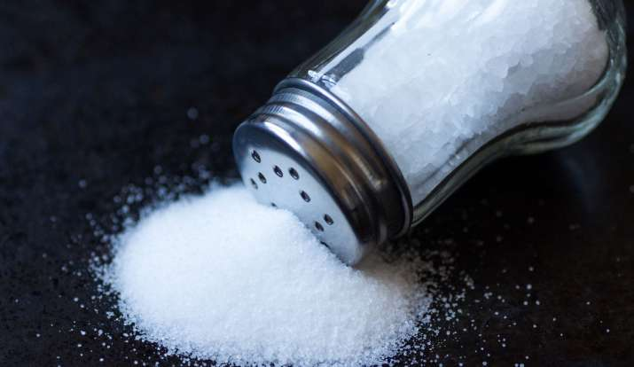
Thank you for your attention.

