Slide 1

Vitamins
MUDr. Miroslava Hlaváčová, PhD.
Department of Biochemistry, Faculty of Medicine, MU

Slide 2
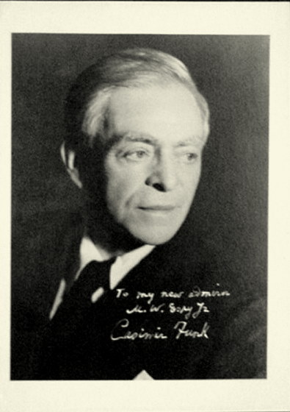
History
Casimir Funk – in 1912 first introduced the word "vitamine" derived from words vital and amine
later the final "e" was dropped

Slide 3
Definition
Vitamins are low molecular weight organic compounds with different chemical properties, that human body cannot synthetize and in low quantities are necessary for many biochemical and physiological functions.
They belongs to essential nutrients together with nutrients of energetic metabolism (for example linoleic acid), essential amino acids, minerals and trace elements.

Slide 4
Characteristics
solubility – basic dividing characteristic
stable when in crystal powder
less stable in water solutions (risk of oxidation)
pH (acidic pH OK, alkaline not - acidification)
temperature
oxygen (reducing agents)
UV radiation (vit. A, B2), light (flavonoids)
metal ions (chelating agents)

Slide 5
Determination
microbiological tests – obsolent, incubation of sample extract with microbe dependent on vitamin
chemical methods without separation – mostly analyses of food and pharmaceutical samples, not biological ones (too many interferences), these methods use physical and chemical chracteristic of vitamins

Slide 6
Determination II.
separative methods – most often used, mostly HPLC with different types of detection, or in combination with mass spectrometry; they enable also detection of isomers
enzymatic methods – activity of vitamin-dependent enzyme is determined

Slide 7
Determination III.
immunochemical methods – they use specific antibodies; simple; main problem are cross reactions
preparation of sample – protection before and during transport (see p. 4), concentration and purification of a sample

Slide 8
RDA*
Recommended dietary allowance of vitamins
Vitamin | Unit | Quantity
B₁ | mg | 1,1
B₂ | mg | 1,4
B₃ | mg | 16
B₅ | mg | 6
B₆ | mg | 1,4
B₉ | μg | 200
B₁₂ | μg | 2,5
Vitamin C | mg | 80
Biotin | μg | 50
A | μg | 800
D | μg | 10 (=400 IU)
E | mg | 12
K | μg | 75
*valid for healthy people between 23-50 years, non-pregnant women, also sex-related charts exist

Slide 9
Classes of vitamines
water-soluble vitamins |  | fat-soluble vitamins
B₁ | thiamine | A | retinoids
B₂ | riboflavin | D_{1, 2, 3}
B₃ | niacin (vitamin PP) | E | tocopherols
B₅ | pantothenic acid | K_{1, 2, 3,}
B₆ | pyridoxine
B₇ | biotin (vitamin H)
B₉ | folic acid/folate
B₁₂ | cobalamin
C | ascorbic acid
„B – complex“

Slide 10
Comparison of vitamin classes
 | water-soluble vitamins | fat-soluble vitamins
Absorption | easy* | with lipids (+ bile salts)
Transport proteins | no* | yes
Storage | no* | yes
Excretion | yes | no
Deficit | arise quickly* | after depletion of reserves
Toxicity | rare | possible hypervitaminosis
Therapy of deficit | regular intake | single high dose possible
*except vitamin B₁₂

Slide 11
Disorders
hypervitaminosis – especially vitamins A and D
hypovitaminosis – inappropriate intake
  deficit in food
  malabsorption
  increased need
avitaminosis – severe stage of deficit

Slide 12
Water-soluble vitamins

Slide 13
Vitamin B1 - thiamine
active form is thiamine pyrophosphate (cofactor of enzymes)
functions:
  oxidative decarboxylation of 2-oxoacids in citrate cycle (pyruvate, α-ketoglutarate)
  cofactor of transketolase in pentose phosphate pathway (PNS, CNS, cardiomyocytes, erythrocytes)
  stimulation of neutrophils a leukocytes
sources – yeast, bran, liver, oatmeal, natural rice, nuts, buckwheat, sprouted grains
alcohol inhibits active transport into enterocytes!!! (passive is functioning, but is able from dose 5mg/day, (RDA 1.1mg))
saccharide metabolism

Slide 14
Deficit of thiamine
beriberi (means fatigue or weakness)
  first signs: anorexia, dyspepsia, weakness, fatigue
  "dry" form: affection of peripheral nerves, especially on lower limbs, paresthesia or anesthesia, paralysis
  "wet" form: edema, dyspnea, hepatomegaly, tachycardia, heart failure, lactic acidosis (pyruvate is conversed to lactate)
Wernicke-Korsakoff syndrome
  symptoms of beri beri + psychosis, ataxia, nystagmus, ophthalmoplegia
beware of parenteral nutrition!! (acidosis non-reacting on alkalization)

Slide 15
Vitamin B₂ - riboflavin
part of cofactors FAD and FMN
functions:
  transport of electrons in respiratory chain
  redox reactions of AA, saccharides, purines
  integrity of cell membrane
  cofactor of glutathione reductase (antioxidative effect)
  detoxification of drugs and xenobiotics
sources – cheese, eggs, meat, broccoli, parsley, yeast, milk, whole wheat products

Slide 16
Deficit of riboflavin
syndrome resulting from isolated deficit is not known, symptoms result mostly from malnutrition and deficit of all vitamin B complex
inflammation of conjunctiva and cornea, neural disorders, angular cheilitis, glossitis
possible influence on decreased immune function
avitaminosis – deprivation of growth

Slide 17
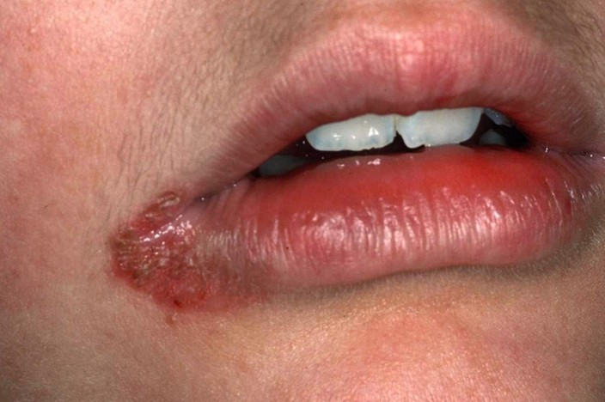
http://healthh.com/cheilosis/

Slide 18
Vitamin B₃ - niacin
part of cofactors NAD⁺ a NADP⁺, in humans partially synthetized from tryptophan (provitamin)
functions:
  cofactor of at least 200 of enzymes involved in redox reactions, citric acid cycle, synthesis and β-oxidation of FA
  vasodilatation
  reduction of total cholesterol and LDL (inhibits flow of free FA from adipose tissue)
  replication and reparation of DNA, apoptosis
sources – meat, liver, tuna fish, sunflower seeds, peanuts, beans, yeast, lower amount in cereals

Slide 19
Deficit of niacin
deficit occurs when the diet is deficient in niacin AND ALSO tryptophan
deficit of vitamins B₁, B₂, B₆, copper, iron and magnesium worsen the conversion of tryptophan to niacin
pellagra – „three D disease“
  dermatitis (rush occurs predominantly on areas exposed to sun, typical is so called Casal‘s collar)
  diarrhoe
  dementia, irritability, later disorientation and hallucinations
  others – smooth beefy red glossitis, neuritis, ataxia, convulsions

Slide 20
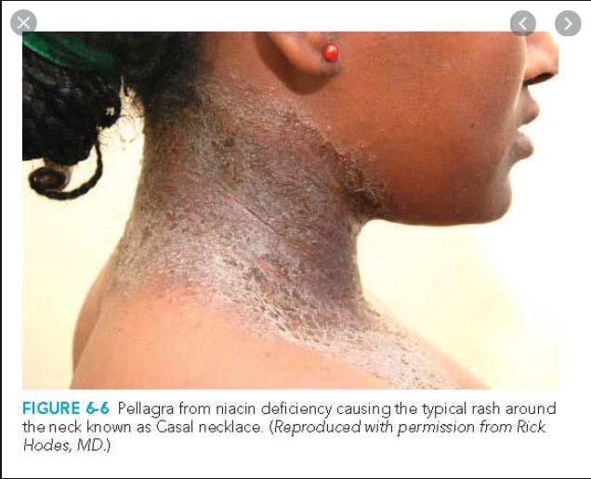
from Color Atlas of Internal Medicine by Richard P. Usatine (Author), Gary Ferenchick (Author), Mindy Ann Smith (Author), E. J. Mayeux Jr. (Author), Heidi Chumley (Author)

Slide 21
Hypervitaminosis of niacin?
it is possible after prolonged intake of higher doses than RDA (e.g. in diabetic patients is niacin used for increase in glucose tolerance and improving of metabolism of saccharides and lipids)
vasodilatation (headache, nausea, vomiting)
hepatitis, even fulminant liver failure
thrombocytopathy
myopathy

Slide 22
Vitamin B₅ – pantothenic acid
part of coenzyme A
functions:
  essential for reactions in metabolism of lipids and saccharides, release of energy in lipids and saccharides
  synthesis of hem, sterols and lipids
  acetylation reactions, gluconeogenesis
sources – small quantities of pantothenic acid are found in nearly every food (pantos = everywhere), with high amounts in fortified whole-grain cereals, egg yolks, liver, partially synthetized by human microflora

Slide 23
Deficit of pantothenic acid
very rare (famine, chronic alcoholics)
possible symptoms:
  Burning Feet Syndrome (Grierson-Gopalan Syndrome)
  impaired hearing, fatigue, depression, insomnia
  impaired wound healing and transplant recovery
  impaired immune system, disposition to infections
despite the fact, that normal varied diet is rich in pantothenic acid, it‘s still favourite dietary supplement

Slide 24
Vitamin B₆ – pyridoxine
active form is cofactor pyridoxal phosphate
function:
  cofactor of at least 100 of enzymes
  decarboxylation, transamination, deamination of AA
  metabolism of lipids, methionine and cysteine
  gluconeogenesis, glycogenolysis
  synthesis of DNA, hem, niacin, neurotransmitters, myelin, taurine
sources – yeast, sprouted grains, whole wheat bread, bananas, nuts and seeds, buckwheat, bran, meat

Slide 25
Deficit of pyridoxine
neurological symptoms (lack of serotonin, adrenaline, noradrenaline, GABA), neuritis (disorders of myelin)
hypochromic sideroblastic anemia
hyperhomocysteinemia
inflammations of eye and mouth corners, follicular hyperkeratosis
developmental anomalies of apoenzymes coupled with pyridoxine leads in infants to mental retardation, bone deformations, osteoporosis, thrombosis and vision disorders

Slide 26
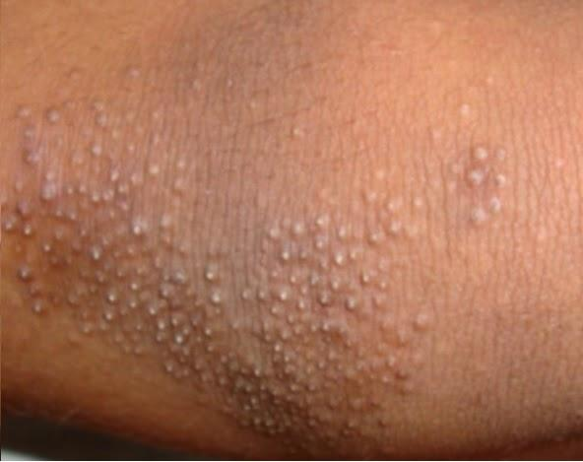
http://www.medyouth.com/2015/04/the-treatment-methods-to-remove.html

Slide 27
Vitamin B₇/H – biotin
cofactor of carboxylases
function:
  reactions of acetyl-CoA, propionyl-CoA, pyruvate
  FA synthesis
  metabolism of PUFA, leucin, cholesterol
  gluconeogenesis, catabolism of branched chain AAs
  cell growth
sources – synthetized by microflora, egg yolk, liver, soya beans, chocolate, cereals, yeast, sea fish

Slide 28
Deficit of biotin
very rare
possible symptoms: nausea, anorexia, vomiting, pale skin, muscle pain, dry skin, hair loss, increased concentration of cholesterol, bile pigments, depression

Slide 29
Vitamin B₉ – folic acid/folate
active form is tetrahydrofolate
functions:
  synthesis of methionine (together with vitamin B₁₂)
  normal function of erythrocytes and leukocytes
  synthesis of purines, DNA
  conversion of homocysteine to methionine, serine to glycine
  key role in growth, division and differentiation of cells
  antitumor effect (colon)
  prevention of neural-tube defects in embryos
sources – yeast, green leafy vegetables, nuts, organ meats, orange juice

Slide 30
Deficit of folate
neural-tube defects in embryos,
hyperhomocysteinemia, increased rick of cardiovascular disorders
macrocytic anemia, thrombocytopenia
gastrointestinal disorders (inflammation and ulceration of mucosa, diarrhea, nausea)
depression and psychical instability

Slide 31
Vitamin B₁₂ – cobalamins
active forms are methyl cobalamin and adenosyl cobalamin
functions:
  maturation of erythrocytes
  cofactor of DNA/RNA synthesis
  cell proliferation, hematopoiesis
  synthesis of myelin a nucleoproteins
  recycling of folate coenzymes
sources – meat, eggs, milk

Slide 32
Deficit of cobalamin
has several stages (decreased plasmatic concentrations, decreased intracellular concentration, metabolic aberration and clinical manifestation)
megaloblastic and pernicious anemia, disorders in methionine, purine and pyrimidine metabolism, homocystinuria
impaired myelin synthesis cause combined degeneration of sensory and motoric neurons → paresthesia, proprioception disorders, impaired body balance, confusion, impaired memory, depression
high doses of folate can cover the signs of deficit in cardiovascular system, but not in nervous system

Slide 33
Vitamin C – ascorbic acid
function:
  synthesis of collagen, formation of osteoid, synthesis of connective tissue‘s proteins
  electron transporter in redox reactions
  hydroxylation reactions (steroid hormones, adrenaline, 5-hydroxytryptophan)
  antioxidant
  metabolism of histamine, carnitine, cholesterol, bile acids
  increase the resorption of iron (also part of iron dietary supplements)
  phagocytosis of leukocytes, immunity
sources – citrus fruits, pepper, potatoes, rose hips, black currant, horseradish, strawberries,

Slide 34
Deficit of ascorbic acid
fatigue, weakness, muscle pain
anorexia, increased disposition to infections, depression
impaired wound healing, anemia, hemorrhage, petechiae, hemarthrosis
fragile and swollen gums, teeth loss
beware of high doses!! (urolithiasis, interference with several biochemical urine tests, e.g. determination of glucose or blood in urine)
scurvy (scorbute)

Slide 35
Fat-soluble vitamins

Slide 36
Vitamin A
terminology and conversions
  active form of vitamin A is only in animal tissues, in plant tissue is as a provitamin A - β-carotene
  vitamin A has several trans/cis isomers (A₁, A₂,...)
  all molecules with vitamin A activity have common name retinoids:
    retinol, retinal, retinoic acid
  conversion between retinol and retinal is reversible, conversion of retinal to retinoic acid is irreversible

Slide 37
Vitamin A
functions:
  process of vision (retinal)
  important factor in gene expression, reproduction and embryogenesis, proliferation, differentiation and apoptosis (RAR and RXR receptor, retinoic acid)
  lipoprotein and immunologic integrity, stability of lysosomes
  potential antioxidant function (carotenoids are probably more potent)
  necessary for correct function of skin and epithelium
sources – liver, dairy products, oily fish, egg yolk (absorbed as a retinol)
sources of carotenoids – yellow and orange vegetables and fruit, green leafy vegetables
storage suffices under physiological conditions for 2 years

Slide 38
Deficit of retinol
night blindness, xeropthalmia (inflammations of eyelid and conjunctiva, keratomalacia – softening of cornea with overgrowing of vessels – risk of loss of the vision)
xeroderma, follicular hyperkeratosis and keratinization of epithelium in respiratory, gastrointestinal and urinary system, increased risk of infections
disturbed immunity (potential antitumor effect)

Slide 39
Hypervitaminosis
potential toxicity after administration of 20 times higher doses in kids or 100 times higher doses in adults
teratogenic effect (abortions, developmental anomalies)
high intake of carotenoids is not toxic
manifestation: alopecia, anemia, dermatitis, hepatomegaly, insomnia, hyperlipidemia, vomiting

Slide 40
Vitamin D
D₂ – ergocalciferol (plant origin)
D₃ – cholecalciferol (formed in skin from precursor)
functions:
  regulation of calcium and phosphate metabolism (more in following lecture)
  not fully understood function in immune system
sources – sunlight (15 min./day), oily fish, egg yolk, liver, milk, butter

Slide 41
Deficit of vitamin D
tooth decay, bone deformities, rachitis, osteomalacia
substitution therapy
  prophylaxis: 400 IU
  deficit: 1000 IU
  rachitis and osteomalacia: 5000 IU
  involutional osteoporosis: thousands of IU

Slide 42
Hypervitaminosis
cause is usually excessive substitution, not sunbathing (formation of D₃ in skin is regulated)
manifestation: permanent thirst, skin itching, diarrhea and vomiting, calcification of vessels and kidneys

Slide 43
Vitamin E – tocopherols
8 natural tocopherols, α-tocopherol has the highest biological activity
functions:
  intracellular antioxidant, mostly of PUFA in membranes (nerves, erythrocytes, LDL)
  synergic effect with selenium against lipoperoxidation
  inhibits mutagens in digestive system
  recently confirmed function in signaling pathways
sources – sprouted grains, poppy seeds, nuts, egg yolk, vegetable oils

Slide 44
Deficit of vitamin E
decrease life span of erythrocytes, even hemolytic anemia
functional defects of peripheral nerves
increased cell death because of membrane damage (lipoperoxidation)
long term deficit – myopathies or muscle necrosis, retinopathies, liver necrosis

Slide 45
Hypervitaminosis
dyspepsia, fatigue, headache, muscle fatigue
can cause developmental anomalies

Slide 46
Vitamin K
functions:
  vitamin K is essential factor of posttranslational carboxylation of glutamate to γ-carboyxyglutamate (coagulation factors II, VII, IX, X, protein C, osteocalcin)
  antidote for warfarin overdose (administered with heparin)
sources – vegetables (especially green leafy vegetables), vegetable oils, cheese, yoghurts

Slide 47
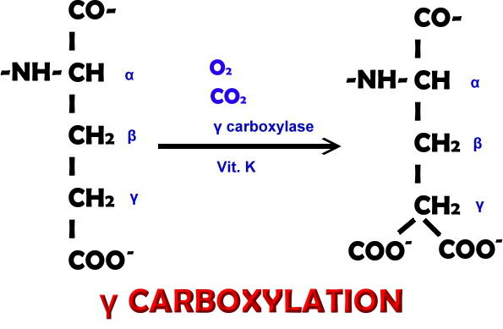

Slide 48
Deficit of vitamin K
rare, risk group are infants (vitamin K cannot pass through placenta and breast milk also contains low levels of it) and patients with lipid malabsorption
petechiae, disposition towards bleedings and hematomas

Slide 49
Hypervitaminosis
risk group are premature babies (substitution needed, but dosing must be watched)
hemolysis, hyperbilirubinemia, kernicterus, brain damage

Slide 50

Thank for your attention.

