Slide 1
Biochemical diagnostics of kidney diseases, their monitoring, functional tests. Urinary sediment. Elimination techniques.
Jan Novák

Slide 2
Kidney Physiology in a Nutshell
Jan Novák

Slide 3
Kidney Functions
Excretory function (= removal of unnecessary or harmful substances from the body)
Urine and N-substances in it (urea, creatinine)
Xenobiotics (drugs, toxic substances)
Maintenance of stable ionic composition (Na⁺, K⁺, Cl⁻, Ca²⁺, PO₃²⁻)
Maintenance of acid-base balance (HCO₃⁻, H⁺)
Endocrine function - renin production (part of RAAS) - vitamin D metabolism
Control of body volume and blood pressure

Slide 4
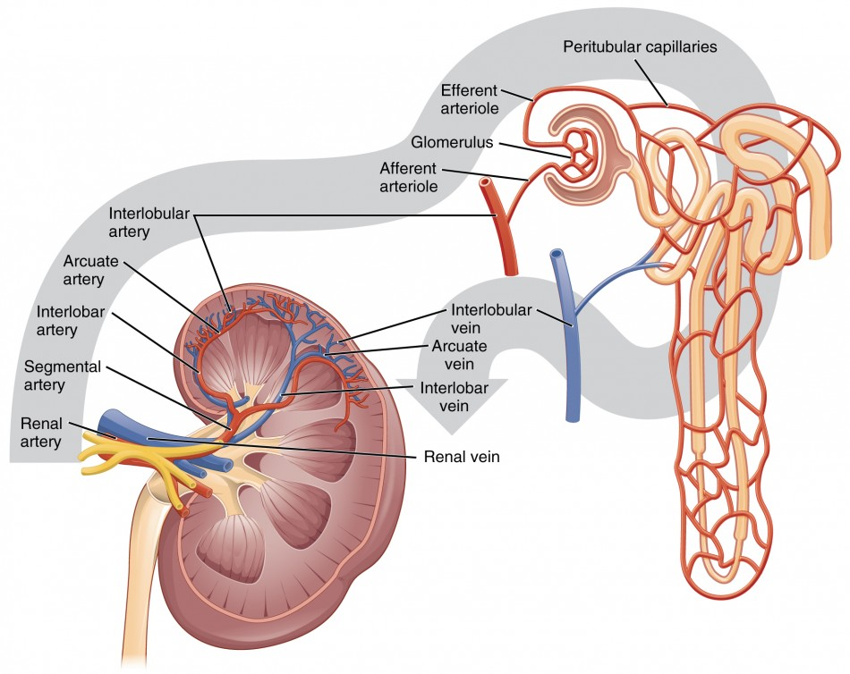
Blood flow through the kidney
20% of cardiac output (1 liter per minute)
"Plasma skimming“
vas afferens - glomerulus - vas efferens
the difference between cortical and juxtamedullary nephrons

Slide 5
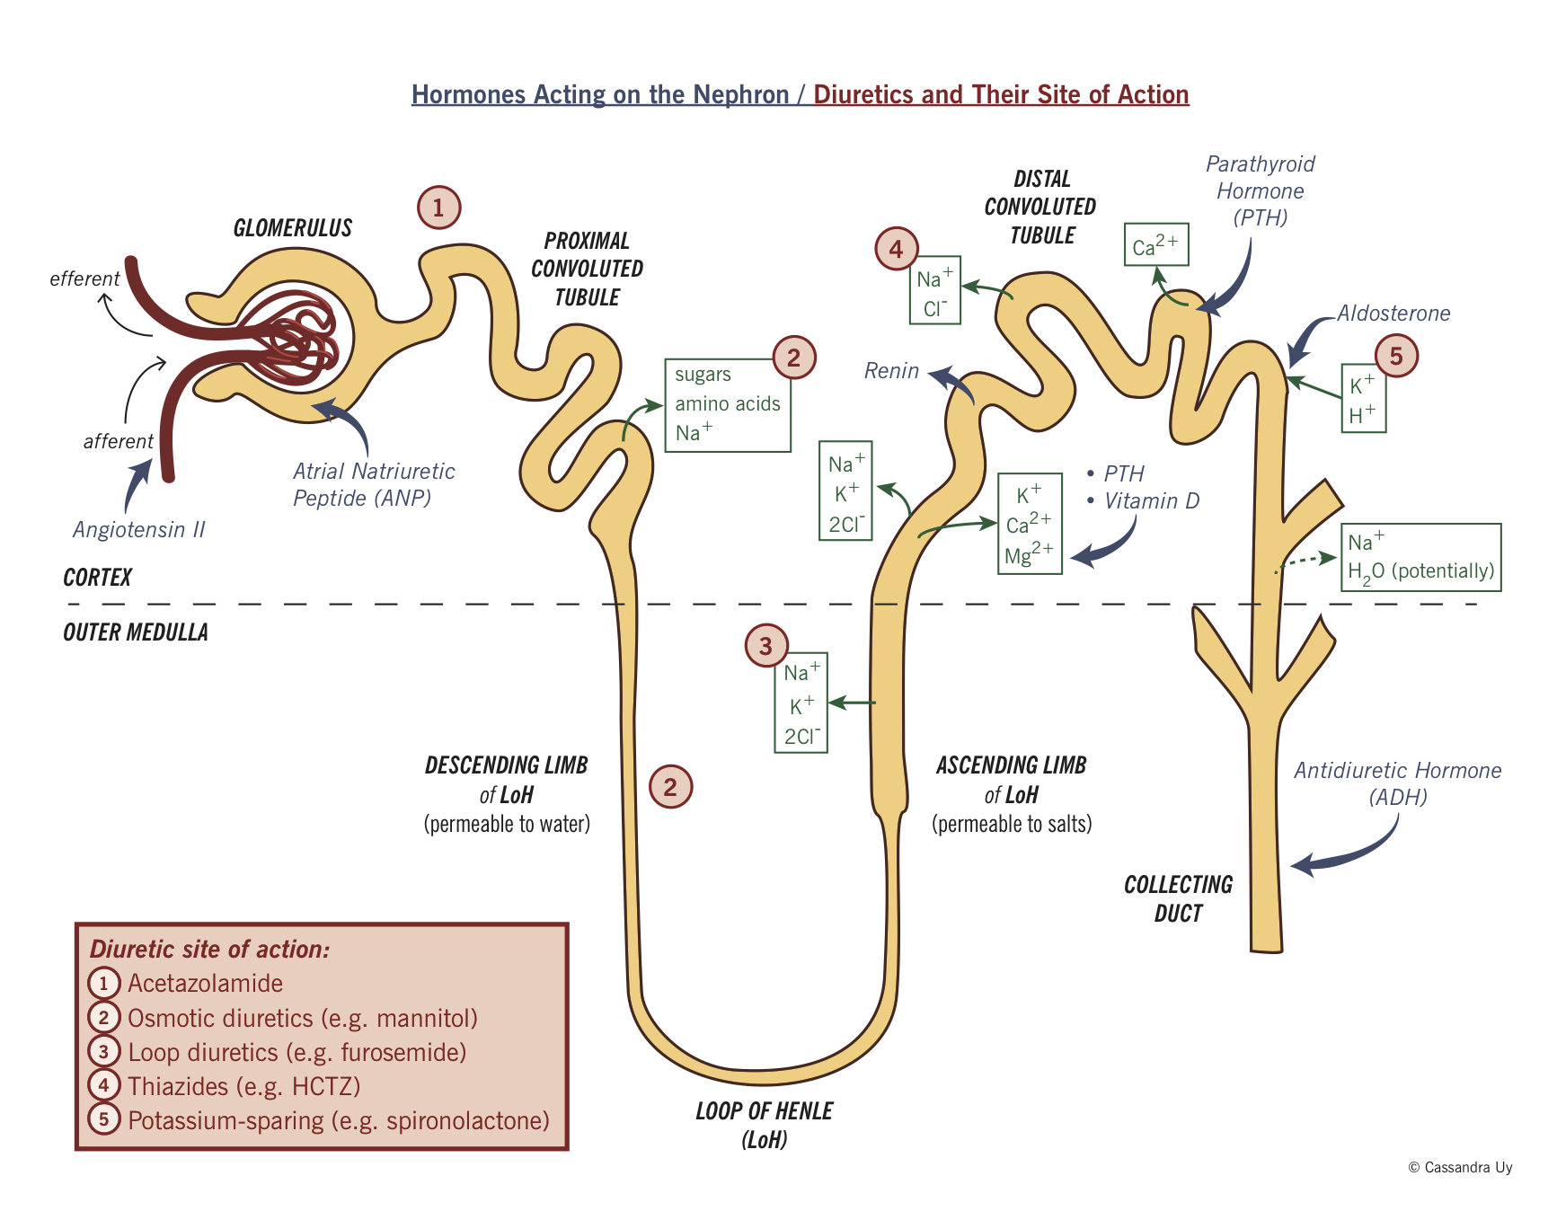
Nephron – the functional morphology
Glomerulus and Bowman's body = GF
Proximal tubule = volume resorption
Loop of Henle = countercurrent system and osmotic stratification of the medulla
Distal tubule = controlled resorption
Collection channel = water resorption due to ADH

Slide 6
Basic urine examination and kidney function tests
Jan Novák

Slide 7
Urine collection
Disposable (one-time) - First / second morning urine - Random sample - Catheterized
Genital cleansing
Medium urine flow (after 2-3s)
Urine collection
24 hours
4 hours
The right technique (the patient urinates and collects 24 hours from that moment)

Slide 8
Physical evaluation (by sight, smell)
Colour
Shades of yellow = state of hydration Light = polyuria "Normal" = normal Dark = dehydration Amber = severe dehydration
Shades of red / brown = hematuria
Green, “cafe au lait", bluish - mostly infections
Turbidity Typically for infections but also sperm, erythrocytes, precipitated substances (when storing urine in the refrigerator)
Odor Fruit sweet = ketonuria Mouse = phenylketonuria Disgusting putrefactive = infection

Slide 9
Urine „chemically + sediment“
Specific density(dimensionless number; ratio of sample density to distilled water; reflects tubular function)
pH (normal 4.5 - 8; e.g. Klebsiella lowers urine pH; important in calcium oxalate stones = formation in acidic environment)
Leukocytes (leukocyte esterase)
Nitrites (bacteria reduce nitrates to nitrites)
Protein (above 150mg / l, the first sign of glomerular or tubular proteinuria)
Blood (heme detection, microscopic x macroscopic, prerenal x renal x subrenal)
Glucose
Ketone bodies (beta-hydroxybutyrate and acetetoacetate)
Bilirubin (conjugated is released into the urine)

Slide 10
Urine „chemically + sediment“
Erythrocytes - if the blood has been proven "chemically" and if there are no erythrocytes in the "sediment", this indicates a prerenal source (hemoglobin, myoglobin in the urine) - if there are erythrocytes in the sediment, we distinguish between glomerular ("wrinkled" = dysmorphic erythrocytes) and subrenal (normal shape)
Leukocytes
Epithelium
Bacteria and yeasts
Parasites
Sperm
Mucus, cylinders, crystals…

Slide 11
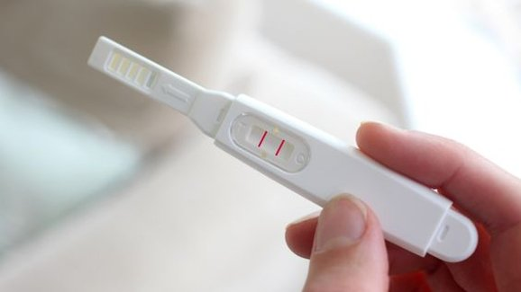
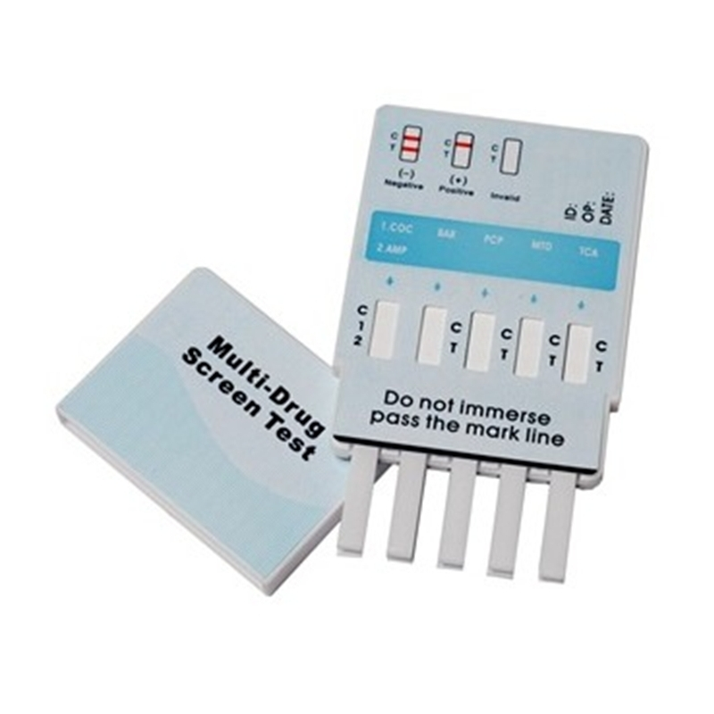
Other detectable analytes from a disposable urine
Pregnancy test (HCG)
The indicative drug tests
amphetamine (AMP)
barbiturates (BAR)
benzodiazepins (BZD)
cocaine (COC)
metamphetamine (MET)
morphine (MOR)
metadone (MTD)
phencyclidine (PCP)
propoxyphen (PPX)
tricyclides (TCA)
marihuana (THC)
ecstasy (XTC)
https://cdn3.volusion.com/7ewna.rufa3/v/vspfiles/photos/DOA194-2.jpg?v-cache=1567517754

Slide 12
24 (4) hours urine collection
Calculation of glomerular filtration => Creatinine clearance
The volume of blood purified from a given substance per unit time
GF = urine volume in 24 h * C creatinine in urine / C creatinine in serum
Examination of tubular functions => Fractional excretion The amount of filtered substance that we can find in the definitive urine e.g. 180 l of primary urine is produced per day, we urinate 1.8 liters = FE 1%
Calculation of excreted substances per day (typically proteinuria)

Slide 13
What are the N-substances?
Urea 1,7 – 8,3 mmol/l
the most quantitatively significant degradation product of amino acids and proteins
blood urea concentration depends on dietary protein content, renal excretion and hepatic metabolic function
Creatinine 44 – 104 μmol/l in women
44–110 μmol/l in men
formed in the muscles from creatine and creatine phosphate
serum levels also reflect the proportion of muscle mass
used to calculate or estimate the glomerular filtration

Slide 14
Estimation of glomerular filtration
Cystatin C: a low molecular weight protein, expressed in a constant amount, freely by the glomerular membrane and is fully resorbed and degraded in the tubule. If serum levels rise, it reflects a decrease in GFR.

Slide 15
Estimation of glomerular filtration
www.mdcalc.com

Slide 16
Estimation of glomerular filtration – why?
We use estimation because accurate calculations over 24 hours of urine collection are often lengthy and burdensome for the patient.
According to GFR, the dosage of various drugs is adjusted (most of the antibiotics, DOACs, LMWH), when GFR is reduced below a certain limit, other drugs are completely contraindicated (eg metformin) or are ineffective (some "weaker" diuretics)

Slide 17
Case study 1: Examination of urine
Jan Novák

Slide 18
Case report # – title
Case description Description of what happened and why the patient is coming.
Medical history
Basic and relevant patient data
FH = family history
PH = personal history
MH = medication
AA = alergies
Abusus

Slide 19
Case report # – title
Urine - chemically
pH
Proteins
Glucosis
Urobilinogen
Bilirubin
Ketones
Nitrites
Leukocytes
Blood
Urine - Sediment
Leucocytes
Erytrocytes
Bacteries
Mucus
Epithelium flat
Epithellium round
Basic biochemistry
Na | 132-142 mmol/l
K | 3,5-5,2 mmol/l
Cl | 97-108 mmol/l
Urea | 1,7 – 8,3 mmol/l
Crea | 44–110 μmol/l
GFR | > 1 ml/s/1,73m²
Gly | 3,9 - 5,5 mmol/l
CRP | 1 – 10 mg/l

Slide 20
Case report 1 – Unconscious patient
Ambulance brings a 88-year-old lady to an internal clinic.
Ambulance was called by the lady‘s family for the gradual deterioration of the mental and body condition during the day, until the unconsciousness, she does not react to the family. Upon arrival: BP 100/60 mmHg, P 70/min, afebrile Vitals: unconsciousness, without jaundice, without dyspnea, miotic pupils, breathing is clean, quiet, slow, heart rate regular, no abdominal pain, legs without swelling, 3 patches of Fentanyl on the back
Medical history
PH: hyertension, light cognitive deficiency, vertebrogenic algic syndrome of lumbar spine
Alergies: no
Mediaction:
Prestarium Neo 5mg tbl 1-0-0
Fentanyl 100ug/h – one patch change every 72 hours
Abusus: non smoker, no alcohol, no drugs (by family)

Slide 21
Case report 1 – Unconscious patient
What next ???
Urine - chemically
pH | 5,0
Proteins | 0
Glucosis | 0
Urobilinogen | 0
Bilirubin | 0
Ketones | 0
Nitrites | 0
Leukocytes | 0
Blood | 0
Urine - Sediment
Leucocytes | 0
Erytrocytes | 0
Bacteries | 0
Mucus | 0
Epithelium flat | 0
Epithellium round | 0
BB
Na | 132-142 mmol/l | 140
K | 3,5-5,2 mmol/l | 4,8
Cl | 97-108 mmol/l | 100
Urea | 1,7 – 8,3 mmol/l | 2,0
Crea | 44–110 μmol/l | 39
GFR | > 1 ml/s/1,73m² | 1,25
Gly | 3,9 - 5,5 mmol/l | 5,2
CRP | 1 – 10 mg/l | 8

Slide 22
Case report 1 – Unconscious patient
The indicative drug tests
amphetamine (AMP)
barbiturates (BAR)
Benzodiazepins (BZD) +++
cocaine (COC)
metamphetamine (MET)
Opiates +++
metadone (MTD)
phencyclidine (PCP)
propoxyphen (PPX)
tricyclides (TCA)
marihuana (THC)
ecstasy (XTC)
https://cdn3.volusion.com/7ewna.rufa3/v/vspfiles/photos/DOA194-2.jpg?v-cache=1567517754

Slide 23
Case report 1 – Unconscious patient
Conclusion:
Intoxication of benzodiazepines
Intoxication of opiates
Checkpoints:
Miotic pupils and respiratory depression = signs of opiate overdose
Explanation:
The patient could not sleep for the last 3 days due to back pain, so she borrowed Lexaurin (BZD) from a neighbor to make her sleep better
Because Lexaurin was not enough, she applied one extra patch in the morning, and because she forgot about it at noon, she applied a third…thus overdosing herself

Slide 24
Case report 2 – Domestic violence
The patient, 29 years old, calls the Police that she was attacked by a friend who beat her, kicked her, maybe even raped her and injected her with some drugs, she is now lying on the ground and unable to get up.
Police arrives at the place, calls ambulance. The patient was found in the apartment in the living room, a laceration on her head, bruises all over her body.
Brought to the surgical outpatient clinic – there was a fracture of the humerus without dislocation and fracture of L2 vertebra according to X-ray, both without dislocation. Ultrasound of the abdomen shown no internal bleeding. Wound on the head was sewed, orthosis and spine corset were applied. Due to possible intoxication with an unknown substance, she was reffered to internal department.
Upon arrival: BP: 120/70 mmHg, pulse 105/min, afebrile Vitals: conscious, oriented, anxious, wound on the headsewed, right arm in the orthosis, respiration clean, heart rate regular, no abdominal pain, peristaltics +,hematomas over the body, legs without swelling
Medical history:
PH: sine
Medication: sine
Alergies: sine
Abusus: smoker (10 cigarettes a day), a week ago she had marijuana, alcohol occasionally, she hadn't drank at all for the last month
Drugs test: THC ++, others neg.

Slide 25
Case report 2 – Domestic violence
BB
Na | 132-142 mmol/l | 139
K | 3,5-5,2 mmol/l | 3,8
Cl | 97-108 mmol/l | 103
Urea | 1,7 – 8,3 mmol/l | 3,5
Crea | 44–110 μmol/l | 82
GFR | > 1,5 ml/s/1,73m² | 1,23
Gly | 3,9 - 5,5 mmol/l | 3,9
CRP | 1 – 10 mg/l | 4,4
Myo | 30 - 80 µg/l | 1424
CK | 0,45-2,45 ukat/l | 77,9
CKMB | 0,2–1,8 ukat/l | 2,13
Urine - chemically
pH | 5,0
Proteins | 0
Glucosis | 0
Urobilinogen | 0
Bilirubin | 0
Ketones | 0
Nitrites | 0
Leukocytes | 0
Blood | 3
Urine - Sediment
Leucocytes | 0
Erytrocytes | 0
Bacteries | 0
Mucus | 3
Epithelium flat | 3
Epithellium round | 1

Slide 26
Case report 2 – Domestic violence
Conclusion:
Muscle trauma after domestic violence = elevation of CK (indirectly CKMB), myoglobin
In the chemical examination of urine we can see a positive test for blood („heme“) but a negative sediment for erythrocytes = evidence of prerenal "overload" of the kidneys with heme
The cylinders and epithelium indicate myoglobin overload of the tubules

Slide 27
Case report 2 – Domestic violence
BB
Na | 132-142 mmol/l | 139 | 137 | 138
K | 3,5-5,2 mmol/l | 3,8 | 3,7 | 3,7
Cl | 97-108 mmol/l | 103 | 105 | 104
Urea | 1,7 – 8,3 mmol/l | 3,5 | 2,9 | 2,6
Crea | 44–110 μmol/l | 82 | 60 | 59
GFR | > 1,5 ml/s/1,73m² | 1,23 | 1,97 | 1,99
Gly | 3,9 - 5,5 mmol/l | 3,9 | 4,4 | 5,0
CRP | 1 – 10 mg/l | 4,4 | 14,3 | 4,1
Myo | 30 - 80 µg/l | 1424 | 332 | 160
CK | 0,45-2,45 ukat/l | 77,9 | 90,8 | 50,4
CKMB | 0,2–1,8 ukat/l | 2,13 | -- | --
Urine - chemically
pH | 5,0
Proteins | 0
Glucosis | 0
Urobilinogen | 0
Bilirubin | 0
Ketones | 0
Nitrites | 0
Leukocytes | 0
Blood | 3
Urine - Sediment
Leucocytes | 0
Erytrocytes | 0
Bacteries | 0
Mucus | 3
Epithelium flat | 3
Epithellium round | 1

Slide 28
Case report 3 – Apartment opened by the Police
The ambulance arrives to the internal departement with an 84-year old patient from an apartment opened by Police.
Ambulance was called by neighbors - the man has not left the apartment for 2 days. The ambulance crew found the patient lying on the ground in the kitchen. Hypothermic, dehydrated, wet, stiff.
The patient states that he has not been well for the last few days, he urinated a lot, while urinating he felt burning. He tried to drink enough, but he had no appetite, then he probably had a fever and when he got up from his chair, he got dizzy and fell and was unable to get up nor to call for help.
Upon arrival: - BP 80/40 mmHg, pulse 86 bpm , TT 36.1 C - V: conscious, slowed psyhomotoric pace, decreased skin turgor, no jaundice, no dyspnea, breathing clean, heart rate regular, no abdominal pain, legs without swelling. After the introduction of urine catheter, it drains amber turbid urine.
Medical history:
PH: hypertension, dyslipidemia, CHOPN, DM2T
Medication:
Prestance 5/5mg tbl 1-0-0
Atorvastatin 20mg tbl 0-0-1
Ultribro breezhaler 1 vdech 1-0-1
Metformin 1g tbl 1-1-1
Alergies: sine
Abusus: The smoker about 20 a day from the age of 18, no use of drugs and alcohol

Slide 29
Case report 3 – Apartment opened by the Police
Urine - Chemically
pH | 6,0
Proteins | 2
Glucosis | 0
Urobilinogen | 0
Bilirubin | 0
Ketones | 1
Nitrites | 3
Leukocytes | 4
Blood | 1
Urine - Sediment
Leucocytes | 4
Erytrocytes | 1
Bacteries | 2
Mucus
Epithelium flat | 3
Epithellium round | 1
Appearance | Turbidity
Colour | Amber
BB
Na | 132-142 mmol/l | 129
K | 3,5-5,2 mmol/l | 4,0
Cl | 97-108 mmol/l | 96
Urea | 1,7 – 8,3 mmol/l | 10,1
Crea | 44–110 μmol/l | 133
GFR | > 1 ml/s/1,73m² | 0,76
Gly | 3,9 - 5,5 mmol/l | 6,2
CRP | 1 – 10 mg/l | 107,5

Slide 30
Case report 3 – Apartment opened by the Police
Conclusion:
The patient had a urinary tract infection for the last few days, gradually weakening and eventually falling
Initially, he had no temperature because he was hypothermic from lying on the ground
From the urinary sediment we can clearly say that the patient has a urinary tract infection (bacteria, nitrites present), is dehydrated with deterioration of kidney function (reduced GFR), BB then confirms inflammation in the body (CRP)
Ketone bodies in urinary sediment reflect starvation
Patient hydrated and treated with ATB

Slide 31
Case report 3 – Apartment opened by the Police
Urine - Chemically
pH | 6,0
Proteins | 0
Glucosis | 0
Urobilinogen | 0
Bilirubin | 0
Ketones | 0
Nitrites | 0
Leukocytes | 0
Blood | 0
Urine - Sediment
Leucocytes | 0
Erytrocytes | 0
Bacteries | 0
Mucus
Epithelium flat | 0
Epithellium round | 0
Appearance | clear
Colour | yellow
BB
Na | 132-142 mmol/l | 129 | 142
K | 3,5-5,2 mmol/l | 4,0 | 3,7
Cl | 97-108 mmol/l | 96 | 105
Urea | 1,7 – 8,3 mmol/l | 10,1 | 7,0
Crea | 44–110 μmol/l | 133 | 94
GFR | > 1 ml/s/1,73m² | 0,76 | 1,16
Gly | 3,9 - 5,5 mmol/l | 6,2 | 5,1
CRP | 1 – 10 mg/l | 107,5 | 37,4

Slide 32
Case report 4 – Unconsciousness and dyspnea
The ambulance arrives to emergency with a young patient, 22 years old, found by a roommate around noon on the dormitory lying on the ground, unresponsive, hyperventilating.
According to a roommate, the patient has been complaining for the last 2 weeks that he has to drink a lot, he urinates a lot, that he has a headache, his vision was blured. That's why he didn't even go to lectures in the morning and after the lectures he found him.
Upon arrival of ambulance the patient is unconscious, hyperventilating, acetone odour from breath. Blood glucose immeasurably high. Transfer to the emergency room.
Vitals at ER: normostenic, unconsciousness, blood pressure 80/60 mmHg, pulse 125 bpm, hyperventilation, respiration otherwise clean, abdomen without pain, peristaltics +, legs without swelling
Medical history:
PH: till now sine
Medication: sine
Alergies: neg.
Abusus: non-smoker, no drugs and alcohol
Drugs test: negat.

Slide 33
Case report 4 – Unconsciousness and dyspnea
Urine - chemically
pH | 5,0
Proteins | 1
Glucosis | 4
Urobilinogen | 0
Bilirubin | 0
Ketones | 2
Nitrites | 0
Leukocytes | 0
Blood | 1
Urine - sediment
Leucocytes | 0
Erytrocytes | 0
Bacteries | 0
Mucus | 1
Epithelium flat | 1
Epithellium round | 0
Appearance | clear
Colour | yellow
BB
Na | 132-142 mmol/l | 132
K | 3,5-5,2 mmol/l | 5,4
Cl | 97-108 mmol/l | 82
Urea | 1,7 – 8,3 mmol/l | 16,1
Crea | 44–110 μmol/l | 217
GFR | > 1 ml/s/1,73m² | 0,47
Gly | 3,9 - 5,5 mmol/l | 61,8
CRP | 1 – 10 mg/l | 6,7
pH | 7,36-7,44 | 6,98

Slide 34
Case report 4 – Unconsciousness and dyspnea
Conclusion:
The patient shows signs of higher glycemia (polyuria, polydipsia, blurred vision, headache) for the last two weeks
Brought in a hyperosmolar hyperglycemia and ketoacidotic coma with Kussmaul (acidotic) breathing, severely dehydrated
Diagnosis of DM recens (=newly diagnosed DM; later DM1T type LADA was confirmed)

Slide 35
Acute kidney injury, chronic kidney disease
Jan Novák

Slide 36
Acute kidney injury (AKI)
AKI term: acute kidney injury (often AKI on CKD) – previously also acute renal failure (ARF)
rapid loss of renal function, increasing N-substances, decrease in GFR and urine production, disturbance of ionic balance (life-threatening is especially hyperkalaemia)
potentially reversible
ETIOLOGY:
Prerenal: heart failure, hypovolemia, hypotension, sepsis
Renal: glomerulonephritis, interstitial tubulonephritis, drug-induced
Postrenal: urinary tract obstruction
classification : RIFLE, AKIN (according to KDIGO)

Slide 37
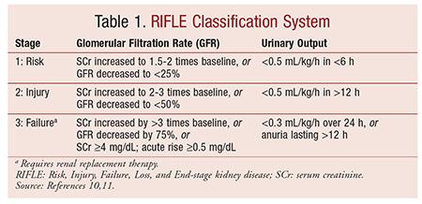
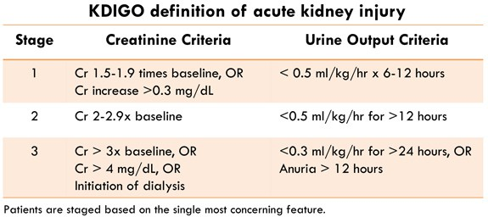
Acute kidney injury - classification
https://www.uspharmacist.com/CMSImagesContent/2015/8/_AcuteKidney-T1.gif
https://img.grepmed.com/uploads/2950/nephrology-diagnosis-kidney-acute-kdigo-original.jpeg

Slide 38
Chronic kidney disease (CKD)
Slow progressive process, with renal function declining over the years
Etiologically: diabetic nephropathy, hypertensive nephrosclerosis, polycystic kidneys, chronic glomerulonephritis
Classification: - according to the GFR - according to albuminuria

Slide 39
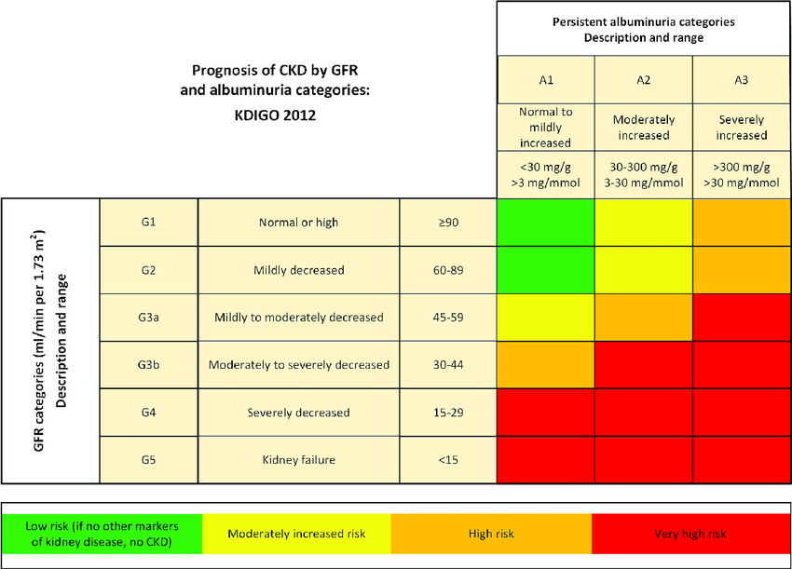
> 1,5
1 – 1,49
0,75 – 0,99
0,5 – 0,74
0,25-0,49
< 0,25
https://www.researchgate.net/publication/335386364/figure/fig1/AS:795585133170688@1566693685000/Stages-of-CKD-Reprinted-with-permission-from-KDIGO-2012-Clinical-Practice-Guidelines-for.png

Slide 40
Case reports 2: AKI, CKD
Jan Novák

Slide 41
Case report 1 – Sportsman
A young man, 19 years old, comes to your clinic for chest pain. Its were formed about 3 hours ago when he was in the gym and doing bench-press. Its haven't stopped since. It is a dull pain, it is related to movement. His uncle had a heart attack recently, so he's afraid he has it too.
Medical report:
PH: sine
Medication: sine
Alergies: neg.
Abusus: smoker about 5 a day from the age of 15, negates drugs and alcohol

Slide 42
Case report 1 – Sportsman
Urine - chemically
pH | 6,0
Proteins | 0
Glucosis | 0
Urobilinogen | 0
Bilirubin | 0
Ketones | 0
Nitrites | 0
Leukocytes | 0
Blood | 0
Urine - sediment
Leucocytes | 0
Erytrocytes | 0
Bacteries | 0
Mucus
Epithelium flat | 0
Epithellium round | 0
Appearance | clear
Colour | yellow
BB
Na | 132-142 mmol/l | 138
K | 3,5-5,2 mmol/l | 4,2
Cl | 97-108 mmol/l | 101
Urea | 1,7 – 8,3 mmol/l | 6,0
Krea | 44–110 μmol/l | 127
GFR | > 1,5 ml/s/1,73m² | 1,16
Gly | 3,9 - 5,5 mmol/l | 4,6
CRP | 1 – 10 mg/l | 2
TnT | 1-14 ng/l | 8

Slide 43
Case report 1 – Sportsman
Concusion:
The patient is an athlete, he goes to the gym often and he takes creatine supplements – he de not have AKI, only the preanalytic phase was affected by non-standard conditions with increased creatinin production and intake
Yyou ask the patient not to take these products for a week and come back for a check-up after 48 hours of non exercising

Slide 44
Case report 1 – Sportsman
Urine - chemically
pH | 6,0
Proteins | 0
Glucosis | 0
Urobilinogen | 0
Bilirubin | 0
Ketones | 0
Nitrites | 0
Leukocytes | 0
Blood | 0
Urine - sediment
Leucocytes | 0
Erytrocytes | 0
Bacteries | 0
Mucus
Epithelium flat | 0
Epithellium round | 0
Appearance | clear
Colour | yellow
BB
Na | 132-142 mmol/l | 138 |  | 138
K | 3,5-5,2 mmol/l | 4,2 |  | 4,2
Cl | 97-108 mmol/l | 101 |  | 101
Urea | 1,7 – 8,3 mmol/l | 6,0 |  | 6,0
Krea | 44–110 μmol/l | 127 |  | 87
GFR | > 1,5 ml/s/1,73m² | 1,16 |  | 1,85
Gly | 3,9 - 5,5 mmol/l | 4,6 |  | 4,6
CRP | 1 – 10 mg/l | 2 |  | 2
TnT | 1-14 ng/l | 8 |  | 8

Slide 45
Case report 2 – Too honest family
The family brings a completely devastated patient, 89 years old woman, to your internal medicine clinic. The daughter reports mother had diarrhea, vomiting, anorexia for the last 3 days, the mother practically does not eat, she drinks a maximum of 0.5 liters of water a day or Coca-Cola in spoons.
The condition gradually worsens, she vomits more and more, the anorexia worsens, she is getting weaker, she can't even walk anymore, she collapsed in the morning, so the family no longer knows what to do.
However, the daughter says, that the mother takes her chronical medication honestly every morning…

Slide 46
Case report 2 – Too honest family
Medical history:
PH: CAD, st.p. STEMI of anterior wall 1998, chronical heart failure due to CAD, atrial fibrilation – med. Warfarine, hypertension, st.p. breast cancer (in remission, disp. oncology)
Medication: Prestance 5/5mg tbl 1-0-0 Furon 40mg tbl 1-1-0
Concor cor 5mg tbl 1-0-0 Verospiron 25mg tbl 0-1-0
Digoxin 0,125mg tbl 1-0-0
Warfarin 5mg tbl dle INR
Alergies: neg.
Abusus: non-smoker, no drugs or alcohol

Slide 47
Case report 2 – Too honest family
Vitals:
BP 80/40 mmHg, pulse 40 bpm irreg (atrial fibrilation)
conscious, oriented, slowed psychomotor pace, decreased skin turgor heart rate irreg, breathing alveolar clean Abdomen soft, no pain, peristaltics + legs without swelling

Slide 48
Case report 2 – Too honest family
BB
Na | 132-142 mmol/l | 141
K | 3,5-5,2 mmol/l | 7,5
Cl | 97-108 mmol/l | 106
Urea | 1,7 – 8,3 mmol/l | 64,2
Krea | 44–110 μmol/l | 984
GFR | > 1 ml/s/1,73m² | 0,06
Gly | 3,9 - 5,5 mmol/l | 6,2
CRP | 1 – 10 mg/l | 3
Hyperkalemia (+ betablocker + digoxin) causes bradycardia
Hyperkalemia is caused by renal failure + medication which elevates potassium levels (aldosteron blocker + ACEi)
Hyperuraemia leads to uremic symdrome with nausea and vomiting
Nausea, vomiting and diarrhea lead to dehydratation. State is even worse, that patient is still using her chronical medication with diuretics … it leads to prerenal kidney injury.

Slide 49
Case report 2 – Too honest family
Conclusion:
The patient has acute renal failure most likely of prerenal etiology with severe dehydration and hypotension
Due to bradycardia (and a history of collapse) and potassium 7.5, she is indicated for acute HD, but due to age and condition (fragile elderly lady), it is possible to conservatively hydrate the patient on the monitored bed.

Slide 50
Case report 2 – Too honest family
BB |  | before | After HD | Conservative therapy
Na | 132-142 mmol/l | 141 | 138 | 139 | 140 | 137
K | 3,5-5,2 mmol/l | 7,5 | 5,5 | 5,3 | 4,9 | 4,5
Cl | 97-108 mmol/l | 106 | 100 | 100 | 101 | 100
Urea | 1,7 – 8,3 mmol/l | 64,2 | 24,5 | 18,3 | 16,4 | 12,1
Krea | 44–110 μmol/l | 984 | 345 | 287 | 221 | 156
GFR | > 1 ml/s/1,73m² | 0,06 | 0,26 | 0,26 | 0,26 | 0,56
Gly | 3,9 - 5,5 mmol/l | 6,2
CRP | 1 – 10 mg/l | 3

Slide 51
Case report 3 – Swelling of the lower limbs does not have to be caused the heart
The patient, man, 56 years old, comes to his general practitioner in the middle of December 2018, saying that his limbs are swollen for the last month – right limb more, he feels more tired overall.
Due to asymmetric swelling, the patient was sent for vascular examination, deep vein thrombosis was detected in the right limb, DOAC (Rivaroxaban) was used; but due to the swelling of both limbs the patient was issued a request for a complete internal examination
The next day, the patient wakes up with leaky eyelids, he breathes heavily after standing, swelling of the limbs is still progressive, he comes to the internal medicine…

Slide 52
Case report 3 – Swelling of the lower limbs does not have to be caused the heart
Medical history:
PH: hypertension, astma bronchiale allergy, sekundary artrosis of talocrural joint, recently treated DVT of right leg
FA: Agen (Ca blocker) 5mg 1-0-0
Controloc (PPI) 40mg 1-0-0
Alvesco 1 inbreathe in the evening
Xarelto 20mg tbl 1-0-0
Alergies: dust, pollen
Abusus: non-smoker, no drugs or alcohol abuse

Slide 53
Case report 3 – Swelling of the lower limbs does not have to be caused the heart
Vitals and other examination:
BP 170/80 mmHg, pulse 66 bpm conscious, well oriented, resting eupnoea, without jaundice, swollen eyelids, HB reg, breathing generally quiet, weakened basally with crackles Abdomen in niveau, soft, painless, subcutaneous penetration lower limbs with swelling to the groin
EKG: low voltage
RTG of chest: pleural effusion bilat., heart shadow dilated in both directions Echokadiography: pericardial effusion, otherwise normal EF

Slide 54
Case report 3 – Swelling of the lower limbs does not have to be caused the heart
Urine - chemically
pH | 6,0
Proteins | 4
Glucosis | 0
Urobilinogen | 0
Bilirubin | 0
Ketones | 0
Nitrites | 0
Leukocytes | 0
Blood | 0
Urine - sediment
Leucocytes | 0
Erytrocytes | 0
Bacteries | 0
Mucus | 0
Epithelium flat | 0
Epithellium round | 0
Appearance | Turbid
Colour | yellow
BB
Na | 132-142 mmol/l | 131
K | 3,5-5,2 mmol/l | 4,4
Cl | 97-108 mmol/l | 102
Urea | 1,7 – 8,3 mmol/l | 23,0
Krea | 44–110 μmol/l | 284
GFR | > 1,5 ml/s/1,73m² | 0,33
Gly | 3,9 - 5,5 mmol/l | 4,9
CRP | 1 – 10 mg/l | 1
Alb | 36-63g/l | 22,8
Urine collection:
Albumin 776 mg/l
Proteins 3,7 g/24h
Lipids:
Cholesterol 8,4
TAG 6

Slide 55
Case report 3 – Swelling of the lower limbs does not have to be caused the heart
Conclusion 1:
The performed examinations show that the patient suffers from nephrotic syndrome: - proteinuria > 3.5 g/24 hours - hypalbuminemia (below 30g/l) - peripheral edema - hypercholesterolemia > 8 mmol/l
The cause of nephrotic syndrome is usually glomerulonephritis = biopsy verification required

Slide 56
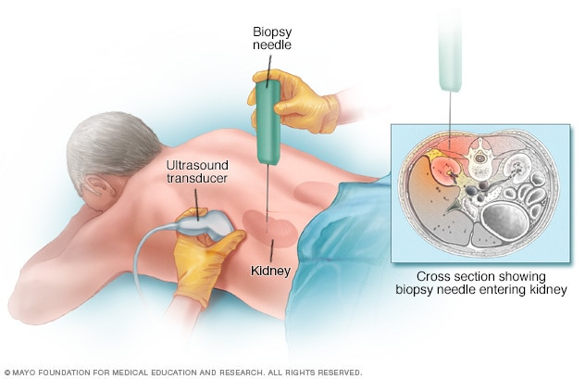
Case report 3 – Swelling of the lower limbs does not have to be caused the heart
Renal biopsy
Invasive procedure, we obtain a sample of kidney tissue under ultrasound control
The patient is monitored after the procedure, including urine ch + s
Urine - sediment |  | 0 | +4 | +8 | +12 | +24
Leukocytes | 0 | 0 | 0 | 0 | 0 | 0
Erytrocytes | 0 | 1 | 4 | 3 | 1 | 0
Bacteries | 0 | 0 | 0 | 0 | 0 | 0
Mucus | 0 | 0 | 0 | 1 | 0 | 0
Epitelia | 0 | 0 | 0 | 0 | 0 | 0

Slide 57
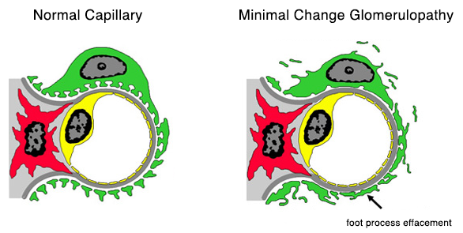
Case report 3 – Swelling of the lower limbs does not have to be caused the heart
Conclusion 2:
The biopsy revealed a minimal change disease
Corticosteroid therapy initiated with a very good effect
https://unckidneycenter.org/files/2017/10/minimal-change-capillary.png

Slide 58
Case report 3 – Swelling of the lower limbs does not have to be caused the heart
BB |  | GP 01/2017 | 2 years withouth controll |  | 18.12. 2018 | 26.12. 2018 | 29.12. 2018 | 18.1. 2019
Na | 132-142 mmol/l |  |  |  | 131 | 137 | 136 | 142
K | 3,5-5,2 mmol/l |  |  |  | 4,4 | 4,3 | 3,9 | 4,7
Cl | 97-108 mmol/l |  |  |  | 102 | 104 | 104 | 102
Urea | 1,7 – 8,3 mmol/l | 6,9 |  |  | 23,0 | 18,9 | 10,2 | 5,7
Krea | 44–110 μmol/l | 80 |  |  | 284 | 162 | 99 | 93
GFR | > 1 ml/s/1,73m² |  |  |  | 0,33 | 0,65 | 1,18 | 1,27
Gly | 3,9 - 5,5 mmol/l |  |  |  | 4,9
CRP | 1 – 10 mg/l |  |  |  | 1
Alb | 36-63g/l |  |  |  | 22,8 | 28 | 35 | 42,5

Slide 59
Case report 4 – „Unnecessary“ permanent urinary catheter
The patient, 88 years old, was transferred to your internal department from a psychiatric hospital, where he was hospitalized for a dementia syndrome with delirious conditions to set up psychiatric medication.
Before admission to a psychiatric hospital in terms of internal – the patient was stable, kidney stage CHRI CKD3a
In a psychiatric hospital, the development of swelling of the lower limbs, Furosemide increased in medication, the swelling does not flare up too much due to this medication
Therefore, blood samples were taken and, with reference to them, a translation of the patient to the internal clinic / see below /

Slide 60
Case report 4 – „Unnecessary“ PUC
Medical history:
PH: Dementia Syndrome, probably vascular etiology, behavioral disorders Chronic heart failure due to CAD, st.p. decompensation 2016 Prostate Ca (2006) pT1c (T3) N0 M0G 3 (combined Gleason score 3 + 5), low-differentiated acinar prostate adenocarcinoma, stp. neoadj. hormone therapy, stp. RT on the prostate and small pelvis Macrocytic anemia from B12 and folic acid deficiency Mixed hyperlipidemia Hypothyroidism, for substitution St.p. herpes zoster reg. glutei lat. hall. v.s. 2016 St.p. stroke 2007 according to doc.
Med.: Nolpaza 40 mg tbl 1-0-0 Carsaxa 100 mg tbl 0-1-0 Ketilept 25 mg tbl 0-0-1 Letrox 50 mg tbl 1/2- 0-0 Mirtazapin 15 mg tbl 0-0-1 Memigmin 10 mg tbl 2-0-0
Furon 40 mg tbl 1-0-0
Alergies: neg. Abusus: neg.

Slide 61
Case report 4 – „Unnecessary“ PUC
Vitals:
Conscious, manifestations of dementia - confused, unfocused HR reg, breathing alveolar, clean abdomen soft, palpable resistance in the lower abdomen, painful under pressure, peristaltics present lower limbs swollen to half shin

Slide 62
Case report 4 – „Unnecessary“ PUC
BB |  | 24.7. | 29.8.
Na | 132-142 mmol/l | 139 | 133
K | 3,5-5,2 mmol/l | 4,6 | 6,6
Cl | 97-108 mmol/l | 103 | 98
Urea | 1,7 – 8,3 mmol/l | 10,6 | 39,4
Krea | 44–110 μmol/l | 107 | 803
GFR | > 1 ml/s/1,73m² | 0,99 | 0,08
Gly | 3,9 - 5,5 mmol/l | 4,4 | 4,5
CRP | 1 – 10 mg/l | 19,6 | 249,5

Slide 63
Case report 4 – „unnecessary“ PUC
Conclusion:
The patient has acute renal failure which has developed within a month
the renal cause unlikely in his age (glomerulonephritis not suspected)
prerenal cause of dementia (decreased fluid intake) and furosemide drainage may be affected
tactile resistance in the lower abdomen is the bladder, after the introduction of PUC drains 2.5 liters of urine
The patient is after radiotherapy due to carcinoma of prostate, he has a stricture of the ureter and should have PUC permanently - after admission to Psychiatry dep. it is pulled out and not placed back again by mistake
After the instillation of PUC, the renal parameters are rapidly corrected, intercurrent infection is cured by ATB

Slide 64
Case report 4 – „Unnecessary“ PUC
BB |  | 24.7. | 29.8. | 30.8. | 1.9. | 3.9.
Na | 132-142 mmol/l | 139 | 133 | 137 | 143 | 140
K | 3,5-5,2 mmol/l | 4,6 | 6,6 | 6,1 | 4,7 | 4,2
Cl | 97-108 mmol/l | 103 | 98 | 105 | 113 | 104
Urea | 1,7 – 8,3 mmol/l | 10,6 | 39,4 | 32,4 | 18,6 | 5,8
Krea | 44–110 μmol/l | 107 | 803 | 624 | 269 | 114
GFR | > 1 ml/s/1,73m² | 0,99 | 0,08 | 0,11 | 0,29 | 0,83
Gly | 3,9 - 5,5 mmol/l | 4,4 | 4,5 | 4,3 | 4,1 | 4,4
CRP | 1 – 10 mg/l | 19,6 | 249,5 | 308,0 | 214,8 | 133,0

Slide 65
Elimination techniquies
Jan Novák

Slide 66
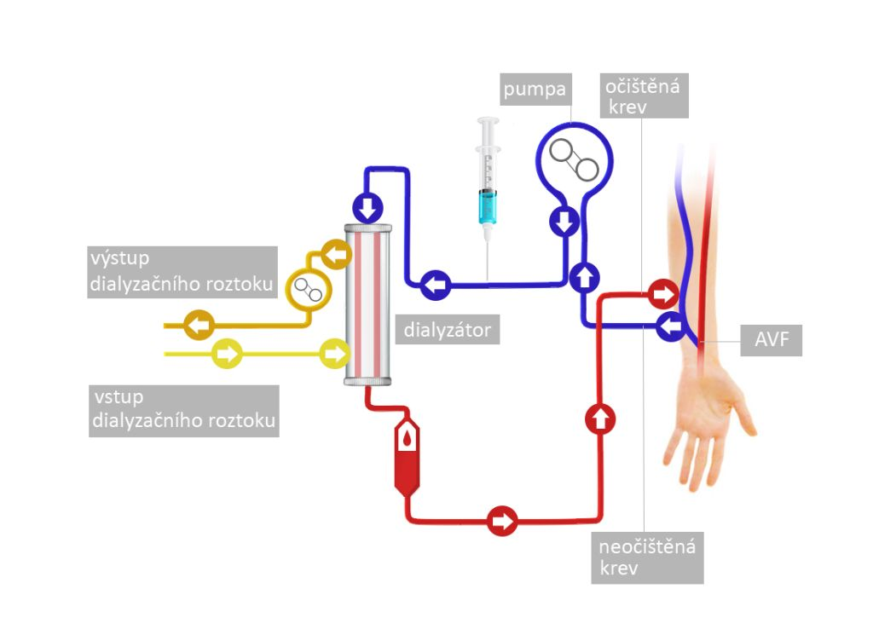
Hemodialysis
Blood from the patient's body is pumped into the capillary of the device
Here, N / toxic substances pass into dialysis soluton after a concentration gradient - dialysis solution, thereby purifying the patient's blood
https://www.dialyza.cz/cs/porozumet/nahrada-funkce-ledvin/hemoeliminacni-metody/hemodialyza/

Slide 67
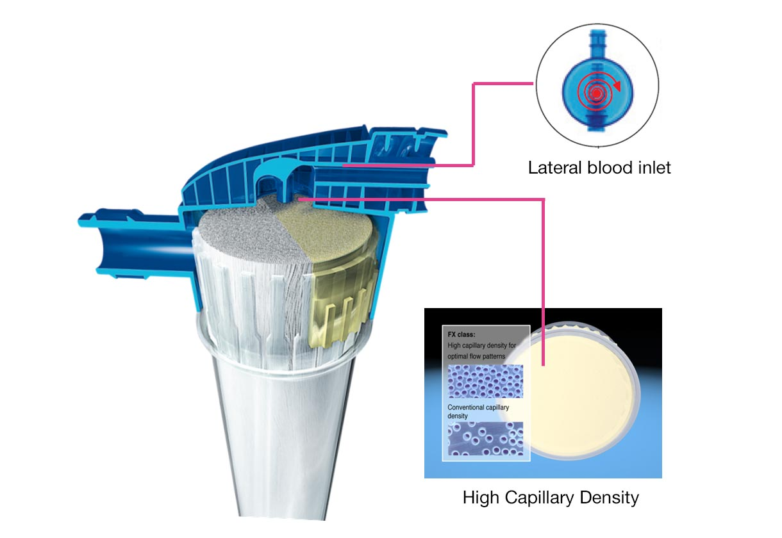
Hemodialysis
Dialysis capillary is a system of very small tubes formed by a highly permeable membrane, inside which blood flows and which are washed with a dialysis solution
Countercurrent system
https://www.freseniusmedicalcare.cz/cs/odborna-verejnost/hemodialyza/dialyzatory/dialyzatory-fx-classix/

Slide 68
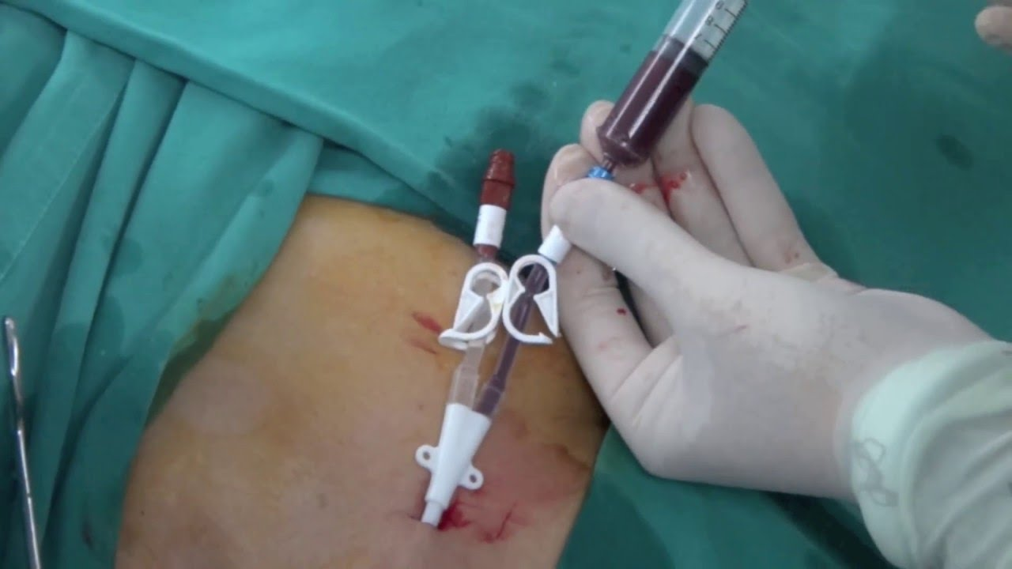
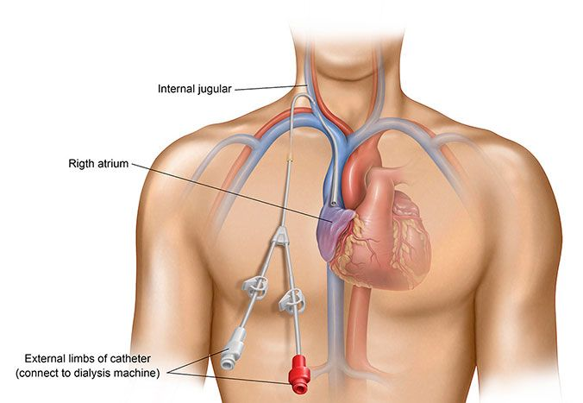
Hemodialysis - access
Acute HD = temporary intravenous HD catheter
V. Jug. Int.
V. Subclavia
V. femoralis
https://www.azuravascularcare.com/infodialysisaccess/types-of-dialysis-access/

Slide 69
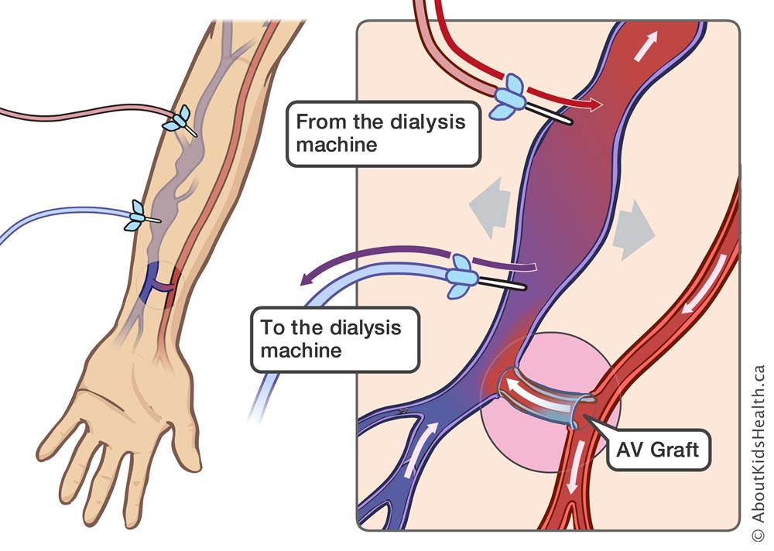
Hemodialysis - access
Chronic HD
PermCath
V. Jug. Int.
V. Subclavia
V. femoralis
Translumbar
AV shunt
https://www.aboutkidshealth.ca/article?contentid=1034&language=english

Slide 70
Hemodialysis
Indications to acute HD
Hyperkalemia > 6 mmol / l
Hypercalcaemia > 3.5 mmol / l
Hyperuricemia > 1000 μmol / l
uncorrectable metabolic acidosis, pH <7.1
hyperhydration with heart failure
oligouria lasting longer than 3 days
intoxication with low molecular weight water-soluble substances

Slide 71
Hemodialysis
Indications to chronic HD program:
urea > 30 mmol/l,
creatinine 600–800 μmol/l,
clearance of creatinine < 0,25 ml/s

Slide 72
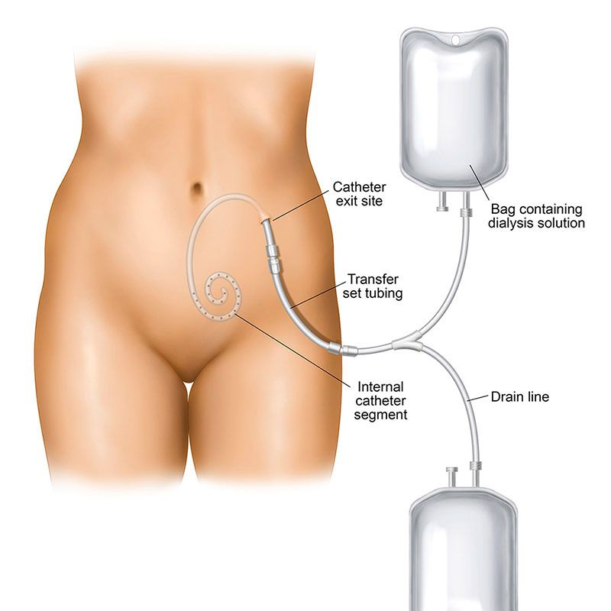
Peritoneal dialysis
https://www.azuravascularcare.com/infodialysisaccess/types-of-dialysis-access/

Slide 73
Case reports 3: Elimination techniques
Jan Novák

Slide 74
Case report 1 – From predialysis to dialysis
A 45-year-old patient with CKD based on diabetic nephropathy and hypertensive nephrosclerosis has been monitored in your nephrology clinic for many years.
Despite proper treatment of blood pressure and diabetes over the years, you can see a gradual decline in renal function, progression of CKD, the patient stops urinating, his lab results worsen (levels of Ca, P,…), so you agree to start HD.
BB |  | 2015 | 2016 | 2017 | 2018
Urea | 1,7 – 8,3 mmol/l | 17,2 | 20,0 | 20,7 | 40,0
Krea | 44–110 μmol/l | 276 | 357 | 353 | 642
GFR | > 1 ml/s/1,73m² | 0,46 | 0,33 | 0,34 | 0,16

Slide 75
Case report 1 – From predialysis to dialysis
The patient goes to a vascular examination - he has good quality vessels on both upper limbs, so an AV shunt is created on a non-dominant upper limb
After the operation, you wait about 4 weeks for AV shunt to dilate and gain its function, after that you can start regular dialysis treatment twice a week.
BB |  | 2015 | 2016 | 2017 | 2018 | after HD | before HD | after HD | before HD | after HD
Urea | 1,7 – 8,3 mmol/l | 17,2 | 20,0 | 20,7 | 40,0 | 18,5 | 34,1 | 16,7 | 17,4 | 5,0
Krea | 44–110 μmol/l | 276 | 357 | 353 | 642 | 262 | 502 | 357 | 588 | 287
GFR | > 1 ml/s/1,73m² | 0,46 | 0,33 | 0,34 | 0,16 | 0,49 | 0,14 | 0,21 | 0,11 | 0,46

Slide 76
Case report 1 – From dialysis to kidney transplant
The patient gradually gets from the HD program twice a week to the three times a week program and at the same time is included in the waiting list for patients for kidney transplantation.
A suitable cadaveric donor appears for the patient after about 2 years.
BB |  | 21.7. | 22.7. | 23.7. | 24.7. | 25.7 | 28.7. | 1.8. | 14.8. | 1.9. | 10.9.
Urea | 1,7 – 8,3 mmol/l | 25,1 | 31,5 | 33,5 | 34,1 | 30,7 | 31,5 | 25,0 | 19,3 | 7,2 | 6,0
Krea | 44–110 μmol/l | 766 | 759 | 728 | 502 | 357 | 297 | 236 | 178 | 99 | 91
GFR | > 1 ml/s/1,73m² | 0,08 | 0,08 | 0,09 | 0,14 | 0,21 | 0,26 | 0,34 | 0,48 | 0,98 | 1,09
Transplantation of kidney
dimision

Slide 77
Case report 2 – Peritoneal dialysis
Patient, 54 years old, with CKD based on chronic IgA nephropathy + FSGS (biopsy verified 2006). He also has nephrogenic anemia, hypertension and hyperparathyroidism, treated with DM2T, is after radical prostatectomy for prostate Ca. Gradually, over the last year, the renal function worsened, so the patients need renal replacement therapy (RRT).
ZBV |  | 11/2019 | 5/2020 | 6/2020 | 7/2020
Urea | 1,7 – 8,3 mmol/l | 29,0 | 35,9 | 36,8 | 35,1
Krea | 44–110 μmol/l | 401 | 521 | 588 | 580
GFR | > 1 ml/s/1,73m² | 0,23 | 0,17 | 0,14 | 0,15
Start of RRT

Slide 78
Case report 2 – Peritoneal dialysis
The patient is an active businessman, he does not want to come to the hospital for hemodialysis twice of three times a week. He prefers a peritoneal dialysis, therefore the Tenckhoff catheter was operated and the peritoneal dialysis program started.
Regime:
Filling (within 15 minutes, 2300 ml of solution), 1st filling in the evening
Delay (time when the solution is in the peritoneal cavity: 1h 28 minutes), then draining
This cycle runs 4 times during the night by an automatic device
After the last change, fill with 500 ml and drain in the evening before the next cycle

Slide 79
Case report 2 – Peritoneal dialysis
Patients in a chronic peritoneal dialysis program tend to have higher urea and creatinine levels than they would on a hemodialysis program.
They will get used to them in the long run.
In the event that the diuresis disappears, solutions with a higher osmolarity are used, which osmotically withdraw water from the body (then the patient fills about 2300 ml and discharges 2500 or more ml)
BB |  | 11/2019 | 5/2020 | 6/2020 | 7/2020 | 8/2020 | 9/2020 | 10/2020
Urea | 1,7 – 8,3 mmol/l | 29,0 | 35,9 | 36,8 | 35,1 | 21,6 | 24,5 | 25,0
Krea | 44–110 μmol/l | 401 | 521 | 588 | 580 | 543 | 540 | 590
GFR | > 1 ml/s/1,73m² | 0,23 | 0,17 | 0,14 | 0,15 | 0,16 | 0,16 | 0,14
Start of PDP

Slide 80
Thank you for your attention!

