Slide 1
TUMOR MARKERS
Michaela Králíková
Department of Biochemistry
Faculty of Medicine
Masaryk University

Slide 2
USE OF TUMOR MARKERS
Screening (Hb in faeces)
Dg and diff. dg in symptomatic individuals
Clinical staging of cancer, is aided by quantitation of the marker, i. e. the serum level of the marker reflects the number of cancer cells present in the body
Monitoring of the disease, monitoring of responses to the therapy
Prognostic indicator of disease progression and patient survival
Detection of cancer recurrence, permits early treatment or a change in therapy
Notes:
Tumor markers play an important role in cancer detection and guiding patient management.
In healthy asymptomatic individuals, biomarkers may be used in the identification of those at increased risk of developing malignancy and in screening for early cancer.
Following a diagnosis of malignancy, tumor markers can be used in determining prognosis, upfront therapy prediction or as a guide to select targeted biologic therapy, in postoperative surveillance and monitoring response to ongoing therapy.

Slide 3
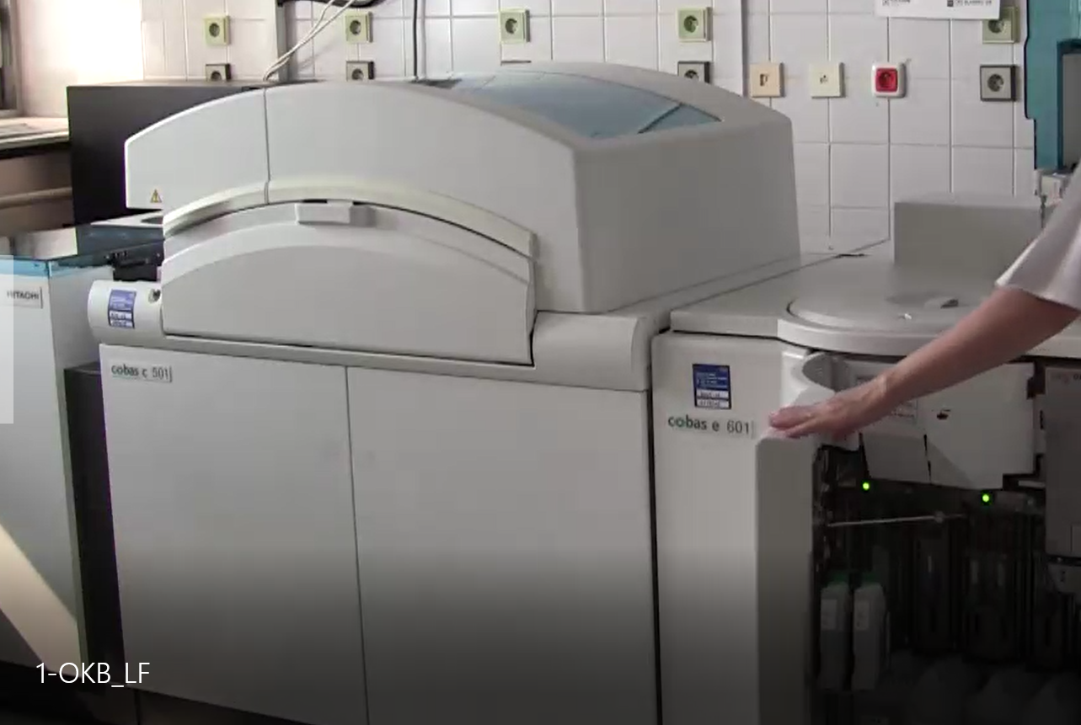
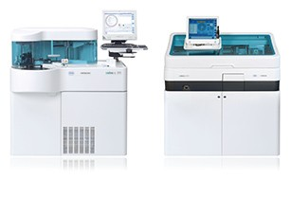
Tumor Markers in the Clinical Biochemistry Lab
Notes:
Analyzers based on immunochemical methods are presented on the picture from Department of Clinical Biochemistry, Faculty Hospital in Brno.

Slide 4
CLASSIFICATION OF TUMOR MARKERS
According to proof: humoral (serum), cellular (tissue)
According to chemical structure (glykoproteins, glykolipids, polypeptides, imunoglobulins, polyamines)
According to visceral specificity
According to physiological function (oncofetal antigens, oncoplacental antigens, enzymes, hormones, serum proteins, receptors and others)
Notes:
Amongst the most widely used serum tumor markers are PSA in screening for prostate cancer, CEA in surveillance of patients with diagnosed CRC, both AFP and HCG in the management of patients with non-seminomatous germ cell tumors, CA 125 for monitoring therapy in patients with ovarian cancer.
Mandatory tissue biomarkers include estrogen receptors and HER2 in breast cancer for predicting response to endocrine and anti-HER2 therapy, respectively.
Of the newest markers, it is necessary to mention "gene" markers, for instatnce KRAS genotyping for selecting patients with CRC likely to be resistant to treatment with anti-EGFR antibodies, BRAF genotyping for predicting response to anti-BRAF therapy in melanoma and EGFR genotyping for predicting response to EGFR TKI in patients with non-small cell lung cancer.

Slide 5
Visceral specificity
high: calcitonin - medullary carcinoma of the thyroid
PSA - prostate cancer
NSE - small cell lung cancer
hCG - germ-cell tumors
AFP - hepatocellular and germ-cell carcinoma
moderate: CA 19-9 - pancreatic cancer
CA 125 - ovarian cancer
CA 15-3 - breast cancer
low: CEA
TPA

Slide 6
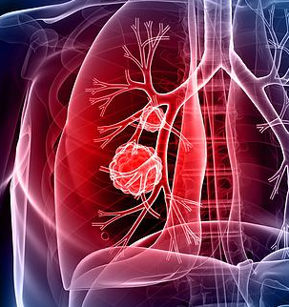
Oncofetal antigens
substances produced during fetal life (present in high concentrations in the sera of fetuses, decrease to low levels or disappear after the birth)
reappear in patients with cancer
Their production demonstrates that certain genes are reactivated as a result of the malignant transformation of the cell.
CEA
CA (carbohydrate antigens)
AFP
SCC (squamous cell carcinoma)
MCA (mucinous carcinoma antigen)
MSA (mammary serum antigen)
TATI (tumor associated trypsin inhibitor)

Slide 7
CEA (carcinoembryonic antigen)
family of related oncofetal cell-surface glycoproteins, the 1st used Tu marker (discovery 1965)
nonspecific
↑: liver cirrhosis, pulmonary emphysema, benign breast cysts disease, ulcerative colitis, rectal polyps
colorectal, lung, ovarian, pancreatic, gastric and bile ducts Ca
marker for colorectal and breast carcinoma, pancreatic, gastric and bile ducts Ca
cut off value < 5.0 ng/ml

Slide 8
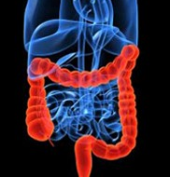
CEA – 1st choise marker of colorectal Ca (CRCA)
One of the most common malignancies in both sexes in economically developed countries
Incidence has increased more than 3 times during last 30 years.
Prevalence is increasing annually by 2−3%.
CR – newly diagnosed around 8 000 patients per year and about half of them die from CRCA.
CR – 3rd most common malignancy in ♂, 4th in ♀
25% is diagnosed metastasized!
2017 data.

Slide 9
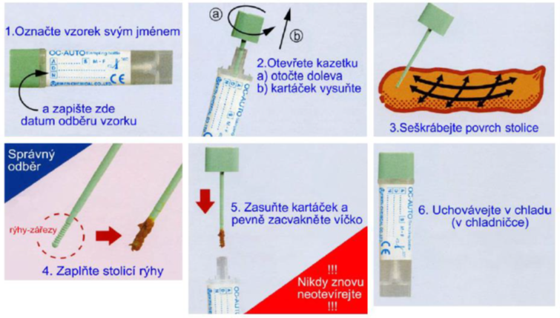
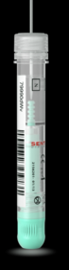
Colorectal carcinoma
Target population participation
~ 20 - 30%
possibilities of prevention :
Primary
Lifestyle, nutrition
Secondary
Broadcast screening from 1.7.2000 (CR)- cyclic fecal occult blood testing in asymptomatic individuals from age 50
or
screening colonoscopy from age 55.
Notes:
Stool collection for occult bleeding takes place into special FOB collection tubes.
Collection procedure (performed by the patient or general practitioner)is as folows:
Unscrew the cap with the collection stick and pull it out.
Take stool samples by immersing the stick in three different places in the stool. / Scrape the surface of the stool with a stick, fill the grooves at the end of the sampling stick with stool.
Put the rod cap back in the tube and screw it on properly. Never reopen the tube.
Mark the tube legibly with the patient's surname, first name and birth number. After collection, store the sample in the refrigerator and transport it to the Clin. Bioch. laboratory as soon as possible.
The actual determination of human Hb takes place in the laboratory of Clinical Biochemistry by immunochemical test.
No dietary measures are required to prepare the patient.

Slide 10
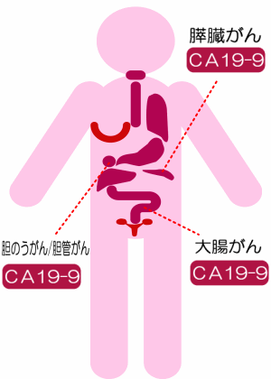
CA (carbohydrate, carcinoma antigens)
CA 19-9
high-molecular-weight glycoproteins (mucins) or just glycoprotein epitopes
produced physiologically prenatally or postnatally typically in tumor cells
Some CAs are big glycoproteins (72-4, 125), other only different epitopes of the same glycoprotein (CA 15-3 and CA 27-29).
CA 15-3
CA 72-4
CA 19-9,
CA 72-4
CA 19-9, CA 125
CA 125

Slide 11
CA 72-4 (carbohydrate antigen 72-4)
TAG 72 (tumor associated glycoprotein 72)
glycoprotein produced by oesophageal, gastric and pancreatic epithelium
in adults ↑: liver diseases, acute pancreatitis, gastric ulcer, inflammations of GIT Ca of stomach, colon, uterus, lung (NSCLC)
marker for monitoring of gastric Ca (1st choice marker), pancreatic, oesophageal and ovarian Ca
cut off ≤ 7 IU/ml
Target of the anti-cancer drugs
anatumomab, mafenatox, minretumomab.

Slide 12
CA 19-9 (carbohydrate antigen 19-9)
glycoprotein of fetal GIT, pancreas and liver epithelium; in adults it is produced by GIT and bronchial epithelium.
marker for pancreatic, colorectal and gastric carcinoma
cut off value ≤ 40 IU/ml

Slide 13
CA 19-9
Sensitivity in selected Tu (Klinická biochemie a metabolismus, 2009)
Ca | Sensitivity / %
pancreatic | 70-90
colorectal | 18-58
cholangiocellular | 22-49
bile ducts | 55-79
gastric | 25-60

Slide 14
CA 19-9 negative patients
patients who lack the Lewis antigen (blood type Le-a,b antigen on ercs; secreted by endothelium, GIT)
about 10% of the Caucasian population
CA 19-9 is not expressed even in large tumors
deficiency of fucosyltransferase (transfers L-fucose from GDP-fucose to oligosaccharide substrate ; reaction needed for synthesis of both Le-a,b and CA 19-9)

Slide 15
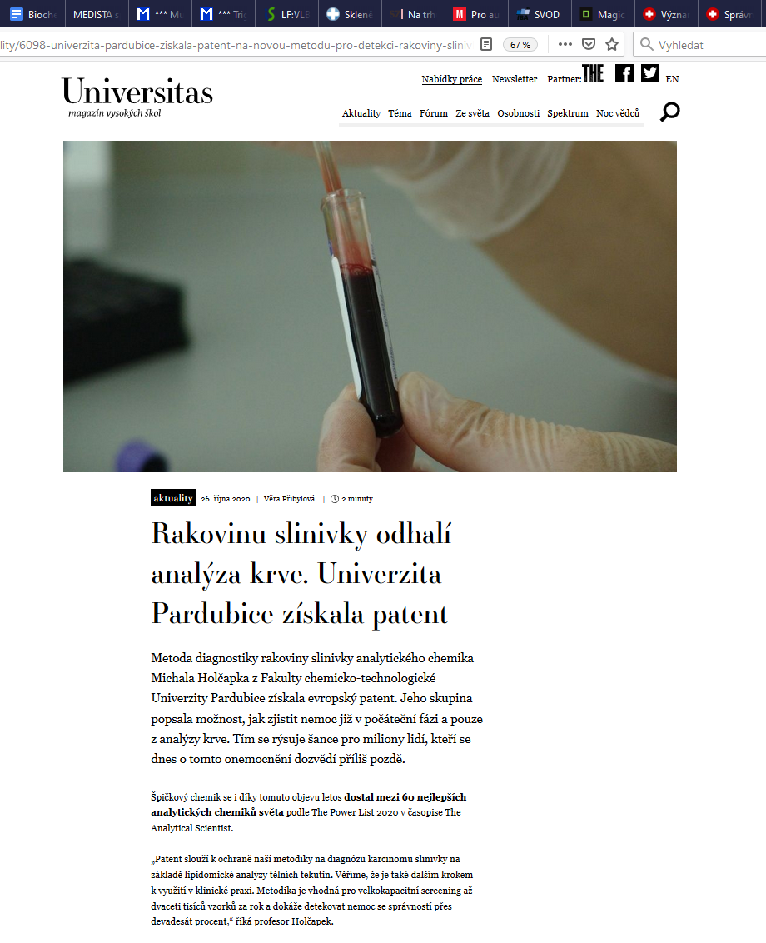


Slide 16
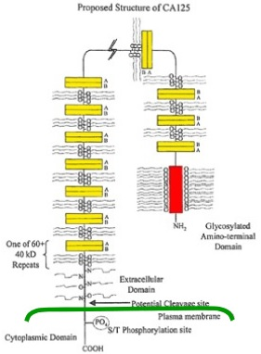
CA 125 (carbohydrate antigen 125)
glycoprotein of the cornea and conjuctiva, the respiratory tract and the female reproductive tract epithelia of both fetuses and adults (lubricating barrier)
↑: *ovarian, colorectal Ca
* endometrial, breast, pancreatic, liver and pulmonary Ca * pregnancy, breast milk * benign diseases of ovaries and endometrium, hepatitis, icterus, pancreatitis
marker for dg and monitoring of therapy of non-mucinous ovarian Ca; additional marker for pancreatic and colorectal Ca
cut off ≤ 35 IU/ml

Slide 17
CA 15-3 (carbohydrate antigen 15-3)
glycoprotein of fetal bronchial and hepatic cells, adult mammary cells
in adults ↑: pregnancy rheumatic dis., chronic dis. of liver, stomach, pancreas, ovaries, uterus, prostatic gland, AIDS Ca of organs mentioned above
marker for breast Ca monitoring
cut off ≤ 35 IU/ml

Slide 18
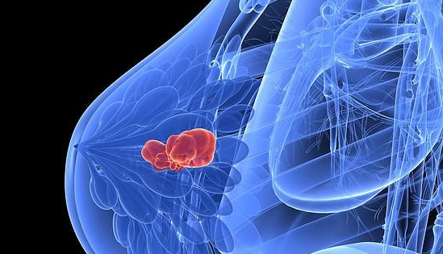
CA 15-3 and CEA – 1st choice markers for breast carcinoma
The 2nd most common Ca in females
Incidence – 1 million of woman worldwide
90 - 95% sporadic
5 – 10% inherited - BCRA1 and 2 gene mutations – possibility of DNA testing from peripheral lymphocytes
The lifetime risk of developing cancer for BRCA1/2 is 87%, in women without mutation 8-10%.
Secondary prevention –mammography or ultrasound examination from 45 years of age

Slide 19
AFP (α1-fetoprotein)
glycoprotein synthesized in large quantities by the fetal yolk sac and liver
one of the major proteins in the fetal circulation
in adults AFP /S ↑: pregnancy liver diseases
marker for hepatocellular and germ-cell carcinoma
cut off value < 10 μg/l

Slide 20
AFP (α1-fetoprotein)
Sensitivity in selected Tu(Klinická biochemie a metabolismus, 2009)
Tumor | Sensitivity / %
Hepatocellular Ca | 80
Embryonal Tu | 80
Teratoma | 20
Yolk sac Tu | 80

Slide 21
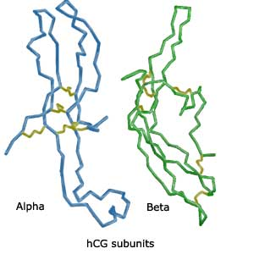
Oncoplacental antigens
Substances produced by the trophoblastic cells of the placenta in both pregnancy and pathological conditions and also by germinative tumors as a mark of malignant dedifferentiation
↑ levels show evidence of ↑ malignancy and metastatic potency of the given tumor
hCG
SP-1

Slide 22
hCG (human chorionic gonadotropin)
glycoprotein secreted by the syncytiotrophoblastic cells of the placenta
↑: pregnant women hydatidiform mole
marker for tumors of placenta (trophoblastic tumors, particularly choriocarcinoma), and germ-cell tumors of the testis and ovary
cut off value < 2.00 IU/l males, < 10.00 IU/l females (βhCG)
α−subunit
common to several other hormones, e. g. FSH, LH or TSH
β −subunit
unique tohCG
can be cleaved to urinary peptide β-core fragment

Slide 23
Enzymes
present in much higher concentrations inside cells
released into circulation as the result of tumor necrosis or a change in the membrane permeability of the cancer cells
PSA
ALP
NSE
TK (thymidinkinase)
LD
kathepsins

Slide 24
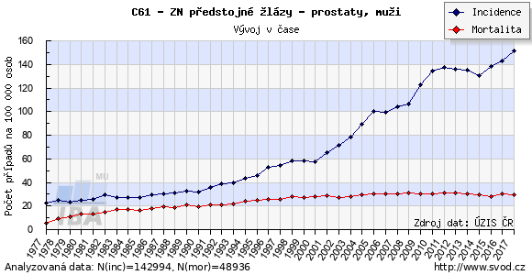
Prostate carcinoma
2nd most common malignancy in men, CR
7 305 new cases in 2016 (141 new cases/ 100 000 males)
Risk factors:
  age,
  life style,
  genetic factors
Year

Slide 25
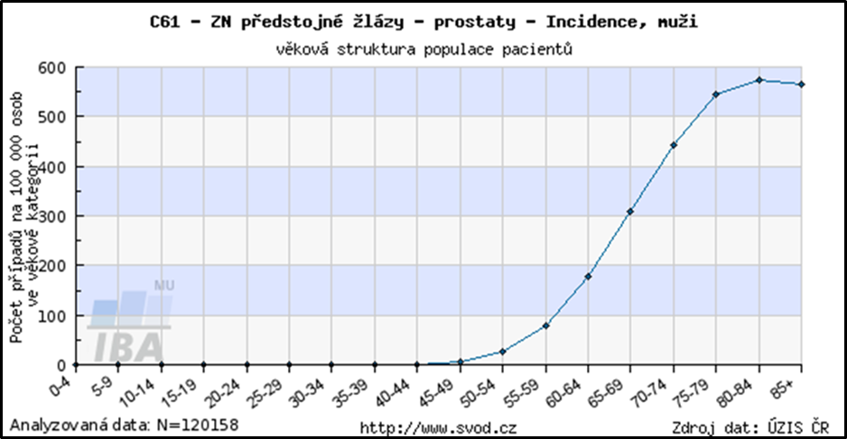
Epidemiology of prostate cancer

Slide 26
PSA (prostate-specific antigen)
glykoprotein protease (237 AA, Mr = 33 000) produced exlusively by the epitelial cells of the prostate gland, secreted into seminal fluid (liquefaction).
Produced as inactive proPSA → PSA.
In serum, it occurs as free fPSA and α₁-antichymotrypsin or α₂-macroglobulin bound (55-95%).
↑: benign prostatic hyperplasia BPH, prostate infammation, urological manipulations
marker for screening (men > 50y, urinating difficulties), dg and monitoring of course and treatment of prostate cancer
cut off value < 4.0 µg/l (= ng/ml) (> 50 y), 2.5 µg/l (< 50 y, see more in age specific levels)
Notes:
PSA is produced as an inactive pro PSA form containing seven leading aminopeptide sequences. Human glandular kallikrein 2 (hK2) activates this inactive form by removing these sequences.

Slide 27
Increased levels of total PSA in plasma / serum
age specific levels:
cut off 40-49 y. 2,5 ng/ml, 50-59 y. 3,5 ng/ml, 60-69 y. 4,5 ng/ml, 70 and more y. 6,5 ng/ml
tPSA > 10 ng/ml: very suspicious PCa, we perform another examinations
tPSA 4 – 10 ng/ml: both PCa & BPH likely, we perform another examinations
Notes:
In addition to determining the total PSA, other options are sought to increase the sensitivity and specificity of PSA and to refine the diagnosis of PCa. The goal is also to reduce the number of unnecessary prostate biopsies within the diagnostic algorithm.
One option is to relate the PSA to the age of the patient.

Slide 28
Derived parameters
index f/t PSA – free/total PSA: fPSA< 15%: probable PCa, fPSA > 20% probable benign condition
tPSAD (tPSA density):
ratio [tPSA]/UTS prostate volume in cm³
adjustment of BPH and PCa: cut off 0.15 ng/ml
PSAV (tPSA velocity):
increase of [tPSA] / year
healthy 0.04 ng/ml/y, BPH 0.07-0.27 ng/ml/y, PCa ≥ 0.75 ng/ml/y
tPSA doubling time:
time to double [tPSA]
tPSA-TZ:
[tPSA] / transition zone volume
Notes:
Another option is to determine free PSA (fPSA), tPSA level relative to prostate volume (PSA density), tPSA level relative to growth rate of PSA (PSA velocity), or the time required to double the PSA level (PSA doubling time).
The tPSA-TZ (transition zone) index determines the ratio of tPSA concentration and prostate transition zone volume.

Slide 29
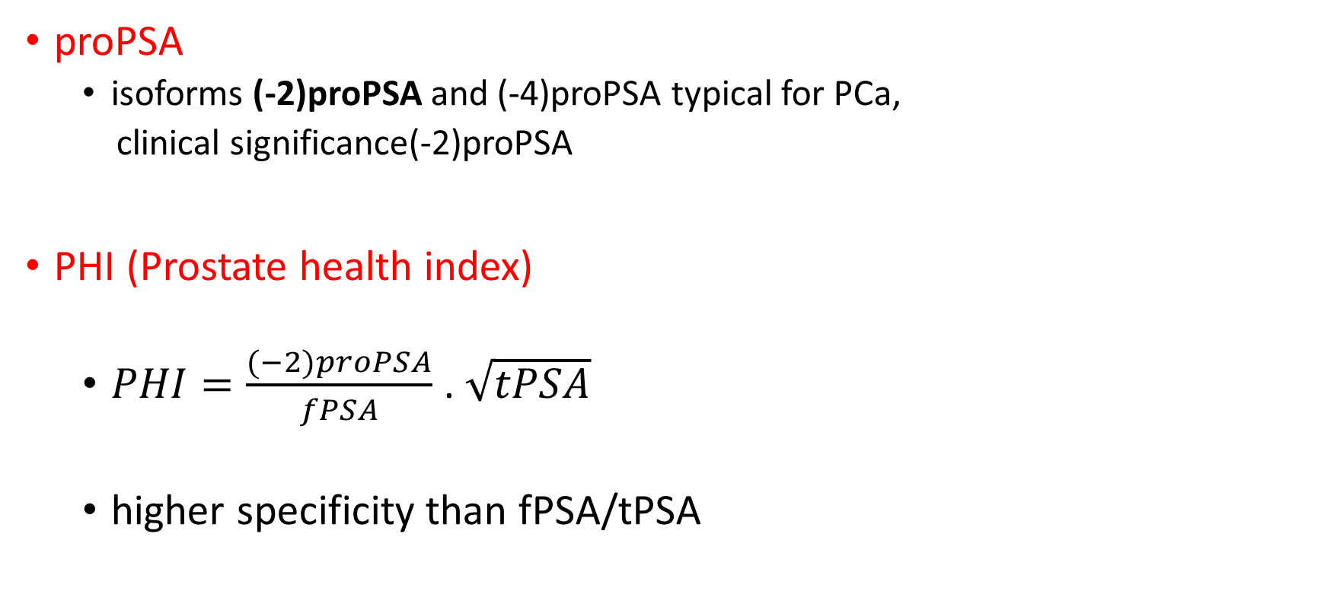
Other derived parameters
proPSA
  isoforms (-2)proPSA and (-4)proPSA typical for PCa,
  clinical significance(-2)proPSA
PHI (Prostate health index)
  $PHI=\frac{(−2)proPSA}{fPSA}$ . $\sqrt{tPSA}$
  higher specificity than fPSA/tPSA
Notes:
Free PSA can be found in the blood in three forms:
BPSA - with benign hyperplasia associated PSA,
proPSA,
inactive PSA.
BPSA is produced by cleaving the amino acids Lys 146 and Lys 182-183 from the intact free PSA molecule. BPSA is associated with a transitory zone that is important in the genesis of benign prostatic hyperplasia.
Prostate cancer tissue contains higher amounts of certain forms of proPSA, namely (-2) proPSA and (-4) pro PSA, compared to tissues affected by BHP.
Inactive PSA is characterized by being enzymatically inactive. There is no difference between the level of inactive PSA in patients with BPH and CaP.
The prostate health index (PHI) is determined from the tPSA, fPSA and isoform (-2)proPSA. Its value is calculated according to the formula: PHI = (-2proPSA / fPSA) x √tPSA. The index increases the specificity of prostate cancer detection and its introduction and extension to clinical practice could reduce the number of unnecessary prostate biopsies. According to available studies in the Czech Republic PHI for BHP equals 0-30, range 30-40 is considered a gray zone, for CaP there are typical values ​​above 40.

Slide 30
Other causes of PSA increase in blood
Other prostate diseases: benign prostate hyperplasia, prostatic inflammation
Mechanical stimulation (fPSA is more susceptible): biopsy, cystoscopy, catetrization, per rectum examination
Ejaculation
PSA is a prostate-specific biochemical marker but is not specific for cancer.

Slide 31
ALP (alkaline phosphatase)
Zn²⁺ glycoprotein, in alkaline environment (pH= 8-10) it catalyses the hydrolysis of H₃PO₄ monoesters and transphosphorylation
bone isoform (b-ALP)
↑: osteoSa, bone metastases other bone affections; growth
liver isoform (l-ALP)
↑: liver metastases other liver diseases
ref.values : adults 0.6-2.6 μkat/l, children and youth ≤ 8 μkat/l

Slide 32
NSE (neuron-specific enolase)
enolase - enzyme of glycolysis (2-phosphoglycerate → phosphoenolpyruvate)
NSE - form of enolase found in neuronal and neuroendocrine tissues
↑: lung and liver dis., renal failure
marker for small-cell lung cancer (SCLC), pheochromocytoma, medullary carcinoma of the thyroid, neuroblastoma, melanoma, and pancreatic endocrine tumors
cut off value < 15 μg/l
Notes:
NSE is a marker of neuroendocrine (SCLC, pheochromocytoma, medullary carcinoma of the thyroid ) and neuroectodermal(neuroblastoma) tumors.

Slide 33
Hormones
The production of hormones in cancer involves two separate routes:
the endocrine tissue that normally produces the given hormone can produce its excess amounts
ectopic syndrome - hormone produced by a distant nonendocrine tissue that normally does not produce this hormone (for instance: ACTH normally produced by the pituitary gland, ectopicaly produced by the lung small cells)
elevation of a hormone is not specific ← it may be produced by a variety of cancers
prolactin
calcitonin
PTH
ACTH
ADH
1.
2.

Slide 34

Serum proteins
produced either by tumor cells or by an organism in the presence of tumor
paraproteins
ferritin
β₂-microglobulin

Slide 35
Monoclonal immunoglobulins (paraproteins)
produced by neoplastic plasma cells in monoclonal gammapathies. In serum, we can identify whole Ig, heavy chains (IgG, M, A; D, E) and κ, λ light chains (Bence Jones proteins) - these are small enough (22 kD) to pass through the kidney into the urine → prerenal „over-flow“ proteinuria.
↑: multiple myeloma and other monoclonal gammapathies, lymphomas and leukemias, osteogenic sarcoma, bone metastases
marker for multiple myeloma and other monoclonal gammapathies
ref. values: FLC (free light chains)/S: κ = 3.3-19.4 mg/l, λ = 5.7-26.3 mg/l, index κ/λ = 0.26-1.65; FLC/U = 1-10 mg/24h; κ/U = 1.25-5.5 mg/l, λ/U = 0.51-3.2 mg/l, index κ/λ = 0.82-3.0
Notes:
Other biochemical findings in MM include hyperproteinemia (Igs from plasma cells) and hypercalcemia (calcium is released form osteolytic lesions).

Slide 36
Receptors
Cellular (tissue) markers
Estrogen rec.
Progesterone rec.
Growth factors receptors (HER1, HER2/neu)
DNA aneuploidy
The main usage: breast Ca, colorectal Ca; brain tumors

Slide 37
Estrogen and progesterone receptors
The most important prognostic markers for breast Ca; detected in tumor tissue.
positivity = ↑ cell diferentiation, ↓ invasivity, better prognosis; = antiestrogen therapy indication
immunohistochemical determination - ELISA

Slide 38
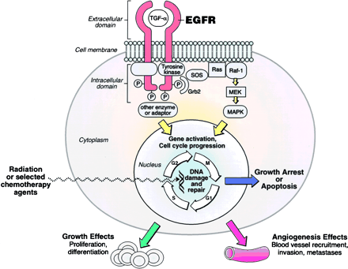
Growth factors receptors
Transmembrane receptors with tyrosinkinase activity – phosphorylation of Tyr residues of protein substrates
The binding of substrate to the extracellular domain causes a conformational change of the receptor, its autophosphorylation and activation of downstream signaling pathways → influence of cel. proliferation, inhibition of apoptosis
HER1 (EGFR), HER2/neu, HER3, HER4

Slide 39
Growth factors receptors
Type of receptor | HER1 | HER2/neu*
Ligands | EGF, TGFα, amphiregulin, betacelulin, epigene, epiregulin | ?
Blocked by | Monoclonal AB - tyrosin kinase inhibitors EGFR TKI (cetuximab, erlotinib, gefitinib) | Monoclonal AB (trastuzumab)
* Nomenclature: HER 2 in humans, neu in rodents
Notes:
The monoclonal autobodies against the receptors are beeing used in the therepy of receptor-positive tumors.

Slide 40
Other tumor markers
substances, which we cannot class with the previously mentioned groups
Ki-67
TPA, TPS
CYFRA 21-1
HE4
Mesothelin
Chromogranin A
Neuropeptide Y
S-100 β
5-hydroxyindolacetic acid

Slide 41
Proliferative antigen Ki-67
The non-histone nuclear protein expressed during active cell cycle phases (max at the G2 interface and mitosis, is absent in the G0 phase).
It affects the spatial layout of chromatin - gene expression control.
Immunohistochemistry detection in biopsy tissue - Anti-Ki-67 antibody.
Ki-67 expression = proliferative tumor activity.
Proliferative activity in cancer correlates with grade and prognosis.
= prognostic marker determined in tumor tissue of solid tumors
Notes:
Another example of a tissue marker is Ki-67. It is a non-histone nuclear protein that affects the spatial arrangement of chromatin. Its expression increases with the proliferative activity of the tumor and is therefore a prognostic marker.

Slide 42
Cytokeratins and their fragments
Cytokeratins = keratins found in the intracytoplasmic cytoskeloeton of epithelial cells.
Clinical significance: fragments of (cyto)keratins No.
8, 18, 19
TPA 18
TPS 18
TPA 19
CYFRA 21-1
TPA 8

Slide 43
TPA, TPS (tissue polypeptide (specific) antigen)
non-specific cytokeratins fragments produced by both normal and tumor cells
↑ levels seen in increased cell proliferation → its estimation is useful for monitoring of the disease
↑: liver dis., DM, rheumatoid dis. breast and GIT tumors
marker for urinary bladder carcinoma
cut off value ≤ 140 IU/l

Slide 44
Breast carcinoma markers - summary
Basic markers: CEA and CA 15-3
Receptor markers:
  Growth factors receptors
  Estrogene receptor
  Progesterone receptor
Proliferative antigen Ki-67
Other markers: TPA

Slide 45
CYFRA 21-1 (cytokeratin fragment)
Cytokeratin 19 fragment present in lung, uterine and GIT cells. Marker of degradation of malignant tissues and necrosis.
↑: cirrhosis, asthma, respiratory infections, renal failure
marker for cervical and pulmonary (NSCLC) carcinoma
cut off value ≤ 3.3 μg/l

Slide 46
CYFRA 21-1
Sensitivity in selected Tu (Klinická biochemie a metabolismus, 2009)
Tumor type | Sensitivity / %
epidermoid pulmonary Ca | 55
big-cell pulmonary Ca | 35
pulmonary adenoCa | 28
urinary bladder Ca | 30

Slide 47
Basic tumor markers – lungs, bronchi, trachea, pleura
Non-parvicellular Ca
(NSCLC)
CEA
CYFRA 21-1
HER1
Parvicellular Ca
(SCLC)
NSE
CYFRA 21 -1
Mesothelioma
Mesothelin
Notes:
EGFR (HER1) genotyping is used for predicting response to EGFR TK inhibitors in patients with non-small cell lung cancer.
Mesothelioma is a highly aggressive Tu of serous membranes, most often a primary pleural tumor. The incidence in the Czech Republic is 0.8 / 100 000 people (men), 0.3 / 100 000 (women). The main etiopathogenetic factors include exposure to asbestos with a latency of 20 - 60 years. Due to the large construction of houses made of asbestos-containing panels in the 1970s, there has been an increase in disease rates since 2000 and further growth is possible.
Mesothelin is a relatively new marker. It is a protein with Mr 40 000, bound by a phosphatidylinositol anchor in the membrane of mesothelial cells, and plays a role in adhesion, recognition and signaling between cells.
Examination: ELISA test MESOMARK: cut off (99th percentile of ref. group) 1.5 nmol/l CR, international values 0.55 - 20.8 nmol/l.

Slide 48
Ovarian tumor markers
Non-mucinous Ca
CA 125
HE4
Mucinous Ca
CA 19-9
CA 72-4
Germinative Ca
TPA/TPS
CEA
hCG
Notes:
Nonmucinous (serous) carcinoma is the most often ovarian malignant tumor.

Slide 49
HE4 – Human Epidydimal Protein 4
in clinical practice since 2014 (CR)
glycoprotein, protease inhibitor with antimicrobial and antiinflammatory effects, first found in epidydimal epithelium (probable role in sperm maturation)
specificity for ovarian Ca 92%, sensitivity 70-80%
level increases as soon as in I. and II. stage of the disease, even in patients with non-elevated CA 125
cut off = 80 pmol/l in postmenopausal women 50 pmol/l in premenopausal women

Slide 50
HE4 in clinical practice
suitable for monitoring the effectiveness of anticancer treatment
can not be used alone but always as part of other investigation method:
combination with CA 125
ROMA score (Risk of Ovarian Malignancy Algorithm)
since 2010
predictive index - risk assessment of ovarian carcinoma in the presence of resistance of unclear nature in a small pelvis
The high risk of epithelial ovarian Ca is indicated by the ROMA score ≥ 11.4% in premenopausal and ≥ 29.9% in postmenopausal women.
Notes:
To calculate the ROMA score, it is necessary to know the HE4 and CA 125 values as well as the patient's hormone status - premenopausal / postmenopausal.
The specific relation for the calculation depends on the type of analyzer used - see eg http://romatools.he4test.com/calculator_row_en.html.

Slide 51
Markers for dg and monitoring of bone metastases
Bone metastases: tumors of lungs, prostate, breast
Monoclonal gamapathies
New bone formation markers
Usage: monitoring the effect of treatment on osteoblastic metastases
Bone resorption
markers
Usage: dg bone mass distribution of solid tumors (PCa), monitoring the effect of antiresorptive treatment

Slide 52
Markers in bone metastases
Bone formation markers
PINP (N-terminal propeptide of type I procollagen)
  tropocollagen → collagen maturation
  PINP, PICP
Osteocalcin - serum levels are proportional to its formation in osteoblasts.
Bone ALP – bone izoform of ALP, serum levels are proportional to osteoblasts activity
procollagen
Notes:
Synthesis of collagen occurs not only in osteoblasts, but also in chondroblasts and fibroblasts - type I collagen occurs in bones, skin, tendons, dentin, is produced by osteoblasts and fibroblasts; for chondroblasts (and therefore cartilage), collagen II is characteristic.
A pre-procollagen is formed on the rough ER, which has C- and N-terminal propeptides at the ends. In the ER, the N-signal sequence is cleaved to introduce into the ER, resulting in procollagen. This is further modified to produce a triple helix which is secreted extracellularly. Here, C- and N-propeptides are removed by proteases, tropocollagen is produced. Terminal propeptides (PINP and PICP) get into the blood where they are determined. Due to collagen I production not only by osteoblasts but also fibroblasts, procollagen I propeptides provide information on the extent of collagen I production not only in bones but also in skin, connective tiss. or blood vessels. PINP is used in clinical practice.
Osteocalcin is synthesized in osteoblasts, is essential for mineralization, because Ca²⁺ binds with γ-carboxy-glutamate residues in osteocalcin molecule. Osteocalcin is the most represented non-collagen osteoid protein.
Bone isoform of ALP is also produced by osteoblasts.

Slide 53
Markers in bone metastases
Bone resorption markers
ICTP (C-telopeptide of type I collagen): marker of collagen degradation by action of MMP 9
CTX-I (β-CTX β-Cross Laps, C-terminal telopeptide of type I collagen): marker of collagen degradation by action of enzymes from osteoclasts
osteoclast
cathepsin K MMP 9
tumor cell
collagen I
CTX-I ICTP
NTX-I
Notes:
Collagen I is degraded in EC matrix of bones by the action of proteolytic enzymes from osteoclasts, mainly cathepsin K, to various fragments. Fragments are cleaved from both the C- and N-terminus, detected in the blood as the C- and N-terminal cross-linking telopeptide. In clinical practice, CTX-I is used. In pathological situations, typically in the case of malignancies, collagen degradation by matrix metalloproteinase 9 (MMP 9) predominates. MMP 9 is produced by tumor cells of bone metastases. Degradation by MMP 9 creates a fragment other than CTX or NTX, called collagen I telopeptide - ICTP.

