Slide 1
Hemostasis in surgery
„All bleeding (eventually) stops“
Sandeep V. Kansal

Slide 2
Why hemostasis is important in surgery
Minimize blood loss during the operation
Avoid tranfusion
Manage increasing of anti -coagulated patients
Reduces complications after surgery

Slide 3
Why Hemostasis is important in surgery
Haemostasis must be achieved in all phases of the surgery.
Effective management of hemostasis during surgery is critical for the patient
It is important to gain haemostasis in the superficial layers before proceeding to the deeper structures

Slide 4
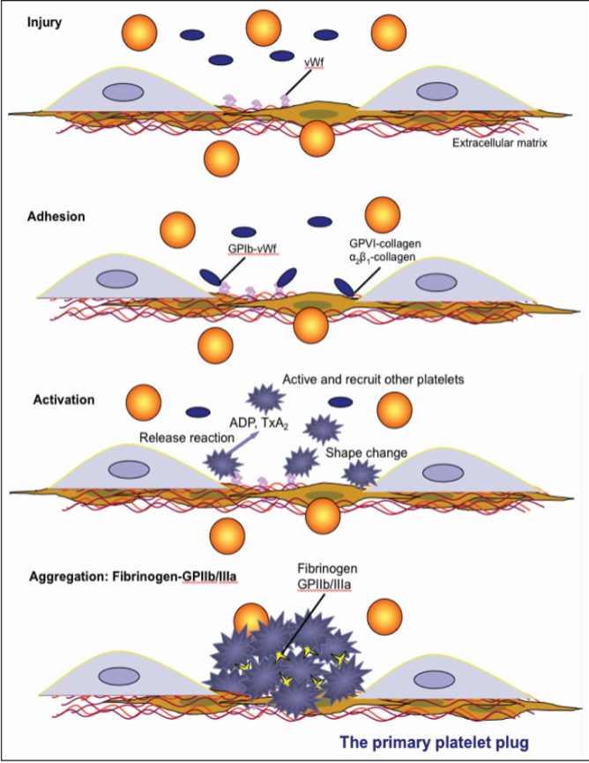
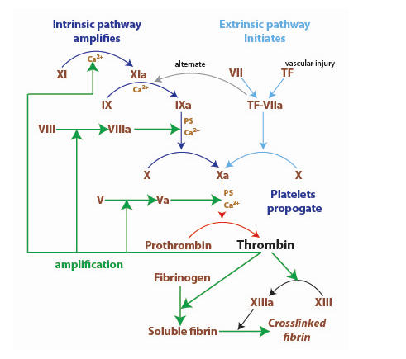
Hemostasis
Primary Hemostasis
  Vasocontriction
  Formation of platelet plug
Secondary Hemostasis
  Activation of coagulation cascade
  Formation of permanet plug
Notes:
Primary hemostasis is the initial stage of hemostasis defined by the formation of a platelet plug at the site of injured blood vessels, preventing the leakage of blood. The three main components of primary hemostasis are activated platelets, von Willebrand factor (vWf), and the vessel wall.
Secondary hemostasis is the second stage of hemostasis that results in the formation of a stable, fibrin clot by aggregated platelets and fibrin. Secondary hemostasis involves a number of components including cells such as platelets, fibroblasts, endothelial cells, and lymphocytes, enzymatic coagulation factors including factor XI, X, IX, VII, and II, cofactors including tissue factor, Factors V, and VIII, fibrinogen, phosphatidylserine, and calcium.

Slide 5
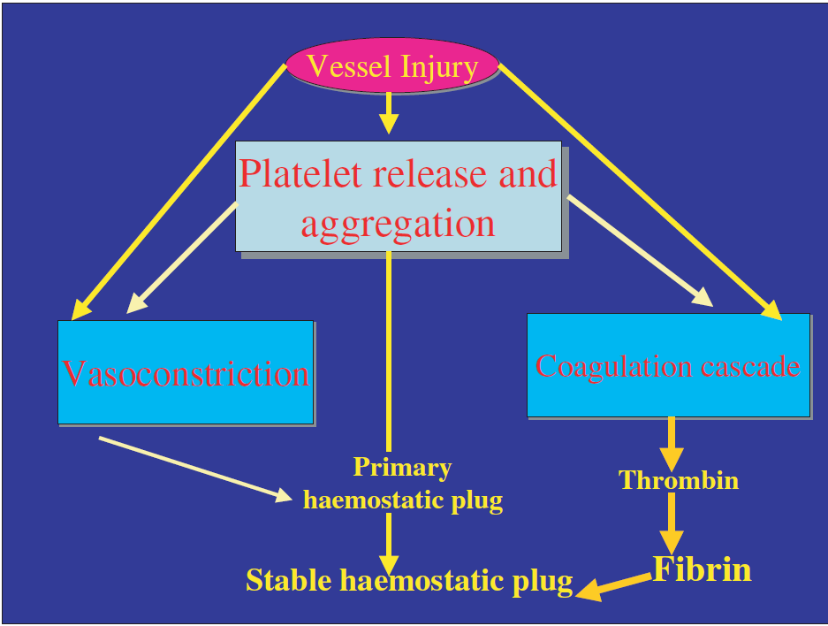
Pathophysiological Aspects of Coagulation
Scheme of primary haemostatic function
A. Shlebak
Notes:
Hemostasis is a host defence mechanism that protects the integrity of the vascular system after tissue injury. It is responsible for minimissing blood loss. It is critical that formation of blood clot in response
to a breach in the vascular endothelium occurs rapidly. Systemic activation of the coagulation cascade or extensive local extension of thrombosis resulting in vascular occlusion, however, should not
occur. Immediate vasoconstriction of the injured vessel and reflex constriction of adjacent small arteries and arterioles are responsible for an initial slowing of blood flow to the injured area

Slide 6
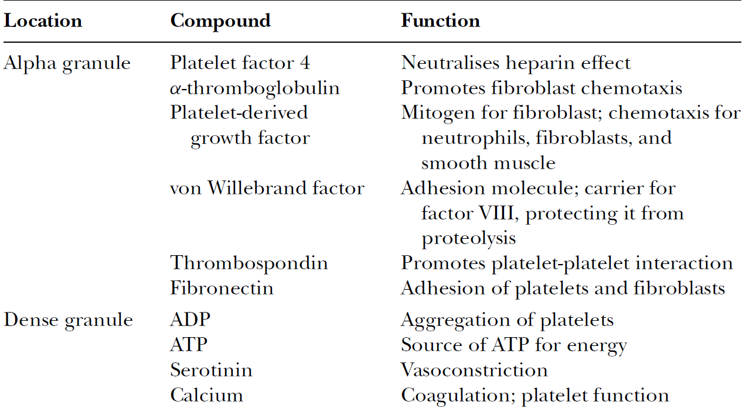
Platelet Granule Content and Their Biological Functions
A. Shlebak

Slide 7
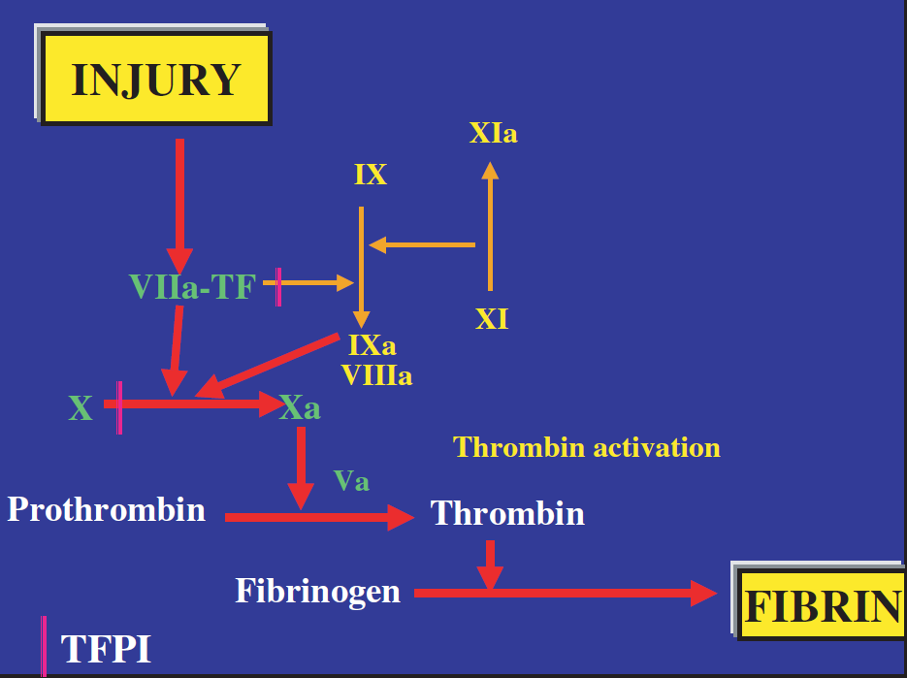
Classical waterfall hypothesis of coagulation
A. Shlebak

Slide 8
Hemostasis
Minutes
Vessel Injury
Vasoconstriction
Hours
Fibrin clot
Days
Recanalisation
Mixed platelet
Clot retraction
Platelet Adhesion
Platelet Aggregation
Platelet of Hemostatic Plug

Slide 9
Methods of hemostasis
Mechanical
Press, ligation-- etc
Cauterization
Topical absorbable
Chemical
Vasocontrictor

Slide 10
Mechanical Methods of haemostasis
Direct pressure
Clamps
Ligation Clips
Sutures
Staples
Bone Wax
External bandages

Slide 11
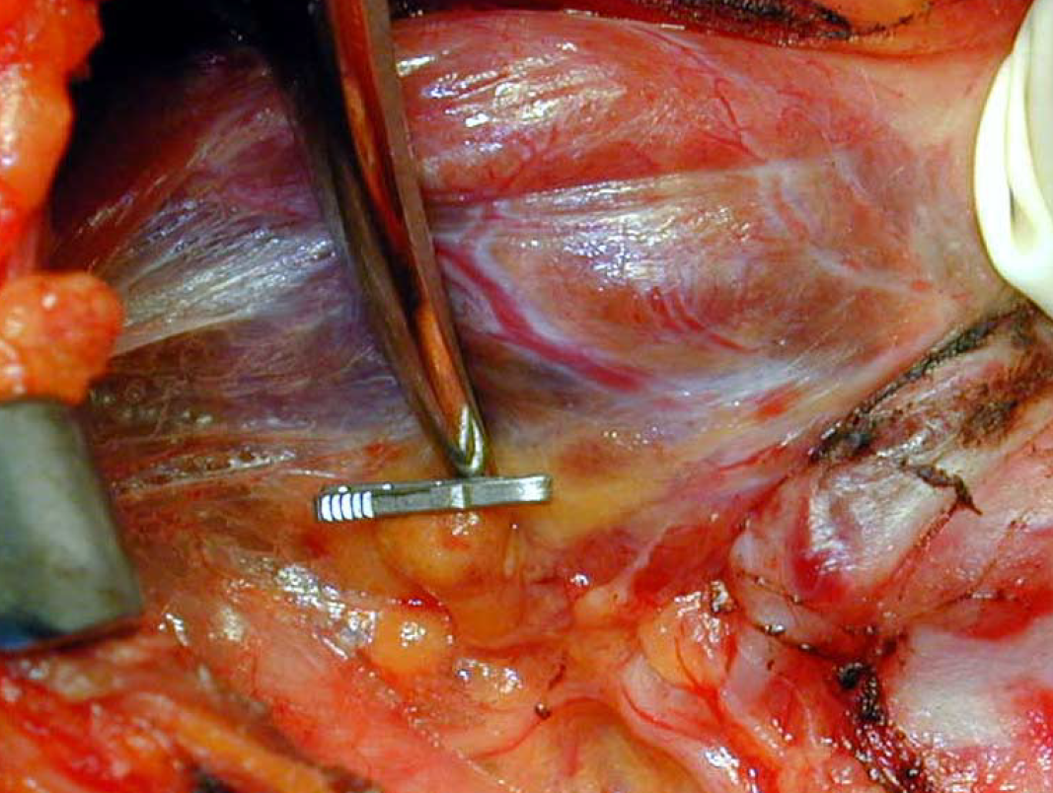
Ligaclip

Slide 12
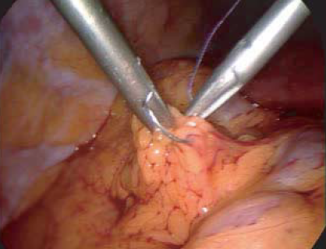
Suture ligation during laparoscopic surgery

Slide 13
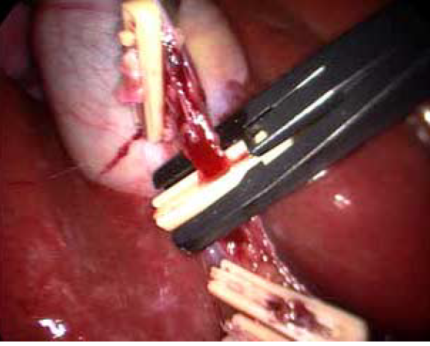
Application of laparoscopic clips

Slide 14
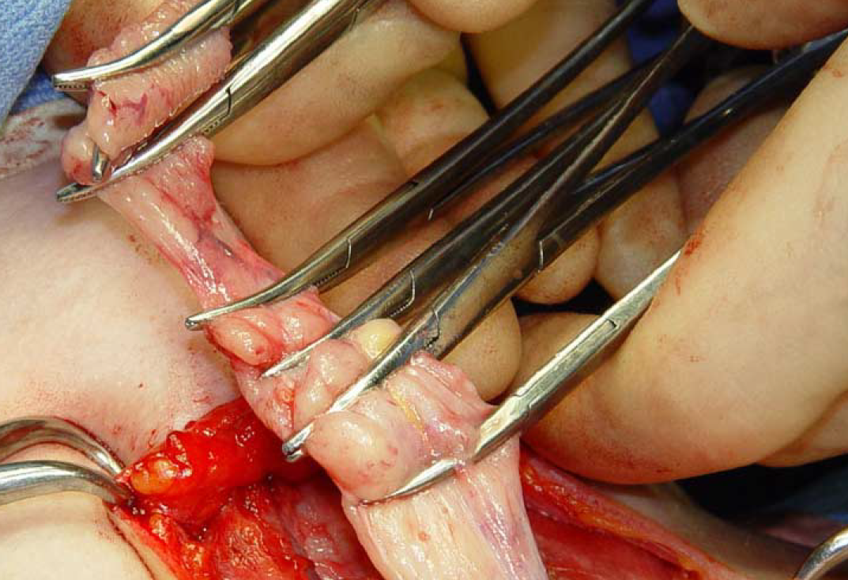
Excision of the thymus

Slide 15
Cauterization Methods of haemostasis
Thermal Cautry
Harmonic Scalpel
Laser
Cryosugery
Electrocautry
Monopolar
Bipolar
RF

Slide 16
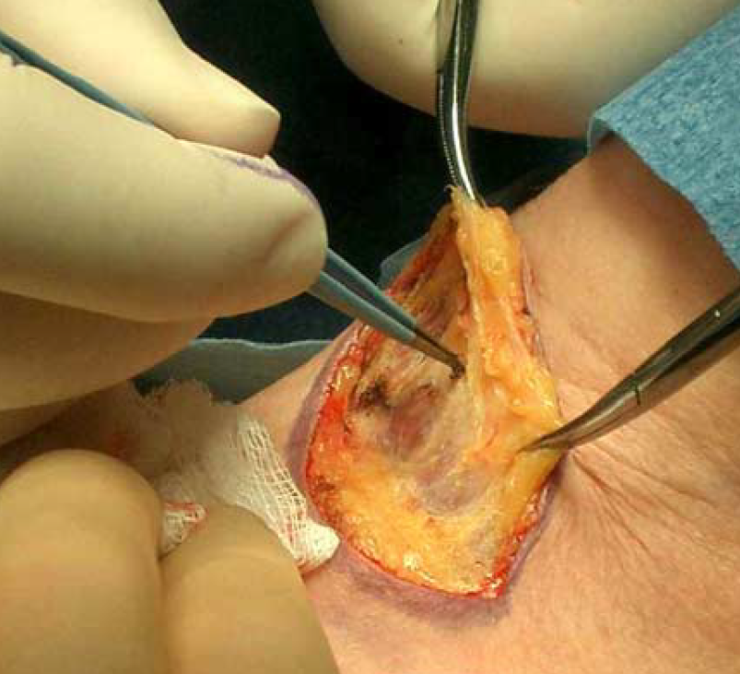
Raising of superior skin flap with monopolar diathermy forceps

Slide 17
Bipolar coagulation
Bipolar coagulation is fundamental to neurosurgery because it enables precise coagulation of small vessels without dangerous spread of the current to adjacent neural and vascular structures.
  A range of bipolar forceps of different sizes and lengths should be available
P. Bullock & R. Arya

Slide 18
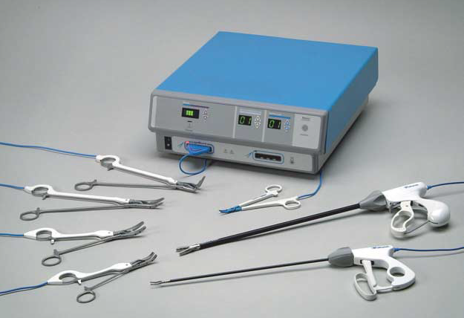
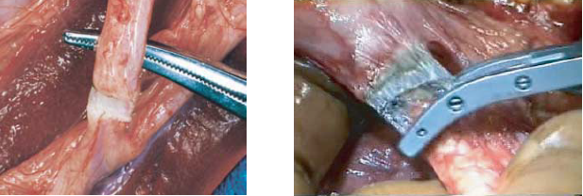
Liga-Sure and application of Liga-Sure.

Slide 19
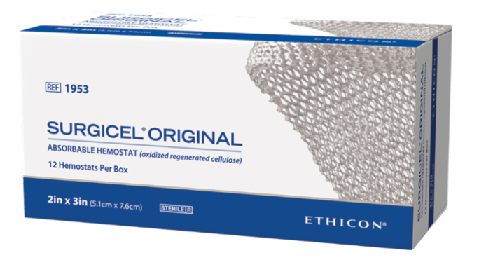
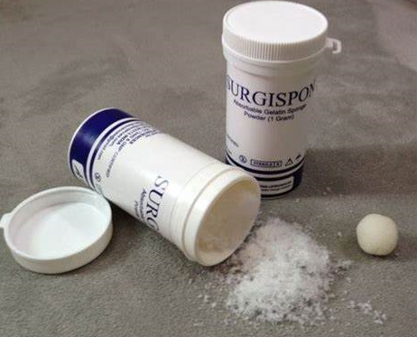

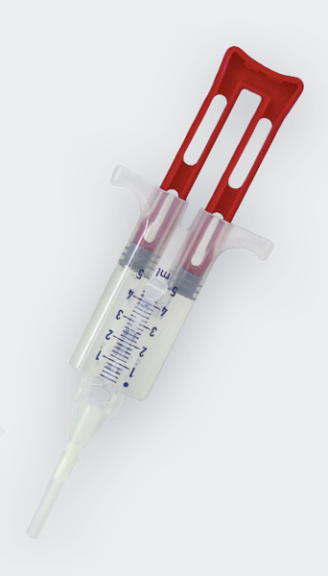
Chemical Methods of haemostasis
Topical absorbable
Oxidized Regenerated Cellulose
Gelatin Sponge or Powder
Collagen
Thrombin
Fibrin Glue
Notes:
Chemical hemostatic agents agents like surgicell are often using in transplant surgery, because these products control bleeding without occluding the vessel lumen and cause no thermal injuries to adjacent structures. A topical haemostat is often the technique of choice to control bleeding in the case of diffuse capillary and venous oozing. These haemostats have been used in surgical procedures for more than 30 years, however, new application forms like Surgicel fibrillar and Surgifoam powder entail different handling options.

Slide 20
Surgical Blood Loss
Potential negative outcome of intra- operative blood loos
Anemia
Hypovolemia
Potential negative outcomes of blood tranfusion
Increased post op infection rates
Allergic and hemodynamic tranfsfusion reaction
Viral transmission

