Slide 1
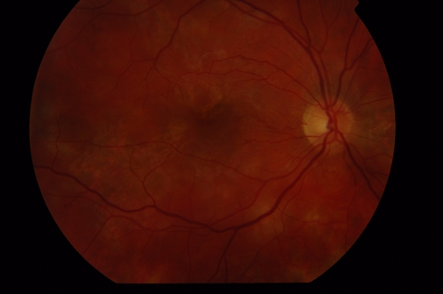
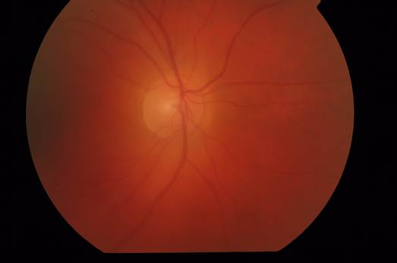
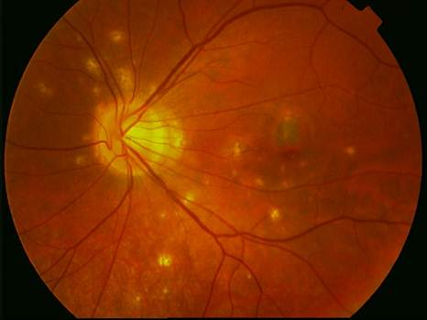
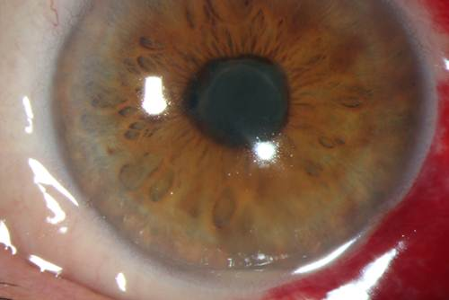
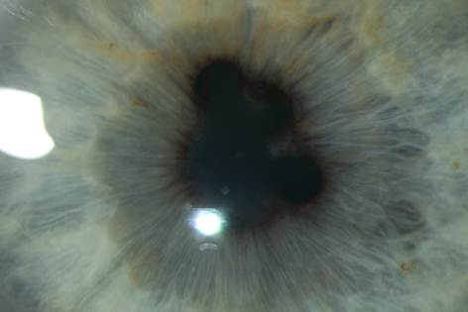
Inflammation of THE Uvea - uveitiS

Slide 2
anatomy and physiology of the uvea
3 parts:
iris (iris)
ciliary body (corpus cilliare)
choroid (choroidea)
Function:
regulation of the entry of the light into the eye (pupil)
accomodation
production of aqueous humor

Slide 3
Definition of uveitis
Uveitis – inflammation of the uvea
Intraocular inflammation causes damage of the endothelium of intraocular vessels with the collapse of the blood-barrier.
There is a dilation of blood vessels, leakage intravascular content into the intravascular space, migration of leukocytes and other cells.

Slide 4
classifiCATION of uveitis
Anatomical:
anterior (iritis, iridocyclitis)
intermediate (pars planitis, cyclitis, vitritis)
posterior (choroiditis, chorioretinitis)
all parts (panuveitis)
Clinical:
acute - symptoms suddenly, lasting no longer than 6 weeks
chronical - gradual onset of symptoms, duration of more than 6 weeks

Slide 5
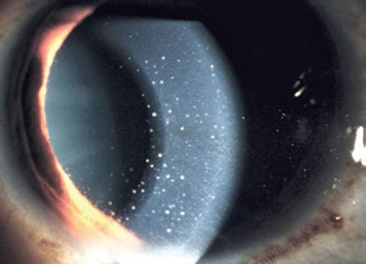
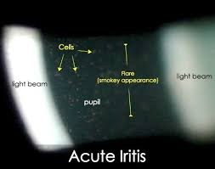
classification of the uveitiS
nongranulomatous – acute formation, short duration, significant cilliary injection, small precipitates on the corneal endothelium, cells in the anterior chamber, fibrinous exsudate

Slide 6
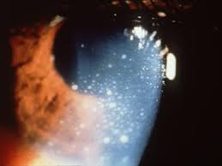
classification of the uveitiS
granulomatous – slow formation, protracted course, significant cillary injection, precipitates on the corneal endothelium, iris nodules, vitritis, often affected choroid

Slide 7
classification of the uveitis
According to the etiology:
Exogennous (injury uvea, microorganism invasion from the outside)
Endogennous (inner, systemic inflammatory origin)
uveitis associated with systemic disease
(eg. ankylosing spondylitis, sarcoidosis, tuberculosis,
multiple sclerosis)
uveitis associated with parazitic infection (eg. toxokarosis)
uveitis associated with viral infection (eg. herpes simplex)
uveitis asscoiated with fungal infection (eg. candida)
idiopathic uveitis (comprises about 25% of all uveitis)

Slide 8
Acute NonGranulomatous iridocyclitis
Signs and symptoms:
eye pain, photophobia, epiphora
ciliary injection
small precipitates on the corneal endothelium, abundant cells in the anterior chamber, in the course of severe fibrinous exudate in the anterior chamber
hypopyon
synechiae formation (adhesions between the iris and lens)
dilation of blood vessels in the iris
Chronic complications (formation of synechiae in case of delayed treatment, complicated cataract development)
Treatment: corticosteroids locally, parabulbar, if necessary, generally, mydriatics, in the case of viral etiology antivirals

Slide 9
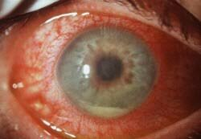
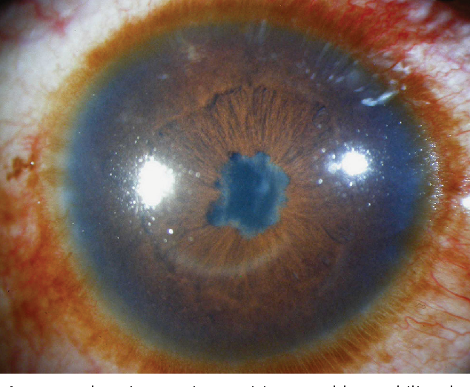

Slide 10
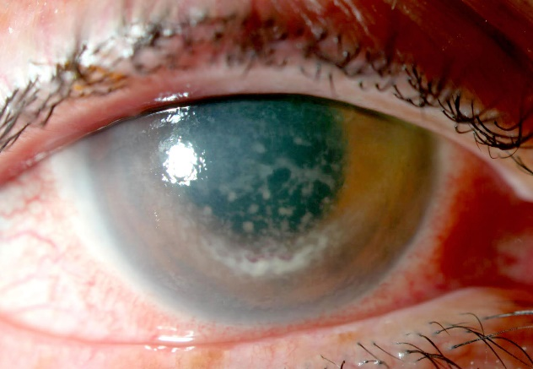
AcutE Anterior nONgranulomatous iridocyclitiS
Etiology:
HLA B27+ izolation, Ankylozing spondilitis ( M. Bechtěrev), Reiter syndrom, M. Crohn, Colitis ulcerosa,
Psoriatic artritis
Phacoanafylaktic uveitis – imunological reaction on free proteins of the lens
Viral diseases – Herpes simplex, herpes zoster in combination with keratitis

Slide 11
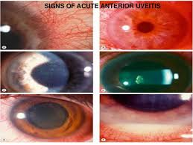

Slide 12
Chronic Anterior iridocyclitis
Signs and symptoms:
creeping course, variable symptoms, usually no pain or only mild pain
mild ciliary injection, mostly pale bulb,
a small amount of precipitates on the corneal endothelium, a small number of cells in the anterior chamber
lower tendency to the formation of the synechiae,
chronic complications according to the disease activity (formation of complicated cataract, secondary glaucoma)
Treatment: corticosteroids and nonsteroidal anti-inflammatory drugs locally, if necessary parabulbar or systemic, mydriatics, and according to etiology

Slide 13
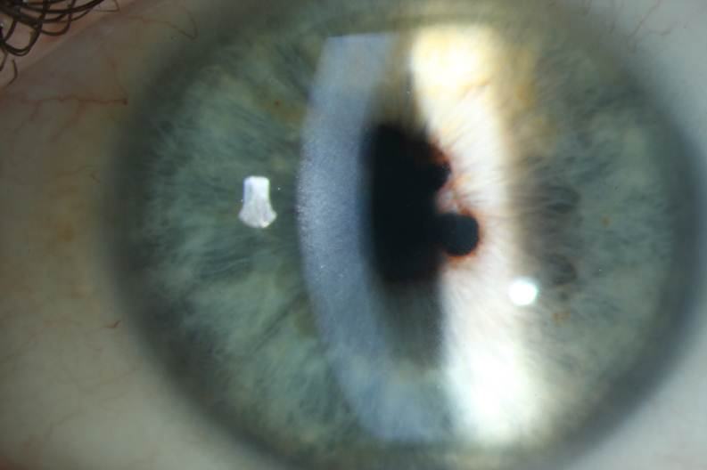
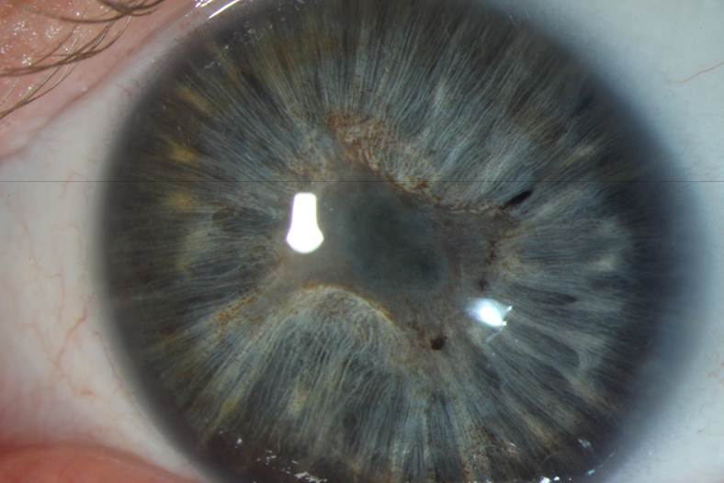
Chronic Anterior iridocyclitis
Notes:
13

Slide 14
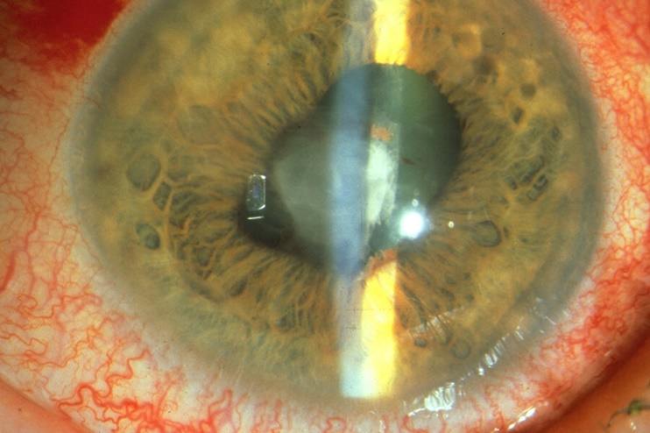
Chronic Anterior iridocyclitis
Etiology:
Juvenile rheumatoid arthritis
Sarcoidosis (granulomatous inflammation type)
Syphilis ( roseolae of iris )
Lyme disease
TBC ( granulomatous inflammation type, yellow nodules on iris)

Slide 15
Intermediate uveitis (Cyclitis, Pars planitis)
Manifestations, symptoms, etiology:
creeping course, without pain, decrease vision- opacities, fog
mostly pale bulb
vitritis - vitreous opacities (snowballs, snow benches)
with increased activity of inflammation macular edema
chronic complications (development of complicated cataract, macular epiretinal membranes, preretinaland subretinal neovascular membranes)
Treatment: according to the disease activity monitoring, corticosteroids overall or intravitreal corticosteroids, immunosuppressants (cyclosporine), biological therapy, PPV
possible link with MS or Lyme disease or unclear

Slide 16
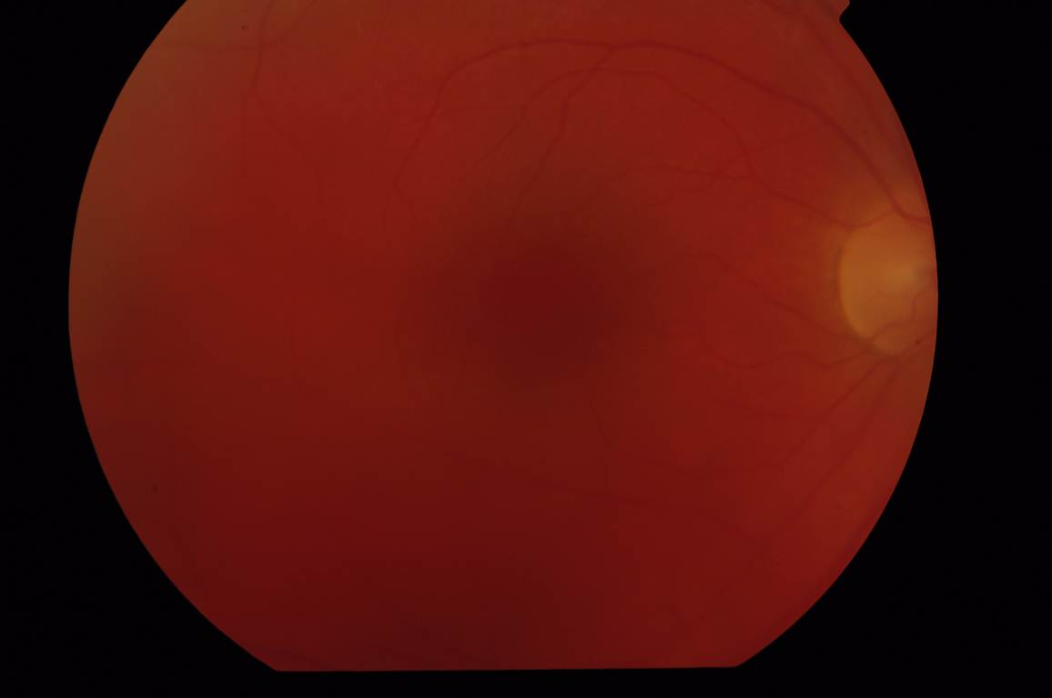
intermediate uveitis (Cyclitis, Pars planitis)
Notes:
16

Slide 17
Posterior uveitiS ( chorioretinitiS, choroiditiS)
Manifestations symptoms:
beginning acute without pain, decrease vision- vitreous opacities, fog
mostly pale bulb
vitritis - vitreous opacities
Well demarcated lesions affecting retina and choroid (focal or multifocal)
with increased activity of inflammation macular edema
chronic complications (development of chorioretinal scars)
Treatment: due to etiology, in infectious etiology causally antibiotics, antivirals systemically, in autoimmune etiology systemic corticosteroids or systemic imunosupressants

Slide 18
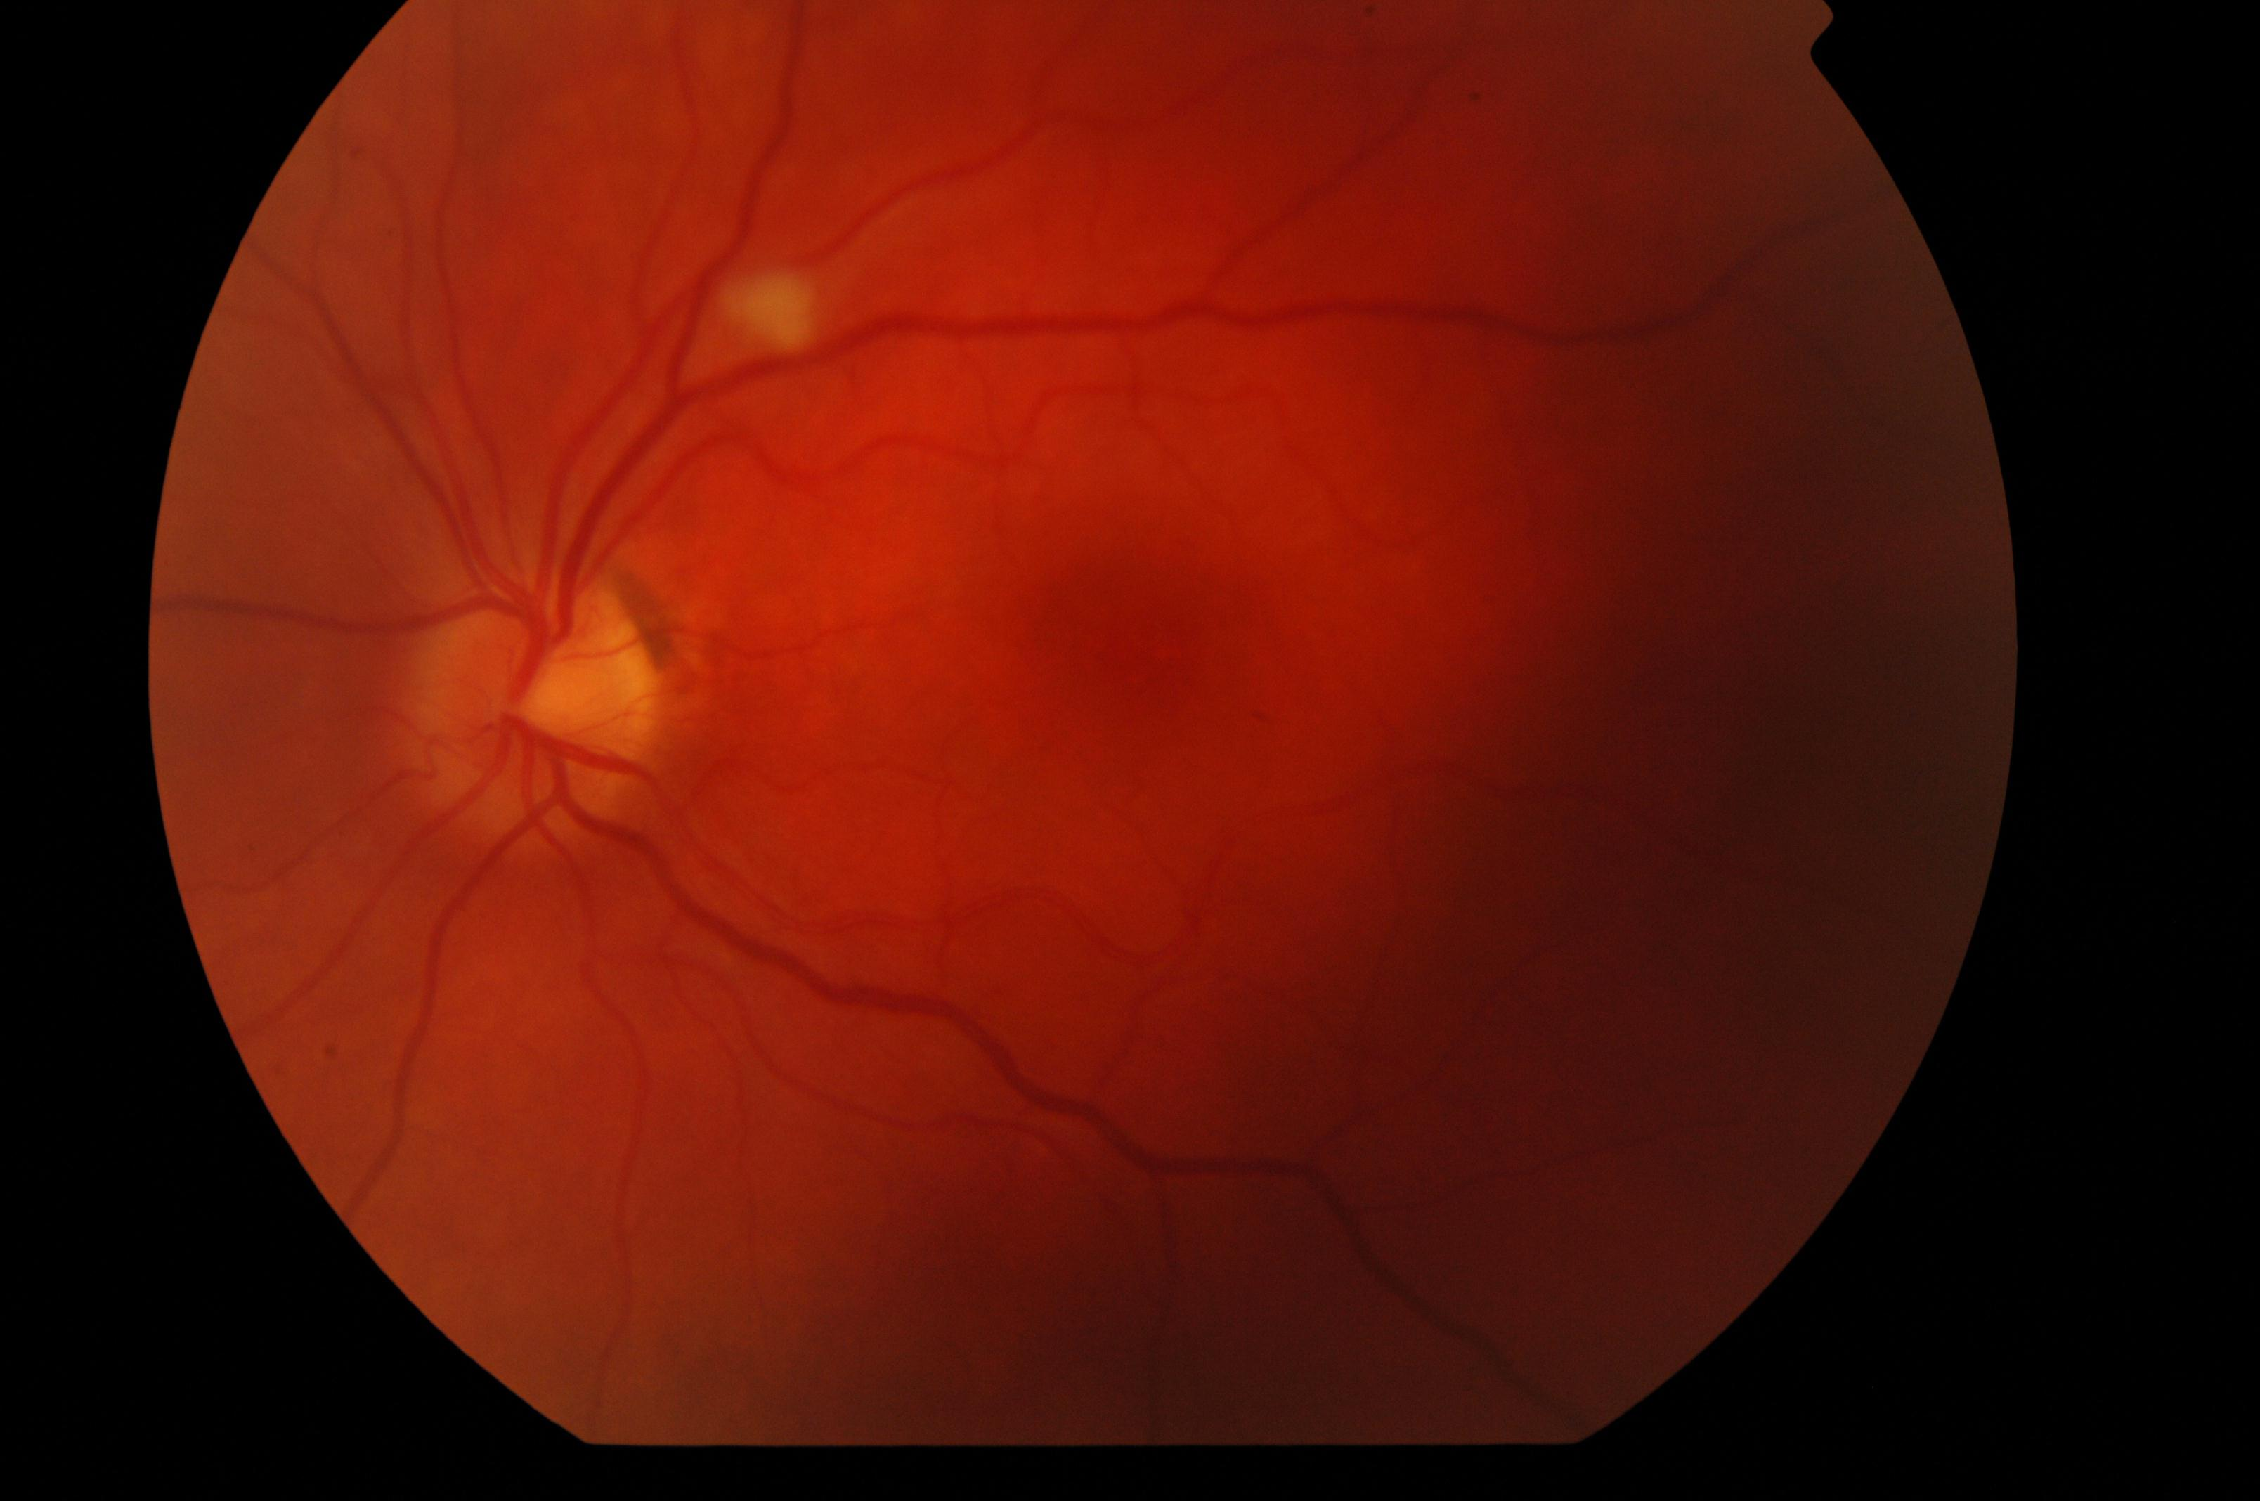
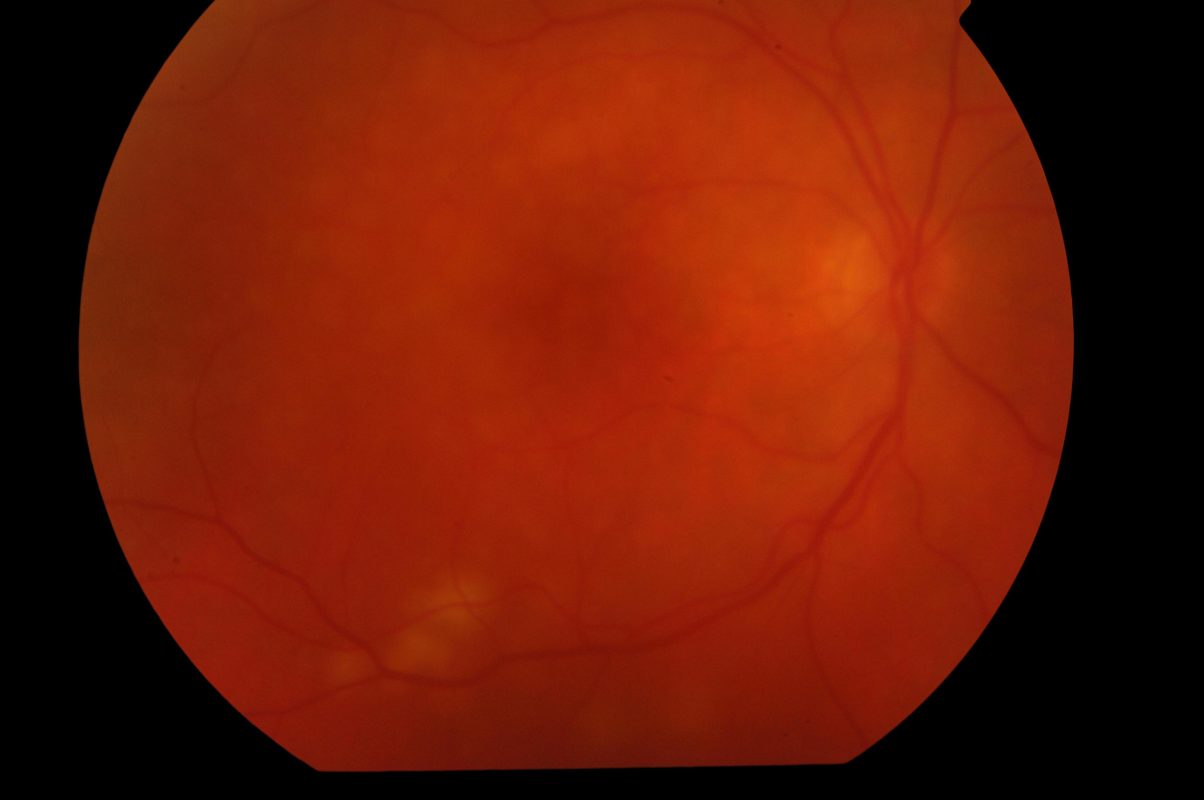
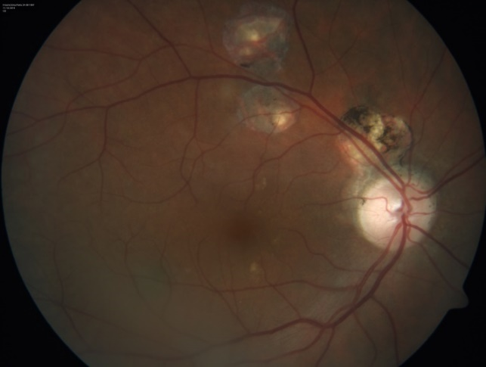
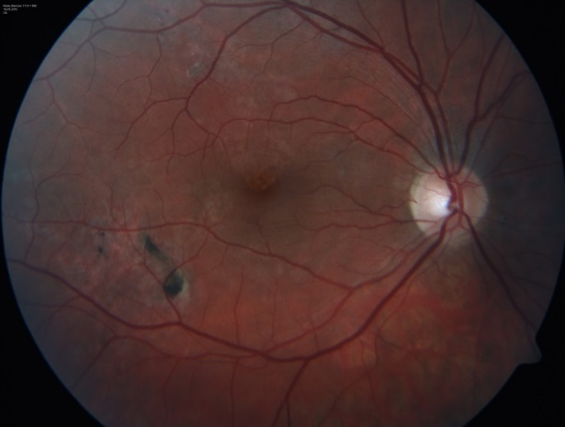
Posterior uveitiS ( chorioretinis, choroiditis)
Notes:
18

Slide 19
Posterior uveitiS ( chorioretinitiS, choroiditiS)
Etiology:
Toxoplasmosis (frequently)
Toxocarosis
Candidosis (in patient with decreased imunity)
Sarcoidosis,TBC (granulomatous inflammation type)
Herpes simplex, zoster retinitis
CMV retinitis ( in immunocompromised patients)
White dot syndroms (isolated autoimmune inflammation against retinal structures)
Sympathetic ophthalmia

Slide 20
Endophthalmitis
Severe form of intraocular inflammation affecting intraocular tissue structures, but does not go beyond the sclera.
Exogenous - postoperative (acute 1-14 days after surgery, chronic two weeks up to two years after surgery), post-traumatic
Endogenous - hematogenous transmission of pyogenic bacteria or mold (candida) for generalized septicemia
Frequently agent: Staphylococcus, Streptococcus, Candida, Propionibacterium, Klebsiella, Haemophilus, Escherichia

Slide 21
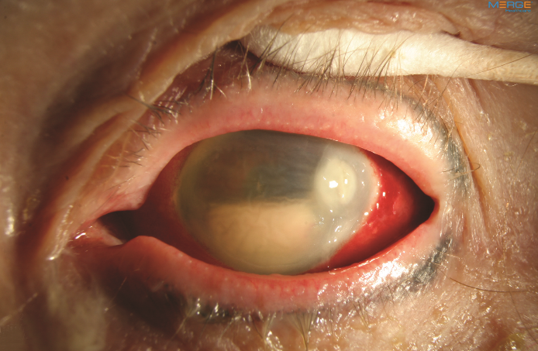
EndophthalmitiS
Manifestation, Symptoms:
Acute endophthalmitis – pain, sudden decrease in vision, conjunctivitis, edema of the eyelids, corneal edema, hypopyon, vitritis, necrosis of the retina
Chronic endophthalmitis – without pain, visual acuity decreased only slightly, hypopyon just sometimes, mild vitritis
Treatment:
ATB, antimycotics in infusions, eventuel. intravitreal
PPV

Slide 22
