Slide 1
Orbit
MUDr. Veronika Matušková, Ph.D., FEBO

Slide 2
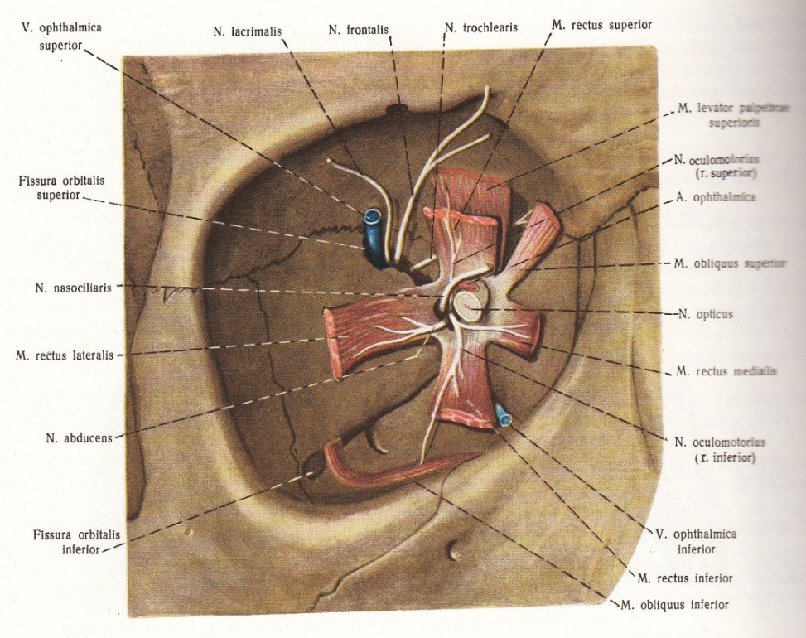
Fractura orbitae
Anatomy
Canalis opticus
Fissura orbitalis superior
Fissura orbitalis inferior

Slide 3
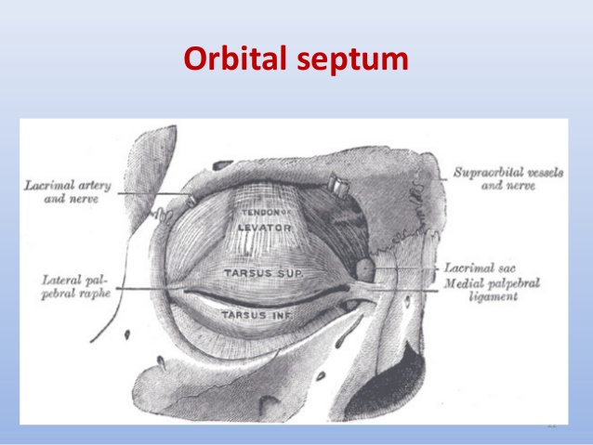

Slide 4
Fracturae of orbit
Roof - frontobasal, orbitofrontal
Lateral wall – orbitozygomatic
Medial wall – orbitoetmoideal
Floor – retromarginal, „blow out fracture“

Slide 5

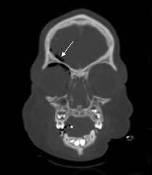
Fracture of roof
Cause – failing on a sharp object, blow to the
Forehead (head in bend)
Signs: hematoma of the upper eyelid, disturbance of craniofacial bones
Small fractures require no treatment
Fractures extending into the anterior cranial fossa - competence NCH
Damage visual functions - ischemic neuropathy n. II
Therapy ischemic neuropathy: decompression optical channel or megadoses of methylprednisolone

Slide 6
Fracture of lateral wall
Cause - blunt trauma on cheekbones
Usually part of zygomatikomaxilárního complex (ZMK)
Symptoms: pain, hematoma of eyelids, conjunctiva chemosis, visual disturbances and eyeball displacement (diplopia, enophthalmos)
Dg. - CT, NMR
Treatment - Indications for surgery is persistent diplopia, limited mouth opening and flattening of the facial region

Slide 7
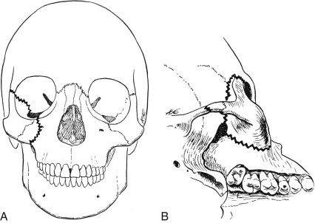
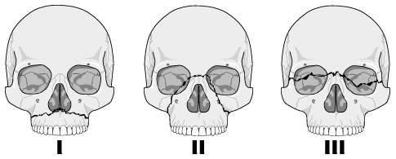
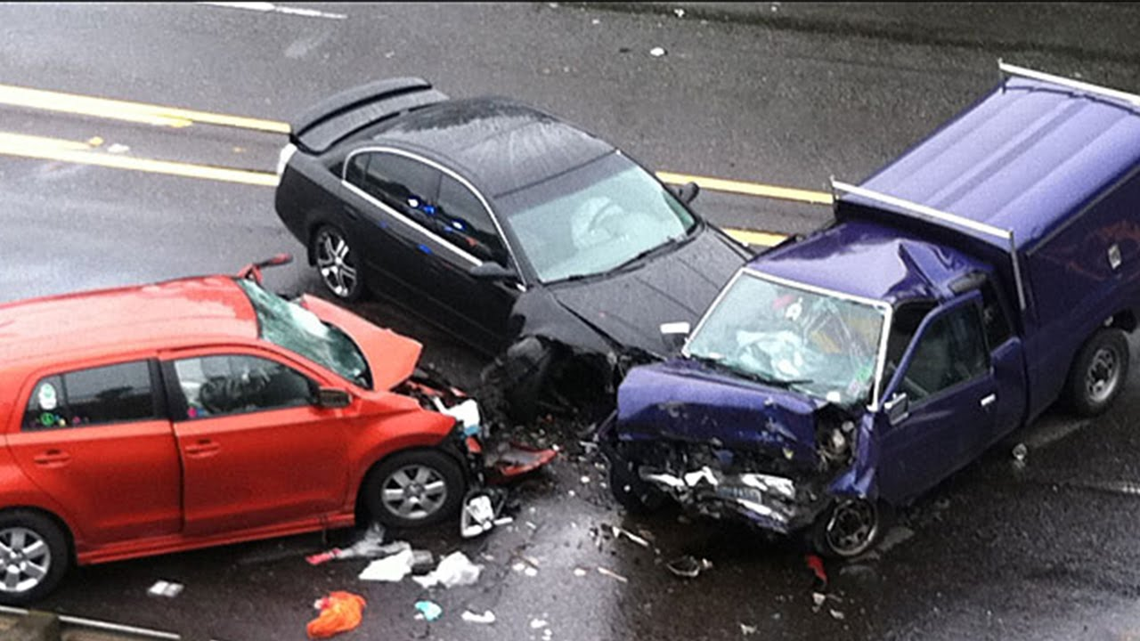

Slide 8
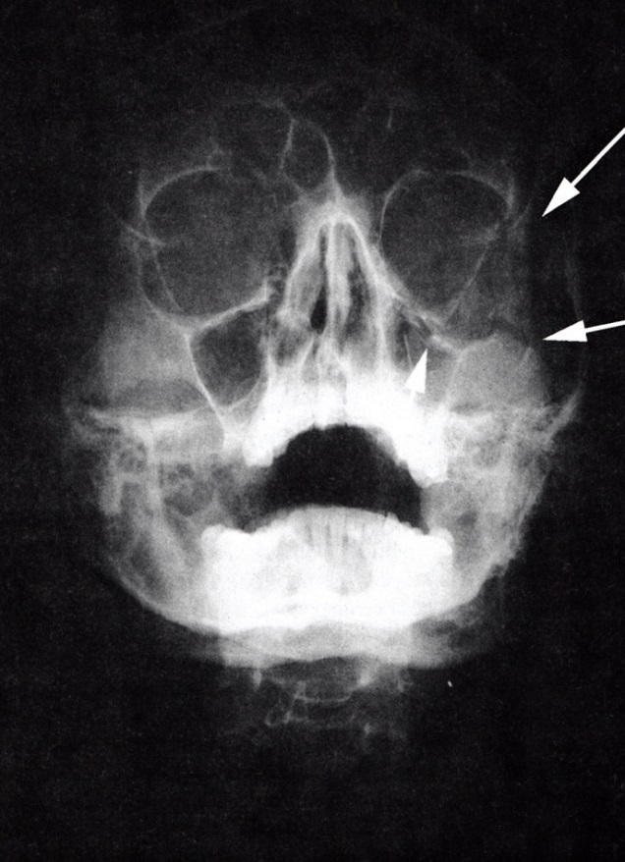
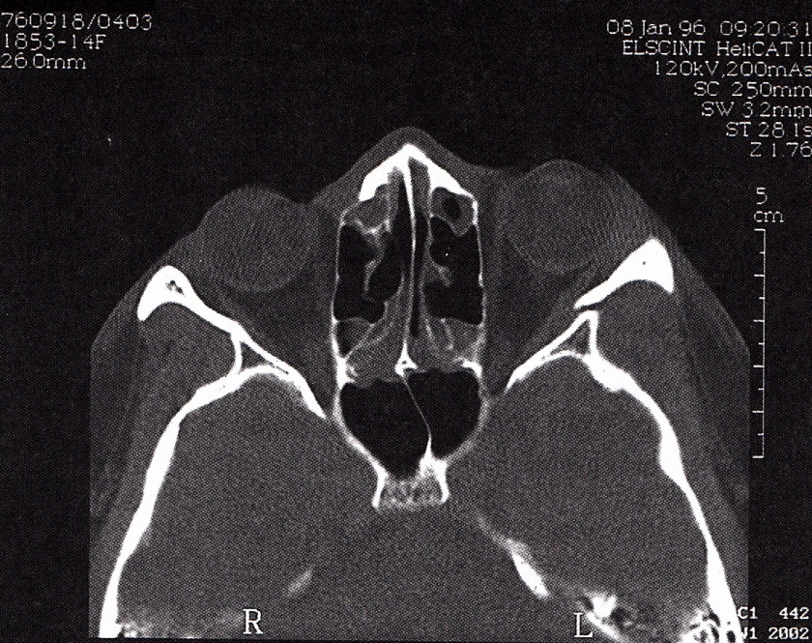
Orbit fracture
Fractura of ZMK
Isolated fracture of lateral wall

Slide 9
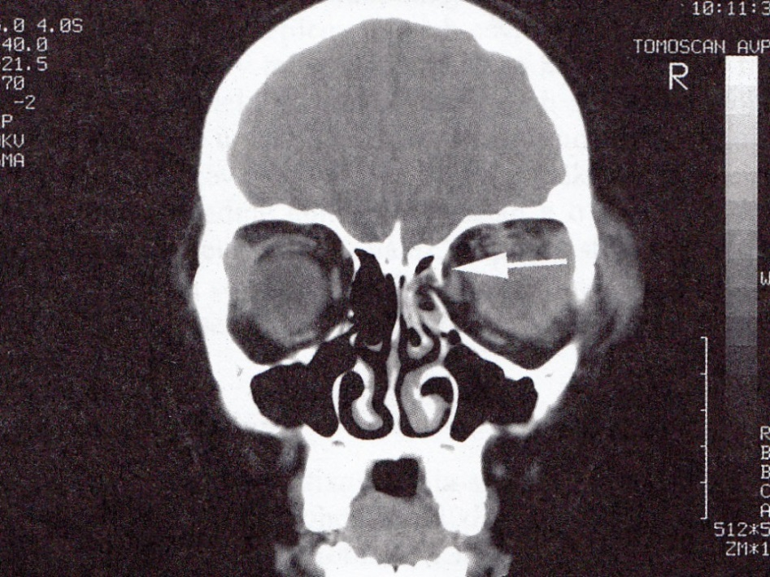
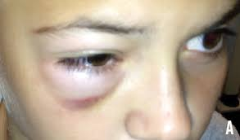
Medial wall fracture
Cause - blunt trauma
Symptoms - hematoma eyelid , subcutaneosu emphysema develops on blowing nose
Dg. - CT
Treatment – conservative

Slide 10
Blow out orbital floor fracture
Cause – sudden increase in the orbital pressure by a striking object ( larger than 5 cm)
The symptoms - swelling, hematoma of eyelids pseudoptóza, diplopia, inability to move the eyeball upwards (seriously elevation).
Paresthesia, hypoesthesia in n.infraorbitalis.

Slide 11
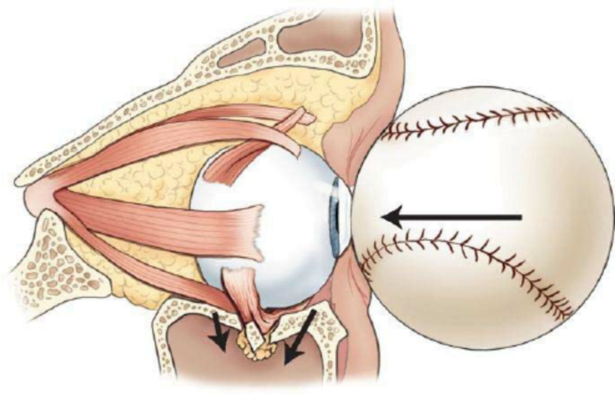

Slide 12
Blow out orbital floor fracture
Dg. - X-ray orbit, CT
Symptom - hammlock - wide breaking orbital floor. Significant enophthalmos, without incarceration of m.r. inf.
Symptom - hanging drop - fisure fracture with soft tissue entrappment
Double diplopia
Test passive duction
Treatment - Surgery – in case of entrappemnt (in 3-5 days -resolved orbital hematoma).

Slide 13
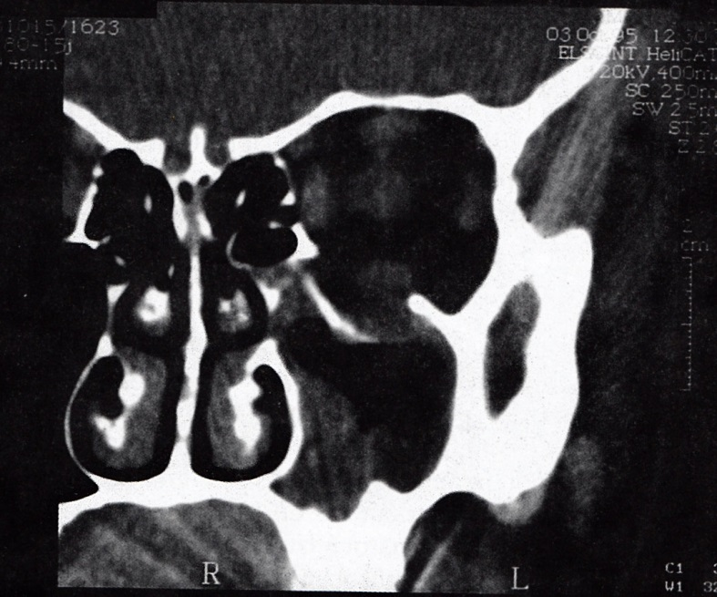
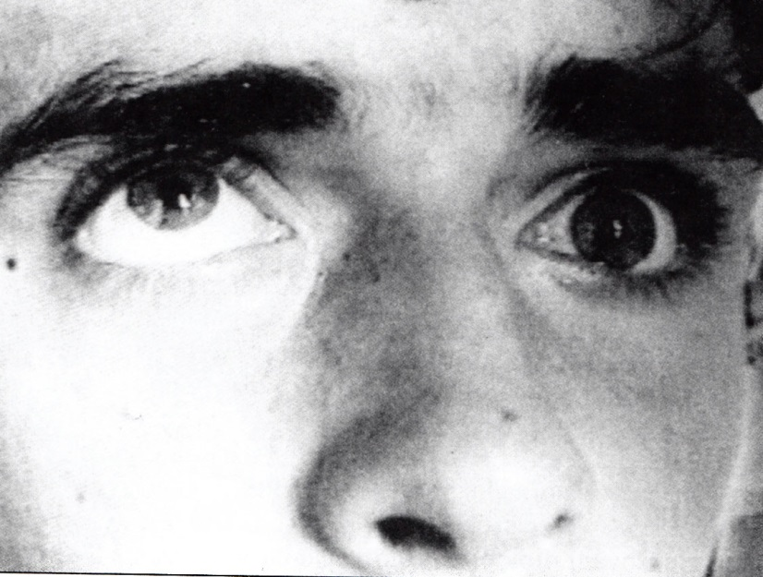
Blow out orbital floor fracture

Slide 14
Disease of lacrimal gland
Acute dacryadenitis – rare, in isolation
S: swelling of the lateral aspect of the eyelid – charakteristic „S“ shaped ptosis
T: usually is not required
Tumors: Lacrimal gland carcinoma - high mortality and morbidity
T: surgery and radiotherapy

Slide 15
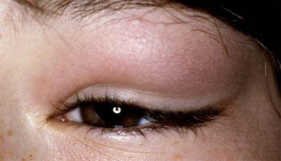
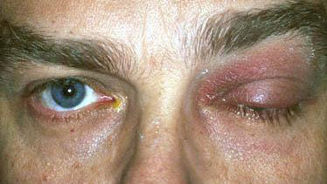
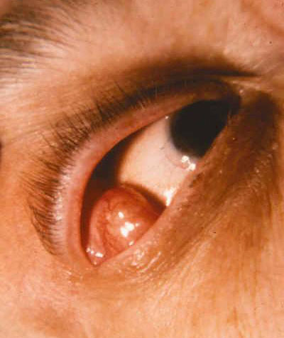
Disease of lacrimal gland
Dacryadenitis
Pleomorfic adenoma

Slide 16
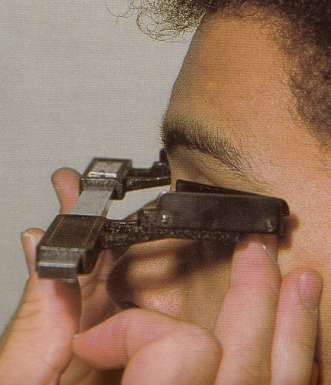
Helter exophtalmometr
Measurement of the position of the eye
Hertel exoftalmometr measures the distance corneal apex - the external edge of the bony orbit (diameter 17 mm, above 20 - pathology)
Side difference to 2 mm - physiological
Always should be recorded the distance of the outer edges of the orbits

Slide 17
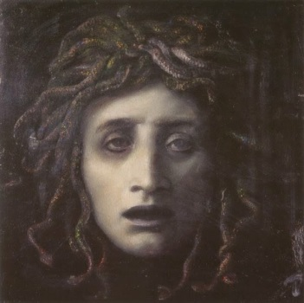
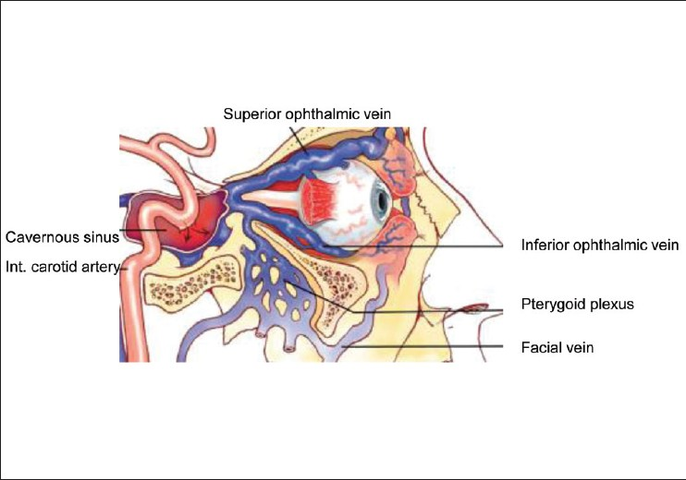
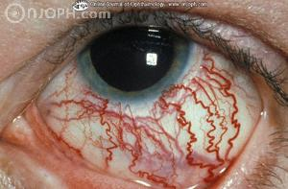
Disease of orbit
Pulsatile proptosis - the carotid cavernous fistula – abnormal communication btw vein and artery ( carotid artery and orbital cavernous sinus vein )

Slide 18
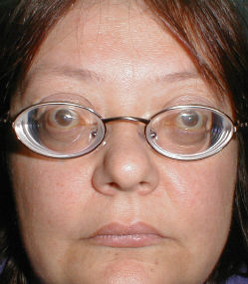
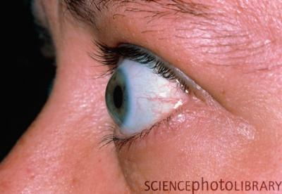
Disease of orbit
Intermittent proptosis - a symptom of vascular malformations in orbit (varix) - Valsalva maneuver
Pseudoproptosis - high axial myopia
enophthalmos

Slide 19
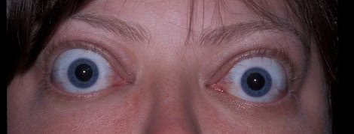
Disease of orbit
Axial proptosis - only in the sagittal plane (Graves' disease, orbitocellulitis )
Paraaxial proptosis - lesions of peripheral lateral space (lacrimal gland tumors, frontoetmoidal mucocele, tumors of PN sinus)
Bilateral proptosis - thyreotoxicosis and EO

Slide 20
Examination of orbit
X ray
Ultrasound
CT
NMR

Slide 21
Inflammation of orbit
Etiopatogenesis:
Microbial infection
Immune responses hyperergická-allergic-type
Endocrine ophthalmopathy (Graves disease)
Microbial infections:
orbitocellulitis
phlegmone orbit
abscess of orbit
Tenonitis
myositis orbitalis
Inflammatory pseudotumor of the orbit

Slide 22
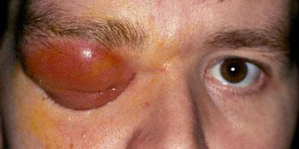
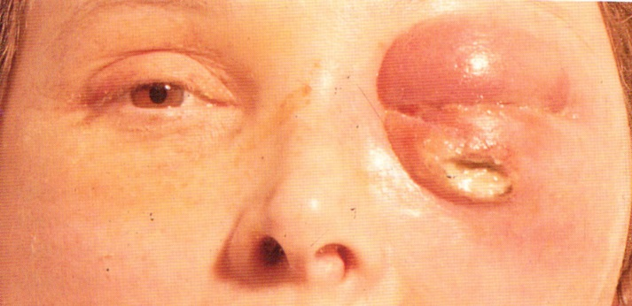
Inflammation of orbit
Orbitocelulitis
Abscess of orbit

Slide 23
Endocrine orbitopathy (EO)
Autoimmune disease with the formation of a binding antibodies on cells of thyroid gland
Orbital fat
Subcutaneous tissue front of the lower leg
Clinical picture:
Eyelid symptoms
Eye movement disorder
Pseudoglaukom
Exophtalmus
Neuropathy n.II

Slide 24
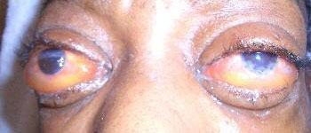
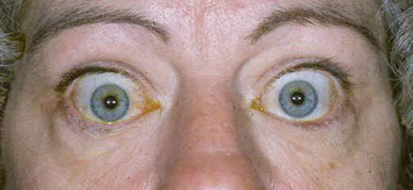
Endocrine orbitopathy (EO)

Slide 25
Endocrine orbitopathy (EO)
Diagnosis:
laboratory findings
Imaging (ultrasound B scan, NMR, CT)
Test passive duction (muscle fibrosis)
Complications of EO - the cornea exposure, elevated intraocular pressure, changes in the orbit (neuropathy)
Treatment:
Endokrinologist
Ophthalmologist - serious ocular complications - megadoses of steroids, orbital decompression, the treatment of ocular disorders

Slide 26
Tumours of orbit
Primary
vascular tumors
dermoid cyst
nerve tumors
lacrimal gland tumors
meningiomas orbit
malignant lymphomas
rhabdomyosarcoma
Benign and malignant
primary
secondary
metastatic

Slide 27
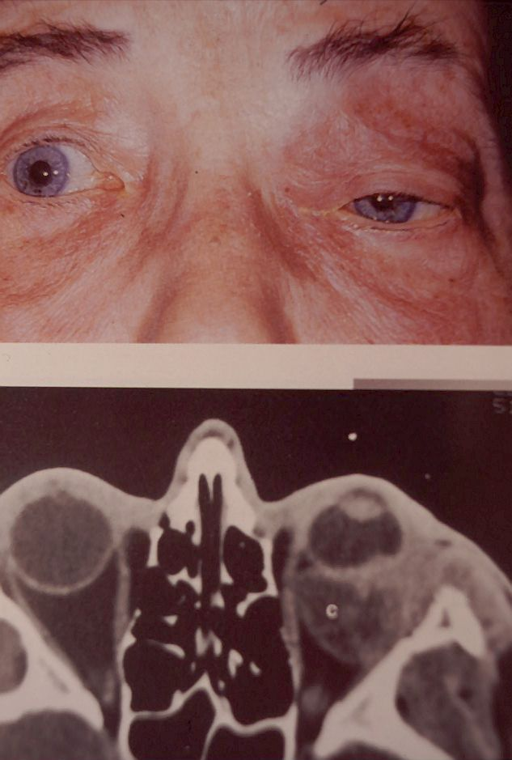
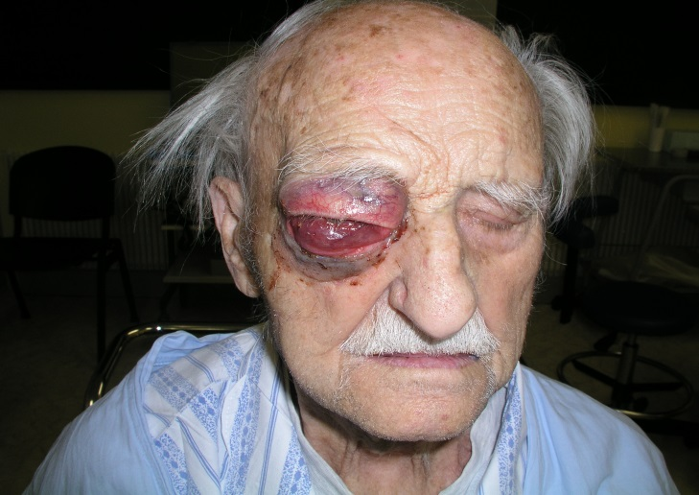
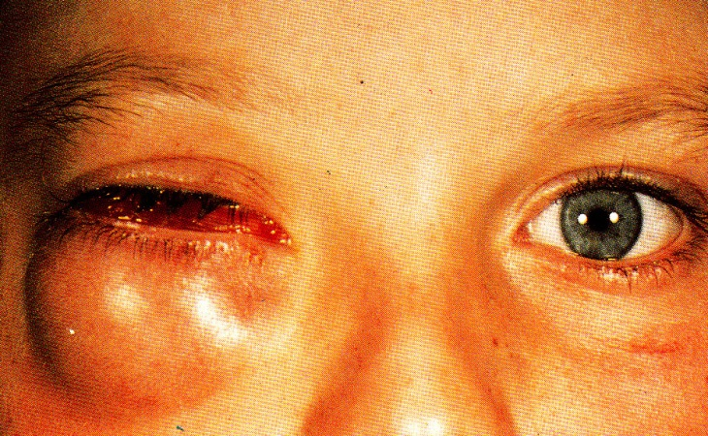
Tumours of orbit

Slide 28
Tumours of orbit
Secondary
tumors of PN sinuses
carcinomas of the eyelids
Extrabulbar expansion of intraocular tumors
metastatic -
Adenocarcinomas (breast, lung, prostate, colon, pancreas, testis)
Treatment
According to type, location and size of the tumor. Interdisciplinary cooperation
Anterior, lateral, and transcranial transetmoidální orbitotomy.
Orbital decompression, exenteration of the orbit.

Slide 29
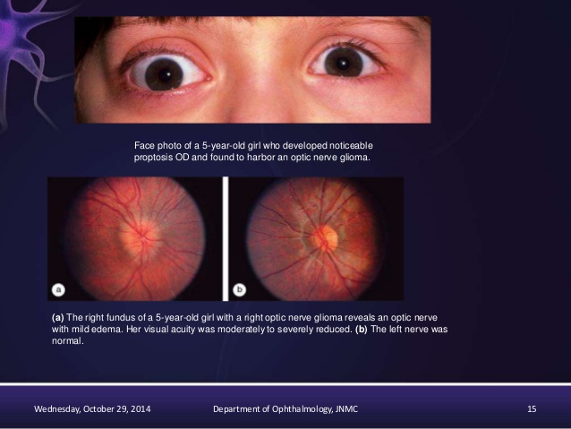
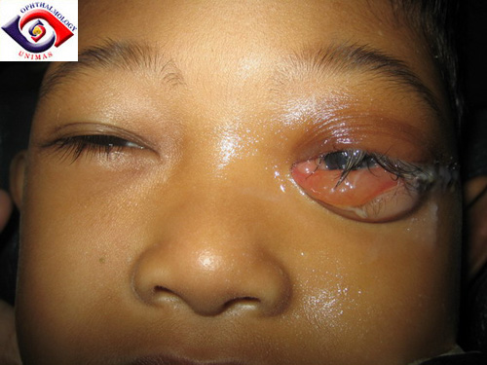
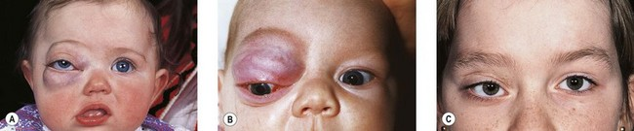

Slide 30

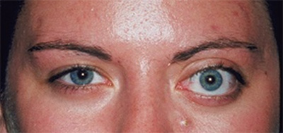

Slide 31
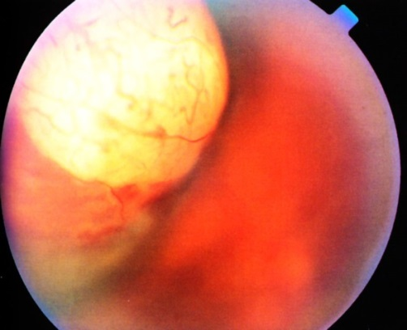
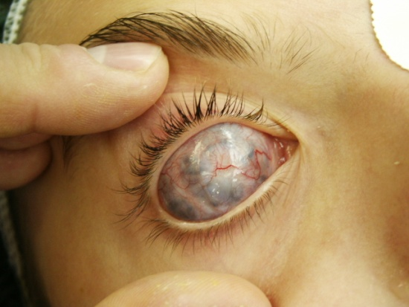
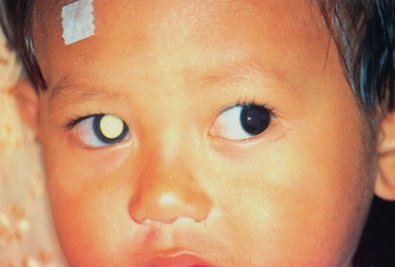
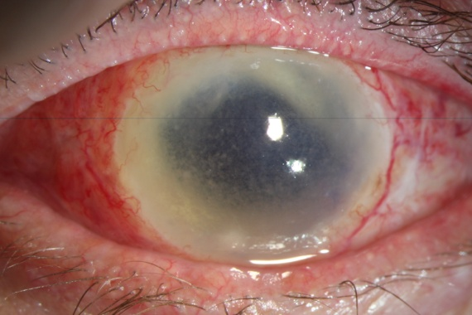
Enucleation and exenteration
Enucleation of the eyeball –
Removing the whole globe after
( transection of eye ocular muscles and optic nerve)
Indications:
malignant intraocular tumors without extrabulbární promotion
painful blind bulbus
cosmetically unsightly blind bulbus
devastating eye injury (primary enucleation)
sympathetic ophthalmia

Slide 32
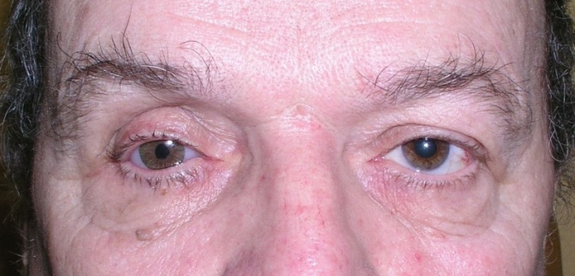
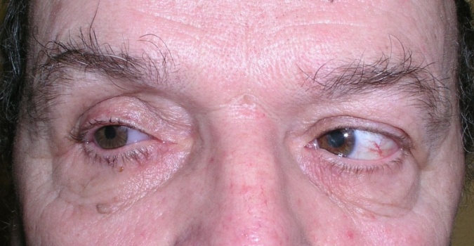
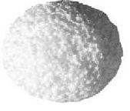
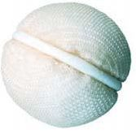
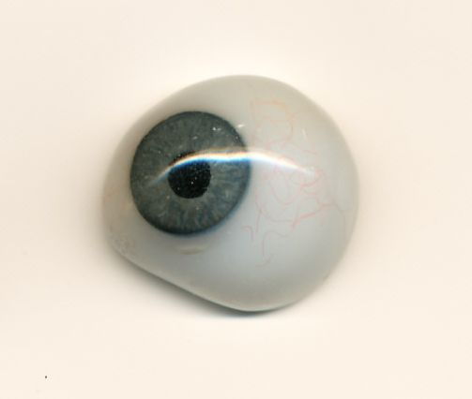
Enucleation and exenteration
Enucleation of the eyeball
surgical procedure
without orbital implant
orbital implant

Slide 33
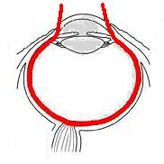
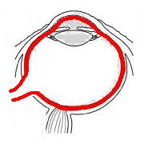
Exenteration of bulbi
Evacuating of the contents of the eyeball, leaving its packaging.
Indications:
Endophthalmitis (panoftalmitida)
The devastating trauma of the globe with the evacuation of its contents

Slide 34
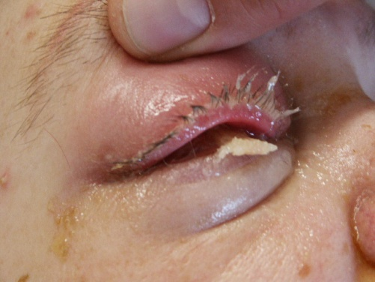
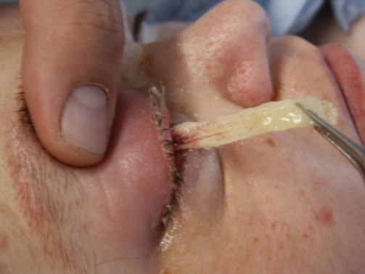
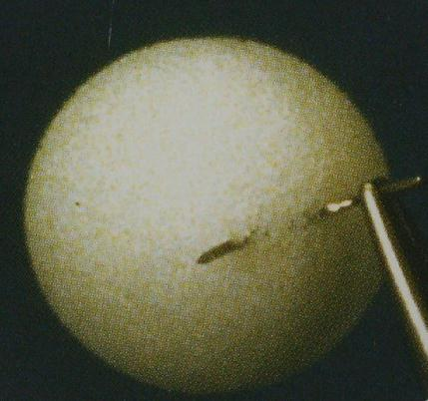
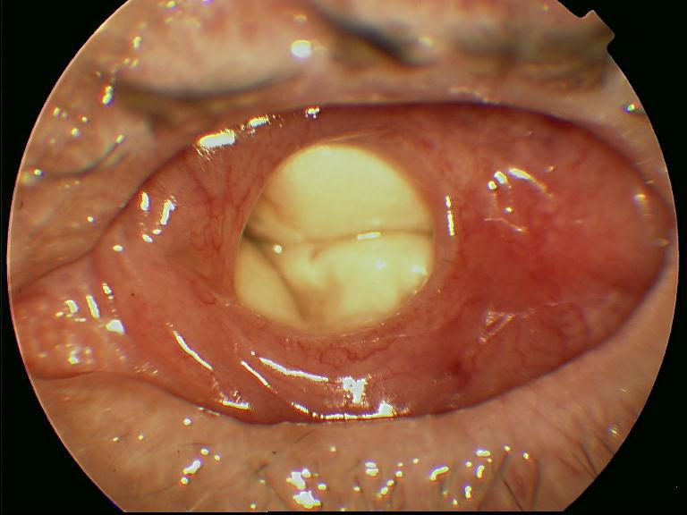
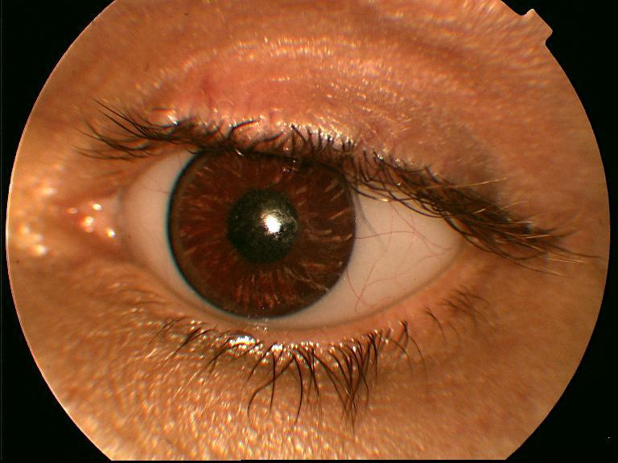


Enucleation and exenteration
Without implant
With implant

Slide 35


Enucleation and exenteration
Benefits of implant:
good motility of the globe
satisfactory cosmetic effect
Disadvantages of implant:
elimination of implant
the possibility of infection

Slide 36



Exenteration of the orbit
Removing the entire contents of the orbit and the periosteum
without retaining caps,
preserving eyelid
indications:
tumors of the orbit
tumors of the eyelids and eyeball with propagation into orbit
intractable infectious processes
trauma (devastating injuries with extensive tissue necrosis)

Slide 37




Exenteration of the orbit
Ways of dealing with the defect:
healing granulation tissue
free skin graft
tissue flap with pedicle (muscle, fat, skin)

Slide 38




Exenteration of the orbit
Permanent Cosmetic Solutions:
Spectacle ectoprotesis (prostheses)
Fixed implants

