Slide 1
Arterial stiffness

Slide 2
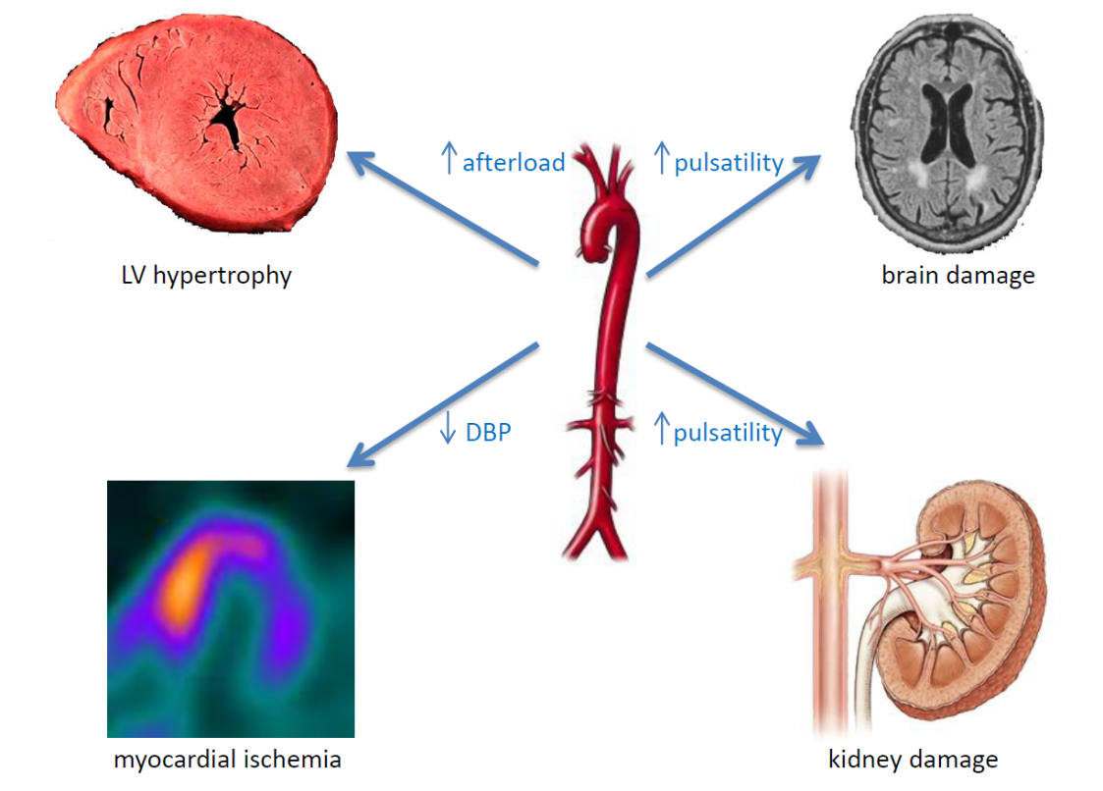
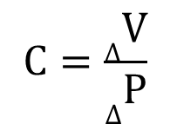
COMPLIANCE
INTIMA
Compliance
MEDIA
$$C=\frac{∆V}{∆P}$$
ADVENTITIA
MEDIA + ADVENTITA - responsible for arterial stiffness
Stiffness is ability to resist distension when a force is applied to it.

Slide 3
COMPLIANCE
Endothelial cells:
endothelial dysfunction
↑ permeability
Media:
↑ collagen
↓ elastin
↑ AGE`s, MMP, VSMC
Intima:
↑ collagen
↓ elastin
↑ AGE`s, TGF-β, VSMC
Adventicia:
↑ collagen
fibroblasts
Extrinsic influences

Slide 4
MEASUREMENT OF THE
COMPLIANCE
Indirect ways
Ultrasound
Sphygmography (PWV a PWA)
CAVI measurement
Bioimpedance

Slide 5
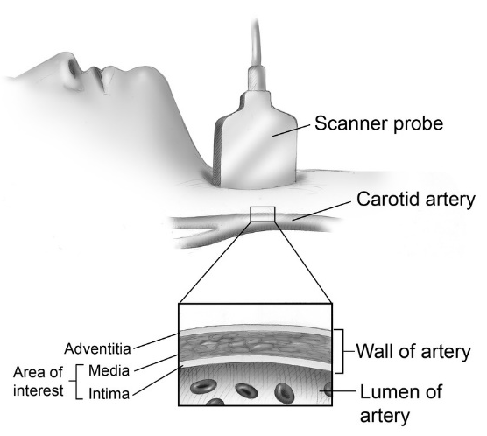
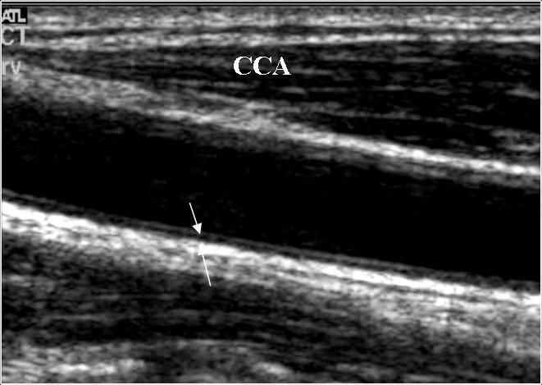
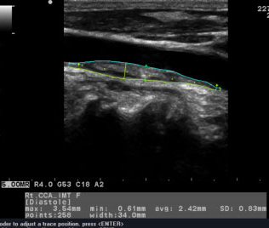
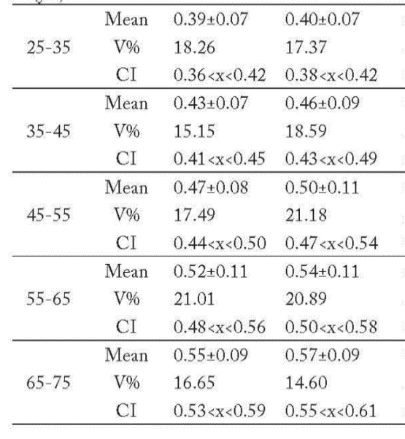
ULTRASOUND MEASUREMENT
Intima Media Thickness (IMT)
věk
IMT_{R} (mm)
IMT_{L} (mm)
5

Slide 6
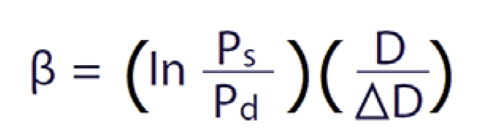
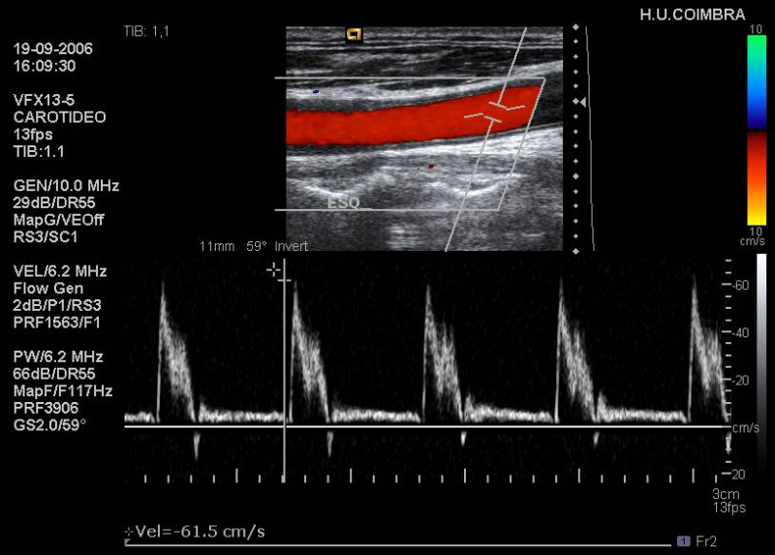

ULTRASOUND MEASUREMENT
β – index measurement
6
6

Slide 7
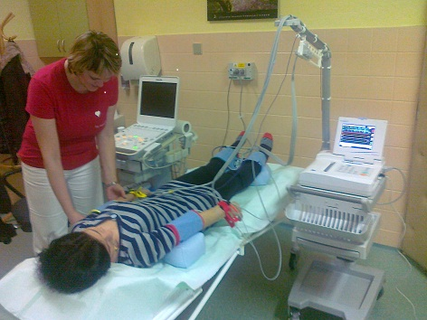
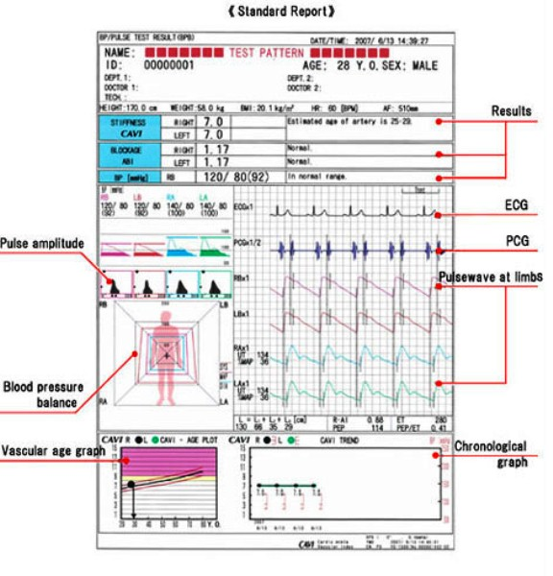
CAVI MEASUREMENT
7

Slide 8
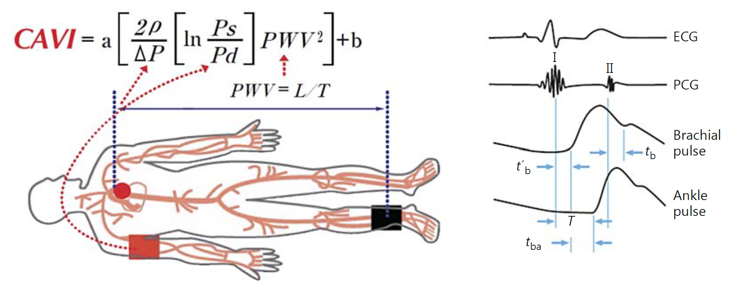
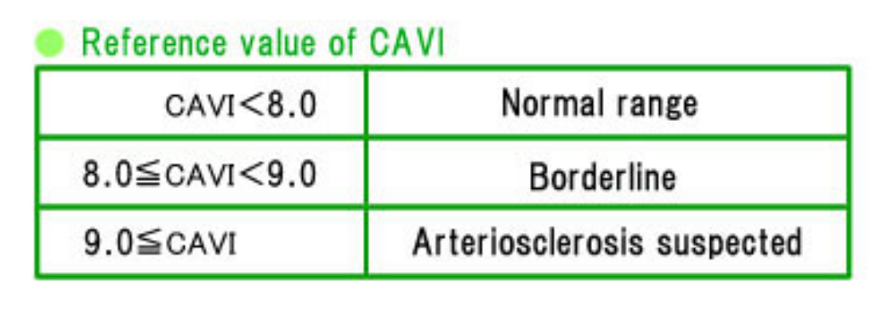
CAVI MEASUREMENT

Slide 9
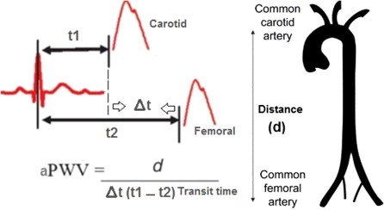
PWV MEASUREMENT
PWV = distance (m) / transit time (s)
transit time = t2 – t1
A highly compliant aorta has a relatively low PWV (< 6 m/s)

Slide 10
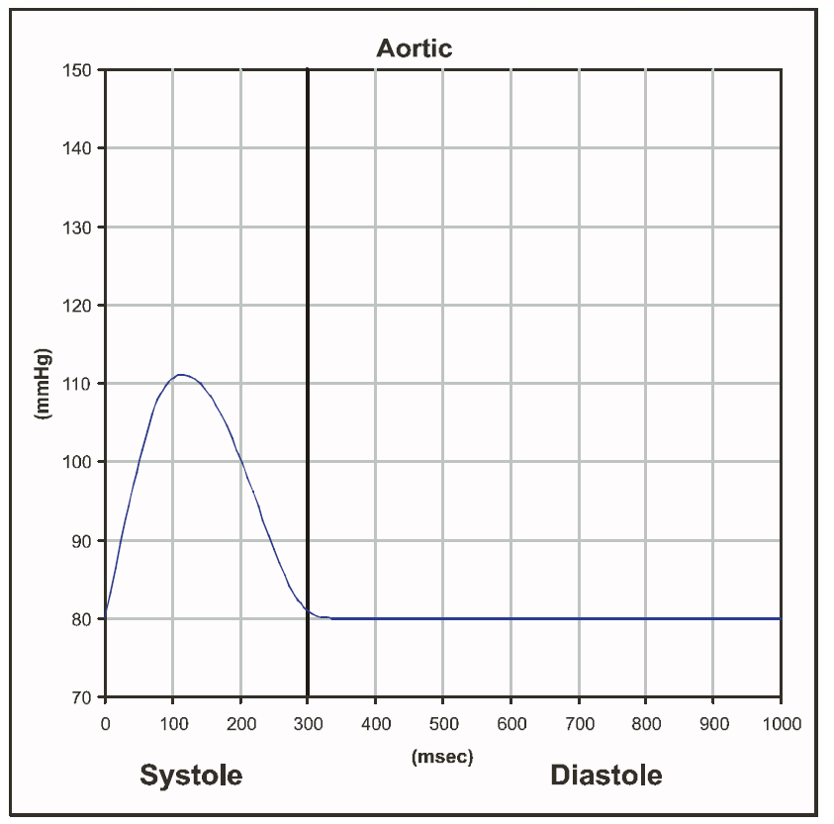
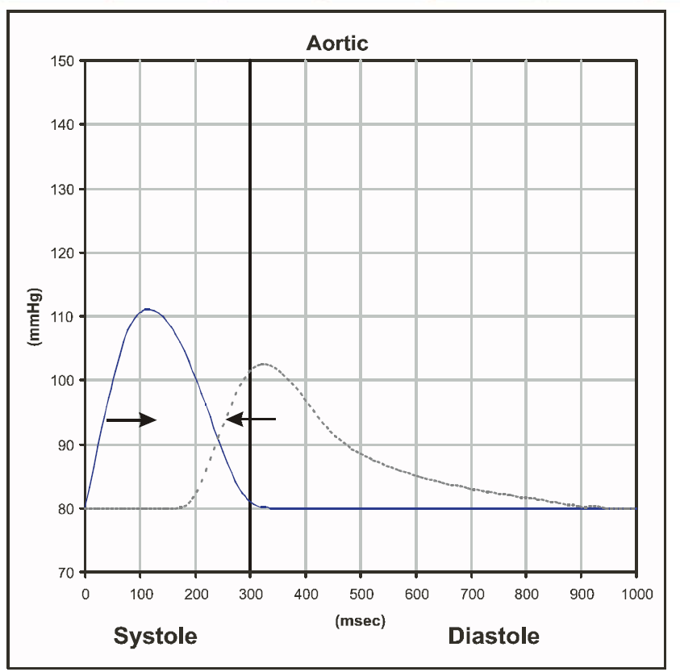
PULSE WAVE

Slide 11
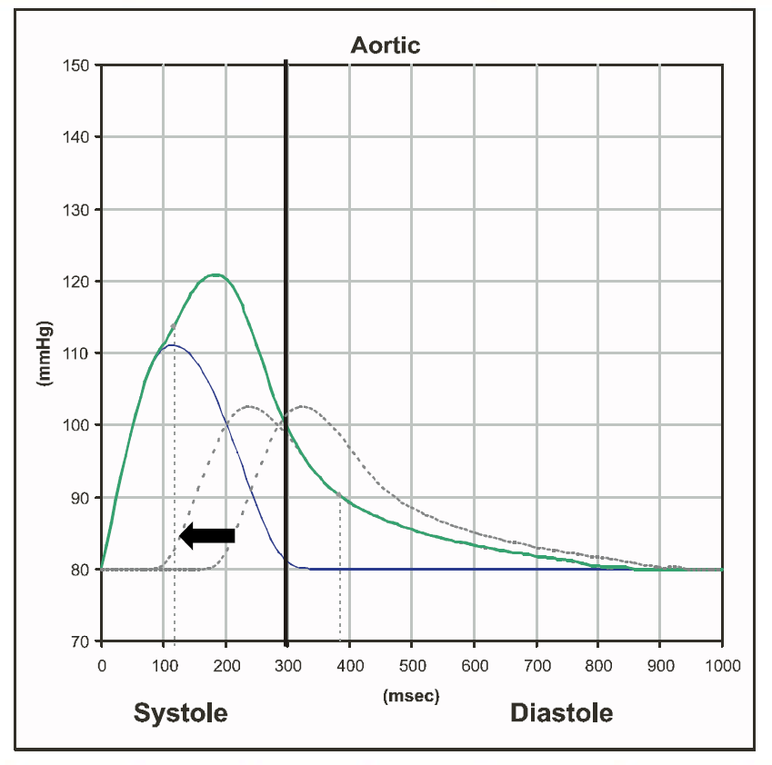
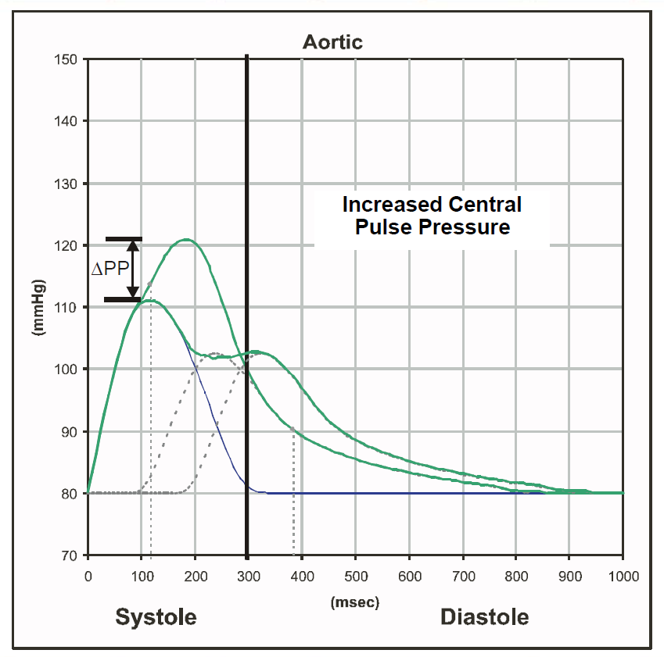
PULSE WAVE

Slide 12
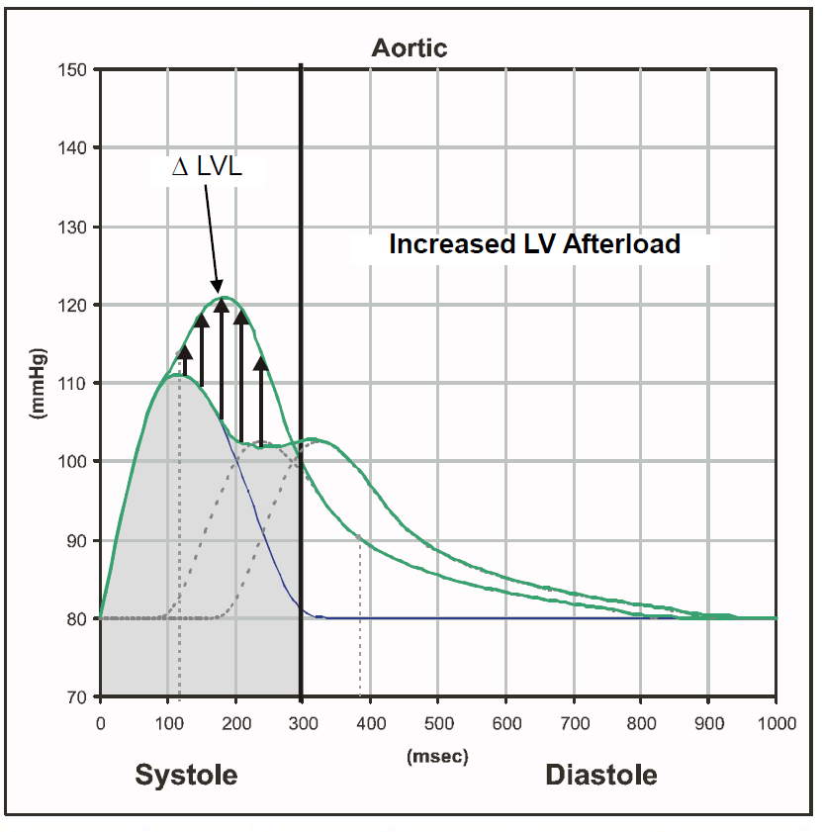
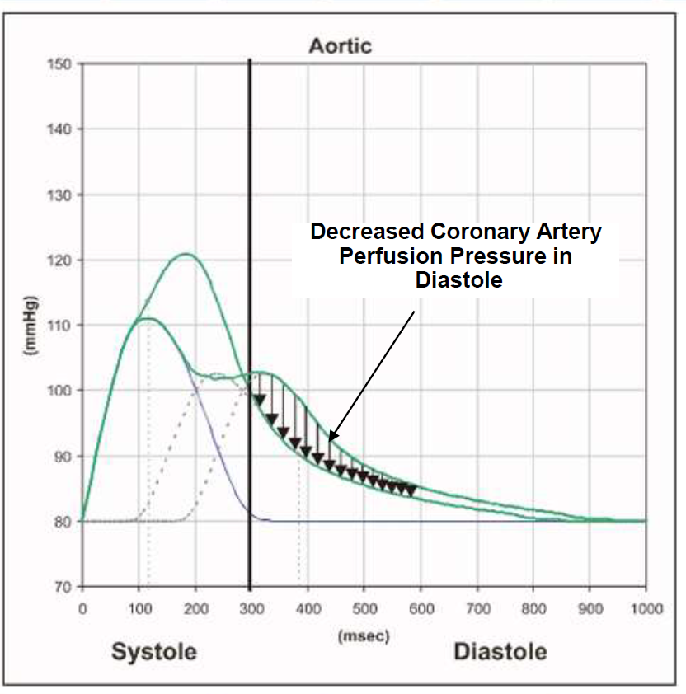
PULSE WAVE

Slide 13
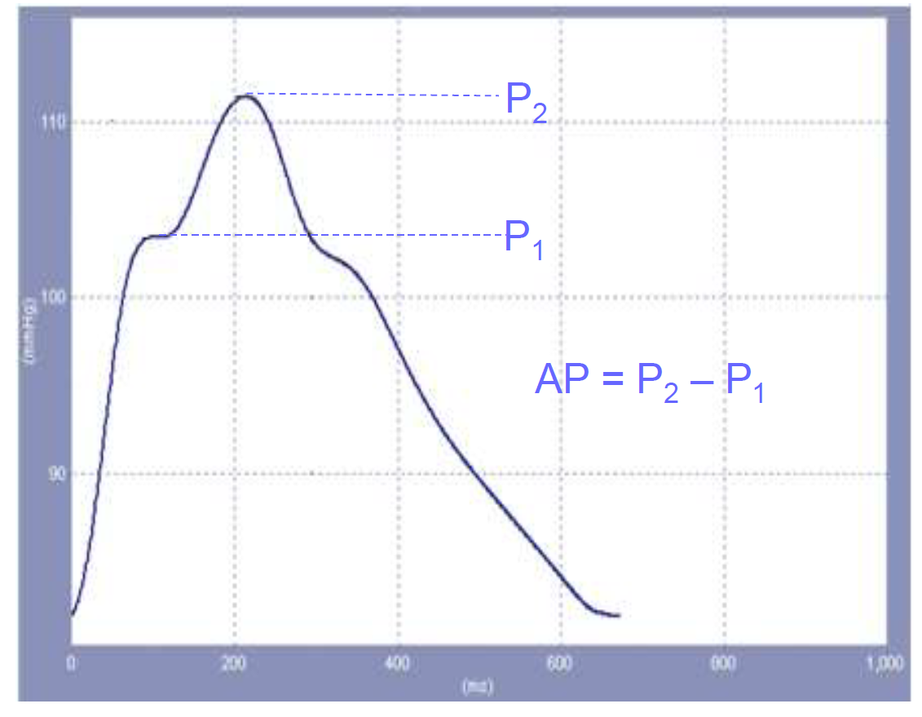
PULSE WAVE ANALYSIS
P1 corresponds to the pressure at peak systolic flow and is usually identified by the first shoulder of the pressure wave.
P2 corresponds to the peak of the reflected wave and is usually identified by the peak of the pressure wave after the first shoulder.

Slide 14
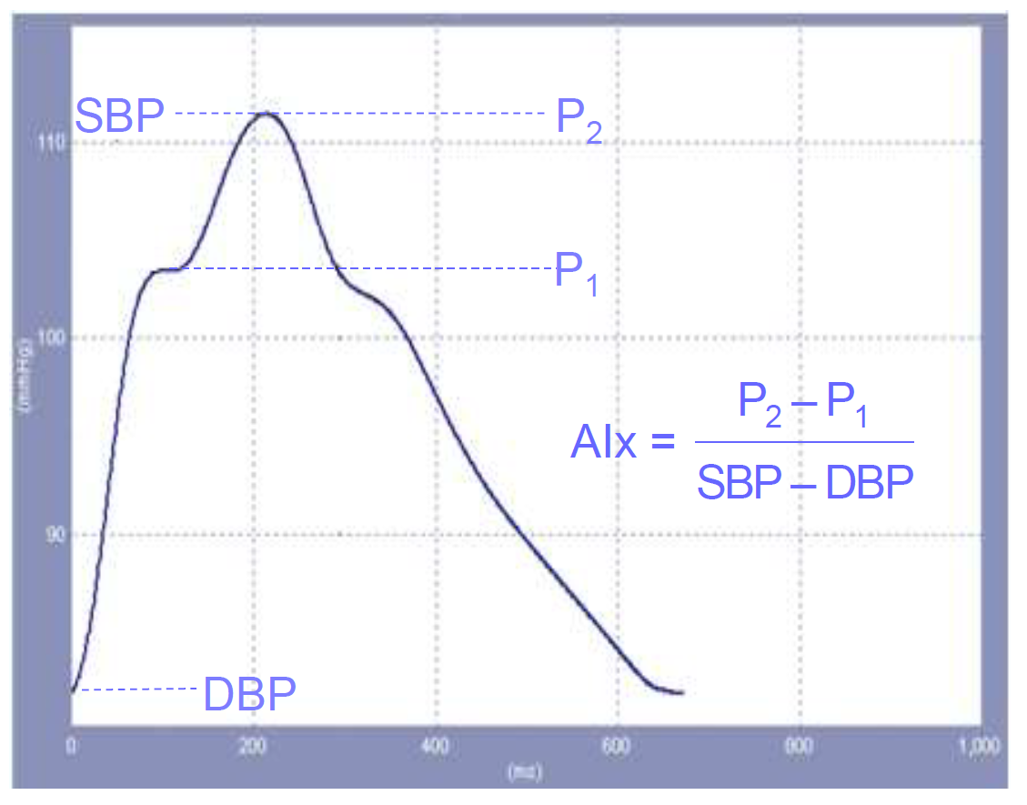
PULSE WAVE ANALYSIS
Higher values of AP and AIx indicate increased wave reflection from the periphery and/or early return of the reflected wave as a result of increased pulse wave velocity (due to increased arterial stiffness)
14

Slide 15
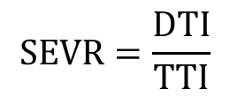
PULSE WAVE ANALYSIS
Tlak [mmHg]
$$SEVR=\frac{DTI}{TTI}$$
SEVR>140%
SBP
PBP
TTI
DTI
DBP
Čas [s]
TTI - Tension Time Index (area under systolic part of the pulse curve)
DTI - Diastolic Time Index (area under diastolic part of the pulse curve)
SEVR - Buckberg Sub-Endocardial Viability Ratio – subendocardial blood supplying

Slide 16
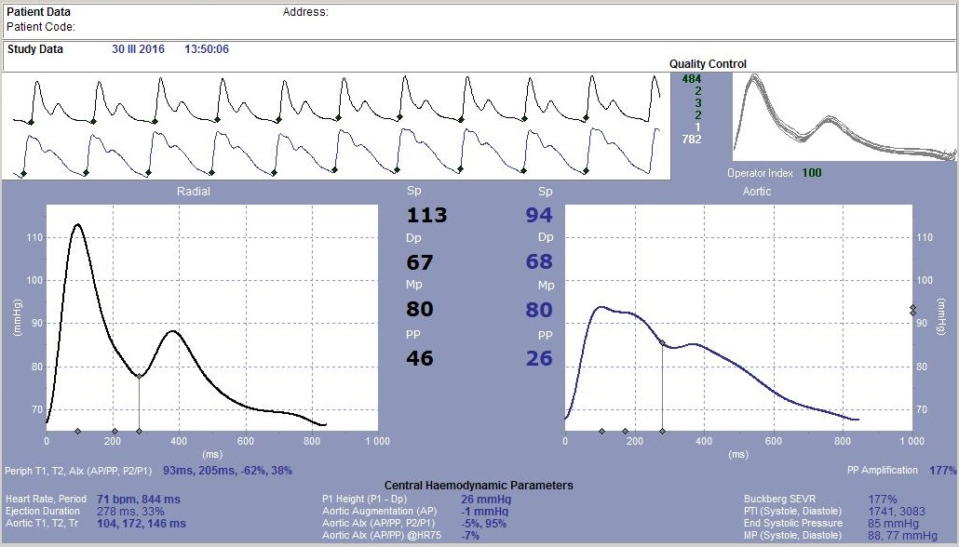
PULSE WAVE ANALYSIS

