Slide 1

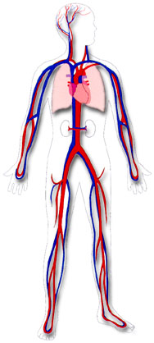
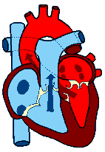
Lectures on Medical Biophysics
Department of Biophysics, Medical Faculty,
Masaryk University in Brno
Biophysics of cardiovascular system

Slide 2
Lecture outline
Mechanical properties of blood vessels
Reynolds number
Blood flow in blood vessels
Peripheral resistance of blood vessels
Mechanical work and power of heart
Capillary ultrafiltration
Kidneys: renal work and glomerular ultrafiltration
Blood pressure measurement

Slide 3
Mechanical properties of cardiovascular system
Closed circulation and transport system
Main parts:
Heart muscle (myocardium)
Closed system of blood vessels
Blood
Main functions:
Supplying cells by nutrients and oxygen,
Transport of hormones and other chemical signals,
Removal of waste and side products from cells (tissues)
Heat transfer - thermoregulation

Slide 4
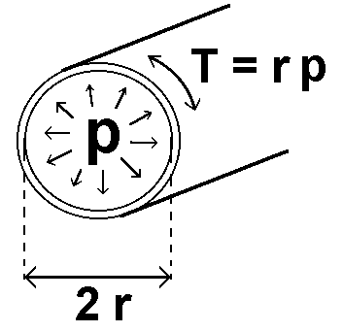
Mechanical properties of blood vessels
Tension T in walls of some blood vessels:
vessel | r(m) |  | p(kPa) | T(N·m⁻¹)
aorta | 0.012 |  | 13 | 156
artery | 0.005 | 12 |  | 60
capillary | 6 x 10⁻⁶ |  | 4 | 0.024
vein | 0.005 |  | 2 | 10
vena cava | 0.015 |  | 1.3 | 20
Laplace law – mechanical stress of blood vessel walls is directly proportional to the pressure and vessel radius

Slide 5
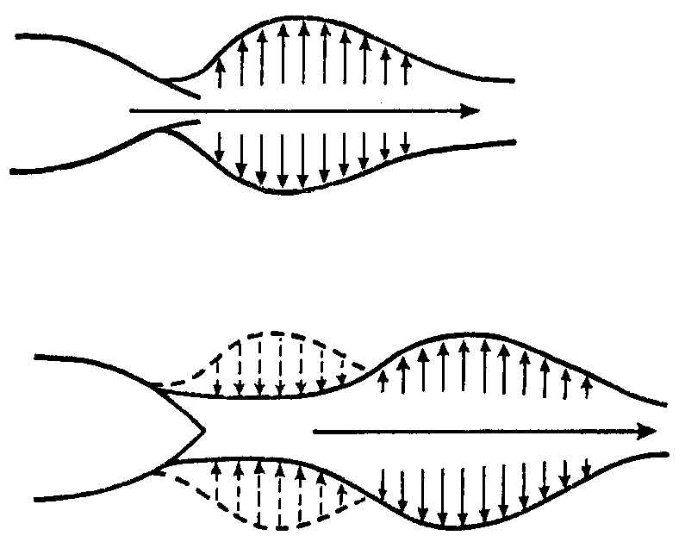
Elastic and muscular blood vessels
Aorta behaves like typical elastic vessel
Arterioles are muscular vessels able of vasodilatation and vasoconstriction

Slide 6
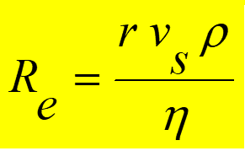
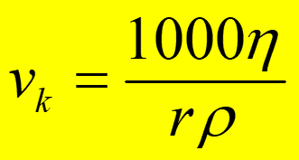
Reynolds number
Blood flow: laminar (ordered)
turbulent (chaotic, eddy)
Reynolds (1883)
Reynolds number (for a liquid flowing in a cylindrical tube):
ρ – liquid density, v_{m} – mean flow rate, r – vessel radius, η – coefficient of dynamic viscosity
Critical flow rate:

Slide 7
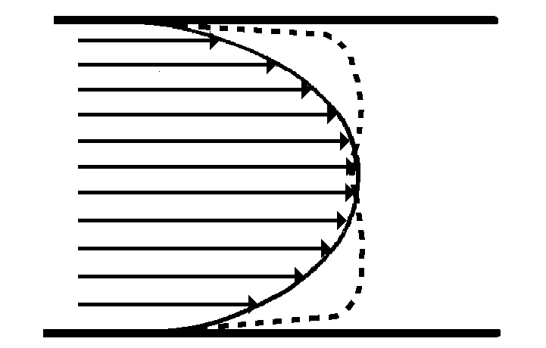
Blood flow in blood vessels
The differences between theoretical and real flow rate profiles are given mainly by the fact that blood is a non-Newtonian liquid and is influenced by the distensibility and compliance of the vessel wall..
The flow rate profile changes during pulse wave.
We can obtain important diagnostic information from values of blood velocity and the shape of the flow rate curve.

Slide 8
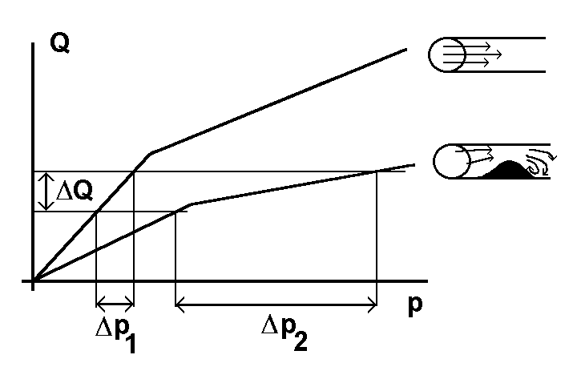
Blood flow in an obstructed blood vessel
Fig. after Cameron et al., 1999
The upper curve represents blood flow in a vessel without atherosclerotic stenosis (narrowing), the lower one in a vessel with stenosis.
We need bigger increase of pressure Δp for the same increase in blood flow ΔQ (volume per time unit).

Slide 9
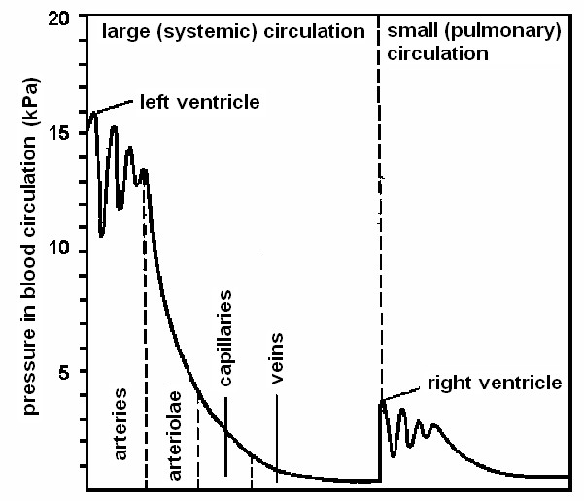
Pressure in individual segments of blood circulation

Slide 10
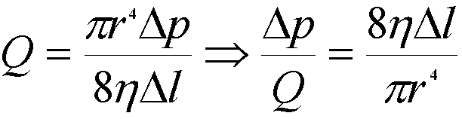
Peripheral impedance (resistance) of blood vessels
Analogy of electrical impedance (R = U/I)
Pressure p is an analogy of voltage U
Blood flow volume Q (m³·s⁻¹) is an analogy of electric current I
R = Δp/Q
Considering the Hagen-Poiseuille formula for flow volume:

Slide 11
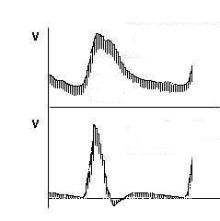
Peripheral resistance of blood vessels
Low vascular impedance
characteristic for brain, liver, spleen and kidney arteries
time
High vascular impedance
characteristic for arteries of skeletal muscles
time

Slide 12
Peripheral resistance of blood vessels
Percentage of total peripheral resistance estimated for individual segments of blood circulation:
arteries ......... 66 %
(among those arterioles 40 %)
capillaries ........ 27 %
veins ............. 7 %
In vasodilatation, R decreases – heart load decreases
In vasoconstriction, R increases – heart load increases

Slide 13
Mechanical work and power of heart
Mechanical work of heart muscle:
Some very small work dW is done against external pressure p during ejection of very small blood volume dV:
dW = pdV
The whole work during a systole:
W = ∫pdV ?????
Very small part of this work is transformed into kinetic energy of the blood ejected.

Slide 14
Estimation of heart work during one systole
p = const. ⇒ W = p_{m}ΔV,
p_{m} is mean blood pressure at the beginning of aorta
Left ventricle Right ventricle
p_{m} = 13.3 kPa p_{m.} = 2.7 kPa
ΔV = 70 ml ΔV = 70 ml
W = 0.93 J W = 0.19 J
Mechanical energy of ejected blood volume W_{k} :
= 0.009 J = 0.0018 J
(since W_{k} = 1/2ρv_{m}²ΔV, r = 1·06x10³ kg·m⁻³, v_{m.} = 0.3 m·s⁻¹, resp. 0.22 m·s⁻¹ in pulmonary artery)

Slide 15
Power of heart
Mechanical power of heart
(for pulse rate 70 min⁻¹) ........ 1.3 W
Total power of heart
(at rest conditions) ......................13 W
Total power of human organism
(at rest conditions) ............................................115 W

Slide 16
Work and efficiency of myocardium
Energy necessary to maintain tonus of myocardium:
α∫Tdt
T – mechanical tension of heart walls (tonus) [N·m⁻¹], t - time
Total energy necessary:
E_{c} = ∫pdV + α∫Tdt
Mechanical efficiency: W/E_{c} (max. 10 %)

Slide 17
Capillary ultrafiltration
 | pressure [kPa]
 | arterial end | venous end
hydrostat. pressure | 4.7 | 2.3
oncotic pressure | -3.5 | -3.5
filtration pressure | 1.2 filtrate enters interstitium | -1.2 filtrate leaves interstitium

Slide 18
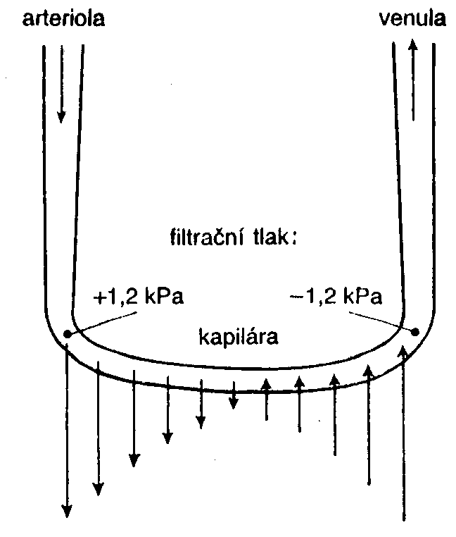
Filtration process in capillary loop
Hydrostatic pressure:
= 4.7 kPa
= 2.3 kPa
Oncotic pressure = 3.5 kPa
filtration pressure
capillary

Slide 19

!!!!!!!!!!!!!
Oedemas arise due to low protein level in blood plasma, which causes low oncotic pressure and increases so the filtration pressure.

Slide 20
Kidneys: renal work and glomerular ultrafiltration
The osmotic work necessary to transfer a substance from a medium with substance concentration C₂ to the medium with substance concentration C₁. (It is transfer of needful substances from primary urine back to the blood.)
W = 2.3 nRT logC₁/C₂
Glomerular ultrafiltration:
Hydrostatic pressure in glomerular capillaries is about 6.6 kPa (50 mmHg). The following pressures have opposite effect: hydrostatic pressure in Bowman’s capsule – 1.3 kPa (10 mm Hg) and oncotic pressure of plasma proteins – 3.3 kPa (25 mm Hg), so the resulting filtration pressure in glomerulus is 2 kPa (15 mmHg) under normal circumstances.

Slide 21
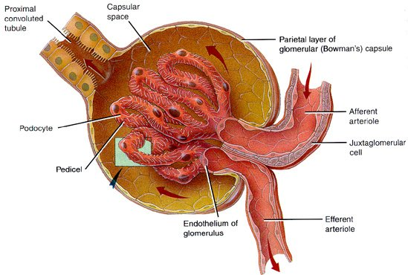
Glomerulus http://coe.fgcu.edu/faculty/greenep/kidney/Glomerulus.html
-1.3 kPa
+2.0 kPa
- 3.3 kPa
+6.6 kPa

Slide 22
Blood pressure measurement
Pressure is defined as a force acting on unit area in a gas or liquid.
p = F/A [N·m⁻²],
where F is the force acting on the area A.
In the SI system, the pressure is measured in N·m⁻², the unit is called pascal [Pa].
The most common way of indicating pressure in medicine is by the height of mercury column in millimetres - mmHg.
1 mmHg = 1 torr = 133.3 Pa

Slide 23
Blood pressure measurement
In arteries, the blood pressure oscillates between a maximum value, i.e. systolic pressure, and a minimum value of the pressure, i.e. diastolic blood pressure.
The time-course of the blood pressure changes is periodical but non-sinusiodal.
The difference between the systolic and diastolic pressures is maximal at the beginning of aorta; the pressure fluctuates in the range of 10.5 to 16 kPa, i.e. 80 to 120 mmHg.
The mean value of blood pressure in lung artery represents only one fifth of the blood pressure in the aorta.

Slide 24
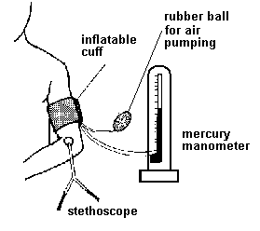
Riva-Rocci method
An inflatable cuff with manometer is put on the arm above the elbow (heart level), inflated to a pressure higher than the systolic pressure in a. brachialis. Blood flow is stopped. The pressure in the cuff is gradually decreased. At systolic pressure, blood starts to flow through the artery. The turbulent flow produces acoustic noise - Korotkoff sounds, audible in a stethoscope placed in the elbow pit. As pressure in the cuff is decreased the sounds become louder, culminate and gradually decrease, disappearing altogether at the diastolic pressure (laminar flow renewed). The maximum loudness is at mean arterial pressure.

Slide 25
Riva-Rocci method
The Riva-Rocci method can be objectified and automatised for patient monitoring. The cuff is regularly inflated by a small compressor (e.g., every ten minutes) and the Korotkoff sounds are recorded by a microphone. Measured values of systolic and diastolic pressures can be displayed (in simple devices) or stored in the instrument memory and evaluated later. This method is called Holter monitoring of blood pressure.
In small children, this auscultation method can fail. In this case, we can use the Doppler flow detectors to detect blood flow in the artery compressed by the cuff.

Slide 26
Direct measurement of blood pressure
Invasive measurement of BP is a direct method. A thin, flexible catheter or probe must be inserted into the blood vessel. Its free end usually is connected to a transducer (capacity or piezoelectric) but it is also possible to insert a piezoelectric transducer directly into the vessel. This method is rather risky, so that it is used relatively seldom. However, it is the only method which allows measurements of pressure in veins or inside the heart.

Slide 27
Author:
Vojtěch Mornstein
Content collaboration
C.J. Caruana, I. Hrazdira,
language revision: C.J. Caruana
Last revision and additon of soundtrack: November 2020

