Slide 1
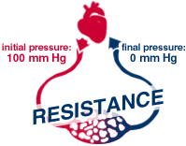
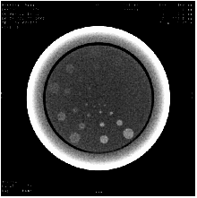
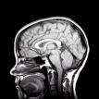
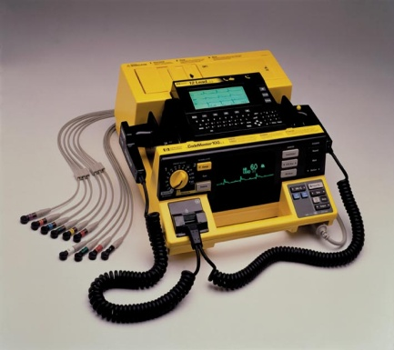


Lectures on Medical Biophysics
Department of Biophysics, Medical Faculty,
Masaryk University in Brno

Slide 2

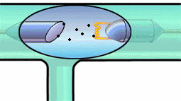
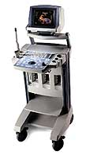


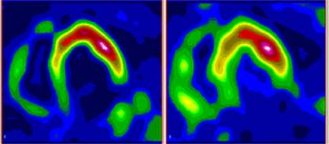
Lectures on Medical Biophysics
Department of Biophysics, Medical Faculty,
Masaryk University in Brno
Medical Devices: Introduction

Slide 3
Medical Biophysics
In Medical biophysics we will be dealing with the physical principles of biomedical methods and devices and their interactions with the human body - which makes them useful in health care, including patient and user safety aspects and healthcare quality issues.
The physical processes in living organisms and the effects of physical factors on them are important as background information.

Slide 4
Links
Natural sciences (physics, chemistry and biochemistry, biology)
Morphological disciplines
Physiology and pathological physiology
Clinical disciplines (almost all!)

Slide 5

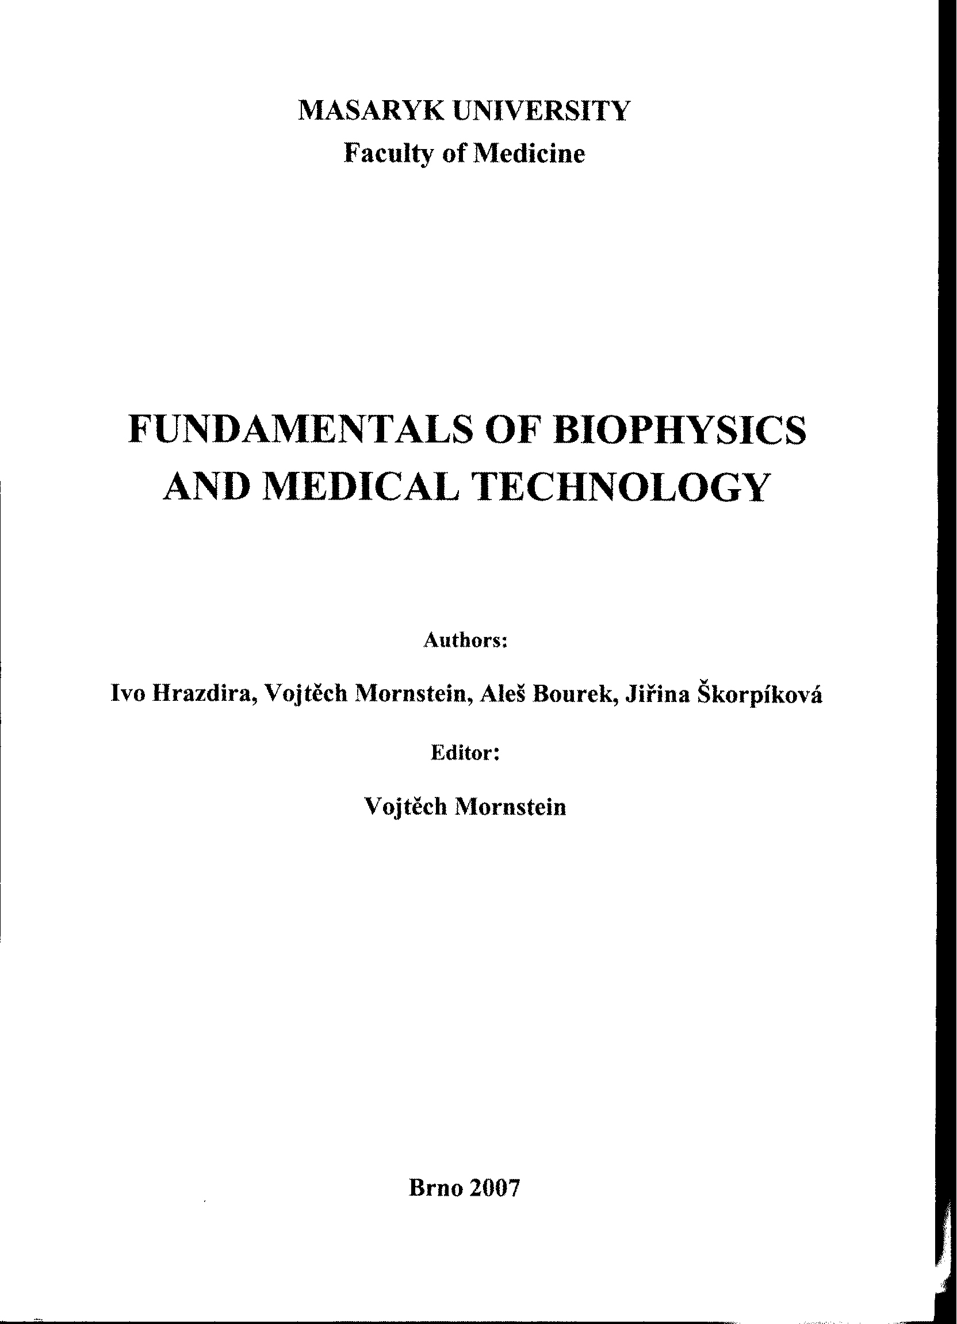
Recommended textbook
This textbook and all the presentations shown in the lectures provide the information necessary to be successful in the exam!!!

Slide 6
How to study?
Studying medical biophysics, there is no problem with the amount of knowledge which is necessary to master, but with understanding the physical principles and their application. Memorisation without understanding will not be sufficient to have a success at the exam.

Slide 7
Medical Devices : Introduction

Slide 8
What is a Medical Device?
“any instrument, apparatus, appliance, material or other article, whether used alone or in combination, including the software necessary for its proper application intended by the manufacturer to be used on human beings for the purpose of:
  diagnosis, prevention, monitoring, treatment or alleviation of disease,
  diagnosis, monitoring, treatment, or alleviation of or compensation for an injury or handicap,
  investigation, replacement or modification of the anatomy or of a physiological process,
  control of conception
and which does not achieve its principal intended action in or on the human body by pharmacological, immunological or metabolic means, but which may be assisted in its function by such means.” (MDD Article 1(2a))

Slide 9
HealthCare Activities
Prevention
Diagnosis
Curative (therapeutic)
Rehabilitation
Palliative care (when cure is not possible)

Slide 10

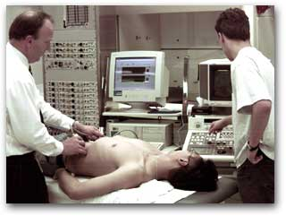
Medical Imaging Devices (in vivo diagnosis)
X-ray projection imaging
Computerised Tomography (CT)
Ultrasound (USI), Doppler imaging
Magnetic resonance imaging (MRI)
Radionuclide imaging (nuclear medicine)
Thermography
Etc.

Slide 11
Medical Imaging Devices (in vivo diagnosis)
Theoretical background:
Ionising radiation (origin, measurement, interactions with matter), properties of atoms and nucleus, radioactivity, basic terms of acoustics, electromagnetic spectrum….

Slide 12
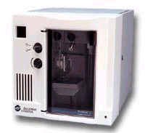

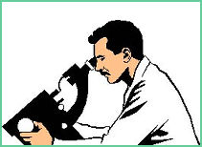
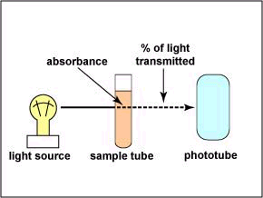

Medical Laboratory Devices (in vitro diagnosis)
sample separation, centrifugation etc
electrophoresis, capillary electrophoresis
pH / ISE meters
particle / cell counters
spectrophotometers
flow cytometry
microscopy
HPLC (chromatography)
clinical chemistry
haematology
immunology
scintillation systems
genetic analysis
………….

Slide 13
Medical Laboratory Devices (in vitro diagnosis)
Theoretical background:
Structure of biopolymers, properties of water and electrolytes, electric properties of living matter, galvanic cell, sedimentation of particles, dosimetry, light absorption…

Slide 14
Physiological Measurement Devices
(in vivo diagnosis)
Instruments for measuring physical and chemical variables in vivo
Thermometers
Cardiovascular physiology: blood pressure monitors, flowmeters, pulsed Doppler US systems
Electrophysiology: ECG, EEG, EMG
Audiology and ophthalmology
Respiratory physiology: spirometers, pulse oximetry, impedance pneumograph….
Endoscopes

Slide 15
Physiological Measurement Devices
(in vivo diagnosis)
Theoretical background:
Introduction to thermodynamics, basic laws of hydrodynamics, origin of bioelectric potentials, properties of sound and light, ear and hearing, eye and vision, mechanical properties of living matter…

Slide 16
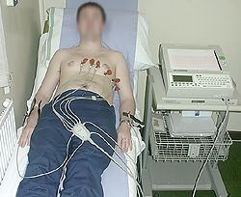
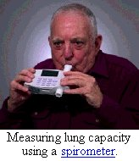
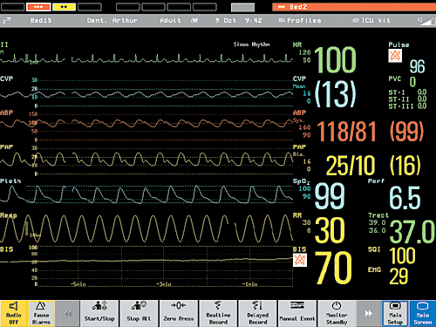
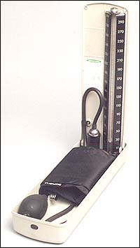
ECG (aka EKG)
Screen of a multipurpose clinical monitor
sphygmomanometer

Slide 17
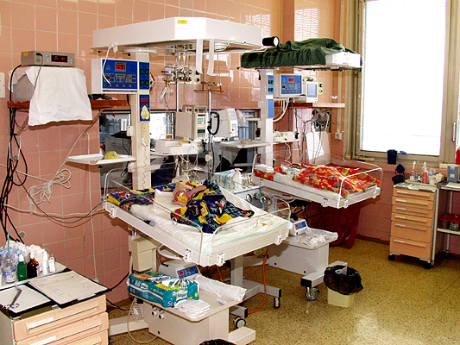
Paediatric Intensive Care

Slide 18
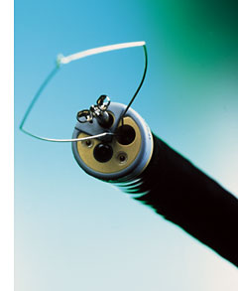
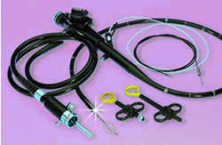
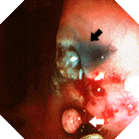
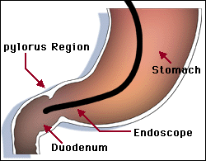
Endoscopy

Slide 19
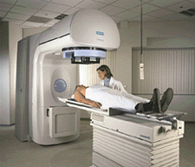
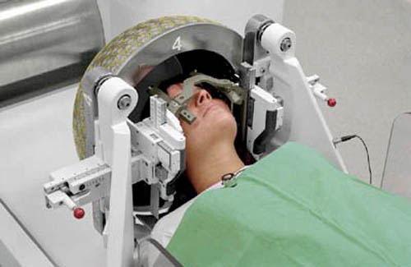
Radiotherapy Devices
X-ray and electron, resp. hadron beams from accelerators (shape, direction, and intensity of beam changed often continuously)
gamma-ray beams from tele-isotope radioactive sources like Co-60
treatment planning systems
simulators
brachytherapy
dosimeters
Linear accelerator
Patient prepared for Leksell gamma knife treatment

Slide 20
Radiotherapy Devices
Theoretical background:
Ionising radiation (origin, measurement, interactions with matter), properties of atom nucleus, radioactivity, biological effects of ionising radiation, dosimetry….

Slide 21
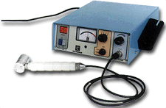
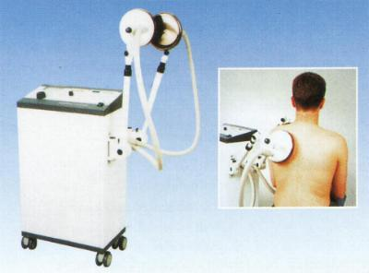

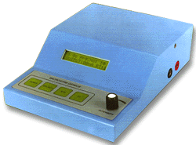
Physical therapy Devices
Electrotherapy
UV and IR therapy
Shortwave diathermy
Ultrasound therapy
Laser therapy
Ultrasound therapy unit
Shortwave diathermy
Muscle stimulator
Laser therapy unit

Slide 22
Physiotherapy Devices
Theoretical background
Biological interactions of ultrasound, electromagnetic fields, electric current, infrared, visible and ultraviolet light, laser principle….

Slide 23
POC (Point of Care) Devices
Address clinicians’ requirements for rapid access to information to support critical care decisions
Advances in microelectronics and biosensor tools have brought technology to the bedside in a miniaturized form.
Examples:
  Performing blood tests at the patient's side rather than in a central laboratory
  portable ultrasound imaging devices

Slide 24
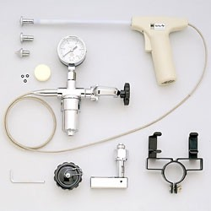
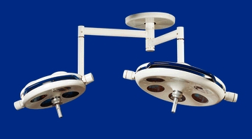

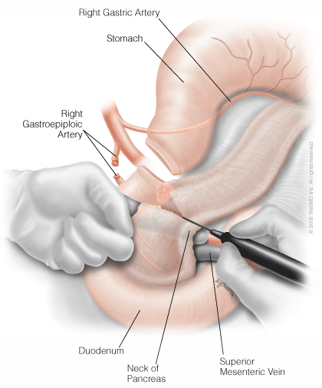
Surgical Theatre Devices, Lithotripsy
Operating lamps
cryosurgery
anaesthesia
electrocautery

Slide 25
Surgical Theatre Devices, Lithotripsy
Theoretical background
Biological interactions of ultrasound, electromagnetic fields, electric current, infrared, visible and ultraviolet light, laser principle, low temperatures, acoustic shock waves…

Slide 26
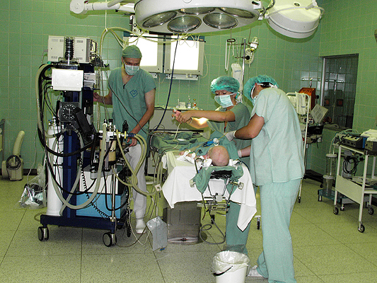
Surgical Theatre Devices

Slide 27

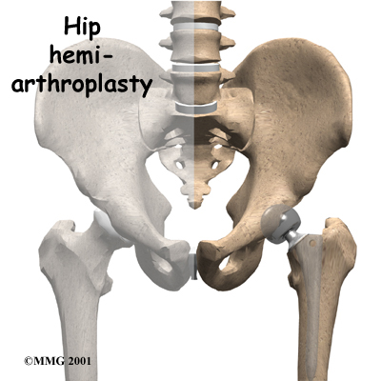
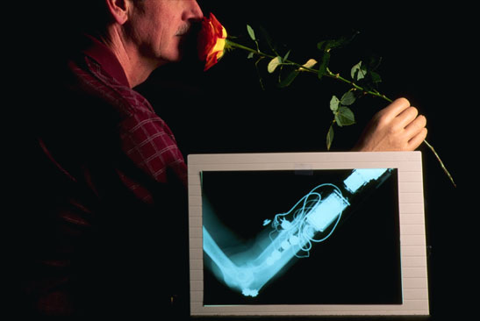
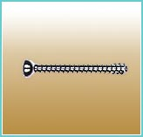
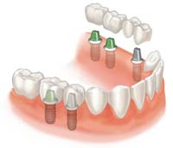
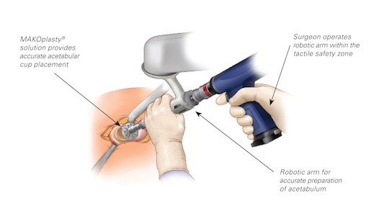
Prosthetic Devices - Implants
Robotic device for acetabular cup implantation

Slide 28
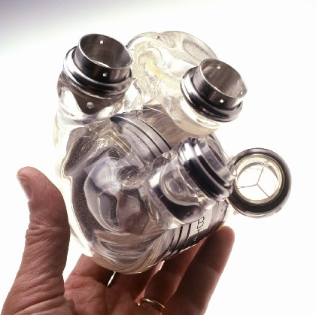
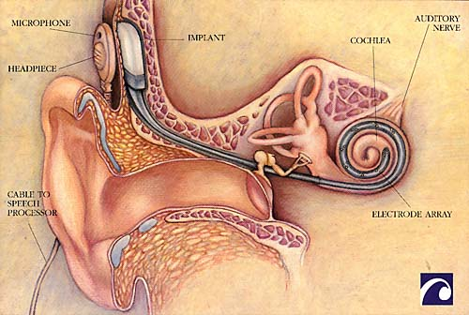
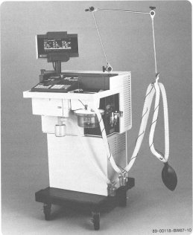
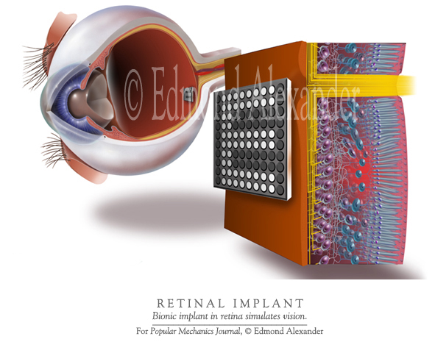
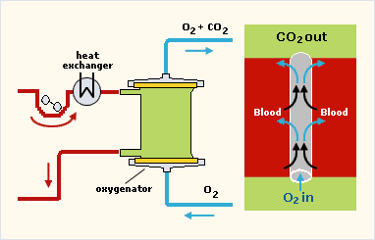
Prosthetic Devices – „Artificial Organs“
Artificial heart
Cochlear implant
Ventilator
Cardiopul-monary bypass
Retinal implant

Slide 29
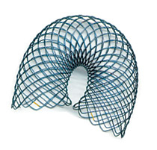
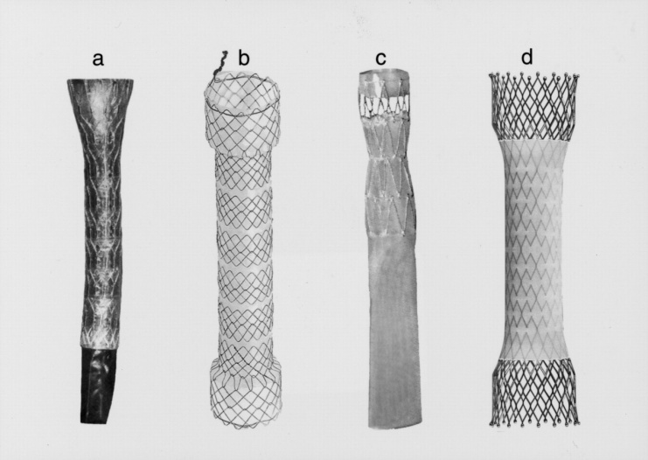
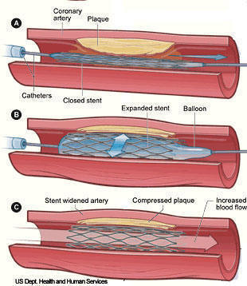
Prosthetic Devices – „Artificial Organs“
Stents are inserted into the damaged blood vessels, oesophagus etc. They are often made of a metal with a „shape memory“ – nitinol, which adopts the intended shape when heated to body temperature.

Slide 30
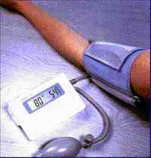
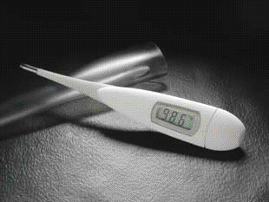
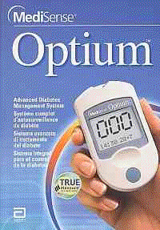
Devices for Self-testing (‘home devices’)
'device for self-testing`: any device intended by the manufacturer to be able to be used by lay persons in a home environment
thermometers, pressure measuring instruments etc
test kits (pregnancy, glucose levels in blood used by diabetes patients etc)
Blood glucose meter

Slide 31
Devices for Performance Evaluation of Devices
'device for performance evaluation`: devices to check the performance of medical devices are also considered as medical devices
Testing contrast resolution in XRI

Slide 32
What is the Purpose of this Course?
Create awareness that medical devices should be used effectively and safely (reduce patient, occupational and others’ risk to a minimum)
Use medical devices in a professional and scientific manner
Appreciate uses of medical devices in the clinical areas and in research
Have an idea of the devices used in other professions

Slide 33
Some Competences for Users of Medical Devices
What is expected the doctor does with or knows about the device
State the specific diagnostic, therapeutic etc outcomes expected when using the device
Explain the physics principles underpinning the functioning of the device and the device use protocols
Describe the structure of commercially available devices including user option settings and controls
Identify possible health hazards (e.g. mechanical, electrical, radiation etc) to patient, self and colleagues
Describe measurable objective device performance indicators which are directly related to device effectiveness or safety

Slide 34
Cont ...
Demonstrates a level of capability in the use of the device that ensures the required level of effectiveness whilst minimising risk to patient, self and others
Explains limitations of the device and contraindications for use
Describes the impact on effectiveness and risk arising from device malfunction or inappropriate user protocol
Demonstrates timely device malfunction recognition and local procedures for reporting such faults
Demonstrates skill in preventive maintenance and quality control including calibration of the device appropriate for users
Demonstrates an awareness that a device should be checked before use and in the case of re-usable devices left in a condition for subsequent use
Demonstrates adherence to International, European, National and local legislation and/or regulations regarding the use of the device

Slide 35
Presentation design:
Lucie Mornsteinová
Authors:
Carmel J. Caruana, Vojtěch Mornstein
Language revision:
Carmel J. Caruana
Last revision, soundtrack added: September 2020

