Slide 1
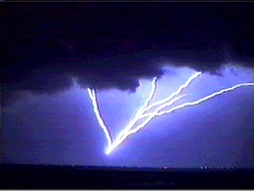
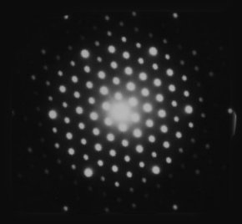
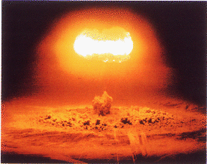
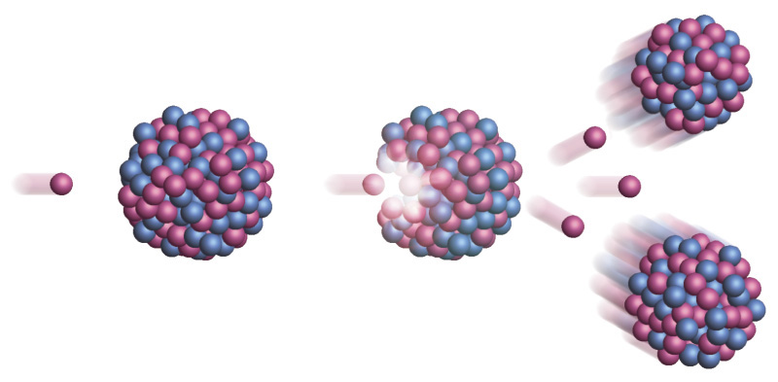
Lectures on Medical Biophysics
Department of Biophysics, Medical Faculty,
Masaryk University in Brno

Slide 2

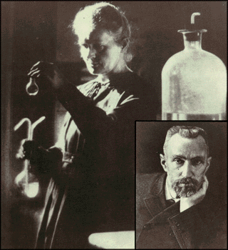

Lectures on Medical Biophysics
Department of Biophysics, Medical Faculty,
Masaryk University in Brno
Marie Skłodowska Curie (1867 – 1934) and Pierre Curie (1859 – 1906)
Structure of matter
http://www.accessexcellence.org/AE/AEC/CC/historical_background.html

Slide 3
Matter and Energy
Everything is made up of basic particles of matter and fields of energy / force, which also means that the fundamental structural elements of the organic and inorganic world are identical.
Living matter differs from non-living matter mainly by its much higher level of organisation.

Slide 4
Elementary Particles of Matter
The elementary (i.e. having no internal structure) particles of matter are leptons and quarks
Leptons – electrons, muons, neutrinos and their anti-particles – light particles without internal structure
Quarks (u, c, t, d, s, b) – heavier particles without internal structure
Hadrons – heavy particles formed of quarks e.g., proton (u, u, d), neutron (d, d, u)

Slide 5
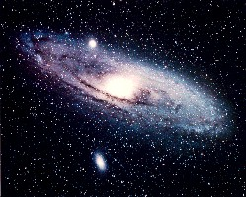
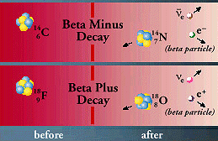
The Four Fundamental Energy / Force Fields
gravitational
electromagnetic
strong
weak
Strong : weak : electromagnetic : gravitational force - 1 : 10⁻⁵ : 10⁻² : 10⁻³⁹ at interaction distance of about 10⁻²⁴ m; 10⁻⁷ : ∼0 : 10⁻⁹ : 10⁻⁴⁶ at a distance of about 10⁻¹⁸ m (1/1000 of atom nucleus dimension). In the distance equal to nucleus dimension goes to zero also strong interaction.

Slide 6
Photons
Photons - energy quanta of electromagnetic field, zero mass
Energy of (one) photon: E = hf = hc/λ
  h is the Planck constant (6.62·10⁻³⁴ J·s),
  f is the frequency,
  c is speed of light in vakuum,
  λ is the wavelength.

Slide 7
Particles and Field Energy Quanta
particles of matter and field energy quanta are capable of mutual transformation (e.g., an electron and positron transform to two gamma photons in the so-called annihilation – this is used in PET imaging)

Slide 8
Quantum Mechanics
The behaviors of ensembles of a given type of particle obey equations which are similar to wave equations.
On the left pattern formed on a photographic plate by an ensemble of electrons hitting a crystal lattice. Notice that it is very similar to the diffraction pattern produced by a light wave passed through optical grating.
(http://www.matter.org.uk/diffraction/electron/electron_diffraction.htm)

Slide 9
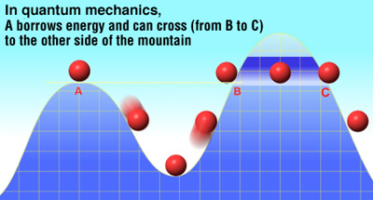
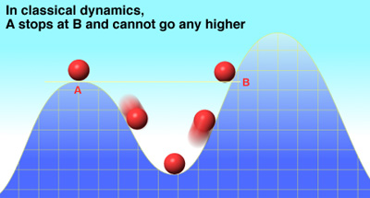
Quantum Mechanics tunnel effect:

Slide 10
Quantum Mechanics: Heisenberg uncertainty relations
δr·δp ≥ h/2π
δΕ·δt ≥ h/2π
The position r and momentum p of a particle cannot be simultaneously measured with independent precision (if the uncertainty of particle position – δr – is made smaller, the uncertainty of particle momentum – δp – automatically increases). The same holds for the simultaneous measurement of energy change δΕ and the time δt necessary for this change. h is the Planck constant.

Slide 11
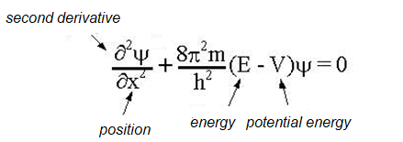

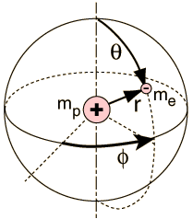
Schrödinger equation
(to admire)
Radial co-ordinates of an electron in a hydrogen atom
Ψ - wave function
„one-dimensional“ S. equation
S. equation for the electron in the hydrogen atom
according http://hyperphysics.phy-astr.gsu.edu/hbase/quantum/hydsch.html

Slide 12
Solution of the Schrödinger Equation
The solution of the Schrödinger equation for the electron in the hydrogen atom leads to the values of the energies of the orbital electron.
The solution of the Schrödinger equation often leads to numerical coefficients which determine the possible values of energy. These numerical coefficients are called quantum numbers

Slide 13
Quantum numbers for Hydrogen
Principal n = 1, 2, 3 …. (K, L, M, ….)
Orbital for each n l = 0, 1, 2, …. n – 1 (s, p, d, f …)
Magnetic for each l m = 0, ±1, ±2, …±l
Spin magnetic for each m s = ±1/2
Pauli exclusion principle – in one atomic electron shell there cannot be present two or more electrons with the same set of quantum numbers.

Slide 14
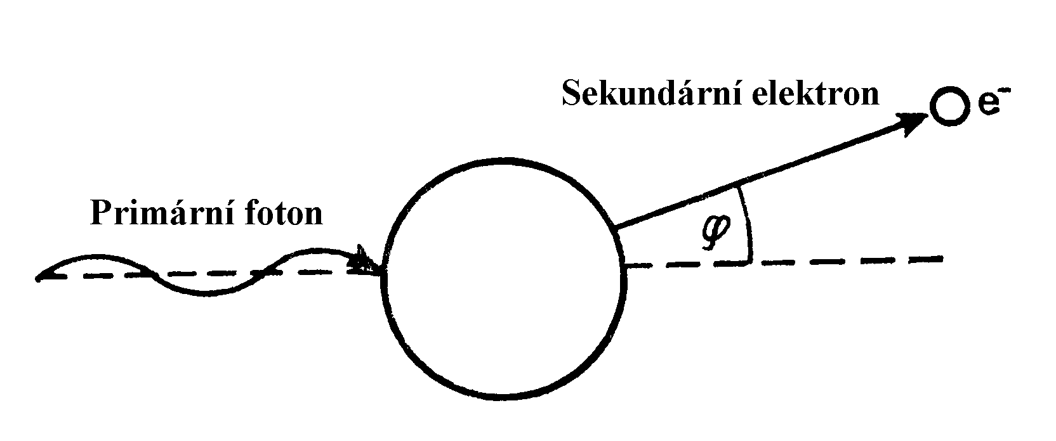
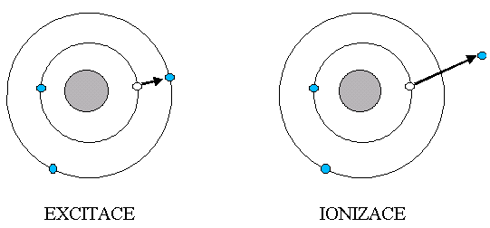
Ionisation of Atoms
The binding energy of an electron E_{b} is the energy that would be required to liberate the electron from its atom – depends mainly on the principal quantum number.
excitation
ionisation
Secondary electron
Example of ionisation: photoelectric effect
hf = E_{b} + ½ mv²
Primary photon

Slide 15
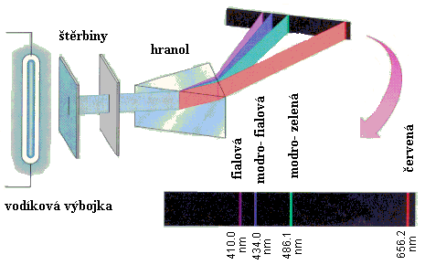
Emission Spectra
Visible emission spectrum of hydrogen.
slits
prism
modro- = bluish
Learn the Czech names of colours ☺
Hydrogen discharge tube
Dexcitations between discrete energy levels result in emitted photons with only certain discrete energies, i.e. radiation of certain frequencies / wavelengths.
http://chemed.chem.purdue.edu/genchem/topicreview/bp/ch6/bohr.html

Slide 16
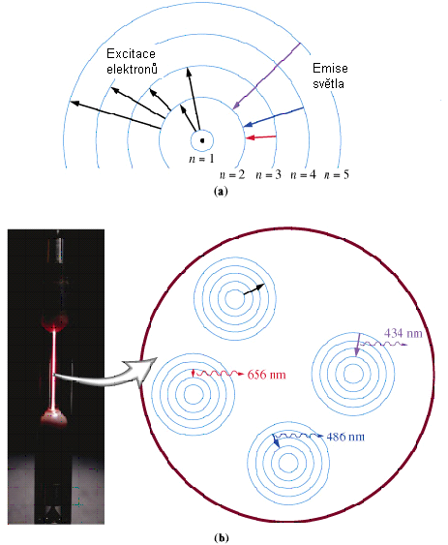
Hydrogen spectrum again magenta, cyan and red line according http://cwx.prenhall.com/bookbind/pubbooks/hillchem3/medialib/media_portfolio/text_images/CH07/FG07_19.JPG
Excitation of electrons
Emission of light

Slide 17
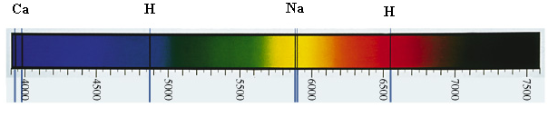
Excitation (absorption) Spectra for Atoms
Absorption lines in visible spectrum of sun light.
Wavelengths are given in Angströms (Å) = 0.1 nm
http://cwx.prenhall.com/bookbind/pubbooks/hillchem3/medialib/media_portfolio/07.html
Transitions between discrete energy states of atoms!!

Slide 18
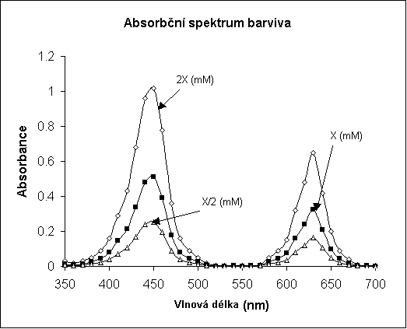
Excitation (Absorption) Spectrum for Molecules
Absorption spectrum of a dye
Absorbance
Wavelength
According: http://www.biochem.usyd.edu.au/~gareth/BCHM2001/pracposters/dyeZ.htm

Slide 19

Atom nucleus
Proton (atomic) number – Z
Nucleon (mass) number – A
Neutron number – N N = A - Z
Atomic mass unit u = 1.66·10⁻²⁷ kg, i.e. the 1/12 of the carbon C-12 atom mass
Electric charge of the nucleus Q = Z1.602·10⁻¹⁹ C
If relative mass of electron = 1 ⇒ Relative mass of proton = 1836 ⇒ Relative mass of neutron = 1839

Slide 20
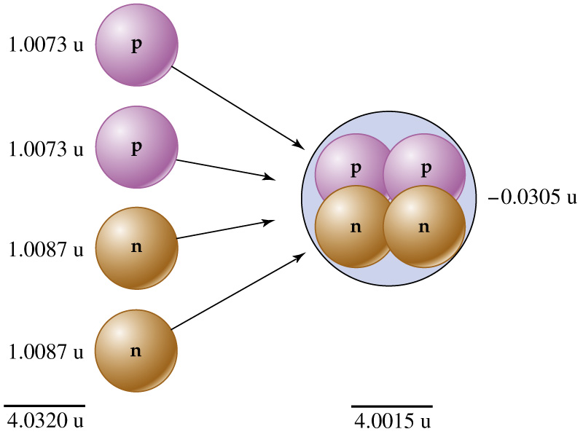
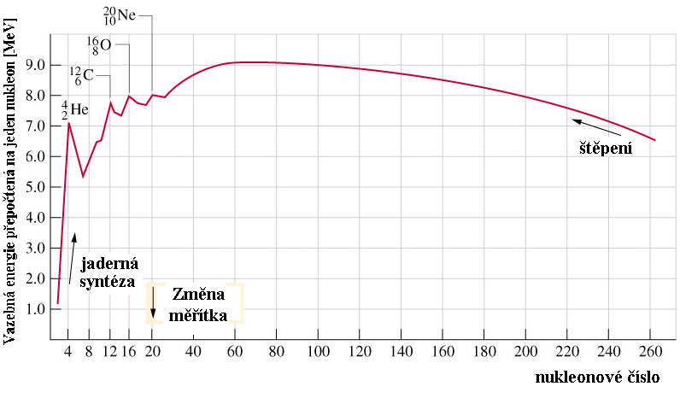
Mass defect of nucleus
= measure of nucleus stability:
δm = (Zm_{p} + Nm_{n}) - m_{nuc}
Sources:
http://cwx.prenhall.com/bookbind/pubbooks/hillchem3/medialib/media_portfolio/text_images/CH19/FG19_05.JPG
http://cwx.prenhall.com/bookbind/pubbooks/hillchem3/medialib/media_portfolio/text_images/CH19/FG19_06.JPG
fission
Binding energy per one nucleon [MeV]
E = δm.c²
This formula allows to calculate amount of energy liberated during the synthesis of the nucleus.
nuclear synthesis
scale change
nucleon number

Slide 21
Nuclides
nuclide - a nucleus with a given A, Z and energy
Isotopes - nuclides with same Z but different A
Isobars – nuclides with same A but different Z
Isomers – nuclides with same Z and A, but different energy (e.g., Tc^{99m} used in gamma camera imaging)

Slide 22
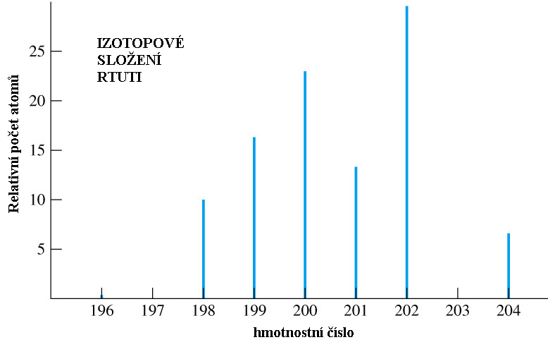
Isotope composition of mercury
% of Hg atoms vs. isotope nucleon number (A)
Percentage of atoms
A
Nucleon number
According to: http://cwx.prenhall.com/bookbind/pubbooks/hillchem3/medialib/media_portfolio/text_images/CH07/FG07_08.JPG

Slide 23
What else is necessary to know?
Radionuclides – nuclides capable of radioactive decay
Nuclear spin:
Nuclei have a property called spin. If the value of the spin is not zero the nuclei have a magnetic moment i.e, they behave like small magnets - NMR – nuclear magnetic resonance spectroscopy and magnetic resonance imaging (MRI) in radiology are based on this property.

Slide 24
Author:
Vojtěch Mornstein
Content collaboration and language revision:
Carmel J. Caruana
Presentation design:
Lucie Mornsteinová
Last revision:December 2018
Author:
Vojtěch Mornstein
Content collaboration and language revision:
Carmel J. Caruana
Presentation design:
Lucie Mornsteinová
Last revision:December 2018

