Slide 1


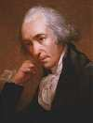

Lectures on Medical Biophysics
Dept. Biophysics, Medical faculty,
Masaryk University in Brno
JAMES WATT
19.1.1736 - 19.8.1819
Thermodynamic principles

Slide 2
Lecture outline
understanding basic concepts of thermodynamics, work and heat, 1st and 2nd Law of thermodynamics
explanation of the relationship between entropy and disorder of a thermodynamic system, Boltzmann principle

Slide 3
Thermodynamics – physical discipline dealing with transformations of energy in macroscopic systems.
Development: 19th century – steam engines, combustion engines, turbines.
At the beginning of 20th century it became solid basis of physical chemistry.
Key to understanding uniqueness of life – non-equilibrium thermodynamics.

Slide 4
THERMODYNAMIC SYSTEM
Definitions:
  Thermodynamic system: A region of space bounded by arbitrary surfaces which delineate the portion of the universe we are interested in
  Isolated system: one which cannot exchange particles or energy with its environment.
  Open system: one which can exchange both particles and energy with its environment.
  Closed system: can exchange energy but not particles.
An isolated system always reaches an equilibrium state in which it does not change macroscopically. Open systems do not in general.
LIVING SYSTEMS ARE OPEN SYSTEMS

Slide 5
Basic terms
Quantities describing a tmd. system in equilibrium are called state parameters.
A defined set of state parameters is necessary for full description of a tmd system.
These parameters are related to each other in the equations of state.
The simplest tmd. system: ideal (perfect) gas.
Equation of state for ideal gas (universal gas law):
pV = nRT
[Pa, m³, mol, J·K⁻¹·mol⁻¹, K]

Slide 6
Reversible process:
is one in which a second process could be performed so that the system and surroundings can be restored to their initial states with no change in the system or surroundings.
Irreversible process
Cyclic process: the initial and final states of the system are identical (but not necessarily the surroundings)
Sign convention: energy given to a system and work done by an external force on the system are considered to be positive, energy lost from the system to its surroundings and work done by the system on its surroundings are considered to be negative.

Slide 7
Work done by / on thermodynamic systems
Gas and piston system
W = pΔV
- This work can be called mechanic or volumetric.
electric system
W = QU
- This the work necessary to transfer an electric charge Q between places with potential difference U.
chemical system
W = μΔn
- This is the work necessary to increase or decrease amount of a chemical compound Δn in chemical reaction. μ is chemical potential.

Slide 8


Other important quantities:
Thermodynamic (Kelvin) temperature is a quantity which indicates the average kinetic energy W_{KS} of the particles in a system e.g., for an ideal monatomic gas:
Internal energy of the system is the sum of all kinetic and potential energies of all particles forming the system.
Heat (thermal energy) is the part of internal energy of the system which can be exchanged between systems as a result of their different temperatures.

Slide 9
1st law of thermodynamics
(a formulation of the law of conservation of energy used in thermodynamics):
ΔU = W + Q
We can read, for example: Internal energy U of the system increases with the work W done on the system, and the heat Q transferred from the environment to the system.
Internal energy is a state parameter, heat and work are not.

Slide 10
2nd law of thermodynamics
2nd law of thermodynamics (definition of entropy S):
It can be shown that, for a system with possible heat exchange with environment, it holds:
dS ≥ dQ/T (T is temperature)
The total entropy of any isolated thermodynamic system (dQ = 0) tends to increase over time, approaching a maximum value i.e.,
dS ≥ 0.
This law determines the “direction” of natural processes, one of the most important natural principles.
dS = 0
for reversible processes only.

Slide 11
Entropy and disorder
Entropy S of a thermodynamic system depends on the number of different possible microscopic arrangements of particles (microstates) that result in the same observed macroscopic state of the thermodynamic system. The entropy of a system is higher when the microscopic arrangement of a system is more disordered and irregular.
Ludwig Boltzmann derived formula (principle) expressing this fact:
S = kln P
Where P is the number of microscopic arrangements (microstates) which can form the respective (the same) macrostate.
k is Boltzmann constant (k = R/N_{A} = 1.38·10⁻²³ J·K⁻¹, N_{A} is Avogadro constant)
S is a state parameter.
Derivation of the above formula is lengthy and relatively difficult. Next slides show rather simplified qualitative explanation.
In following considerations we suppose that the total energy of particles and their number do not change.

Slide 12


„An experiment with balls“
The balls can be labelled by means of letters.
We draw a line parting bottom of a shoe box into two equal halves.
We shake the box and note positions (distribution) of balls.
Simplification: we deal only with positions of the balls, their momentum or energy is ignored.

Slide 13
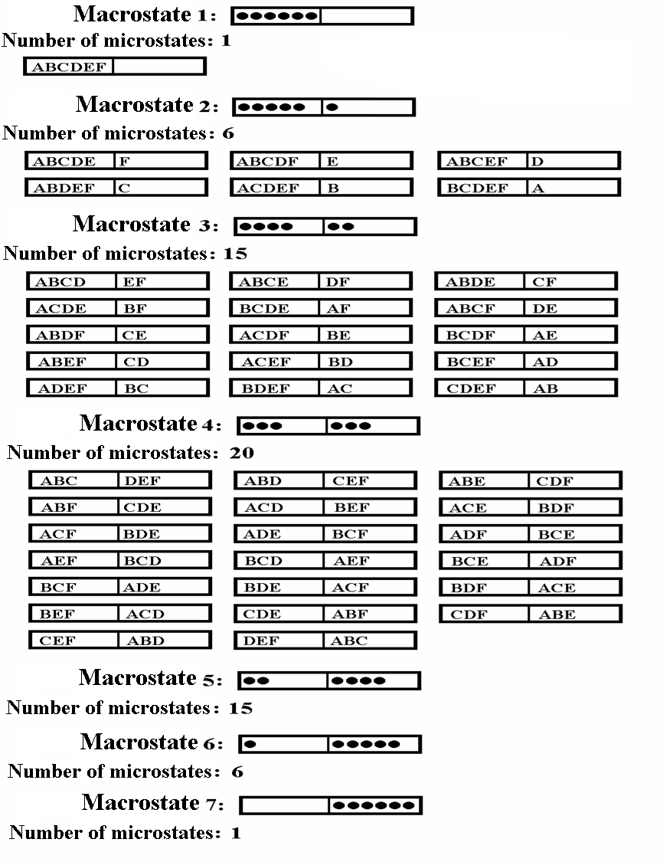

Slide 14
A few terms of statistical physics:
phase space (the bottom of the box ☺)
cell of phase space (halves of the bottom ☺)
“occupation number” (number of balls in one of the halves ☺)
distribution function
microstate and macrostate
Supposed and verified in practice:
Probability of formation of an arbitrary possible microstate is the same.
In the isolated systems, the macrostates of highest probability are formed by largest number of microstates.
The number of microstates forming the same macrostate, is called thermodynamic probability (P).
Macrostates differ one from another by their „occupation numbers“.

Slide 15
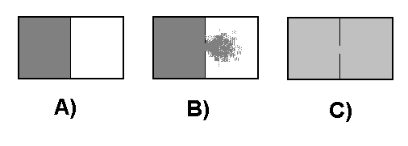
Free expansion of gas:
(time course of an irreversible process in the ideal gas)
A) A box is divided into two parts by a wall. In one of them, there is compressed ideal gas in equilibrium state.
B) We make an opening in the wall, the gas expands in the second part of the box – an irreversible process is in progress.
C) After certain time, in both parts of the box tmd. equilibrium is reached.

Slide 16
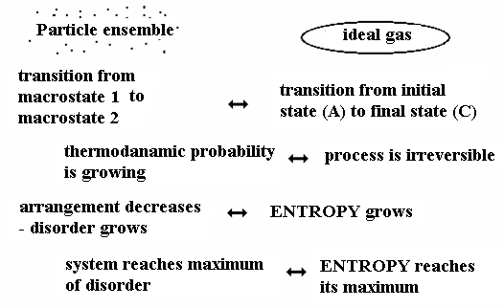
Analogy between both experiments:
4

Slide 17
Author:
Vojtěch Mornstein
Language revision:
Carmel J. Caruana
Last revision and sound track addition: September 2020

