Slide 1
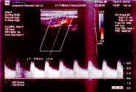
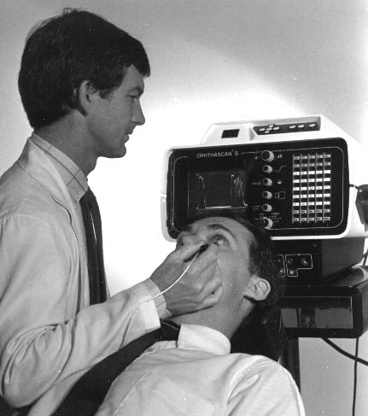
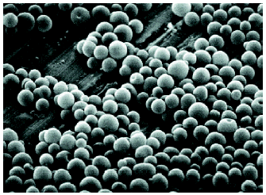
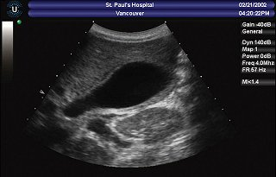
Lectures on Medical Biophysics
Dept. Biophysics, Medical faculty,
Masaryk University in Brno

Slide 2

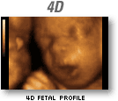
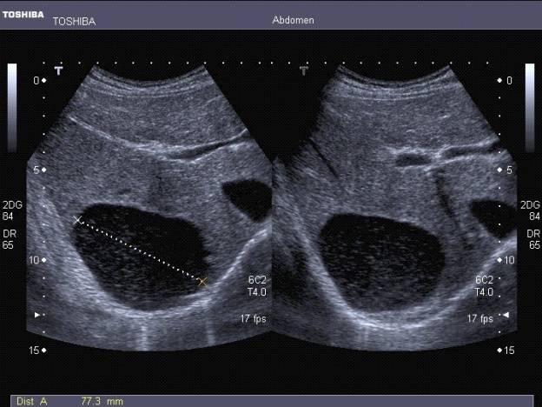
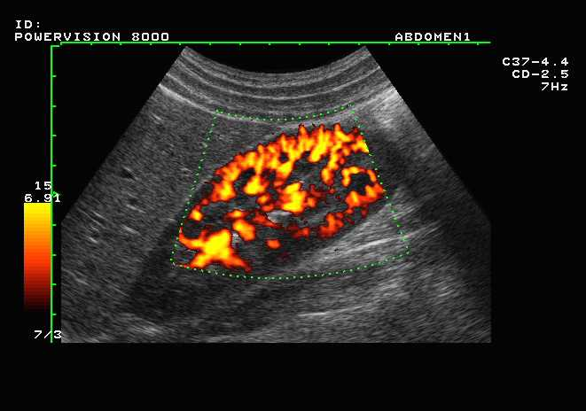
Lectures on Medical Biophysics
Department of Biophysics, Medical Faculty,
Masaryk University, Brno
Ultrasound diagnostics

Slide 3
Lecture outline
Physical properties of ultrasound and acoustic parameters of medium
Ultrasonography
  Impulse reflection method
  A-mode – one-dimensional
  B-mode – two-dimensional
  M-mode
  Basic characteristics of US images
  Interventional sonography
  Echocontrast agents
  Harmonic imaging
  Principle of 3D imaging
Doppler flow measurement
  Principle of Doppler effect
  Principle of blood flow measurement
  CW Doppler system
  Systems with pulsed wave – PW Doppler
  Duplex and Triplex methods
  Power Doppler method
  Tissue Doppler Imaging (TDI)
Elastography
Ultrasonic densitometry
Patient Safety: reducing Ultrasound ‘Doses’

Slide 4
Ultrasound diagnostics
Ultrasound diagnostics started to develop as a clinical method in early 50‘ of 20th century. It allows to obtain cross-sectional images of the human body which can also include substantial information about its physiology and pathology.
Ultrasound diagnostics is based mainly on reflection of ultrasound waves at acoustical interfaces
We can distinguish:
  Ultrasonography (A, B and M mode, 3D and 4D imaging)
  Doppler flow measurement, including Duplex and Triplex methods (Duplex, Colour Doppler, Triplex, Power Doppler)
  Tissue Doppler imaging
  Elastography
  Ultrasound densitometry

Slide 5
Physical properties of ultrasound
Before we will deal with diagnostic devices, we need to understand what is ultrasound and what are the main acoustical properties of medium.
Ultrasound (US) is mechanical oscillations with frequency above 20 kHz which propagate through an elastic medium.
In liquids and gases, US propagates as longitudinal waves.
In solids, US propagates also as transversal waves.

Slide 6
Interactions of US with Tissue
Reflection (smooth homogeneous interfaces of size greater than beam width or the US wavelength, e.g. organ outlines)
Rayleigh Scatter (small reflector sizes, e.g. blood cells, dominates in non-homogeneous media)
Refraction (away from normal from less dense to denser medium, note opposite to light, sometimes produces distortion)
Absorption (sound to heat)
  absorption increases with f, note opposite to X-rays
  absorption high in lungs, less in bone, least in soft tissue, again note opposite to x-rays
Interference: ‘speckles’ in US image result of interference between Rayleigh scattered waves. It is an image artefact.
Diffraction

Slide 7
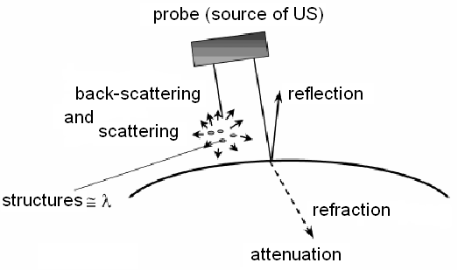
Acoustic parameters of medium:
Interaction of US with medium – reflection and back-scattering, refraction, attenuation (scattering and absorption)

Slide 8
Acoustic parameters of medium
Speed of US c depends on elasticity and density ρ of the medium:
K - modulus of compression
in water and soft tissues c = 1500 - 1600 m·s⁻¹, in bone about 3600 m·s⁻¹

Slide 9
Acoustic parameters of medium
Attenuation of US expresses decrease of wave amplitude along its trajectory. It depends on frequency
I_{x} = I_{o} e^{-2αx} α = α´f²
I_{x} – final intensity, I_{o} – initial intensity, 2x – medium layer thickness (reflected wave travels „to and fro“), α - linear attenuation coefficient (increases with frequency).
Since
α = log₁₀(I₀/I_{X})/2x
we can express α in units dB/cm. At 1 MHz: muscle 1.2, liver 0.5, brain 0.9, connective tissue 2.5, bone 8.0

Slide 10
Acoustic parameters of medium
I or P
[dB]
Attenuation of ultrasound
When expressing intensity of ultrasound in decibels, i.e. as a logarithm of I_{x}/I₀, we can see the amplitudes of echoes to decrease linearly.
attenuation
depth [cm]

Slide 11
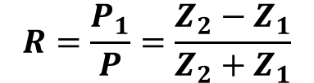
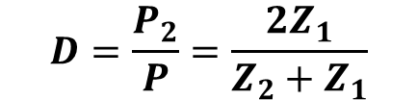
Acoustic parameters of medium: US reflection and transmission on interfaces
Acoustic impedance: product of US speed c and medium density ρ
Z = ρc (Pa·s/m)
Z·10⁻⁶: muscles 1.7, liver 1.65 brain 1.56, bone 6.1, water 1.48
We suppose perpendicular incidence of US on an interface between two media with different Z - a portion of waves will pass through and a portion will be reflected (the larger the difference in Z, the higher reflection).
$$R=\frac{P_{1}}{P}=\frac{Z_{2}−Z_{1}}{Z_{2}+Z_{1}}$$
$$D=\frac{P_{2}}{P}=\frac{2Z_{1}}{Z_{2}+Z_{1}}$$
Coefficient of reflection R – ratio of acoustic pressures of reflected and incident waves
Coefficient of transmission D – ratio of acoustic pressures of transmitted and incident waves

Slide 12
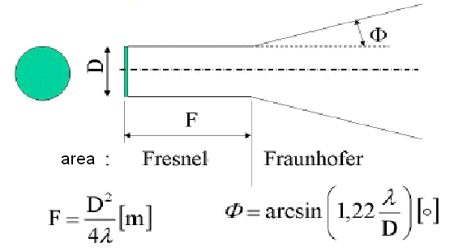
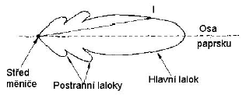
Acoustic parameters of medium: Near field and far field (optional)
Theory and real look
Axis of the beam
Transducer centre
Main lobe
Side lobes
Near field (Fresnel area) – this part of US beam is cylindrical – there are big pressure differences in beam axis
Far field (Fraunhofer area) – US beam is divergent – pressure distribution is more homogeneous
Increase of frequency of US or smaller probe diameter cause shortening of near field - divergence of far field increases

Slide 13
Ultrasonography
Passive US – low intensity waves which cannot cause substantial changes of medium.
In US diagnostics (ultrasonography = sonography = echography) - frequencies used are 2 - 40 MHz with (temporal average, spatial peak) intensity of about 1 kW/m²
Impulse reflection method: a probe with one transducer which is source as well as detector of US impulses. A portion of emitted US energy is reflected on the acoustic interfaces and the same probe then receives reflected signal. After processing, the signal is displayed on a screen.

Slide 14
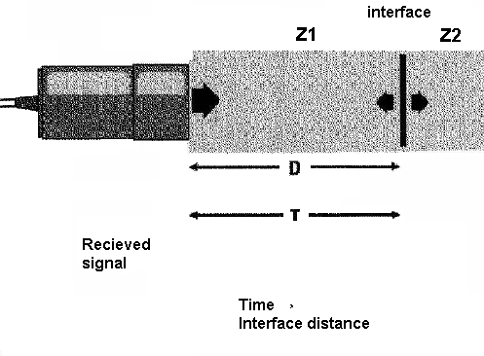
Ultrasonography
Impulse reflection method

Slide 15
Ultrasonography
Impulse reflection method
Main parts of the US apparatus:
Common to diagnostics and therapy
probe with electroacoustic transducer (transducers)
generator of electric oscillations (continuous, pulsed)
Special parts of diagnostic apparatus
electronic circuits for processing of reflected signal (today A/D converter and respective software)
display unit
recording unit

Slide 16
Ultrasonography
A-mode – one-dimensional
Distances between reflecting interfaces and the probe are shown.
Reflections from individual interfaces (boundaries of media with different acoustic impedances) are represented by vertical deflections of base line, i.e. the echoes.
Echo amplitude is proportional to the intensity of reflected waves (Amplitude modulation)
Distance between echoes shown on the screen is approx. proportional to real distance between tissue interfaces.
Today used mainly in ophthalmology.

Slide 17
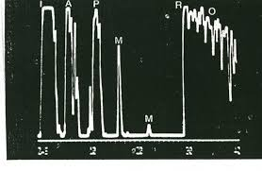
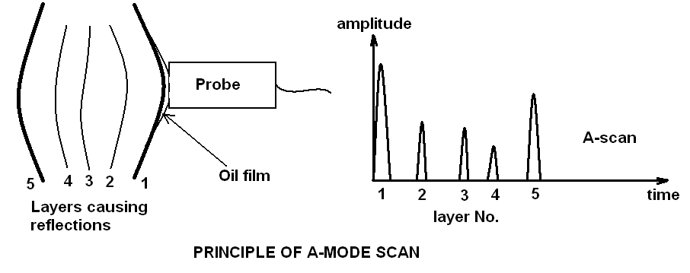
Ultrasonography
A-mode – one-dimensional
Contact gel

Slide 18
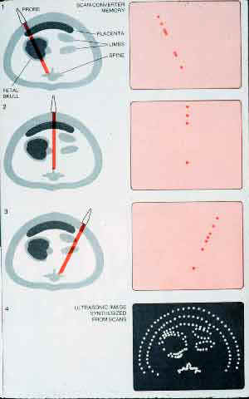
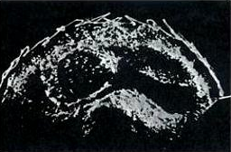
Ultrasonography
B-mode – two-dimensional - static
Foetus in abdomen of pregnant woman
A tomogram is depicted. Brightness of points on the screen represents intensity of reflected US waves (Brightness modulation).
Static B-scan: a cross-section image of examined area in the plane given by the beam axis and direction of manual movement of the probe on body surface. The method was used in 50‘ and 60‘ of 20th century

Slide 19
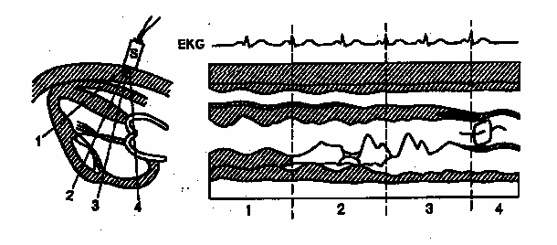
Ultrasonography M-mode
One-dimensional static B-scan shows movement of reflecting tissues. The second dimension is time in this method.
Static probe detects reflections from moving structures. The echoes are represented by points moving vertically on the screen, horizontal shifting of the record is given by slowly running time-base.
Displayed curves represent movement of tissue structures
chest wall
lungs

Slide 20
Ultrasonography
B-mode - dynamic
Repetitive formation of B-mode images of examined area by fast deflection of US beam mechanically (in the past) or electronically „in real time“ today.
Electronic probes consist of many piezoelectric transducers which are gradually activated.

Slide 21
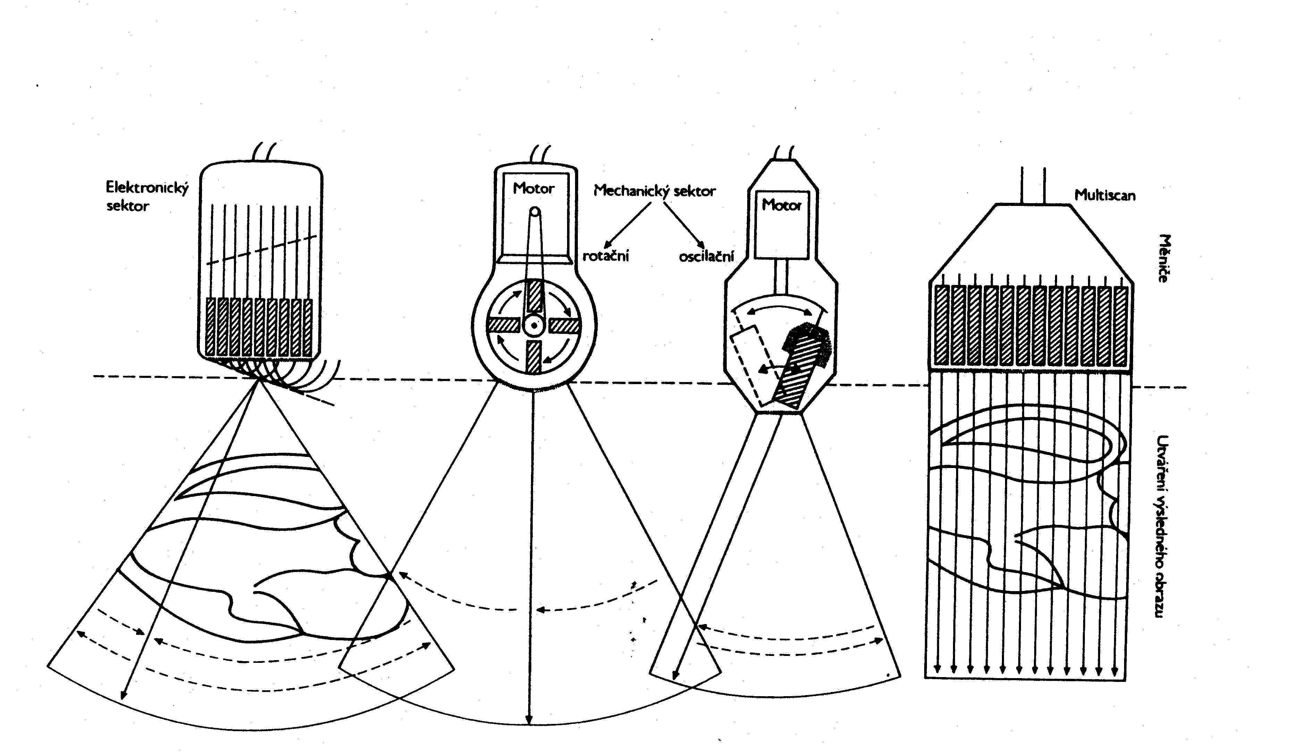
Ultrasonography B-mode - dynamic
Ultrasound probes for dynamic B-mode: electronic and mechanical (history), sector and linear.
Abdominal cavity is often examined by convex probe – a combination of a sector and linear probe.

Slide 22
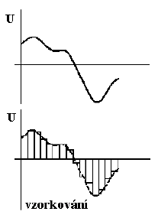
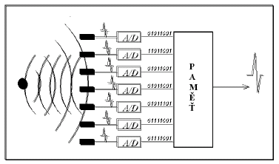
Ultrasonography B-mode - dynamic
MEMORY
sampling
Modern ultrasonography - digital processing of image
Analogue part – detection system
Analogue-digital converters (ADC)
Digital processing of signal – possibility of
programming (preprocessing, postprocesssing), image storage (floppy discs, CD, flash cards etc.)

Slide 23
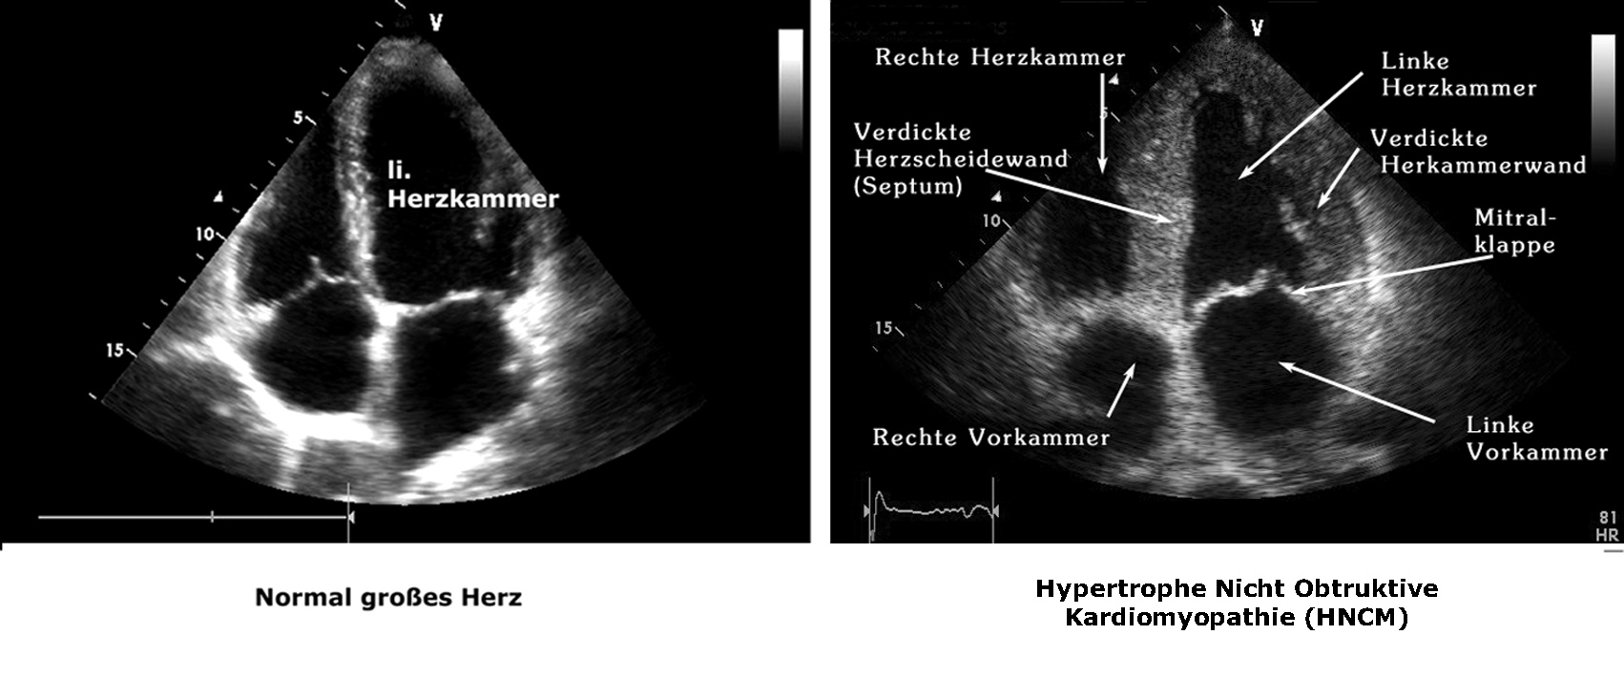
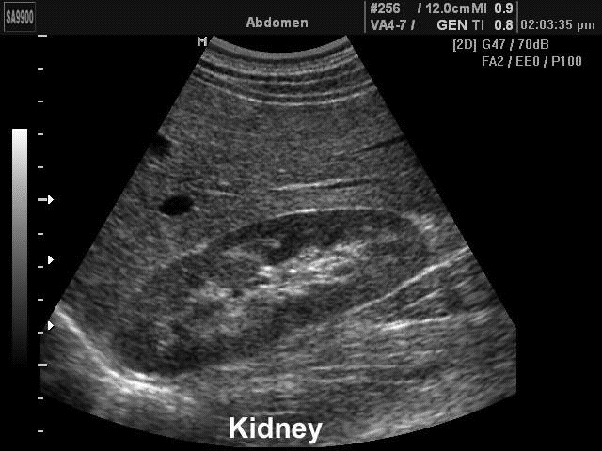
Ultrasonography B-mode - dynamic

Slide 24
Ultrasonography
Basic characteristics of US images
Degree of reflectivity – echogenity. The images of cystic (liquid-filled) and solid structures are different. According to the intensity of reflection in the tissue bulk we can distinguish structures:
hyperechogenic, izoechogenic, hypoechogenic, anechogenic.
Solid structures – acoustic shadow (caused by absorption and reflection of US)
Air bubbles and other strongly reflecting interfaces cause repeating reflections (reverberation, „comet tail“).

Slide 25
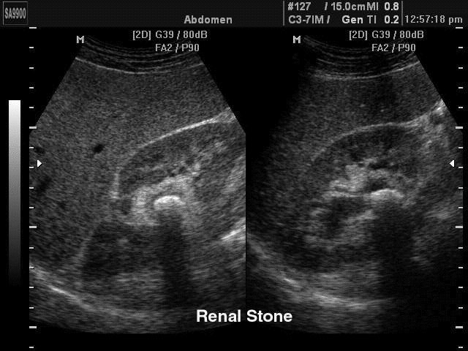
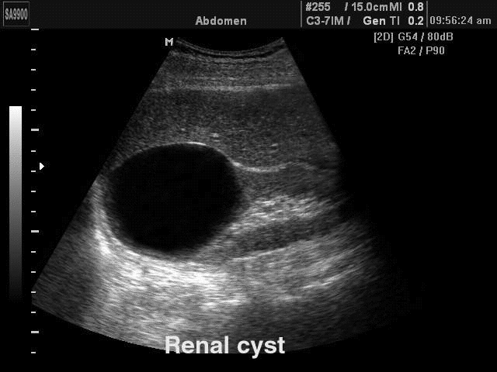
Ultrasonography
Acoustic shadow caused by absorption and reflection of US by a kidney stone (arrow)
Hyperechogenic area below a cyst (low attenuation of US during passage through the cyst compared with the surrounding tissues – arrow)

Slide 26
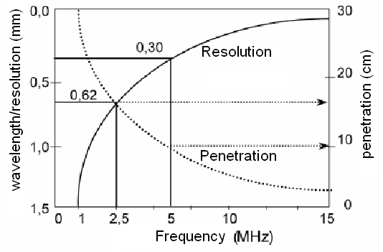
Ultrasonography
Spatial resolution of US imaging system is determined by the wavelength of the US. When the object dimension is smaller than this wavelength only scattering occurs. Hence higher spatial resolution requires higher frequencies
Limitation! – absorption of US increases with frequency of ultrasound = smaller penetration depth
Compromise frequency 3-5 MHz – penetration in depth of about 20 cm

Slide 27
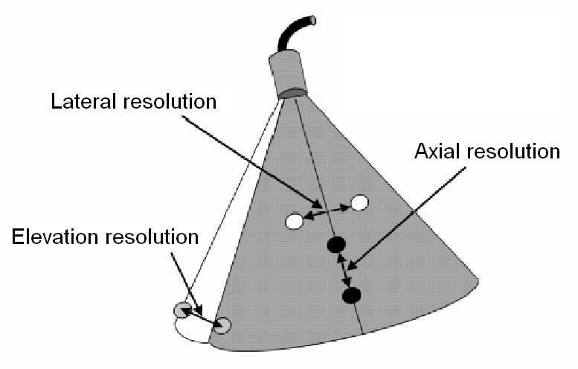
Ultrasonography Spatial Resolution
Optional!
Axial spatial resolution - it is given by the shortest distance of two distinguishable structures lying in the beam axis – it depends mainly on frequency (at 3.5 MHz about 0.5 mm)
Lateral spatial resolution - it is given by the shortest distance of two distinguishable structures perpendicularly to the beam axis – depends on the beam width
Elevation – ability to distinguish two planes (sections) lying behind or in front of the depicted tomographic plane – it depends on frequency and beam geometry

Slide 28
Ultrasonography Spatial Resolution
Optional!
The best resolving power can be found in the narrowest part of the US beam profile.
Focusing – US beam is converged at the examined structure by means of acoustic lenses (shapes of the layer covering the transducer) or electronically.
The probes can be universal or specially designed for different purposes with different focuses.
The position of focus can be changed in most sector probes).

Slide 29
Ultrasonography
Interventional sonography
Interventional sonography is used mainly for guiding punctures
diagnostic – thin needle punctures to take tissue samples for histology
therapeutic – for aspiration of a cyst or an abscess content or an exudate etc.
Puncture can be done by „free hand“ – the probe is next to the puncture site – or the puncture needle is guided by a special probe attachment.

Slide 30
Ultrasonography
Echocontrast agents
- increase echogenity of streaming blood
Gas microbubbles
(mainly air or volatile
hydrocarbons)
- free
- enclosed in
biopolymer
envelope
A SEM micrograph of
encapsulated
echocontrast agent

Slide 31
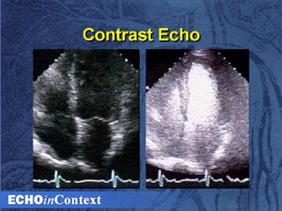
Ultrasonography
Echocontrast agents - application
Enhanced demarcation of heart ventricle after application of the echocontrast agent
Echocontrast image of Focal Nodular Hyperplasia of the Liver
18 s after intravenous application of the echocontrast agent

Slide 32
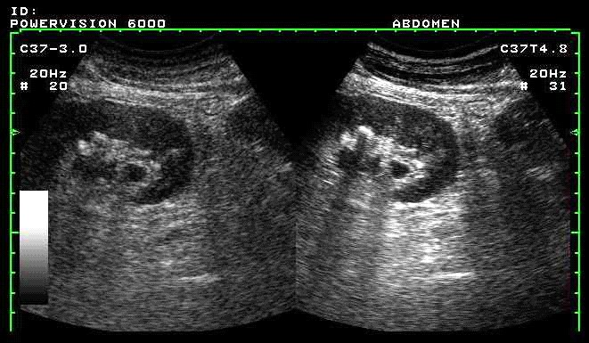
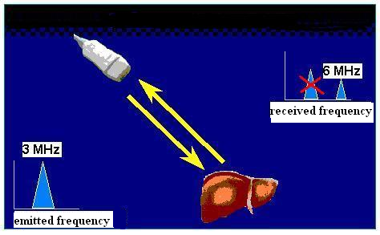
Ultrasonography
Harmonic imaging
An impulse with basic frequency f₀ is emitted into the tissue. The receiver, however, does not detect the reflected US with this same frequency but with the second harmonic frequency 2f₀. Its source is tissue itself (advantage in patients „difficult to examine“). The method is also used with echocontrast agents – source of the second harmonic are oscillating bubbles. Advantageous when displaying blood supply of some lesions.
Conventional (left) and harmonic (right) images of a kidney with a stone.

Slide 33
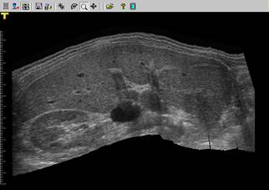
Ultrasonography Panoramic imaging
Purpose of this method is a continuous image record of a tissue or organ in desired plane (direction). Panoramic image enables assessment of dimensions and morphology of the whole body portion.
This method is a supplement to the conventional imaging.
Panoramic image of epigastrium
From left: right kidney, right liver lobe, gallbladder, left liver lobe, spleen

Slide 34
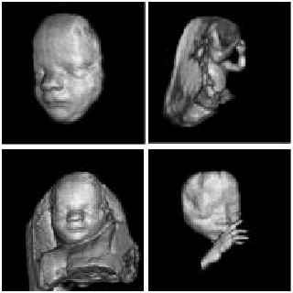
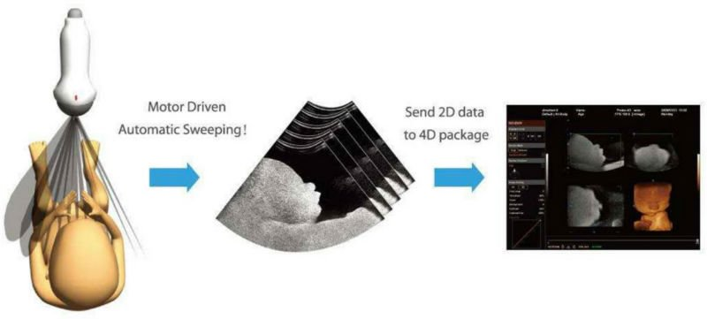
Ultrasonography
Principle of three-dimensional (3D) imaging
- The probe is linearly shifted, tilted or rotated.
The data about reflected signals in individual planes are stored in memory of a powerful PC which consequently performs mathematical reconstruction of the image.
Disadvantages of some 3D imaging systems: relatively long time needed for mathematical processing, price.

Slide 35
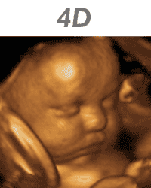
Four-dimensional (4D) image
The fourth dimension is time
https://giphy.com/gifs/4d-14jU1PuglaN1v2

Slide 36
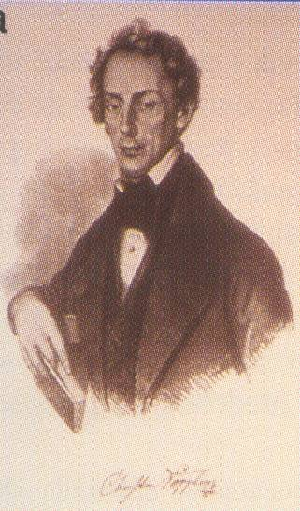
Doppler flow measurement
Christian. A. Doppler (1803-1853), Austrian physicist
and mathematician, formulated his theory in 1842
during his stay in Prague.
The Doppler effect (frequency shift of waves formed or reflected at a moving object) can be used for detection and measurement of blood flow, as well as, for detection and measurement of movements of some acoustical interfaces inside the body (heart, blood vessel walls)
Perceived frequency corresponds with source frequency in rest.
Perceived frequency is higher when approaching it.
Perceived frequency is lower when moving away it.

Slide 37
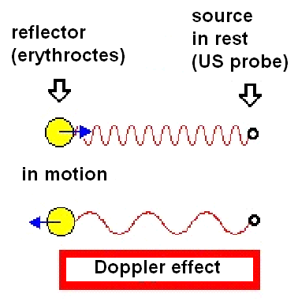
  Doppler flow measurement
  Principle of Doppler effect
Application of Doppler effect in blood flow velocity measurement
Moving reflector (back scatterer) = erythrocytes

Slide 38
  Doppler flow measurement
  Principle of blood flow measurement
US Doppler blood flow-meters
are based on the difference between the frequency of ultrasound (US) waves emitted by the probe and those reflected (back-scattered) by moving erythrocytes.
The frequency of reflected waves is (in comparison with the emitted waves)
higher in forward blood flow (towards the probe)
lower in back blood flow (away from the probe)
The difference between the frequencies of emitted and reflected US waves is proportional to blood flow velocity.

Slide 39
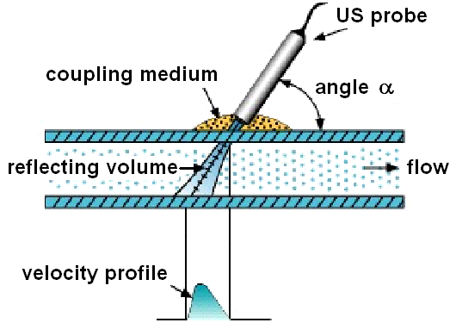
Doppler flow measurement
General principle of blood flow measurement

Slide 40
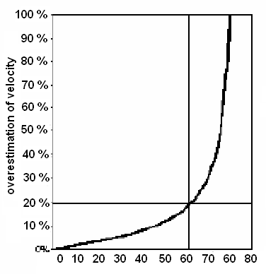
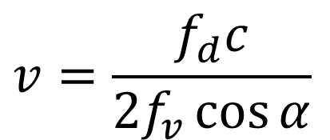

Doppler flow measurement
Calculation of Doppler frequency change f_{d}
Calculation of „reflector“ (erythrocytes) velocity v
1) 2)
f_{v} - frequency of emitted US waves
α - angle made by axis of emitted US beam and the velocity vector of the reflector
c – US speed in the given medium
(about 1540 m/s in blood)
$$f_{d}=\frac{2f_{v}v\cos{α}}{c}$$
$$v=\frac{f_{d}c}{2f_{v}\cos{α}}$$
Dependence of velocity overestimation on the incidence angle α (if the device is adjusted for α = 0, i.e. cosα = 1)
α - angle made by axis of emitted US beam and the velocity vector of the reflector

Slide 41
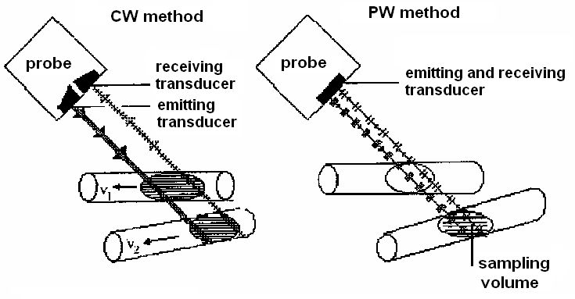
Doppler flow measurement
Systems with continuous wave – CW. They are used for measurement on superficial blood vessels. High velocities of flow can be measured, but without depth resolution. Used only occasionally.
Systems with pulsed wave. It is possible to measure blood flow with accurate depth localisation. Measurement of high velocities in depths is limited.

Slide 42
Doppler flow measurement
Systems with pulsed wave - PW
The probe has only one transducer which acts alternately as emitter and receiver.
The measurement of velocity and direction of blood flow in the vessel is evaluated in the so-called sampling volume with adjustable size and depth.
The pulse duration defines the size of the sampling volume (this volume should involve the whole diameter of the examined blood vessel).

Slide 43
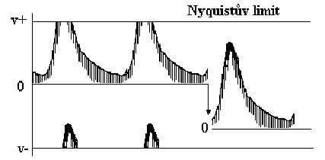
Doppler methods
Pulse wave (PW) systems – optional!
Aliasing – artefact of measurement. At high repetition frequency of pulses the upper part of the spectral curve can appear in negative velocity range
- at velocity above 4m/s aliasing cannot be removed
Nyquist limit

Slide 44
  Doppler methods
DUPLEX method
is a combination
of dynamic B-mode imaging (the morphology of examined area with blood vessels is depicted)
and the PW Doppler system (measurement of velocity spectrum of blood flow).
It allows to examine blood flow inside heart or in deep blood vessels (flow velocity, direction and character)

Slide 45
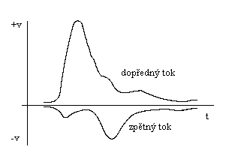
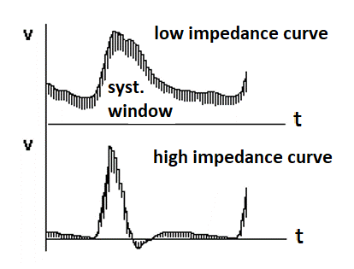
  Doppler flow measurement
Basic spectral curves
directional impedance
Forward flow
Back flow
Low peripheral impedance: brain arteries, arteries in parenchymatous organs
High peripheral impedance: arteries in skeletal muscles
syst. = systolic

Slide 46
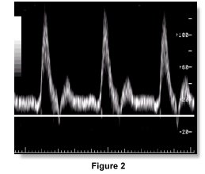
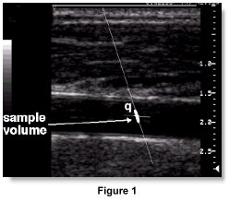
  Doppler methods DUPLEX method
Placement of sampling volume (left) and the record of blood flow velocity spectrum in stenotic a. carotis communis (right)

Slide 47
  Doppler methods
  Colour Doppler imaging
The image consists of black-white and colour part.
The black-white part contains information about reflectivity and structure of tissues.
The colour part informs about movements in the examined section. (The colour is derived from average velocity of flow.)
The apparatus depicts distribution and direction of flowing blood as a two-dimensional image.
BART rule – blue away, red towards. The flow away from the probe is coded by blue colour, the flow towards the probe is coded by red colour. The brightness is proportional to the velocity, turbulences are depicted by green patterns.

Slide 48
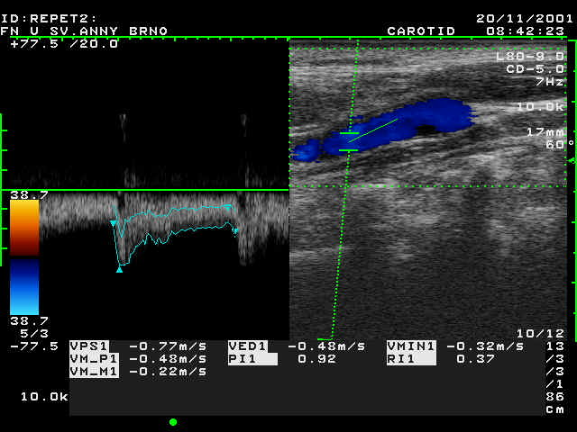
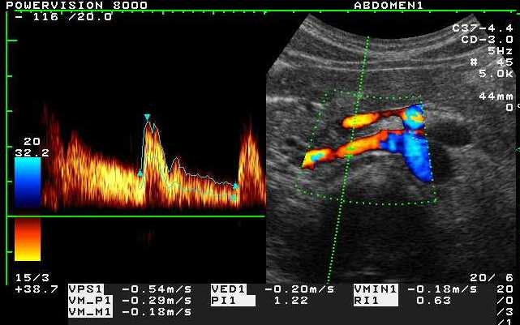
  Doppler flow measurement TRIPLEX method
Combination of duplex method and colour Doppler imaging
Normal blood flow in a. carotis communis (left) and in a. renalis dx (right)

Slide 49
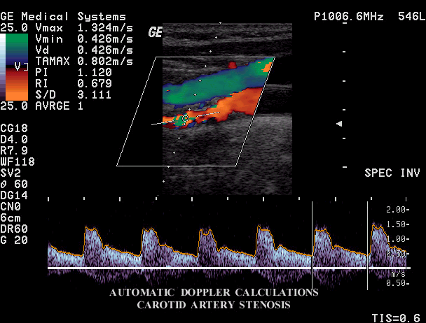
  Doppler methods TRIPLEX method
stenosis
of
a. carotis

Slide 50
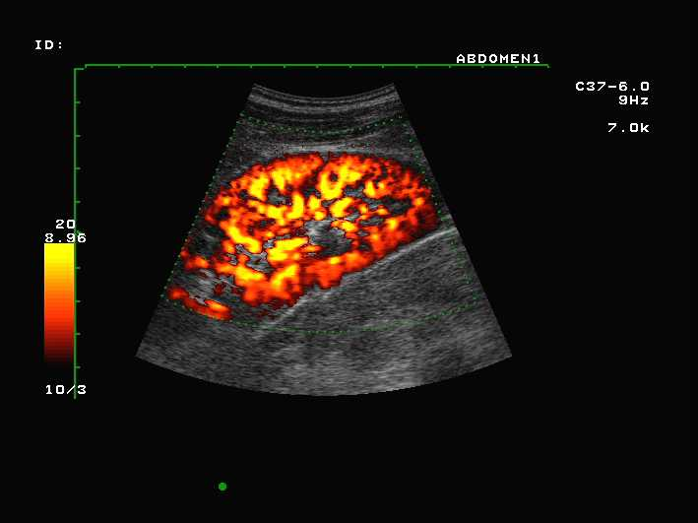


  Doppler methods
  POWER DOPPLER method
the whole energy of the Doppler signal is utilised
mere detection of blood flow only little depends on the
so-called Doppler incidence angle
imaging of even very slow flows (blood perfusion of tissues and organs)
flow direction is not shown
Renal perfusion
Carotid bifurcation

Slide 51

Tissue Doppler Imaging (TDI)
Colour coding of information about velocity and direction of movements of tissues
Velocities 1-10 mm/s
are depicted.
TDI of a. carotis
communis during
systole

Slide 52
Elastography
Elastography is an imaging modality analogous to palpation. Basis: pathological changes of tissues can manifest themselves like changed mechanical properties, e.g. rigidity. The tumour are more rigid than healthy tissues in most cases. This method allows to visualise inner structures of some tissues based on the measurement of the response to the tissue compression from the body surface. This response depends, among others, on the microscopic and macroscopic structure of the tissues. Moreover, the tissues have also the so called viscoelastic and poroelastic properties (poroelasticity is a specific elasticity of porous materials which pores are filled by a liquid).

Slide 53
Elastography
Elastic properties of tissues cannot be evaluated based on a simple sonogram. Hence several ultrasonic elastographic methods were developed:
Strain-Stress Elastography where the tissue deformation is caused by the pressure exerted by the ultrasound probe.
Acoustic Radiation Forced Impulse Elastography where the pressure is exerted by a strong impulse of radiation force.
At present time, the SWE – Shear Wave Elastography is dominant. In this method, instead of the pressure action of the probe, the radiation force of the ultrasound waves is exploited – see the picture. The compression is done by means of relatively long repeated focussed impulses along the imaging axis, which produce the shear (transverse) waves. These waves propagate much slower than the longitudinal waves which speed is proportional to the tissues elasticity (Young modulus). The particles of medium move (oscillate) with the amplitude of some micrometres, and to visualise this movement is needed a special imaging mode denoted as supersonic imaging – it encompasses ultrafast image processing (5000–20000 frames/s). In comparison with the previous method, the information on tissue elasticity is quantitative, the colour scale is calibrated in kPa.

Slide 54

Elastography
SWE elastography of a phantom with two areas of different elasticity. In the upper part we can see an elastogram, in the lower part a grayscale ultrasonogram.

Slide 55
Ultrasonic densitometry
It is based on both the measurement of speed of ultrasound in bone and the estimation of ultrasound attenuation in bone. In contrast to X-ray methods, ultrasound densitometry also provides information on the structure of bone and its elastic properties.
The speed of ultrasound depends on the density and elasticity of the measured medium. The anterior area of the tibia and the posterior area of the calcaneus are frequently used as places of measurement. The speed of ultrasound is given by the quotient of measured distance and the transmission time.
Ultrasound attenuation depends on the physical properties of the given medium and the frequency of the ultrasound applied. For the frequency range 0.1 - 1 MHz the frequency dependence is nearly linear. Attenuation is currently expressed in dB/MHz/cm.
Clinical importance: diagnostics of osteoporosis

Slide 56

Ultrasonic densitometry
Ultrasound measurements used
to assess bone density at the calcaneus

Slide 57
Patient Safety: reducing Ultrasound ‘Doses’
(see also the lecture on ultrasound cavitation)

Slide 58
Prudent use of Ultrasound
US is non-ionising BUT since many bioeffects of ultrasound have not yet been studied fully, ‘prudent’ use is recommended
ALARA – as low as reasonably achievable (exposure)
In practice ‘prudent’ = justification + optimisation

Slide 59
Biological Effects
Possible bioeffects: inactivation of enzymes, altered cell morphology, internal haemorrhage, free radical formation …
Mechanisms of bioeffects:
  Mechanical effects
    Displacement and acceleration of biomolecules
    Gas bubble cavitation (stable and transient) – see the lecture on biological effects of ultrasound
  Elevated tissue temperatures (absorption of ultrasound and therefore increase in temperature high in lungs, less in bone, least in soft tissue)
All bioeffects are deterministic with a threshold (cavitation) or without it (heating).

Slide 60
Output Power from Transducer
varies from one machine to another
Increases as one moves from real-time imaging to colour flow Doppler
M-mode output intensity is low but dose to tissue is high because beam is stationary

Slide 61
Risk Indicators
To avoid potentially dangerous exposures, two indices were introduced. Their values (different for different organs) are often displayed on device screens and should not be exceeded.
Thermal Index (TI): TI = possible tissue temperature rise if transducer is kept stationary
  TIS: soft tissue path
  TIB: bone near focus of beam
  TIC: Cranium (near surface bone)
Mechanical Index (MI): measure of possible mechanical bioeffects

Slide 62

More on the TI and MI
Thermal index – device power divided by the power that would increased the temperature by one degree under conditions of minimum heat loss (without perfusion).
Mechanical index (for assessment of cavitation-conditioned risk, increased danger when using echocontrast agents):

Slide 63
Justification
No commercial demos on human subjects
No training on students
No ‘see baby just for fun’ or excessive screening in obstetrics

Slide 64
Optimisation of ‘Dose’
Minimise TI and MI and use appropriate index (TIS, TIB, TIC), care in cases when these underestimated
Check acoustic power outputs on manual
Use high receiver gain when possible as opposed to high transmit power
Start scan with low transmit power and increase gradually
Avoid repeat scans and reduce exposure time
Do not hold transducer stationary
Greater care when using contrast agents as these increase the possibility of cavitation
Exceptional care must be taken in applying pulsed Doppler in obstetrics
Regular quality control of the ultrasound device

Slide 65

Authors:
Vojtěch Mornstein, Ivo Hrazdira, Pavel Grec
Content collaboration and language revision:
Carmel J. Caruana
Graphical design:
Lucie Mornsteinová
Last revision: December 2018
http://www.freehotgame.com

