Slide 1

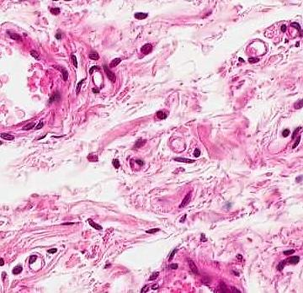
CARDIOVASCULAR SYSTEM
Heart
Vessels arteries
veins
capillaries continuous
fenestrated
sinusoids

Slide 2
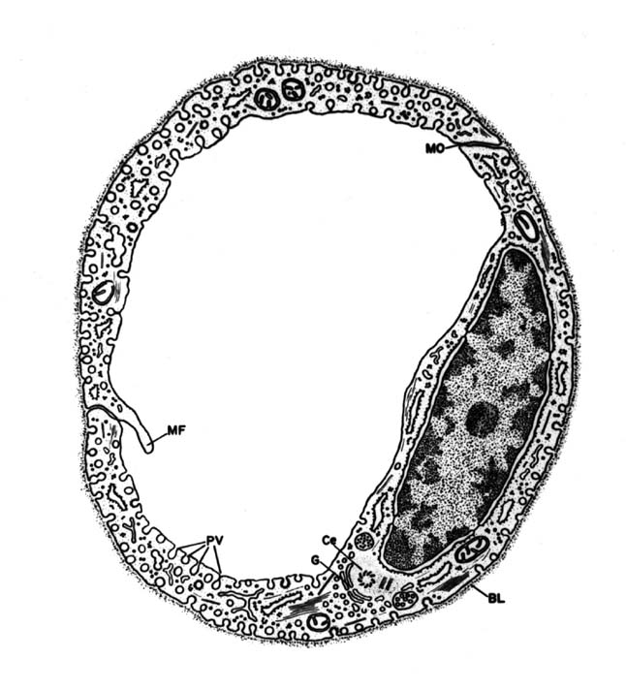
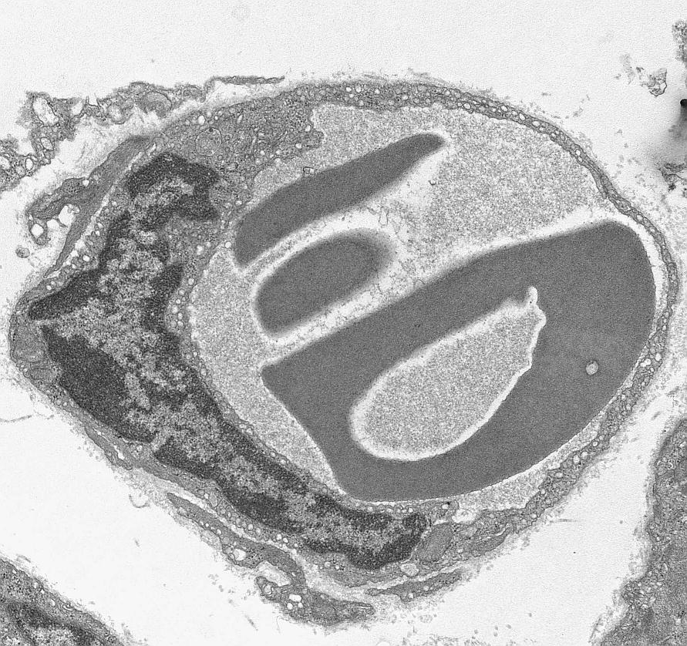

Continuous capillary

Slide 3
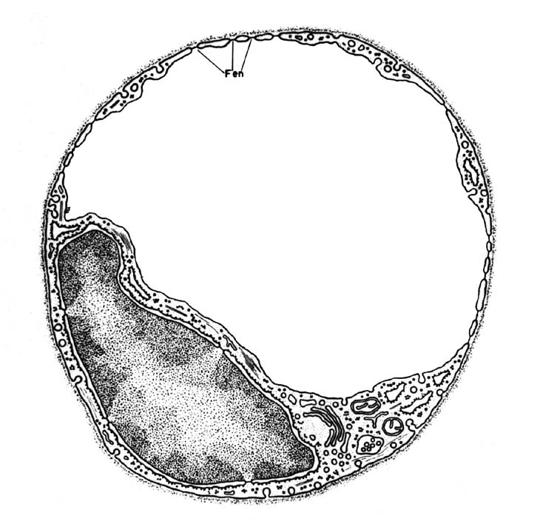
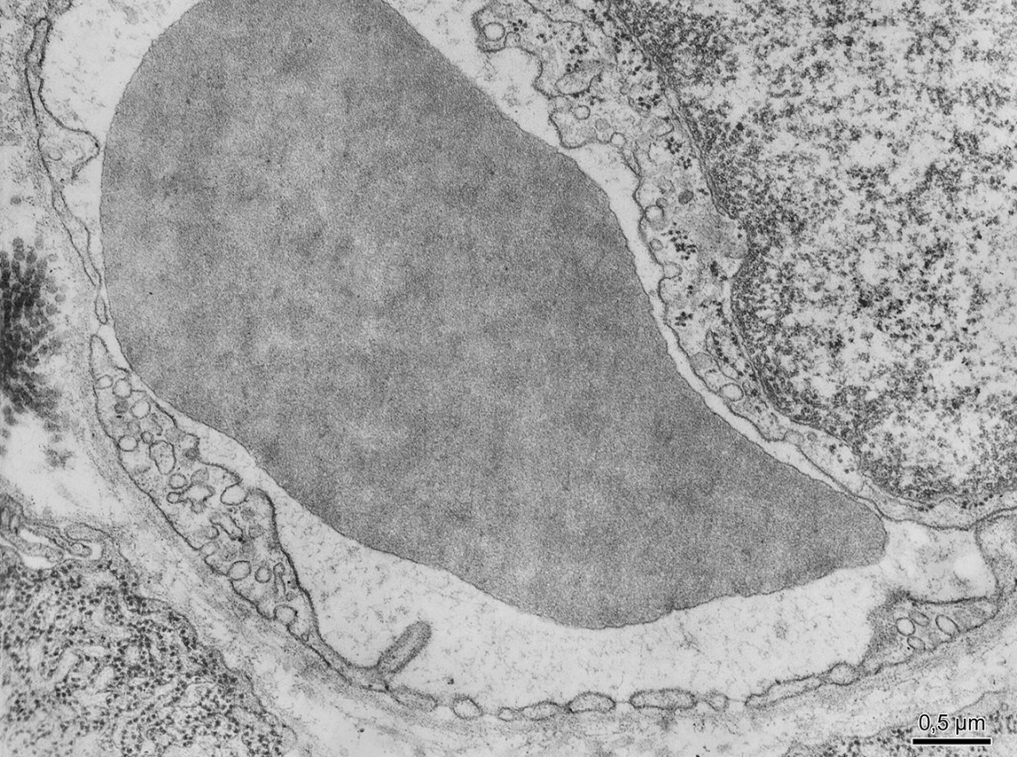
Fenestrated capillary

Slide 4
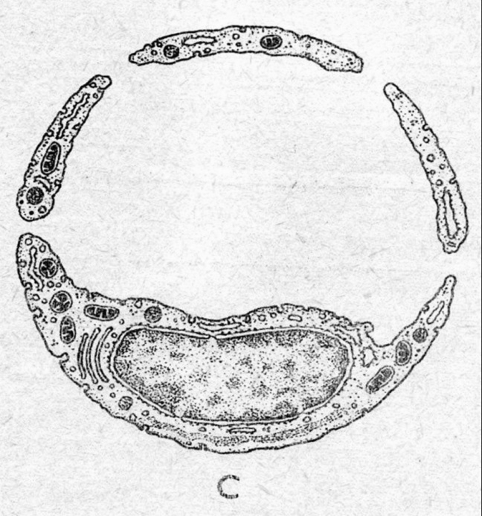
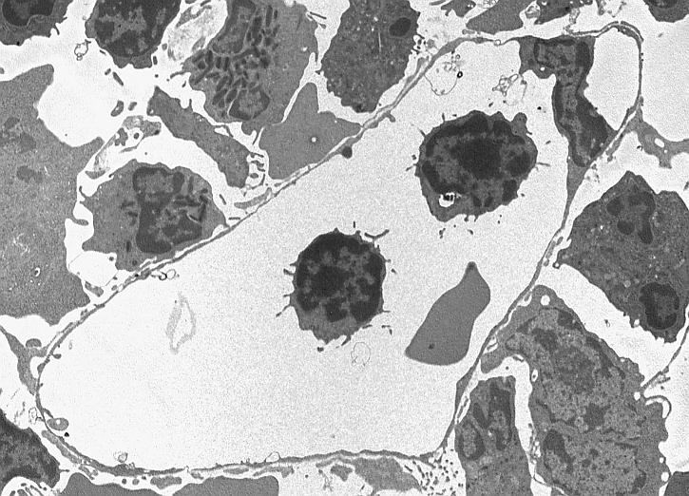
Sinusoid

Slide 5
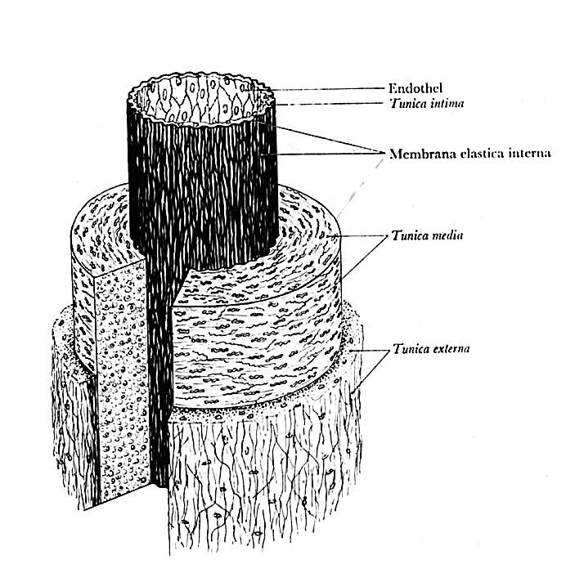
General structure
of blood vessels

Slide 6
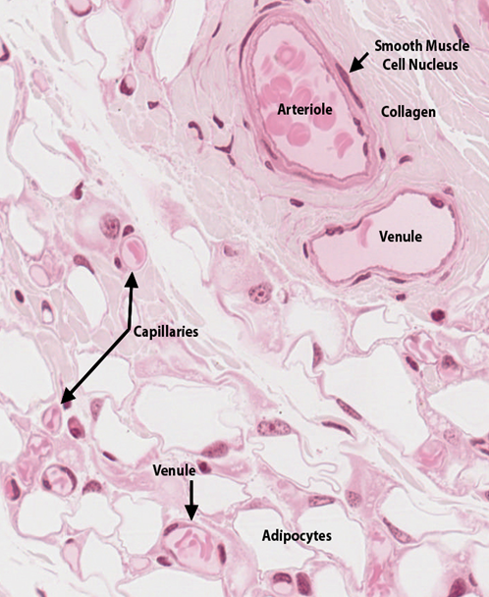
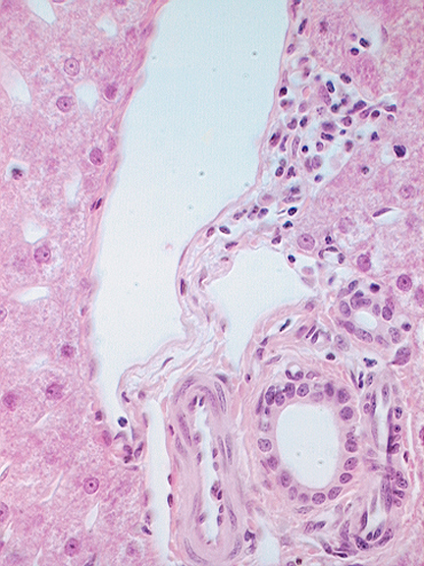
capillaries, arterioles, venules [endothelium], ducts [epithelium]
A
D
V
V

Slide 7
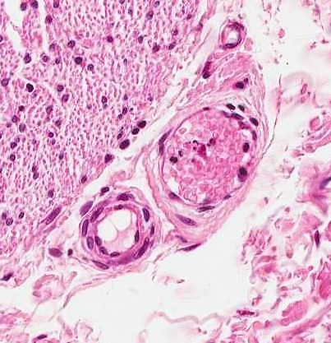
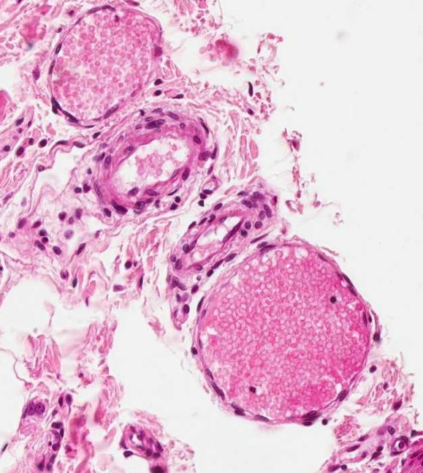
arteriole and venule
V
A
V
A
V

Slide 8
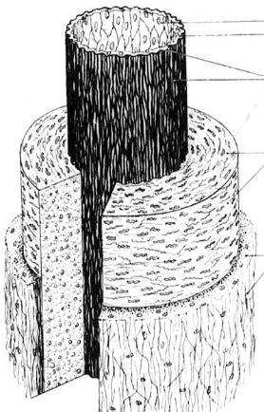
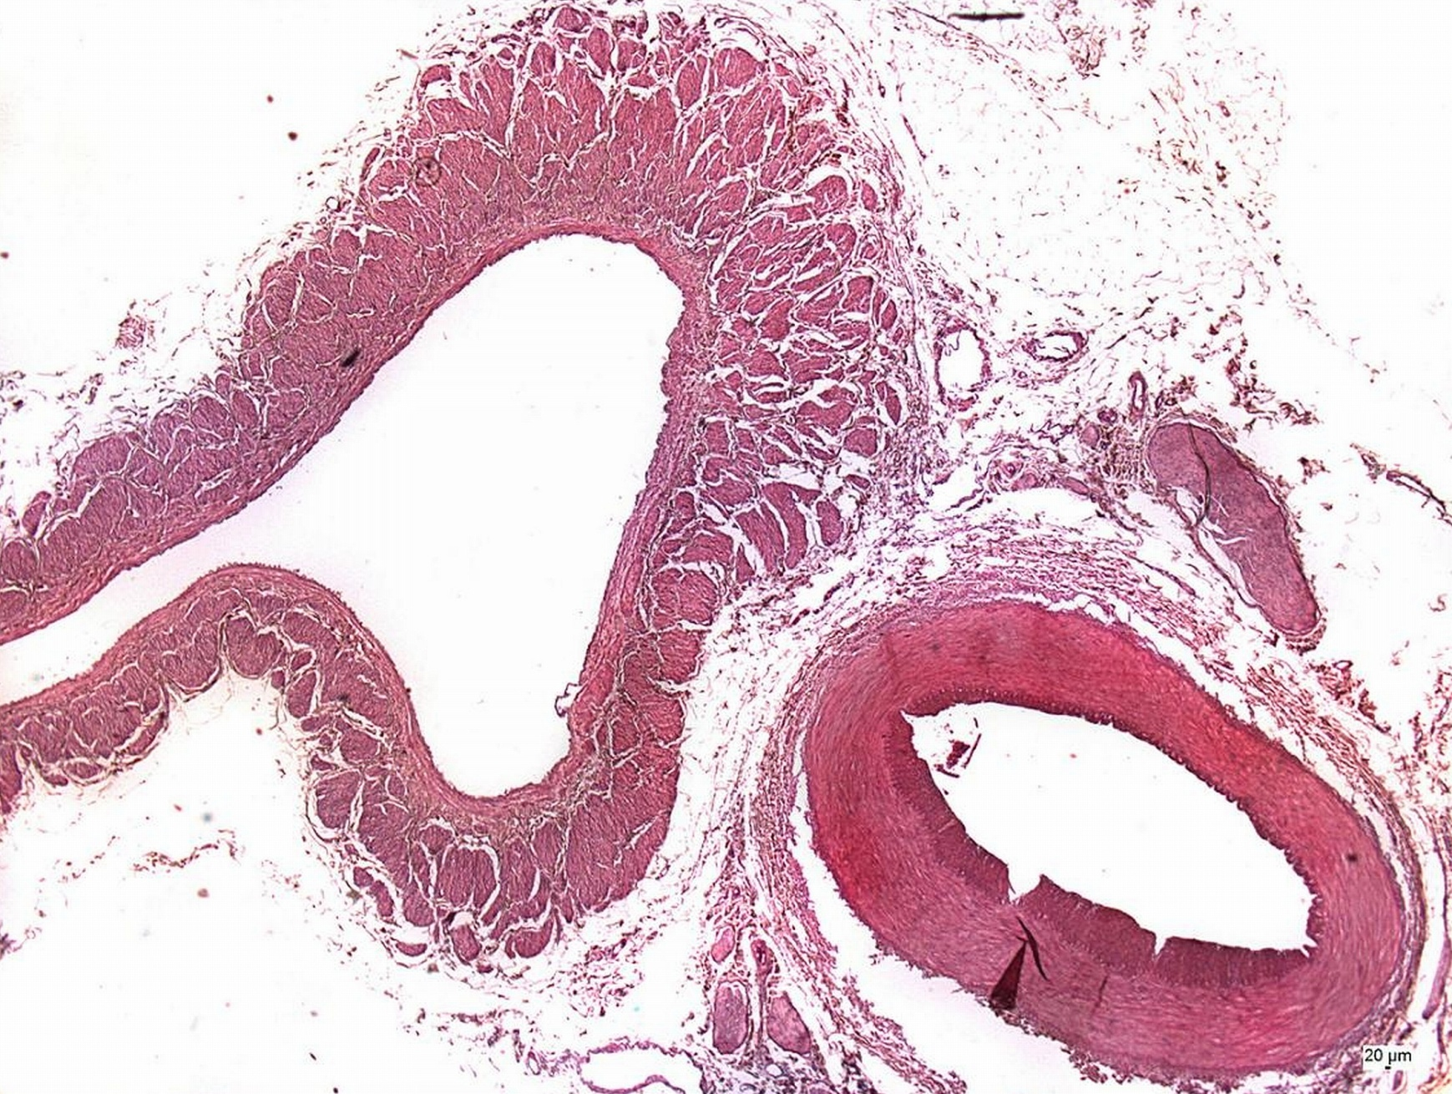
muscular artery and vein - HE
V
A

Slide 9

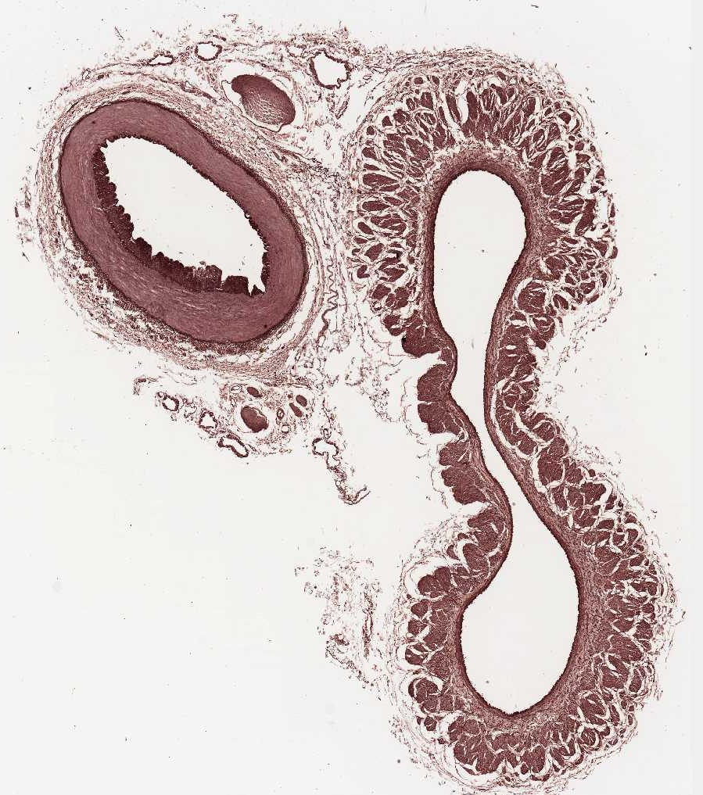
muscular artery and vein - orcein
V
A

Slide 10
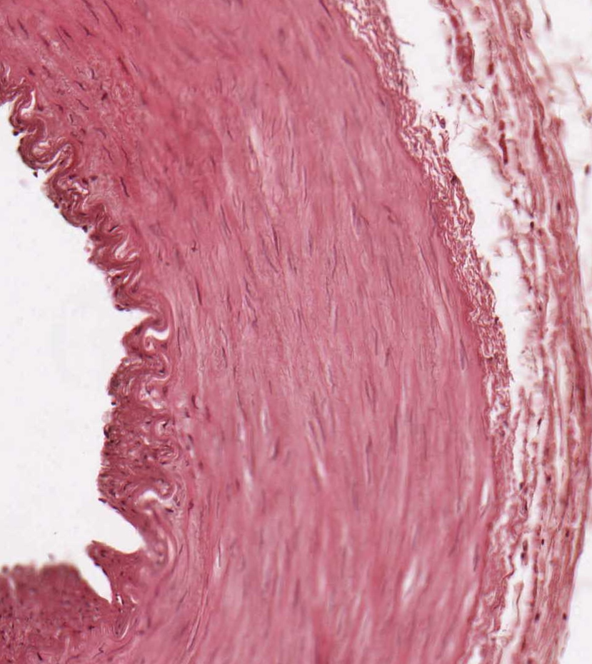
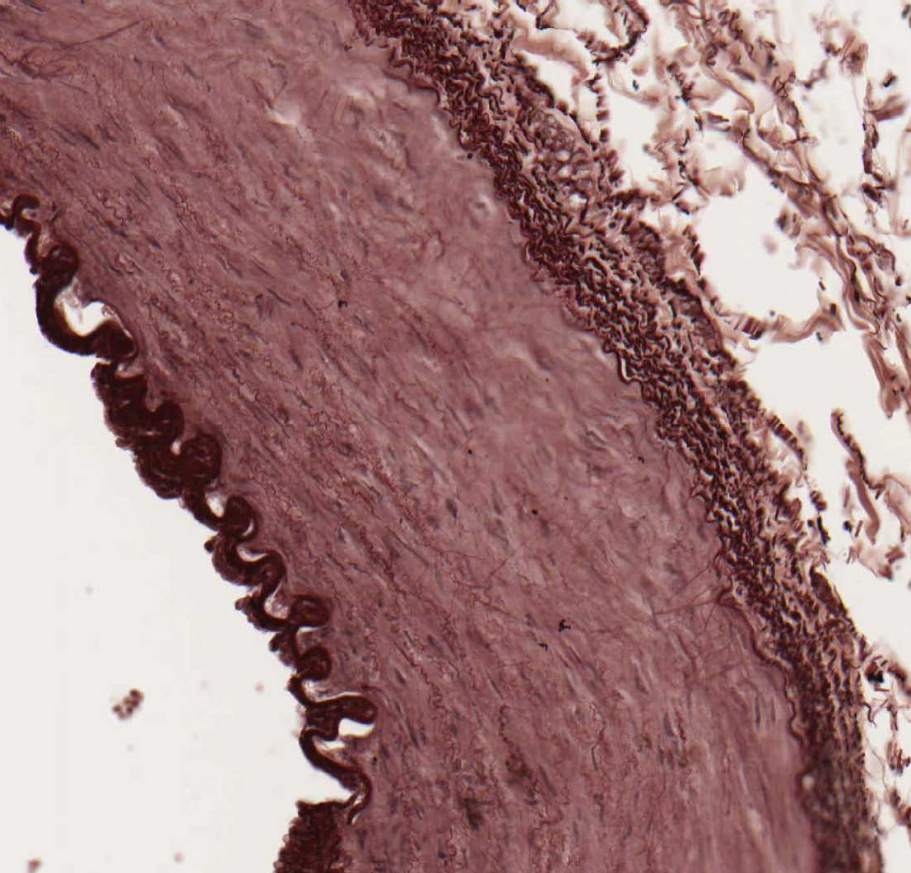
muscular artery
HE orcein
membrana elastica interna

Slide 11
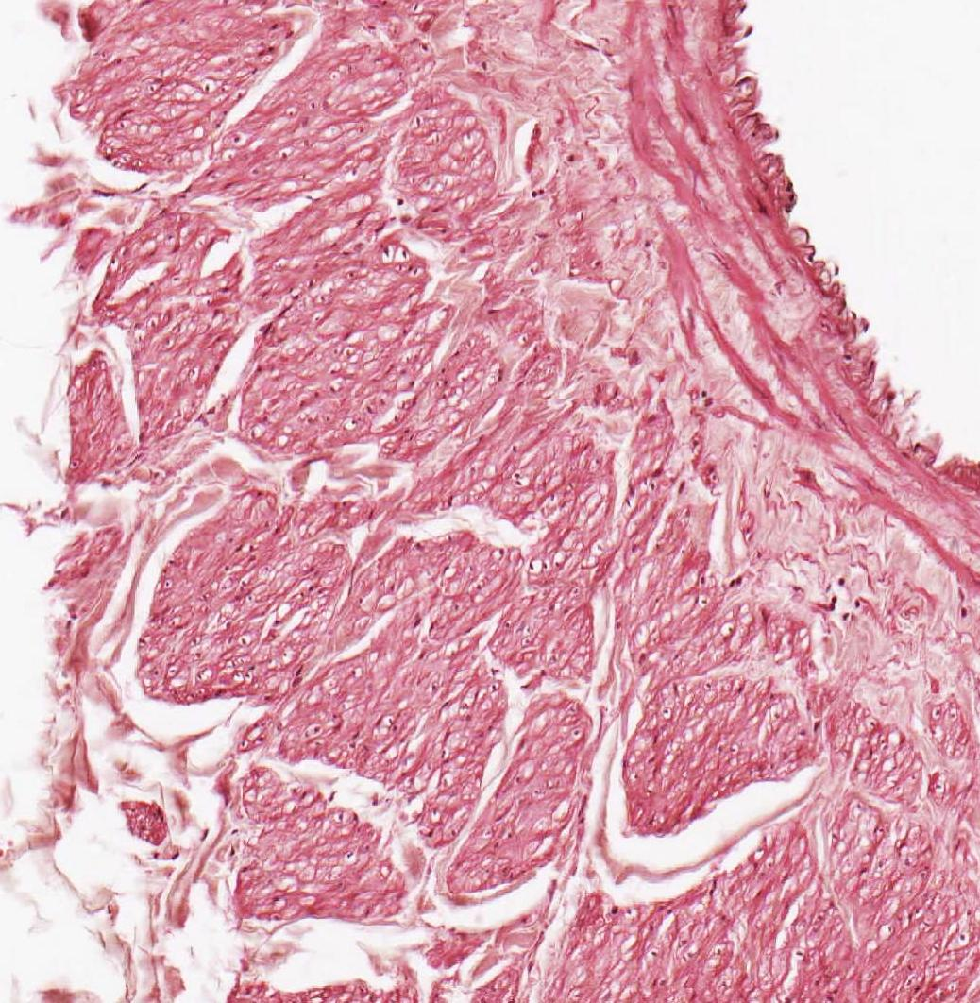
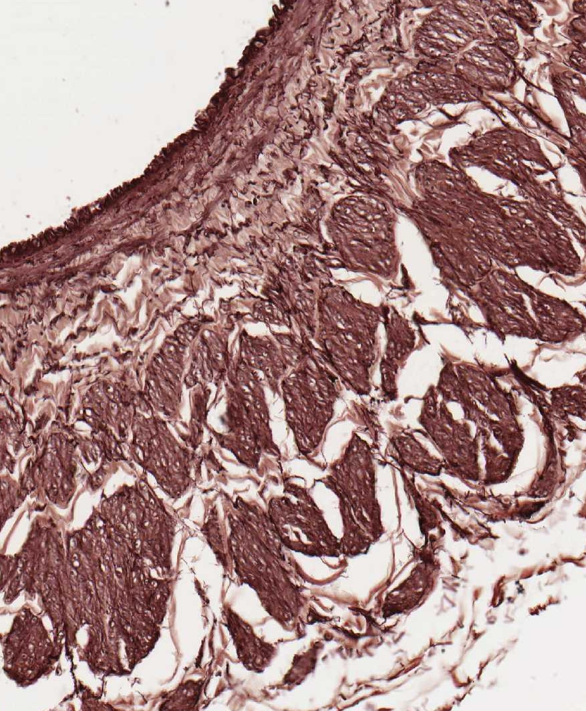
vein (1-intima, 2-media, 3-adventitia)
HE orcein
1
2
3

Slide 12
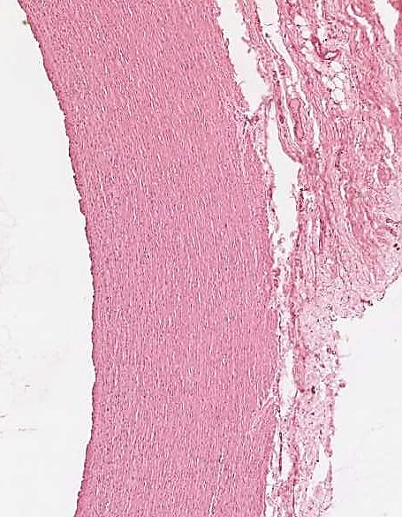
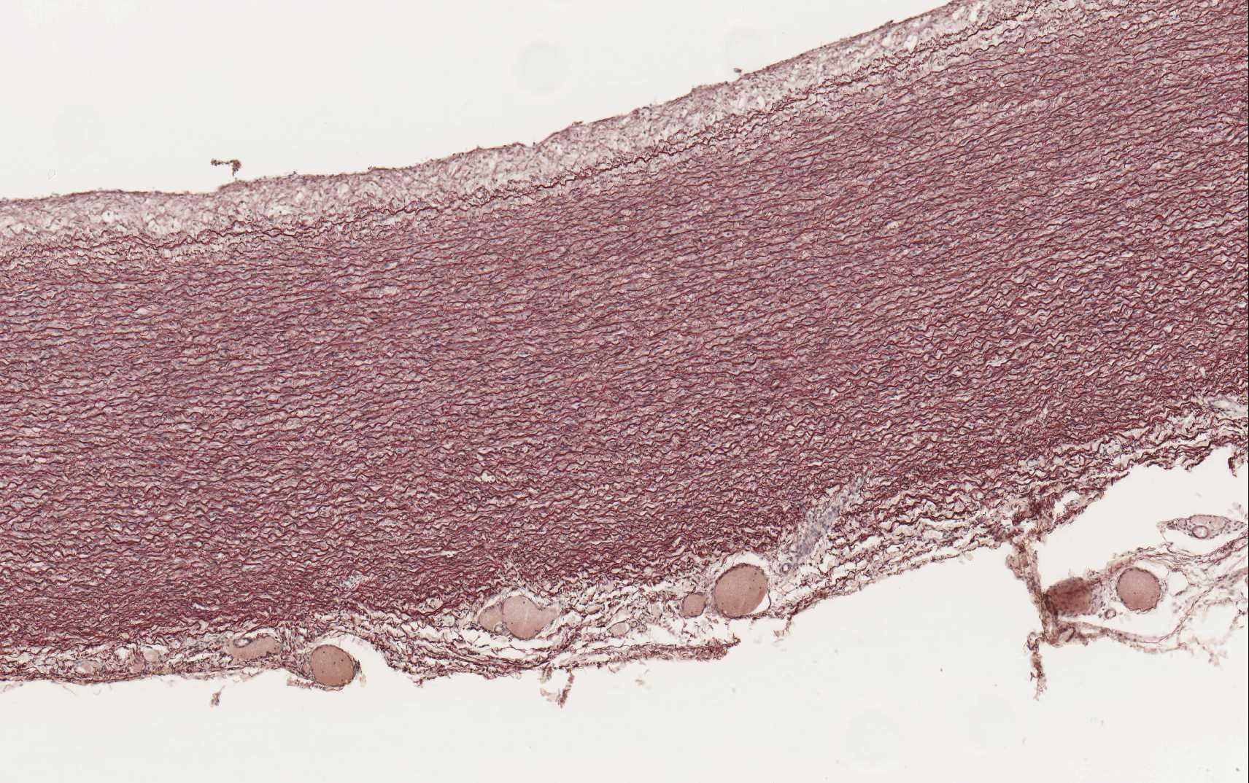
aorta
HE orcein

Slide 13
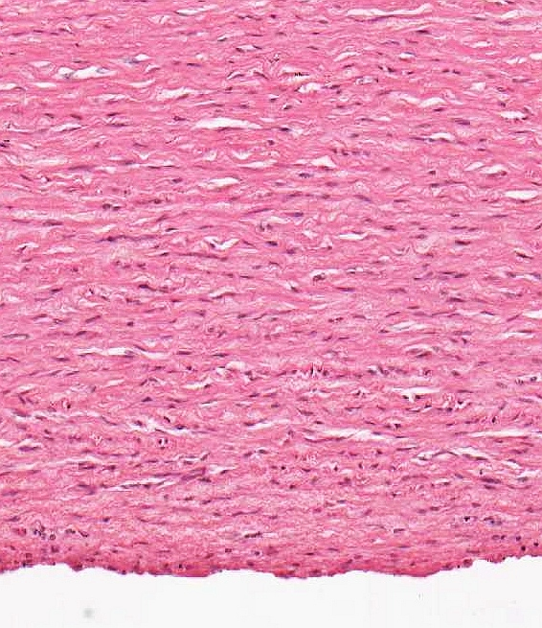
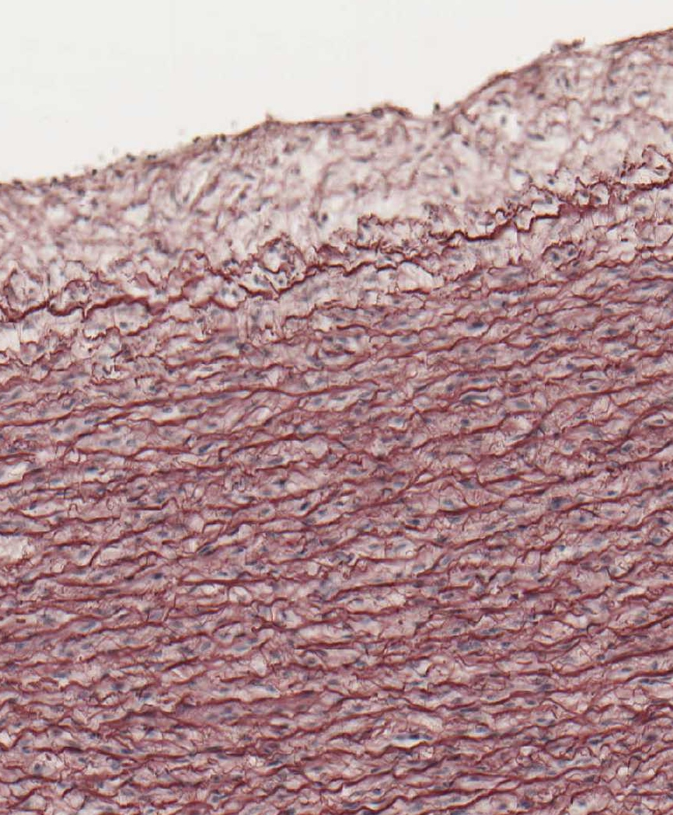
aorta – intima *
HE orcein
*
*

Slide 14
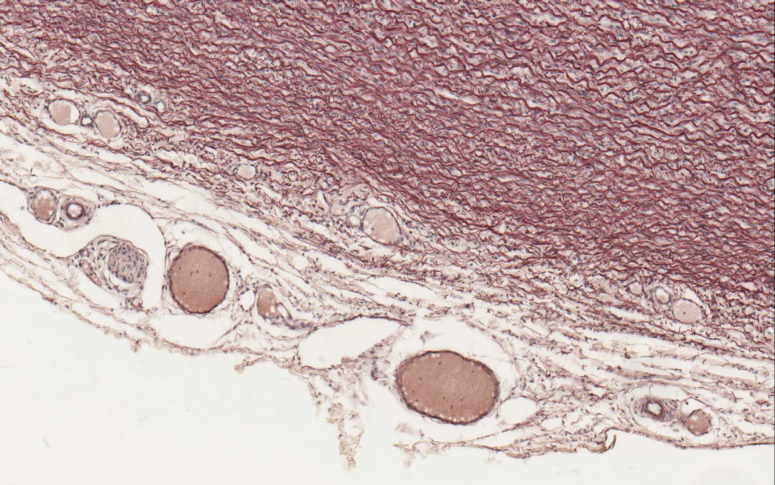
aorta (orcein) – adventitia, vasa vasorum, nervi vasorum

Slide 15
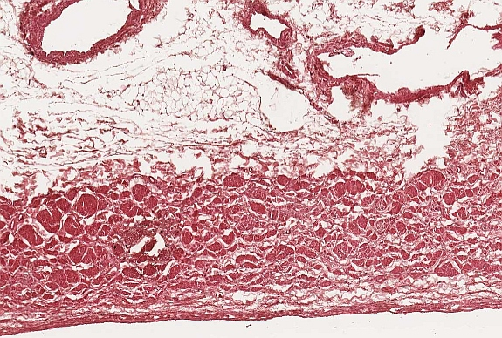
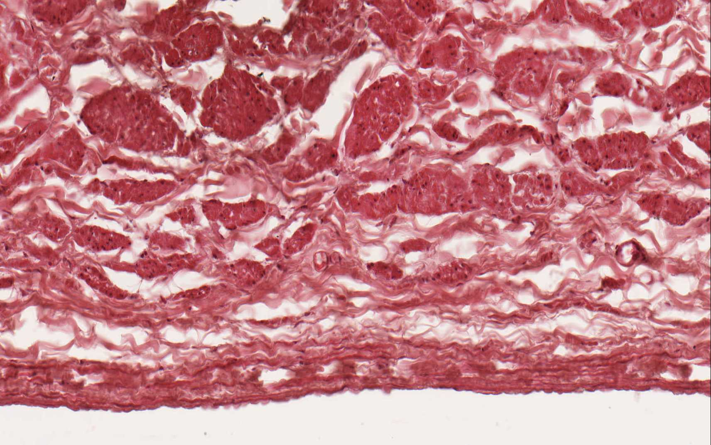
vena cava (HE)

Slide 16
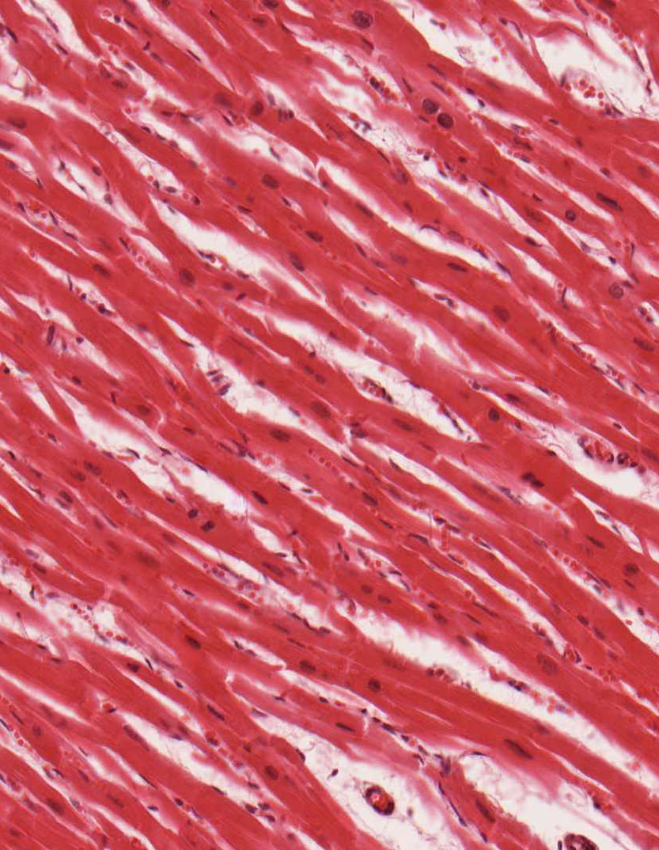
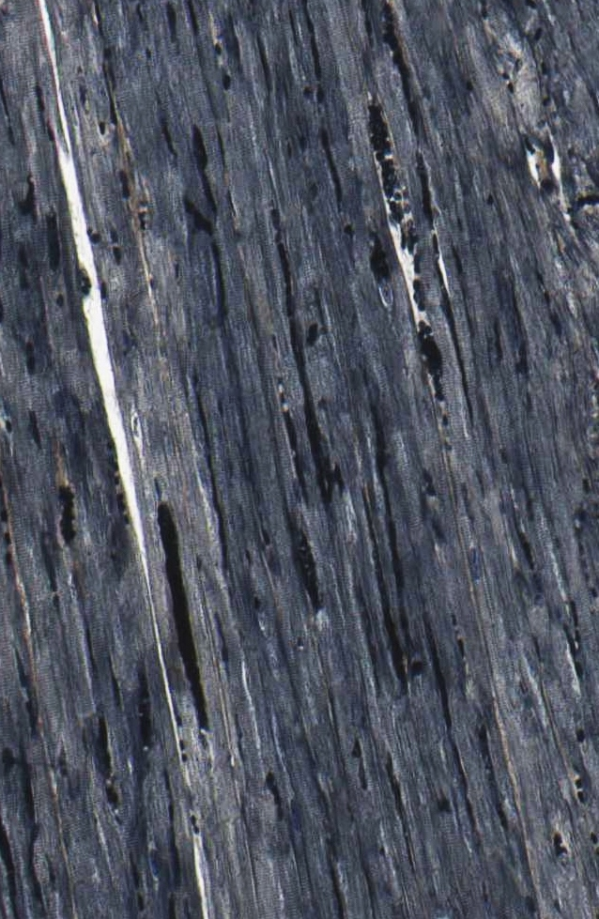
myocardium
HE Heidenhain

Slide 17
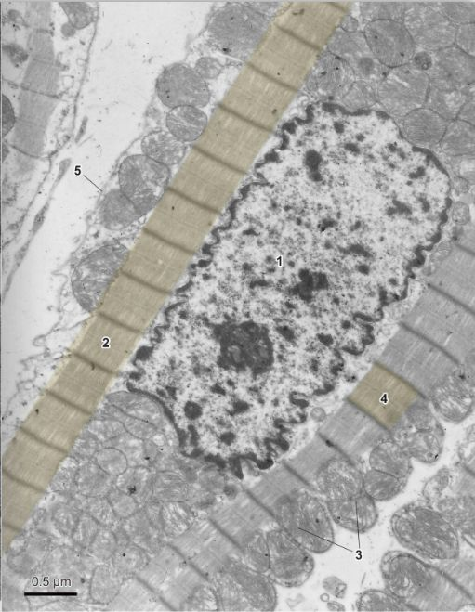
cardiomyocyte (TEM)

Slide 18
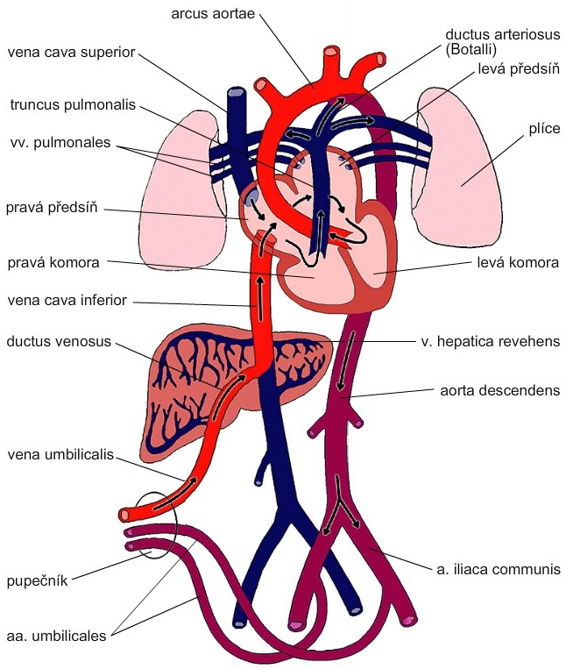
Fetal
blood circulation
left atrium
lung
right atrium
right ventricle
left ventricle
umbilical cord

Slide 19
CARDIOVASCULAR SYSTEM
Slides
Muscular artery and vein (59 – HE, 60 - orcein)
Aorta (61 – HE, 62 - orcein)
Vena cava (63 - HE)
Myocardium (64 – HE, 65 - Heidenhain)
Atlas EM:
Arteriole (59)
Continuous capillary (55)
Fenestrated capillary (56, 57)
Sinusoid capillary (58)
Cardiomyocyte (44-46)
Development of heart, embryonic and fetal blood circulation (91-93)

