Slide 1

The Basisc of Hygiene in Dentistry:
Prevention (types, goals, methods).
Preventable risk factors in cardiovascular and oncologic diseases.
Assoc. Prof. Jindřich Fiala
Dept. of Public Health

Slide 2
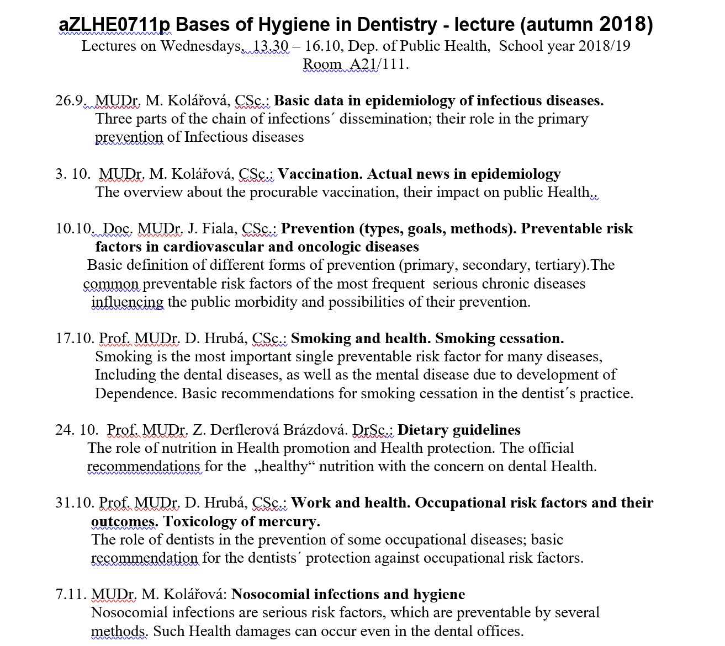

Slide 3
Subject scope
The basic general principles and methods of health protection
Non-infectious factors affecting health (environmental, occupational, nutritional and other lifestyle factors…)
Infectious factors (infectious epidemiology)

Slide 4
Exam questions (topics)
A) Hygiene and preventive medicine – 15 questions
B) Epidemiology of infectious disease – 22 questions
For the exam, every student picks randomly one A-question and one B-question

Slide 5
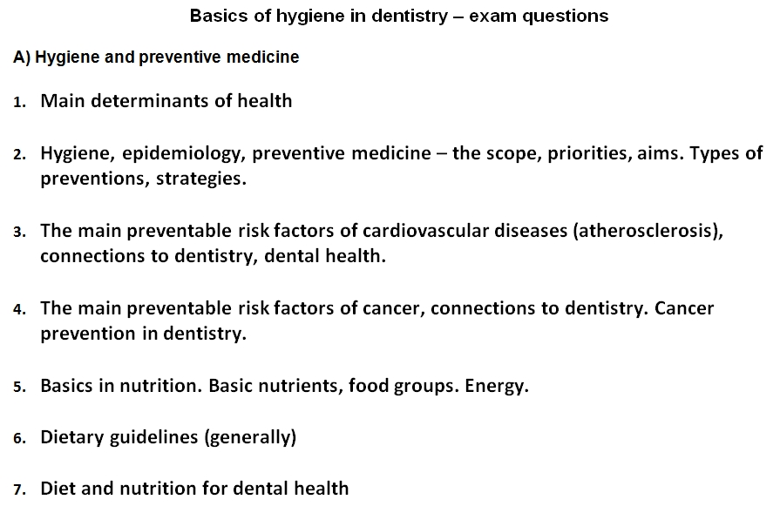

Slide 6
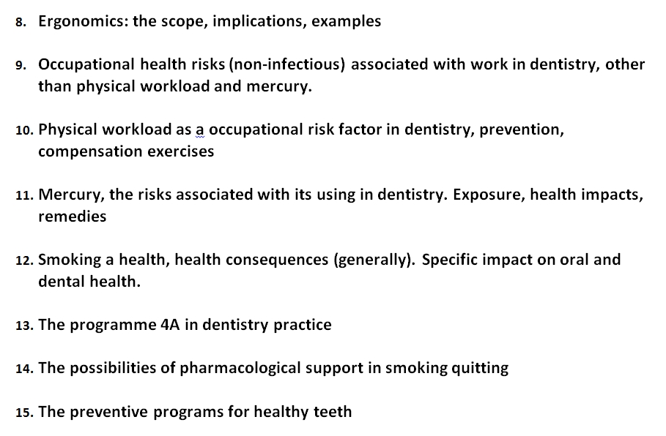

Slide 7
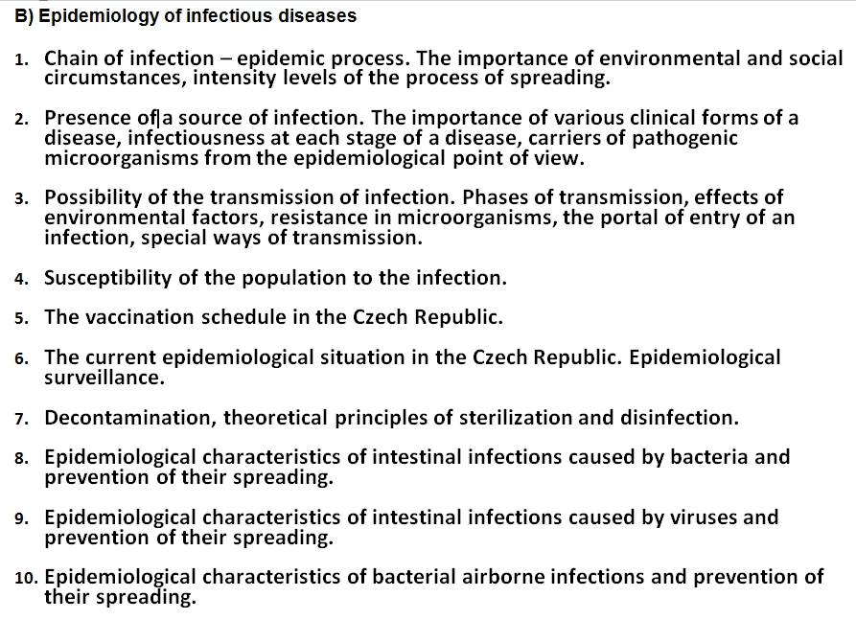

Slide 8
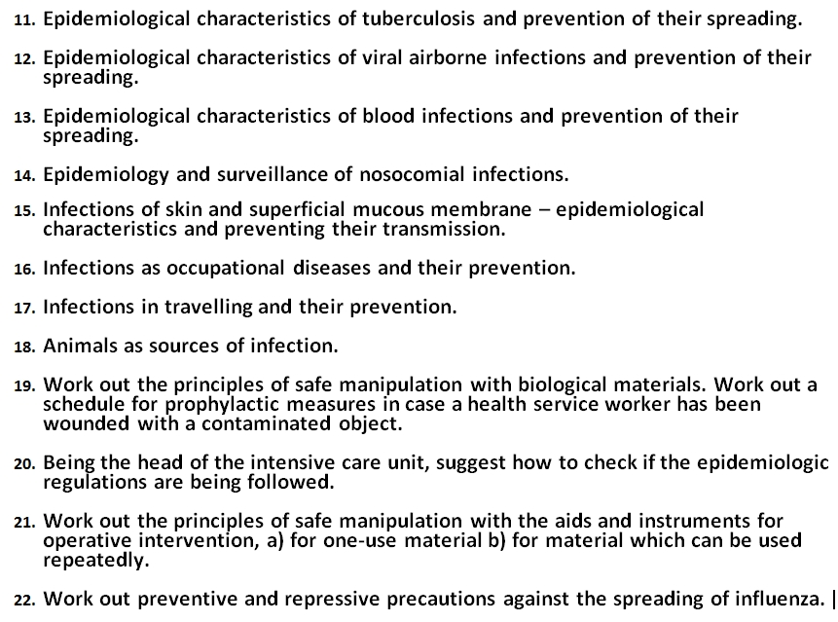

Slide 9
Why?

Slide 10
5 Reasons for teaching Hygiene and Preventive Medicine in Dentistry:
Prevention works also in dentistry
Oral health is greatly influenced by factors like nutrition, smoking, hygiene, infections….)
Oral health is closely connected with main diseases and their risk factors
Occupational hygiene (physical and chemical factors): risks both for medical staff and patients
Infections (respiratory, parenteral): risks both for medical staff and patients

Slide 11
Determinants of health
External influences
(including lifestyle)
Hereditary
dispositions
(genotype)
Health

Slide 12
On what depends, how healthy we are
Socioeconomic
factors
Lifestyle
factors (70%)
Health Care
(quality, availability,
effectiveness)
up to 20%
Inherited
dispositions
Environment
(air pollution, water quality,
noise, chemicals, etc.)
(up to 5 %)
Time (age)
Health

Slide 13
Health determinants
The result depends on the balance
Protective
factors
Risk
factors
ILLNESS - HEALTH?
Genetic basis

Slide 14
Progress of individual health– different combinations of genetics ans lifestyle
Excellent health (condition)
Excellent genotype + very healthy lifestyle
Excellet genotype + very unhealthy lifestyle
Health quality (of life)
Bad genotype + healthy lifestyle
Health
Disease
Bad genotype + unhealthy lifestyle
Serious illness, death
Youth
Time, age
Elderly

Slide 15
Health protection and promotion
Protection against harmful external influences
Environmental (physical, chemical, biological)
Harms mediated by bad lifestyle
Health promotion
Healthy lifestyle
Medical promotion of imunity
15
Notes:
15

Slide 16
Hygiene, preventive medicine, epidemiology
Hygiene:
Environment and its impact on health (living conditions, work…)
Preventive medicine:
Health protection, disease prevention, health promotion
Epidemiology:
Study of the distribution and determinants of diseases

Slide 17
TYPES OF PREVENTION
 | Principle:
Prevention levels
Prevent the origin of ilness – by eliminating the causes of disease and/or by promoting the resistence
Primary
Early diagnosis of disorder, interruption of the development of the disease before the symptomatic stage
Secondary
Reduce the progression of disease, prevent new attacs of disease
Terciary

Slide 18
Levels of prevention a) primary, b) secondary, c) tertiary
a. Primary prevention is the prevention of disease or injury. Primary prevention activities can be directed at individuals or at the environment.
(1) Health education: encouraging people to develop good health habits (nutrition, exercise), to avoid harmful substances (alcohol, tobacco, drug abuse) and harmful circumstances (driving while intoxicated) and to use specific protective measures (e.g., immunizations, condom use).
(2) Environmental modification can decrease injuries from falls, fires, or automobile accidents. Environmental sanitation is used to provide an adequate sewage system, safe drinking water, clean air, and environment free of toxic substances.

Slide 19
b. Secondary prevention
is the early detection and prompt treatment of disease.
(1) Screening programs are used to detect diseases in early preclinical stages, when effective therapy may either cure the disease or limit its progression (e.g., neonatal detection of phenylketonuria, the Pap test to detect in situ carcinoma of the cervix, glaucoma testing).
(2) Primary medical care is the predominant form of secondary prevention. Most health expenses are spent on, and most health care personnel are employed in, primary care.
c. Tertiary prevention is the limitation of disability and the rehabilitation from disease. It emphasizes a person’s remaining abilities and attempts to restore the person to as normal a life as possible.

Slide 20
2 strategies in prevention:
Population approach
Individual approach
(also „high risk strategy“)
20
Notes:
20

Slide 21
What belongs to primary prevention
Lifestyle:
No-Smoking
Healthy diet
Physical activity
Occupational hygiene
Environmental hygiene
(air, water, noise, radiaton…)
Food safety
Common hygiene (transmission of infections)
Vaccination

Slide 22
What belongs to secondary prevention
Screening, preventive check-ups with the aim of early diagnosis

Slide 23
Cardiovascular diseases – epidemiology, risk factors (etiology), prevention

Slide 24
Mortality structure
Digestive
4%
Respiratory
5%
Other
6%
Injuries
7%
Cardio-vascular
52%
Cancer
26%

Slide 25
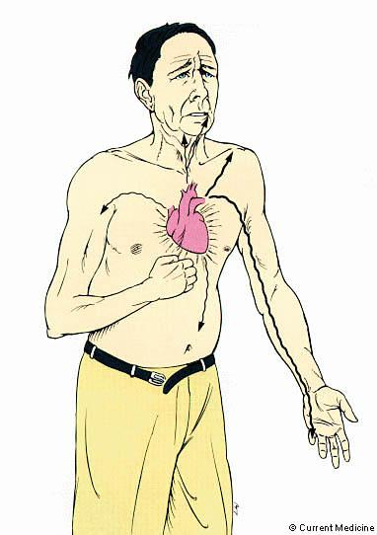
Severe pain by myocardial infarction

Slide 26
Cardiovascular dieseases
Atherosclerosis =
Common denominator, and the principal cause of the main cardiovascular diseases
Clinical consequences of atherosclerosis:
Myocardial infarction
Stroke

Slide 27
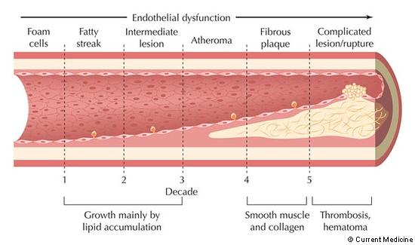
Development of atheroslerosis in type ( it takes40-50 years)

Slide 28
Causes of atherosclerosis
Main modifiable risk factors
Lifestyle factors
Physiologic characteristics
(Modifiable directly
(Modifiable undirectly, secondarily)
High blood Cholesterol
Smoking
High Blood Pressure
Diet - rich in saturated fats, cholesterol and energy
Overweight, obesity
Diabetes,
elevated blood sugar
Physical inactivity
Alcohol – high consumption
Trombogenic factors

Slide 29
Smoking
The single most important risk factor for cardiovascular diseases (and cancer)
Harms even in the smallest dose
Basicaly very easy modifiability

Slide 30
Prevention of cardiovascular diseases by diet
People should be able to choose healthy foods and compose healthy diet for lowering the risk of atherosclerosis

Slide 31
Food, diet and the risk of atherosceloris – what matters:
Fats – mainly their composition
(different types of fatty acids):
Saturated FA (animal fat in meat, milk fat, coconut…)
Unsaturated FA (in plant oils, fish)
- MUFA – Mono Unsaturated
- PUFA – Poly Unsaturated FA
- „Trans“ fatty acids (in cheap pastries etc.)
Cholesterol in food (but this is not the most important factor)
Too much energy
Protective substances (phytochemicals)

Slide 32
Diet for prevention of CVD:
Diet must be varied
Energy intake to maintain BMI in the range 18.5 - 25
Promote the consuption of following foods:
Fruits and vegetables
Wholegrain cereals and breads
Low-fat dairy products
Fish and omega-3 FA especially protect against CVD
Fats:
Fats should acount for 25-35% of energy intake
Saturated – up to 7% of total energy intake
Dietary cholesterol < 200mg / day
Saturated fats should be replaced by carbohydrates and MUFA+PUFA

Slide 33
The effect of physical activity on cardiovascular risk factors
Lifestyle factors
Physiologic characteristics
Smoking
High blood Cholesterol
Diet - rich in saturated fats, cholesterol and energy
High Blood Pressure
Overweight, obesity
Physical inactivity
Diabetes,
Glucose intolerance
Trombogenic factors
Alcohol – high consumption
Low
cardiorespiratory
fitness

Slide 34
Recommendations of physical activity
Practice physical activity on regular basis:
Endurance, aerobic
Type of activity:
Frequency:
(how often)
Preferably daily
Length - duration:
(of 1 session)
>30 minutes
Intensity:
Moderate to Vigorous
(60-80 % of max. HF)
Max.HF (Heart Frequency) = 220 - age

Slide 35
Blood cholesterol
Total cholesterol (TC)
< 5 mmol/l, by hi-risk < 4,5 mmol
LDL-cholesterol (LDL-C)
< 3 mmol/l, by hi-risk < 2,5 mmol
HDL-cholesterol (HDL-C)
> 1 mmol/l (the higher, the better)

Slide 36
Body weight, fatness
Maintan the balance between energy intake a output to keep
BMI 18,5 - 25
Weight [kg] / (Height)² [m]
Underweight | Normal weight | Overweight | Obesity
< 18,5 | 18,5 - 25 | 25 - 30 | > 30

Slide 37
Blood pressure
Systolic | Diastolic | Category
< 120
< 80
Optimal
120 - 129
80 - 84
Normal
130 - 139
85 - 89
High normal
> 140
> 90
Hypertension

Slide 38
Cancer

Slide 39
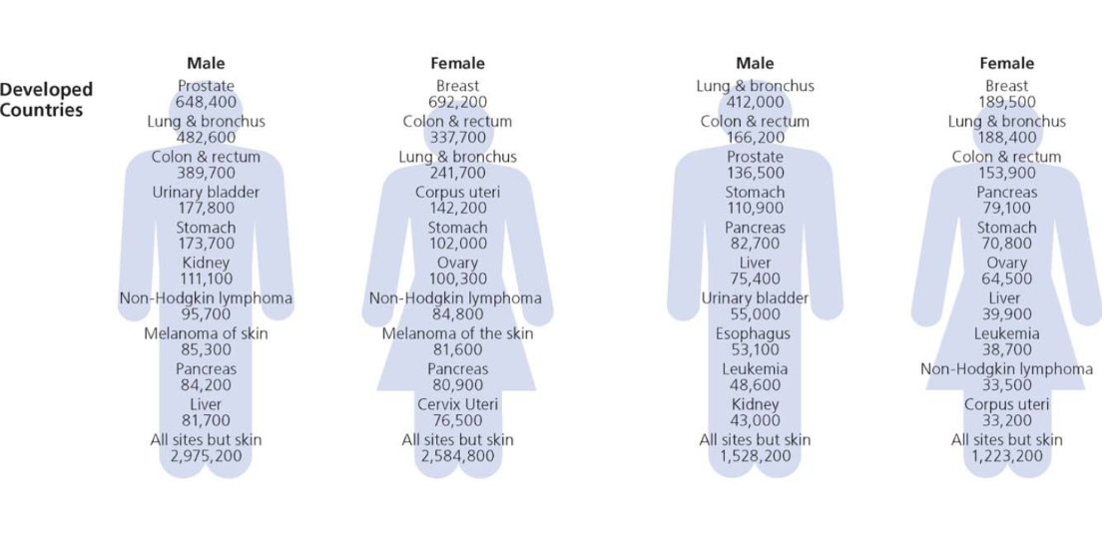
Incidence and mortality according to cancer sites

Slide 40
Main risk factors
Causes of cancer

Slide 41
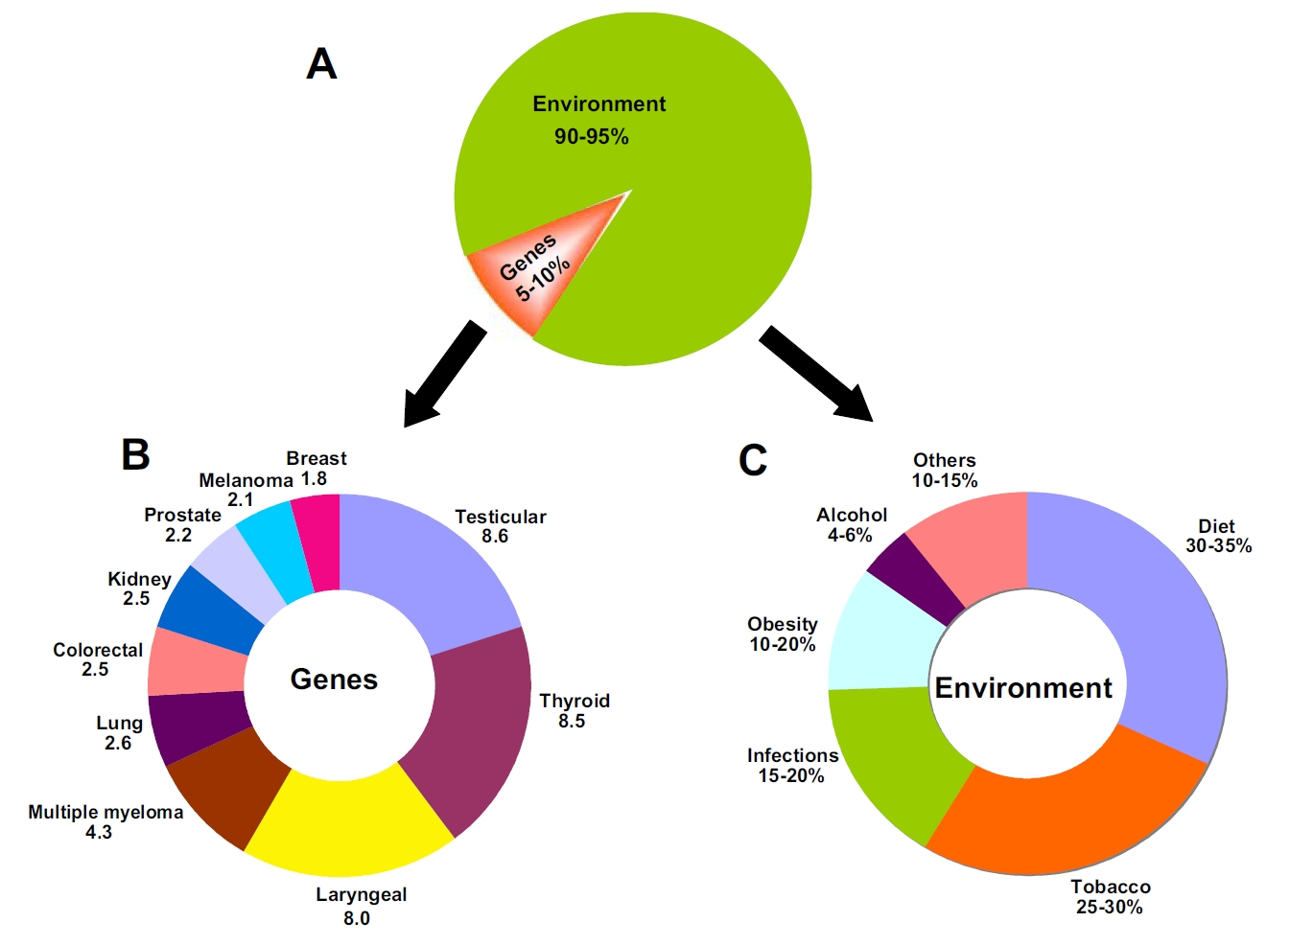
Cancer Causes
41
Anand et al. (2008)
Notes:
41

Slide 42
Attributive part of overall cancer mortality
Cancer causes
Modifiable factors cause 90-95 % of all cancers!
Diet
35 %
Smoking
30 %
5 %
Physical inactivity
5 %
Alcohol
Infections
Radiation (including Sun)
Occupational exposures
Chemical pollution and residuals
%
0
5
10
15
20
25
30
35
40

Slide 43
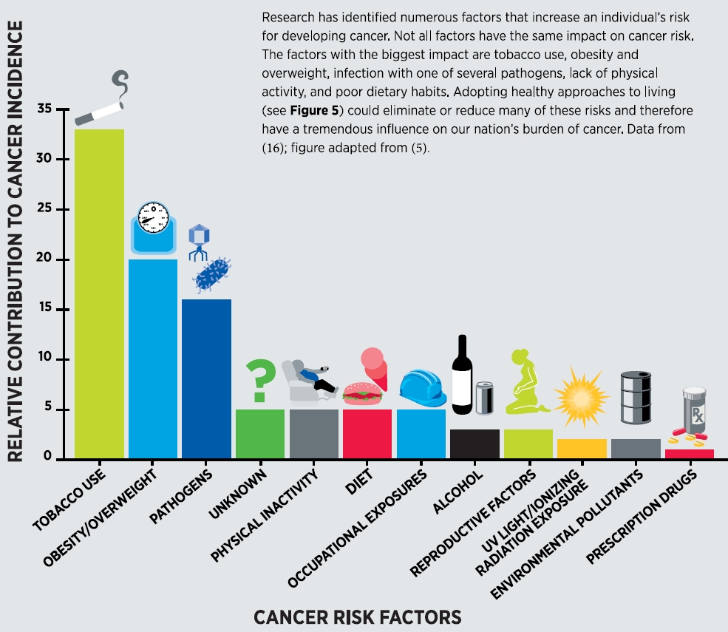
43
Notes:
43

Slide 44
Smoking and cancer risk
The most important single cause of cancer
(It causes approx. 30% of all cancer deaths)
There are approx. 60 proved human carcinogens in cigarette smoke (!!!)
Cigarettes classified as Carcinogen class I (=proved human carcinogen)
And normally, freely being sold ??????
Provably causes cancer of 19 sites (!!!)

Slide 45
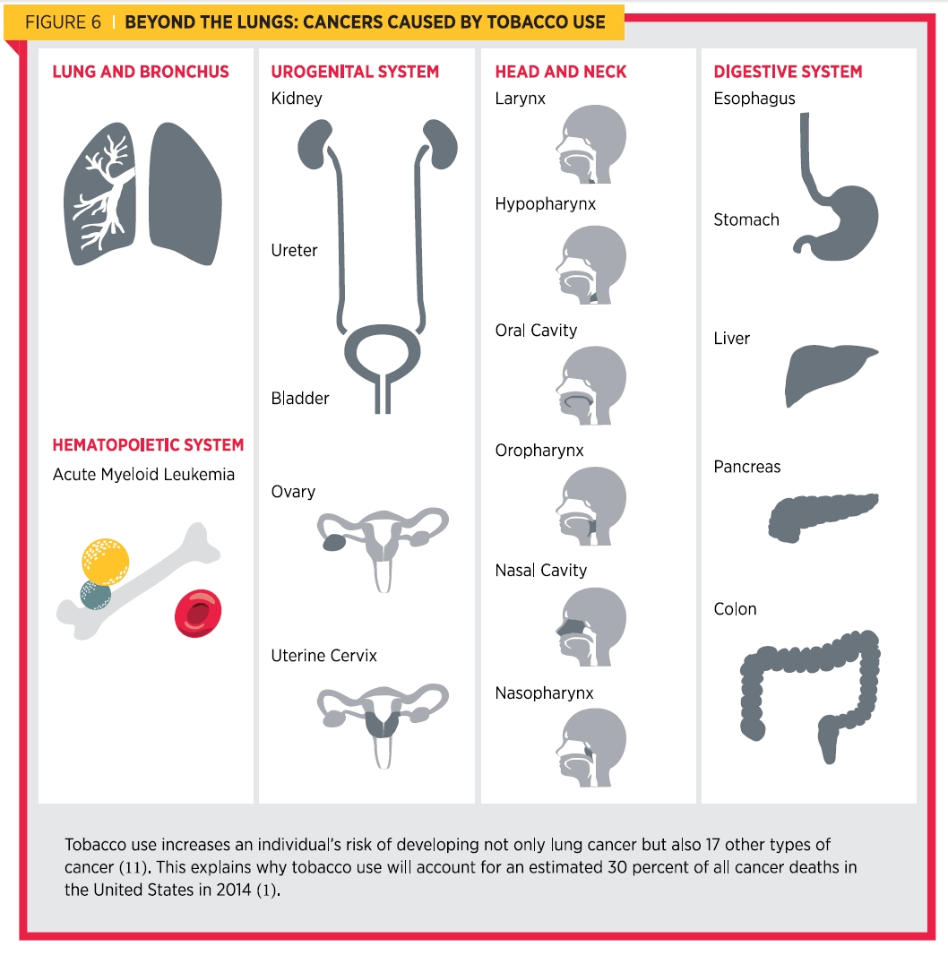
Kouření a rakovina
45
Notes:
45

Slide 46
Cancer sites with evidence of carcinogenity of smoking (Secretan 2009)
Mouth
Oropharynx
Nasopharynx
Hypopharynx
Oesophagus
Stomach
Colorectum
Liver
Packreas
Nasal cavity and paranasal sinuses
Larynx
Lung
Cervix uteri
Ovarium
Bladder
Kidney
Ureter
Bone marrow (myeloid leukemia)
Breast (limited evidence)
46
Notes:
46

Slide 47
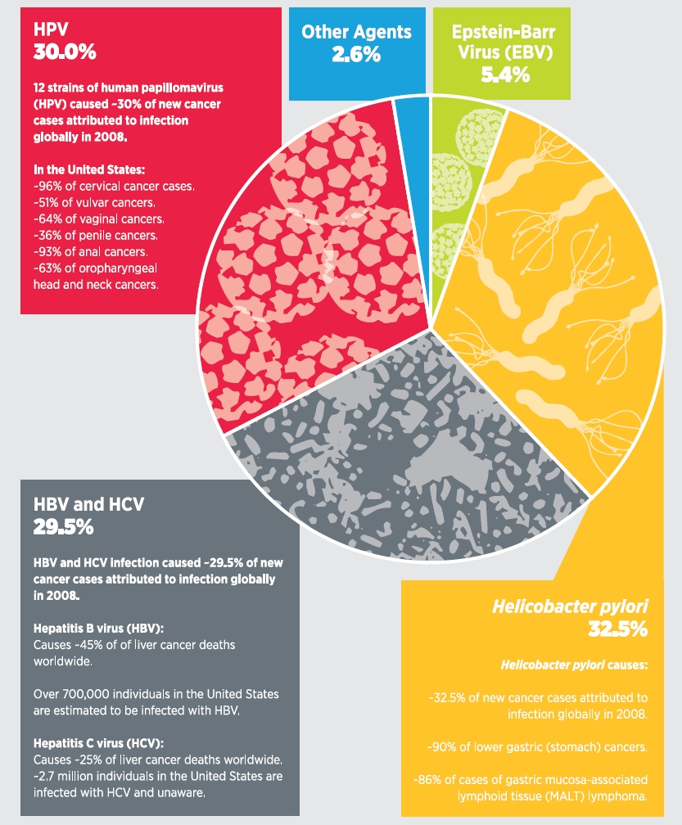
Infekce
47
Notes:
47

Slide 48
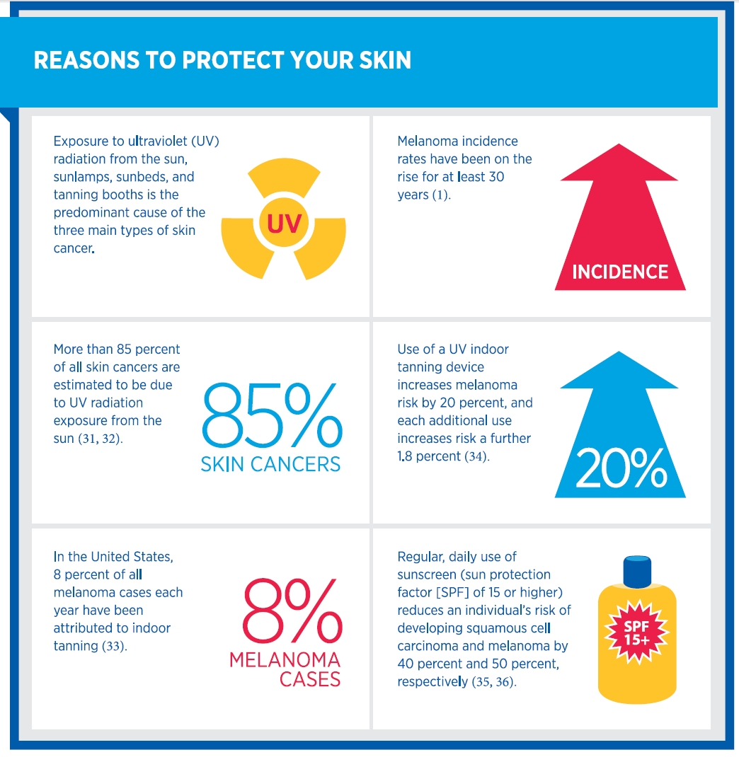
Infekce
48
Notes:
48

Slide 49
Diet and the risk of cancer

Slide 50
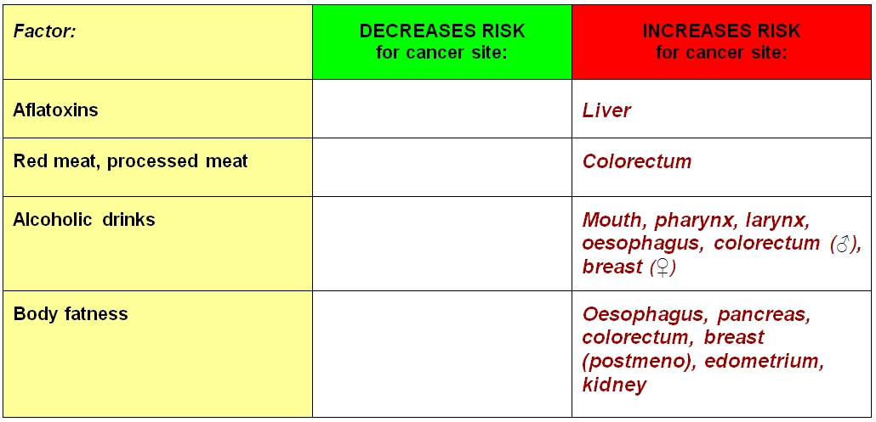
Summary I – dietary factors with CONVINCING evidence of effect on cancer risk:
50
Notes:
50

Slide 51
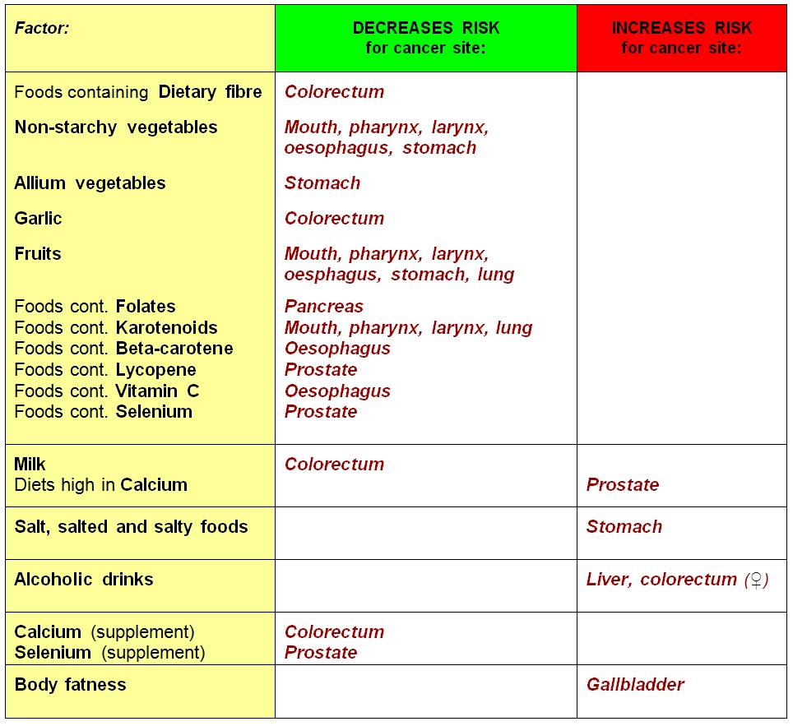
Summary II – dietary factors with PROBABLE evidence:
51
Notes:
51

Slide 52
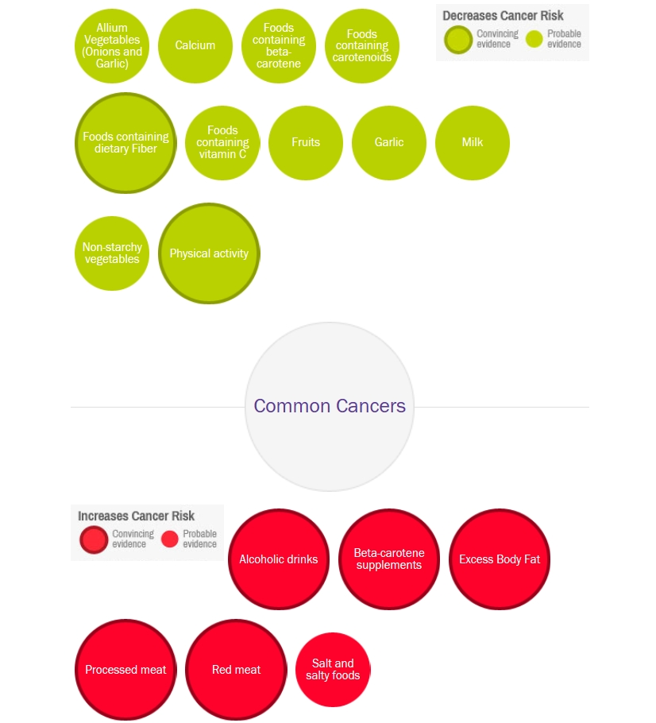
52
Notes:
52

Slide 53
And what is without any substantial effect on cancer risk (both adverse or favourable:
„E-numbers“ in food
Pesticide and other chemicals residuals in food
Artificial sweeteners
Green tea, black tea
Coffee
Suplemments, pills againts cancer (vitamin etc.)
Organic food (no other effect on cancer than normal foods)
53
Notes:
53

Slide 54
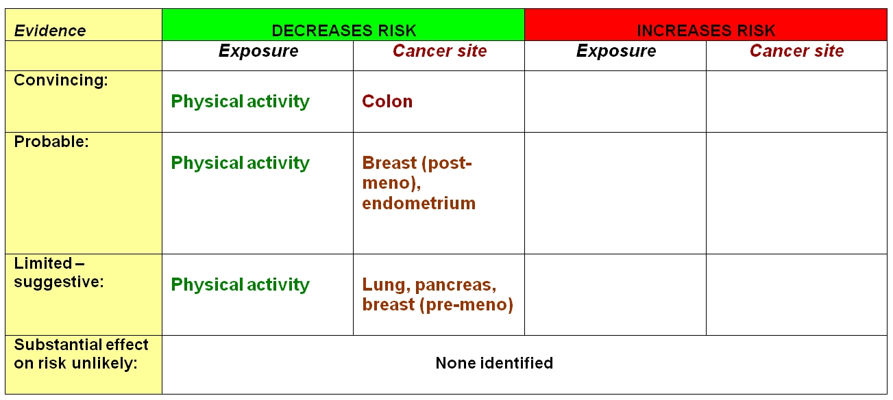
Physical activity

Slide 55
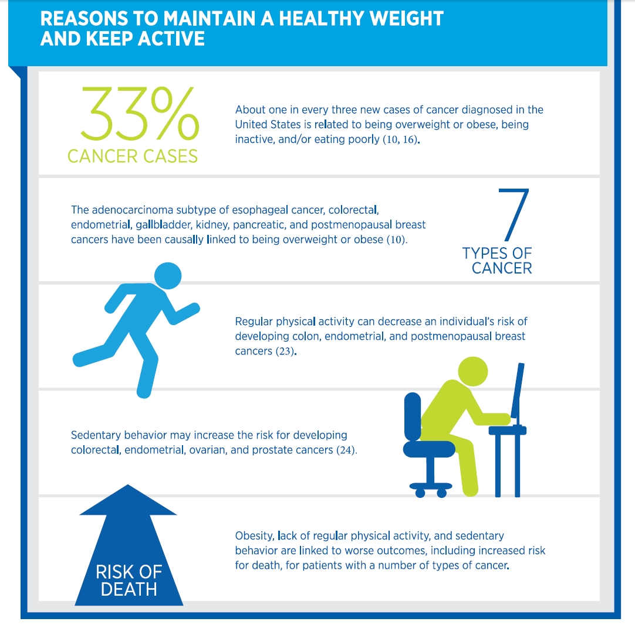

Slide 56
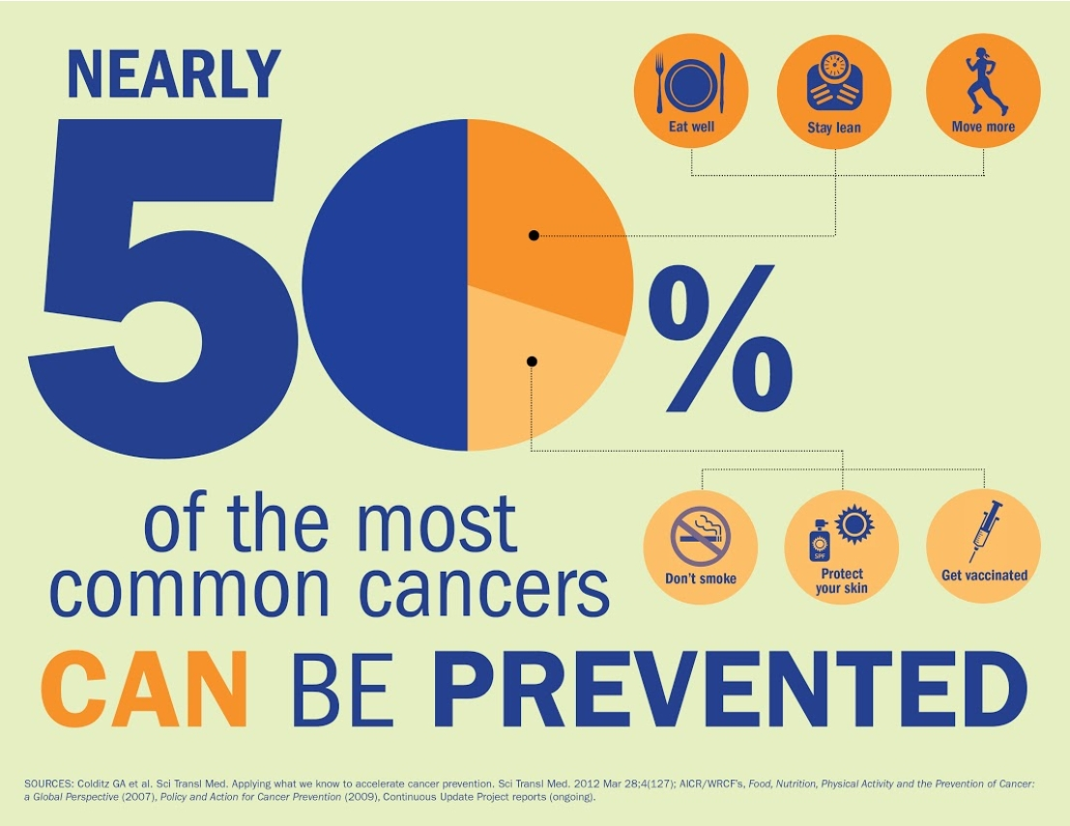
56
Notes:
56

