Slide 1
Restorative dentistry 3rd year Lecture 1
L. Roubalíková

Slide 2
Preparation of dental caries (cavity preparation)
Instrumental treatment that removes dental caries
The rest of the tooth must be restorable with filling materials
The rest of the tooth as well as the filling must be resistant against occlusal forces
The risk of secondary caries must be minimized

Slide 3
Step by step procedure
Acces to the cavity
Preparation of cavosurface margin and
Extention for prevention
Retention of the filling
Resistance of the restored tooth
Excavation of carious dentin
Finishing of the walls
Final control (light, mirror, magnification)

Slide 4
Basic rules
Acces to the cavity
Preparation through the hard dental tissues
Removal the undermined enamel
Separation of teeth
Separation or removal of gingiva

Slide 5
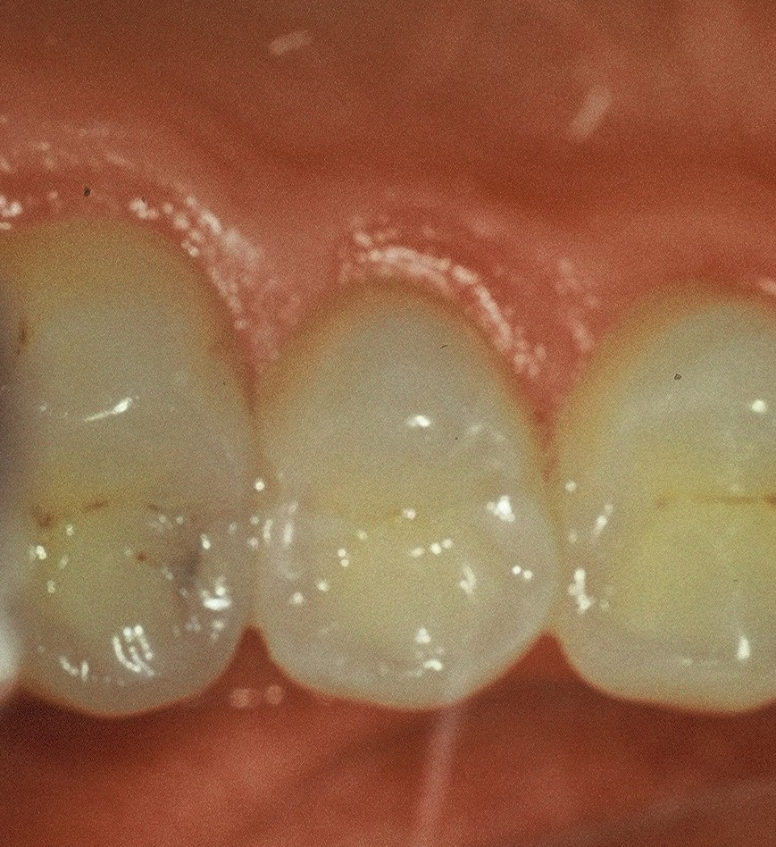
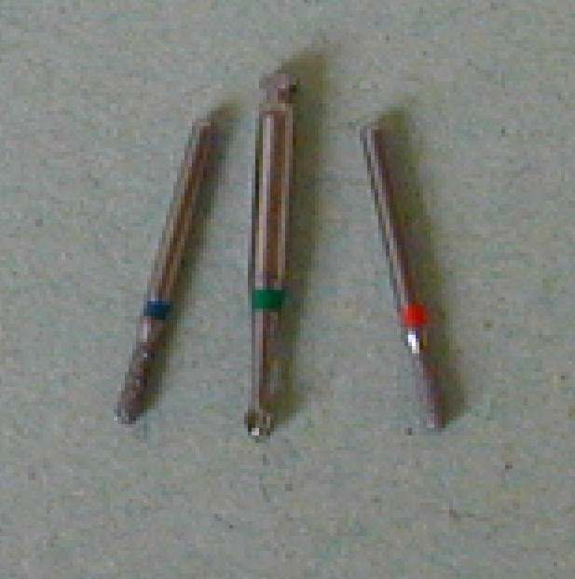

Slide 6
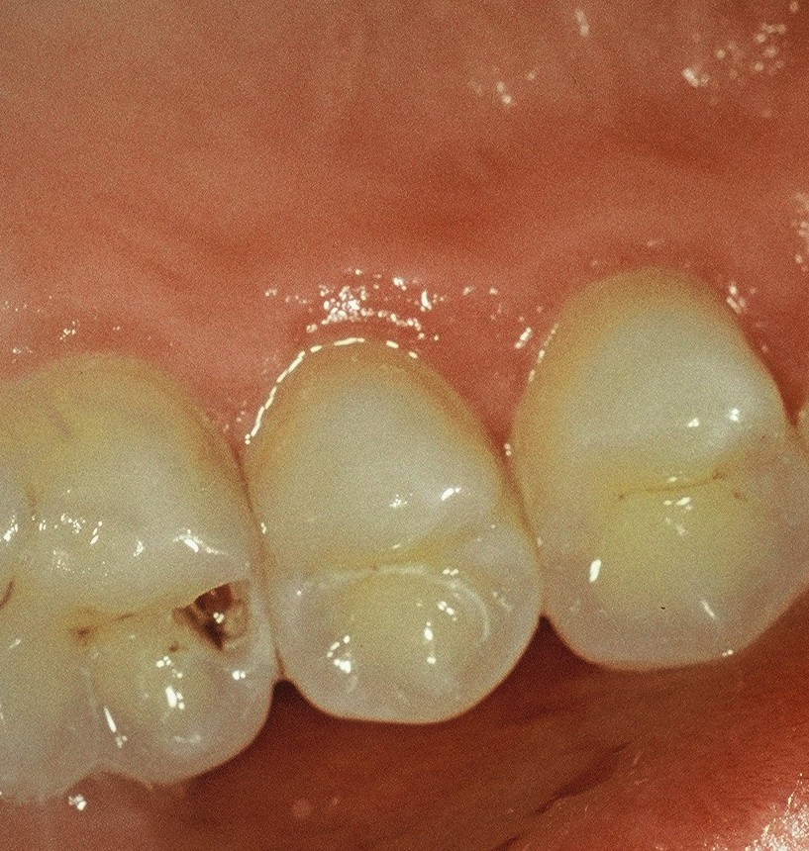
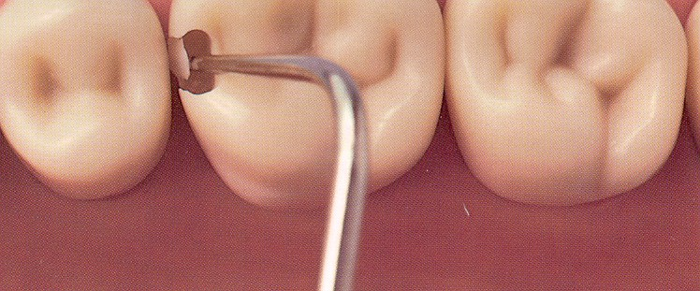

Slide 7
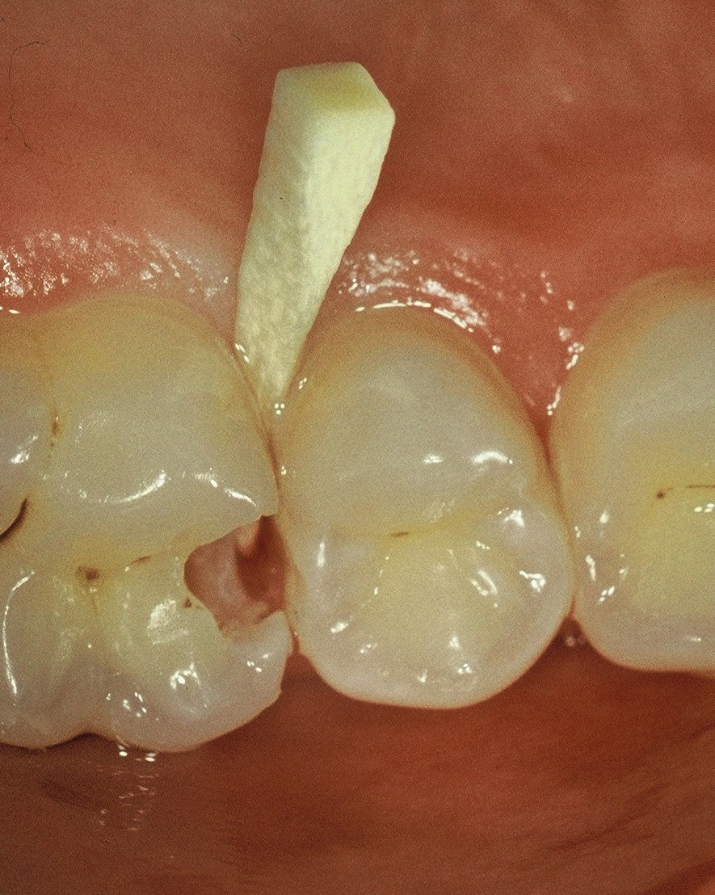

Slide 8
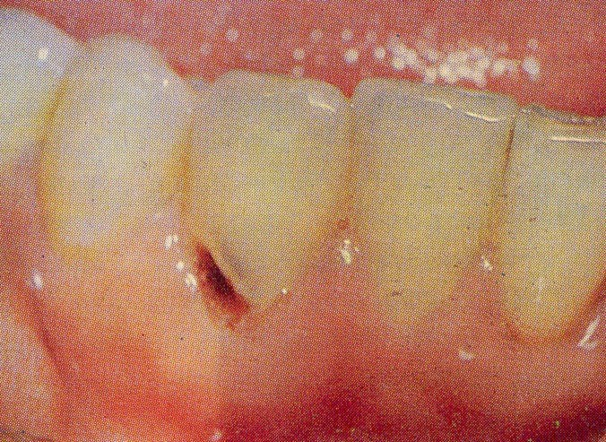

Slide 9
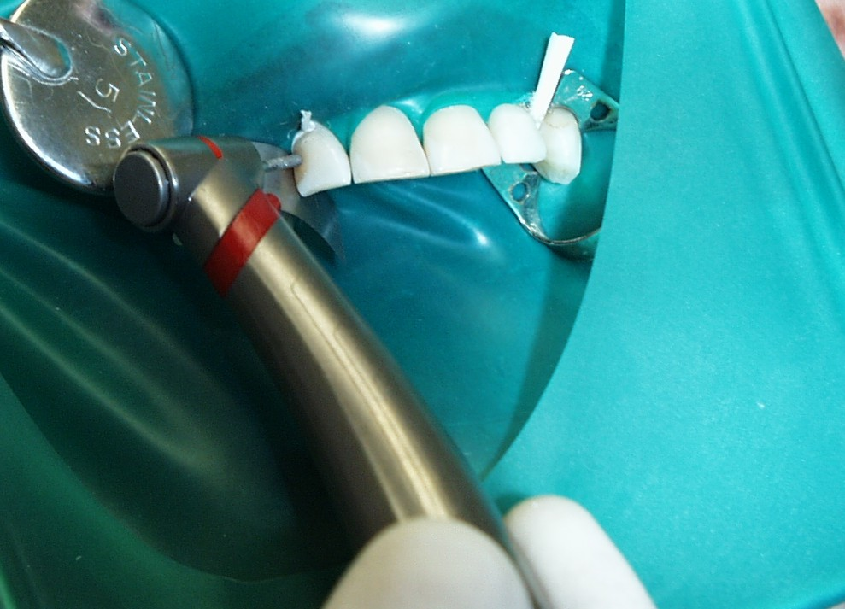
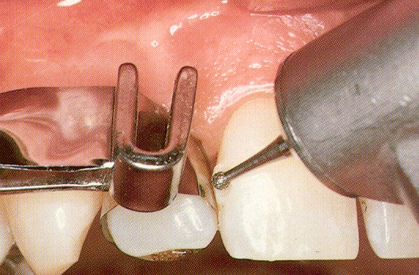
Old filling is being removed

Slide 10
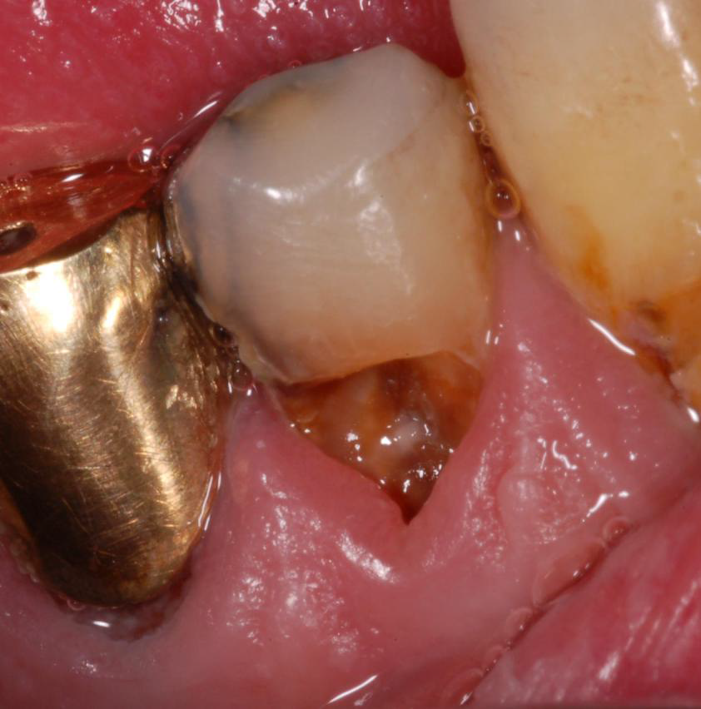
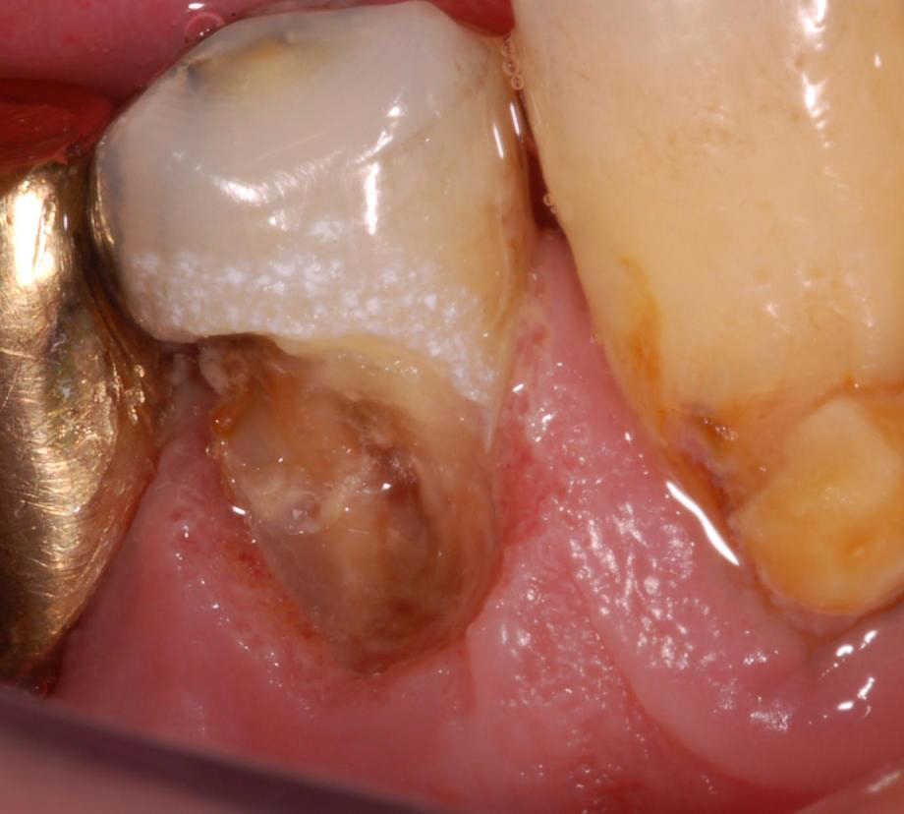
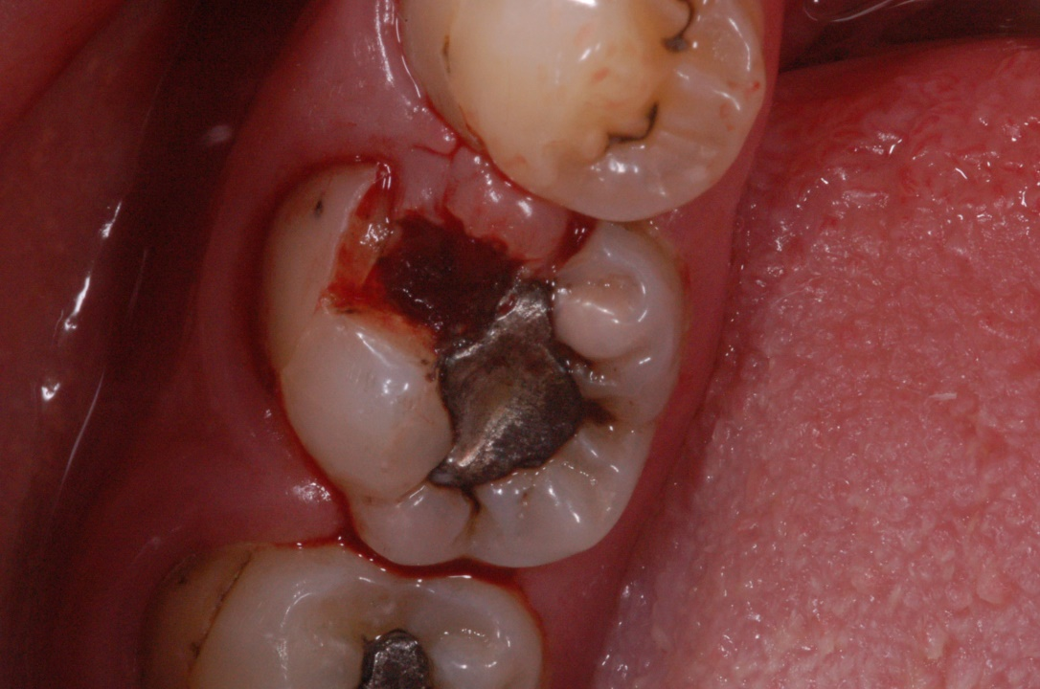

Slide 11
Basic rules
Preparation of cavity borders and extention
for prevention (Cavosurface margin)
Depends on
Dental material
Oral hygiene
Precautions of secondary caries

Slide 12
Basic rules
Retention of the filling
Precautions of its lost
Macromechanical retention
Micromechanical retention
Chemical retention

Slide 13
Basic rules
Resistance of the restored tooth
Against occlusal and other forces
Depends on
Material
Individual occlusal forces

Slide 14
Basic rules
Excavation of carious dentin
Necessary (risk of recurrent caries)
Ball shaped (spheric) bur - slow speed (3000 rpm)
or
Excavator (hand instrument)

Slide 15
Basic rules
Finishing of the walls
Depends on the kind of material
Bevel or without bevel
Fine diamond bur

Slide 16
Basic rules
Final control
Direct or indirect view
Good illumination
Magnification

Slide 17
Preparation
Hand
Excavator, cleaver
Power driven
Burs, diamonds

Slide 18
Chisel – for enamel Cleaver

Slide 19
Chisel for enamel

Slide 20
Excavator

Slide 21
Instruments for cavity preparation
Power driven (powered) instruments for cutting
Rotary instruments
Comon design characteristics
shank
neck
head
lenka.roubalikova@tiscali.cz

Slide 22
Cutting instruments - burs
Steel
Tungsten carbide

Slide 23
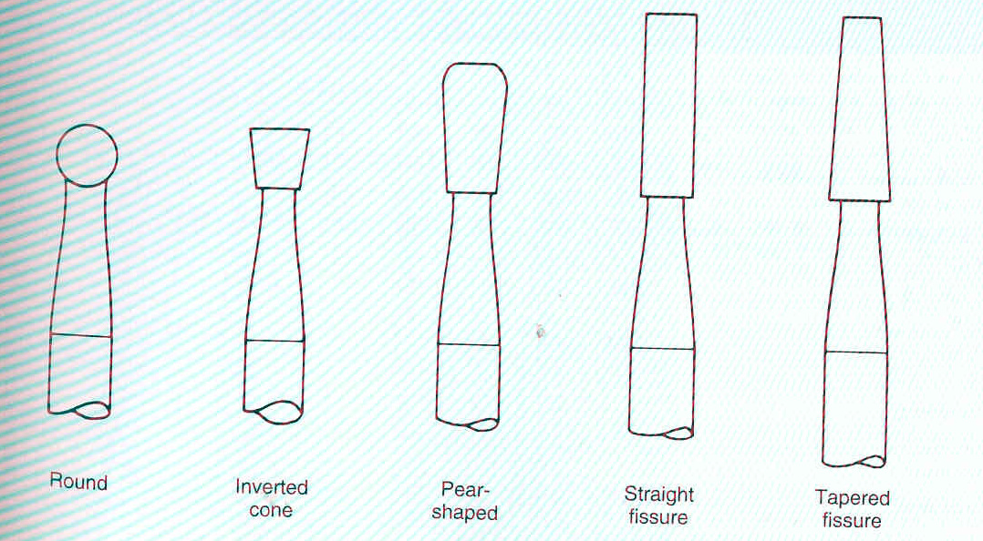
Cutting instruments – burs head shapes
Round (ball shaped)

Slide 24
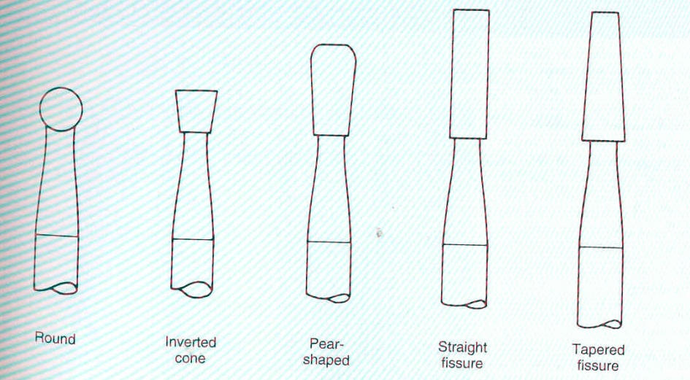
Cutting instruments – burs head shapes
Fissure with flat end
Fissure with pointed end
Straight or tapered form

Slide 25
Cutting instruments – burs head shapes
Pear

Slide 26
Cutting instruments – burs head shapes
Inverted conus

Slide 27
Cutting instruments – diamonds
Extra coarse – black
Coarse – green
Standard – blue or without any marker
Fine - red
Extra fine - yellow
Ultrafine - white

Slide 28
Cutting instruments – diamonds head shape
Ball, pear, cylinder,taper,flame, torpedo, lens and others…..

Slide 29
Hazards with cutting instruments
Pulpal precautions
Soft tissue precautions
Eye precautions
Ear precautions
Inhalation precautions

Slide 30
Filling materials
Temporary
Definitive, permanent

Slide 31
Temporary filling materials
Zinkoxidsulphate cement and one
component derivates
Ziknoxidphosphate cement
Zinkoxideugenol cement
Polymer based materials
Guttapercha

Slide 32
Permanent filling materials
Amalgam
Composites
Glasionomers

Slide 33
Amalgam

Slide 34
Amalgam
Metal-like restorative material composed of
silver-tin-copper alloy and mercury.

Slide 35
Types of amalgam restorative materials
Low – Copper Amalgam (5% or less copper)
Composition – wt%
Silver 63 - 70 %
Tin 26 – 28 %
Copper 2 - 5%
Zinc 0 - 2%

Slide 36
Types of amalgam restorative materials
High – Copper Amalgam (13% - 30%)
copper
Composition – wt%
Silver 40 - 70 %
Tin 26 – 30 %
Copper 2 - 30%
Zinc 0 - 2%

Slide 37
Particles of the alloy
Irregulary shaped (filings - lathe cut)
Microsphers
Combination of the two.

Slide 38
Particles shape
High – Copper Amalgam
Microsphers of the same composition
(unicompositional)
Mixture of irregular and spherical particles of
different or the same composition (admixed)

Slide 39
Production of irregular particles
Metal ingrediences heated, protected from
oxidation, melted and poured into a mold to
form an ingot.
Phases of the alloy: (intermetallic
compounds)
Ag₃Sn - γ
Cu₃Sn - ε
Cu₆Sn₅ - η
Ag₄Sn - β

Slide 40
Production of irregular particles
Ingot cooled slowly
Ingot heated at 400°C (6 – 8 hours)
(homogeneous distribution of Ag₃Sn)
Ingot cut on the lathe, particles passed trough a fine sieve
and ball milled to form the proper particle size.
Aging of particles (60 - 100°C, 6 – 8 hours)
Particle size: 60 – 120 μm in length
10 – 70 μm in width
10 – 35 μm in thickness

Slide 41
Production of irregular particles
Molten alloy is spraying into water under
high pressue
Irregulary shaped high-copper particles

Slide 42
Production of spherical particles
Molten alloy is spraying under
high pressue of inert gas through a fine
crack in a crucible into a large chamber
Diameter of the spheres: 2 – 43μm

Slide 43
Amalgamation processes
Metal alloy is mixed with pure mercury
Trituration

Slide 44
Amalgamation processes
Intermetallic compounds
Hg
Ag₃Sn – γ
Cu₃Sn – ε
Ag
Cu
Sn
Cu
Sn
Ag
Cu
Ag
Cu
Sn
Ag
Sn
Ag
Cu
Sn

Slide 45
Amalgamation processes
High copper amalgam – copper dissolved in mercury has high reaction afinity
to tin that is also dissolved in mercury. It reacts with tin in gamma2 phase
and eta phase comes into existence.
The gamma 2 phase disappears.
Ag₃Sn – γ
Cu₃Sn – ε
Cu₆Sn₅ - η
Sn₇Hg – γ₂
Ag₂Hg₃ – γ₁
Ag
Cu
Sn
Cu
Sn
Ag
Cu
Ag
Cu
Sn
Ag
Sn
Ag
Cu
Sn

Slide 46
Setting of low copper amalgam
Principle of setting is crystallization
Structure of the amalgam filling
Ag-Hg: gamma 1
Sn-Hg: gamma 2
Gamma phase (Ag-Sn) does not dissolve
completely – remains in the structure
These phases crystallized – become hard

Slide 47
Risks of the gamma 2 phase
Non stable
Tin is released due to electrogalvanism in oral cavity and mercury from this phase reacts with remaining gamma phase.
This is external electrochemical corrosion.
Low copper amalgam has worse mechanical and corrosion resistance than high copper amalgam

Slide 48
High copper amalgam
Content of copper increased: 12 – 13%
(Less tin)
Or up to 25% ( Less tin and silver)
Better mechanical and corrosion resistance

Slide 49
Amalgamation processes
High copper amalgam
γ₂ phase disappears or does not occur
depending on the content of copper
Ag₃Sn – γ
Cu₃Sn – ε
Cu₆Sn₅ - η
Sn₇Hg – γ₂
Ag₂Hg₃ – γ₁
Ag
Cu
Sn
Cu
Sn
Ag
Cu
Ag
Cu
Sn
Ag
Sn
Ag
Cu
Sn
Gamma two disapears or it does not occur when content of copper is high

Slide 50
Amalgam - properties

Slide 51
Amalgam
Wear and pressure resistance (2mm thickness ast least)- brittleness
Easy handling
Low price
Thermal and electrical conductivity
Corrosion
Bad aesthetics
Flow (deformation of not completely set amalgam if the filling is loaded)
Creep – completely set amalgam can be deformed due to bite forces. The filimng is principly hammered.

Slide 52
Biocompatibility
More than 160 years, more than 200 milions Ag fillings every year in USA.
Allergy rare
Precautions in children and in pregnancy.
AMALGAM IS STILL A MATERIAL OF CHOICE

Slide 53
Toxicity
Organic compounds
Vapours, aerosol
Precautions
Ventilation
Rests of amalgam in water
Amalgam separators
Dangerous waste (180 110)

Slide 54
Amalgam indications
Posterior area
I. a II. class : moderate or large cavities,
V. class
Other factores for consideration
When oral hygiene is not excellent
When patient wants low cost filling.

Slide 55
Indications and contraindications of amalgam
Indications
Moderate and large cavities in posterior area (class I., II. V)
Contraindications
Fillings in frontal area
Pregnancy, children till the age of 15
Allergy
Other factores for consideration
When oral hygiene is not excellent
When patient wants low cost filling.

Slide 56
Mixing of amalgam
Hand mixing (obsolete)
Power driven trituration
Amalgamators

Slide 57
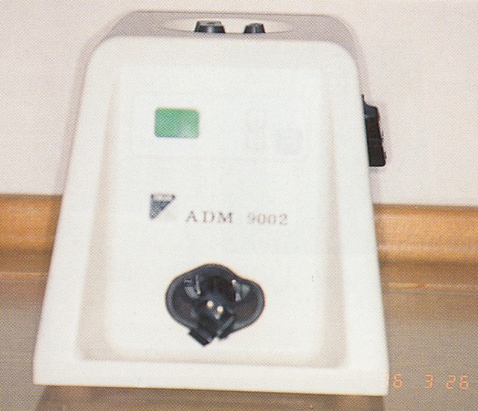
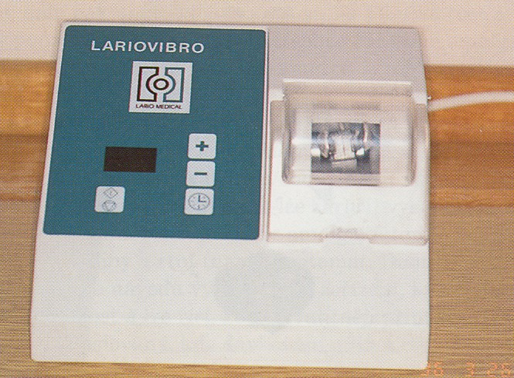
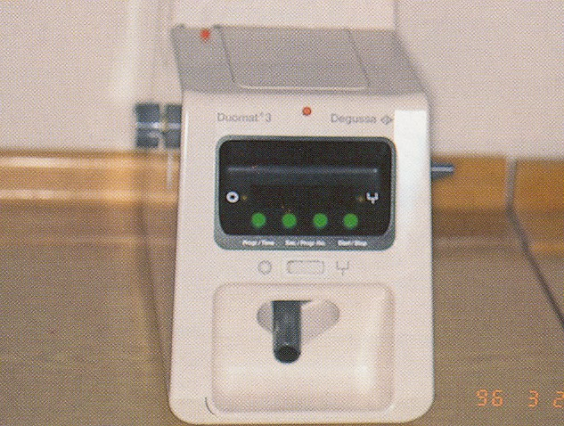

Slide 58
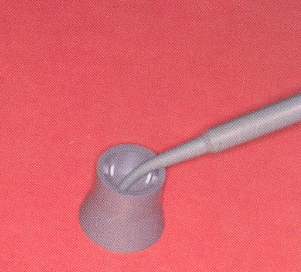
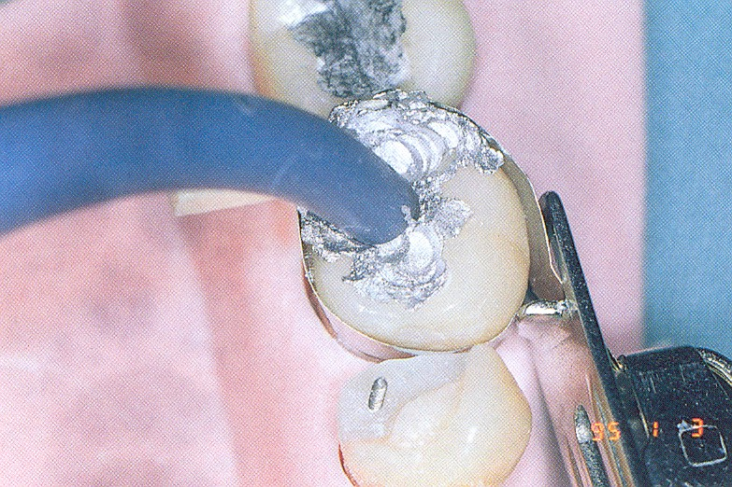
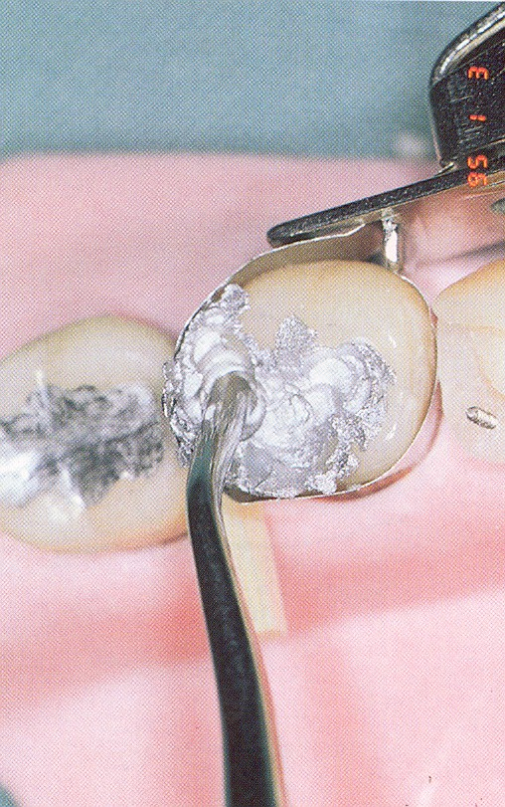
Cup
Amalgam gun
Condensor

Slide 59
Amalgam gun
Crucible (cup)

Slide 60
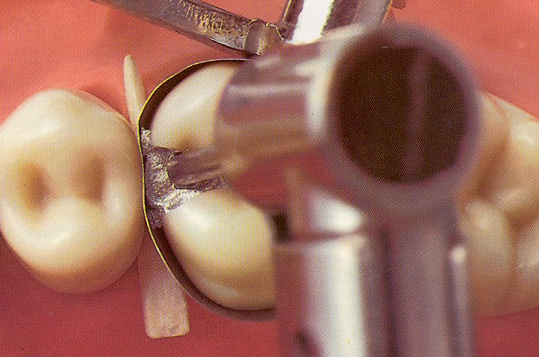
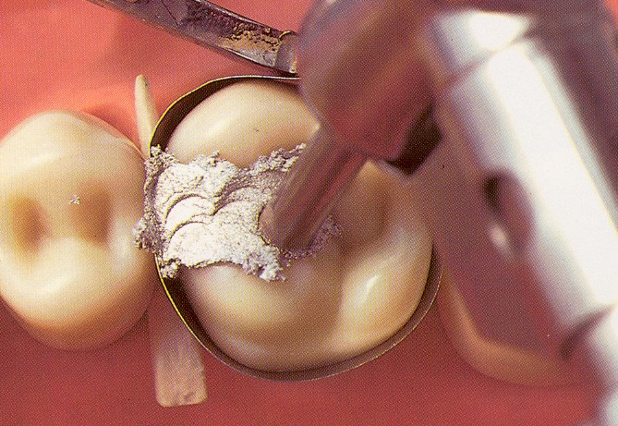
Power driven condensation
handpiece
condensor

Slide 61
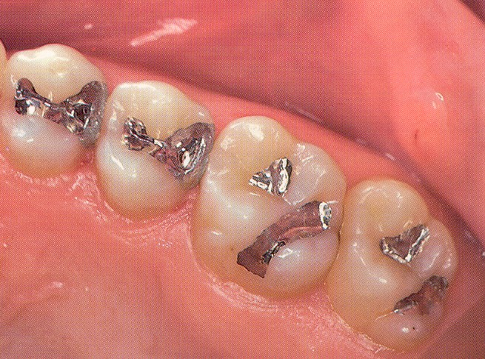

Slide 62
Instruments
Preparation instruments
Filling instruments
Carvers
Burnishers

Slide 63
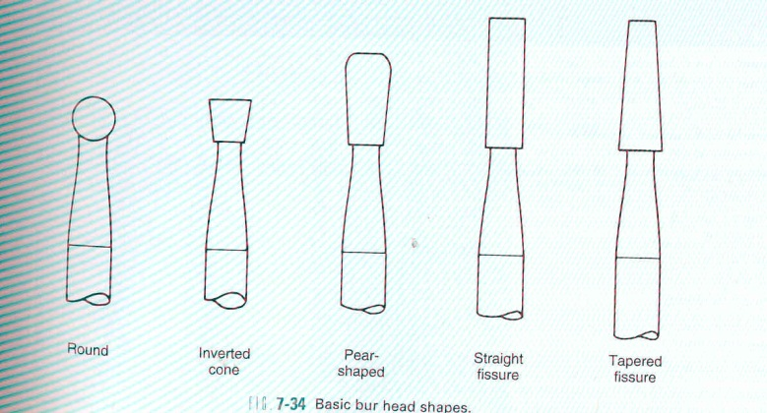
Instruments
Preparation instruments - power driven
Burs
Diamonds

Slide 64
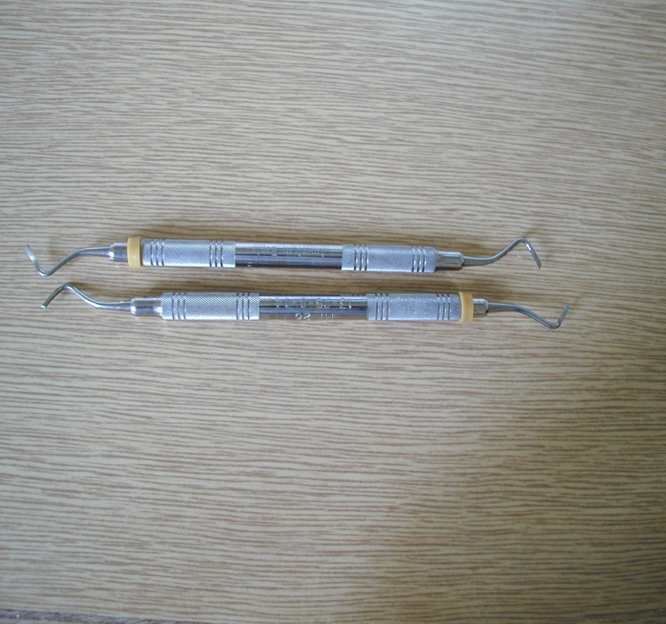
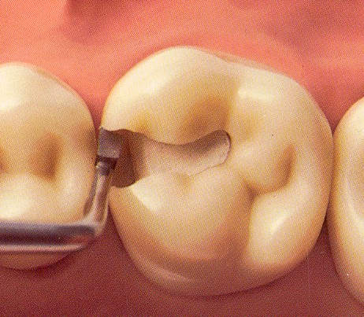
Instruments
Preparation instruments - hand
Chisel
Excavator

Slide 65
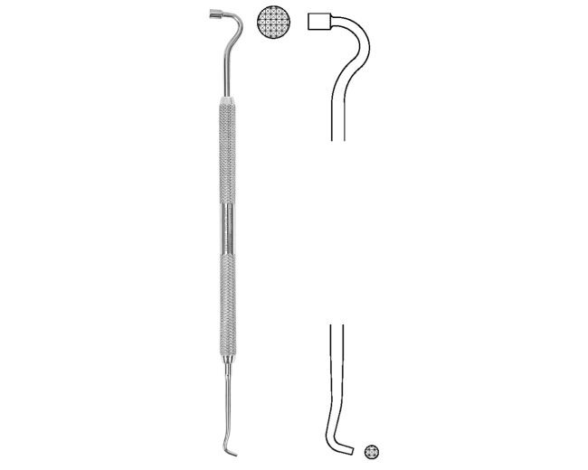
Amalgam carrier

Slide 66
Amalgam carrier

Slide 67
Instruments
Filling instruments condensors and spatulas

Slide 68
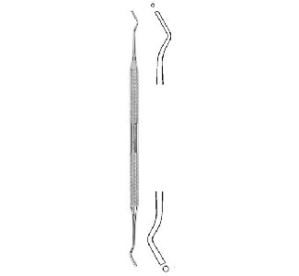
Condensor with flat front

Slide 69
Condensor with flat front

Slide 70
Condensor and burnisher - spatula combined

Slide 71
Power driven condensor
Special handpiece

Slide 72
Burnisher - spatula Angular- trough edge trough face

Slide 73
Burnisher – spatula, angular three face

Slide 74
Instruments
Burnishers

Slide 75
Ball condensor – used as a burnisher at most

