Slide 1
Restorative dentistry 3rd year
Lecture 2
L. Roubalíková

Slide 2
Composite materials
Chemically bonded mixture of organic
matrix and inorganic fillers

Slide 3
Coupling agent – binds organic matrix and the filler together
Homogenous distribution of the filler particles in the material
Excellent mechanical properties

Slide 4
Binding of the coupling agents to glass particles
CH2=C(CH3)-R
CH2=C(CH3)-R
CH2=C(CH3)-R
H O-Si
H O-Si
H O-Si
Double bond -polymerizable
Glass particle

Slide 5
Importance of the components
matrix – a transfer mechanical loading on inorganic fillers, protects the filler against moisture
filler - a support of the material, carries the loading
coupling agents - a homogenous distribution of the filler in matrix

Slide 6
Filler – material
Milled quartz
Aluminimum silicate glass
Silicium dioxide
Prepolymer (composite material is polymerized with high pressure in fabrics, than milled – particles of the fiiler are made of cured composite)
Complexes of microfiller (aglomerates) – e-g-. siliciumdioxide or zirconiumoxide

Slide 7
Filler acc to the size of particles
Macrofiller ( size of particles µm ot tenth of µm )
Mikroplnivo (hundredths od µm)
Nanofiller (nm)
Combination– hybrid
Conventional (µm )
Microhybrid (hundredths od µm, µm)
Nanohybrid (hundredths od µm, µm, nm)

Slide 8
Macrofiller
Particles µm or tenths of µm
Good mechanical resistance , abrasion resistance, bad polishability.

Slide 9
Microfiller
• Silicium dioxide (pyrogenous)
• Particles hundreths µm
Less amount of filler due to big surface
Lower mechanical resistence, good polishability.

Slide 10
Microfiller in complex particles
Prepolymer
Aglomerates
- Higher amount of filler, good mechanical resistance, good polishability

Slide 11
Nanoparticles
Particles 10 nm and less
Special technology, size, shape and binding to monomer

Slide 12
Today
Microhybrid or nanohybrid composites:
Good mechanical properties, good polishability, propagation of cracks is minimized.

Slide 13
Matrix
Bis GMA – Bowen´s monomer • (2,2-bis[4-(2hydroxy-3-metakryloyloxypropoxy) • fenyl]propan)
• Bis DMA
• UDMA
• TEGMA /triethylenglykoldimethacrylate
• EGMA ethylenglykoldimethacrylate
• e Bis –GMA
• HDMA hexandioldimethacrylate
Dimethacrylates - mixture of materials with high and lower molecular weight

Slide 14
Matrix - modification
- Acid modified resins (compomers)
Polysiloxan chains with
polymerizable groups (ormocers)
- Silorans (ring opening monomers)

Slide 15
Coupling agent
G -methacryloxypropyltrimetoxysilan (A 174)

Slide 16
Other components
Activator and initiator
Pigments
Fluorescents
Absorbers of light
Inhibitors

Slide 17
Selfcuring composites
Activator Initiator
Dibenzolyperoxide Tertiary amine
Initiator Activator

Slide 18
Light curing composites
Initiator and sometimes also activator
Camphorchinon CQ
Phenylpropandion PPP
Trimetylbenzoylphosphino xid TPO

Slide 19
Camphorchinon (CQ) - initiator
Yellow colour
Activator is present: etyl-4-(N,N’-dimetylamino)benzoát (4EDMAB), N,N’-dimetylaminoetylmetakrylat (DMAEMA)
Light shades of composites: combination of CQ and other initiators.

Slide 20
Composite materials – basic characteristics
Matrix Filler
Compressive strength
Elasticity
Polymerization shrinkage
Polymerization stress
Water sorption

Slide 21
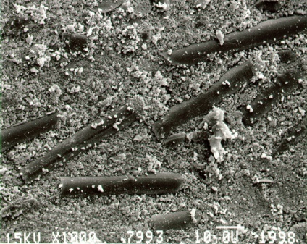
Classification of composite filling materials
Size of the filler particles
Macrofilled, microfilled (homogenous, non homogenous, hybrid)
Matrix (monomers)
Dimethacrylate, acid modifies, ormocers, silorans
Viskosity (flowable, thick)

Slide 22
History
Dimetacrylates
Bowen 1960 – Bowen´s monomer
Buoconore 1955 – acid etching

Slide 23
History
Fusayama 1979
Adhesion to dentin
Yoshida. Nakabaiashi
Van Meerbeck

Slide 24
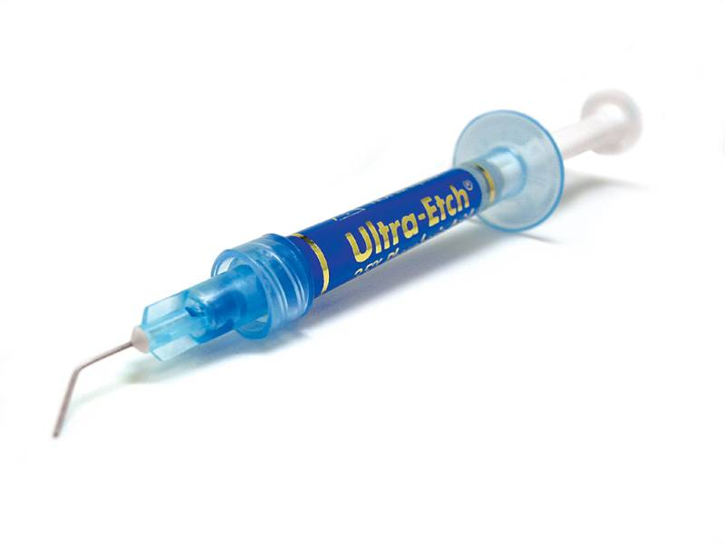
35% - 37% phosphoric acid silica particles blue dye

Slide 25
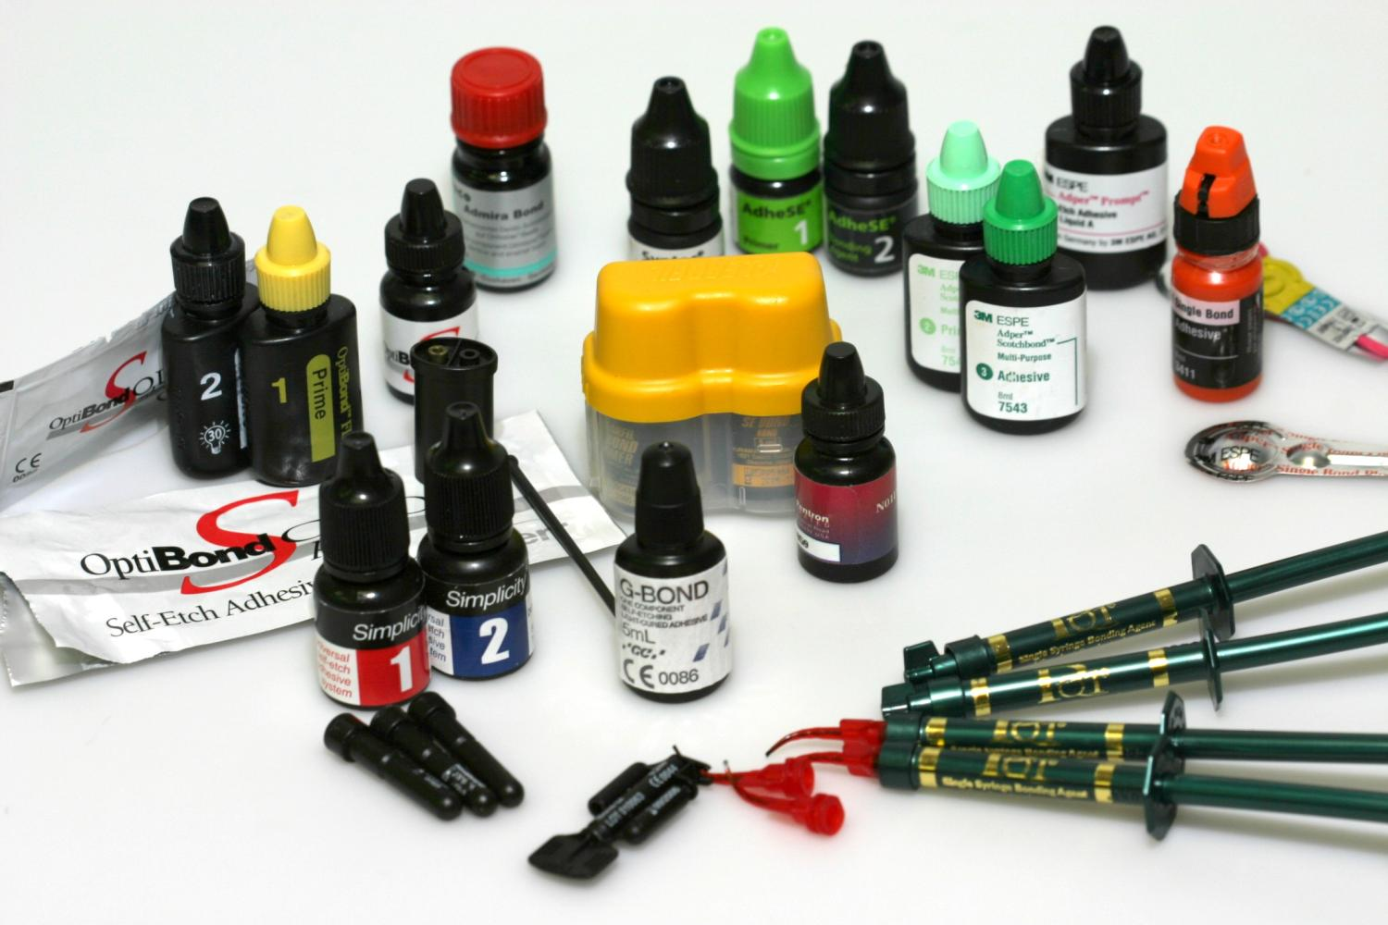

Slide 26
Adhesion
Mechanical adhesion
Specific adhesion
Intermolecular forces
Chemical binding

Slide 27
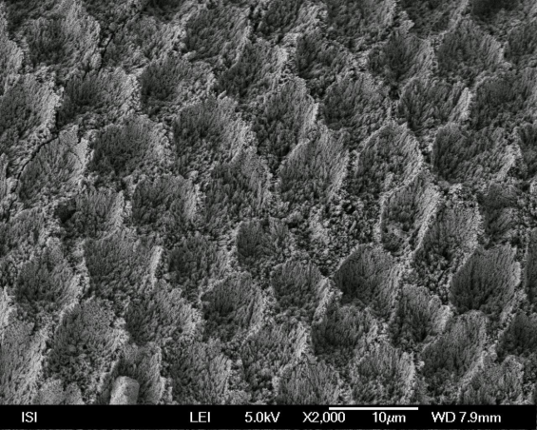
Enamel

Slide 28
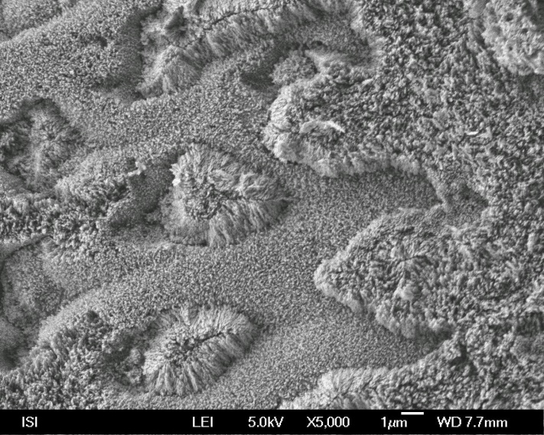
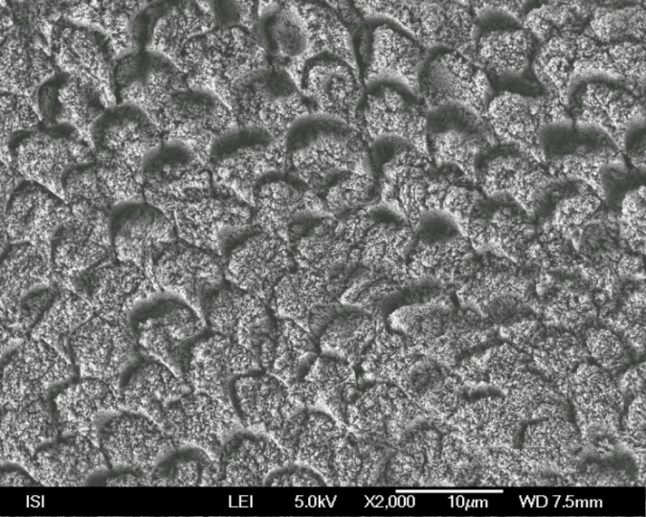
Acid on aprismatic enamel
Acid on prismatic enamel

Slide 29
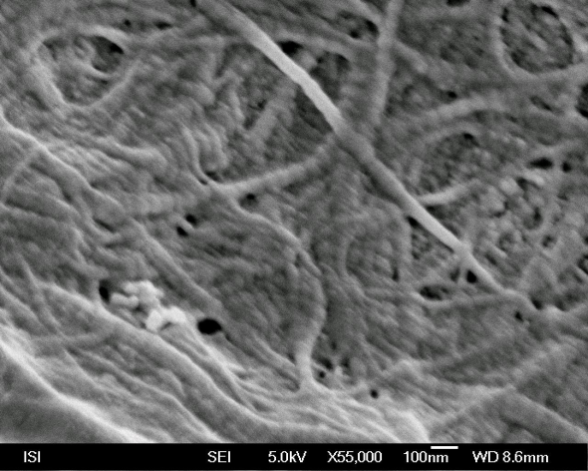
Dentin
Bonding agent

Slide 30
Adhesive system connects resin to enamel and dentin
Bond is a hydrophobic resin principally of the same composition as composite filling material but without the filler or with a small amount of filler. It works in enamel. In dentin primer is necessary before bond.
Why?

Slide 31
Dentin – special composition
More water – always wett
Less minerals
Low surface energy
Smear layer
Composite is hydrophobic, we need hydrofilic substance

Slide 32
Adhesive systems contain resin monomers
Hydrophobic monomers - bond works in enamel it does not work in dentin without primer
Amphiphilic monomers – hydrophobic + hydrophilic part - in primer
Primer is necesssary for dentin.
The hydrophillic part flows into dentin (tubules, spaces in collagen network) and keep the collagen network open, the hydrophobic part of primer binds to hydrophobic bond that flows into dentin pretreated with primer-
If primer applied on enamel – residual of water can be removed.

Slide 33
Adhesive systems contain resin monomers
Primer:
4-META •
HEMA •
TEGMA •
PENTA P •
5-NMSA •
Bis-GMA
Bond: Bis-GMA ot other dimetacrylates. Hydrophpobic.

Slide 34
Dissolving agents
Aceton
Alcohol
Water
Water/alcohol

Slide 35
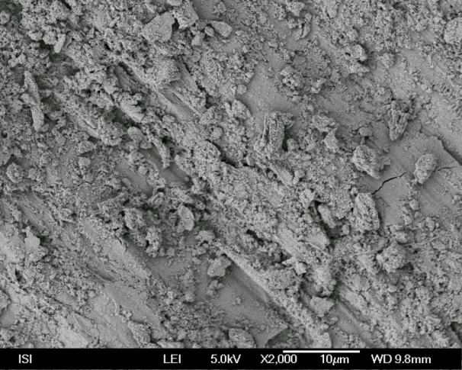
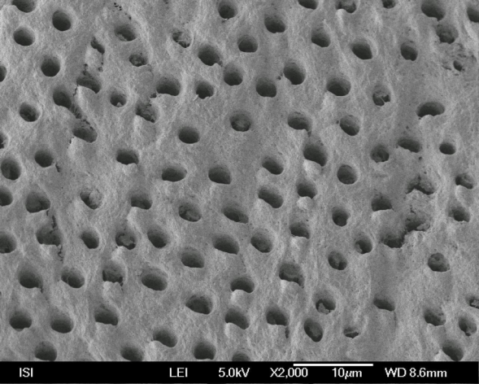
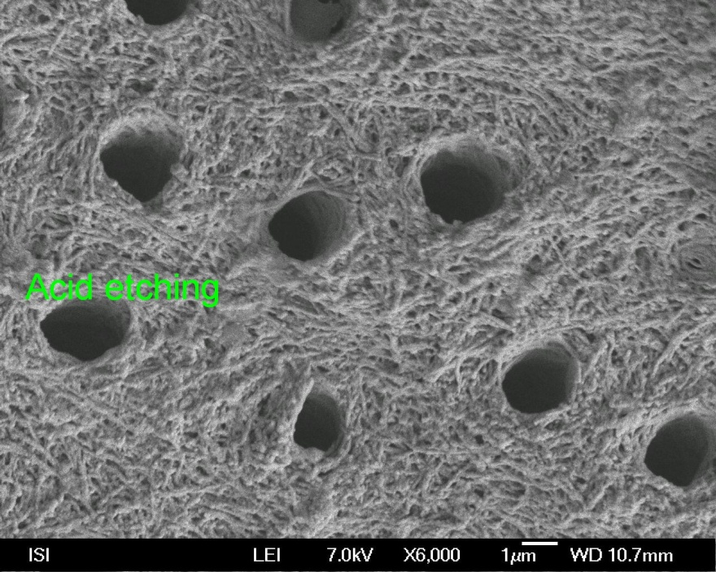
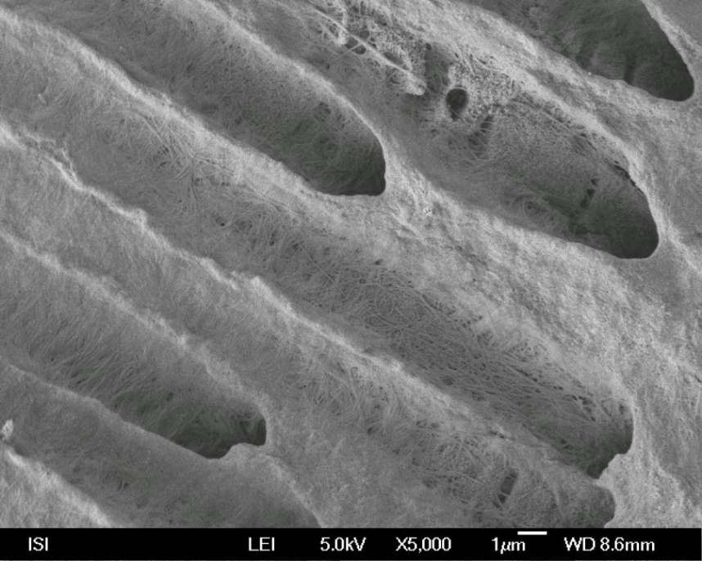

Slide 36
Clinically oriented classification of
the adhesive systems acc
to number of steps
Acid etching | Rinsing | Priming |  | Bonding
Acod etchin | Rinsing | Priming a bonding
Selfetching priming |  |  | Bonding
Selfetching bonding)

Slide 37
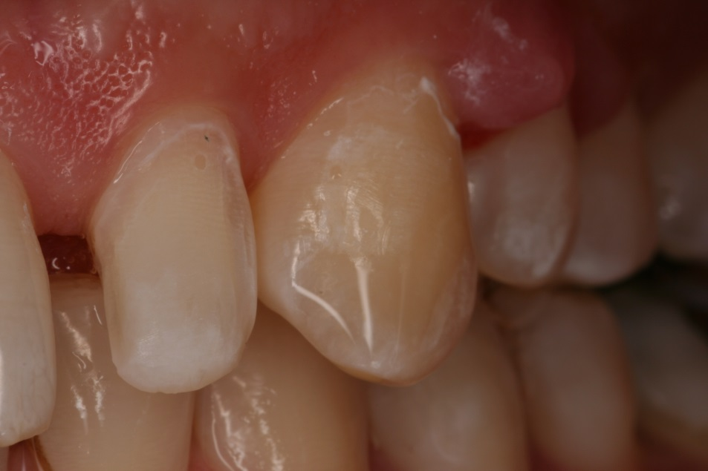
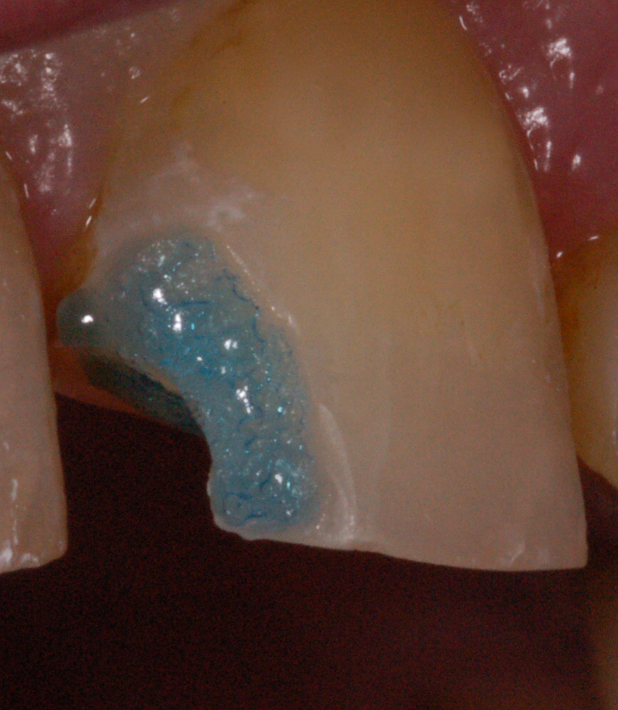
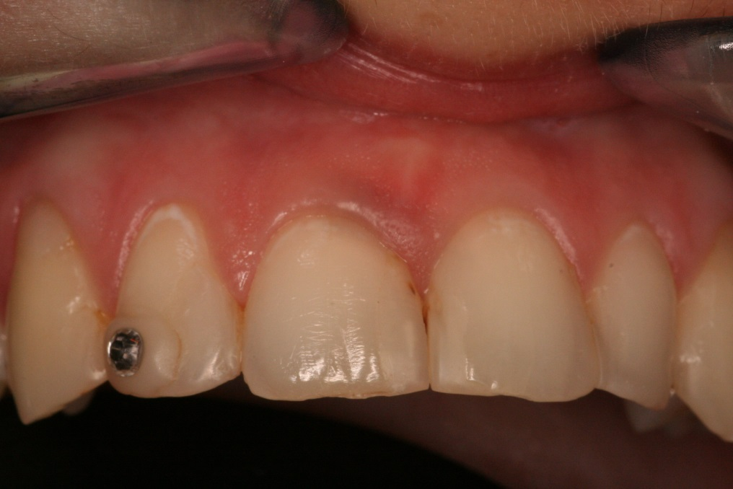

Slide 38
Srelfetching bonding agents

Slide 39
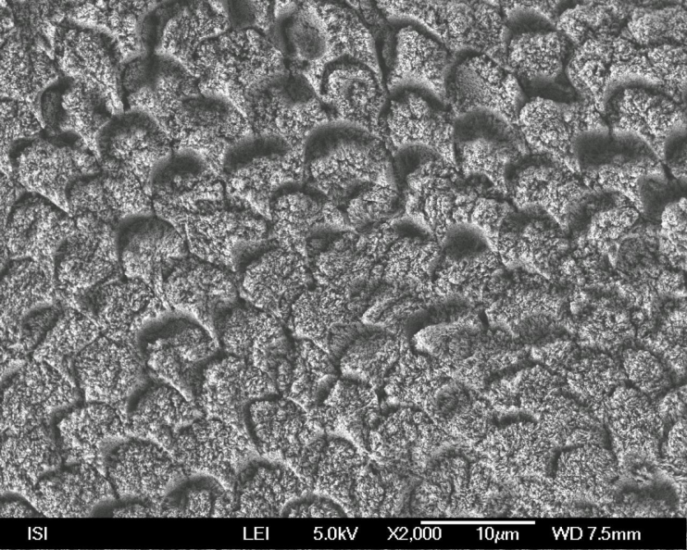
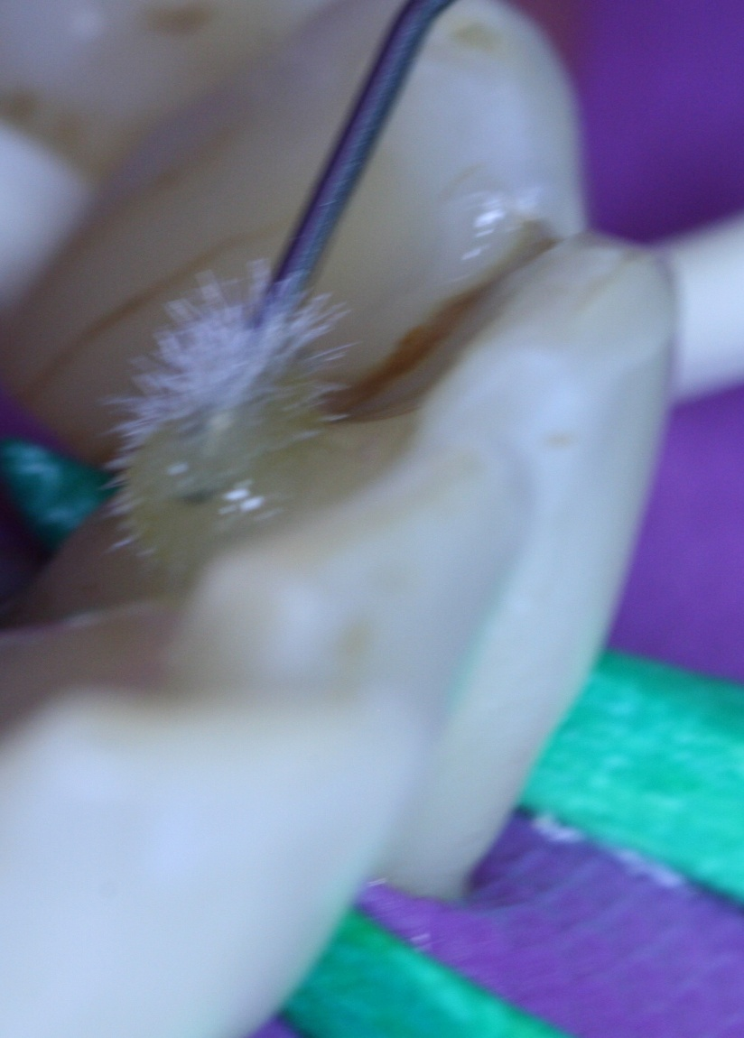
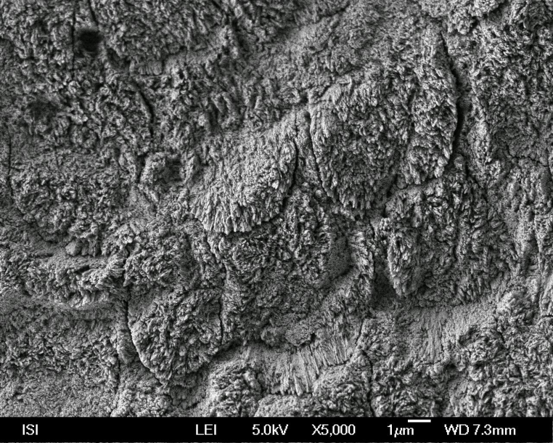
TE – Total etch,
ERA
SE – Self etching
SEA

Slide 40
Two steps selfetching agents
Acidic hydrophilic primer – evaporation of the solvant, penetration, dissolving of the smear layer
Hydrofobic bond – sealing of the surface

Slide 41
One step selfetching agents
More vulnerable bonding, risk of hydrolysis
FAKT !!!

Slide 42
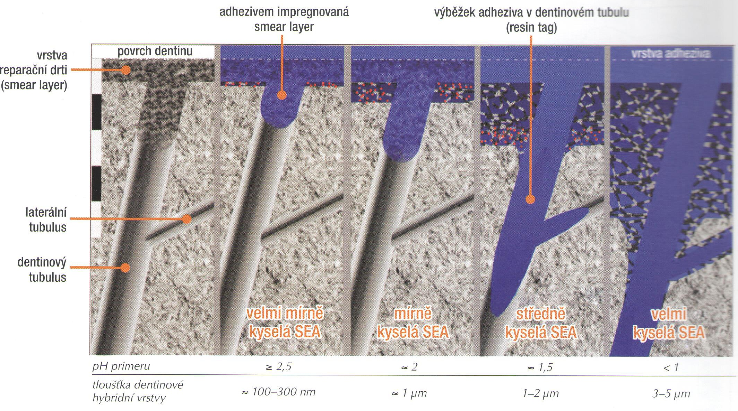
surface of dentin smear layer impregnated resin tag
with the adhesive system
Smear layer layer
Dentin
tubules
very mild acidic sea
mild acidic sea
acidic sea
strong acidic sea
pH of the adhesive system
thickness of the hybrid layer
Source: Dudek M. Adhezivní spoj
a adhezivní systémy I. LKS 11/2013

Slide 43
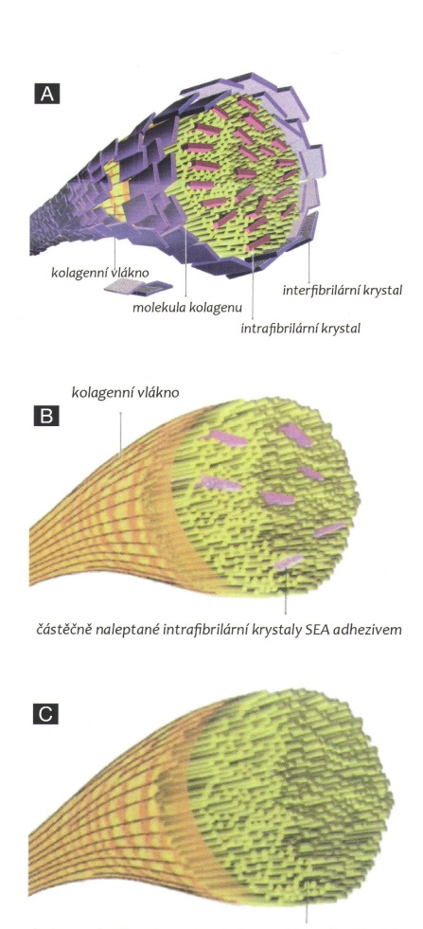
Colagen fibers with interfibrilar and
Instrafibrilar crystals od hydroxyapatite
Colagen fibers with intrafibrilas crystals
of hydrpoxyapatite only
Colagen fibers without crystals
of hydroxyapatites
Zdroj obrázku: Dudek M. Adhezivní spoj
a adhezivní systémy I. LKS 11/2013

Slide 44
Importance of hydroxyapatite
Protection of collagen against hydrolysis
as well as enzymatic degradation of collagen (due to activation of matrix metaloproteinasis)
Strong mineral acid id dangereous for good long term bonding
Clorhexidin for one minute can stabilize collagen

Slide 45
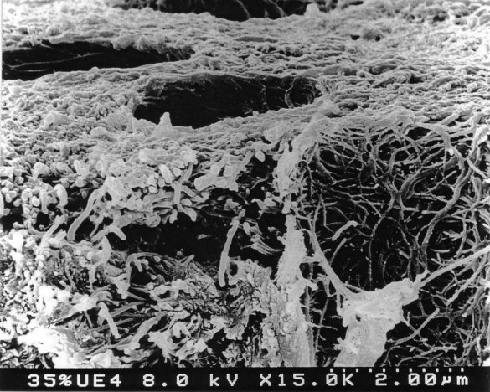
Enzymatic degradation of
collagen

Slide 46
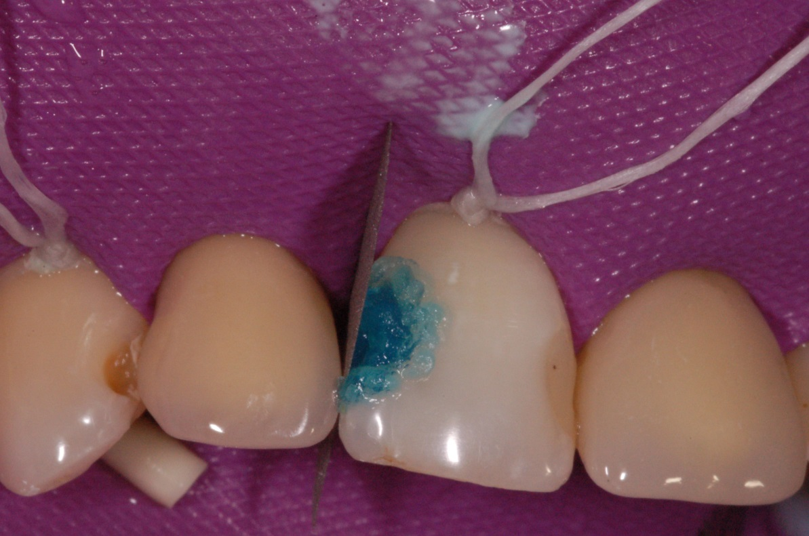
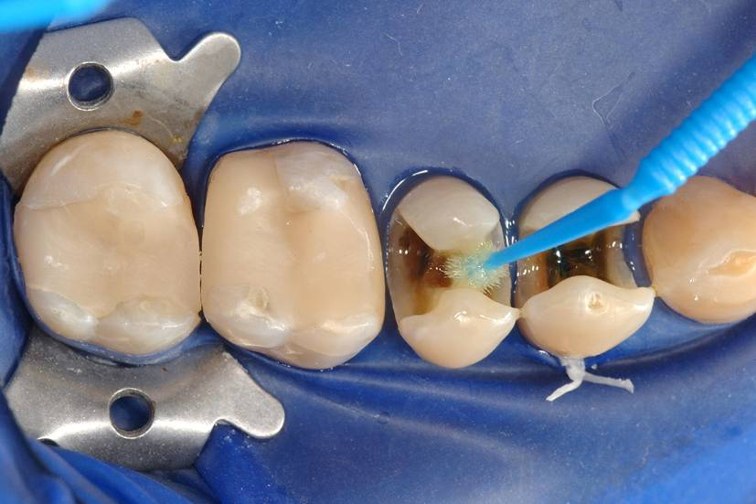

Slide 47
Factors affecting quality of bonding
Structure and composition of hard dental tissues
Quality of their surface – esp. presence of smear layer, contamination with moisture, saliva and blood
Configuration factor – C- factor
Mechanical loading of the adhesive connection
Oral environment and external chemical materials (tooth pastes, asntiseptics, bleaching agent rtc.)

Slide 48
Light
Polymerization
Monomer
Polymer

Slide 49
Pre gel phase should be long – soft start !!!!
Pre –gel
Gel
Post -gel

Slide 50
Three phases
Phases
Pre-gel – material is soft
Gel-point – material became hard
Post –gel – material is not soft, postgel shrinkage

Slide 51
48μm
Photocomposite
102μm

Slide 52
57 μm
Photocopomosite
3mm
3,2mm
8,5mm

Slide 53
42μm
Selfcuring composite
434343
43μm

Slide 54
Polymerization stress depends on
Quality of the material
C- factor
Mode of application
Mode of polymerization

Slide 55
Polymerization stress depends on
Quality of the material
C- factor
Mode of application
Mode of polymerization

Slide 56
High content of filler increases the modulus of elasticity
High modulus of elasticity increases the polymerization stress
High content of filler decreases the polymerization shrinkage
Polym. Stress
Modulus of elasticity
Polymerization shrinkage

Slide 57
Polymerization stress depends on
Quality of the material
C- factor
Mode of application
Mode of polymerization

Slide 59
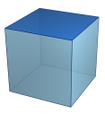
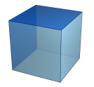
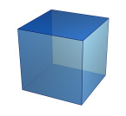
5
2
1
Bonded area : Free area
1:1 and less - optimal

Slide 60
Polymerization stress depends on
Quality of the material
C- factor
Mode of application
Mode of polymerization

Slide 61
Mode of application
Incremental technique
Layer by layer with big free surface
Importance of flowables
Thin layer of flowable first –big free surface
Good marginal adaptation
Compensation of the stress of the other layers
Bulk fill materials do not solve the problem with polymerization stress

Slide 62
Placement of the material

Slide 63
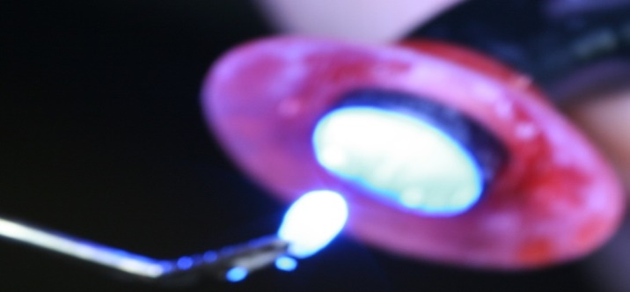
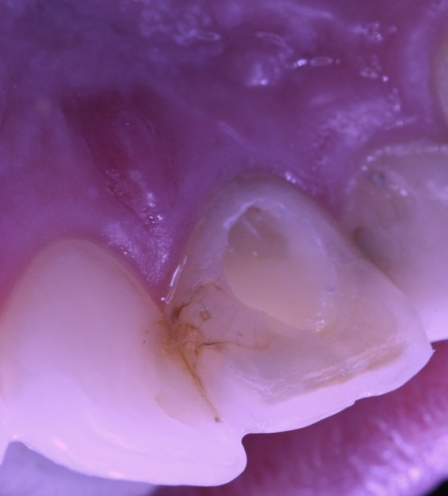
Placement of the material
Photocomposite
Thin layer with the maximal free surface (with respect of C-factor of each layer)
Combination of materials of various viscosity
GIC + photocomposit (two visits better)
Increment of cured material into the soft non
cured material

Slide 64
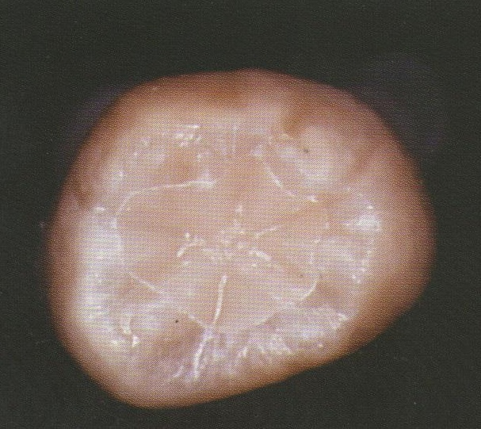
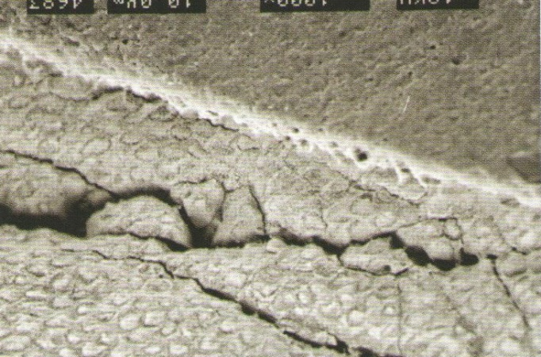
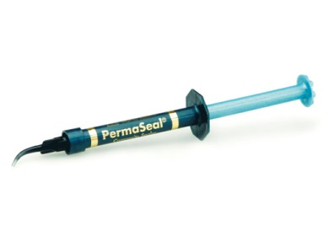
Consequences of high C- factor
White line around the filling
Sealing of the filling . Acid etching around the cavosurface margin,
application of the unfilled resin

Slide 65
Polymerization stress depends on
Quality of the material
C- factor
Mode of application
Mode of polymerization

Slide 66
48μm
Fotokompozit
102μm

Slide 67
42μm
Selfcuring material
434343
43μm

Slide 68
Duration of pre-gel phase
Longer pre-gel phase is better for releasing of polymerization stress
Soft start
Combination of materials (selfcuring composite materials have longer pre gel phase)

Slide 69
Factor that influence the quality of bonding
Configuration factor – C- factor +polymerization stress
Structure and composition of hard dental tissues
Quality of their surface – esp. presence of smear layer, contamination with moisture, saliva and blood
Mechanical loading of the adhesive connection
Oral environment and external chemical materials (tooth pastes, asntiseptics, bleaching agent rtc.)

Slide 70
Cpontemporary possibilities polymerization
Quarz halogen units (halogen lamp)
Plasma units
LED units (diode – monocgromatic light, need of more diods)
Laser (strictly monochromatic light)

Slide 71
Polymerization units – output energy
Quarz halogen
LED (3.generation)
Plasma
600 -800 mW/cm²
1000 -1800 mW/cm² modré
50 – 100 mW/cm² fialové
1500 - 2000mW/cm²

Slide 72
Output energy and time of polymerization
Recomended power is 12000 – 16000 mJ/cm²
12 000 mWs/cm²
measured intensity mW/cm²
Time in seconds
Usually 20 s
Radiometer ois recommended

Slide 73
Photoinitiators
Kafrchinon
CQ
Phenylpropandion
PPP
Trimetylbenzoylphosphinoxid TPO

Slide 74
Absorbtion spectrum of fotoiniciators
Photoinitiator | Absorbtion spectrum (nm) | Maximum (nm)
CQ | 440 - 500 | 470
PPD | 380 – 430 | 400
TPO | 350 - 410 | 380

Slide 75
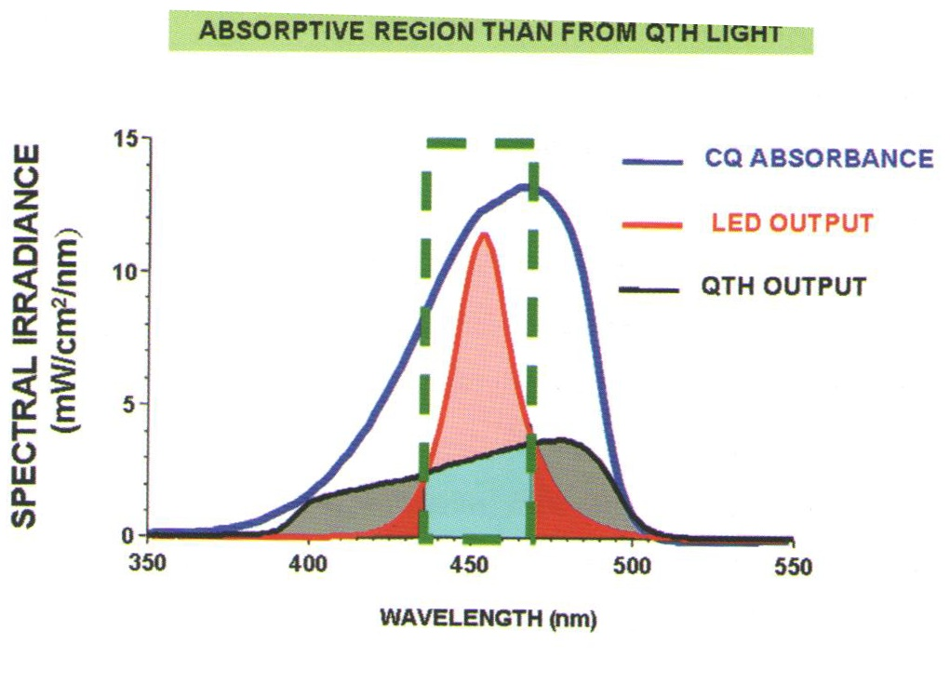

Slide 76
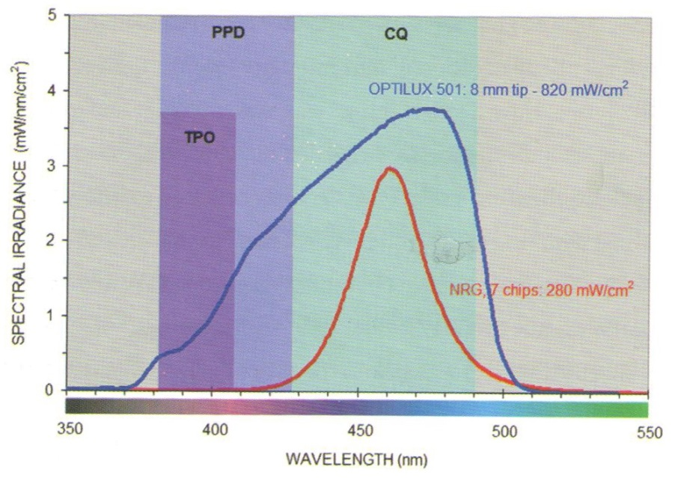
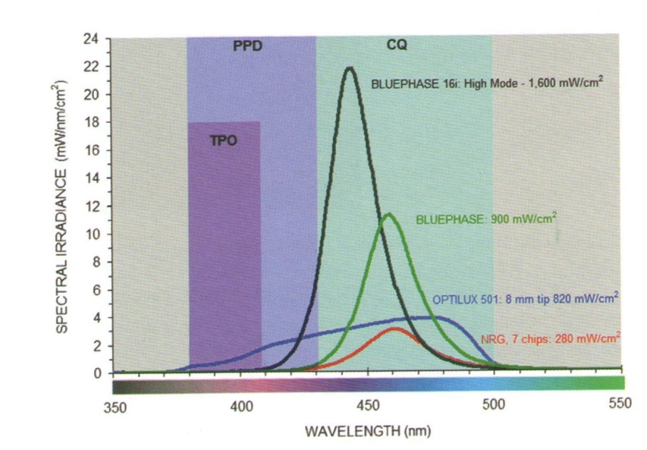
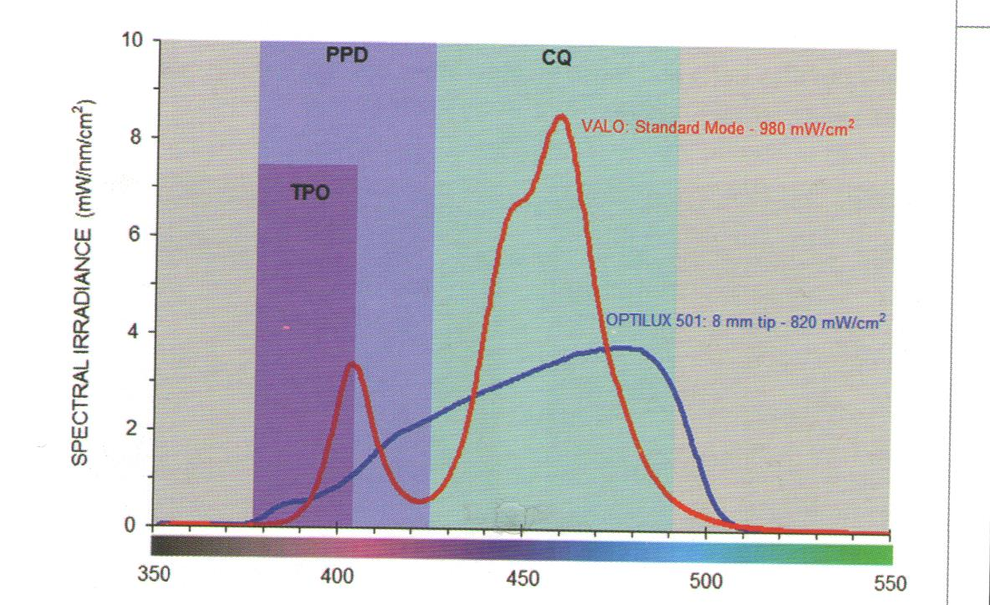

Slide 77
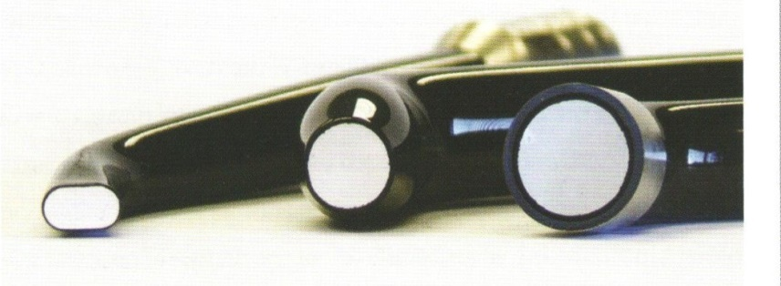
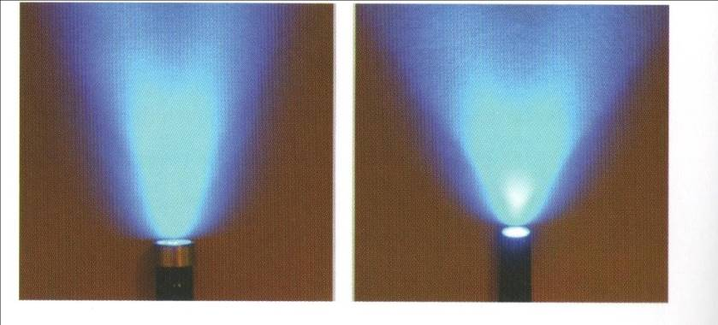
Light conductor
Small area – higher concentration of output energy, but bigger dispersion
The average distance is 4 mm – 10 mm.
Standard light conductor – more reliable for daily is
Standardní a kónický světlovod

Slide 78
Mode of curing
Continuous curing at a constant intensity level: 40s of 500 mW/cm²
Continuous two step curing
10 s 150 W/cm² then 750 mW/cm²
for remaining time
Two step ramp – low intensity level gradually increases (5-10s) to achieve a final high intensity
Puls delay
Low intensity short time, 100 - 300 mW/cm²unit is turn off. 3 min pause
Final curing 600 mW/cm²
Othe factors for consideration
Shade
Increments towards dentin walls
Pulse delay technique is dedicated to the layer that contacts enamel

Slide 79
Flowables
– marginální adaptation (material flows)
- small polymerization stress – importance in incremental technique
- block out of undercuts
- small cavities, corrections

Slide 80
Composite materials with high viscosity
Small polymerization shrinkage
Hihg polymerization stress
Worse marginal adaptation

Slide 81
Bulk fill
Application and curing in one bulk
Higher amount of fotoinitiators
Higher translucency
The problem with polymerization stress is not comlpetely solved
Group of various materials:
Flowables
Condensables
Sonic Fill (KaVo)

Slide 82
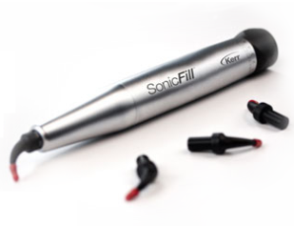
Sonic Fill
Big bulk up to 5mm (less – 4 mm
is recommended)
Sonic „activation“ – vibration
decrease viscosity
Internal dispersion of light
Long term expeerience?

Slide 83
Factors that influence the quality of bonding
Structure and composition of hard dental tissues
Quality of their surface – esp. presence of smear layer, contamination with moisture, saliva and blood
Configuration factor – C- factor
Mechanical loading of the adhesive connection
Oral environment and external chemical materials (tooth pastes, asntiseptics, bleaching agent rtc.)

Slide 84
Working procedure and variables affecting the bonding

Slide 85
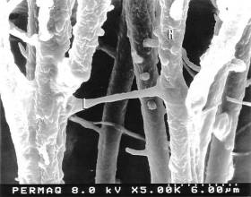
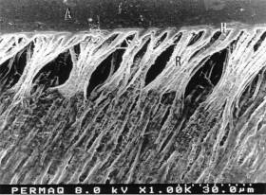
What affects the quality of bonding?

Slide 86

Variables that affect quality of bonding
1) Etching
Etching too long can etch too deep, making it difficult for the resins to reach sound tooth structure.
1.9µm

Slide 87
Variables that affect quality of bonding
2) Drying dentin
Over drying the dentin after etching can be very destructive to bond values with some adhesives.

Slide 88
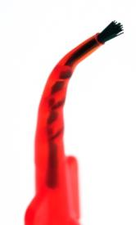
Variables that affect quality of bonding
3) Application time
Too short of application time may not allow for proper volatilization of the solvents or complete resin hybridization. This is critical with self etching systems.

Slide 89
Variables that affect quality of bonding
4) Thinning / drying
Too thin of adhesive layer doesn’t allow for proper curing due to oxygen inhibition. Too thick and the adhesive may still contain solvents.
O₂
O₂
O₂
O₂
O₂
O₂

Slide 90
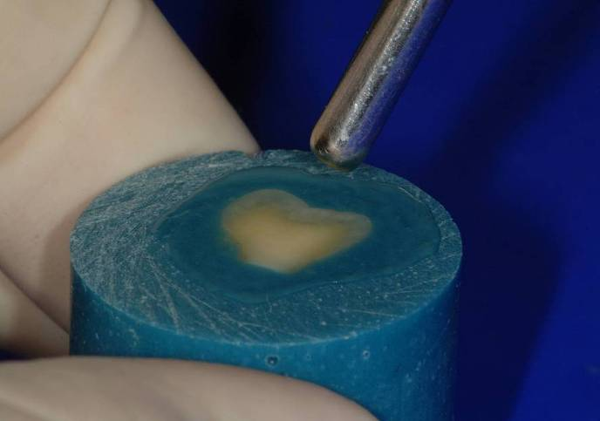
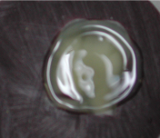
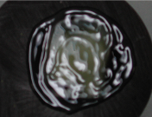
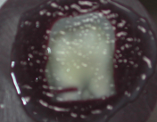
Air thin / Dry
TO TRANSLUCENCY

Slide 91
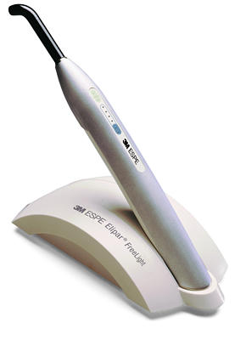
Variables that affect quality of bonding
5) Light curing
Too short or insufficient light cure equals partially polymerized resins.

Slide 92

Variables that affect quality of bonding
6) Composite Placement
Improper adaptation of the composite to the adhesive can create voids at the bonding interface.
Condenser

Slide 93
Variables that affect quality of bonding
7) Contamination
Blood
Sulcular fluid
Saliva
etc…

Slide 94
Variables that affect quality of bonding
8) Deteriorated product
Expired
Volatilized

Slide 96
Indication of composite materials
Filling of all classes:
I., II. class: small to moderate restorations
III. Class
IV. Class
V. Class
Other factors for consideration:
Level of oral hygiene
Occlusal loading
Quality of hard dental tissues

Slide 97
Other indication
Splinting
Postendo treatment (post and core)
Cementation (special materials) – adhesive cementation
Fissure sealing
Venners – direct, indirect

Slide 98
Contraindication of composite materials
Bad level of oral hygiene
Large cavities in posterior teeth (alternative is amalgam or inlay/onlay,
Heavy occlusal stress (deep bite , bruxis)
Cavities out of enamel (esp. cervical area)
Social aspects

Slide 99
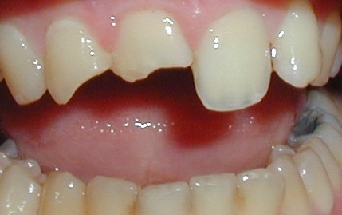
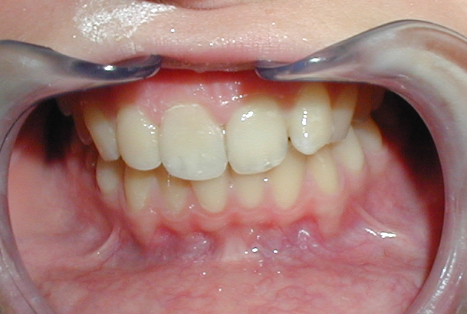

Slide 100
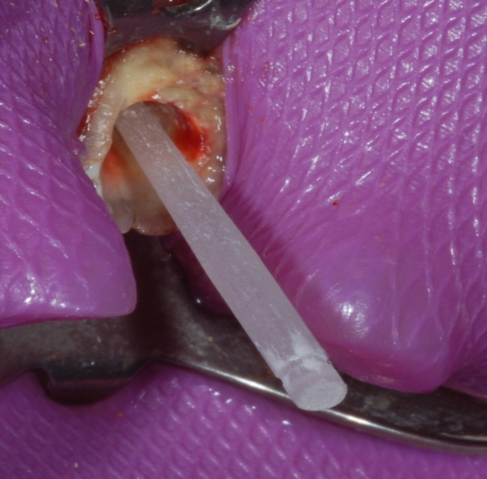
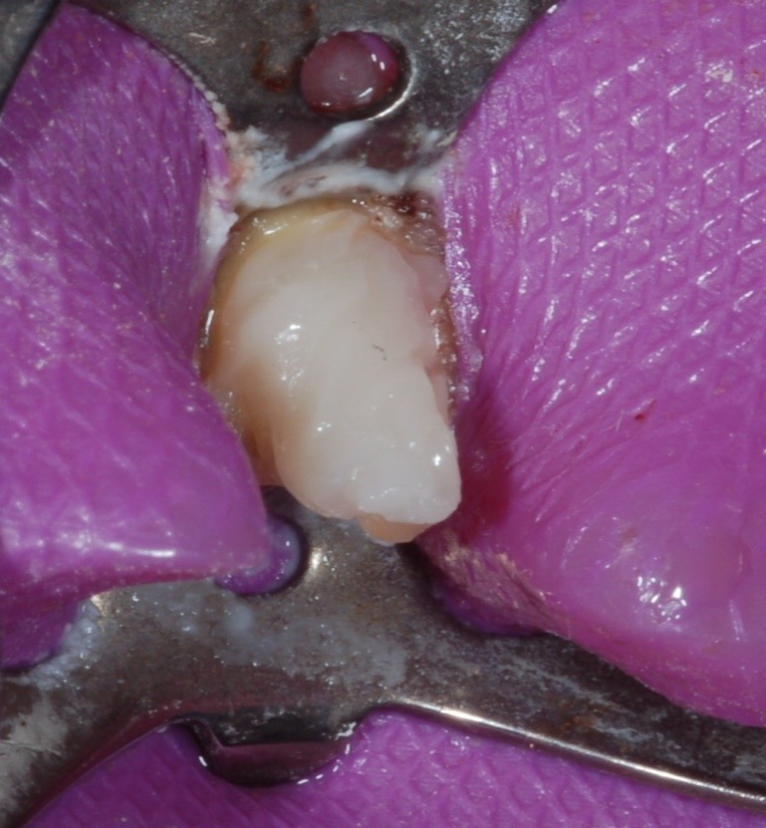
Postendo – post and core

Slide 101
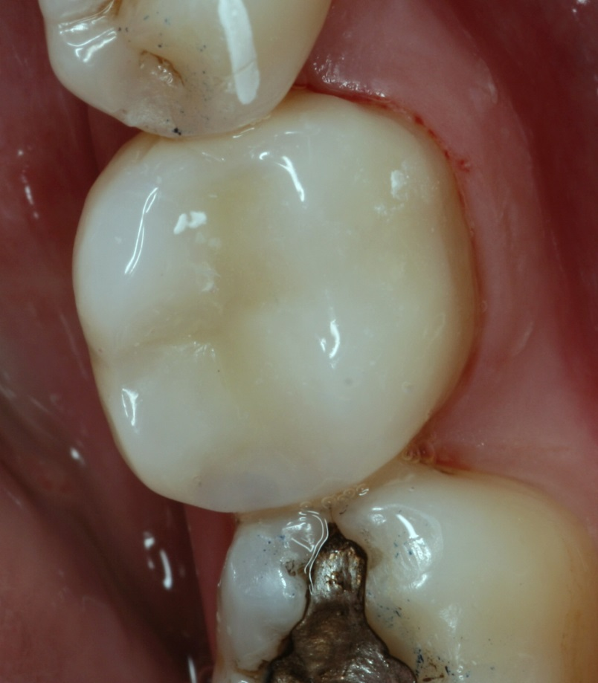


Postendo using flowable and onlay
Flowable at the bottom
Composite onlay
Onlay after 8 years

Slide 103




Slide 104




Slide 105


Slide 106




Slide 107




Slide 108



lenka.roubalikova@tiscali.cz

