Slide 1
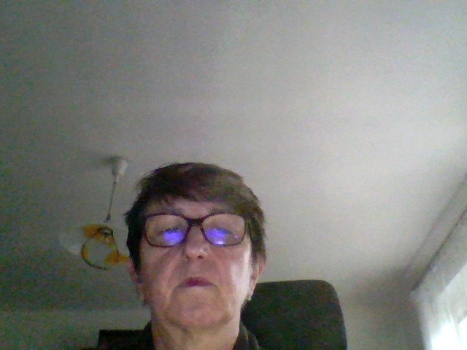
Restorative dentistry 3rd year
Lecture 2
Indications of dental materials

Slide 2
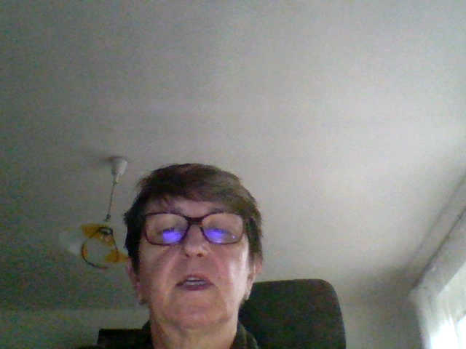
Classification of dental caries
Black
I. class – pit and fissure caries
II.class – caries on proximal surfaces of premolars and molars
III. – caries on proximal surfaces incisors and canines without lost of incisal edge
IV. - – caries on proximal surfaces incisors and canines with lost of incisal edge
V- cervical caries
( VI. Caries on incisal edges or cusps)

Slide 3
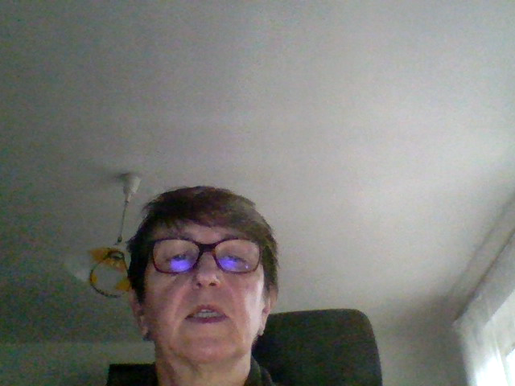
Classification of dental caries
Mount and Hume
Location
Occlusal
Proximal
Cervical
Size
Small
Medium
Large

Slide 4
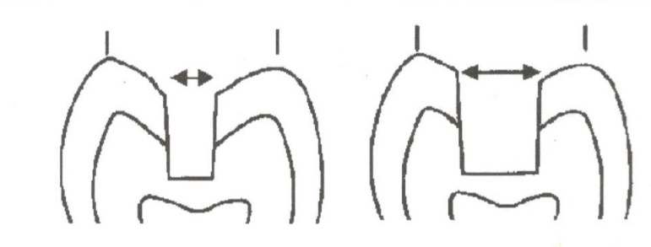
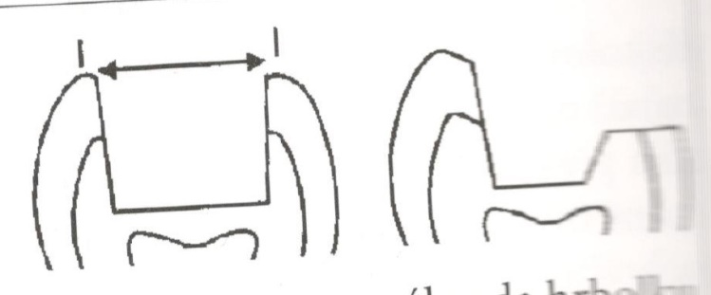

Classification acc. to Mount and Hume
Occlusal caries
11 composit, amalgam
12 composit, amalgam
- 13 metal or adhesive inlay/onlay or amalgam with cusp replacement

Slide 5
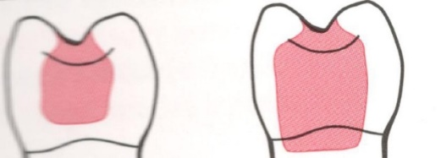
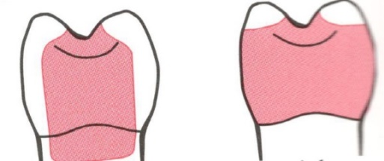
Classification acc. Mount and Hume
Proximal caries in posterior teeth
21 – composit, amalgam
22 – composit, amalgam, adhesive inlay, metal inlay
23 – amalgam, adhesive or metal inlay

Slide 6
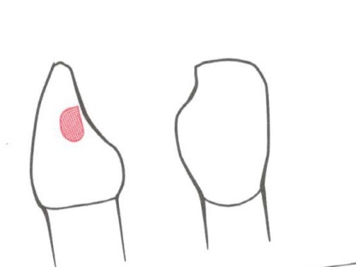
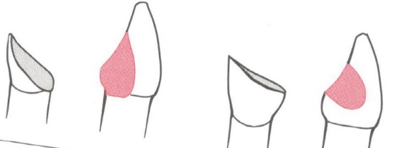
Classification acc. Mount and Hume
Proximal caries in anterior teeth
21,22,23 – composit
GIC – patients with worse cooperation (disabled, oral hygiene not optimal)
24 (loss of incisal edge),
composit, veneer, crown

Slide 7
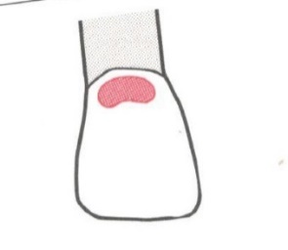
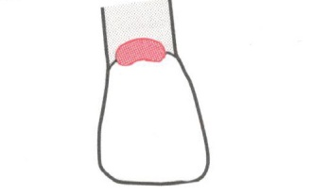
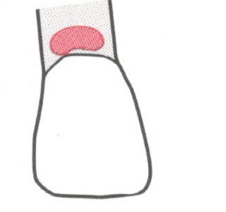
Classification acc. Mount and Hume
Cervical caries
31 – 33:
Depends on location
Composit
Glassionomer
Amalgam –posterior teeth, esp. In patients with worse level of oral hygiene

Slide 8
Indications of dental materials
Consideration
Caries -Size - Location
Regional circumstances
Level of oral hygiene
Intermaxillary relations Bite forces
Patient -General health -Cooperation
Choice of the material

