Slide 1
Restorative dentistry 3rd year Lecture 2
Glassionomers

Slide 2
Glassionomers
Materials that have been developed by Wilson and Kent was a
product of an acid-base reaction between basic
fluoraluminosilicate glass powder and polycarboxylic acid.
Glassionomer cement is a water based materiál that herdens
following the acid-base reaction between this glass and aqueous
solution of polyacid.

Slide 3
Glassionomers contain metals
Aluminium
Calcium
Strontium
Zinc
Sodium
Potassium
Lanthanum

Slide 4
Phosphates and fluorides
Are used to decrease the melting temperature in the production process and are incorporated to the glass composition to modify the setting characteristics.

Slide 5
X-ray contrast - radioopacity
Lanthanum oxide, strontium oxide (incororated into the glass)
Baryum sulphate

Slide 6
Essential ingredients of the glass are aluminiumoxide and silicium dioxide

Slide 7
Liquid of glassionomers
Liquid is based on polycarboxylic acid:
Polyacrylic acid
Polymaleic acid
Acrylic acid- itaconic acid copolymer
Acrylic acid- maleic acid copolymer and others.
Water, tartaric acid (acelerator)

Slide 8
Acids can be a component of powder also
Freeze dried powder
These cements are mixed with water or with the polycarboxylic acid.

Slide 9
Glassionomers
Principle of setting – acid base reaction
Hydrogen ions of the acid attack the glass particles in the presence of water, releasing calcium, strontium and aluminíum ions
The metal ions react with the carboxylic acid groups to form the polyacidsalts matrix. The glass surface is changed to a silica hydrogel. Glass core remain intact.

Slide 10
Glassionomers
The structure of the cement is a network of polyacid salts. Inside this network remain particles of glass (silica hydrogel on the surface). The setting time is long (days – months)

Slide 11
Glassionomers - characteristics
Chemical bonding to hard dental tissues (carboxy groups react with calcium in hard dental tissues)
Thermal expansion similar to dentin
Realease fluoride ions (cumulative releasing)
Mechanical not strong enough
Aesthetics acceptable

Slide 12
Types of glassionomers
Conventional glassionomers
Conventional glassionomers for direct restorations
Metal reinforced glassionomers
Highly viscous glassionomers Low viscosity glassionomers
Base and liners
Luting
Sealers

Slide 13
Types of glassionomers
Resin modified glassionomers
These cements were designed to produce favorable physical properties similar to composite materials.
The water solubile resin component has been added into an aqueous solutions of polyacrylic acid.
Liquid: polycarboxylic acid, water and 2-hydroxyethylmethacrylate (HEMA). In some materials pendant methacrylate groups are on polycarbocylic acid.

Slide 14
Types of glassionomers
Resin modified glassionomers
Two setting reactions:
acid-base reaction
polymerization

Slide 15
Types of glassionomers
Resin modified glassionomers - benefits
- Significantly less sensitivity to water
Improved mechanical properties
Higher translucency

Slide 16
Types of glassionomers
Resin modified glassionomers
Restorative materials
Base and liners
Luting
Orthodontic cementing material

Slide 17
Glassionomers acc to curing
Acid – base reaction
Dual cured glassionomers (resin modified)

Slide 18
dentin

Slide 19
water

Slide 20
water

Slide 21
resinmodified

Slide 22
high strength

Slide 23
Glassionomers - indications
Fillings
Class V.
Class III.
Class I. and II. in primary dentition
Base – sandwich filling
Sealants
Surface protection
Internal mineralization
Other indications
Endodontic sealers
Luting materials

Slide 24
Glassionomers - contraindications
Haevy occlusal stress:
Class I. and II. in permanent dentition
Class IV. Restoration
Caries pulape proxima or open dental pulp

Slide 25
Mixing
Hand
Power driven – capsulated

Slide 26
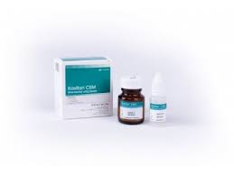
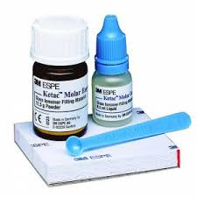
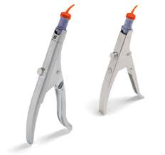
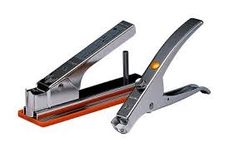
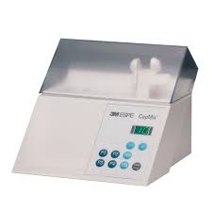
Hand and power driven mixing of the GIC
Forceps for activation and application
Mixing machine

Slide 27
Making filling
Preparation
Smoth bordes
Limited on caries lesion only
Conditioning (25% polyacrylic acid 20s´)
Washing
Filling in one block
Varnish after setting
Polishing in next appointment

Slide 28
