Slide 1
Week 1 : Introduction to the course
Introduction to Bioinformatics (LF:DSIB01)

Slide 2
Introductions
Introduce ourselves
Name
Project
Motivation for the course
Introductions
Let’s take 1 minute to introduce ourselves, our name, our background
the main project we work on, and our motivation for taking this class

Slide 3
Bioinformatics
What is bioinformatics?

Slide 4
What is Bioinformatics?
Biology
A science that uses Computational and Statistical tools in order to address Biological questions.
Key Skills
Scientific Rigor
Engineering Mentality
Collaborative Spirit
Interdisciplinary Understanding
Simplification and Presentation
Biostatistics
Computational
Biology
Bioinformatics
Key Pitfalls
Hacker Mentality
Bad Code > Reproducibility
Uninterpretable Models
Jargon and Gatekeeping
Losing track of goal: Biology
Statistics
Data
Science
Computer
Science

Slide 5
Goals of this course
Someone finishing this course should:
Have a basic understanding of the theory and practice of Bioinformatic Research
Be able to practically function in a Bioinformatics research group setting or other collaborative setting
Be able to produce and present analysis results

Slide 6
Syllabus / week
Week | Date | Material
Week 1 | 17-Sep-21 | Introduction to the course
Week 2 | 24-Sep-21 | Intro to Molecular Biology / Genomics | Organizing data, Git
Week 3 | 1-Oct-21 | Exploring the human genome | Sequence Databases, Preprocessing NGS data
Week 4 | 8-Oct-21 | Sequence Alignment | NGS data Alignment, Peak Calling
Week 5 | 15-Oct-21 | Sequence (over)Representation | Motif Finding Tools
- | 22-Oct-21 | Week Off
- | 29-Oct-21 | Week Off
Week 6 | 5-Nov-21 | Evaluation Metrics and Data Visualization
Week 7 | 12-Nov-21 | ML techniques I (log regresion, SVM)
Week 8 | 19-Nov-21 | ML techniques II (decision trees, random forest)
Week 9 | 16-Nov-21 | ML techniques III (ANN, perceptrons)
Week 10 | 3-Dec-21 | ML techniques IV (CNN) + Advances
- | 10-Dec-21 | Wrap up
- | 17-Dec-21 (?) | Colloquium

Slide 7
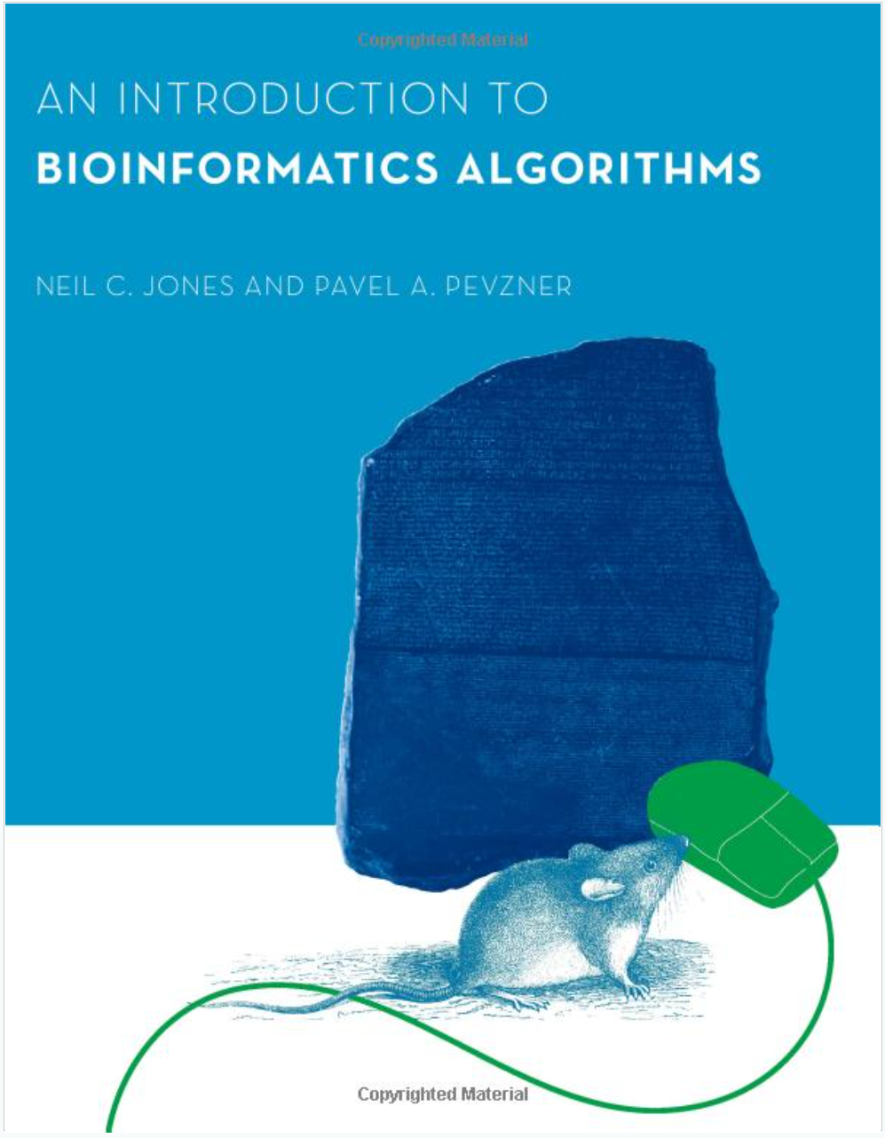
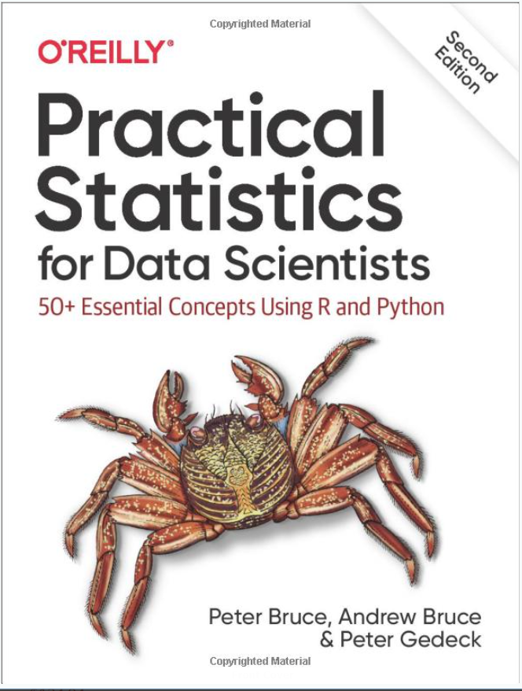
Resources / Tools
Tools
Python
Github
Google Colaboratory
Jupyter Notebook
Resources
https://www.kaggle.com/learn/overview
https://wiki.python.org/moin/BeginnersGuide/NonProgrammers
https://wiki.python.org/moin/BeginnersGuide/Programmers
https://guides.github.com/activities/hello-world/
https://research.google.com/colaboratory/faq.html
https://www.dataquest.io/blog/jupyter-notebook-tutorial/
http://www.biostathandbook.com/index.html
Linux

Slide 8
Evaluation
Ongoing project through the semester
Small task after each practical – can be finished at home
Colloquium: discussion of questions, results etc

Slide 9
CEITEC
@CEITEC_Brno
For any questions, comments etc
panagiotis.alexiou@ceitec.muni.cz
www.ceitec.eu

