Slide 1
Week 2 : Algorithm Basics
Introduction to Bioinformatics (LF:DSIB01)
Panos Alexiou
panagiotis.alexiou@ceitec.muni.cz

Slide 2
Basics of Algorithms
Definition of an algorithm
Pseudocode Notation
Exercise: The Coin Change Problem
Brute force, Iterative, Recursive
Big-O notation

Slide 3
What is an algorithm
A sequence of instructions one must perform to solve a well formulated problem
A step-by-step method of solving a problem
A set of instructions designed to perform a specific task
Sequence of instructions
Step-by-step method
Set of instructions
Solve
Perform
Well formulated problem
Specific task

Slide 4
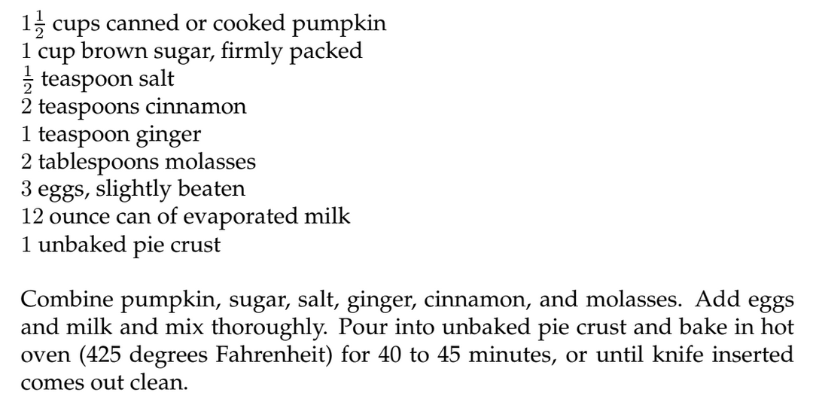
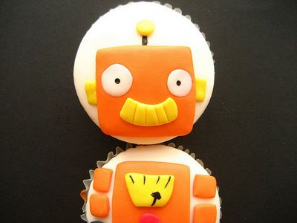
Sequence of instructions
Step-by-step method
Set of instructions
Solve
Perform
Well formulated problem
Specific task

Slide 5
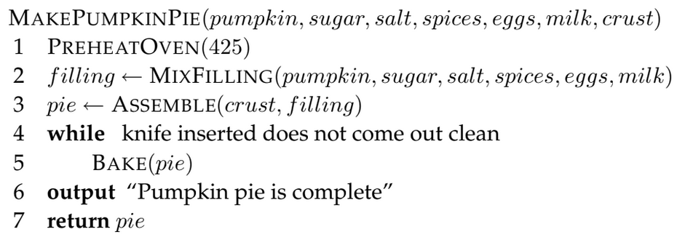
Pseudocode Notation

Slide 6
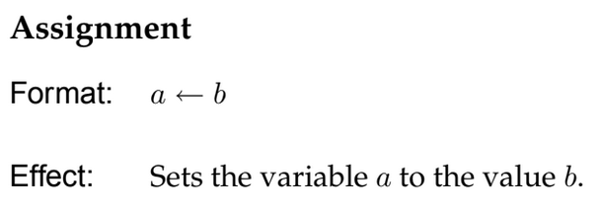
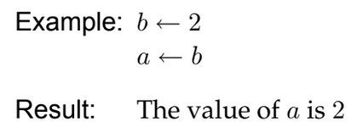
Pseudocode Notation

Slide 7
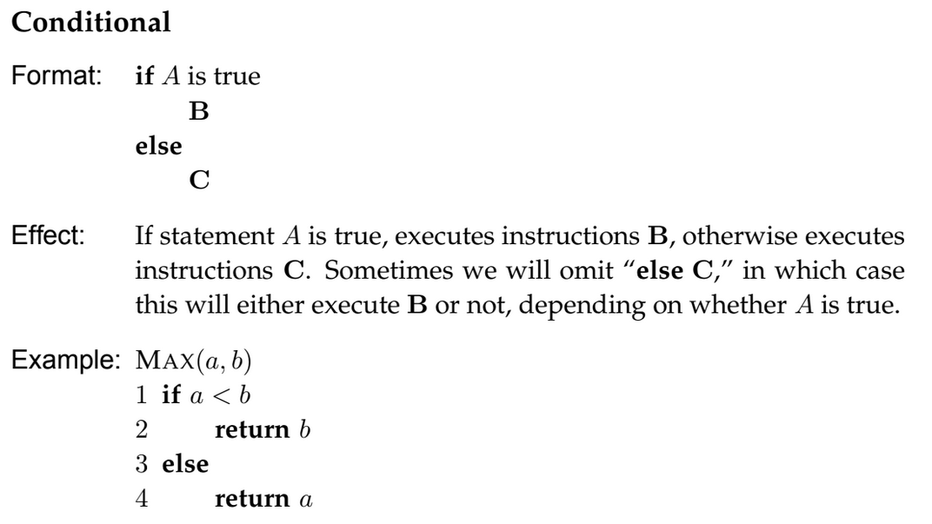
Pseudocode Notation

Slide 8
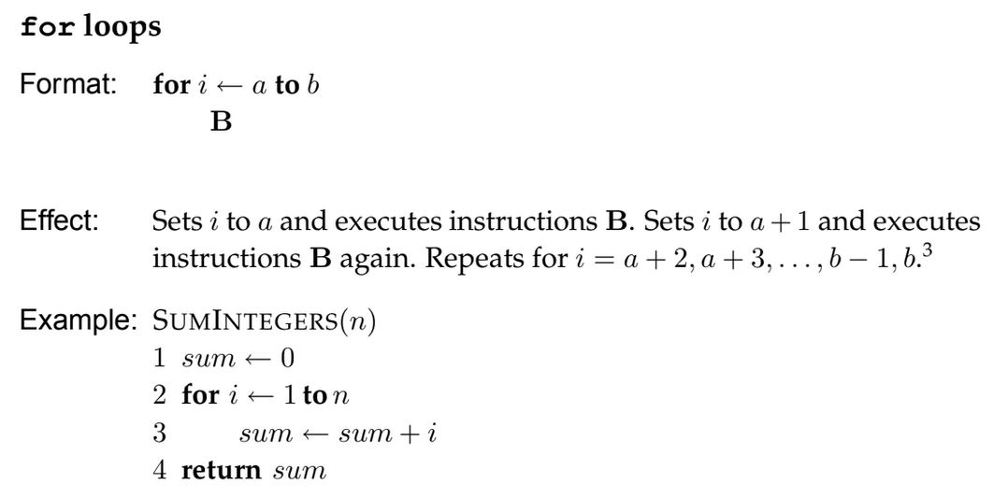
Pseudocode Notation

Slide 9
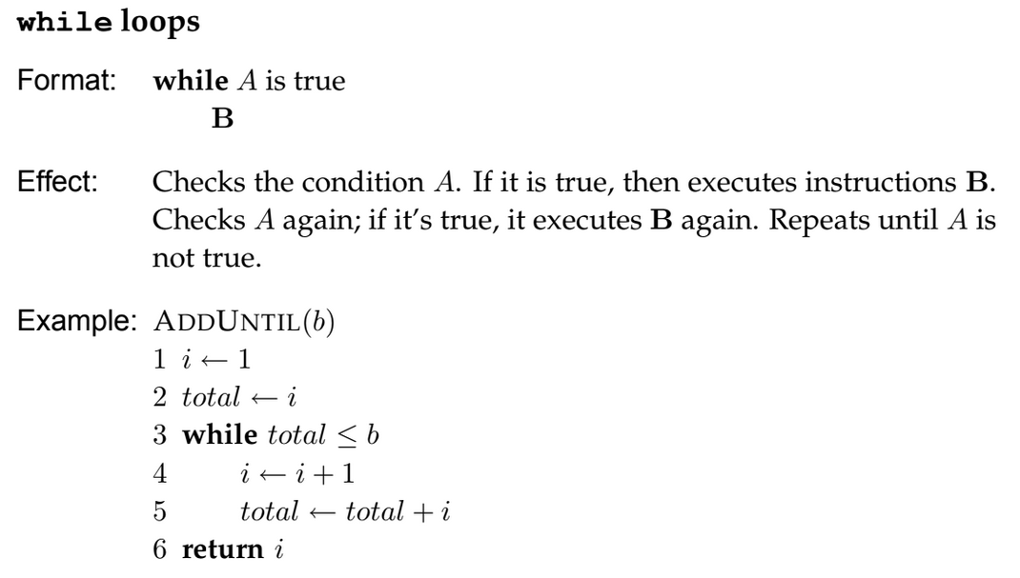
Pseudocode Notation

Slide 10
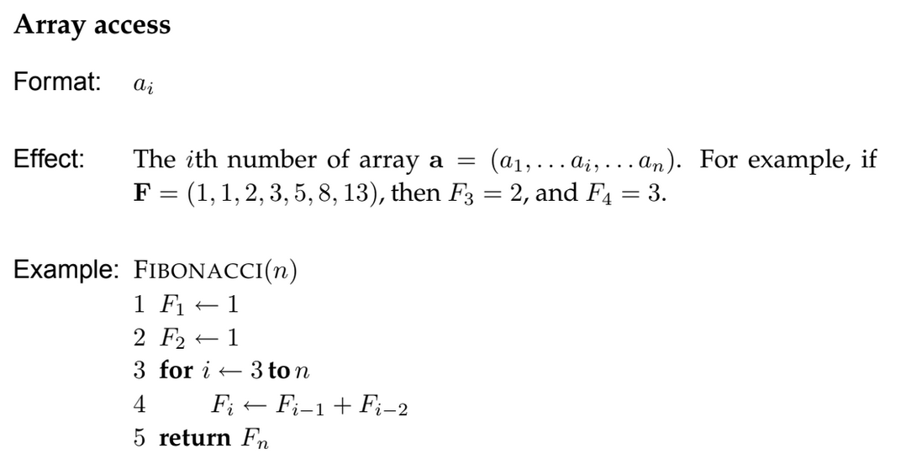
Pseudocode Notation

Slide 11
Pseudocode vs Computer Code
If you were to build a machine that follows these instructions, you would need to make it specific to a particular kitchen and be tirelessly explicit in all the steps (e.g., how many times and how hard to stir the filling, with what kind of spoon, in what kind of bowl, etc.)
This is exactly the difference between pseudocode (the abstract sequence of steps to solve a well-formulated computational problem) and computer code (a set of detailed instructions that one particular computer will be able to perform).

Slide 12
Pseudocode Exercise: Coin Change (Euro coins)
Convert an amount of money into the fewest number of coins
Input: Amount of money (M)
Output: the smallest number of 50c (a), 20c (b), 10c (c), 5c (d), 2c (e) and 1c (f)
such that 50a+20b+10c+5d+2e+1f = M
Try: M=60c; M=55c; M=40c

Slide 13
Pseudocode Exercise: Coin Change (Generalised)

Slide 14
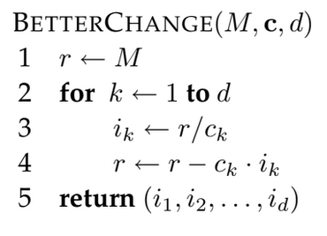
Pseudocode Exercise: Coin Change (US coins)
Try
M = 40; c1=25, c2=10, c3=5, c4=1
NB: Division = “floor”

Slide 15
Pseudocode Exercise: Coin Change (US coins)
M = 40; c1=25, c2=20, c3=10, c4=5, c5=1
Discontinued
1875
for being too
confusing
NB: Division = “floor”

Slide 16
Pseudocode Exercise: Coin Change (US coins)
BetterChange
40=
1x25 + 1x10 + 1x5=
3 coins
Incorrect!
40 = 2x20=
2 coins
M = 40; c1=25, c2=20, c3=10, c4=5, c5=1
Discontinued
1875
for being too
confusing
NB: Division = “floor”

Slide 17
Pseudocode Exercise: Coin Change
Tries every combination
Guaranteed to find optimal
Slow

Slide 18
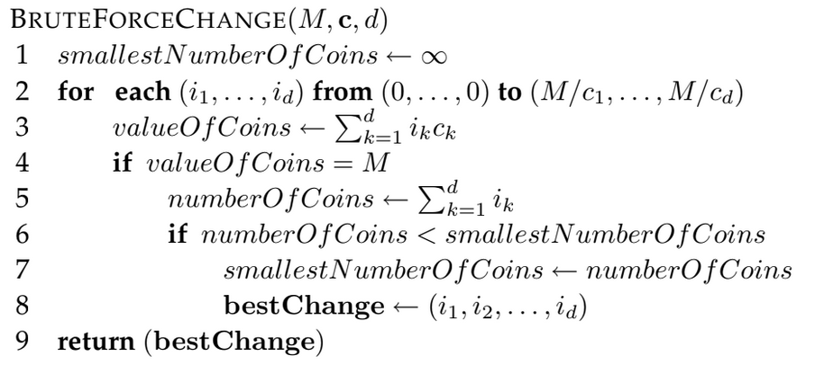
Brute Force Algorithm
Tries every combination
Guaranteed to find optimal
Slow
Spoiler: (There is a better solution: Stay tuned for Week 4)

Slide 19
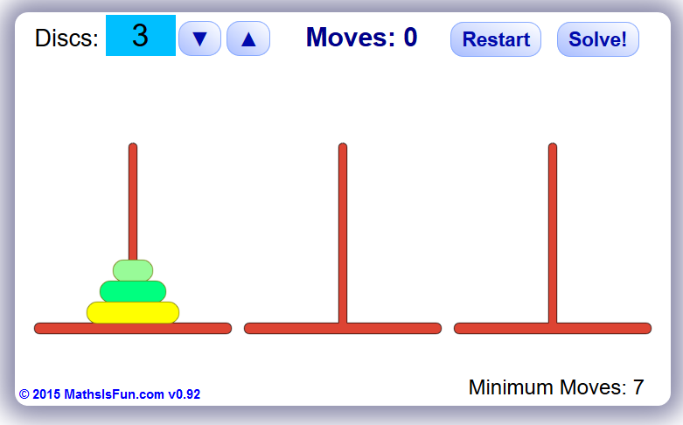
Recursive Algorithms
1 disc = 1 move
2 discs = 3 moves (1-2, 1-3, 2-3)
3 discs = 7 moves (1-3, 1-2, 3-2, 1-3, 2-1, 2-3,1-3)
…
https://www.mathsisfun.com/games/towerofhanoi.html

Slide 20
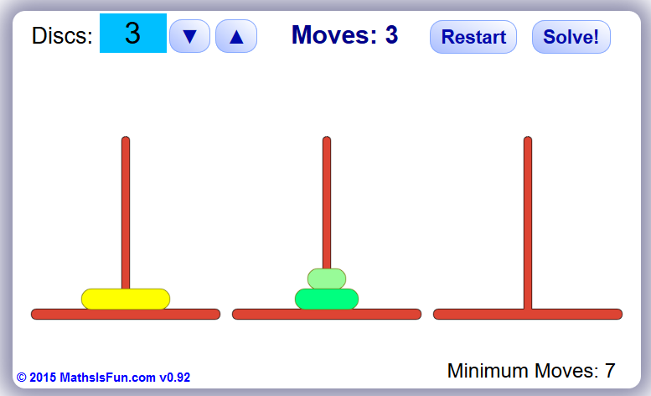
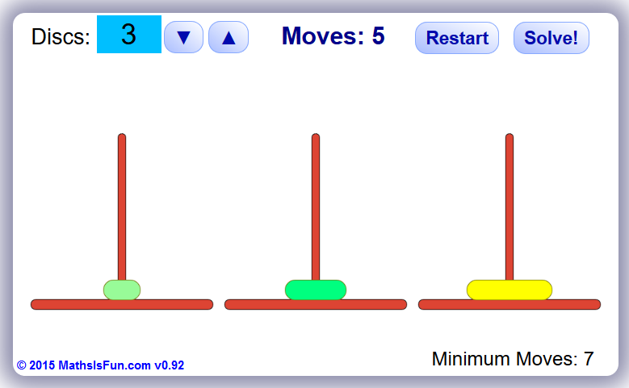
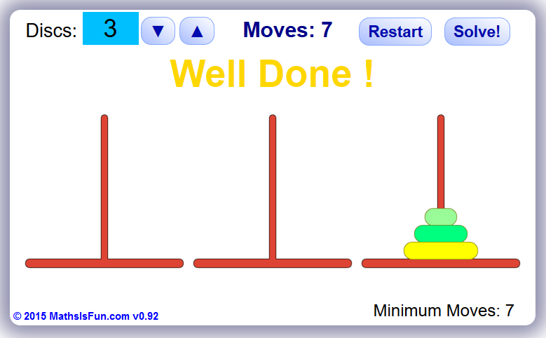
Towers of Hanoi (3 disks)
7 moves (1-3, 1-2, 3-2, 1-3, 2-1, 2-3,1-3)
More generally, to move a stack of size n from the left to the right peg, you first need to move a stack of size n − 1 from the left to the middle peg, and then from the middle peg to the right peg once you have moved the nth disk to the right peg.
To move a stack of size n − 1 from the middle to the right, you first need to move a stack of size n − 2 from the middle to the left, then move the (n − 1)th disk to the right, and then move the stack of n − 2 from the left to the right peg, and so
on.
https://www.mathsisfun.com/games/towerofhanoi.html

Slide 21
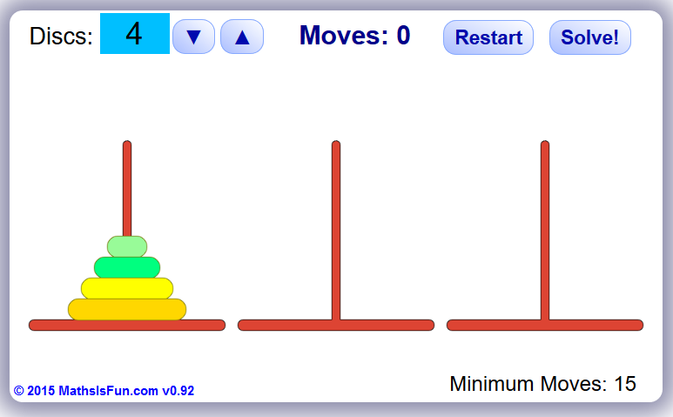
Towers of Hanoi: N disks
?
https://www.mathsisfun.com/games/towerofhanoi.html

Slide 22
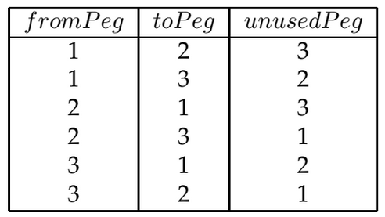
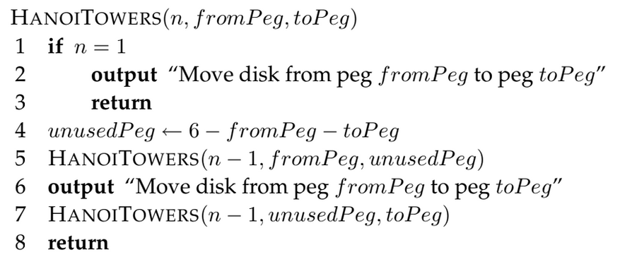
Towers of Hanoi: N disks
https://www.mathsisfun.com/games/towerofhanoi.html

Slide 23
Towers of Hanoi: N disks
https://www.mathsisfun.com/games/towerofhanoi.html

Slide 24
Towers of Hanoi: 4 disks
https://www.mathsisfun.com/games/towerofhanoi.html

Slide 25
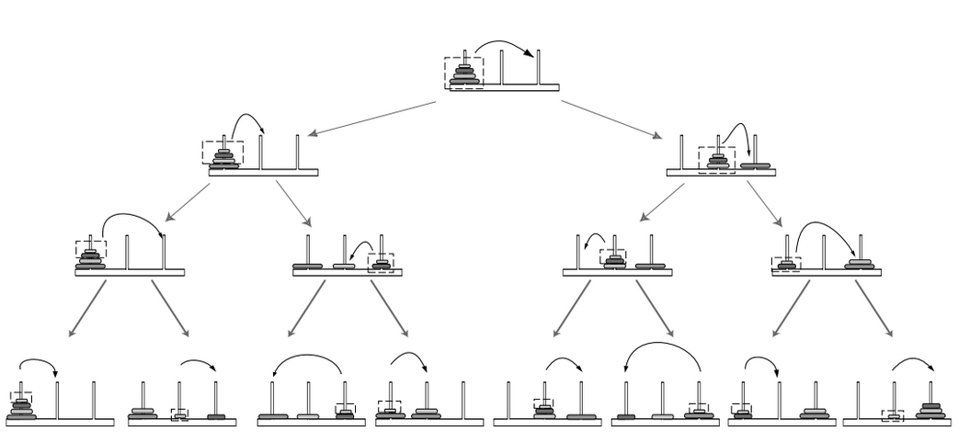
Towers of Hanoi: 4 disks
https://www.mathsisfun.com/games/towerofhanoi.html

Slide 26
Iterative Algorithms – Fibonacci Series

Slide 27
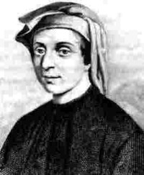
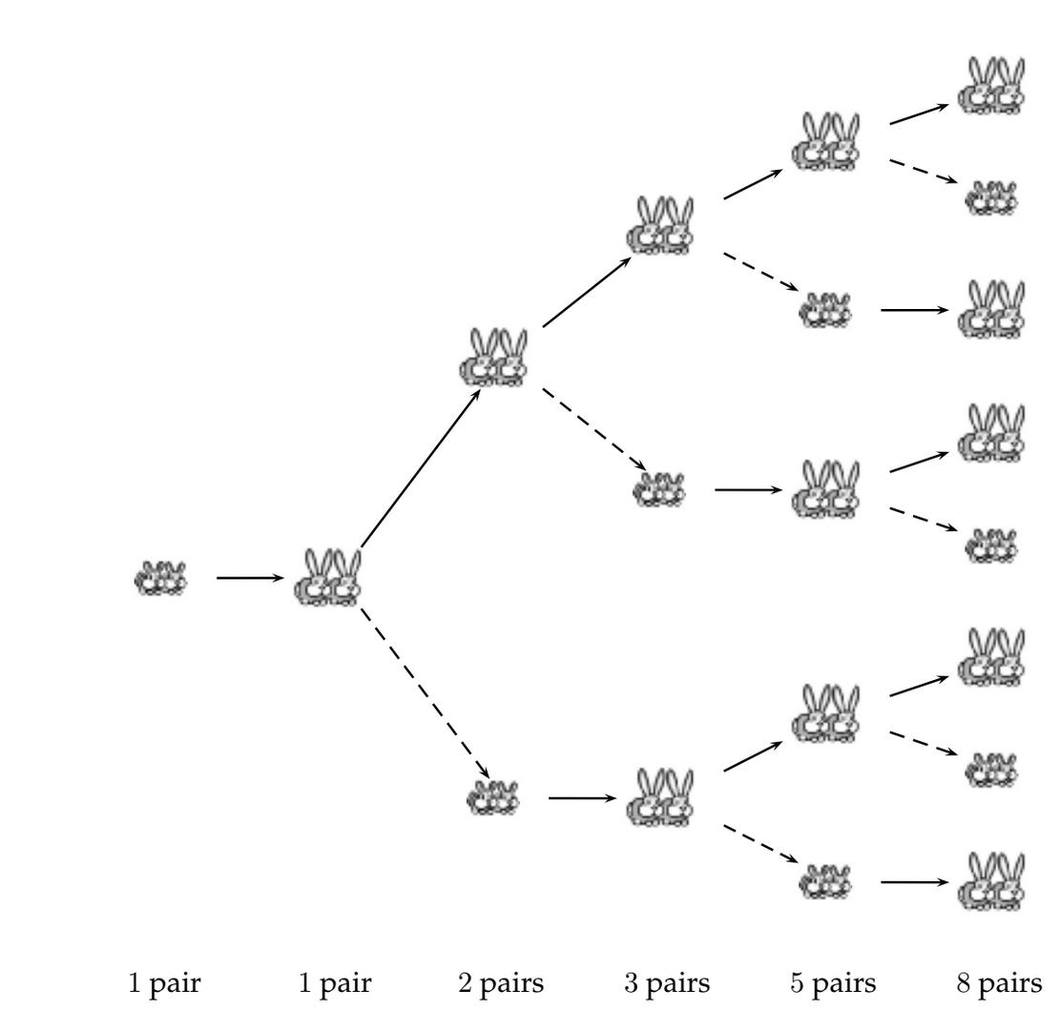
Iterative Algorithms – Immortal Rabbits
1,1,sum of previous two, …
A baby pair of rabbits takes the same time to mature
as a mature pair of rabbits takes to produce a new pair.
How many rabbits are there after N iterations?
PS: rabbits cannot die!

Slide 28
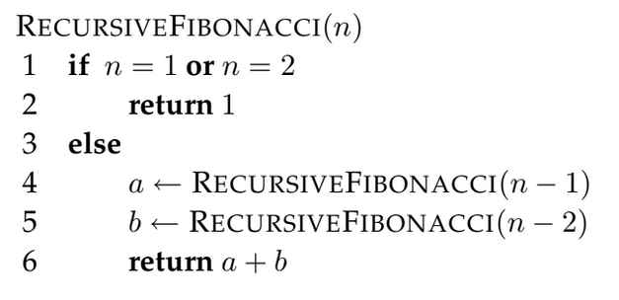
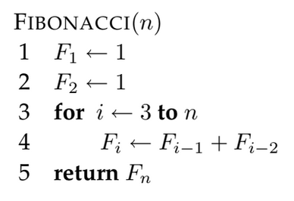
Iterative Algorithms vs Recursive Algorithms
Iterative: Fast (linear)
Recursive: Slow (exponential)

Slide 29
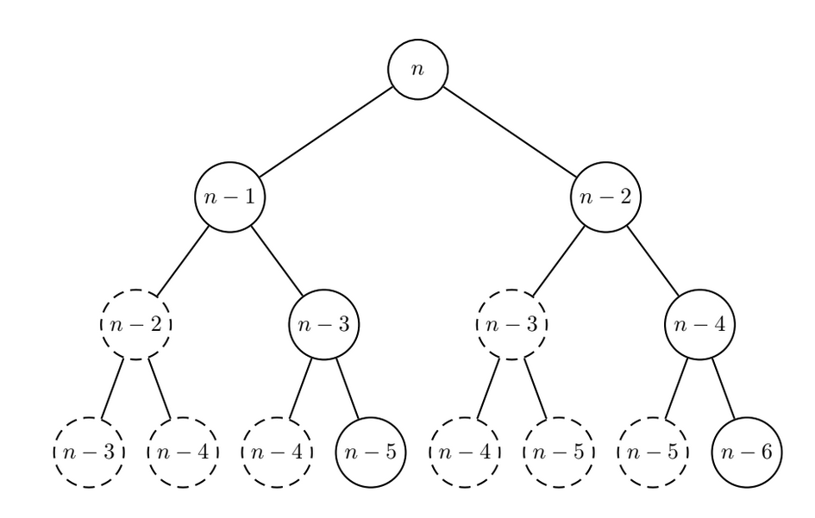
Recursive: Slow (exponential)

Slide 30
Algorithms
Brute force : Try Everything, slow but always correct
Recursive : To Solve for n, first solve for n-1
Iterative : Loop on something, can be faster

Slide 31
Fast vs Slow algorithms
How many operations does an algorithm take as N increases?
Is the relationship linear? Quadratic? Exponential?
What is the upper limit of the running time of an algorithm as N increases?

Slide 32
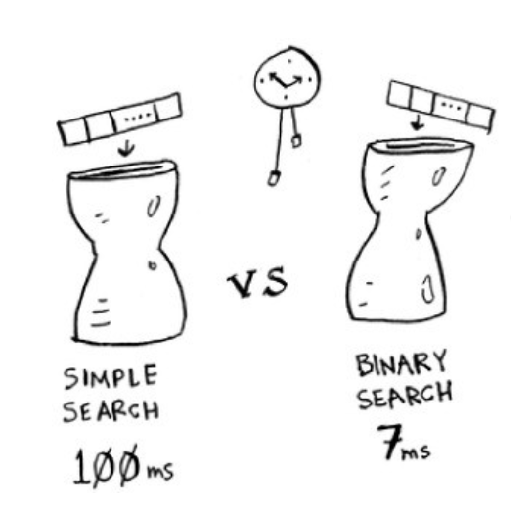
Guess random number (up/down)
1ms / check
N = 100
Simple search:
For i in 1 to N
If i == the number
return i
Binary search:
Range-min = 1
Range-max = N
While ()
i = middle number of range
if i == the number; return I
elsif i < number; Range-max=i;
elsif i > number; Range-min=i;

Slide 33
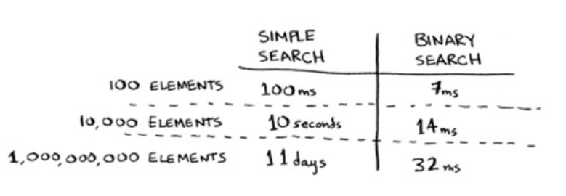
Guess random number (up/down)
~15 times faster
??? Guess ???

Slide 34
Guess random number (up/down)
~15 times faster
~450ms ?
~15 times faster ?

Slide 35
Guess random number (up/down)
~15 times faster
~15 times faster doesn’t make sense!

Slide 36
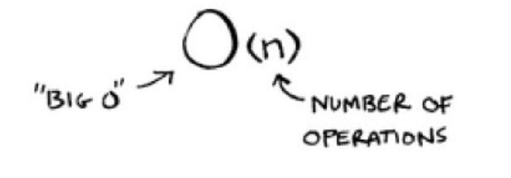
Guess random number (up/down)
Linear
1 ms/element
O(n)
Logarithmic
1 ms/log2(element)
O(log n)
(Worst case scenario)

Slide 37
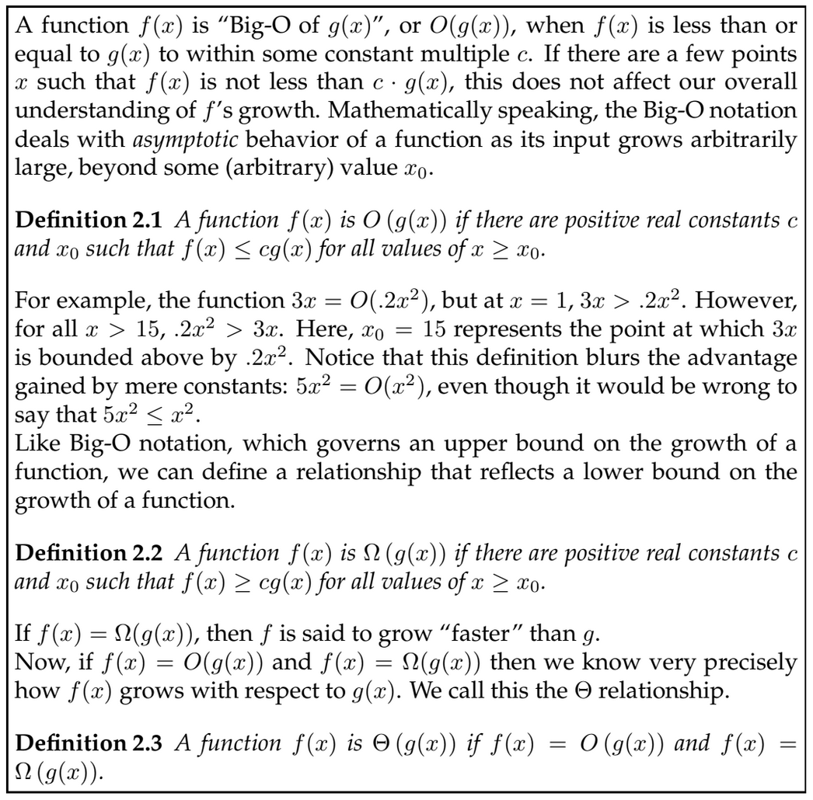

Slide 38
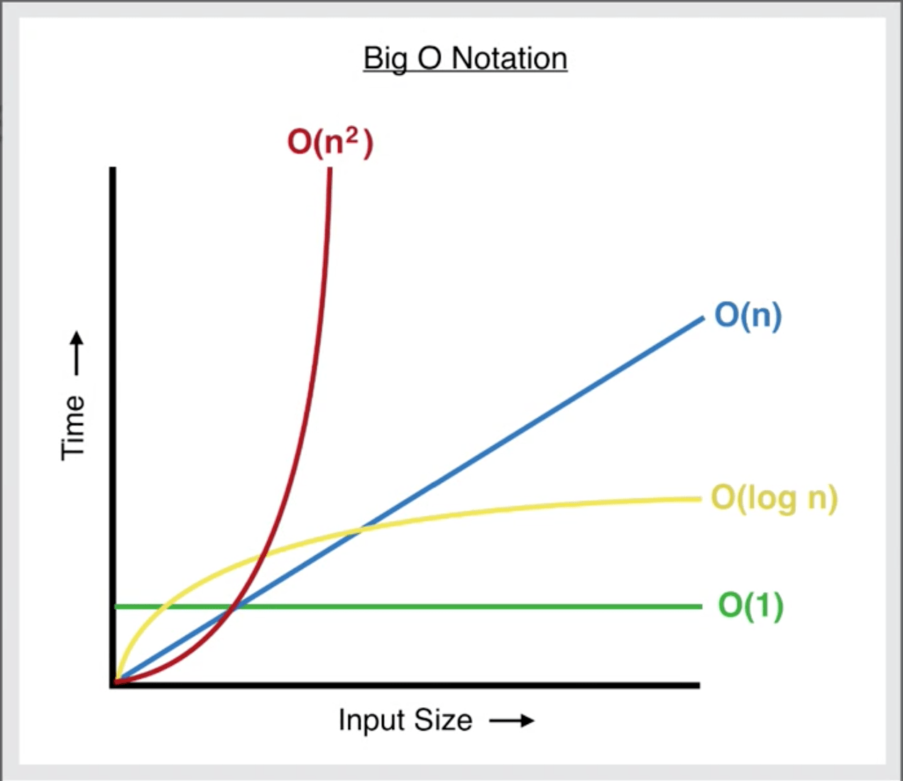
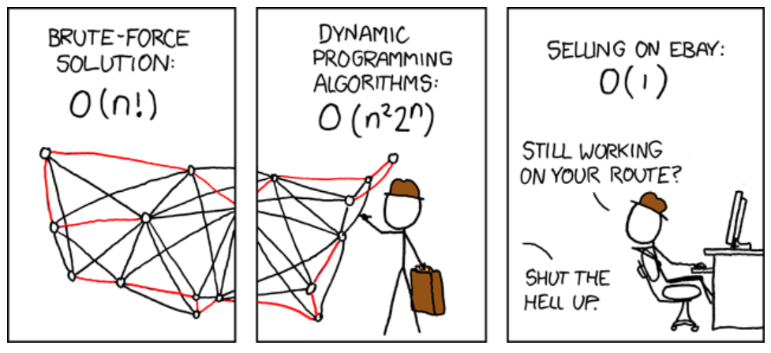
Common Big-Os
"Given a list of cities and the distances between each pair of cities,
what is the shortest possible route that visits each city and returns to the origin city?"
https://www.freecodecamp.org/news/big-o-notation-simply-explained-with-illustrations-and-video-87d5a71c0174/

Slide 39
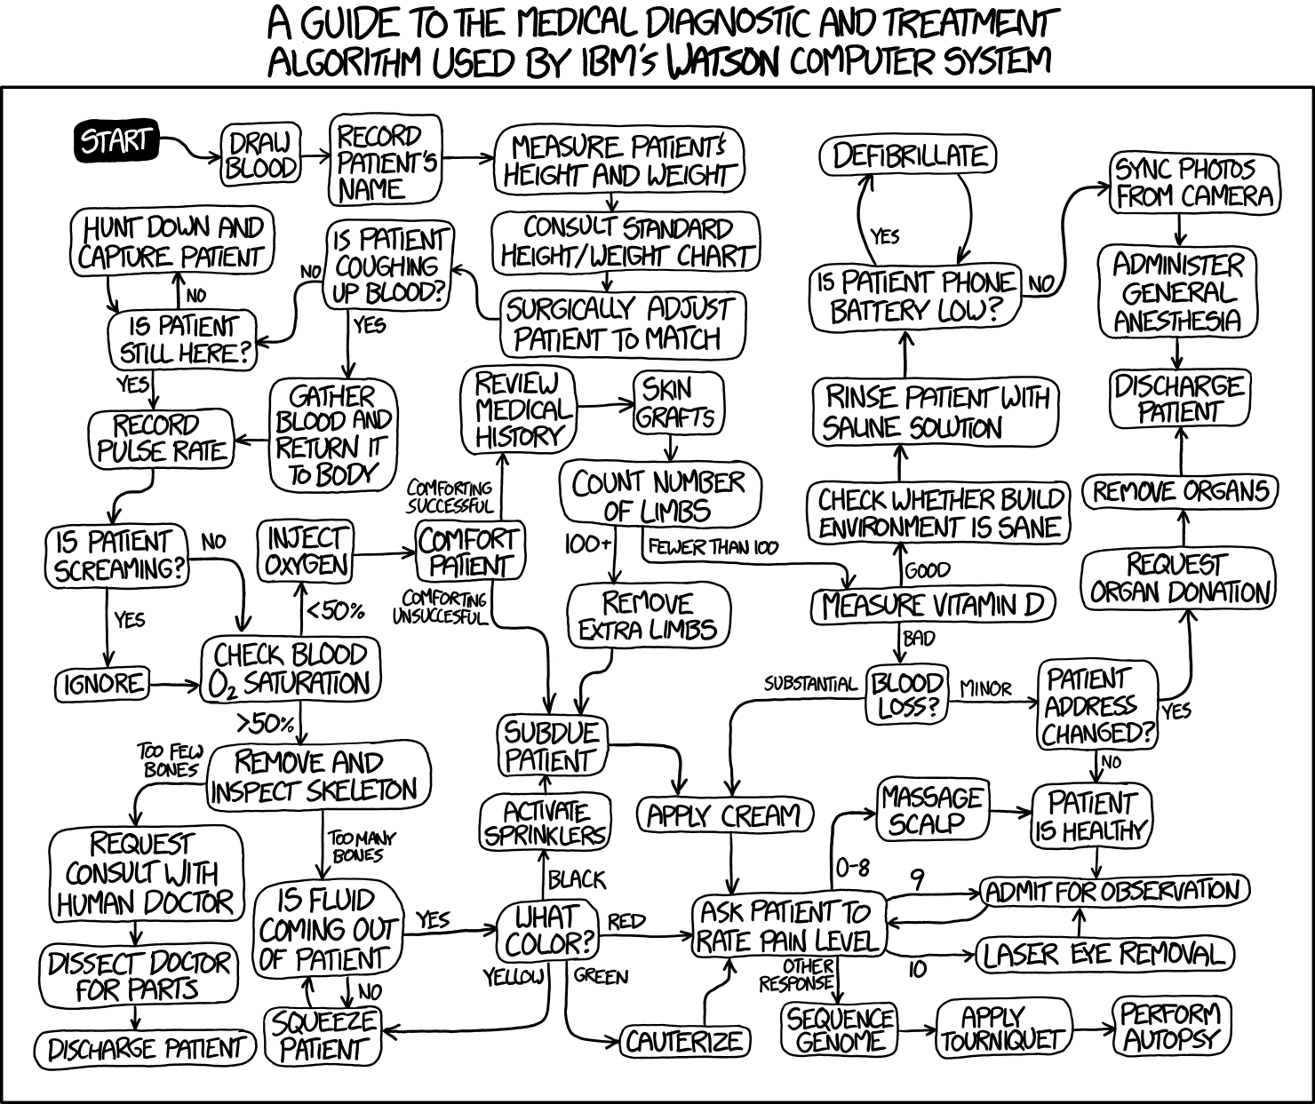
Week 1 Summary
I know what an algorithm is
I can write pseudocode
I understand
Brute force
Iterative
Recursive
Big-O = how slow

Slide 40
CEITEC
@CEITEC_Brno
Thank you for your attention!
60 minutes lunch break.
Panos Alexiou
panagiotis.alexiou@ceitec.muni.cz
www.ceitec.eu

