Slide 1

Week 3 : Filetypes and Browser
Introduction to Bioinformatics (LF:DSIB01)

Slide 2
Encoding Genomic Information for Bioinformatics Use
Location Based Formats (.bed)
Count/Coverage Based Formats (.bedgraph .wig)
Feature Based Formats (.gtf)
Sequence Based Formats (.fasta .fastq)
Multiple Alignment Files
Alignment Based Formats (.sam)

Slide 3

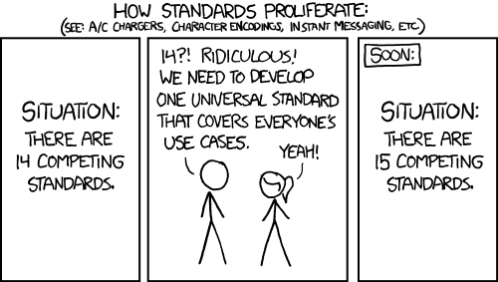

Slide 4
BED (Browser Extensible Data) file format
Tab Delimited Text File
Number of columns consistent per line
No Empty fields (some can have “.” as N/A)
BED 3 columns : chrom, chromStart, chromEnd
BED 6 columns : BED3 + name, score, strand
BED 12 columns : BED6 + thickStart, thickEnd, itemRGB, blockCount, blockSizes, blockStarts
https://genome.ucsc.edu/FAQ/FAQformat.html#format1

Slide 5
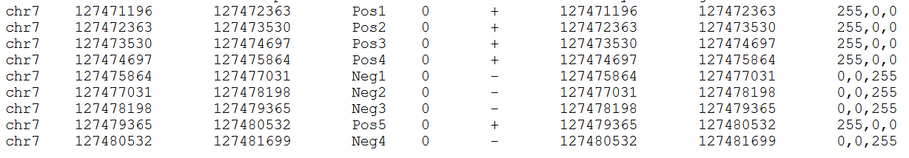
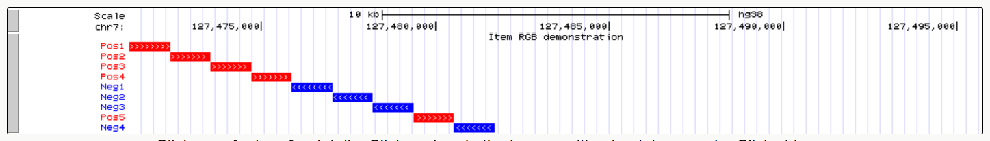
BED 3 columns : chrom, chromStart, chromEnd
BED 6 columns : BED3 + name, score, strand
BED 12 columns : BED6 + thickStart, thickEnd, itemRGB, blockCount, blockSizes, blockStarts

Slide 6
BED pros and cons
Generic
Human Readable
Useful for simple genomic loci
Awkward handling of splice events
Not useful for variable scores
Must repeat BED3 info every line

Slide 7
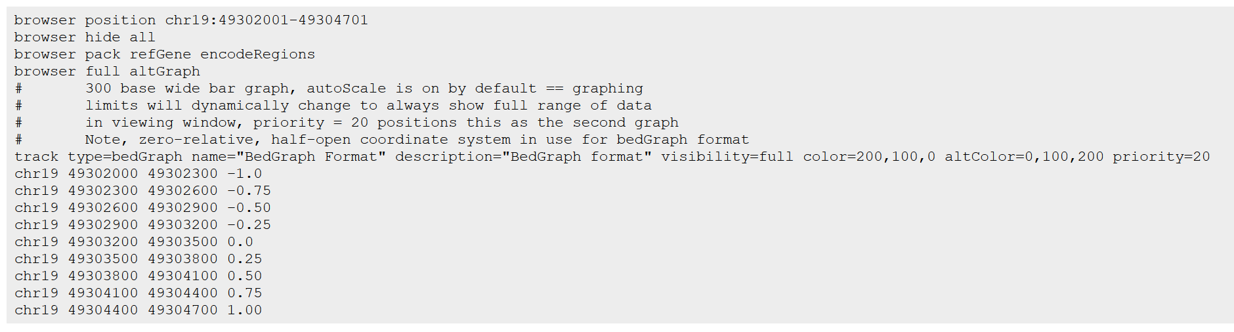
bedGraph
Used to display continuous data
Header “browser” + Header “track” + Sorted BED lines (chr, start, stop, score)

Slide 8
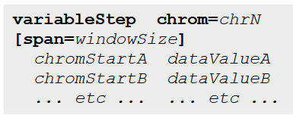
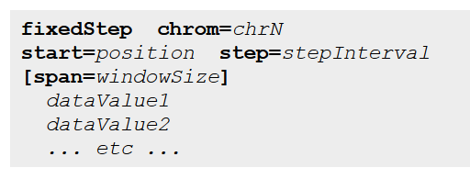
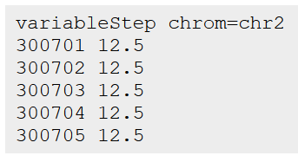
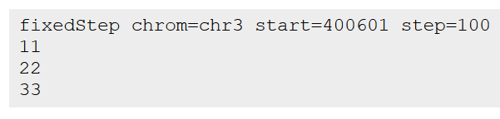
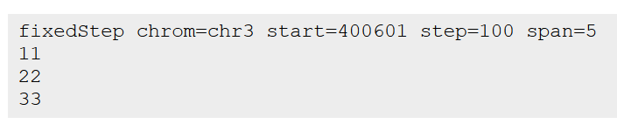

wiggle file (.wig)
Comes in two flavors: variablestep vs fixed step

Slide 9
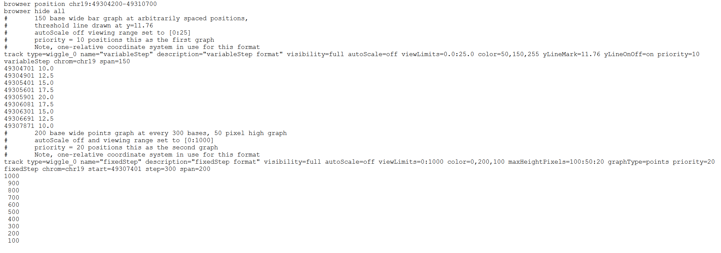
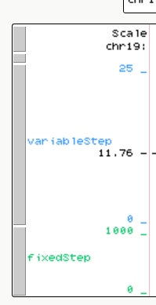
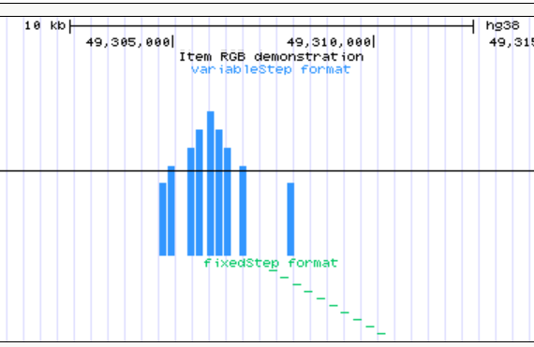

Slide 10
Wig pros and cons
Compact
Wide variety of values
Difficult for human readability
Difficult to add/subtract lines

Slide 11
General transfer format (.gtf)
Also commonly known as .gff (general feature format)
1. seqname (chr)
2. source (program generating seq)
3. feature (what is it? “CDS”, “exon”, “enhancer” etc)
4. start (position)
5. end (inclusive)
6. score (can be any float. Ideal: between 1-1000 for UCSC browser)
7. strand (“+”, “-”, “.”)
8. frame (for exons, frame is between 0-2 representing open reading frame, else “.”)
9. group; list of attributes (gene_id, transcript_id etc)

Slide 12
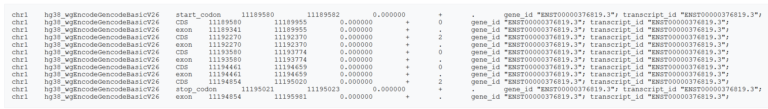

Slide 13
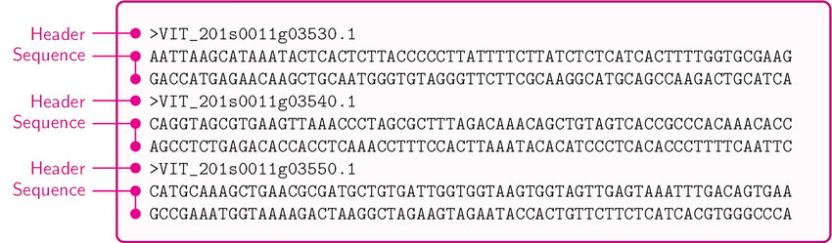
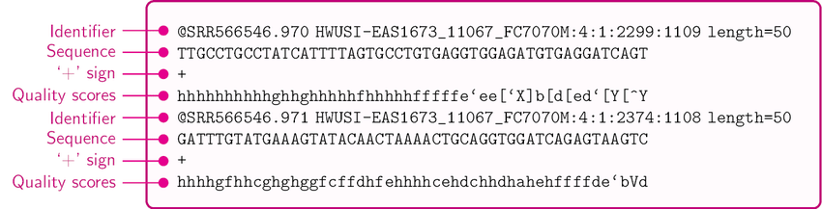
Fasta & Fastq

Slide 14
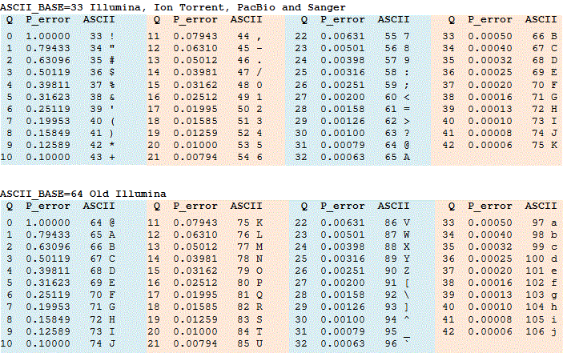
Fastq Quality Scores

Slide 15
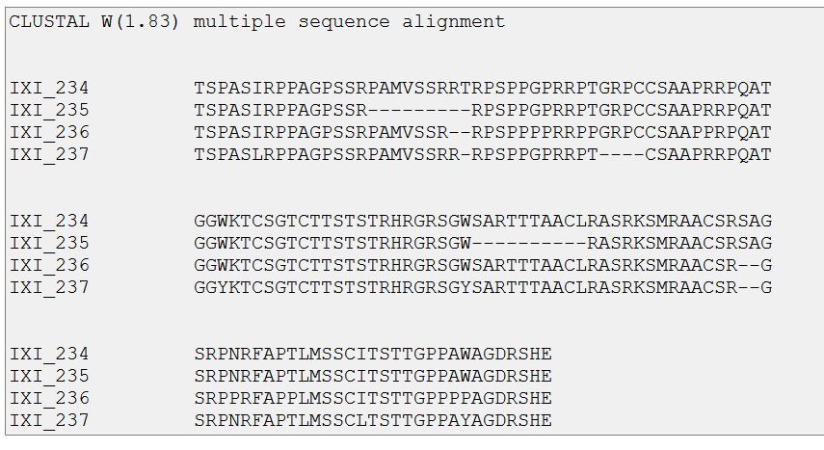
Multiple Alignment File

Slide 16
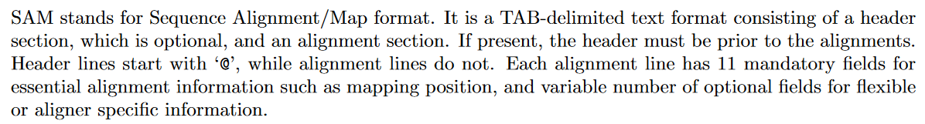
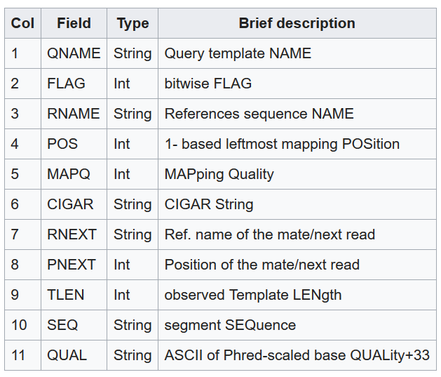
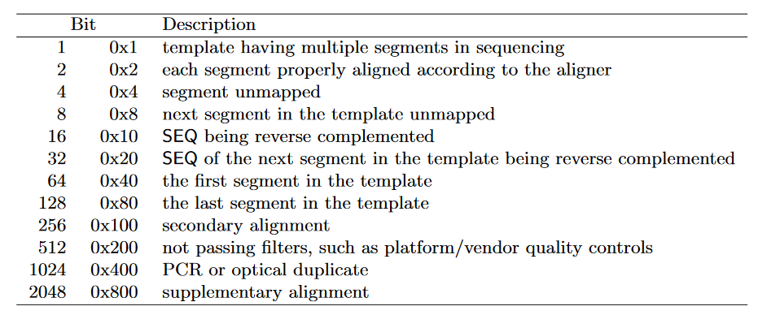
Sequence Alignment Map (.sam)
https://www.samformat.info/

Slide 17
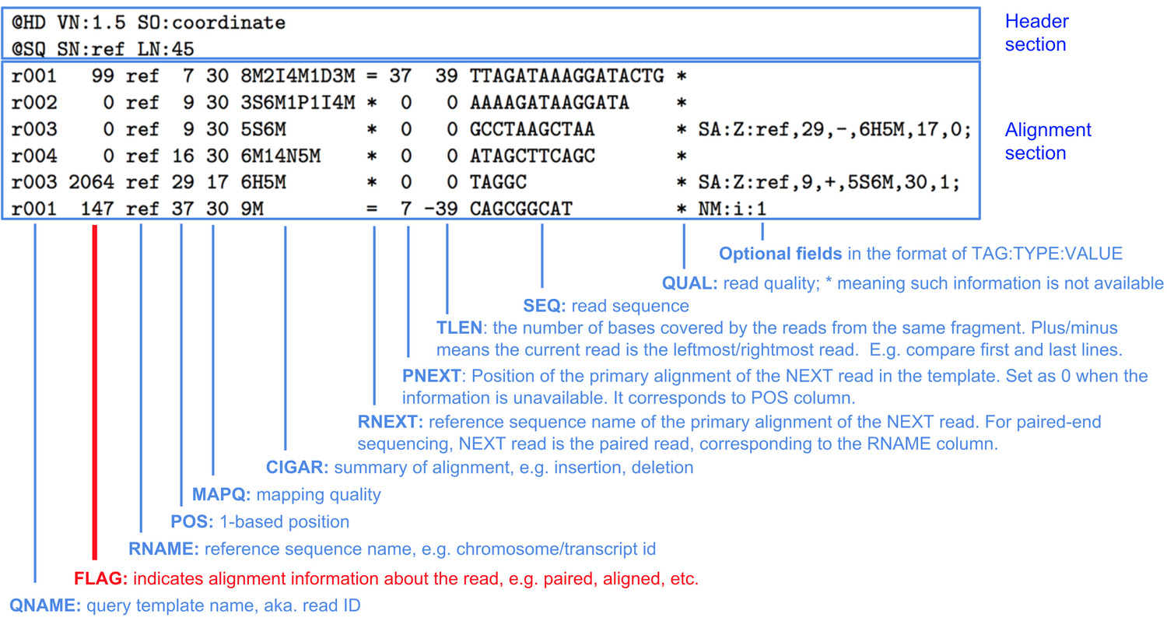
Sequence Alignment Map (.sam)
.bam format
(Binary SAM)

Slide 18
Encoding Genomic Information for Bioinformatics Use
Location Based Formats (.bed)
Count/Coverage Based Formats (.bedgraph .wig)
Feature Based Formats (.gtf)
Sequence Based Formats (.fasta .fastq)
Multiple Alignment Files
Alignment Based Formats (.sam)

