Slide 1
Week 4 : Next Generation Sequencing: techniques and data
Introduction to Bioinformatics (LF:DSIB01)

Slide 2
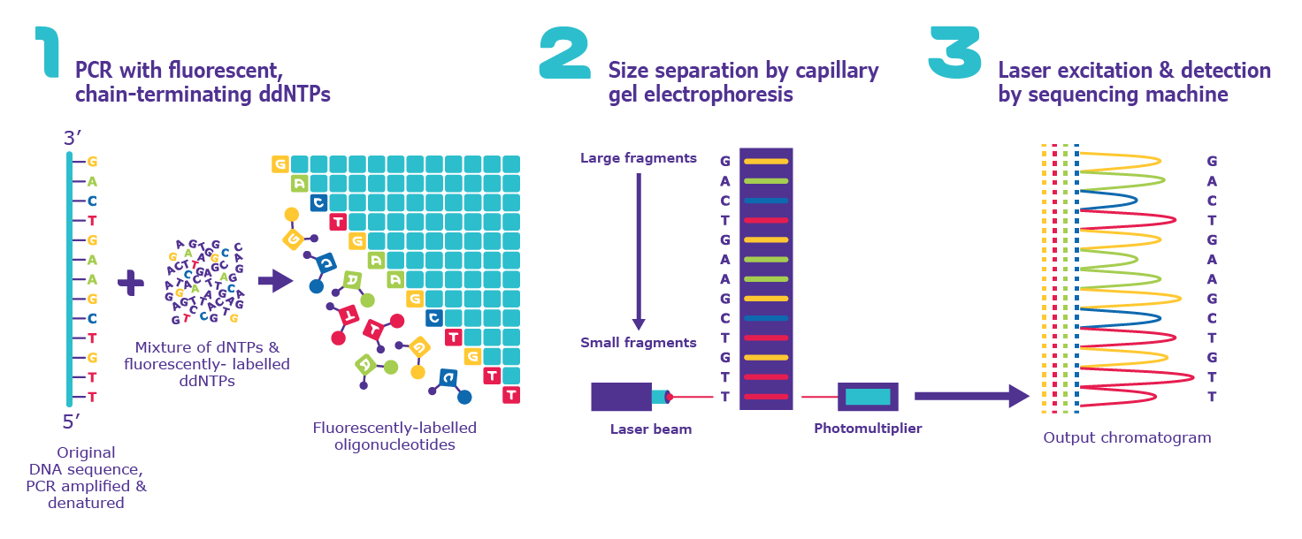
Nucleic Acid Sequencing History
Sanger Sequencing – Bacteriophage genome sequenced: 1977

Slide 3
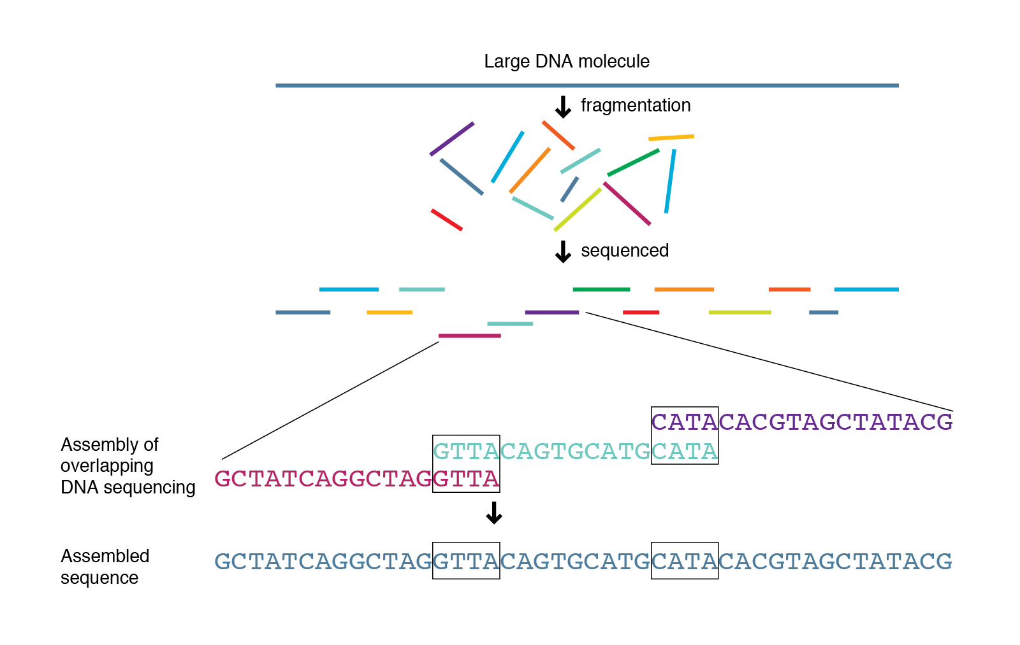
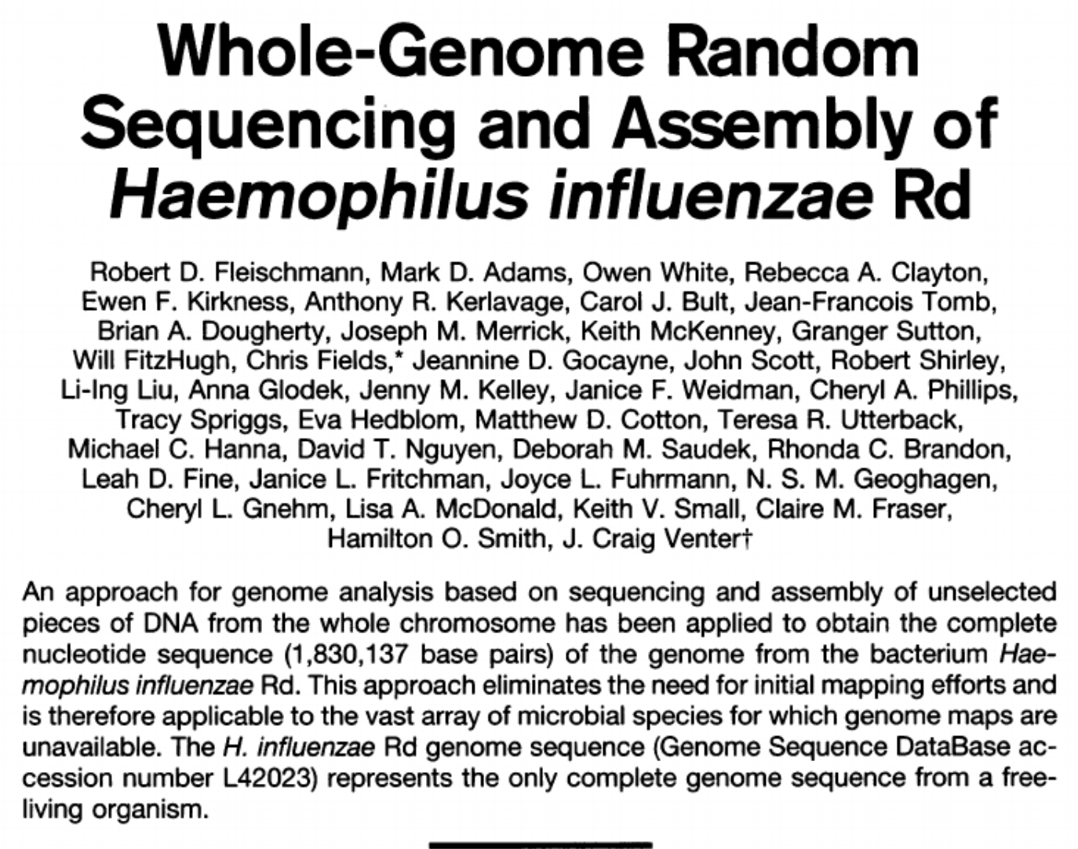
Nucleic Acid Sequencing History
1995 – Shotgun Sequencing

Slide 4
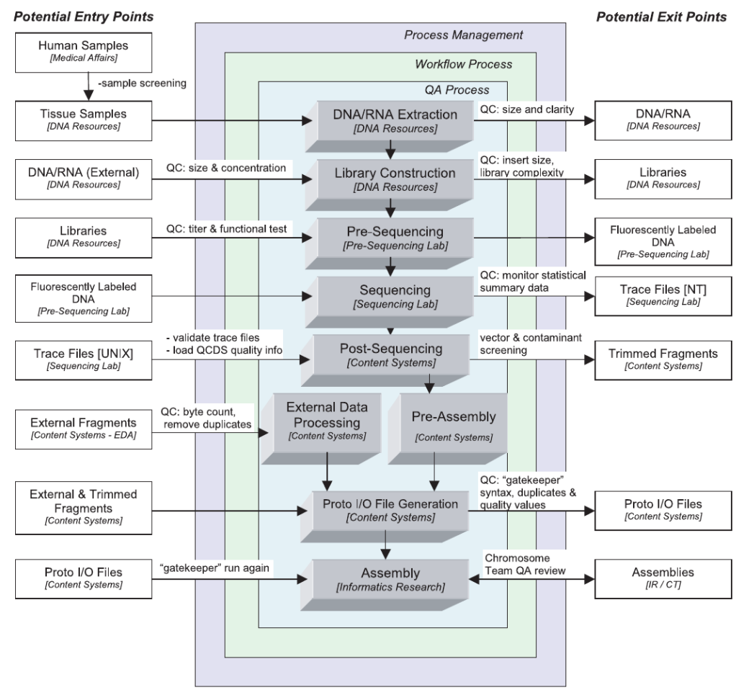
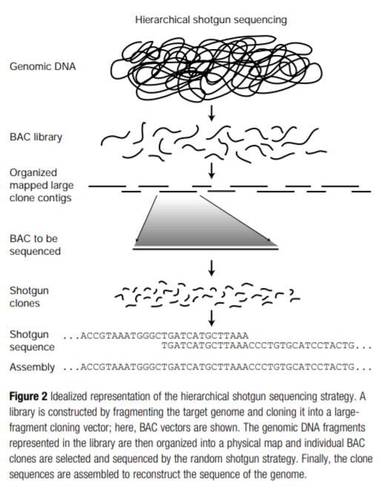
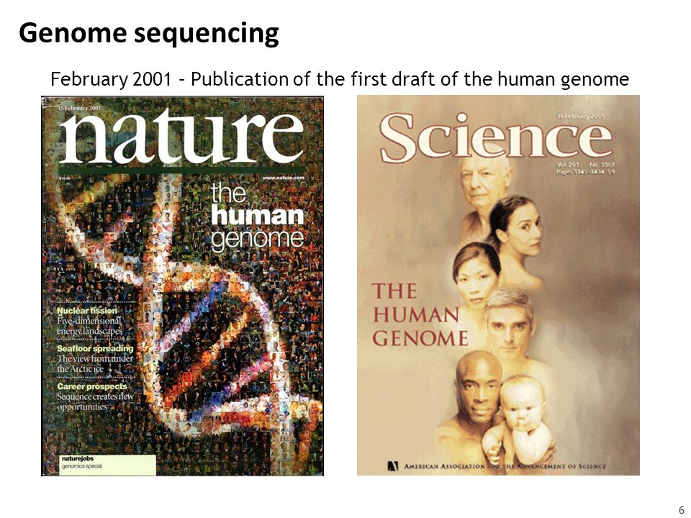
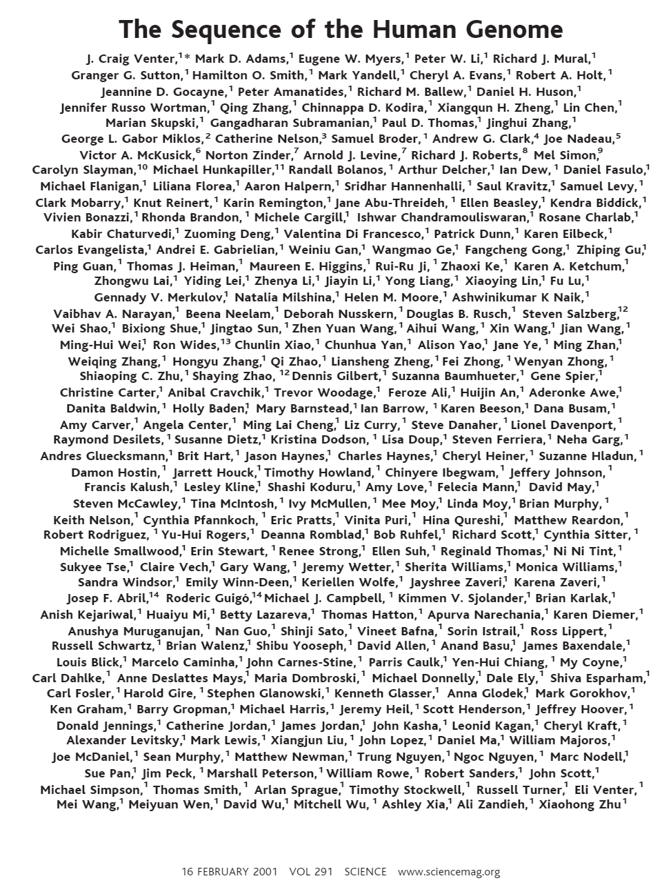
Nucleic Acid Sequencing History
2001
Human Genome Sequenced
Cost: ~300M USD

Slide 5
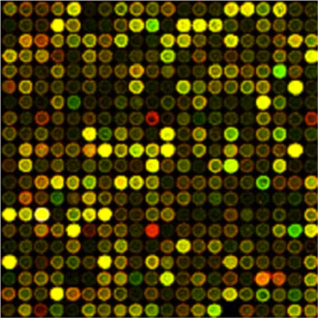
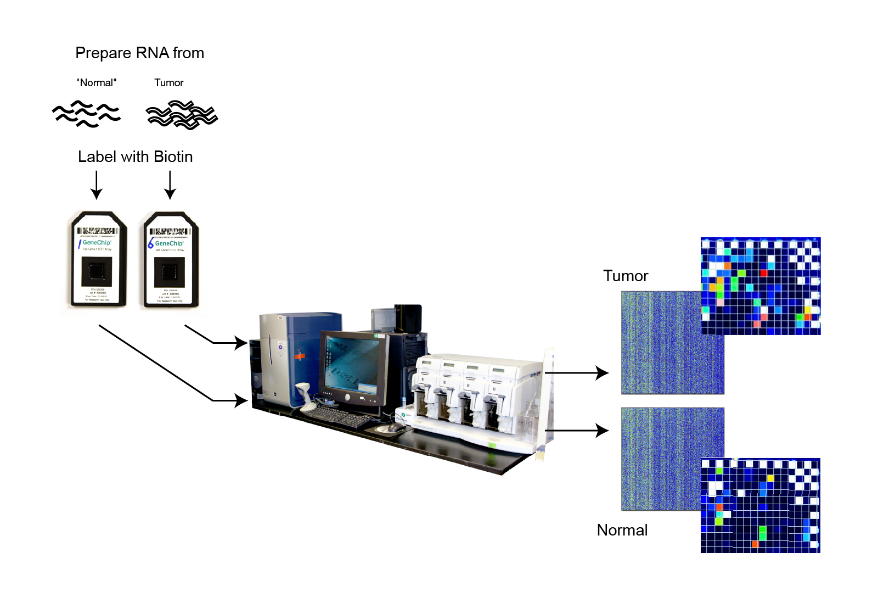
Nucleic Acid (not-)Sequencing History
2000s - Microarrays

Slide 6
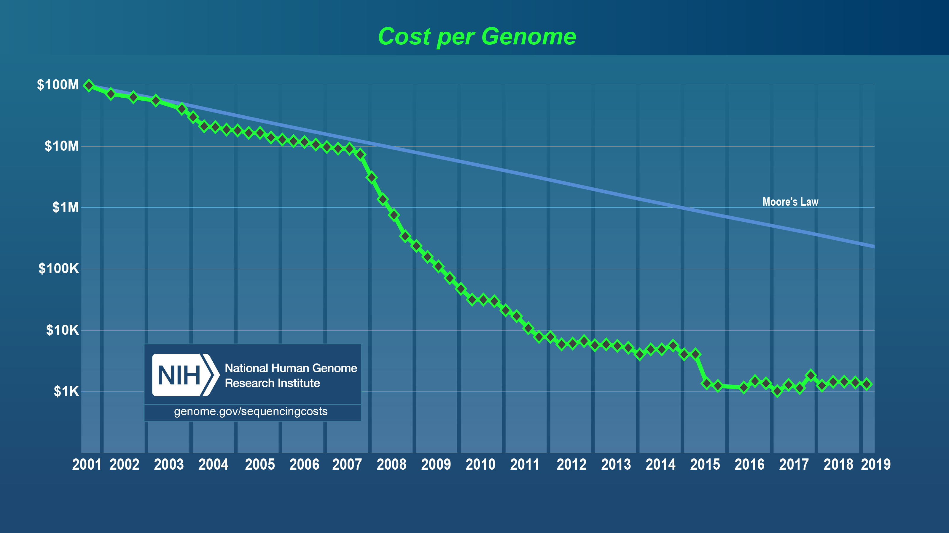
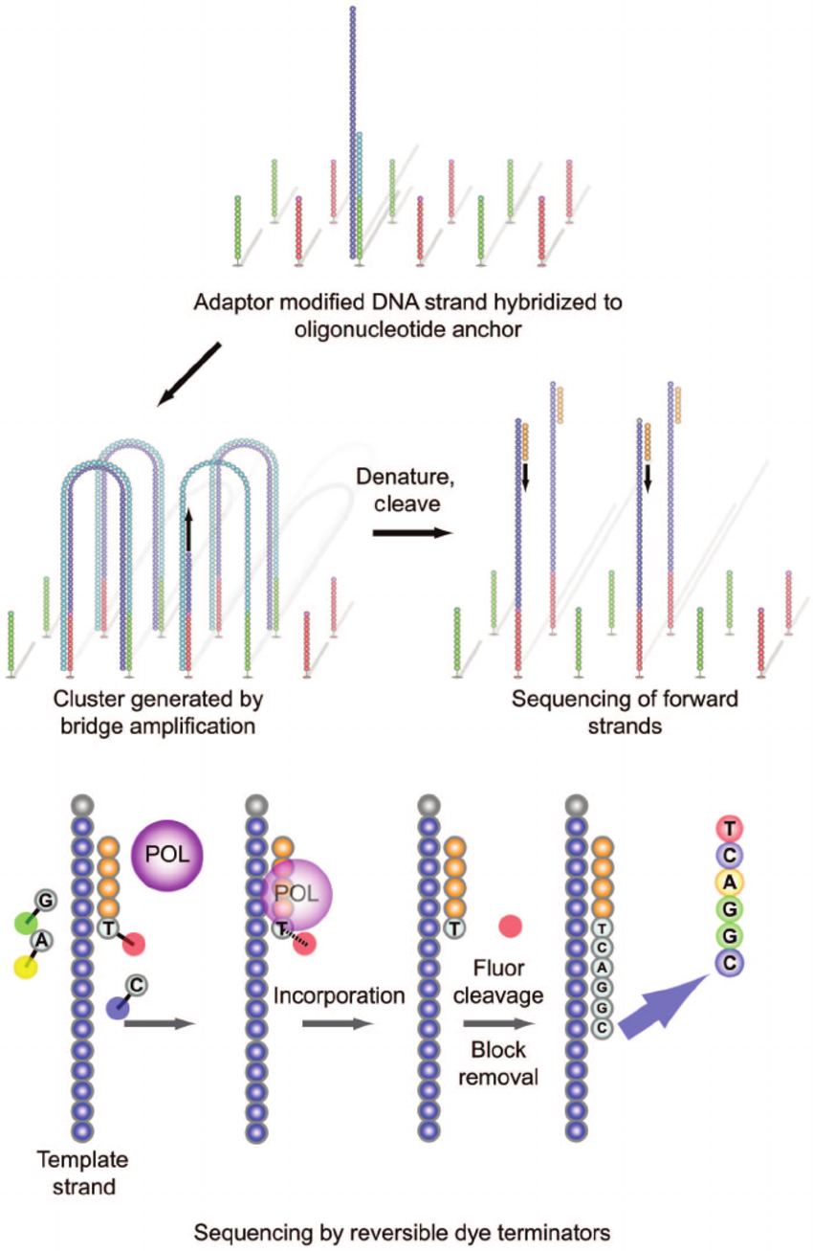
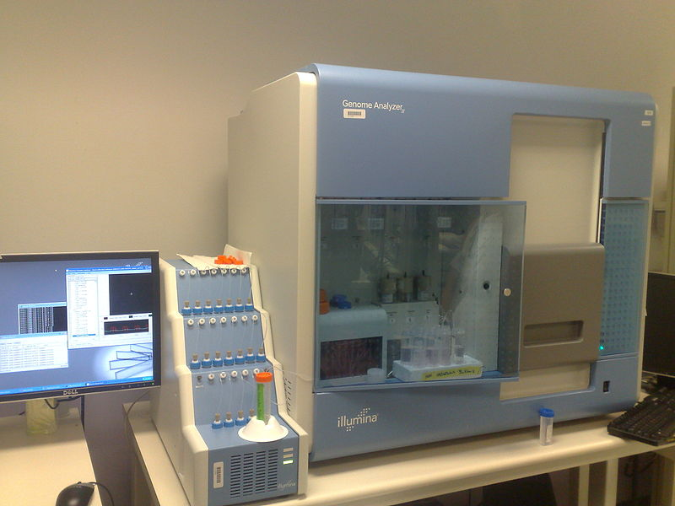
Nucleic Acid Sequencing History
Next Generation Sequencing
New Generation Sequencing
NGS
2006 – Solexa Genome Analyser
2007 – Solexa bought by Illumina
2015

Slide 7
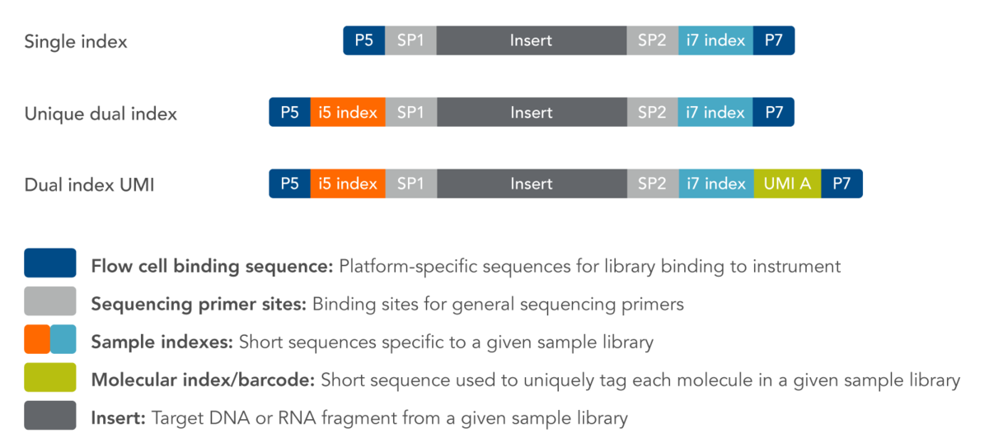
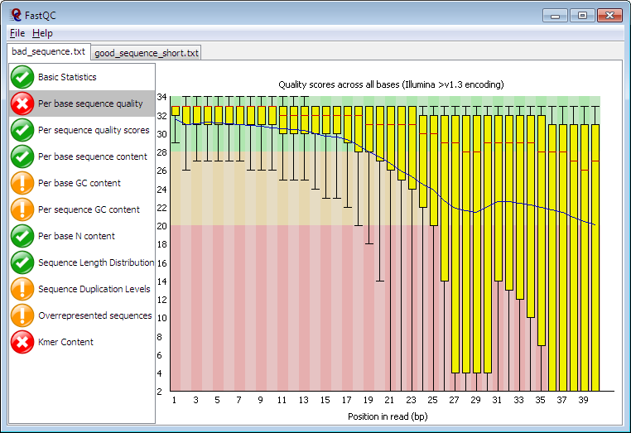
NGS Data analysis workflow
Sequencing
Adaptor Trimming
Quality
Control
Alignment to Reference
Today’s Practical
Next Lecture + Practical

Slide 8
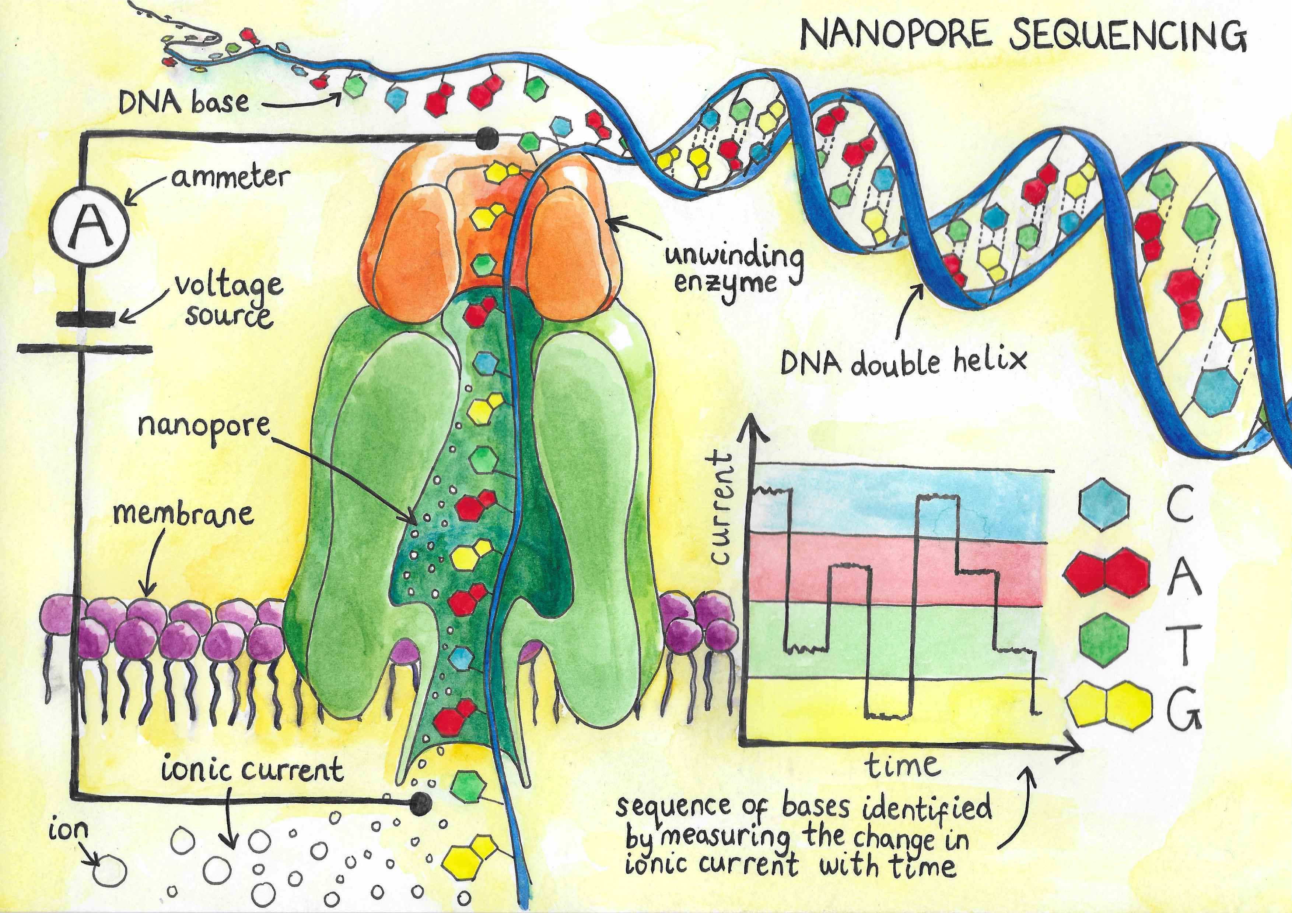
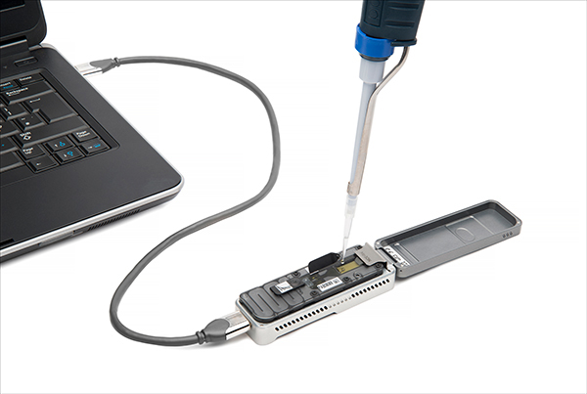
Long Read Sequencing
Long Reads – Low per read accuracy

Slide 9
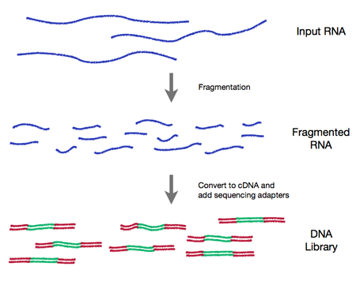
RNA-Seq

Slide 10
RNA-Seq Analysis
Alignment to transcriptome or genome (gapped)
Poly-A selection or Ribosomal RNA depletion
Can be used to quantify RNA, or to identify structural differences (e.g. splicing)
Usual downstream analysis: Fold Change between conditions

Slide 11
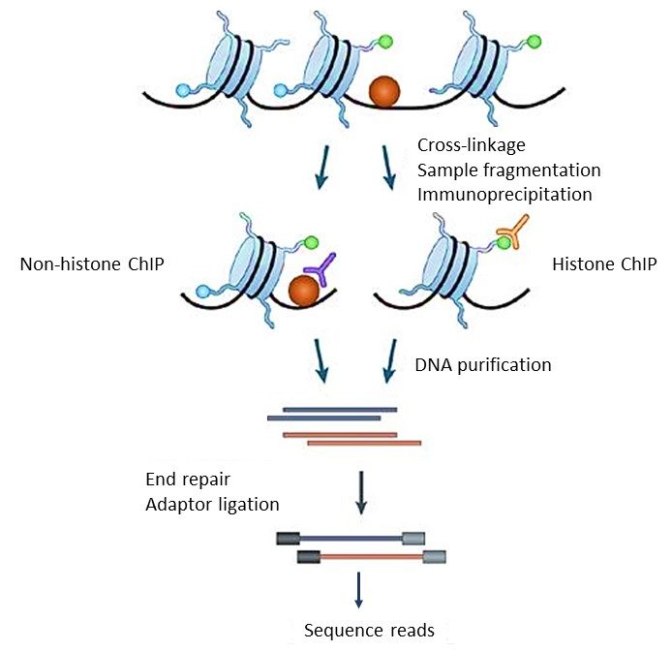
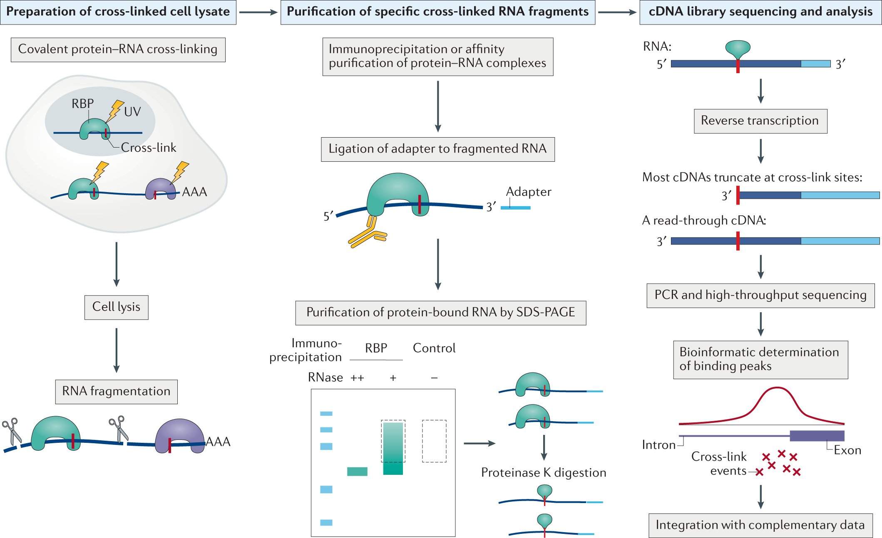
Immunoprecipitation based techniques
ChIP-Seq : DNA Binding Proteins
CLIP-Seq : RNA Binding Proteins

Slide 12
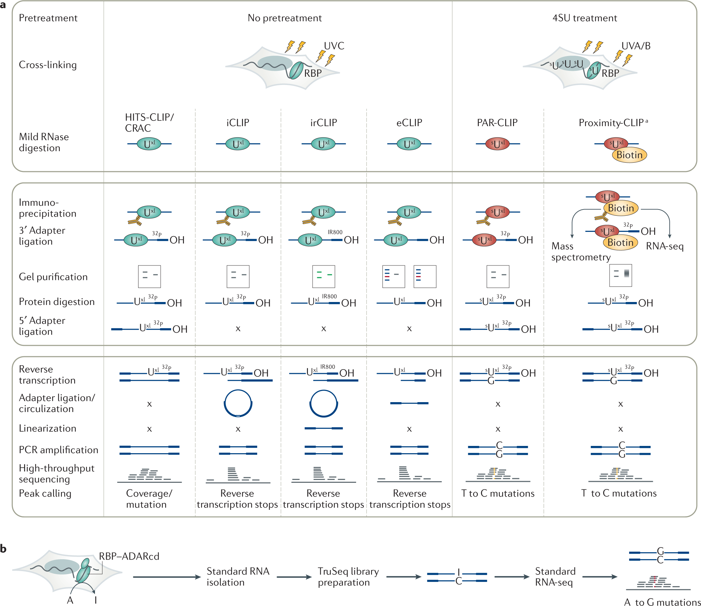
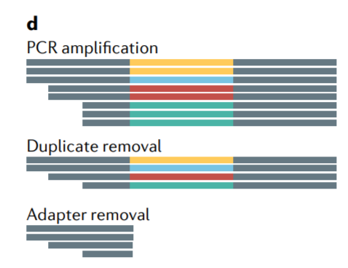
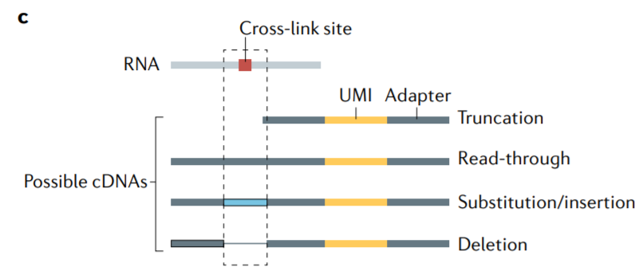
https://www.nature.com/articles/s43586-021-00018-1

Slide 13
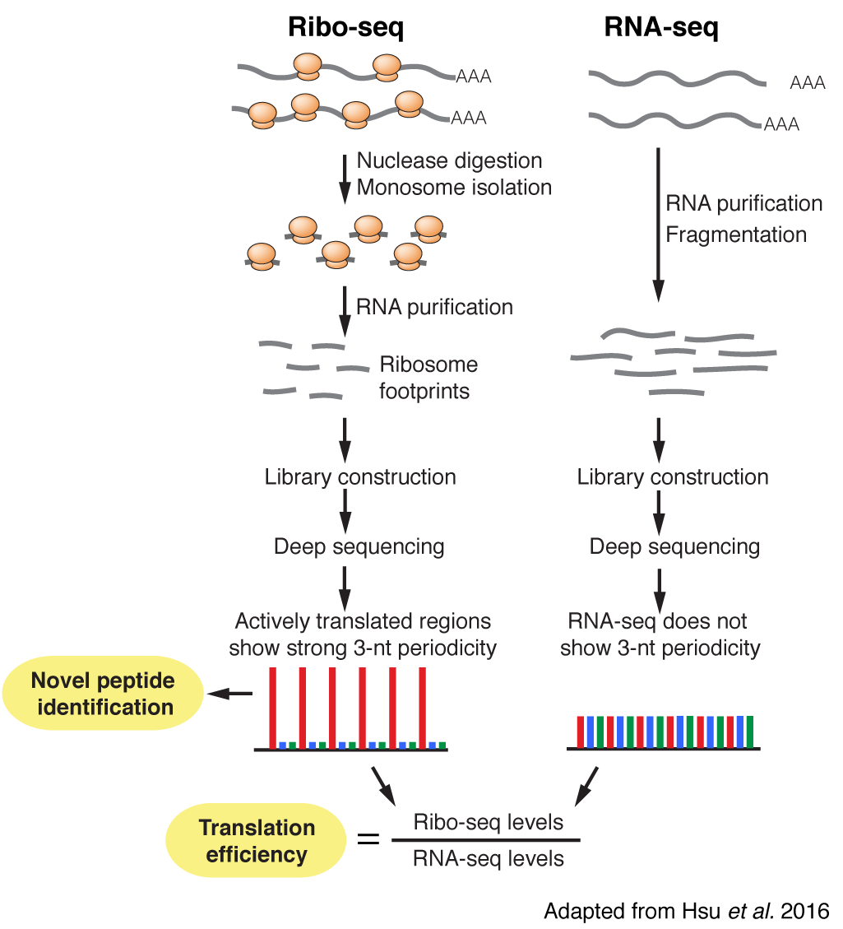
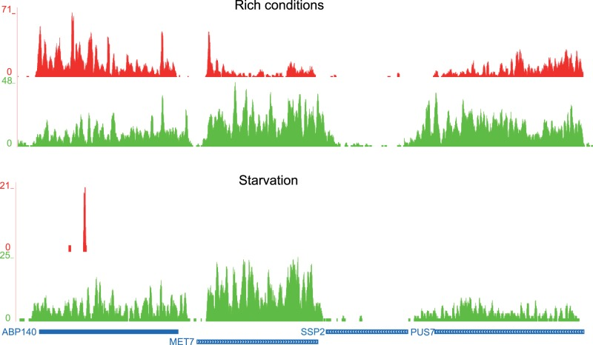
Ribo-Seq
Identification of actively translated RNA
Exact position of Ribosome

Slide 14
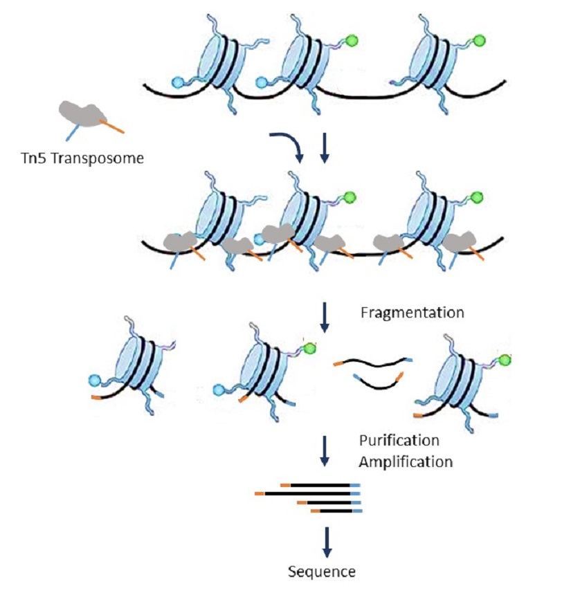
ATAC-Seq
Identification of accessible chromatin areas

Slide 15
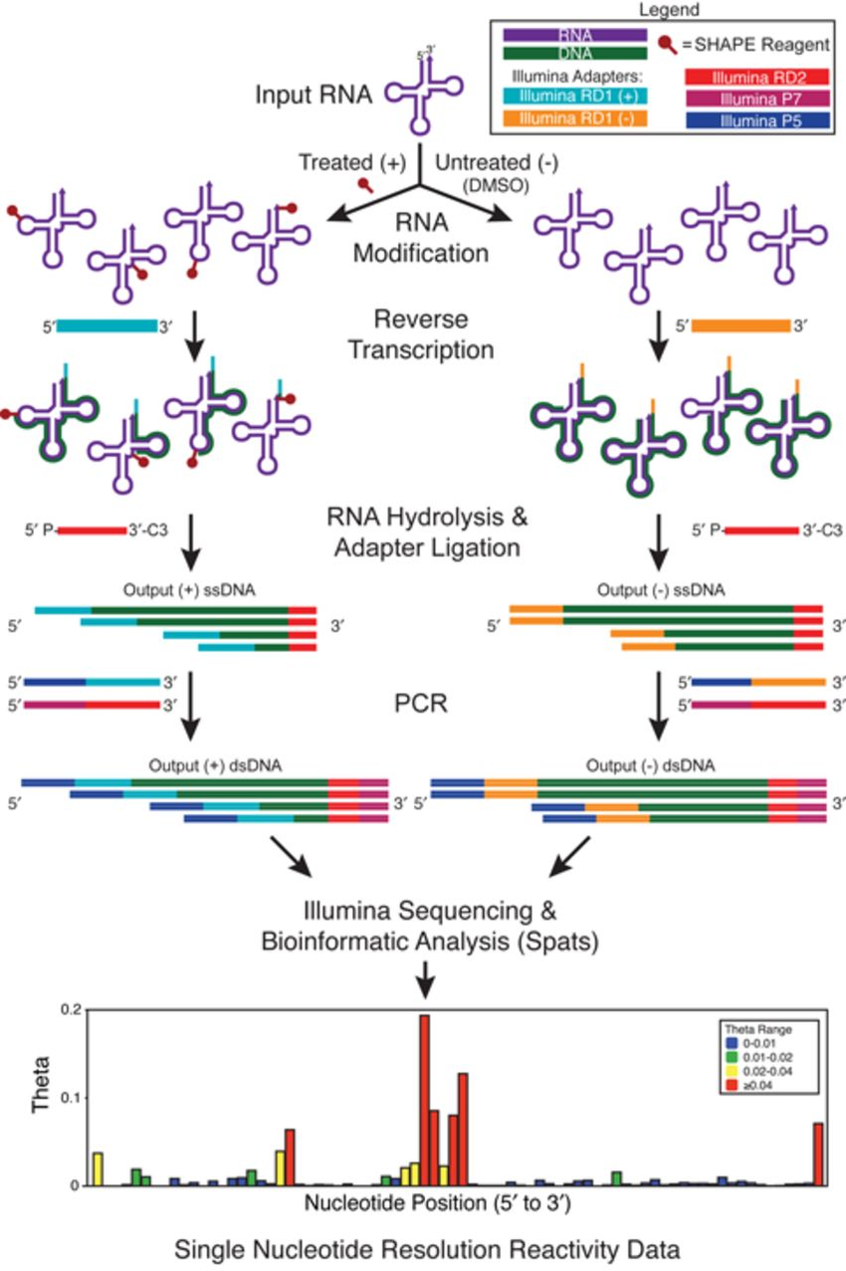
Shape-Seq

Slide 16
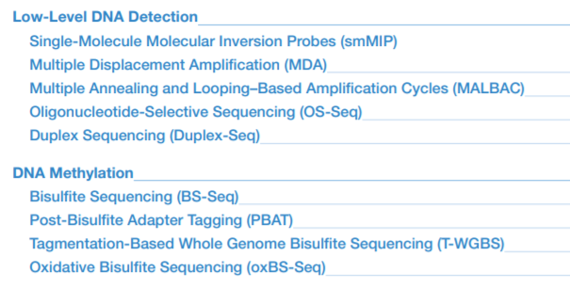
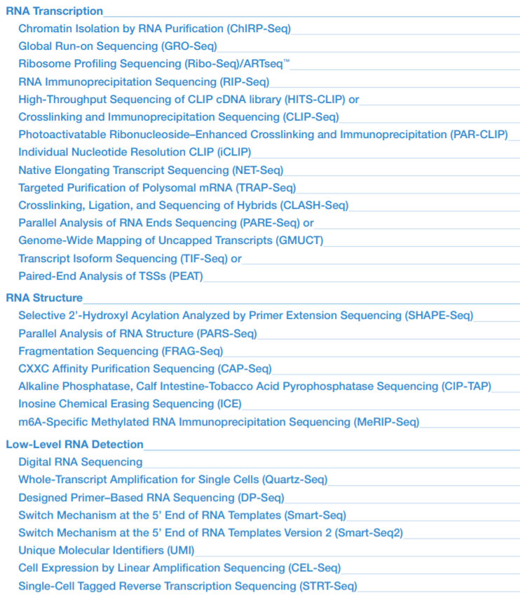
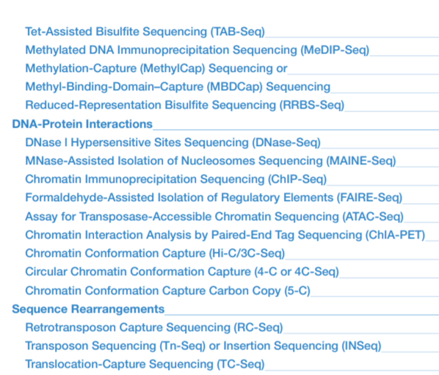
… and others
Link

Slide 17
CEITEC
@CEITEC_Brno
www.ceitec.eu

